Slide 1
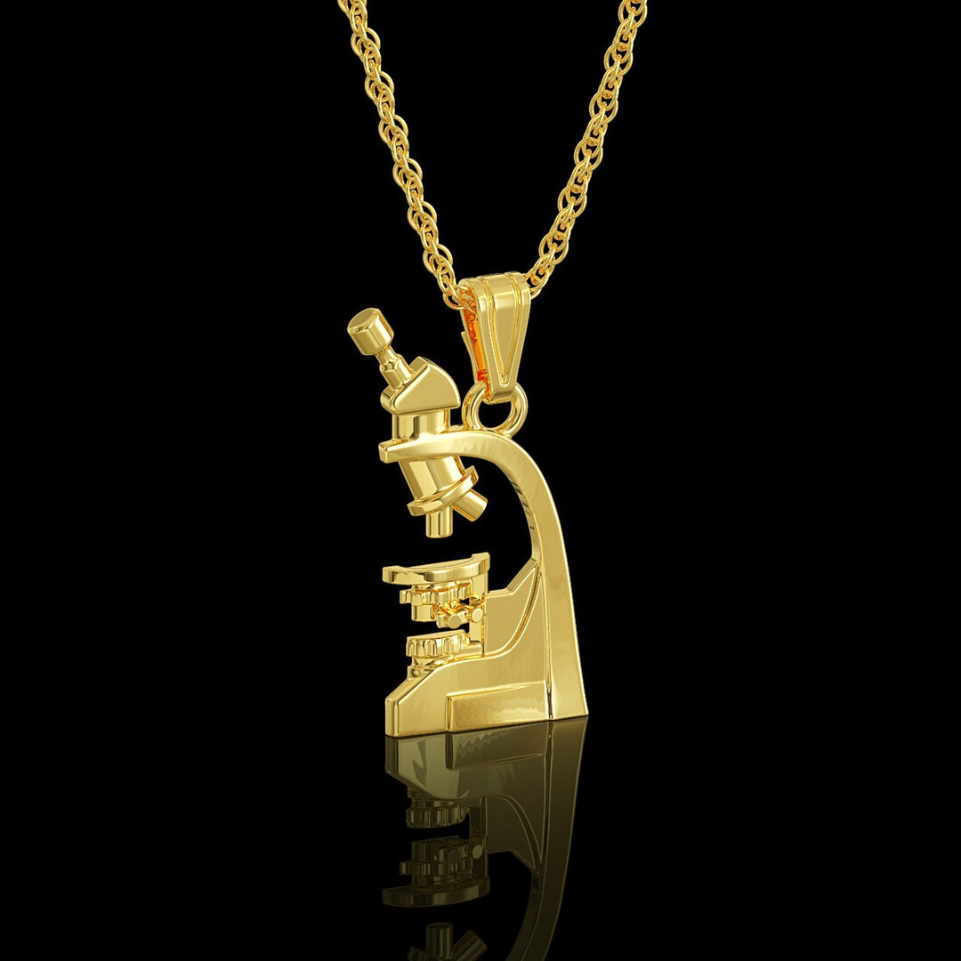
صناعة المجاهر بين الماضي و الحاضر

Slide 2
Microscope
Microscope is an instrument used to see objects that are too small to be seen by the naked eye.
microscopy is the science of investigating small objects and structures using such an instrument.
Microscopic means invisible to the eye unless aided by a microscope.

Slide 3
A brief history of microbiology
Science cannot be explored without proper tools, and all of these tools on the shelves inside the laboratory have an interesting history, and together we will review the history of one of the most important laboratory tools is the microscope
And we will find that it is wrong to call the microscope an invention, because it is considered a discovery, and the date of discovery of the microscope is related to the discovery of lenses. In fact, the date did not mention exactly where the first lens came from, but the oldest known example of lenses is “Nimrod lens or lens Layard ”, a piece of crystal carved convex, dating back to 750 BC, is found in Assyrian civilization

Slide 4
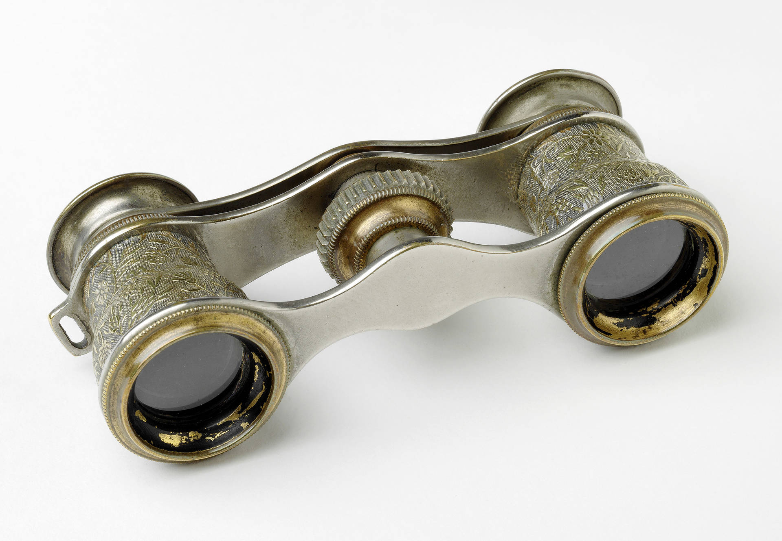
Others say that the lenses used to magnify texts did not arise until the eleventh century, and the ancient sculptors of ancient Middle Eastern civilizations filled glass balls with water to enlarge the sculptures
In the 1st Century AD, the Romans invented the glass and used them to magnify objects.
In the early 14th Century AD,
eyeglasses were made
by Italian spectacle makers,
Painter.

Slide 5
Although all these years have passed since the use of lenses, humans did not discover the microscope except in 1590 AD by one of the Dutch optical manufacturers named Zakrias Jansen and his father Hans Lippershey in the city of Middleburg, Holland, It was a simple tube with 2 lenses system and had 9X magnification..

Slide 6
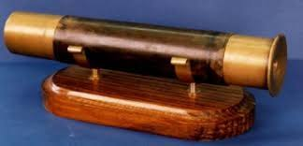
Zakrias Jansen glass

Slide 7
The biologist Robert Hooke was the first to use the microscope for scientific purposes in 1667 AD, as he modified his design to become closer to the shape we use now, and the model developed revolutionized as he was able to enlarge things 50 times, and he was the first From the description of the plant cell after being examined with this microscope After that there were several developments on the microscope, and at the same time that Hooke was able to describe the flea, and used of "The Cell" in Biology, it’s a glass ball into a convex lens and used it to make a single-lens microscope .
Then came the biggest contribution in this field after that from Anthony van Levenhoek Who discovered red blood cells and sperm and helped generalize microscopy as a method of research and study. On1676, Anthony van Levenhoek announced the discovery of microorganisms then he made a monocular microscope, which could enlarge objects 200 times , he first observed the bacterial cells.

Slide 8
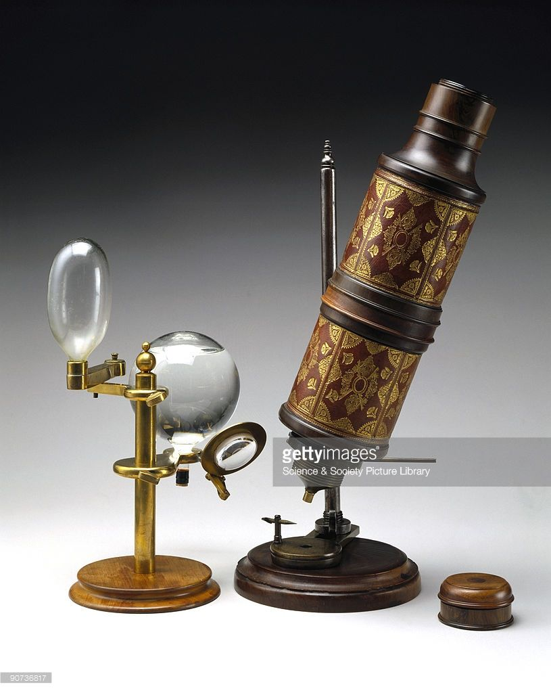
Hook microscope, as shown in the drawings of the book "microography"

Slide 9
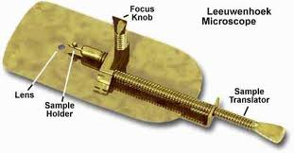

Slide 10
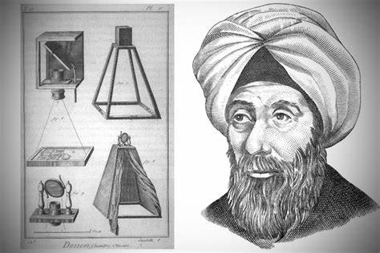
أول من اخترع العدسات عند العرب ؟
الجواب : حسن ابن الهيثم وهو من اول العلماء المسلمين وساعد على اختراع العدسة المكبرة عن طريق فرض عدد كبير من النظريات، فقد كان يعمل في تأليف العديد من الكتب العلمية واضطر اللى اختراع العدسة المكبرة بعدما ضعف نظره، فأجرى الكثير من التجارب العلمية على الزجاج للقيام بصنه العدسة المكبرة . كما بحث في قوة التكبير في العدسات مما جعله المبدع
الرائد لفكرة أول نظارة في العالم،
والممهد الأول الذي ساعدت بحوثه
البصرية على إصلاح عيوب الإبصار
في العين وتعديلها.

Slide 11
And the first to coin the name of "microscope" or "microscope small" on the microscope was the German doctor Giovanni Faber in 1625 to describe the compound microscope of the Italian scientist Galileo who had been called "the small eye".
Galileo Galilei (also sometimes cited as compound microscope inventor) seems to have found after 1610 that he could close focus his telescope to view small objects and far away ships, after seeing a compound microscope built by Drebbel exhibited in Rome in 1624, built his own improved version.

Slide 12
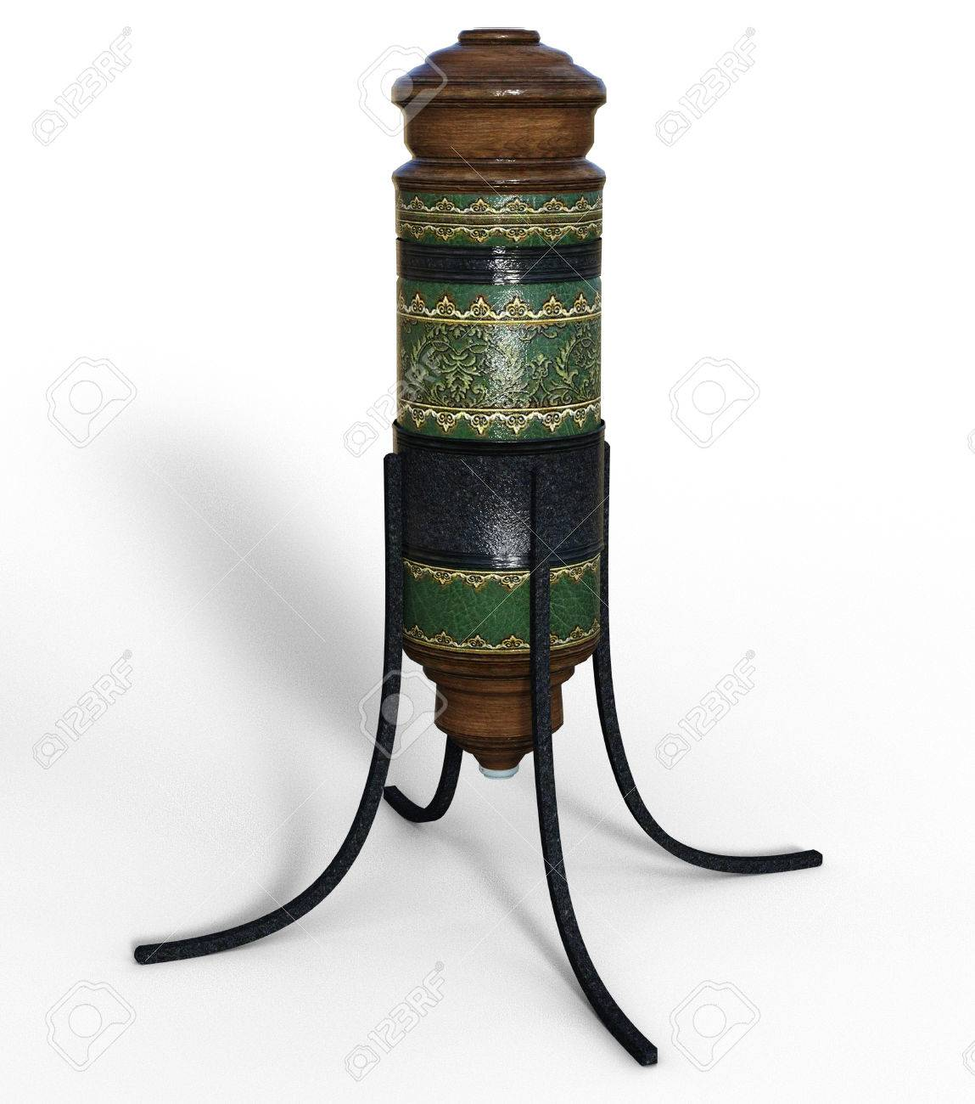
Gallilo microscope

Slide 13
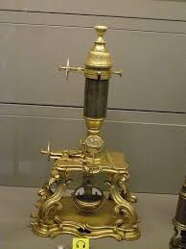
there are Microscopes from the eighteenth century at the Louvre Museum of Arts and Crafts, Paris

Slide 14
In 1878, Ernst Abbe, a German Physicist and Optical Scientist, developed a mathematical theory relating wavelength with image resolution. He was the first to develop and use water and oil immersion lenses.
In 1932, Frits Zernike invented the phase-contrast microscope.
In 1938, Max Knoll and Ernst Ruska invented the first electron microscope. It was a transmission electron microscope (TEM). It used a beam of an electron instead of light to make an enlarged image.

Slide 15
In early 1940, Russian physicist Sergey Y. Sokolov developed concept of ultrasound microscope. But, only in 1970, its working model was developed in America.
In 1942, Ernst Ruska improved TEM into a scanning electron microscope (SEM). In this type, electron beams are passed across the specimen instead of passing through it as in TEM.
In 1951, British physicists William Nixon and Ellis Coslett invented X-ray microscope.
In 1981, Gerd Binnig and Heinrich Rohrer invented the scanning tunneling microscope. This allowed us to get the 3-D image of an object.

Slide 16
Types of microscopes
There are many types of microscopes, and they may be grouped in different ways. One way is to describe the way the instruments interact with a sample to create images, either by sending a beam of light or electrons to a sample in its optical path, or by scanning across, and a short distance from the surface of a sample using a probe. The most common microscope (and the first to be invented) is the optical microscope, which uses light to pass through a sample to produce an image. Other major types of microscopes are the fluorescence microscope, the electron microscope (both the transmission electron microscope and the scanning electron microscope).

Slide 17
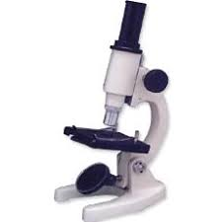
Types of microscopes and their uses
Optical microscopes (light microscope) : Uses optical microscope light and a set of lenses to enlarge the sample; where is one of the most common types of microscopes widespread and simplest, as it is low cost , making it ideal for use in education, medical field, and for the amateur also, it has advantages that it provides the ability to monitor cell activities Live, such as: movement, division , and absorption of food. Simple microscope is a type of optical microscope, and it is a microscope that consists of only one lens.
it is simple and can be used to observe living cells and microorganisms.

Slide 18
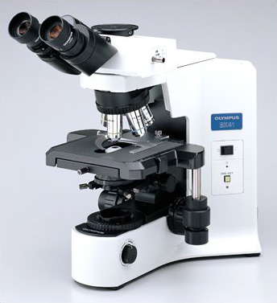
Compound optical microscope
microscopes consist of an ocular lens through which the sample to be studied, and an objective lens, is called this name because it is close to the object Enlarging it, as for the modern complex microscopes, they are more complicated, and they consist of an eye lens and 2-4 objective objects in addition to a light bulb, or a mirror that directs light towards the transparent glass slide over which the sample is place

Slide 19
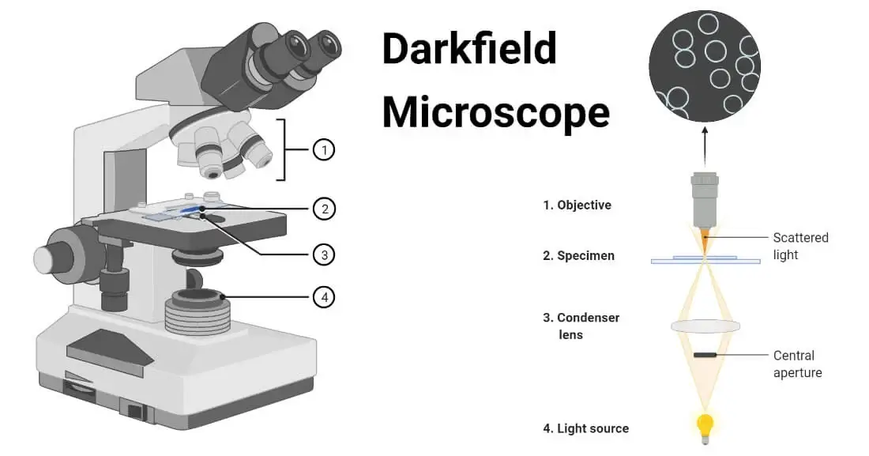
Dark Field Microscopy uses dark-ground microscopes. The reflected light is used, instead of transmitted light, to form a magnified image. it is used to observe very thin specimens and motility of flagella and cilia.

Slide 20
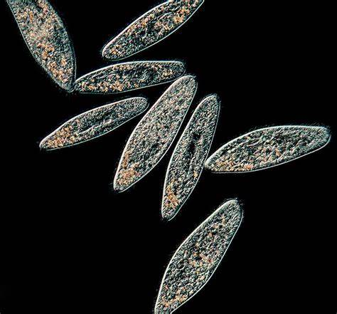

Slide 21
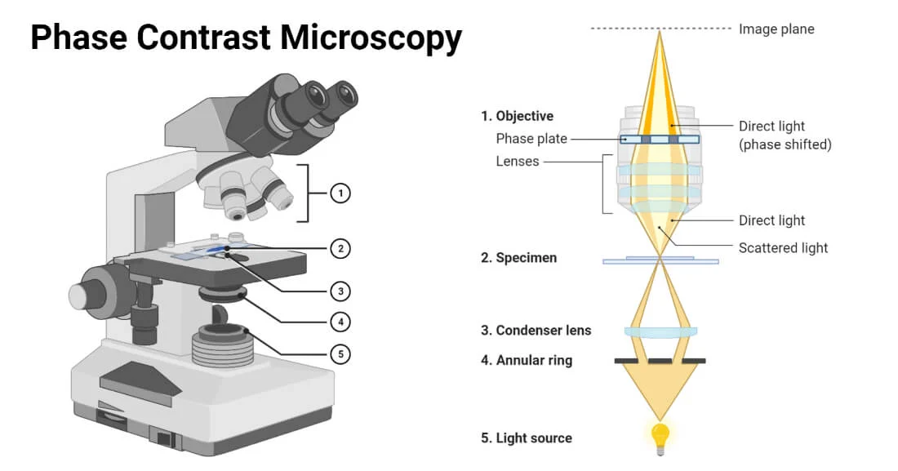
Phase Contrast Microscopy, the phase-contrast microscope is used. It converts phase shifts into differences in intensity of light-producing more contrast images. it is used for observing living cells and cellular structures.

Slide 22
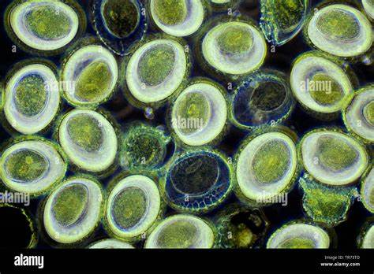

Slide 23
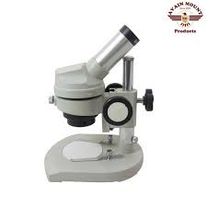
Anatomical microscope
Anatomical microscope: The anatomical microscope consists of one or two eye lenses, and objective lenses, and gives a three-dimensional image of the surface of the sample to be studied and enlarged fifty times or less. Anatomical microscopy is used in anatomy, microscopic surgery, jewelry and watchmaking , digital devices and the study of samples that cann’t be seen with the naked eye such as insects and crystals.

Slide 24
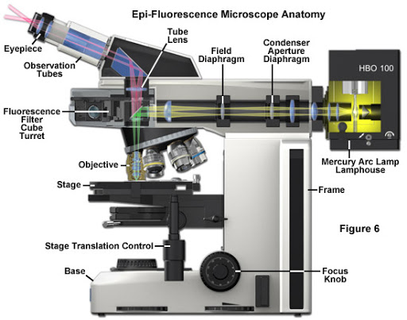
fluorescence microscope
is a microscopy technique that uses a fluorescent microscope with a UV light source. It is widely used in detecting antigens, antibodies, and other macromolecules.

Slide 25
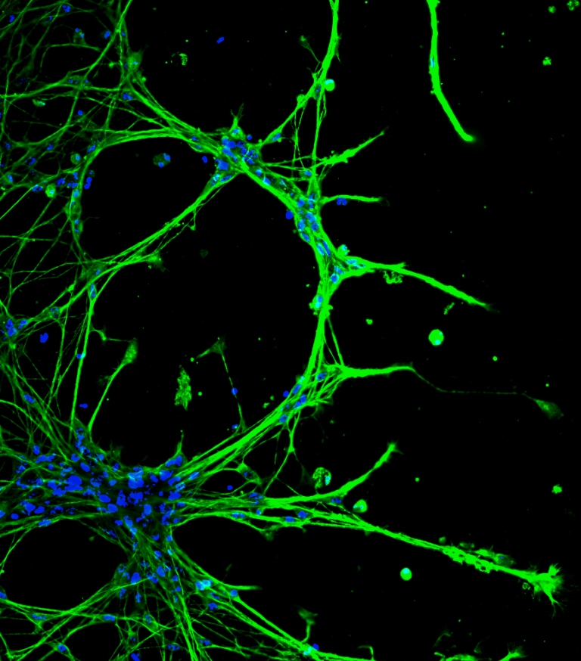

Slide 26
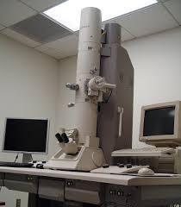
Electron Microscopy is a microscopy technique that uses a beam of electrons to develop a highly magnified image of microscopic samples.
- Scanning Probe Microscopy is a microscopy technique that uses a physical probe to scan specimens and form magnified images. This measures the surface features of the specimen. Unlike the Transmission Electron Microscope which uses transmitted electrons, the scanning electron Microscope uses emitted electrons, that can magnify between 1 to 50 million times
(TEM) The penetrating electron microscope enlarges things up to 200,000times,

Slide 27
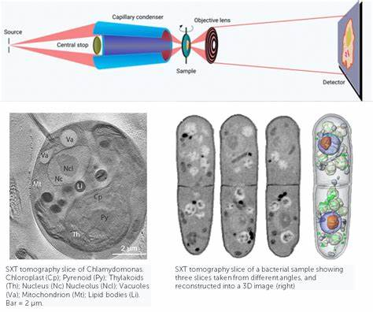
X-ray Microscopy is a microscopy technique that uses soft X-ray radiation to produce a magnified image of the specimen. X-Ray Microscopy is a nondestructive technique that generates images of the internal features of materials using X-rays, allowing for high-resolution imaging and the ability to observe three-dimensional structures.

Slide 28
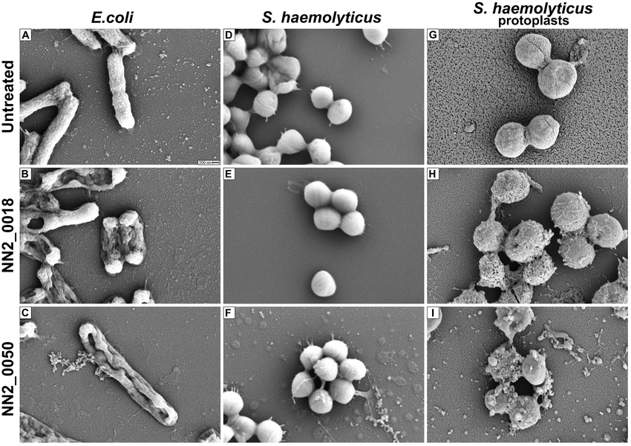
scanning Electron Microscope images

Slide 29
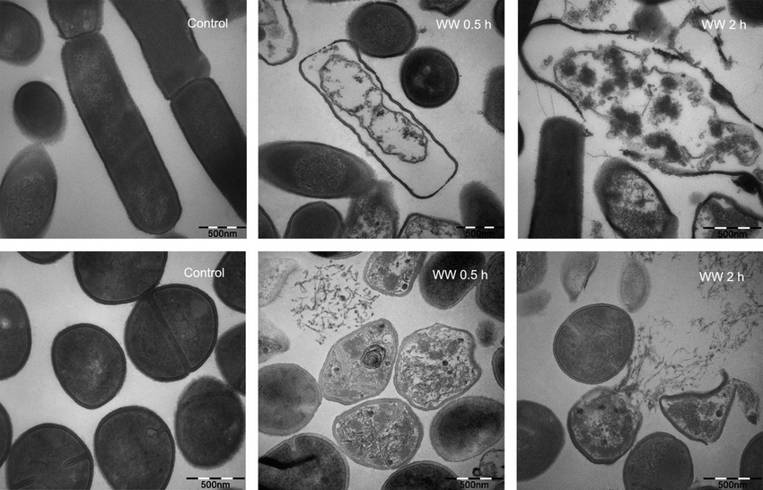
Transmission Electron Microscope images

Slide 30
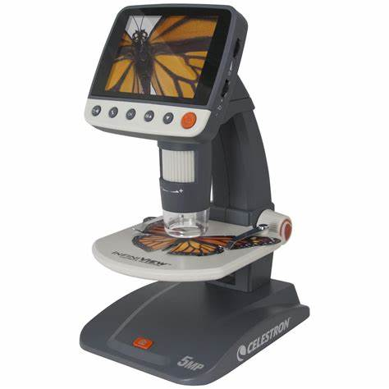
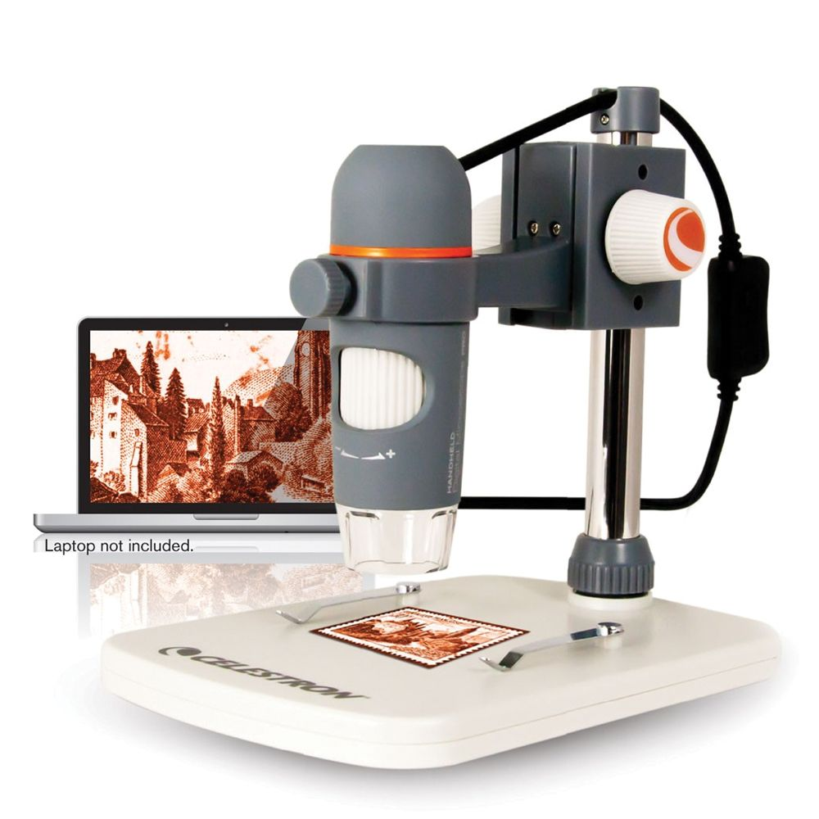
Digital Microscope (USB microscope)
They have a digital camera which is the detector and the image output device. The display of the image is done on a computer screen or monitor, defining the microscope’s digital scope.

Slide 31


