Slide 1
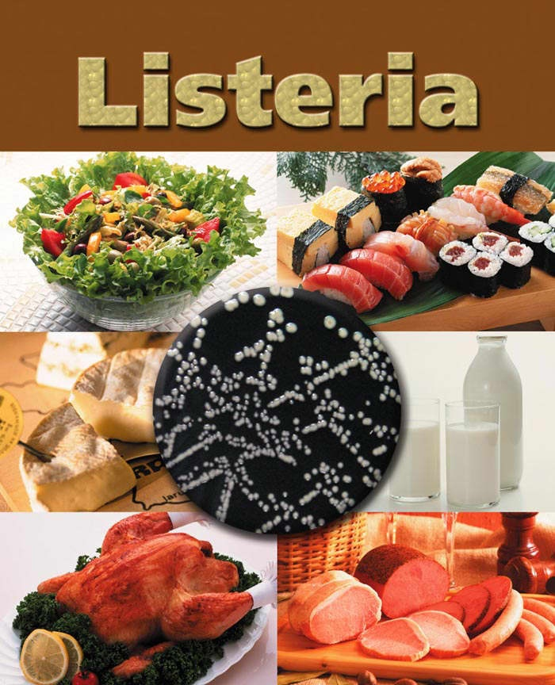
Food born listeria infection

Slide 2
The eating of contamination foods with pathogenic bacteria and their products such as toxins and enzymes leading to serious diseases.
Listeria monocytogenes is a foodborne pathogen that can cause listeriosis, a severe disease that can lead to septicemia, meningitis, and spontaneous abortion.

Slide 3
Listeria monocytogenes is one of the most virulent foodborne pathogens. Twenty to thirty percent of foodborne listeriosis infections in high-risk individuals may be fatal.
In the European Union, listeriosis continues an upward trend that began in 2008, causing 2,161 confirmed cases and 210 reported deaths in 2014, 16% more than in 2013. In the EU, listeriosis mortality rates also are higher than those of other foodborne pathogens.

Slide 4
this bacterium is responsible for an estimated 1,600 illnesses and 260 deaths in the United States annually, listeriosis ranks third in total number of deaths among foodborne bacterial pathogens, with fatality rates exceeding even Salmonella spp. and Clostridium botulinum.

Slide 5
Both L. ivanovii and L. monocytogenes are pathogenic in mice, but only L. monocytogenes is consistently associated with human illness. The 13 serotypes of L. monocytogenes can cause disease, but more than 90% of human isolates belong to only three serotypes: 1/2a, 1/2b, and 4b. L. monocytogenes serotype 4b strains are responsible for 33 to 35% of sporadic human cases worldwide and for all major foodborne outbreaks in Europe and North America since the 1980s.

Slide 6
L. monocytogenes was first described by E.G.D. Murray (Everitt George Dunne Murray) in 1924 based on six cases of sudden death in young rabbits, and published a description with his colleagues in 1926.
Murray referred to the organism as Bacterium monocytogenes before Harvey Pirie changed the genus name to Listeria in 1940 (named for Joseph Lister).
Although clinical descriptions of L. monocytogenes infection in both animals and humans were published in the 1920s, it was not recognized as a significant cause of neonatal infection, sepsis, and meningitis until 1952 in East Germany.

Slide 7
L. monocytogenes was not identified as a cause of foodborne illness until 1981, however. An outbreak of listeriosis in Halifax, Nova Scotia, involving 41 cases and 18 deaths, mostly in pregnant women and neonates, was epidemiologically linked to the consumption of coleslaw containing cabbage that had been contaminated with L. monocytogenes-contaminated sheep manure. Since then, a number of cases of foodborne listeriosis have been reported, and L. monocytogenes is now widely recognized as an important hazard in the food industry.

Slide 8
Invasive infection by
L. monocytogenes causes the disease listeriosis.
When the infection is not invasive, any illness as a consequence of infection is termed febrile gastroenteritis.
The manifestations of listeriosis include sepsis, meningitis (or meningoencephalitis), encephalitis, cornealulcer, pneumonia, myocarditis, and intrauterine or cervical infections in pregnant women, which may result in spontaneous abortion (second to third trimester) or stillbirth.

Slide 9
Surviving neonates of fetomaternal listeriosis may suffer granulomatosis infantiseptica — pyogenic granulomas distributed over the whole body — and may suffer from physical retardation.
Influenza-like symptoms, including persistent fever, usually precede the onset of the aforementioned disorders. Gastrointestinal symptoms, such as nausea, vomiting, and diarrhea, may precede more serious forms of listeriosis or may be the only symptoms expressed.

Slide 10
The onset time to serious forms of listeriosis is unknown, but may range from a few days to 3 weeks. The onset time to gastrointestinal symptoms is unknown, but probably exceeds 12 hours. An early study suggested that L. monocytogenes is unique among Gram-positive bacteria in that it might possess lipopolysaccharide,which serves as an endotoxin. Later, it was found to not be a true endotoxin. Listeria cell walls consistently contain lipoteichoic acids. These lipoteichoic acids resemble the lipopolysaccharides of Gram-negative bacteria in both structure and function, being the only amphipathic polymers at the cell surface.

Slide 11
L. monocytogenes has D-galactose residues on its surface that can attach to D-galactose receptors on the host cell walls. Once attached to host cells, L. monocytogenes can translocate past the intestinal membrane and into the body. Alternatively, losses of structural integrity (such as small lacerations) in the gastrointestinal epithelium could allow the microorganism to penetrate from the gastrointestinal tract to the bloodstream.

Slide 12
The infective dose of L. monocytogenes varies with the strain and with the susceptibility of the victim. From cases contracted through raw or supposedly pasteurized milk, one may safely assume that, in susceptible persons, fewer than 1,000 total organisms may cause disease. L. monocytogenes may invade the gastrointestinal epithelium. Once the bacterium enters the host's monocytes, macrophages, or polymorphonuclear leukocytes, it becomes blood borne (sepsis) and can grow. Its presence intracellularly in phagocytic cells also permits access to the brain and probably transplacental migration to the fetus in pregnant women.

Slide 13
The pathogenesis of L. monocytogenes centers on its ability to survive and multiply in phagocytic host cells.
It seems that Listeria originally evolved to invade membranes of the intestines, as an intracellular infection, and developed a chemical mechanism to do so. This involves a bacterial protein internalin (InlA/InlB), which attaches to a protein on the intestinal cell membrane "cadherin" and allows the bacteria to invade the cells .

Slide 14
These adhesion molecules are also to be found in two other unusually tough barriers in humans — the blood-brain barrier and the fetal–placental barrier, and this may explain the apparent affinity that L. monocytogenes has for causing meningitis and affecting babies in utero. Once inside the cell, L. monocytogenes rapidly acidifies the lumen of the vacuole formed around it during cell entry to activate listeriolysin O, a cholesterol-dependent cytolysin capable of disrupting the vacuolar membrane.

Slide 15
Following internalization, the bacterium must escape from the vacuole/phagosome before fusion with a lysosome can occur. Three main virulence factors that allow the bacterium to escape are listeriolysin O (LLO encoded by hly) phospholipase A (encoded by plcA) and phospholipase B (plcB). Secretion of LLO and PlcA disrupts the vacuolar membrane and allows the bacterium to escape into the cytoplasm, where it may proliferate.

Slide 16
Motility in the intracellular space is provided by actin assembly-inducing protein, which allows the bacteria to use the host cell's actin polymerization machinery to polymerize the cytoskeleton to give a "boost" to the bacterial cell so it can move in the cell. The same mechanism also allows the bacteria to travel from cell to cell.

Slide 17
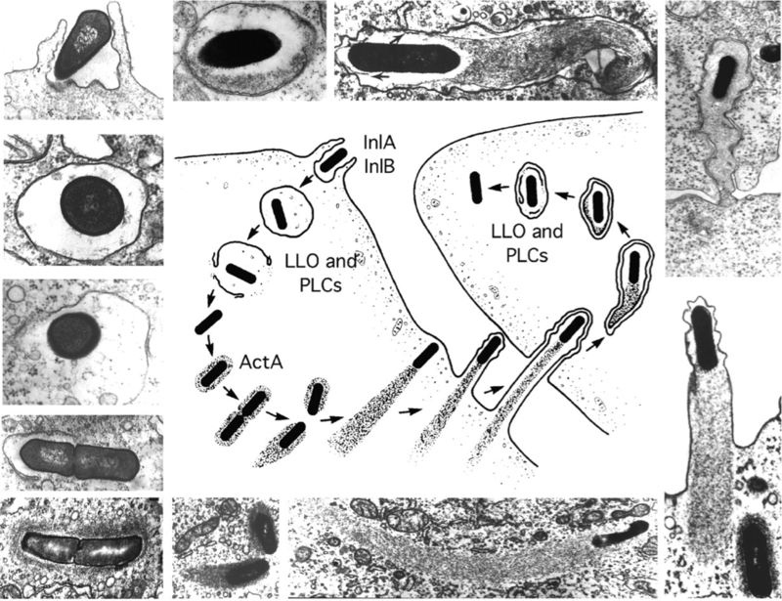
Stages in the intracellular lifecycle of L. monocytogenes: (Center) Cartoon depicting entry, escape from a vacuole, actin nucleation, actin-based motility, and cell-to-cell spread. (Outside) Representative electron micrographs from which the cartoon was derived. LLO, PLCs, and ActA are all described in the text. The cartoon and micrographs were adapted from Tilney and Portnoy (1989).

Slide 18
This bacterium is widely distributed in nature, as it is recognized as a primary inhabitant of the soil and decomposing vegetation. It is able to grow at acidic PH, rich concentrations of NaCl; as a psychrotrophic species, it handles living in the cold environment. This, besides other harsh conditions, has made it a great deal of concern to the food industry sector.

Slide 19
Almost all listeriosis cases are foodborne, high variety of foods could be contaminated by L. monocytogenes including raw poultry meat, ground beef, soft dairy products, and fish.
A wide range of animal species can become infected with L. monocytogenes, including mammals, domesticated animals, pets, fish, birds, and crustaceans . cows is very rarly infected with this bacteria in opposite to the sheep which is more sensitive to be infected with listeria and the highest incidnce of listeriosis occured in cold seasons.

Slide 20
Listeria monocytogenes has been associated with such foods as raw milk, cheeses (particularly soft-ripened varieties), ice cream, raw vegetables, fermented raw-meat sausages, raw and cooked poultry, raw meats (of all types), and raw and smoked fish. Most bacteria can survive near freezing temperatures, but cannot absorb nutrients, grow or replicate; however, L. monocytogenes has the ability to grow at temperatures as low as 0 °C which permits exponential multiplication in refrigerated foods.

Slide 21
Within the recent era, after the increasing of listeriosis infections which associated with food consumption , specifically in the meal of ready-to-eat (MRE) products including soft cheese , processed and chilled poultry products , deli luncheon meat products or hotdogs, and even some epidemiologically monitored flare-ups that have been recorded , this bacterium has been declared as a primer food-borne pathogen.

Slide 22
Consumer lifestyle has changed, and less time is available for food preparation. Modern lifestyle has markedly changed eating habits worldwide, with a consequent increased demand for RTE foods; therefore, more RTE and take away foods are consumed. There is a concern that many Listeria outbreaks are reported from hospital.
Listeriosis, with a mortality rate of about 24%, is found mainly among pregnant women, their fetuses, and immunocompromised persons, with symptoms of abortion, neonatal death, septicemia, and meningitis.

Slide 23
High-risk individuals (i.e., the elderly, pregnant women, and most immunocompromised individuals) should be provided with guidance on healthy eating, including specific information on high-risk foods that they should avoid, and strategies to reduce their risk, such as thorough cooking, avoidance of cross-contamination, and short-term refrigerated storage of cooked perishable foods. Those at low risk for listeriosis should receive information on safe food handling practices, preferably starting at a preschool age.

Slide 24
Good manufacturing practices, appropriate cleaning, sanitation and hygiene programs, and temperature control required for prevention or inhibition of growth of the pathogen to high levels are critical for control of L. monocytogenes in the retail and food service sector.
Strict public health and food safety system is urgently needed to reduce the human health risks associated with pathogens.

Slide 25
Ongoing efforts are needed to further reduce the incidence of listeriosis, due to its high mortality rate. The use of a risk-based approach to identify strategies that will have the greatest impact on reducing foodborne listeriosis.
A continuum of risk for listeriosis is observed in the human population, ranging from exquisitely sensitive groups, who are highly immunocompromised and at very high risk of listeriosis, through the normal healthy population younger than 65 years of age, who appear to have a minimal risk for listeriosis.

Slide 26
The International Life Sciences Institute, Risk Science Institute Expert Panel concluded that certain foods pose a high risk for causing listeriosis. High-risk foods have all of the following properties: (1) have the potential for contamination with L. monocytogenes; (2) support the growth of L. monocytogenes to high numbers; (3) are ready to eat; (4) require refrigeration; and (5) are stored for an extended period of time.
Control strategies are needed in the food chain from preharvest through consumption to minimize the likelihood that food will become contaminated by L. monocytogenes and to prevent the growth of the organism to high numbers.

Slide 27
The Expert Panel identified three main strategies for ensuring continuous improvement in reducing foodborne listeriosis: (1) preventing contamination of foods with L. monocytogenes; (2) preventing growth of L. monocytogenes to high numbers in foods; and (3) science-based education messages targeted to susceptible populations and their caregivers. Of these strategies, the Expert Panel concluded that preventing growth of L. monocytogenes to high numbers would have the greatest impact in reducing cases of listeriosis.

Slide 28
This requires implementation of effective food safety control measures and ensuring that these control strategies are consistently met. Most effective strategies to control L. monocytogenes in high-risk foods include (1) good manufacturing practices, sanitation standard operating procedures, and hazard analysis critical control point programs to minimize environmental L. monocytogenes contamination and to prevent cross-contamination in processing plants and at retail; (2) an intensive environmental sampling program in plants processing high-risk foods and an effective corrective action plan to reduce the likelihood of contamination of high-risk foods;

Slide 29
(3) time and temperature controls throughout the entire distribution and storage period, including establishing acceptable storage times of foods that support growth of L. monocytogenes to high numbers; (4) reformulating foods to prevent or retard the growth of L. monocytogenes; and (5) using postpackaging treatments to destroy L. monocytogenes on products.

Slide 30
Science-based education and risk communication strategies aimed at susceptible populations and focused on high-risk foods should be delivered through health care providers or other credible sources of information.
Exquisitely sensitive consumers may become ill when exposed to low numbers of L. monocytogenes or other opportunistic pathogens, so reducing the risk to this population could be achieved by maintaining them on restricted low-microbe diets during those periods when they are most severely immunocompromised.

Slide 31
L. monocytogenes makes a huge concern to the public health and to the food industry as well because of its prevalence in the environment and adaptability to survive or even thrive under very harsh circumstances. The increasing rate of L. monocytogenes contamination in foodborne outbreaks, especially in modern eating style, has led to the rapid action of the discovery of new and fast methods for testing food products.
Many biomolecular methods and techniques have been established for diagnoses of L. monocytogenes including DNA probes and PCR (polymerase chain reaction) techniques .

Slide 32
In addition, direct method for detection of L. monocytogenes in food products by PCR has been recorded in some studies .
Because of high sensitivity, specificity, and low time consumption of PCR method , this technique and other molecular methods have been recommended . However, the sensitivity and specificity of the PCR are dependent upon many factors as DNA extraction procedures, the target genes, and the primer sequences . a PCR assay can determine the presence or absence of bacteria rather than quantify bacterial cells.

Slide 33
Detection of L. monocytogenes in food by The conventional methods (microbiological method) involves the growth in a pre-enrichment medium, then growth on a selective medium followed by a series of biochemical and serological tests to confirm the diagnoses . These work-intensive methods are time-consuming as they may take up to 10 days to get finished.
PCR is rapid and allows an accurate identification and precise nucleic acid sequences quantification. As knowledge of the molecular and applied biology of L. monocytogenes increases, progress can be made in the prevention and control of human infection.

Slide 34
L. monocytogenes is a Gram-positive, non-spore-forming, motile, facultatively anaerobic, rod-shaped bacterium. It is catalase-positive and oxidase-negative, and expresses a beta hemolysin, which causes destruction of red blood cells. This bacterium exhibits characteristic tumbling motility when viewed with light microscopy. Although L. monocytogenes is actively motile by means of flagella at room temperature (20−25 °C), the organism does not synthesize flagella at body temperatures (37 °C).

Slide 35
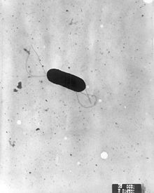

Slide 36
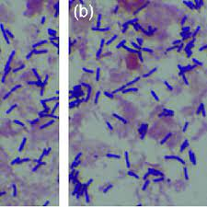

Slide 37
L. monocytogenes has the ability to grow in a broad range of temperatures (from 4°C to 45°C) but also under freezing conditions no significant changes in the live bacteria population was observed.

Slide 38
Tolerance to low temperatures resulted in the frequent detection of these bacteria in food products stored under refrigeration conditions . The mechanisms of this phenomenon are complex and involve a decrease in the metabolism of the bacterial cells, changes in cell membrane composition, expression of cold shock proteins, and uptake of cryoprotective compounds from the environment .

Slide 39
Cold enrichment method should be used for culturing this bacterium, this method used for specimens from heavily contaminated sources to reduce the contamination. The ability of listeria to multiply at low temperatures overgrowing other organisms which grow more slowly . The growth on listeria agar BALCAM ,this medium is a selective medium used for the isolation of L. monocytogenes from foods, displayed greyish/black colonies with black halos .

Slide 40
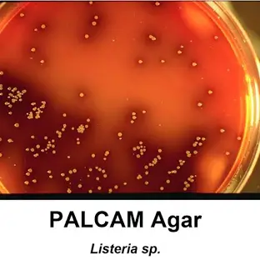

Slide 41
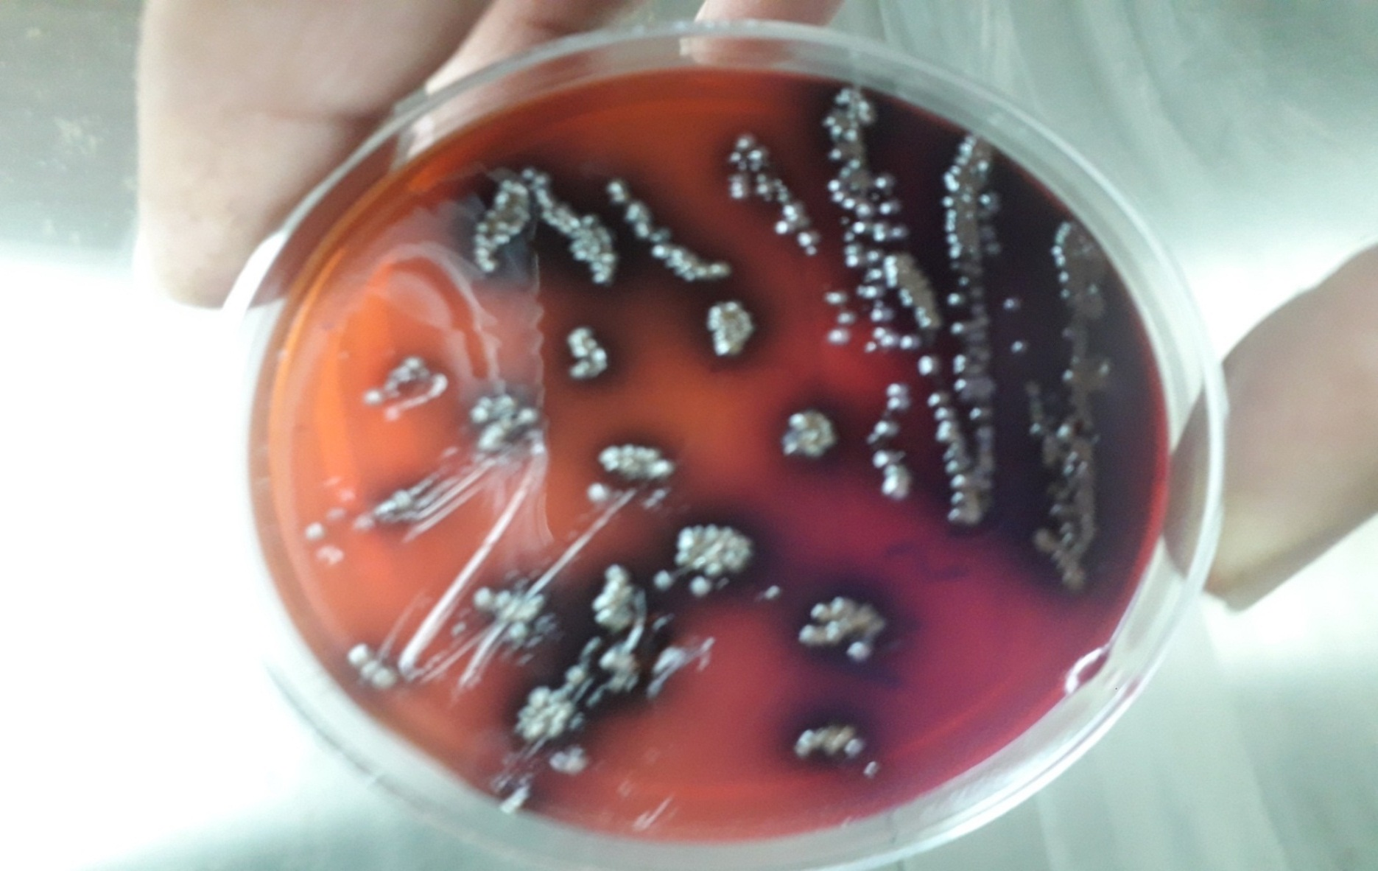
Listeria monocytogenes
On listeria agar (BALCAM)

Slide 42
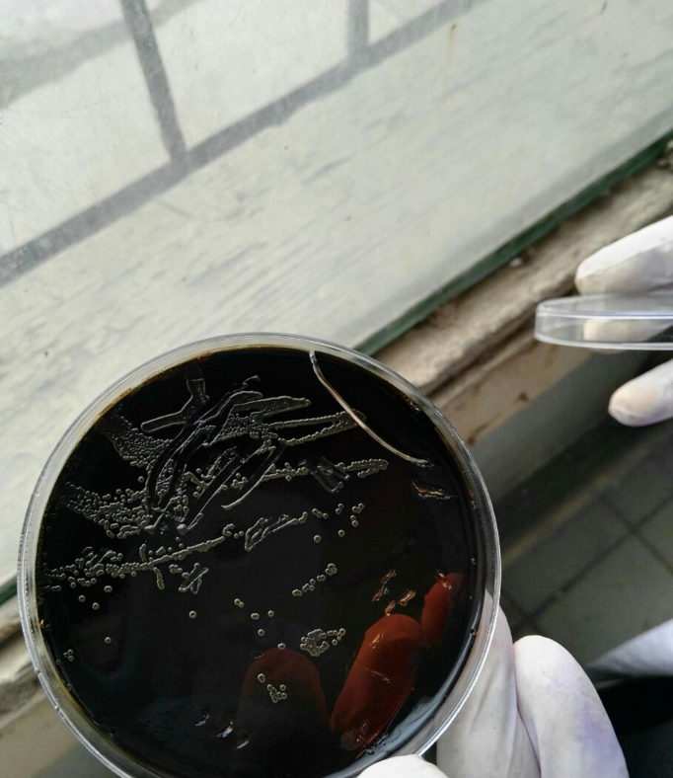

Slide 43
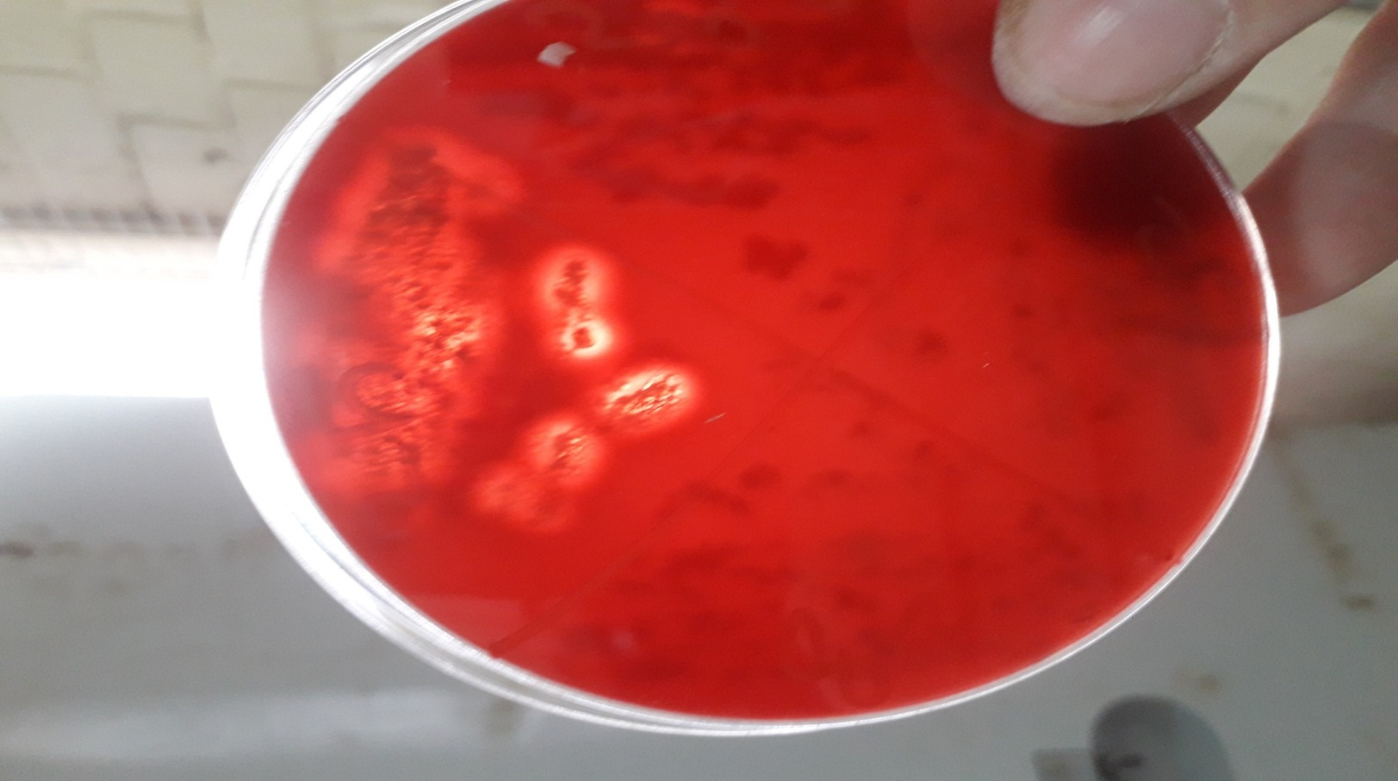
Listeria monocytogenes
Narrow zone of beta-hemolysis On blood agar

Slide 44
Treatment:
When listeric meningitis occurs, the overall mortality may reach 70%, from sepsis 50%, and from perinatal/neonatal infections greater than 80%. In infections during pregnancy, the mother usually survives. Reports of successful treatment withparenteral penicillin or ampicillin exist. Trimethoprim-sulfamethoxazole has been shown effective in patients allergic to penicillin.

Slide 45
A bacteriophage, Listeria phage P100, has been proposed as food additive to control L. monocytogenes. Bacteriophage treatments have been developed by several companies. EBI Food Safety and Intralytix both have products suitable for treatment of the bacterium.

Slide 46
The U.S. Food and Drug Administration (FDA) approved a cocktail of six bacteriophages from Intralytix, and a one-type phage product from EBI Food Safety designed to kill L. monocytogenes. Uses would potentially include spraying it on fruits and ready-to-eat meat such as sliced ham and turkey.

Slide 47
Thank you

