Slide 1


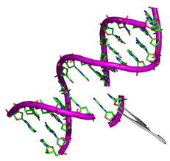
Genetic Engineering Between Legislations and Application Concerns
Prepared by
Prof. Dr. Inam Jasim Lafta
PhD Molecular Biology/ Department of Microbiology, College of Veterinary Medicine/ University of Baghdad.
20th February 2025

Slide 2
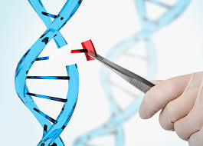
Genetic Engineering- Lecture
Introduction
Definision, history…
Processes and techniques
Mechanism of the CRISPR-Cas9 System
Applications of Genetic Engineering
GMO, Three-person in vitro fertilization, gene editing, gene therapy, three-parent baby….
Socio-Ethical Aspects
Perspectives

Slide 3
Genetic Engineering
The term genetic engineering initially referred to various techniques used for the modification or manipulation of organisms through the processes of heredity and reproduction.
In the latter part of the 20th century, however, the term came to refer more specifically to methods of recombinant DNA technology (or gene cloning), in which DNA molecules from two or more sources are combined in vitro and are then inserted into host organisms in which they are able to propagate.
The recombinant DNA technology emerged with the discovery of restriction enzymes in 1968 by Swiss microbiologist Werner Arber.
The following year American microbiologist Hamilton O. Smith purified so-called type II restriction enzymes, which were found to be essential to genetic engineering for their ability to cleave a specific site within the DNA.

Slide 4
American molecular biologist Daniel Nathans helped advance the technique of DNA recombination in 1970–1971 and demonstrated that type II enzymes could be useful in genetic studies.
Genetic engineering based on recombination was pioneered in 1973 by American biochemists Stanley N. Cohen and Herbert W. Boyer, who were among the first to cut DNA into fragments, rejoin different fragments, and insert the new genes into E. coli , which then reproduced.
A subsequent generation of genetic engineering techniques that emerged in the early 21st century centred on gene editing.
Genome editing technology emerged in the 1990s, and various methods have since been developed for targeted gene editing.

Slide 5
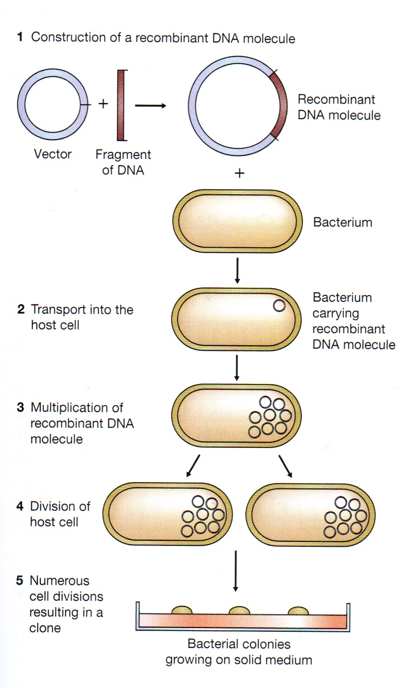
Processes and techniques
Most recombinant DNA technology involves the insertion of foreign genes into the bacterial plasmids.
By incorporating foreign DNA (recombinant DNA) into a bacterium, researchers can obtain an almost limitless number of copies of the inserted gene.
Furthermore, if the inserted gene is operative (i.e., if it directs protein synthesis), the modified bacterium will produce the protein specified by the foreign DNA.

Slide 6
Gene editing is performed using enzymes, particularly nucleases that have been engineered to target a specific DNA sequence, where they introduce cuts into the DNA strands, enabling the removal of existing DNA and the insertion of replacement DNA.
Key among gene-editing technologies is a molecular tool known as CRISPR-Cas9, which is one of the most important findings and inventions in the present century.
CRISPR-Cas9 functioned with precision, allowing researchers to remove and insert DNA in the desired locations.
CRISPR-Cas9 functions as a cut and paste tool for DNA editing.

Slide 7
Origin, Development, and Mechanism of the CRISPR-Cas9 System
The CRISPR was first reported by Yushizumi Ishino (1987), but its biological application was unknown at the time.
The acronym CRISPR refers to clustered regularly interspaced short palindromic repeats, which are found in most bacterial genomes.
CRISPR-Cas9 is a powerful technology discovered in 2012 by American scientist Jennifer Doudna, French scientist Emmanuelle Charpentier and colleagues and refined by American scientist Feng Zhang and colleagues.
This system targeted the human genome for the first time in 2013.
According to effector proteins, this system has been categorized into two main classes with six subtypes.
The type2 CRISPR-Cas9 system is the most widely used item in the field of genome editing.
This system consists of two components:
(1) the Cas9 protein which can cleave the DNA.
(2) the guide RNA that distinguishes the sequence of DNA to be rectified.

Slide 8
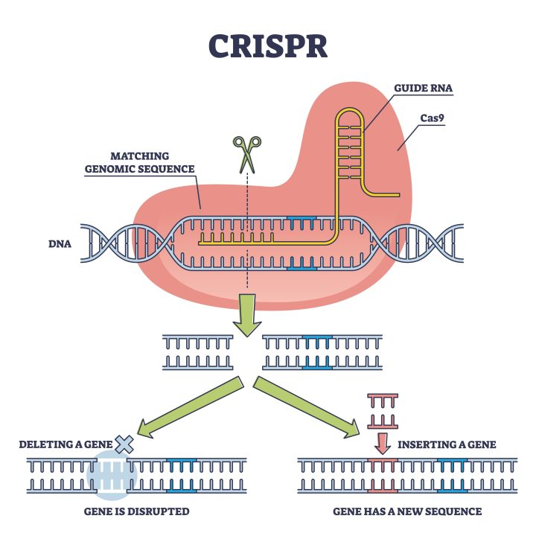
Figure 1. Schematic of CRISPR-Cas9 genome editing system.

Slide 9
Applications of Genetic Engineering
In 1980 the “new” microorganisms created by recombinant DNA research were deemed patentable…
In 1986 the U.S. Department of Agriculture approved the sale of the first living genetically altered organism—a virus, used as a pseudorabies vaccine.
Since then several hundred patents have been awarded for genetically altered bacteria and plants.
Through recombinant DNA techniques, bacteria have been created that are capable of synthesizing human insulin, human growth hormone, alpha interferon, a hepatitis B vaccine, and other medically useful substances.
Plants may be genetically adjusted to enable them to fix nitrogen, and genetic diseases can possibly be corrected by replacing dysfunctional genes with normally functioning genes.
Genes for toxins that kill insects have been introduced in several species of plants, including corn and cotton.

Slide 10
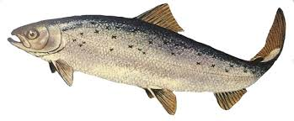
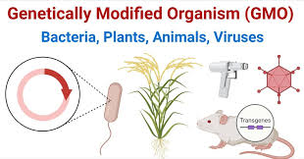
Bacterial genes that confer resistance to herbicides also have been introduced into crop plants. Other attempts at the genetic engineering of plants have aimed at improving the nutritional value of the plant.
Despite 30 years of research and a number of successful research projects using genetic engineering, only a single GE food animal has been approved in a single country.
The fast growing AquAdvantage® Atlantic salmon, first reported by Canadian university researchers in 1992, was finally approved by the United States Food and Drug Administration (FDA) as a new animal drug in 2015, and by Canadian authorities in 2016. It is currently only available for sale in Canada.

Slide 11
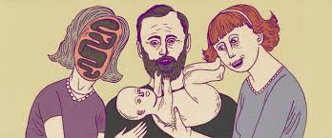
In 2001 the U.S. Food and Drug Administration (FDA) introduced a special-permissions requirement for the use of mitochondrial manipulation technologies, which essentially banned their use by requiring reproductive clinics to seek explicit authorization from the FDA.
A panel in 2012 in the United Kingdom concluded that the use of the technologies was ethical.
Laws in the United Kingdom prevented germ-line alteration, but a proposal was introduced in 2014 that raised the possibility of legalizing the generation of three-parent babies.
In early 2015, members of Parliament in the United Kingdom voted in favour of allowing three-parent babies; the country the first to introduce laws to guide the use of three-person in vitro fertilization (IVF).

Slide 12
In 2017, the year following the birth of the first baby born using mitochondrial replacement therapy (MRT), medical scientists in Ukraine reported the birth of two babies from MRT.
The technique has since been applied to treat infertility and genetic diseases in other countries, including Greece.
In late 2018 a Chinese scientist announced the birth of the world’s first gene-edited human babies; the infants, twin girls, were said to carry an edited gene that reduced the risk of becoming infected with HIV.
More practically, some researchers attempted to use gene editing to alter genes in human sperm. This would enable the edited genes to be passed on to subsequent generations, while others sought to alter genes that increase the risk of certain types of cancer, with the aim of reducing cancer risk in offspring.
To date, CRISPR-Cas9 has been commonly used to create gene editing in plants, animal, and human samples.
This technique is widely used in various scientific fields, including medical science and therapeutics, as well as plant and animal sciences.

Slide 13
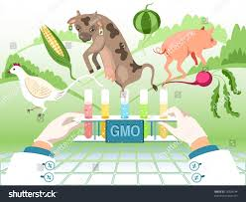
CRISPR-Cas9 has been used in a variety of ways. For example, it has been applied to early embryos to create genetically modified organisms (GMOs), and it has been injected into the bloodstream in laboratory animals to achieve substantial gene editing in subsets of tissues.
Approaches based on CRISPR-Cas9 have been used to modify the genomes of crop plants, farm animals, and laboratory model organisms, including mice, rats, and nonhuman primates.
By modifying the genomes of bacteriophages with CRISPR-Cas9 technology, scientists have been able to develop methods to destroy antibiotic-resistant bacteria.
CRISPR-Cas9 systems also enabled the creation of animal models for human disease and the removal of HIV from infected cells.

Slide 14
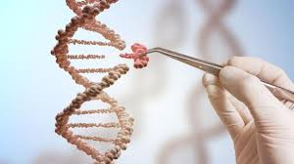
The correction of genetic errors associated with disease in animals suggests that gene editing has potential applications in gene therapy for humans.
Gene therapy is the introduction of a normal gene into an individual’s genome in order to repair a mutation that causes a genetic disease.
When a normal gene is inserted into a mutant nucleus, it most likely will integrate into a chromosomal site different from the defective allele; although this may repair the mutation, a new mutation may result if the normal gene integrates into another functional gene.
If the normal gene replaces the mutant allele, there is a chance that the transformed cells will proliferate and produce enough normal gene product for the entire body to be restored to the undiseased phenotype.

Slide 15
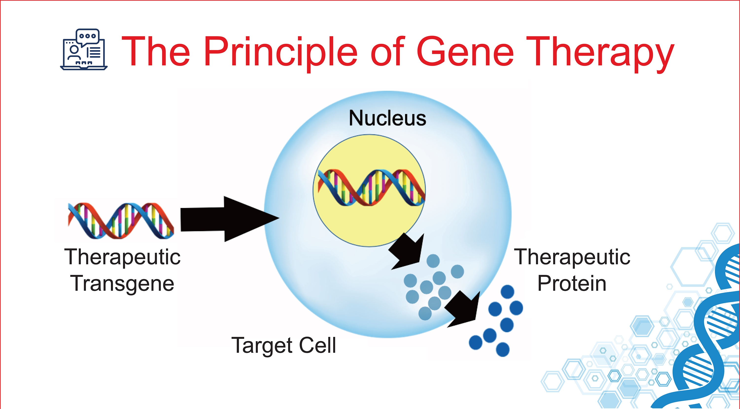

Slide 16
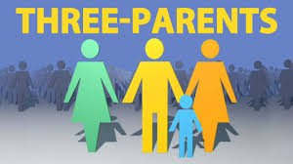
Three-parent baby
In general, the reproductive technologies used to produce three-parent babies focus on replacing or otherwise reducing the effects of mutations that occur in the DNA of cellular organelles known as mitochondria, which reside in the cell cytoplasm.
The various approaches could help women overcome infertility and could prevent the transmission of potentially debilitating mitochondrial diseases to their offspring.
Ooplasmic transfer was introduced in the mid-1990s at a reproductive
medical center in the United States to treat infertility in women over
age 35 who had failed to conceive despite repeated attempts with
traditional IVF techniques.
The first three-parent babies were born in the 1990s and early 2000s.

Slide 17
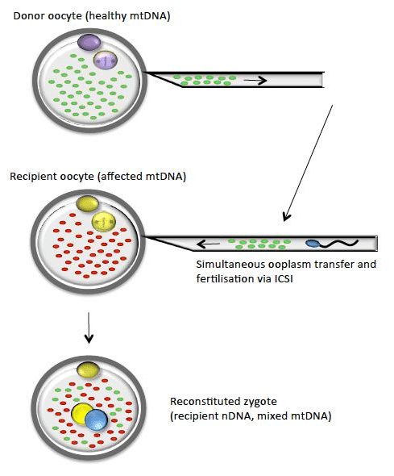
Mitochondrial replacement therapy
Ooplasmic transfer entails the injection of a small amount of cytoplasm from an egg cell (ovum) donated by a healthy woman into the mother’s egg, which is then fertilized by the father’s sperm and implanted into the mother’s uterus using IVF.
Because ooplasmic transfer involves the mixing of cytoplasm from maternal and donor eggs—the health and hereditary risks of which could be significant—interest in its potential use to overcome infertility or mitochondrial disease has declined.

Slide 18
British scientists devised the new IVF technique, in which the child has genetic material from three people, but does not inherit any of the donor’s characteristics. Opponents include the Church of England.
Other techniques have supplanted ooplasmic transfer, the two most significant of which are maternal spindle transfer and pronuclear transfer.
Pronuclear transfer (a pronucleus is the nucleus of the egg or sperm at the stage of fertilization prior to nucleus fusion). The mother’s egg is first fertilized with the father’s sperm, producing a zygote. The pronuclei of the egg and sperm are then removed from the zygote and inserted into a donor egg that has been fertilized and has had its own nucleus removed. The zygote derived from the donor egg is then implanted into the mother’s uterus.
Maternal spindle transfer. The nucleus is removed from a donor egg, leaving behind the cytoplasm. The nucleus from the mother’s egg cell is then inserted into the donor egg. The egg is fertilized with the father’s sperm and then transferred to the mother’s uterus for normal gestation, similar to other IVF procedures.

Slide 19
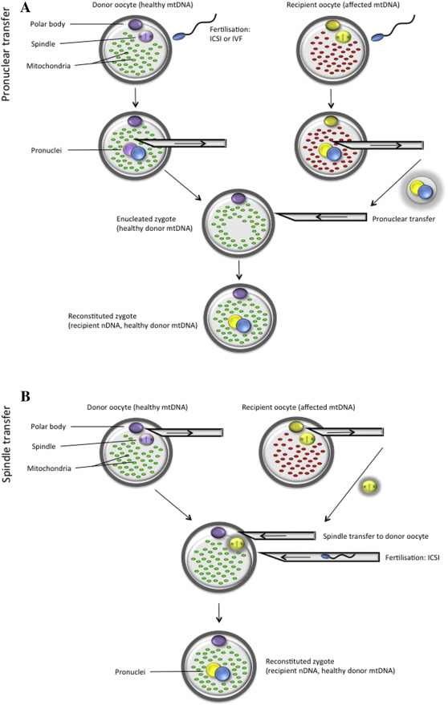

Slide 20
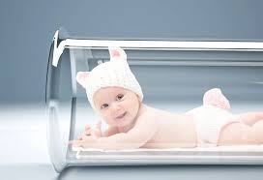
In 2015, mitochondrial replacement therapy (MRT) was legalized in the United Kingdom for the purpose of preventing genetic disease.
The following year a medical scientist in the United States reported the birth of the first three-parent baby produced using MRT; the procedure was carried out in Mexico in order to bypass U.S. regulations.
The development was again greeted with excitement and controversy. Much was unknown about the safety of various three-parent IVF techniques, and their use to generate human babies raised ethical and social concerns, among them the possible impacts on health and heredity.
The precise mechanisms by which any of the three techniques could potentially treat infertility or prevent inherited mitochondrial disease are not fully known.

Slide 21
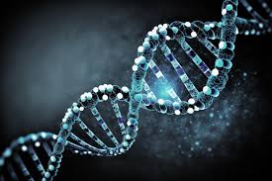
الجوانب الاجتماعية والأخلاقية (Socio-Ethical Aspects)
اثار الاهتمام بالهندسة الوراثية مخاوفًا من أنها قد تؤدي إلى إدخال سمات غير مرغوبة وربما خطيرة في الكائنات الحية الدقيقة التي كانت خالية منها سابقًا - على سبيل المثال، مقاومة المضادات الحيوية، أو إنتاج السموم، أو الميل إلى التسبب في المرض.
كانت احتمالات إساءة استخدام الهندسة الوراثية هائلة. وعلى وجه الخصوص، كان هناك قلق كبير بشأن الكائنات المعدلة وراثيًا، وخاصة المحاصيل المعدلة، وتأثيراتها على صحة الإنسان والبيئة.
أثار إطلاق البعوض المعدل وراثيًا والكائنات المعدلة الأخرى في البيئة مخاوف.
أدى الارتفاع السريع لـ CRISPR-Cas9 مقارنة بالتقنيات الأخرى إلى ظهور قضايا أخلاقية جديدة في مختلف مجالات العلوم البيولوجية.
لا يزال تأثير التلاعب بالميتوكوندريا على الوراثة غير معروف.
نظرًا للمخاطر العديدة غير المتوقعة، فإن استخدام التلقيح الاصطناعي ثلاثي الاباء مقيد.
أثار تطبيق تحرير الجينات لدى البشر مخاوف أخلاقية كبيرة، وخاصة فيما يتعلق بإمكانية استخدامه لتغيير سمات مثل الذكاء والجمال.

Slide 22
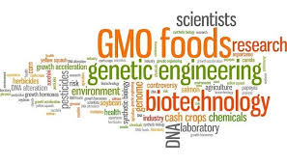
لا تزال الأسئلة الأساسية المتعلقة بالسلامة البيولوجية والبيئة عالقة دون إجابة.
إن دور الجينات التنظيمية في التعبير، والنتيجة المشتركة للعديد من العوامل الوراثية، والتأثير المتعدد الجينات، والوراثة المستقرة لقطع الحمض النووي، واحتمالات هروب الجينات من الكائنات المعدلة وراثيًا هي أسئلة لم تتم الإجابة عليها بعد.
كما أن تأثير العوامل epigenetic factors لم يتم التحقيق فيه بشكل مناسب في تكنولوجيا الحمض النووي المؤتلف.

Slide 23
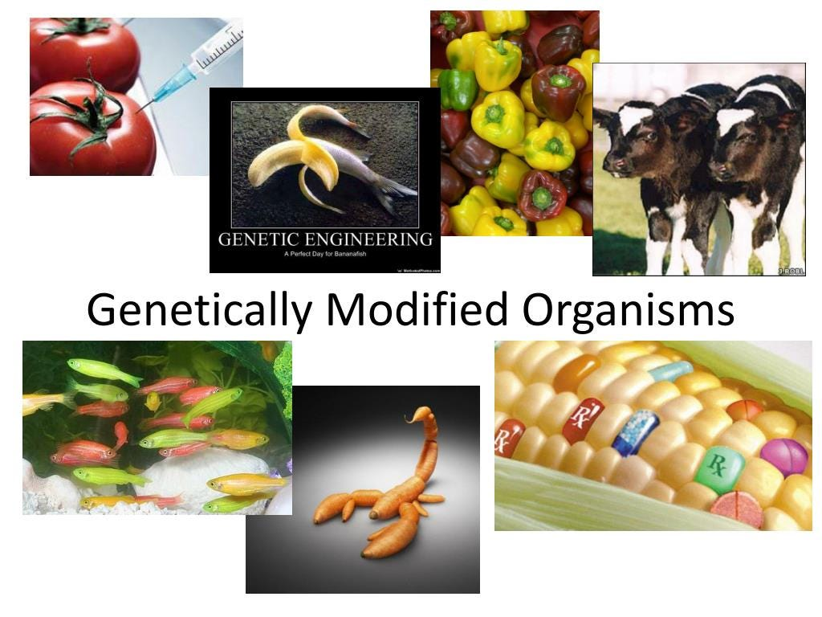
التوصيات/ وجهات نظر خاصة بتطبيق الهندسة الوراثية
تطوير الكائنات المعدلة وراثيًا ذات المخاطر البيئية الأقل. وهذا أمر بالغ الأهمية لأن هذا يؤثر بشكل مباشر على البشر.
الحاجة إلى تقنيات أكثر تقدمًا لتطوير نباتات معدلة وراثيًا ناجحة على نطاق واسع لتلبية متطلبات الغذاء في المستقبل.
يجب تقييد تطبيق تقنية CRISPR-Cas9 على البشر على الأقل حتى يمكن النظر بشكل كافٍ في سلامة وعواقب تحرير الجينات البشرية.
يجب الاستمرار في الدراسات طويلة الأمد لتقييم صحة الأطفال ذوي الثلاثة آباء المولودين باستخدام تقنية العلاج باستبدال المايتوكوندريا.

Slide 24
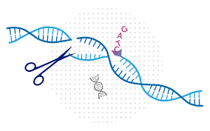

Thanks
for
Your
Interest

