Slide 1
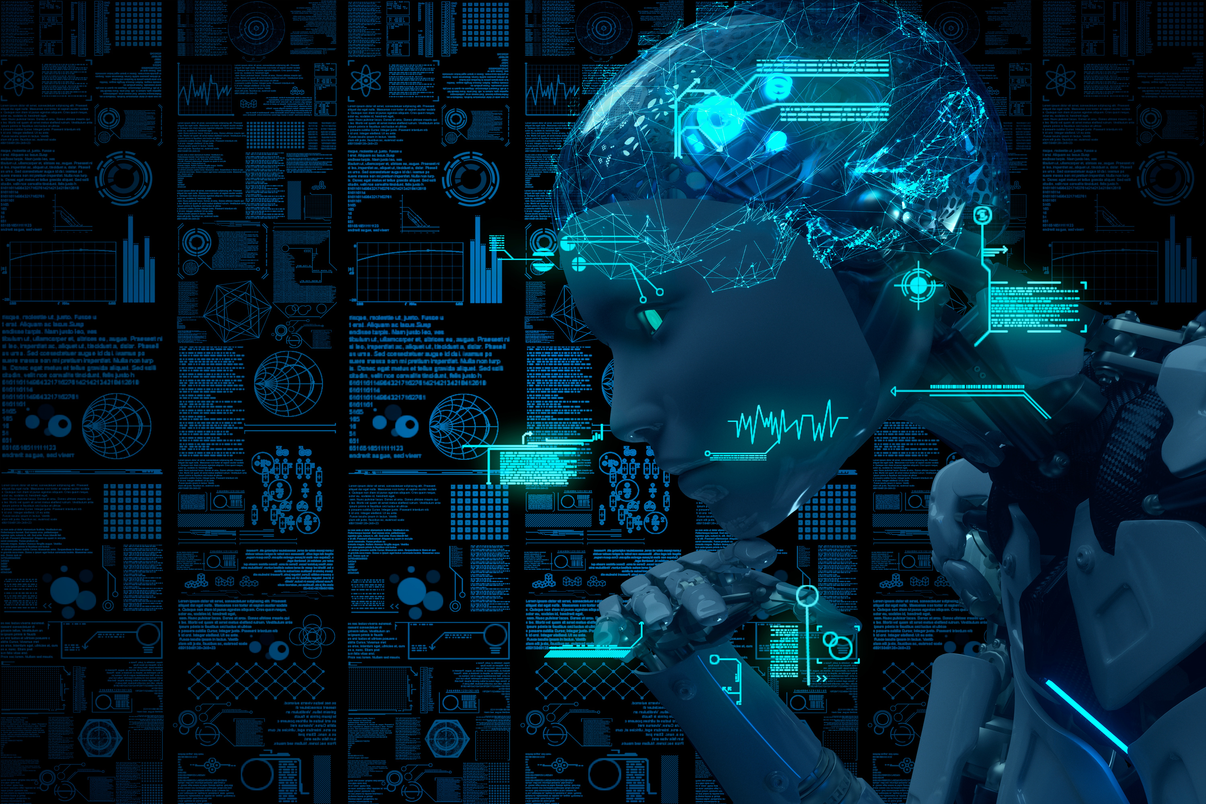
The Role of AI and Machine Learning in Medical Data
Noor Faris AbdulKareem

Slide 2
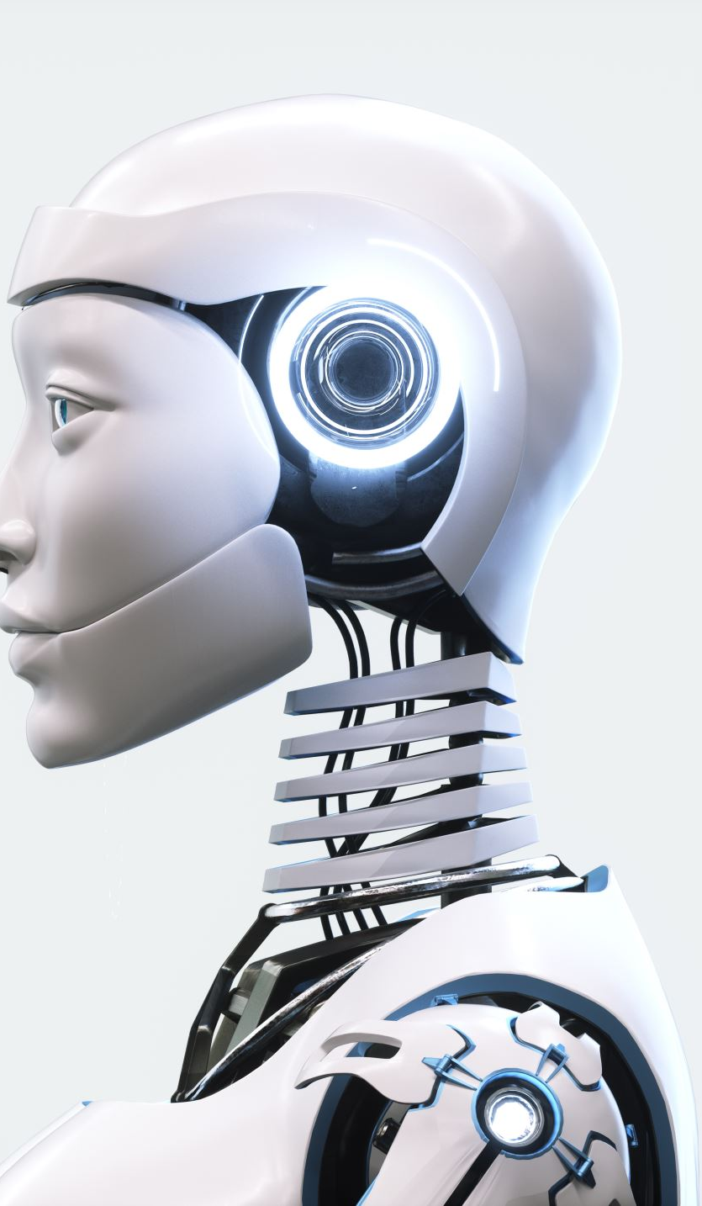
What is Artificial Intelligence (AI)?
Artificial Intelligence, or AI, is the ability of machines to perform tasks that typically require human intelligence. These tasks include understanding language, recognizing images, solving problems, and making decisions.

Slide 3
How Does AI Work?
AI works by
Learning from large amounts of data.
Using algorithms to identify patterns in the data.
Making predictions or decisions based on these patterns.
Think of it as teaching a computer by showing it many examples.

Slide 4
Where Do We See AI in Everyday Life?
AI is all around us! Some examples include
Virtual assistants like Siri, Alexa, or Google Assistant.
Movie and song recommendations on Netflix and Spotify.
Self-driving cars that navigate roads safely.
Smart home devices like thermostats that adjust automatically.
Chatbots that answer your questions online.

Slide 5
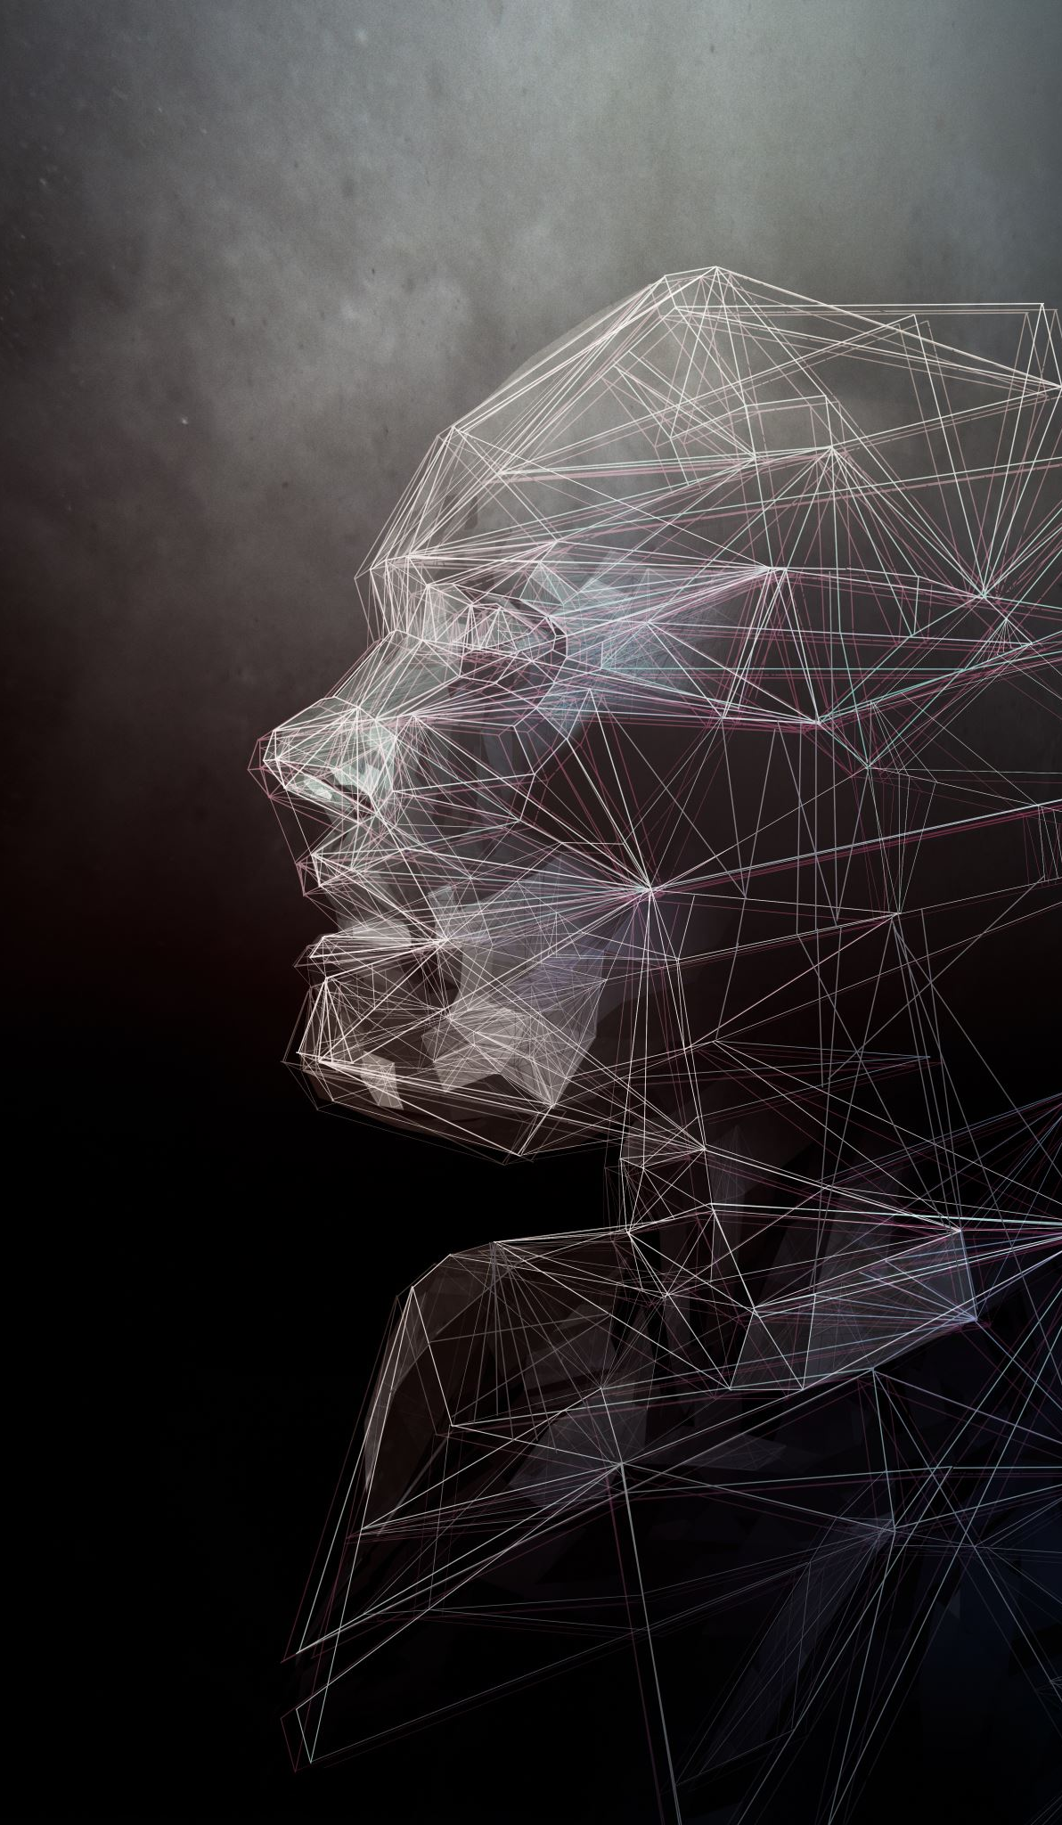
Types of AI: Based on Capabilities
Narrow AI: AI designed to perform a specific task, like virtual assistants or recommendation systems.
2. General AI: AI with the ability to perform any intellectual task a human can do (currently theoretical).
3. Super AI: A future concept where AI surpasses human intelligence in all fields.

Slide 6
Types of AI: Based on Functionality
Reactive Machines: AI that reacts to inputs without memory, like chess-playing AI.
Limited Memory: AI that uses past data for decision-making, like self-driving cars.
Theory of Mind: Hypothetical AI that understands emotions and social interactions.
Self-aware AI: Future AI with consciousness and self-awareness (currently speculative).

Slide 7
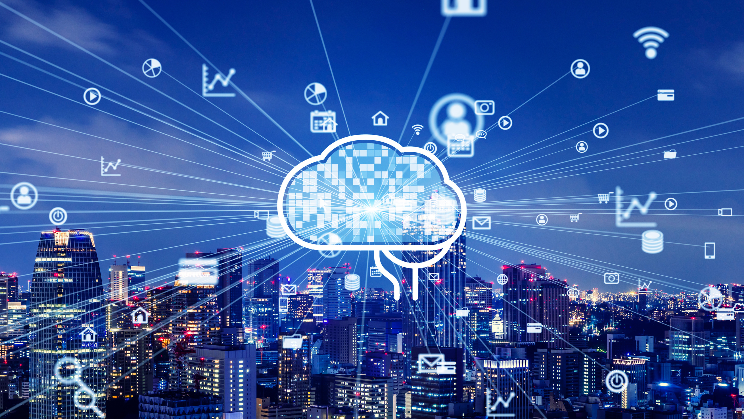
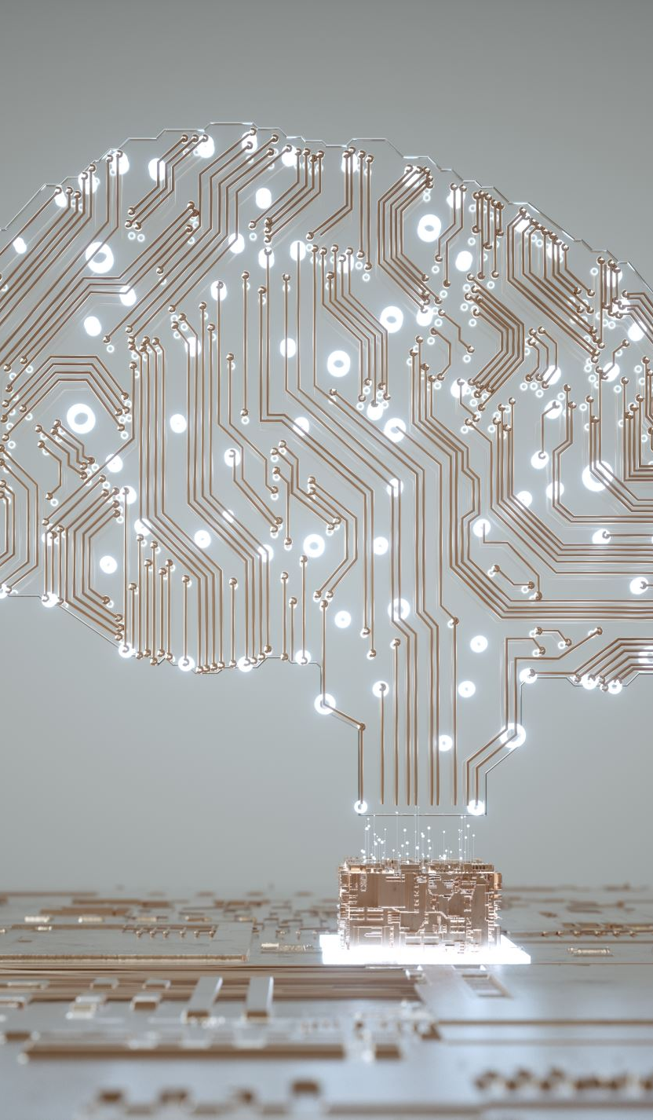
Key Components of AI
Machine Learning (ML)
Deep Learning:
Natural Language Processing (NLP)
Computer Vision
Robotics

Slide 8
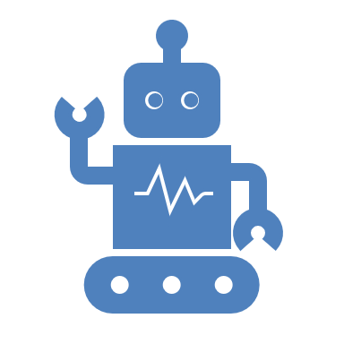
Introduction to Machine Learning (ML)
Machine Learning is a subset of Artificial Intelligence (AI) that allows systems to learn and improve from experience without being explicitly programmed. It uses data and algorithms to mimic the way humans learn.

Slide 9
Key Medical Applications:
Disease Diagnosis:
Radiology: ML models analyze X-rays, CT scans, and MRIs for detecting anomalies like tumors.
Pathology: Identifying cancerous cells in tissue samples.
Personalized Medicine:
Predicting the best treatments based on a patient’s genetic profile and medical history.
Healthcare Operations:
Predicting patient admissions and optimizing hospital resource allocation.

Slide 10
Introduction to Deep Learning (DL)
Deep Learning is a subset of Machine Learning that focuses on neural networks with many layers (deep architectures). It is designed to simulate the functioning of the human brain to process complex patterns in data.

Slide 11
Key Medical Applications:
Imaging Analysis:
Recognizing patterns in radiological images for diseases like lung cancer or brain disorders.
Diagnosing diabetic retinopathy using retinal images.
Natural Language Processing (NLP):
Analyzing unstructured data from clinical notes and medical literature.
Summarizing patient histories for quick reference.
Genomics:
Identifying genetic markers for diseases.
Understanding gene expression patterns for precision medicine.
Examples:
Google's DL algorithm for breast cancer detection outperforms human radiologists in specific tasks.

Slide 12
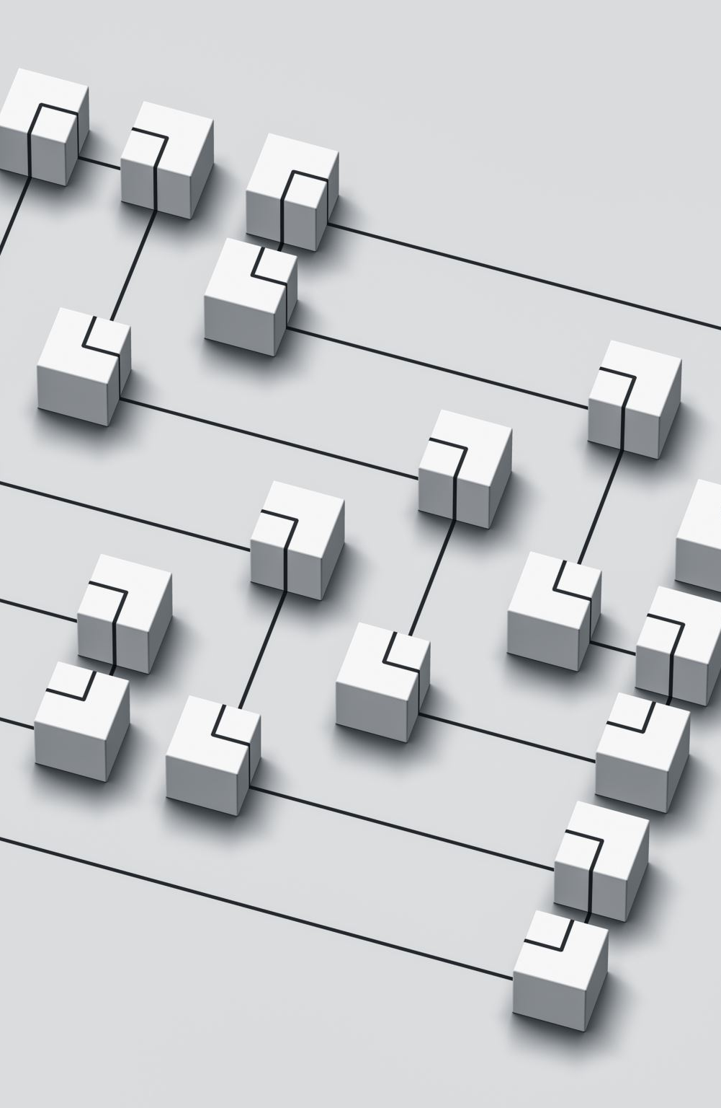
How Machine Learning Works
Machine Learning involves training a model using data, evaluating its performance, and using it to make predictions or decisions. Steps include:
1. Data Collection
2. Data Preprocessing
3. Model Training
4. Model Evaluation
5. Deployment and Iteration

Slide 13
Types of Machine Learning
1. Supervised Learning
2. Unsupervised Learning
3. Reinforcement Learning

Slide 14
Supervised Learning
In supervised learning, models are trained using labeled data. The algorithm learns from the input-output pair to predict outcomes.
Classification: Predicting a category (e.g., disease diagnosis: "cancer" or "no cancer"). Algorithms like Logistic Regression, Support Vector Machines (SVMs), Random Forests, and Neural Networks are used.
Regression: Predicting a continuous value (e.g., hospital stay duration). Algorithms like Linear Regression, Ridge Regression, and Support Vector Regression are used.

Slide 15
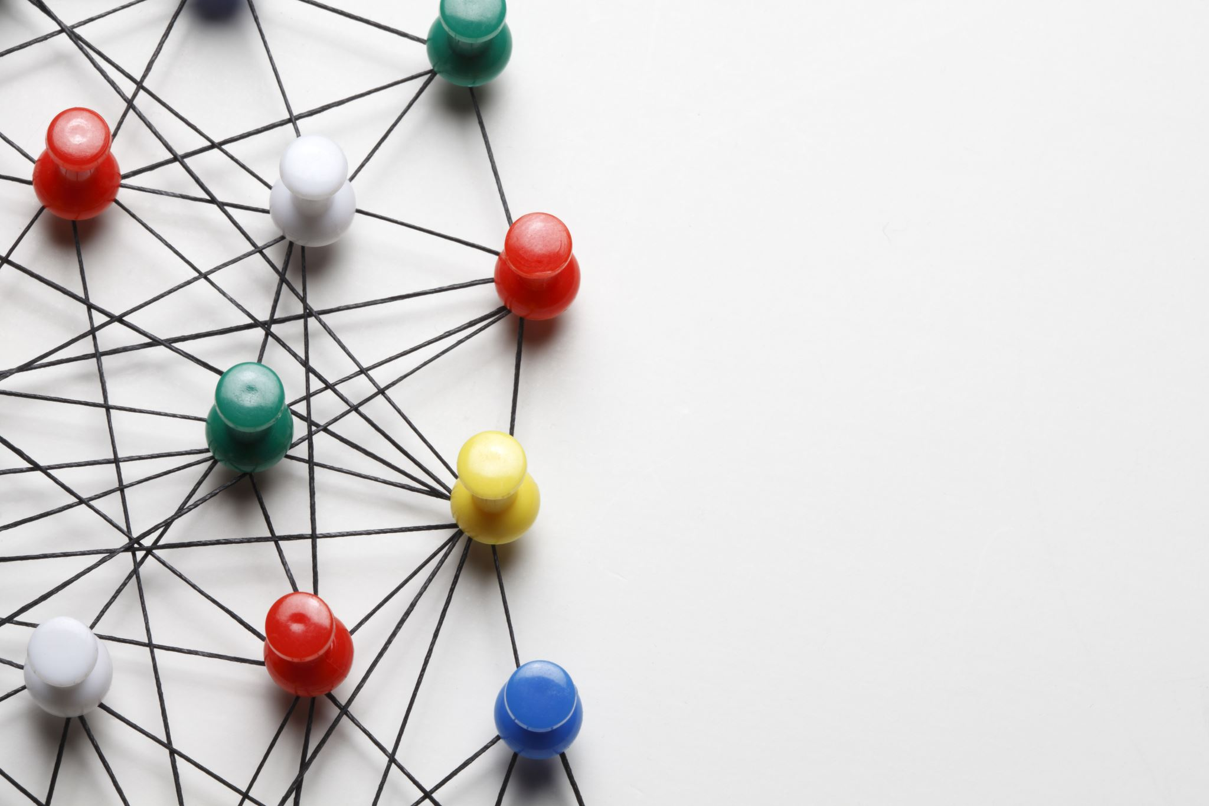
Unsupervised Learning
Unsupervised learning involves training a model on unlabeled data. The model identifies patterns, structures, or relationships in the data.
Clustering: Grouping similar data points (e.g., patient stratification based on symptoms). Algorithms like k-means, hierarchical clustering, and DBSCAN are used.
Dimensionality Reduction: Reducing the number of variables while preserving important information (e.g., simplifying gene expression data). Algorithms like Principal Component Analysis (PCA) and t-SNE are used.

Slide 16

Reinforcement Learning
Reinforcement Learning: An agent learns to interact with an environment by taking actions and receiving rewards or penalties. This is less common in direct medical diagnosis but has applications in robotics for surgery and personalized treatment strategies.

Slide 17
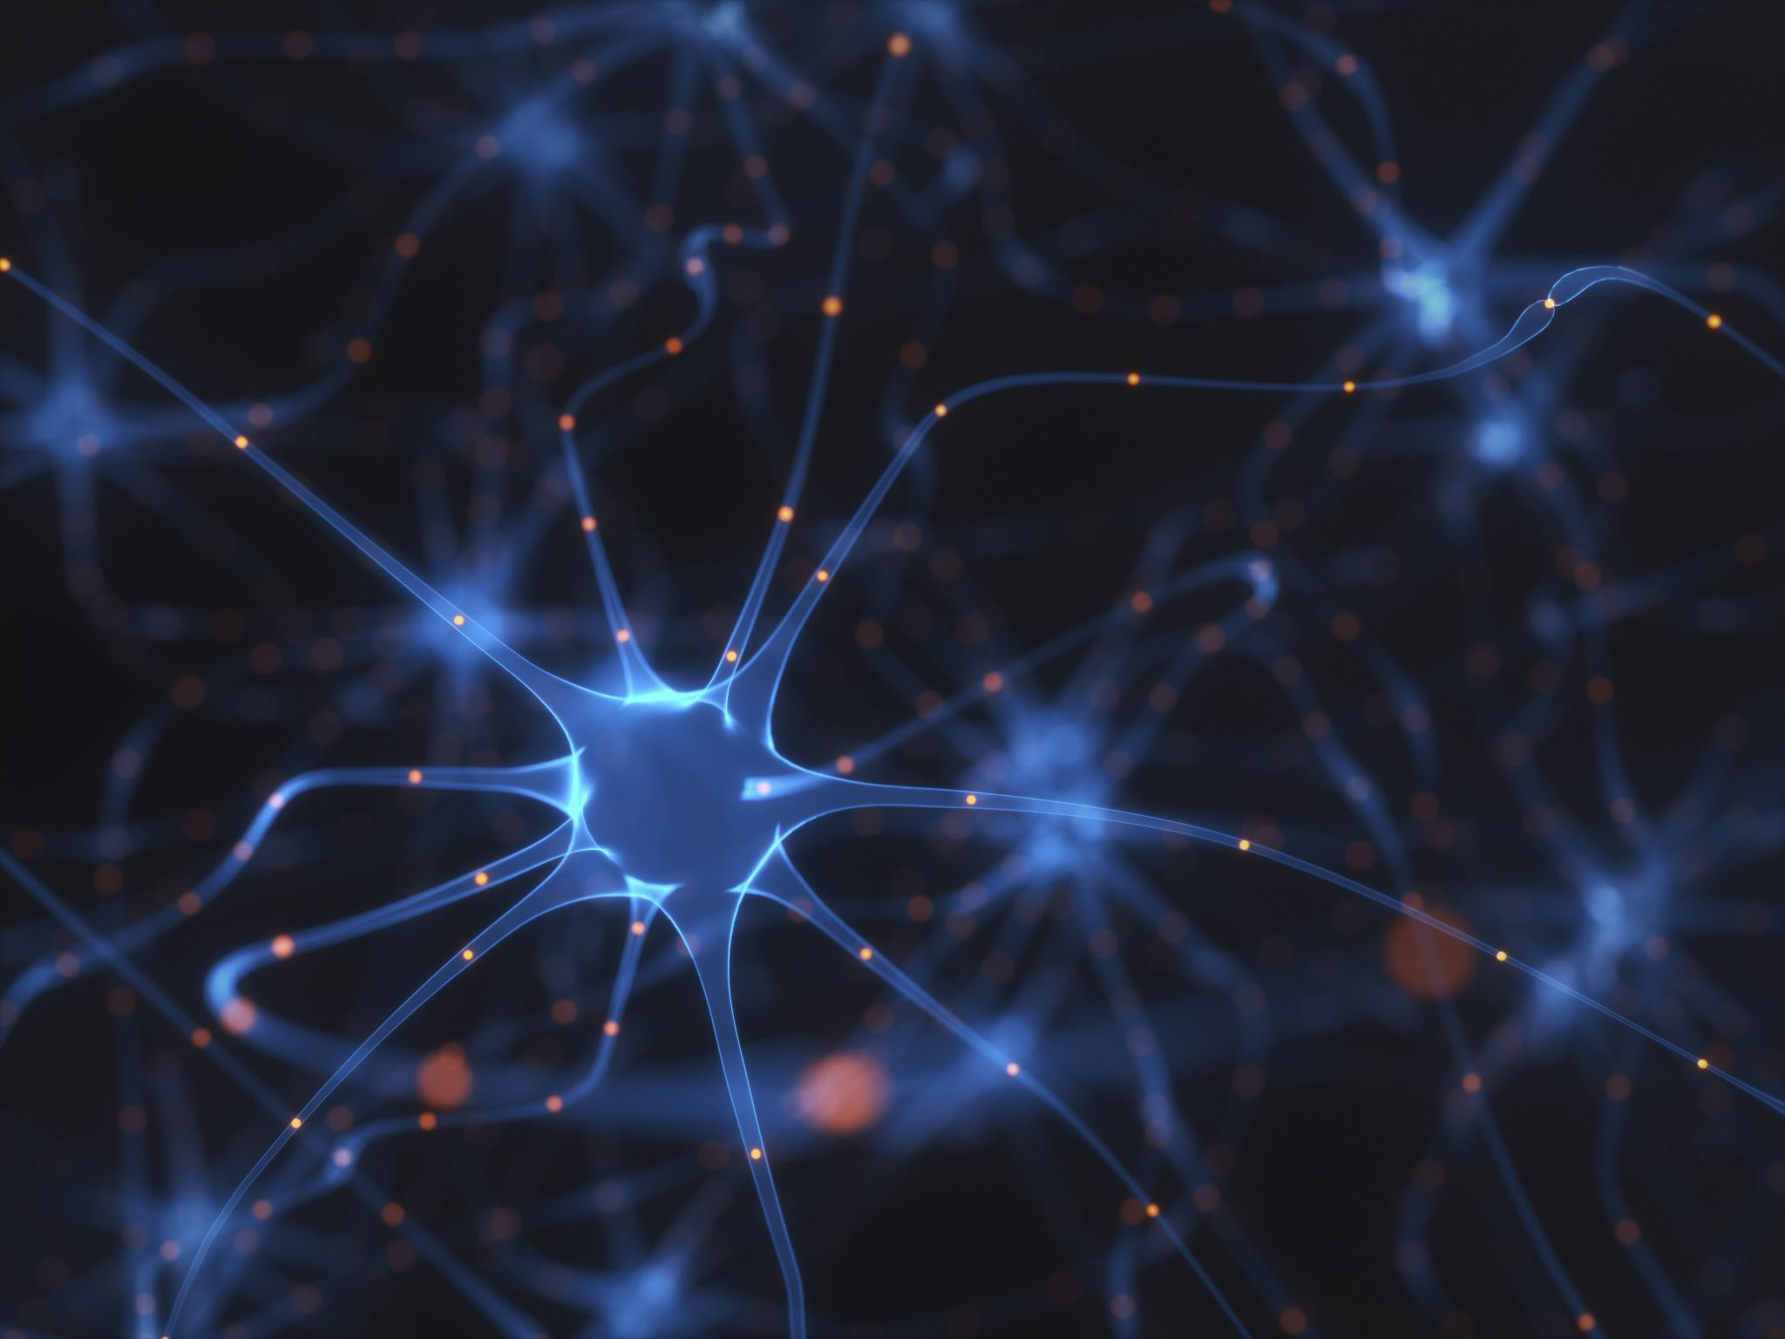
Introduction to Neural Networks
Neural networks are the backbone of Deep Learning. They are composed of layers of interconnected neurons that process data sequentially.

Slide 18
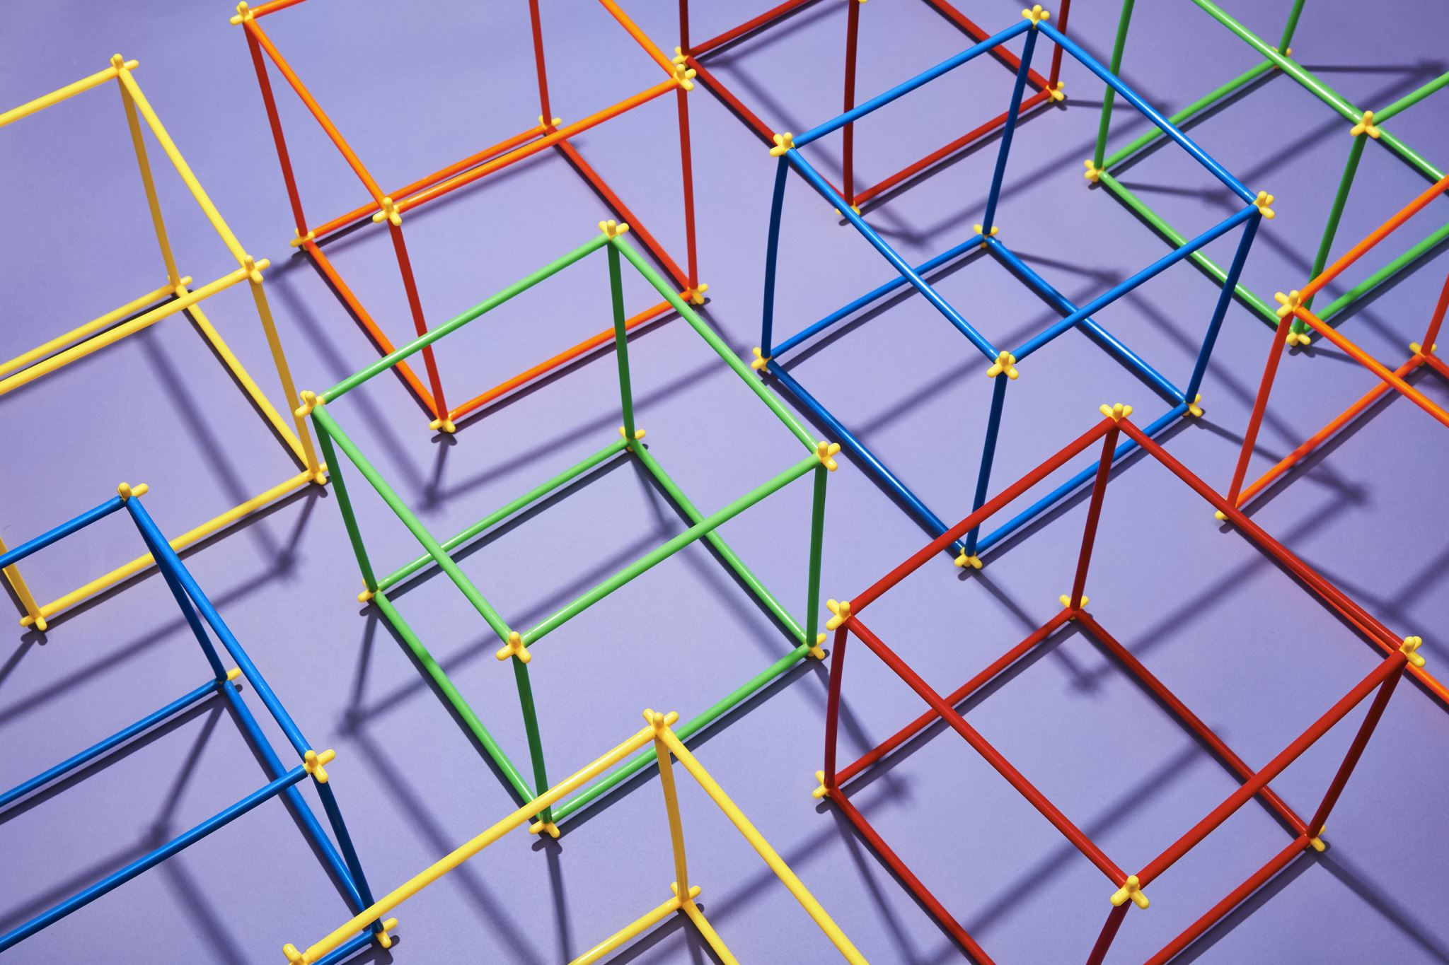
How Deep Learning Works
Deep learning is a type of artificial intelligence (AI) that helps computers learn from large amounts of data, just like humans learn from experience. It uses special programs called neural networks, which are inspired by how the human brain works. These networks can recognize patterns, make decisions, and improve over time.
Basic Parts of Deep Learning:
Neural Networks:
Think of them as layers of "virtual neurons" that process information step by step.
They take input (like an image or text), process it, and give an output (like identifying a face in a picture).

Slide 19
How Deep Learning Works
Layers of a Neural Network:
Input Layer: Takes raw data (like images or text).
Hidden Layers: Process the data and find important patterns.
Output Layer: Gives the final result (like “This is a cat” or “This is a dog”).
Learning Process (Step-by-Step):
Input Data: Give the model examples (like thousands of cat and dog pictures).
Processing: The network looks for patterns in the data.
Prediction: It tries to guess the correct answer.
Feedback (Error Checking): If it's wrong, the system adjusts to improve next time.
Repeat: The process continues until the model becomes accurate.

Slide 20
How Deep Learning Works
How Deep Learning Gets Better (Training Process):
The system adjusts tiny settings (called weights and biases) to improve accuracy, like learning from mistakes.
The learning process happens in cycles, called epochs, where the model improves each time it sees the data.
Common Uses of Deep Learning:
Healthcare: Finding diseases in medical images.
Self-Driving Cars: Detecting obstacles and making driving decisions.
Voice Assistants: Understanding and responding to speech (like Alexa or Siri).
Social Media: Recognizing faces and filtering content..

Slide 21
How Deep Learning Works
Challenges of Deep Learning:
Needs a Lot of Data: It works best with large amounts of examples.
Computational Power: Training deep learning models requires powerful computers.
Difficult to Explain: Sometimes, it's hard to understand how the AI made a decision.
Conclusion:
Deep learning helps computers learn complex tasks by recognizing patterns in data. It powers many modern technologies, and as it improves, it will continue to change industries like healthcare, transportation, and entertainment.

Slide 22
Types of Deep Learning Models
1. Convolutional Neural Networks (CNNs)
2. Recurrent Neural Networks (RNNs)
3. Generative Adversarial Networks (GANs)

Slide 23
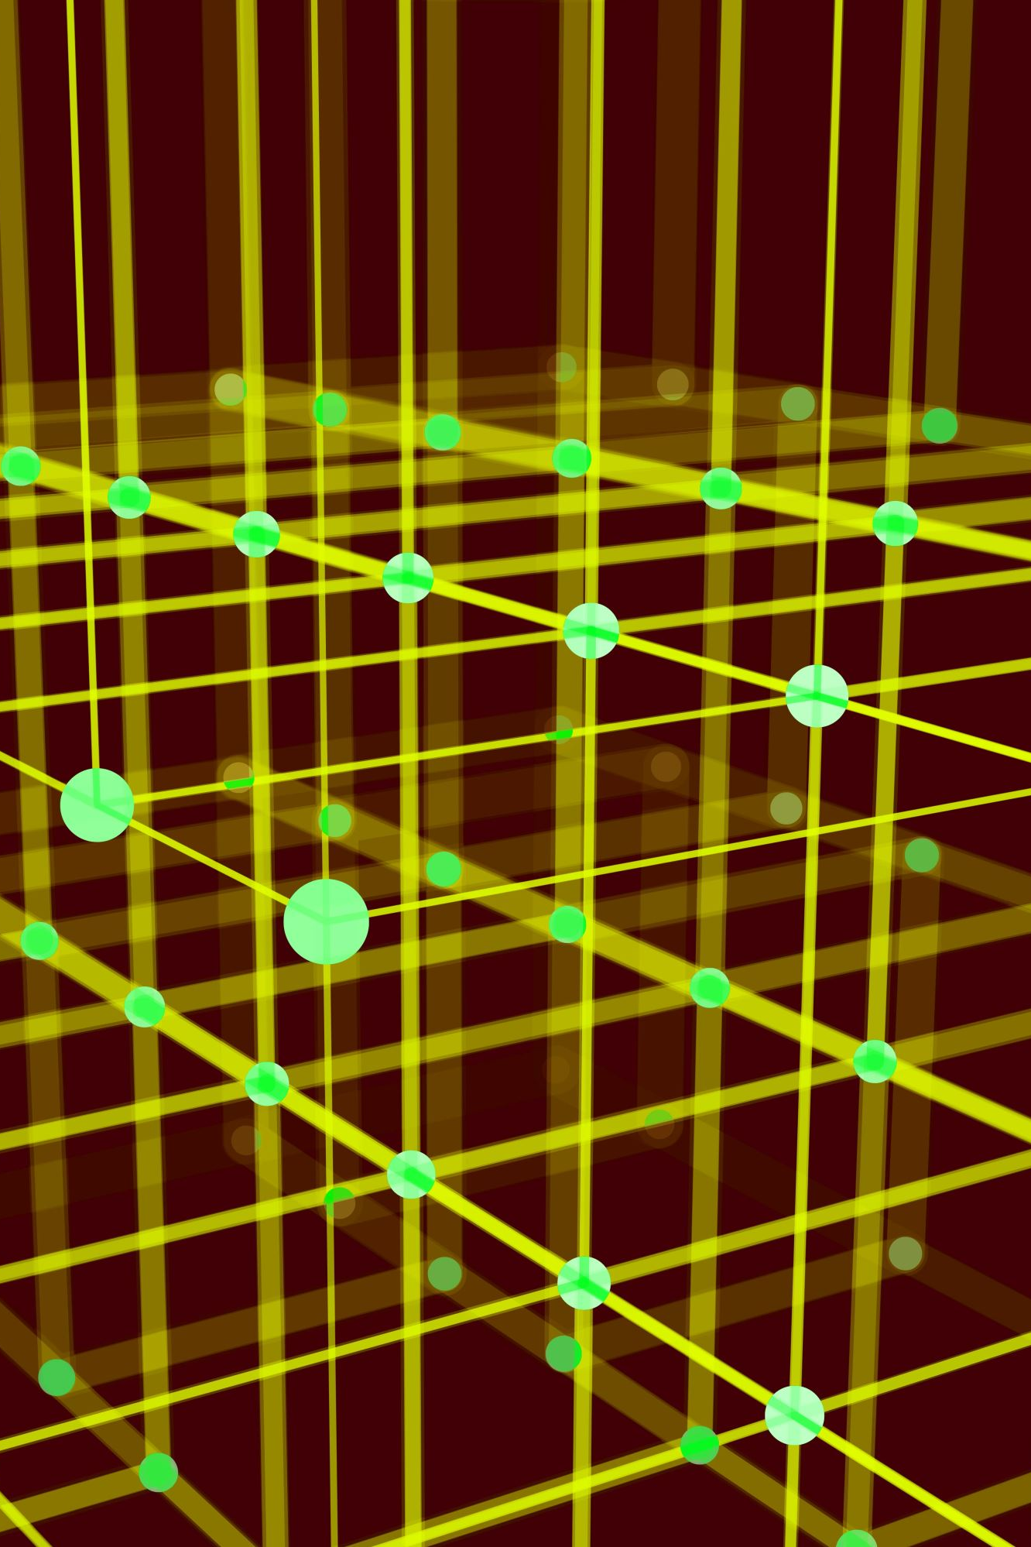
Convolutional Neural Networks (CNNs)
Specialized in processing spatial data (e.g., images). They extract patterns using convolutional layers. Common in image recognition and medical imaging.

Slide 24
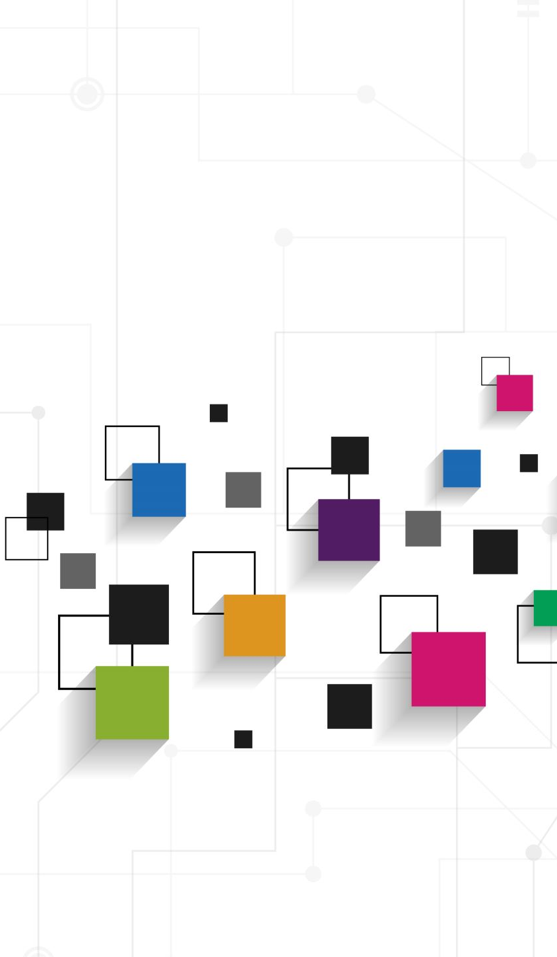
Recurrent Neural Networks (RNNs)
Designed for sequential data (e.g., time series, natural language processing). They have memory to store past inputs and make context-aware predictions.

Slide 25
Generative Adversarial Networks (GANs)
Consist of two networks (generator and discriminator) competing to produce realistic data, often used in image synthesis and creative AI applications.

Slide 26
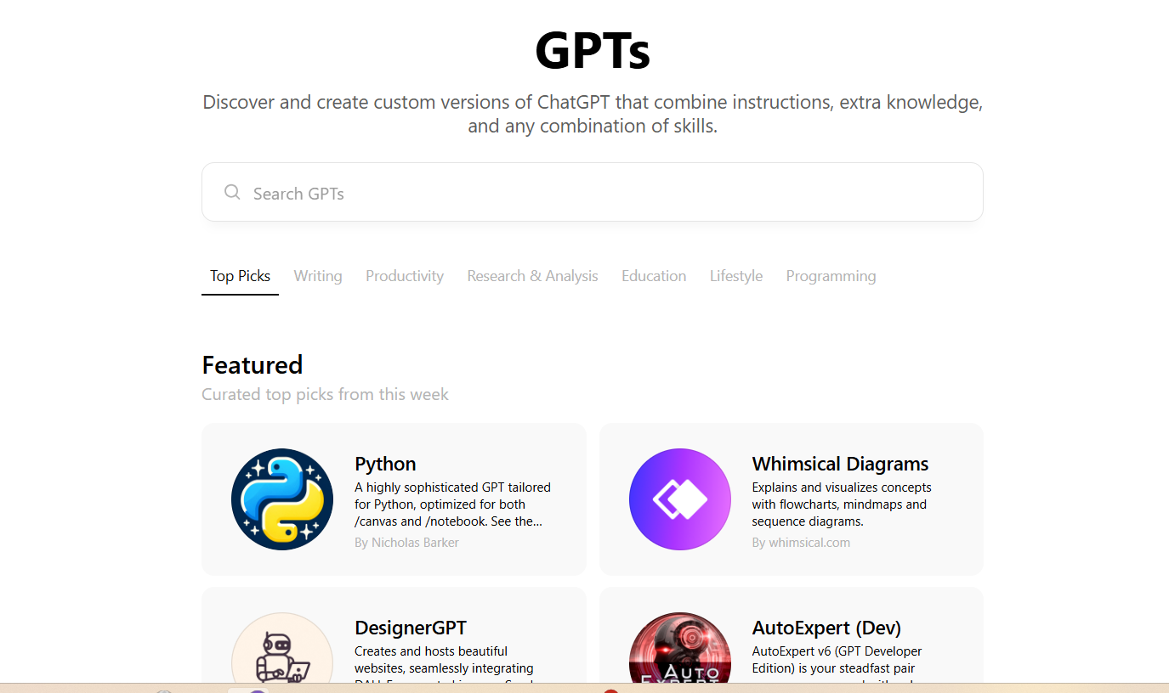
Transformer Networks
State-of-the-art models (e.g., GPT, BERT) used for language understanding and generation. They process sequential data in parallel, improving efficiency in tasks like translation and text summarization.

Slide 27
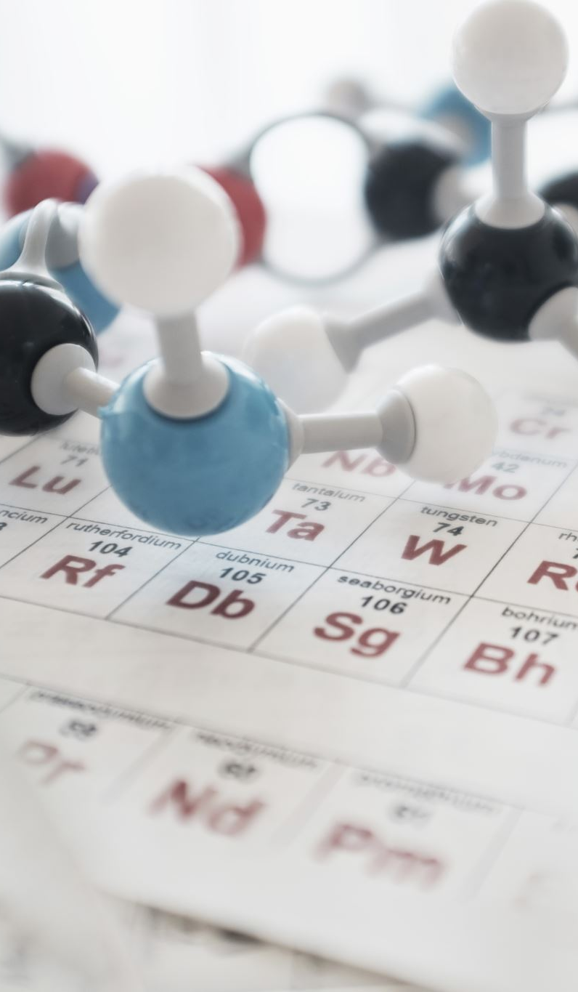
Applications of ML and DL in Medicine
1. Disease diagnosis
2. Predictive analytics for patient outcomes
3. Drug discovery
4. Personalized medicine

Slide 28
How Machine Learning Enhances Medical Data
Machine Learning processes large datasets to
Identify patterns and trends
Reduce errors in diagnosis
Provide actionable insights

Slide 29
How Deep Learning Enhances Medical Data
Deep Learning excels in analyzing complex medical data
Medical imaging (X-rays, MRIs)
Genomics and proteomics data
Early disease detection.

Slide 30
Challenges of Using AI in Medicine
Data privacy concerns
2. High computational requirements
3. Ensuring ethical use of AI
The black box problem refers to the lack of transparency and interpretability of AI algorithms. As a matter of fact, it is difficult to understand how an AI system arrives at its conclusions or predictions. This poses a significant challenge.
4. Limited access to quality data

Slide 31
Future of AI in Medicine
AI is poised to revolutionize healthcare by enabling
Real-time monitoring through wearable devices.
AI-powered telemedicine.
More accurate and faster diagnosis.

Slide 32
Ethical Considerations
Transparency in AI algorithms
Addressing biases in training data
Ensuring AI complements, not replaces, medical professionals.

Slide 33
Conclusion
Machine Learning and Deep Learning are transforming medicine by enhancing diagnostics, improving patient outcomes, and enabling precision medicine. Their potential is immense, but challenges must be addressed responsibly.

