Slide 1
Hashimoto's disease
اعداد:- م.م مياسة عبدالله علي

Slide 2
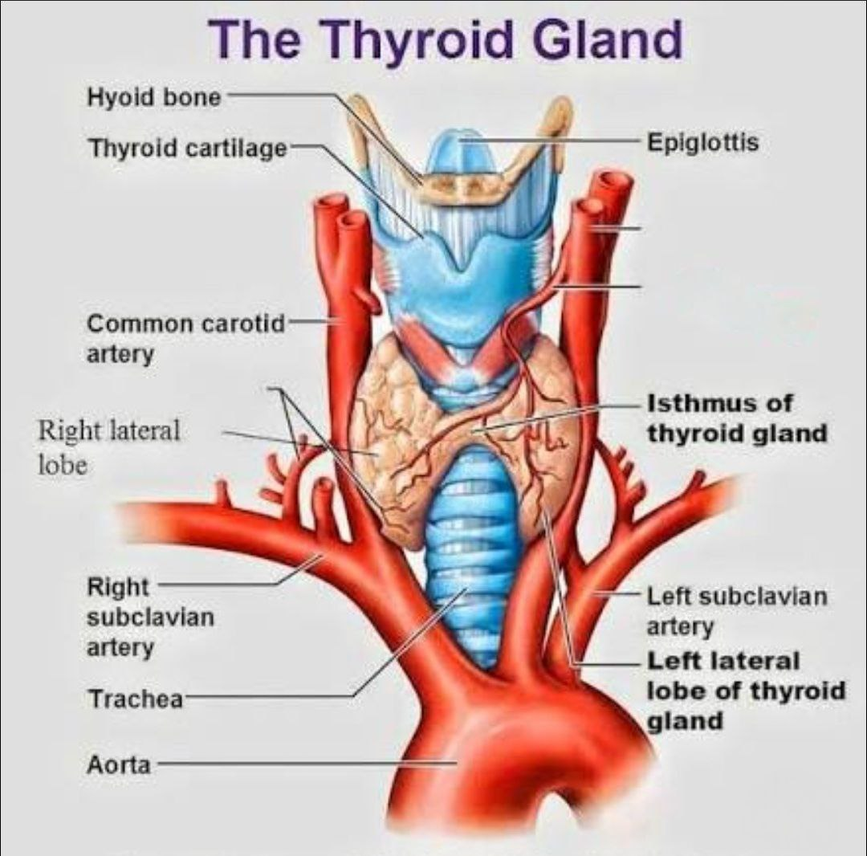
Hashimoto’s disease, also known as chronic autoimmune thyroiditishashimoto’s disease (chronic autoimmune thyroiditis), is an autoimmune disorder in which the immune system mistakenly attacks the thyroid gland, leading to chronic inflammation, gradual destruction of thyroid tissue, and eventually hypothyroidism (underactive thyroid).

Slide 3
1. Cause and Pathophysiology
In hashimoto’s disease, the immune system produces autoantibodies against thyroid components, primarily:anti-thyroid peroxidase antibodies (anti-tpo)anti-thyroglobulin antibodies (anti-tg)these antibodies attack and damage thyroid cells, leading to 1. Chronic inflammation of the gland. 2. Gradual destruction of thyroid hormone-producing cells. 3. Decreased secretion of thyroxine (T4) and triiodothyronine (T3). 4. Elevated thyroid-stimulating hormone (TSH) levels from the pituitary gland as compensation

Slide 4
2. Risk Factors and Triggers
There is no single cause, but several genetic and environmental factors contribute:Genetic predisposition (family history). 1-female gender (especially between ages 30–50). 2- other autoimmune diseases, such as type 1 diabetes, vitiligo, or 3- pernicious anemia. Iodine imbalance (deficiency or excess). 4- radiation exposure or chronic stress. 5- viral or bacterial infections that may trigger immune activation

Slide 5
3. Symptoms
Symptoms develop slowly over months or years and resemble those of hypothyroidism. General symptoms: 1-persistent fatigue and weakness. 2-weight gain despite normal or decreased appetite. 3-cold intolerance. 4-slowed speech and movements. 5-mild swelling in the neck (goiter).

Slide 6
Skin and hair
1-dry, rough skin. 2-hair loss or thinning. 3-pale or puffy face.
1-depression and slowed thinking. 2-poor memory and concentration 1-irregular or heavy menstrual periods. 2-infertility or recurrent miscarriage in severe cases.
Neurological and psychological
Reproductive (in women)

Slide 7
4. Diagnosis
Diagnosis is based on:
1. Blood tests
Elevated TSH. Low T4 and T3. Presence of anti-tpo or anti-tg antibodies. Detects thyroid enlargement or shrinkage
2.Physical examination
Shows a heterogeneous, coarse thyroid texture, typical of autoimmune thyroiditis.
3.Ultrasound

Slide 8
5. Treatment
There is no cure to stop the autoimmune attack, but treatment focuses on hormone replacement:
-1The main therapy is levothyroxine, a synthetic form of T4 hormone. -2The dosage is individualized based on TSH levels. -3Patients are monitored every 6–12 weeks initially until stable levels are achieved. 1-Take the pill in the morning on an empty stomach, 30 minutes before eating -2Avoid taking it with iron or calcium supplements at the same time, as they reduce absorption.
Important medication tips

Slide 9
-1Severe hypothyroidism (myxedema), which can be life-threatening. -2Goiter formation due to chronic TSH stimulation. -3High cholesterol and heart disease. -4Infertility or recurrent pregnancy loss. 1-Type 1 diabetes. -2Vitiligo. -3Pernicious anemia. -4Systemic lupus erythematosus (SLE).
6. Possible Complications (If Untreated)
7. Autoimmune association

Slide 10
-1Treatment is usually lifelong. -2Regular follow-up every 6 months to check tsh and t4 levels. -3Maintain a balanced diet and avoid excessive iodine intake (e.g., Seaweed supplements). -4Moderate physical activity helps improve energy and mood
8. Living with Hashimoto’s Disease

Slide 11
Thank you for listening

