Slide 1
Akkermansia muciniphila as a Potential Target for Oncotherapy
By
Ass. Prof. Dr Mohammed Abdalmalek Al-Bedhawi

Slide 2
Introduction
The human gut microbiota, a complex ecosystem of trillions of microorganisms, plays a crucial role in maintaining host health, influencing metabolism, immunity, and even cancer development. Among the myriad of gut bacteria, Akkermansia muciniphila has emerged as a key player in gut homeostasis and systemic health. This mucin-degrading bacterium, which constitutes 1-4% of the gut microbiota in healthy individuals, has garnered significant attention for its potential therapeutic applications, particularly in metabolic disorders, inflammatory diseases, and cancer. Recent studies have highlighted the role of A. muciniphila in modulating the immune system and its potential as a target for oncotherapy.
In this symposium will explores the mechanisms by which A. muciniphila influences cancer development and progression, its interactions with the immune system, and its potential as a therapeutic target in oncology.

Slide 3
1. The Role of Akkermansia muciniphila in Gut Homeostasis and Immune Modulation
Akkermansia muciniphila is a Gram-negative, anaerobic bacterium that resides in the mucus layer of the gastrointestinal tract. It thrives on mucin, a glycoprotein that forms the protective mucus layer, and its presence is associated with a healthy gut barrier function. By degrading mucin, A. muciniphila promotes the renewal of the mucus layer, which is essential for maintaining gut integrity and preventing the translocation of harmful bacteria and toxins into the bloodstream.
Beyond its role in gut barrier function, A. muciniphila has been shown to modulate the host immune system. It interacts with dendritic cells and macrophages, promoting the production of anti-inflammatory cytokines such as interleukin-10 (IL-10) and transforming growth factor-beta (TGF-β). These cytokines play a critical role in maintaining immune tolerance and preventing excessive inflammation, which is a hallmark of many diseases, including cancer. Additionally, A. muciniphila has been shown to enhance the production of short-chain fatty acids (SCFAs), such as acetate and propionate, which have anti-inflammatory and immunomodulatory effects.

Slide 4
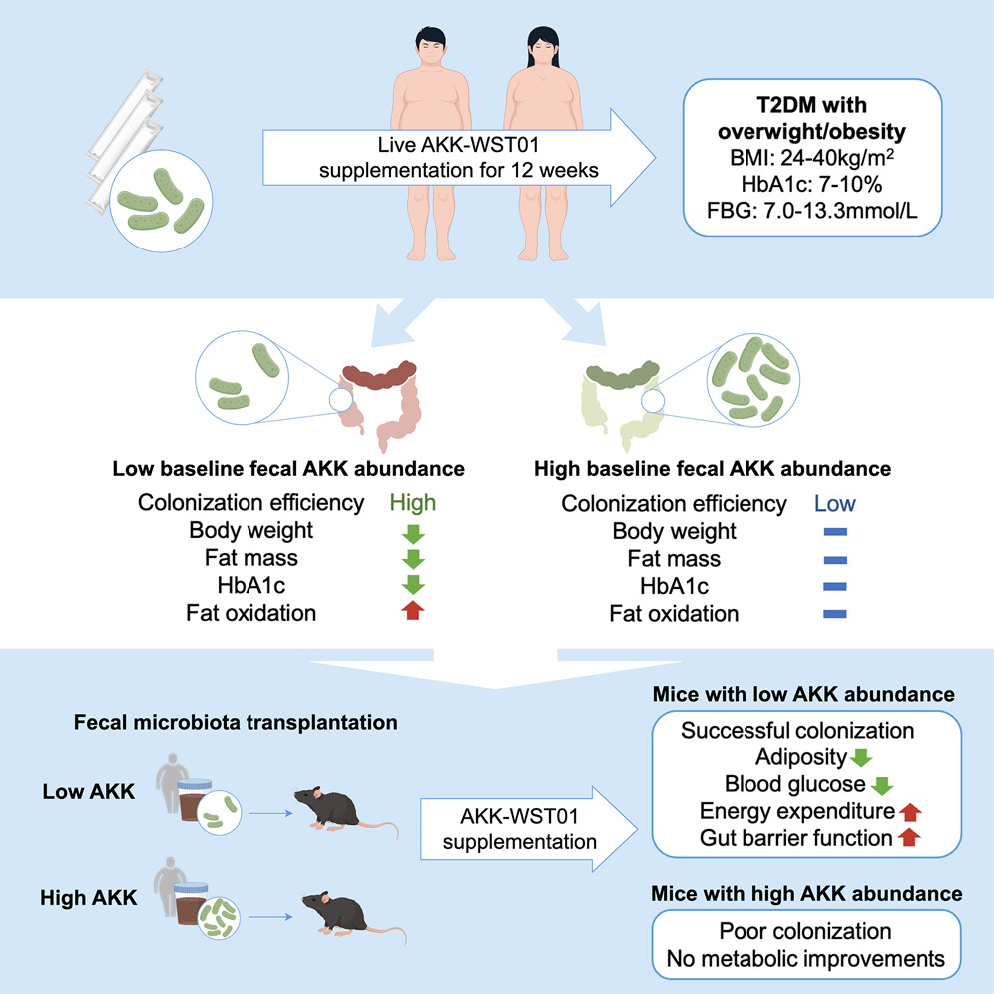
https://doi.org/10.1016/j.cmet.2024.12.010

Slide 5
2. Akkermansia muciniphila and Cancer: A Double-Edged Sword
The relationship between A. muciniphila and cancer is complex and context-dependent. While some studies suggest that A. muciniphila may have protective effects against certain types of cancer, others indicate that it could promote tumorigenesis in specific contexts. This duality underscores the importance of understanding the mechanisms by which A. muciniphila influences cancer development and progression.
2.1 Protective Effects of A. muciniphila in Cancer
Several studies have demonstrated that A. muciniphila may exert protective effects against cancer, particularly in the context of colorectal cancer (CRC). The bacterium's ability to maintain gut barrier integrity and reduce systemic inflammation is thought to play a key role in its anti-cancer effects. Moreover, A. muciniphila has been associated with improved responses to cancer immunotherapy, particularly immune checkpoint inhibitors (ICIs). ICIs, such as anti-PD-1 and anti-CTLA-4 antibodies, have revolutionized cancer treatment by enhancing the immune system's ability to recognize and destroy cancer cells. However, not all patients respond to these therapies, and the gut microbiota has been implicated in modulating their efficacy. Studies have shown that patients with higher levels of A. muciniphila in their gut microbiota are more likely to respond to ICIs, suggesting that the bacterium may enhance the anti-tumor immune response.

Slide 6
Risks
2.2 Potential Tumor-Promoting Effects of A. muciniphila
Despite its potential protective effects, A. muciniphila has also been implicated in promoting tumorigenesis in certain contexts. For example, some studies have suggested that A. muciniphila may contribute to the development of gastric cancer by degrading the protective mucus layer, exposing the underlying epithelial cells to harmful pathogens and toxins. Additionally, A. muciniphila has been shown to produce ammonia as a byproduct of mucin degradation, which can induce DNA damage and promote tumorigenesis.
Furthermore, the immunomodulatory effects of A. muciniphila may have contrasting effects depending on the tumor microenvironment. While the bacterium's ability to promote anti-inflammatory responses may be beneficial in some cancers, it could also suppress anti-tumor immunity in others. For instance, in cancers that rely on a pro-inflammatory microenvironment for growth and progression, the anti-inflammatory effects of A. muciniphila may accidentally promote tumorigenesis
Notes:
Colorectal Cancer: Chronic inflammation, such as that seen in inflammatory bowel disease (IBD), is a major risk factor for colorectal cancer. Inflammatory cytokines like IL-6, TNF-α, and IL-1β promote tumor growth, angiogenesis, and metastasis.
Pancreatic Cancer: Pancreatic ductal adenocarcinoma (PDAC) is strongly associated with a pro-inflammatory microenvironment. Inflammatory cells, such as tumor-associated macrophages (TAMs) and cytokines like IL-6 and TGF-β, contribute to tumor progression, immune evasion, and fibrosis.
Hepatocellular Carcinoma

Slide 7
3. Mechanisms of Akkermansia muciniphila-Mediated Immune Modulation in Cancer
The immunomodulatory effects of A. muciniphila are mediated through several mechanisms, including the production of short-chain fatty acids, modulation of dendritic cell function, and interaction with Toll-like receptors (TLRs). These mechanisms collectively influence the anti-tumor immune response and may have implications for cancer therapy.
3.1 Short-Chain Fatty Acids (SCFAs) and Anti-Tumor Immunity
SCFAs, particularly acetate, propionate, and butyrate, are produced by A. muciniphila through the fermentation of dietary fiber and mucin.
3.2 Dendritic Cell Modulation and Antigen Presentation
Dendritic cells (DCs) are key players in the immune system, responsible for capturing, processing, and presenting antigens to T cells.
3.3 Toll-Like Receptor (TLR) Signaling
TLRs are a family of pattern recognition receptors that play a critical role in the innate immune response by recognizing pathogen-associated molecular patterns (PAMPs). A. muciniphila has been shown to interact with TLR2 and TLR4, leading to the activation of downstream signaling pathways that modulate immune responses.

Slide 8
4. Akkermansia muciniphila as a Therapeutic Target in Oncology
Given its immunomodulatory effects and potential influence on cancer development, A. muciniphila has emerged as a promising therapeutic target in oncology. Several strategies have been proposed to harness the therapeutic potential of A. muciniphila, including the use of probiotics, prebiotics, and fecal microbiota transplantation (FMT).
4.1 Probiotics and Prebiotics
Probiotics are live microorganisms that confer health benefits when administered in adequate amounts. A. muciniphila has been proposed as a potential probiotic for cancer therapy, particularly in combination with immune checkpoint inhibitors ICIs. Preclinical studies have shown that oral administration of A. muciniphila can enhance the efficacy of (ICIs) in mouse models of cancer, leading to improved tumor control and survival. Prebiotics, which are non-digestible food ingredients that promote the growth of beneficial bacteria, have also been explored as a means to increase the abundance of A. muciniphila in the gut. For example, dietary supplementation with polyphenols, which are found in fruits and vegetables, has been shown to promote the growth of A. muciniphila and enhance its beneficial effects.
Notes:
immune checkpoint inhibitors (ICIs)

Slide 9
4.2 Fecal Microbiota Transplantation (FMT)
FMT involves the transfer of fecal material from a healthy donor to a recipient, with the aim of restoring a healthy gut microbiota. FMT has been explored as a potential therapy for various diseases, including cancer.
4.3 Challenges and Future Directions
While the therapeutic potential of A. muciniphila in oncology is promising, several challenges remain. First, the dual role of A. muciniphila in cancer, with both protective and tumor-promoting effects, underscores the need for a deeper understanding of its mechanisms of action. Second, the safety and efficacy of A. muciniphila-based therapies need to be carefully evaluated in clinical trials. Finally, the development of standardized protocols for the production, storage, and administration of A. muciniphila-based therapies is essential to ensure their widespread use in clinical practice.

Slide 10
Conclusion
Akkermansia muciniphila is a key player in gut homeostasis and immune modulation, with significant potential as a therapeutic target in oncology. Its ability to enhance the efficacy of immune checkpoint inhibitors and modulate the tumor microenvironment makes it a promising candidate for cancer therapy. However, the dual role of A. muciniphila in cancer, with both protective and tumor-promoting effects, highlights the need for further research to fully understand its mechanisms of action and optimize its therapeutic potential. As our understanding of the gut microbiota and its role in cancer continues to evolve, A. muciniphila may emerge as a valuable tool in the fight against cancer.

