Slide 2
It is a test that reads the percentage of blood bound to glucose molecules. It measures the amount of blood sugar (glucose) attached to hemoglobin over the past three months (red blood cells have three months to live) Why is a cumulative sugar test?

Slide 3
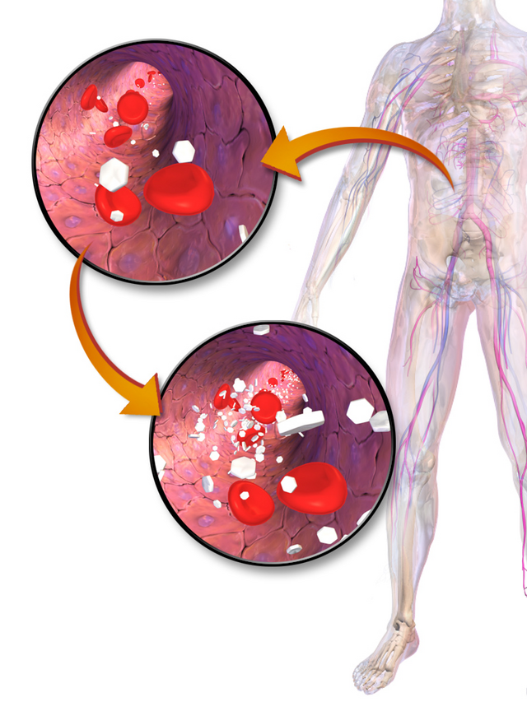
The cumulative sugar test is performed when a doctor requests it to diagnose diabetes or to monitor blood sugar levels in people who have a high risk of developing diabetes, the test is repeated regularly between three to six months, based on the person’s health status.

Slide 4
HbA1c is a blood test that is used to diagnose type 2 diabetes. It is also used to monitor blood glucose control in people with diabetes.
HbA1c is short for glycated haemoglobin. The test is also sometimes called haemoglobin A1c.

Slide 5
Haemoglobin (Hb) is the protein in red blood cells that carries oxygen through your body. HbA1c refers to glucose and haemoglobin joined together (the haemoglobin is ‘glycated’). The amount of HbA1c formed is directly related to the amount of glucose in your blood.
Red blood cells live for an average of 120 days, so HbA1c gives an indication of how much sugar there has been in your blood over the past few months. It’s different to a blood glucose test, which measures how much sugar is in the blood at that moment.

Slide 6
Why would I need an HbA1c test?
If you are at increased risk of type 2 diabetes, your doctor may recommend this test to check if you have diabetes. The HbA1c test may also be done if you have symptoms of type 2 diabetes, to confirm a diagnosis.
For people with diabetes, the test is used to indicate how well your diabetes has been controlled over the last few months. People with diabetes are advised to have this test every 3 months. This can be less frequent if your blood sugar levels are well controlled.

Slide 7
Monitoring HbA1c in people with diabetes is important. That’s because the higher your HbA1c, the greater your risk of developing diabetes complications such as:
diabetic retinopathy
diabetic kidney disease
diabetic neuropathy

Slide 8
How to prepare for an HbA1c test
No preparation is needed for this blood test.
Understanding your results
It’s important to discuss your test results with your doctor to see what they mean in your situation.

Slide 9
Diagnosis of diabetes
A diagnosis of diabetes can be made if your HbA1c result is 6.5% (48 mmol/mol) or more. Sometimes the test needs to be repeated to confirm the result.
If your HbA1c level is lower than this, you might need other tests to check whether you have diabetes or not.

Slide 10
Diabetes monitoring
If you have diabetes, the recommended general HbA1c target is 7% (53 mmol/mol) or less.
Your HbA1c target will depend on several factors, such as:
the type of diabetes you have
how long you have had diabetes
your health in general
If your HbA1c result is higher than your target range, your doctor may consider changing your treatment or monitoring your blood sugars more closely.

Slide 11
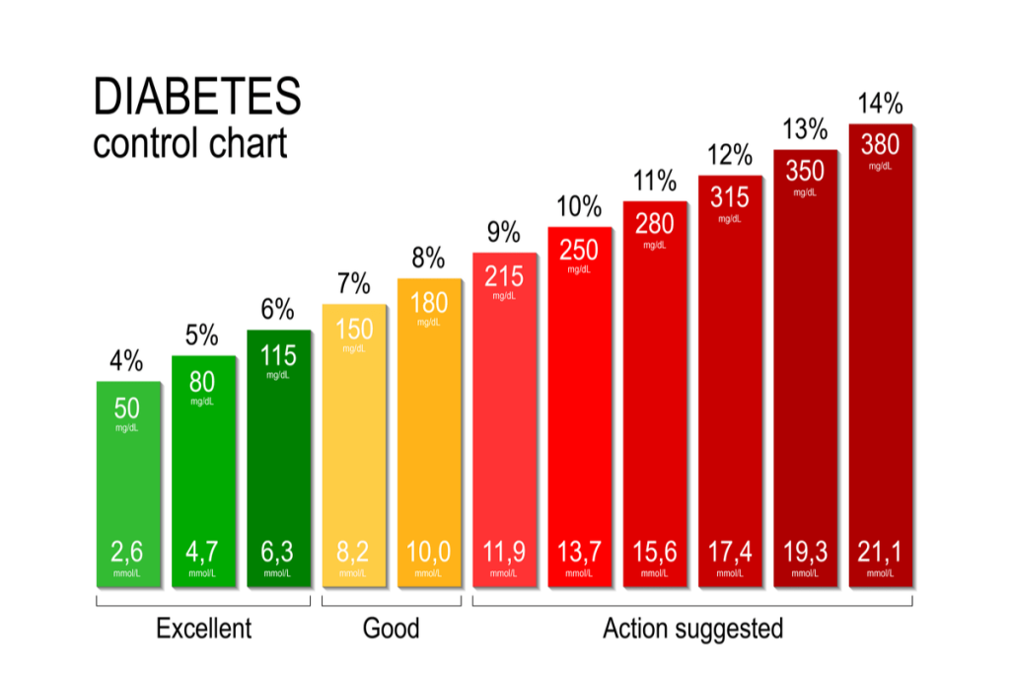
What can affect the results
Some medical conditions can alter HbA1c results, including:
anaemia
iron deficiency
kidney failure
pregnancy
Talk to your doctor about your results and what they mean for you.

Slide 12
What is it used for?
An A1C test may be used to screen for or diagnose:
Type 2 diabetes. With type 2 diabetes your blood glucose gets too high because your body doesn't make enough insulin to move blood sugar from your bloodstream into your cells, or because your cells stop responding to insulin.
Prediabetes. Prediabetes means that your blood glucose levels are higher than normal, but not high enough to diagnosed as diabetes. Lifestyle changes, such as healthy eating and exercise, may help delay or prevent prediabetes from becoming type 2 diabetes.

Slide 13
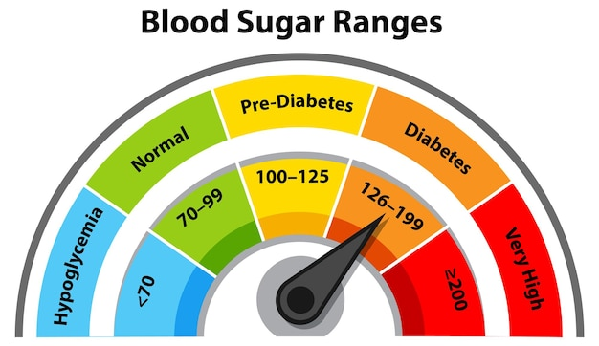
If you have diabetes or prediabetes, an A1C test can help monitor your condition and check how well you've been able to control your blood sugar levels

Slide 14
Why do I need an HbA1C test?
The Centers for Disease Control (CDC) recommends A1C testing for diabetes and prediabetes if:
You are over age 45.
If your results are normal, you should repeat the test every 3 years.
If your results show you have prediabetes, you will usually need to be tested every 1 to 2 years. Ask your provider how often to get tested and what you can do to reduce your risk of developing diabetes.
If your results show you have diabetes, you should get an A1C test at least twice a year to monitor your condition and treatment.

Slide 15
You are under 45 and are more likely to develop diabetes because you:
Have prediabetes.
Are overweight or have obesity.
Have a parent or sibling with type 2 diabetes.
Have high blood pressure or high cholesterol levels.
Have heart disease or have had a stroke.
Are physically active less than 3 times a week.
Have had gestational diabetes (diabetes during pregnancy) or given birth to a baby over 9 pounds

Slide 16
You may also need an A1C test if you have symptoms of diabetes, such as:
Feeling very thirsty
Urinating (peeing) a lot
Losing weight without trying
Feeling very hungry
Blurred vision
Numb or tingling hands or feet
Fatigue
Dry skin
Sores that heal slowly
Having more infections than usual

Slide 17
What happens during an A1C test?
A health care professional will take a blood sample from a vein in your arm, using a small needle. After the needle is inserted, a small amount of blood will be collected into a test tube or vial. You may feel a little sting when the needle goes in or out. This usually takes less than five minutes.

Slide 18
Will I need to do anything to prepare for the test?
You don't need any special preparations for an A1C test.
Are there any risks to the test?
There is very little risk to having a blood test. You may have slight pain or bruising at the spot where the needle was put in, but most symptoms go away quickly.

Slide 19
What do the results mean?
A1C results tell you what percentage of your hemoglobin is coated with glucose. The percent ranges are just a guide to what is normal. What's normal for you depends on your health, age, and other factors. Ask your provider what A1C percentage is healthy for you.
To diagnose diabetes or prediabetes, the percentages commonly used are:
Normal: A1C below 5.7%
Prediabetes: A1C between 5.7% and 6.4%
Diabetes: A1C of 6.5% or higher

Slide 20
Is there anything else I need to know about an HbA1C test?
The A1C test is not used to diagnose gestational diabetes or type 1 diabetes.
Also, if you have a condition that affects your red blood cells, such as anemia or another type of blood disorder, an A1C test may not be accurate for diagnosing diabetes. Kidney failure and liver disease can also affect A1C results. In these cases, your provider may recommend different tests to diagnose diabetes and prediabetes.

Slide 21
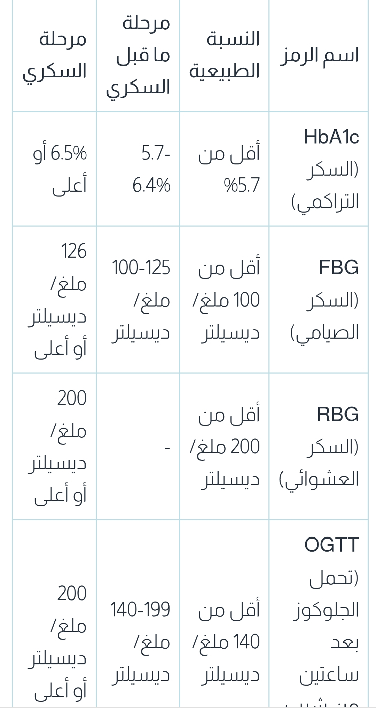

Slide 22
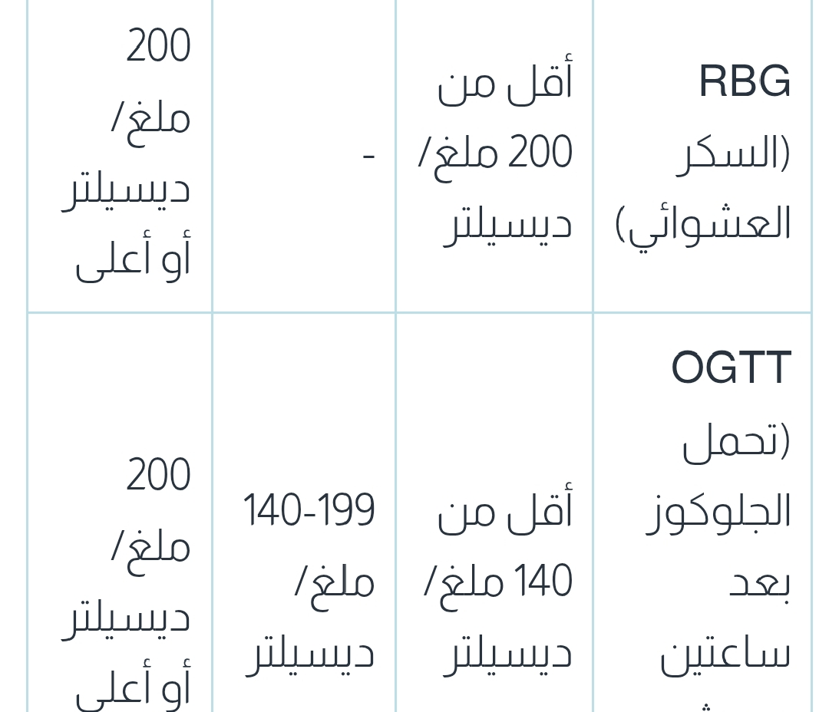

Slide 24
Thank you for attention

