Slide 1
Clear Retainer Fabrication
Haider Mohammed Ali Ahmed

Slide 2
Introduction
Orthodontic retention refers to holding the teeth in their final functional and aesthetic position. As orthodontic treatment involves moving the teeth to a new position by leveling and alignment or translation movement, time is required for reorganizing tooth neighboring structures.

Slide 3
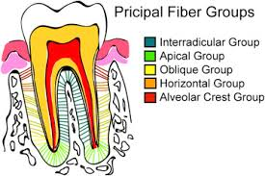
These structures involve bone, gingival and trans-septal fibers. Also, neuromuscular and soft tissue adaption of neighboring structures is necessary to accommodate these teeth in their new positions.

Slide 4
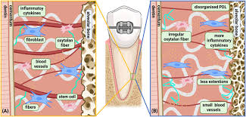
Reorganization and adaptation of these structures prevent relapse or moving back of the teeth to their original position. Reorganization of the different structures requires different times, such as PDL fibers reorganizing in 3–4 months, gingival collagenous fibers in 4–6 months and elastic fibers requiring up to 6 months. Furthermore in young patients retention is required till the patient is growing.

Slide 5
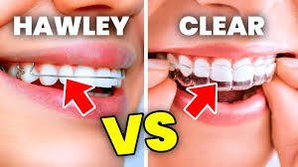
Removable and fixed retainers are used for orthodontic retention. These retainers work on the principle that they should not interfere with the physiological movement of the teeth so that reorganization of the gingival and periodontal fibers can easily take place.

Slide 6
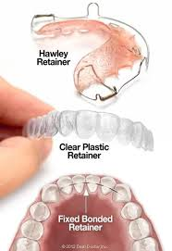
The most popular removable retainers are the Hawley retainer (HR), Begg or Wraparound retainer, Spring or Barrer retainers or clip-on retainers and Vacuum or pressure-formed retainers (VFR or PFR).

Slide 7
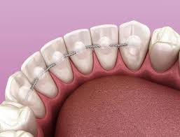
In fixed retainers, 0.017-inch multi-stranded wire, 0.0195-inch coaxial wire, fiber-reinforced composite wires, polyethylene ribbon-reinforced resin retainers, twist flex, flex tech, Beta-titanium and NiTi or titanium-based CAD CAM retainers

Slide 8
In contemporary orthodontics, the retention protocol depends upon patient preferences, clinician experience, type of malocclusion, type of tooth movement during treatment, final occlusal outcomes and cost of the retainers . This workshop answers important questions related to the selection of orthodontic retainers, the retention protocol and potential problems associated with these retainers.

Slide 9
Clinical Question :
Why Orthodontic Retainers Should Be Used?

Slide 10
Evidence
Systematic Review and Meta-Analysis
Littlewood, 2016
This Cochrane systematic review included two RCTs investigating the stability of lower incisors by using Little’s Irregularity Index. The average relapse was 0.43 mm and 1.03 mm using fixed and removable appliances after 1 year of retention in one trial, while this was 0.05–0.07 after 18 months in another trial. Authors' conclusions
They did not find any evidence that wearing thermoplastic retainers full‐time provides greater stability than wearing them part‐time, but this was assessed in only a small number of participants.
Overall, there is insufficient high quality evidence to make recommendations on retention procedures for stabilizing tooth position after treatment with orthodontic braces. Further high quality RCTs are needed.

Slide 11
Randomized Controlled Trial
Naraghi, 2021
1.In this trial, the researchers recruited 63 impacted canine patients with a moderate irregularity index of the upper anterior six teeth.
2.They randomly allocated 32 patients to the retention group and 31 patients to the non-retention group.
3.In the retention group, the upper removable vacuum-formed retainer on the day of debonding was given to all the patients. The patients were told to wear the retainer 22–24 h/day for 4 weeks.
4.After 4 weeks the patients were instructed to wear the VFR for 10–12 h/day.

Slide 12
5.In the non-retention group, after active treatment, the arch wires were removed while the brackets were left in place, and the patients were followed for 10 weeks.
6.The mean treatment time was 29.7 ± 7.0 months in the retention group and 30.1 ± 9.1 months in the non-retention group, with no significant difference between groups.
7.The researchers found that the change in irregularity index was statistically higher in the non-retention group (1.3 mm) when compared with the retention group (0.4 mm) in the follow up period.
8.The maximum increase in the irregularity index was 2.5 mm in the retention group while it was 3.2 mm in the non-retention group.
9. No statistically significant changes between the groups were found in arch length or inter-canine and inter-molar width. After the 1-year observation period, 93.5% of patients in the retention group and 80% of patients in the non-retention group had lower incisors irregularity index (LII) of less than 3 mm.

Slide 13
Evidence Summary
The best available evidence suggests that the relapse after 1 year of retention was 0.43 mm and 1.03 mm using fixed and removable retainers, respectively . The irregularity index was higher in the non-retention group (1.3 mm), while it was 0.4 mm in the retention group in 10 weeks follow up .
The maximum increase in LII was up to 3.2 mm in the non-retention group and 2.5 mm in the retention group. After 1 year of follow up, 20% of the non-retention group patients had LII of more than 3 mm, while only 6.5% of the retention group got LII of more than 3 mm.

Slide 14
Common Retention Protocols
Clinical Question :
Which Are the Most Commonly Used Retainers by Orthodontists?

Slide 15
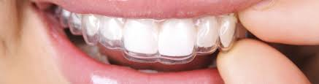
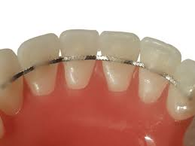
Evidence
Systematic Review
Bahije, 2018
This systematic review included seven studies to evaluate different retention protocols. Six studies reported that the common retention protocols were a vacuum-formed retainer (VFR) or a Hawley retainer (HR) in the upper arch and fixed retainers (FR) in the lower arch.

Slide 16
Evidence Summary
The best available evidence suggests that the most common retention protocols among orthodontists are vacuum-formed or a Hawley retainer in the upper arch and fixed retainers in the lower arch .
In Class II division I cases, the most common retainer was VFR in both arches in hospital settings, and VFR in the maxilla and the combination of bonded and VFR in the mandible in the private setting.

Slide 17
Removable and Fixed Retainers
Clinical Question : What Should Be the Choice of Orthodontic Retainers, Removable or Fixed Retainer?

Slide 18
Evidence
Systematic Review and Meta-Analysis
Littlewood, 2016
This systematic review included two RCTs comparing the effectiveness of fixed retainers (multi-strand) and removable (thermoplastic) retainer in the stability of lower anterior teeth.
One included trial found a statistically significant higher relapse with VFR by 0.6 mm/year than the fixed retainer . Similarly another trial found a statistically significant of 0.05 mm, also favoring the fixed retainer. The quality of evidence was low.

Slide 19
Evidence Summary
Looking into evidence collectively, the best available evidence suggests that VFR and FR are effective for orthodontic retention with a higher statistically but not clinically significant relapse in VFR when compared to FR.
This difference in relapse ranged from 0.05 to 0.6 mm between VFR and FR for 1 year of retention.
FR and VFR have similar retention capacities with a better retention result in the lower arch when FR was used, especially for the long-term follow-up. However, after 1 year of retention, FR was associated with more gingival inflammation and calculus accumulation. The failure rate was higher with BR than VFR in the lower arch, while it was a controversy between studies in the upper arch.

Slide 20
Removable Retainers
Clinical Question : Which Is a Better Removable Retainer?

Slide 21
Evidence
Systematic Reviews
Outhaisavanh, 2020
This systematic review included 15 RCTs. Five included trials compared Hawley and vacuum-formed retainers. They found that there is no statistically significant difference between the two types of retainers in both maxillary and mandibular arches. Two included trials reported that there is no significant difference in the arch length when wearing full-time HR and VFR. In contrast, one trial found that VFR was more effective than HR in terms of the maxillary arch length (P = 0.007). likewise, two studies found that VFR is more effective than HR in both arches regarding Little’s Irregularity Index (LII).

Slide 22
Evidence Summary
Looking into the evidence collectively, the best available evidence suggests that VFR and HR are effective in terms of teeth stability during the retention period. Regarding arch length, no significant difference was found between HR and VFR in the two reviews . On the other hand, one trial found that VFR is more effective than HR in terms of the maxillary arch length. Two reviews found more LII change in the HR group than in the VFR group, with more rotation in the HR group. No statistically significant difference between the two retainers was found in overjet, overbite, inter-canine and inter-molar width.

Slide 23
Wearing Schedules
Clinical Question : What Should be The Wearing Schedule for Removable Retainers?

Slide 24
Evidence
Systematic Reviews
Outhaisavanh, 2020
Five included trials compared full versus part-time wear of removable retainers. There was no statistically significant difference between the two-duration wear of the removable retainers in both maxillary and mandibular arches. One study investigated using VFR for two-duration wear and found that there was no statistically significant difference between full-time wear and night-time wear regarding overjet and overbite. In contrast, another study found a statistically significant difference between both wearing schedule regarding the overbite (P = 0.02), but the difference was only 0.6 mm, which seems to be not clinically significant.

Slide 25
Evidence Summary
Looking into evidence collectively, the best available evidence suggests that there is no statistically significant difference between part and full-time wearing of removable retainers. Only one trial found a statistically but not clinically significant difference in the overbite changes (0.6 mm) between full and part-time wear of removable retainers.

Slide 27
Thank you

