Slide 1


Artificial Intelligence for Combating Multidrug Resistant Bacteria
Assist. Prof. Dr. Ali Al-Shammary
Food Microbiology and Immunology,
Milk Hygiene and Public Health
www.alideerwoeesh76@gmail.com
ΩΨςΕΡΝ76

Slide 2



ABSTRACT
DESIGN
RESEARCH
We based our research on market trends and social media
We believe people need more products specifically dedicated to this niche market
Minimalist and easy to use
“Genetic material can be transferred either by conjugated plasmids or transformation from external forbidden genetic materials of killed and lysed XDR bacteria within environmental ecosystems of food, water and air chains, and via transduction forbidden prohibited lysogenic prophages. These scenarios of induced bioterrorism overwhelmed with recalcitrant biofilm.”

Slide 3
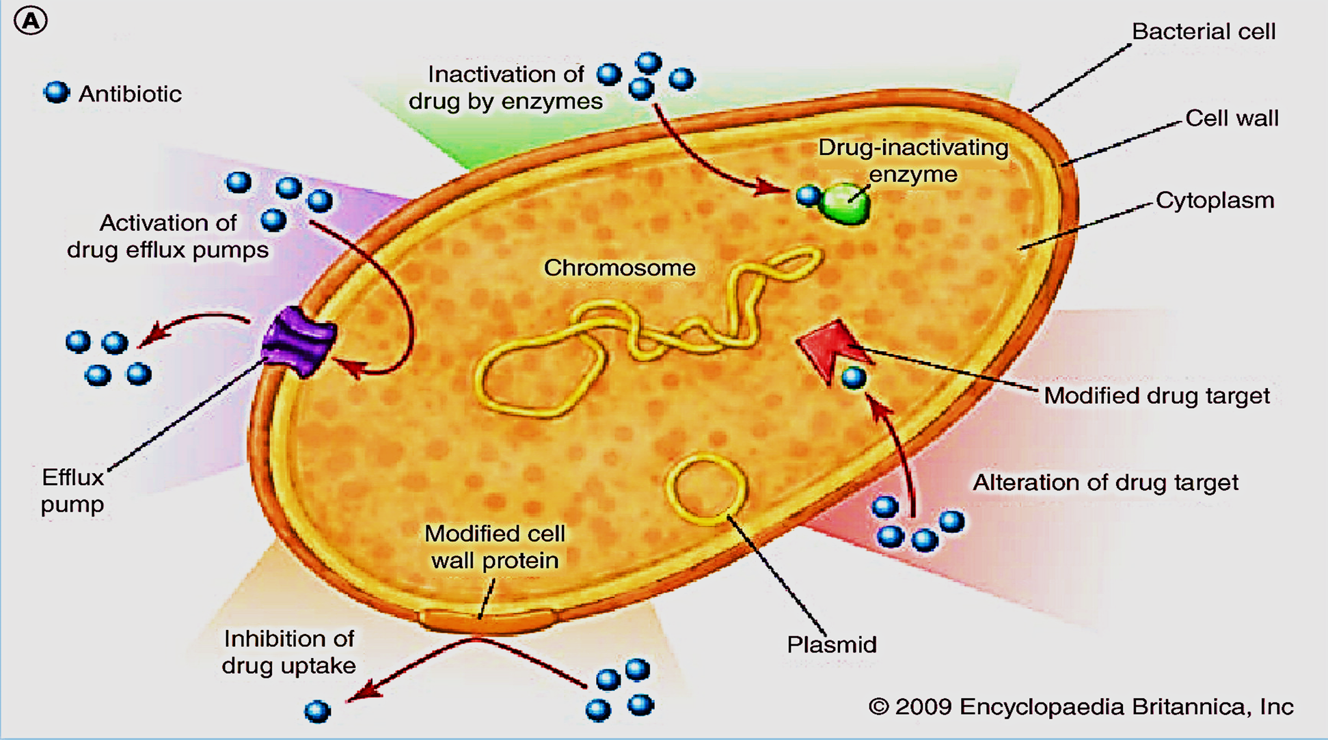

Slide 4
Either, Epigenetic Drift Tolerance i.e., Partial stress on the environment ecosystem surrounding genetic material of bacteria causing sensitization to antimicrobial agents that developed to partial resistance called tolerance; that could be terminated via versatile modules, or Genetic Shift Resistance resulted from continuous mutating stressors to evolved as pluripotent clones carrying divers and versatile evolved genetic materials as stress hardening phenomenon surrounded by recalcitrant quorum sensing electromagnetic clouds of Biofilm,

Slide 5
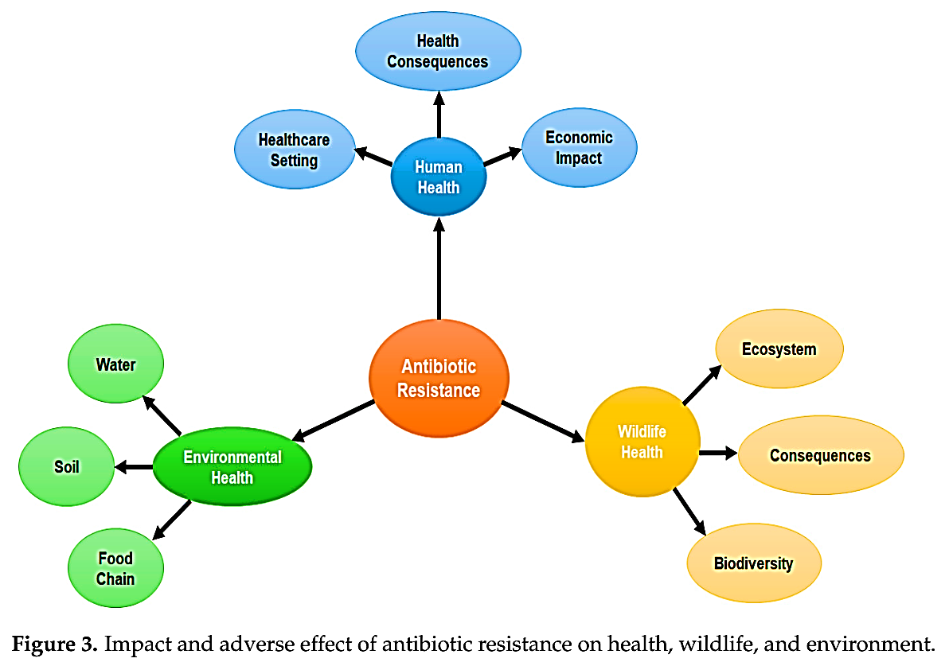
Muteeb et al (2023)

Slide 6
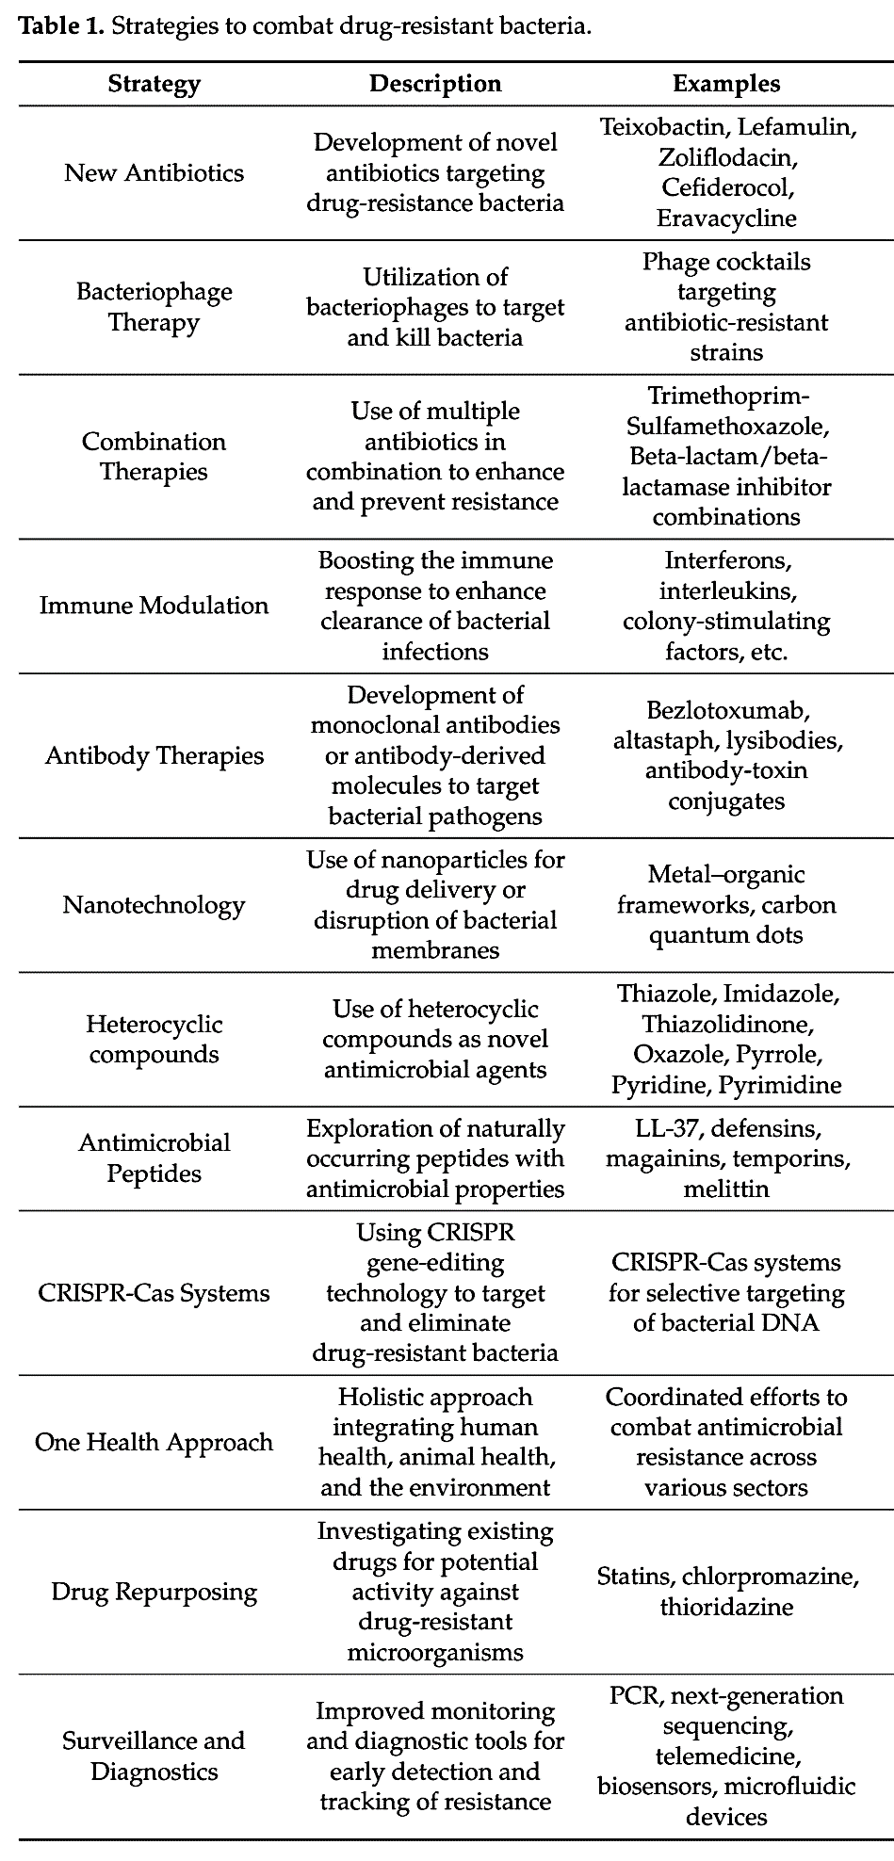
Muteeb et al (2023)

Slide 8
From Data to Decisions: Leveraging Artificial Intelligence and Machine
Learning in Combating Antimicrobial Resistance
The emergence of drug-resistant bacteria poses a significant challenge to modern medicine. In response, Artificial Intelligence (AI) and Machine Learning (ML) algorithms have emerged as powerful tools for combating antimicrobial resistance (AMR). AI NPU chipsets cascaded management with a focus on identifying pathogens, understanding resistance patterns, predicting treatment outcomes, and discovering new antibiotic agents. Machine Learning algorithms can analyze genomic data to identify genetic markers associated with antibiotic resistance, enabling the development of targeted treatment strategies (Giske et al., 2024; de la Lastra et al., 2024).

Slide 9
AI systems can help clinicians select the most appropriate antimicrobial therapy by analyzing data and providing personalized treatment recommendations. Clinical decision support systems (CDSS), integrated into electronic health records (EHRs), guide antibiotic selection, dosing, and duration based on patient-specific factors. Computational designs can predict novel AMPs from genome sequences, providing insight into chemical properties and bioactivities in AMP sequences. ML algorithms such as random forest, support vector machine (SVM) or logistic regression, decision trees, and deep learning can predict antimicrobial properties from sequences.

Slide 10
Pathogenic microbial biofilms critically enclosed recalcitrant electromagnetic charged clouds barriers within food chain bridges of horizontal genes transfer represent a significant threat to the healthcare industry due to their resilience against traditional antimicrobial treatments.
Artificial intelligence NPUs guided a smart policy for redirected lytic phages in special time and location for targeted biofilm before production at late lag phase or at early or mid or late log phase, therefore reducing or preventing formation of biofilm a major cause of stress resistance phenomenon.

Slide 11
Fanous et al (2025) express dangerous phase of Salmonella that behaves with clever defense tolerance to evade antibiotics that they susceptible to it by creating dormant silence sleeping slow growing phase (Persisters) via downregulating metabolism to reduce and even stop actions of antibiotics (works only on active growing curves) on them with generating biofilm quorum sensing machine and extending their lag phase until crisis Era of antibiotics gone or terminated.

Slide 12
Unfortunately, due to the lack of stewardship regarding the use of antibiotics and the natural process of evolution, bacteria have circumvented the efficacy of clinically relevant antibiotics, leading to antibiotic resistance. Intrinsic genetic mutations and transferrable antibiotic resistance genes (ARGs) are at the core of the development of antibiotic resistance. Artificial intelligence (AI) methods and approaches can potentially augment the detection of ARGs and identify antibiotic targets and antagonistic bactericidal and bacteriostatic molecules wit MIC & MBC thresholds critical points that are or can be developed as new redirected modules (Olatunji et al., 2024).

Slide 13
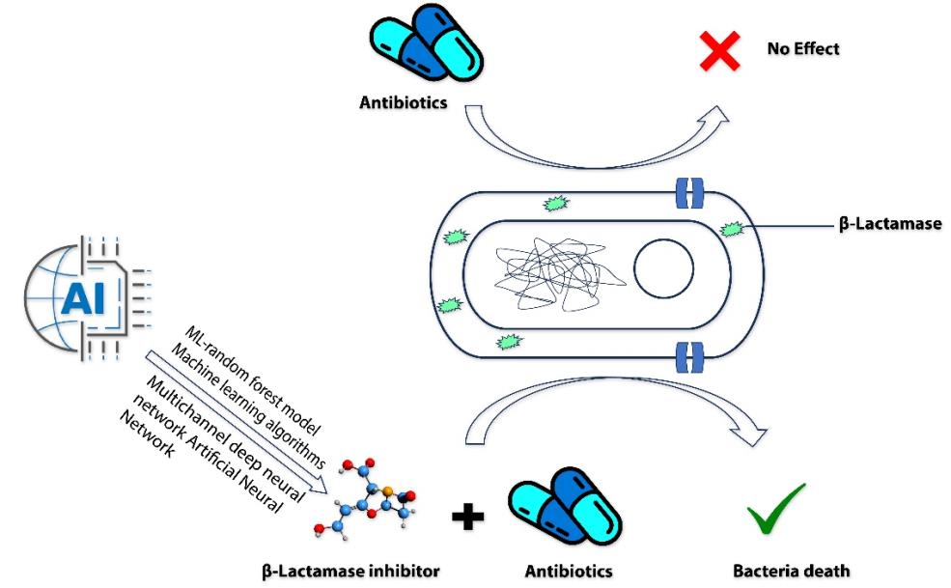
In recent years, AI has been used to develop new β-lactamase inhibitors to combat AMR and the organism. This process uses a Multichannel deep neural network (DeepBLI), Machine learning algorithms, DeepBL Deep Learning-Assisted Photochromic Sensor, and ML-random forest model.
Figure 2. Effect of AI-discovered beta-β-lactamase inhibitors combined with antibiotics on β-lactamase containing bacteria (Masud et al., 2023).

Slide 14
Dual Drive Shoot Designed an AI Redirected New Deciphered Antibiotics: In December 2024 Aleksandrova et al. discovered a new AI learning machine algorithm to synthesize dual action-oriented new antibiotics known as Macrolones that target bacterial ribosomes and DNA gyrase and can evade resistance mechanisms. Gyrase is involved primarily in supporting nascent chain elongation during replication of the chromosome, whereas topoisomerase IV separates the topologically linked daughter chromosomes during the terminal stage of DNA replication.

Slide 15
Growing resistance towards ribosome-targeting macrolide antibiotics has limited their clinical utility and urged the search for superior compounds. Macrolones are synthetic macrolide derivatives with a quinolone side chain, structurally similar to DNA topoisomerases-targeting fluoroquinolones. While macrolones show enhanced activity, their modes of action have remained unknown. However, while many of those efforts have been based on ingenious chemical synthesis techniques, they have been largely driven by the rather serendipitous generation of derivatives and establishing structure-activity relationships by microbiological testing. Transition to knowledge-based approaches for antibiotic development requires a clear understanding of the mode of target engagement and mechanism of action of the new compounds (Aleksandrova et al., 2024).

Slide 16
Macrolones efficiently inhibit both the ribosome and DNA topoisomerase in vitro. However, the primary cellular target of chemically distinct macrolones differs dramatically. In contrast to macrolide or fluoroquinolone antibiotics alone, dual-targeting macrolones are less prone to select resistant bacteria carrying target site mutations and also fail to activate inducible macrolide resistance genes. Furthermore, because some macrolones engage Erm-modified ribosomes, they retain activity even against strains with constitutive erm resistance genes (Aleksandrova et al., 2024).

Slide 17
The idiosyncratic interactions of macrolones with the NPET alter the context specificity of action observed for macrolides10, thereby preventing induction of resistance genes. Notably, the double-prong activity of the macrolones that can concomitantly target either the ribosome and DNA gyrase makes it more difficult for cells to gain resistance by acquiring target site mutations. Our findings provide a structural and functional framework for rationally improving conjugation of macrolide antibiotics with other bioactive molecules, such as fluoroquinolones (Aleksandrova et al., 2024).

Slide 18

ا. م. د. علي الشمري 2025

