Slide 1
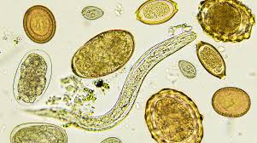
Detection of Eggs and Larval stages of some parasites
Dr.Howaida hamle

Slide 2
Introduction
In the field of diagnostic Medical Parasitology, proper specimen collection is critical since the final laboratory results are based on parasite recovery and identification will depend on the initial quality of the samples taken.
Unless the appropriate specimens is properly collected, preserved and processed, these infections may not be detected.
Laboratory procedures detects organisms within clinical specimens using morphological criteria, rather culture or biochemical tests and/or physical growth characteristics.

Slide 3
Microscopy
The introduction of the microscope had an influential effect on the field of medical diagnostics. For any new diagnostic method, whether it is molecular, serological, or proteomic, to have a meaningful impact in the field of diagnosis, it is likely to be compared with microscopy, which is still considered the gold standard.
The popularity of this technique lies in its simplicity.
Diagnosis via microscopy requires nothing more than the microscope itself, the specimen, and, for some techniques, a readily available dye.
Microscopy has been the mainstay diagnostic tool for decades, and even though other techniques may exist, often results still require confirmation by microscopy since the newer diagnostic methods often lack standardization

Slide 4
Microscopic Examination The majority of intestinal, blood, urinary and skin parasites are usually detected by microscopically in stained or unstained; either directly or following concentrations
A\ Stool Examination
General Stool Examination (GSE) is carried out in laboratories for various diagnostic purposes. Examination of stool is very helpful in the diagnosis of disease of the gastrointestinal tract.
The most frequently performed parasitological procedure is the stool examination.
The detection and identification of parasites; such as adult worms, larvae, eggs, trophozoites and cysts depends on its proper collection.

Slide 5
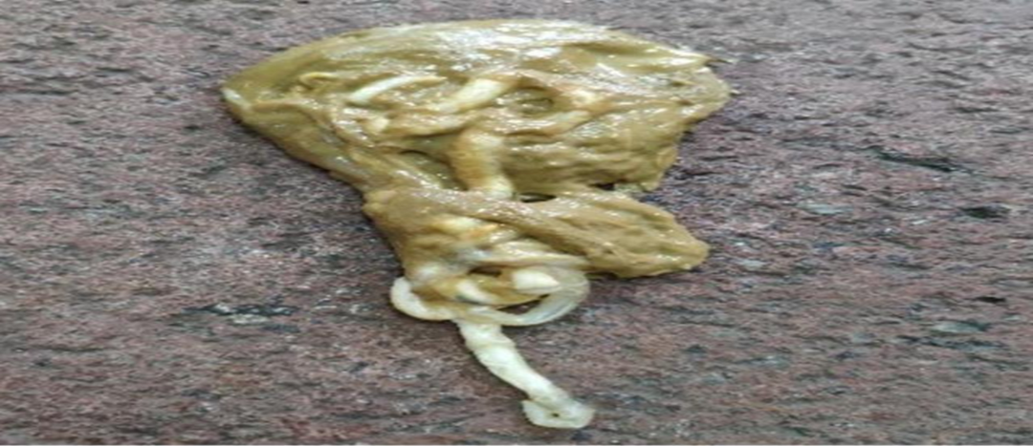
A. Physical examination of stool:
1. Presence of worms:- may have adult helminthes or segments
Example: Ascaris, Taenia species, E.vermicularis and gravid Taenia species.

Slide 6

2. Consistency (degree of moisture)- It varies in diet but certain clinical conditions associated with parasite presence may be suggested by particular consistencies.
- It will be described as hard, formed, semi-formed and diarrhoeic(watery).
3. Colour:- any abnormal colour E.g., pale yellowish passed in steatorrhoea conditions such as giardiasis, dark or black-stools occur when iron or bismuth is taken or when there is intestinal hemorrhage.
like Heamonchus

Slide 7

4-Odor: Odor of stools may become offensive in conditions like, Intestinal amoebiasis.
In cases of bacillary dysentery and cholera the stools are not foul smelling due to the absence of fecal matter..

Slide 8
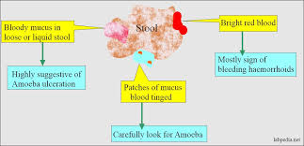
5. Abnormal features seen (composition): mucus, blood or fat globules.

Slide 9
b. Microscopic examination of stool: the stool can be examined by the following techniques
.
a) Wet mounts examination. (a) Saline wet mount examination: to observe large molecules, cells, ova and helminthes, then to the 40X objective to complete the test. It is preferable to keep the condenser down and the intensity of the light low for proper visualization of the ova and cysts.
(b) Iodine examination: Iodine preparation leads to better visualization of morphological details of ova and cysts as it stains the glycogen in them. However it has the disadvantage that the live trophozoites of Entamoeba histolytica and other live parasites cannot be seen as the iodine kills them. The examination instructions in normal saline must be followed the same in iodine test.

Slide 11
Protozoa: (a) Entamoeba histolytica: To investigate the vegetative phase (trophozoite) and cyst, causing amoebic dysentery disease.
(b) Entamoeba coli: trophozoite + cyst Note: - most of children diarrhea less than 2 years cause by Entamoeba coli.
(c) Giardia lamblia, trophozoite + cyst, Cause watery diarrhea.
(d) Balantidium coli, trophozoite + cyst, causing Balantidiasis in colon.

Slide 12
Worms : (a) Enterobius vermicularis (pinworm): investigating the eggs that are of convex and flat surface and a pointed end.
(b) Ascaris lumbricoides,Parascaris ,Toxocara : investigating for eggs which characterized by the content of granular yellow to Brown irregular albumin membrane.
(c) Hookworm (Ancylostoma duodenale): investigating the eggs where the egg yolk is divided and surrounded by a thin membrane.
(d) Tapeworms, (Taenia solium): investigating the worm pieces called (gravid segments or Proglottids) that comes out with the feces.
(e) Schistosoma mansoni: Investigating the eggs distinct by lateral spin.

Slide 13
B\ Urine Examination
.
Urine has a long, rich history as a source for measuring health and well-being and remains an important tool for clinical diagnosis.
This test detects ova (egg) or parasites in urine. It is used to evaluate a suspected parasitic infection .A terminal urine sample may be collected randomly or over 24 hours for this test. A terminal urine sample collects the last portion of the urine passed (approximately 10 to 20 milliliters).

Slide 14
PRINCIPLE
Urine samples can be submitted for the detection of Schistosoma hematobium or for the presence of Trichomonas vaginalis.
Adult Schistosomes take up residence near the bladder and start to release eggs. The eggs migrate to bladder and are released when the host urinates .
T. vaginallis lives in the vagina and can produce a frothy secretion which can be released during urination.

Slide 15
SPECIMEN
•For Schistosoma hematobium, obtain the last few drops of urine passed about or shortly after noon.
• For T. vaginalis, obtain the first portion of voided urine.
PROCEDURE
1) Spin urine sample at 500 g for 5 minutes.
2) Examine sediment under low power parasites species in urine sample: helminths • Sch. haematobium.egg • E. vermicularis. egg • Sch. mansoni egg • Micrfilaria (Ov, Wb) • Hydatid sand
protozoa: • Tricomonas. Vaginalis troph

Slide 16
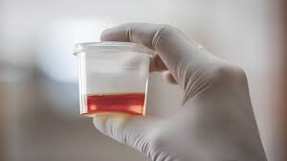
Identification of parasites in centrifuged deposits of urine sediment is a relatively rare occurrence in clinical practice.
A fairly wide morphological spectrum of parasites may be diagnosed microscopic examination of centrifuged urine sediment.
They may present with symptoms like pyuria, hematuria, burning micturition, itching and morphological awareness helps in prompt and effective management in most cases.

Slide 17
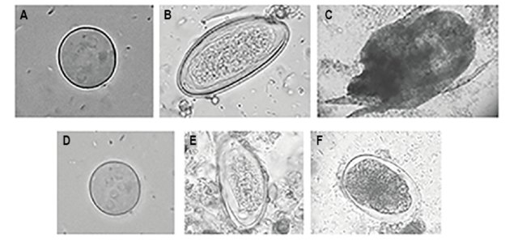
Fig. Urine sediment analysis: (A) Cyst of Entamoeba coli; (B) Egg of Enterobius vermicularis; (C) Organism similar to mites. Microscopic stool examination: (D) Cyst of Entamoeba coli; (E) Egg of Enterobius vermicularis; (F) Egg of hookworm

Slide 18
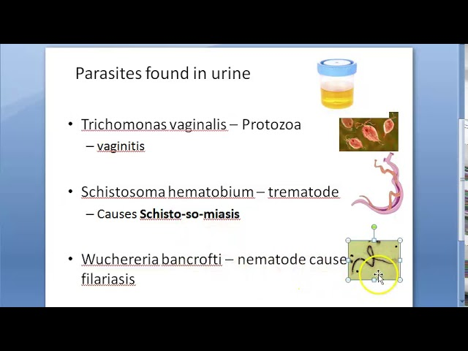

Slide 19
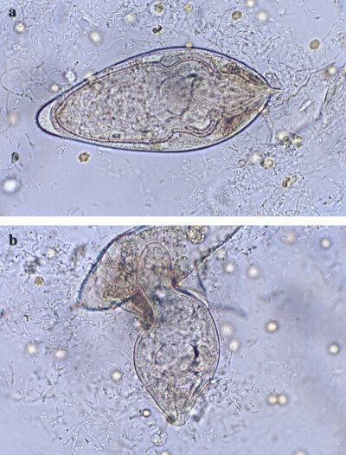

Figure:Sediment examination of a 24-hour urine sample demonstrated a moderate number of live Schistosoma haematobium eggs with movement of the entire miracidium or the flame cells only. Some eggs started to hatch under the microscope light. (b) Miracidium leaving the shell of the egg (wet urine sediment preparation ×400).

Slide 20
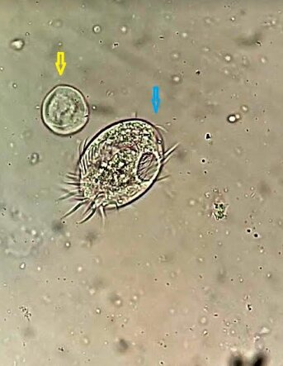
Fig.:Trophozoite stage of Balantidium coli, having a mouth (blue arrow) along with its cyst (yellow arrow) found in an elderly female urine[Wet mount, high power].
In this machine-based, these organisms are easily missed, and though doing things manually becomes cumbersome, microscopic examination of urinary sediments is very important for the diagnosis of these organisms. Various motile organisms that can be seen in urine are Trichomonas, Micofilaria, and Schistosoma hematobium, and other rare organisms are Balantidium. coli and Paramecium.

Slide 21
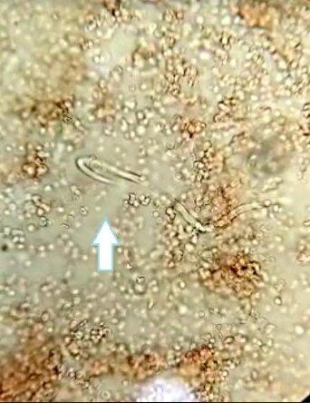
Fig. : Microfilaria (white arrow) associated with marked hematuria [Wet mount, high power]

Slide 22
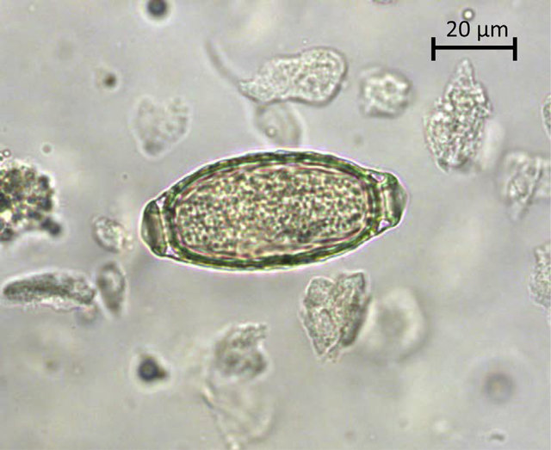
Fig. 1. A typical barrel-shaped Capillaria plica egg in urine sediment from a red fox. The egg show a slightly pitted shell and two opercules with polar plugs. (For interpretation of the references to colour in this figure legend, the reader is referred to the Web version of this article.)

Slide 23
C\ Blood Specimens – Microscopic Examination
Blood smear, this test is used to look for parasites that are found in the blood. By looking at a blood smear under a microscope, parasitic diseases such as filariasis, malaria, or babesiosis, can be diagnosed.
I. Examining thick smears
II. Examining thin smears

Slide 24
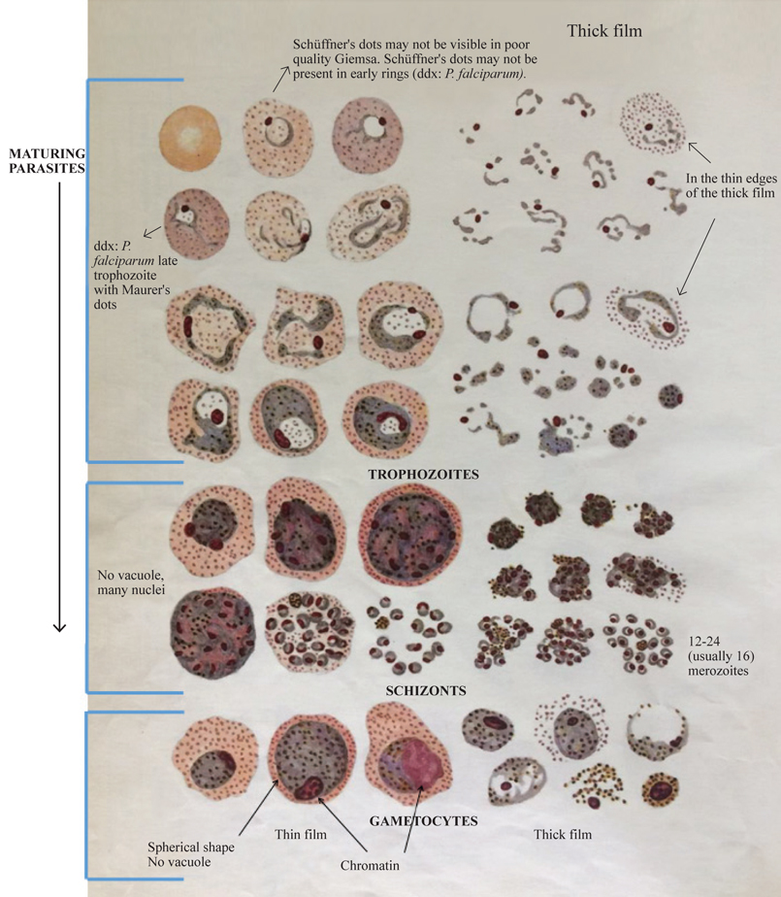

Slide 25
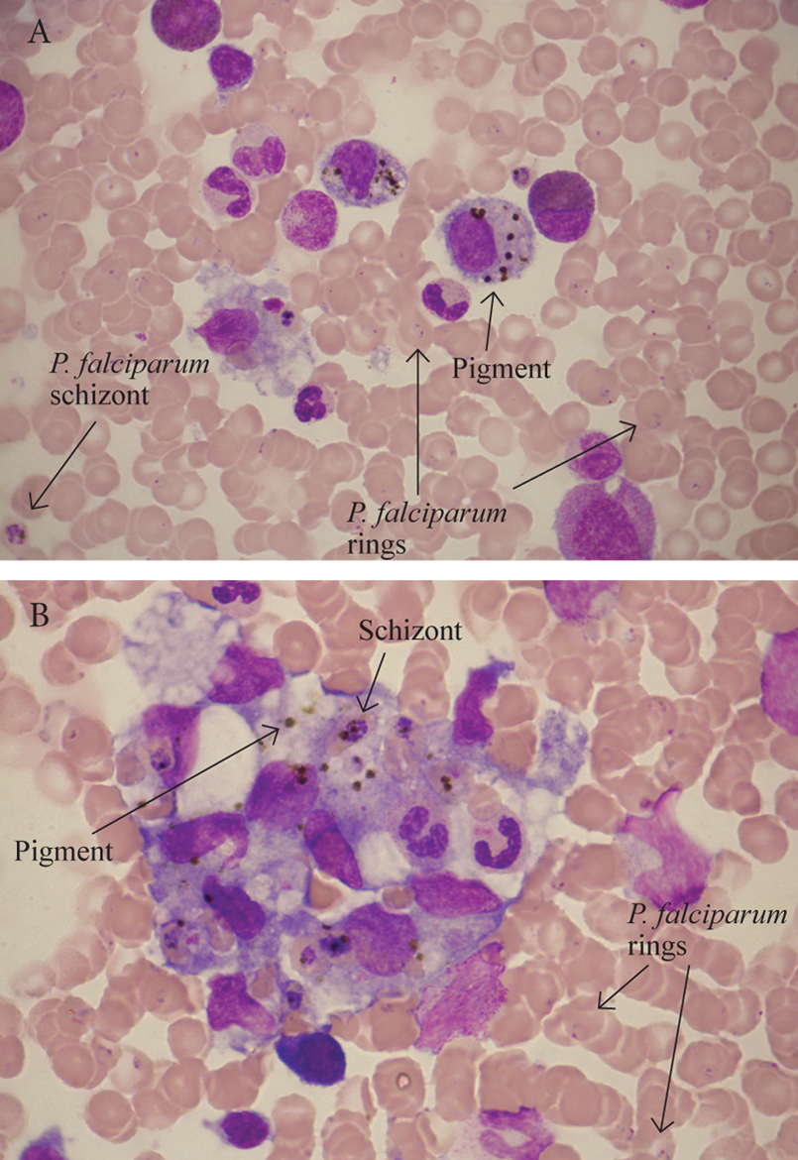

Slide 26
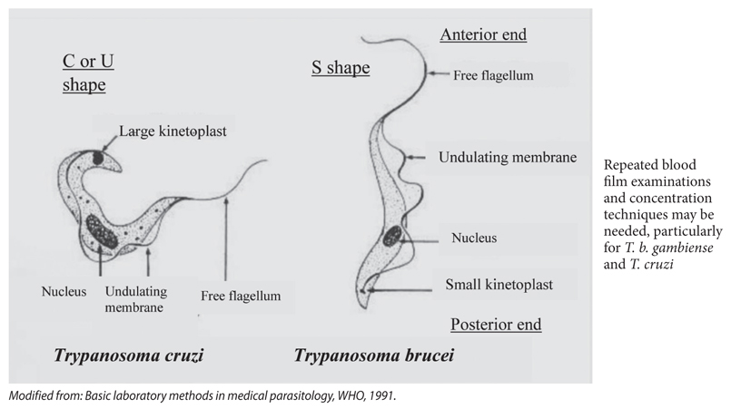
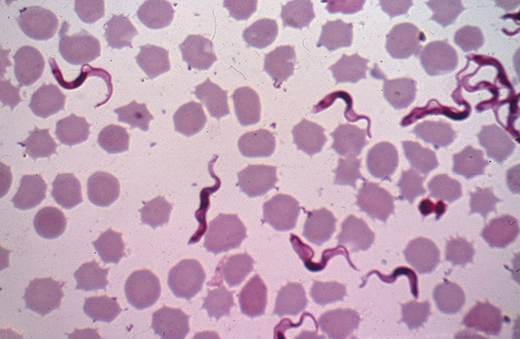

Slide 27
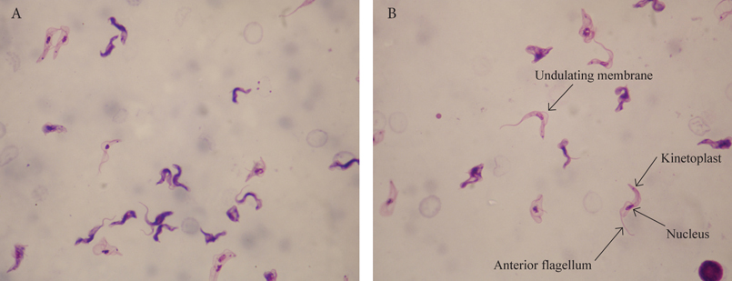
Figure 39. A-B. A 55-year-old man who returned from a safari in East Africa 6 days ago. Fevers, reduced consciousness, diarrhoea, and tachycardia (150 bpm). Thick film with Τ. b. rhodesiense trypomastigotes.

Slide 28
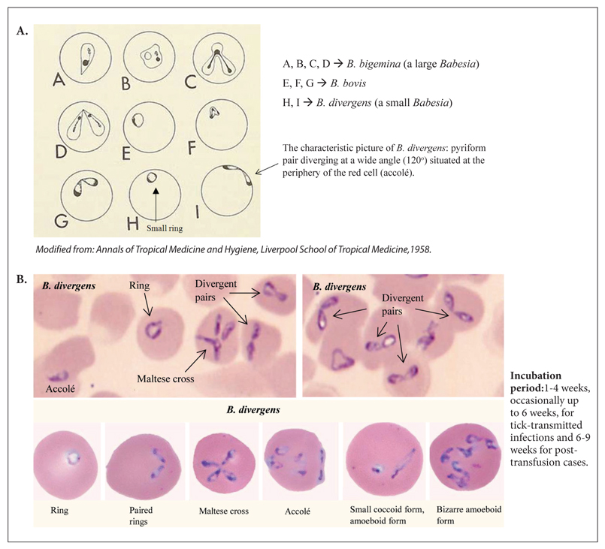

Slide 29
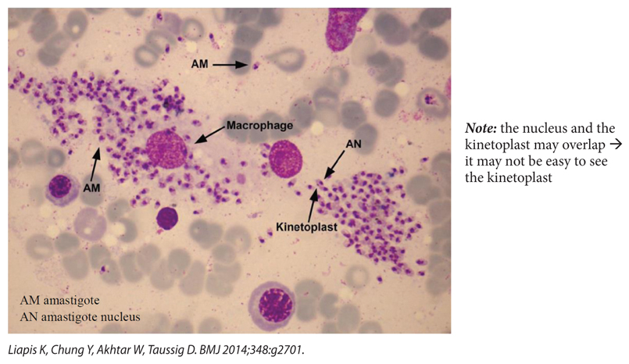

Slide 30
Parasites of the Skin and Subcutaneous Tissues
A variety of arthropods, protozoa, and helminthes infect the skin and subcutaneous tissues and may be identified by anatomic pathologists in standard cytology and histology preparations.

Slide 31
Arthropods are the most commonly encountered parasites in the skin and subcutaneous tissues and include Sarcoptes scabei, Demodex species, Tunga penetrans, and myiasis.Protozoal parasites such as Leishmania may also be common in some settings. Helminths are less often seen, and include round worms (eg, Dirofilaria spp.), tapeworms (eg, Taenia solium, Spirometra spp.), and flukes (eg, Schistosoma spp.).

Slide 32
TABLE 1. Arthropod Parasites of the Skin and Subcutaneous Tissues Parasite (Infection) Cutaneous/Subcutaneous Manifestation
Parasite (Infection) | Cutaneous/Subcutaneous Manifestation
Demodex species (demodicidosis) | papulopustular rosacea, blepharitis, perioral dermatitis, folliculitis, and abscesses
Fly larvae (myiasis) | Furuncles and ulcers (furuncular myiasis), wound myiasis
Pthirus pubis (pthiriasis) | Adults/nits on pubic and/or axillary hairs, eyebrows; bluish macula on trunk (maculae ceruleae)
Sarcoptes scabei (scabies) | Pruritic papules/vesicles and short erythematous tracts (classical scabies), widespread crusted hyperkeratotic plaques (crusted scabies)

Slide 33
TABLE 2. Protozoa Parasites of the Skin and Subcutaneous Tissues.
Parasite | Cutaneous/Subcutaneous Manifestation
Entamoeba histolytica (amebiasis cutis) | Anogenital ulcers, exophytic lesions; extension of visceral disease to skin around abdominal wounds/colostomy site
Free-living amebae: Acanthamoeba species, Balamuthia mandrillaris (amebiasis) | Ulcers, pustules, nodules, plaques
Leishmania species (cutaneous and mucocutaneous leishmaniasis) | Cutaneous: varies by form of disease, ulcers, macules, papules, nodules, patches; Mucocutaneous: destructive ulcerative lesions
Toxoplasma gondii (toxoplasmosis) | Macules, papules; hemorrhagic, lichenoid, exfoliative lesions
Trypanosoma | Chancre at bite site, maculopapular rash with circinate forms

Slide 34
FIG. Crust from a patient with crusted scabies showing three scabies mite eggs (arrows) and a coiled empty egg shell (arrow head) commonly referred to as a “pink pigtail” (hematoxylin and eosin, ×100).

Slide 35
FIG. Biopsy demonstrating 2 adult mites within the stratum corneum with associated hyperkeratosis and parakeratosis (hematoxylin and eosin, ×100). Cuticular spines (inset, arrow) are visible with higher magnification (×400).

Slide 36
FIG. Two Demodex folliculorum adult mites within a hair follicle (A, hematoxylin and eosin, ×400). The morphologic features are most clearly seen in skin scrapings (B, ×1000); note the presence of 8 short legs (arrow head) and mouthparts (arrow)..

Slide 37
FIG. Anterior end of an unspecified myiasis-causing fly larvae showing the mouthparts (arrow) and cuticle with sclerotized spines (hematoxylin and eosin, ×20). The spines are seen in greater detail in the inset (×100, arrow head).

Slide 38
FIG. Punch biopsy taken from the edge of an ulcer due to cutaneous leishmaniasis. Note the diffuse involvement of the epidermis and dermis, extending into the underlying subcutaneous tissue (A, hematoxylin and eosin, ×20). On higher magnification (B, ×1000), collections of amastigotes are seen within histiocytes (arrow). The morphology of the amastigotes including the small eccentric nucleus and kinetoplast are best seen on Giemsa-stained air-dried touch preparations and aspirates (C, arrow heads, ×1000).

Slide 39
FIG.Cutaneous amebiasis due to polymerase chain reaction proven Balamuthia mandrillaris. Both cysts (arrow head) and trophozoites (arrows) are visible among the necrosis and inflammatory cells at high magnification (hematoxylin and eosin, ×400 A, ×1000 B). A careful search is often necessary to identify organisms.

Slide 40
FIG. Subcutaneous onchocercoma showing several cross-sections and longitudinal sections of male and female Onchocercavolvulus (A, hematoxylin and eosin, ×20). Higher magnification (B, ×200) demonstrates a female worm with characteristic “doublebarrel” uterus (asterisk placed directly above uterus) containing numerous microfilariae. Microfilariae are also present in the surrounding host tissue (arrow head). The microfilariae have a pointed tail, and the internal nuclei do not extend to the tip (arrow, C, ×1000).

Slide 41
FIG. Zoonotic hookworm larva causing cutaneous larva migrans of volar skin with an associated eosinophilic infiltrate (A, arrow,hematoxylin and eosin, ×200). Higher magnification (B, ×600) shows the larval nature of the worm, with its lack of defined internal structures other than small longitudinally oriented nuclei. Image courtesy of Carles Saus, MD, Hospital Universitari Son Espases, Palma de Mallorca, Spain.

Slide 42
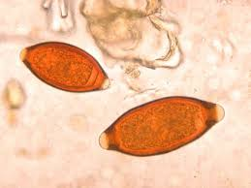
THANKS
FOR
LISTINGING

