Slide 1




Artificial Intelligence in Dental Imaging
Prof.
Zainab H. Al-Ghurabi

Slide 2

INTRODUCTION
In recent years, Artificial Intelligence (AI) has made substantial inroads into various fields of medicine and healthcare revolutionizing diagnostic and treatment approaches

Slide 3

In the past, dentistry heavily depend on manual image analysis and diagnostic procedures, which could be time-consuming and prone to human error.
The advent of artificial intelligence (AI) has brought transformative steep to the field, promising enhanced accuracy and efficiency in various dental imaging tasks

Slide 4

One really interesting piece of AI technology is Diagnocat.
so let's dive into its pros, cons and benefits of it.

Slide 5

What is Diagnocat?
In short, Diagnocat is a powerful AI service that analyzes dental images and provides you with a report.
These reports are generated from X-rays include 3D CBCTs, and 2D images like panoramic X-rays, bitewings, and periapical radiographs.
Much like other AI services in dentistry, it is completely web-based and utilizes cloud computing.
In simple terms, you upload any x-ray to the Diagnocat website, it takes a minute or two to read it, and then generates a report.

Slide 6

Several available systems are capable of AI diagnosis of dental radiographic images, including :
Diagnocat
One of the things that makes Diagnocat stand out is that most other AI software can only do 2D images.
In comparison, Diagnocat can do both 2D and CBCT diagnosis.
This is one of the first AI software in the world to completely focus on dentistry and, in particular - CBCT images.

Slide 7

Every tooth in the radiograph is identified by its ISO (FDI) or Universal (American) number automatically.
It can even pick up missing teeth.
This is all labeled and identified in its intelligent reporting system.

Slide 8

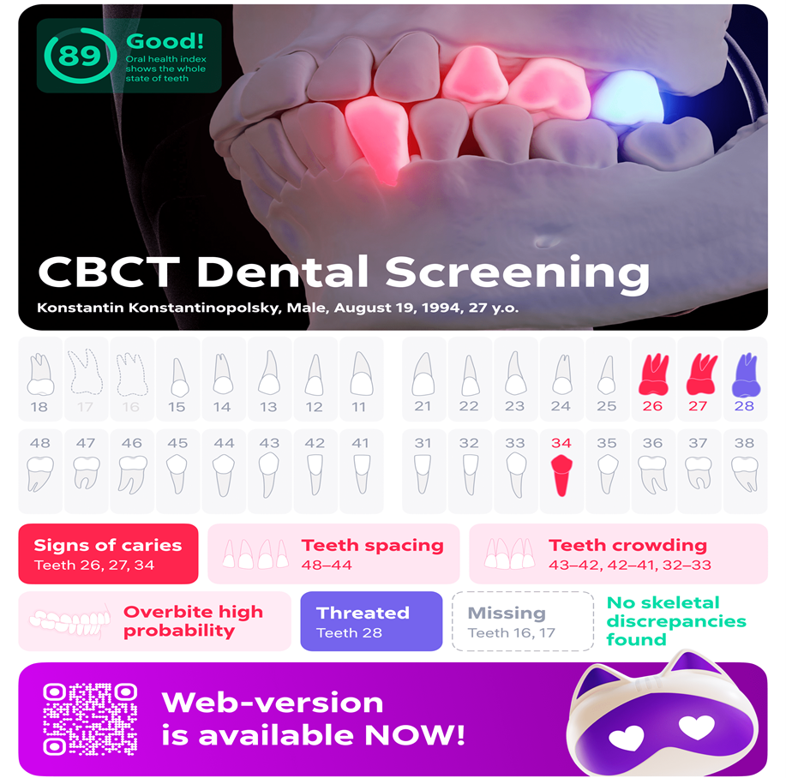

Slide 9
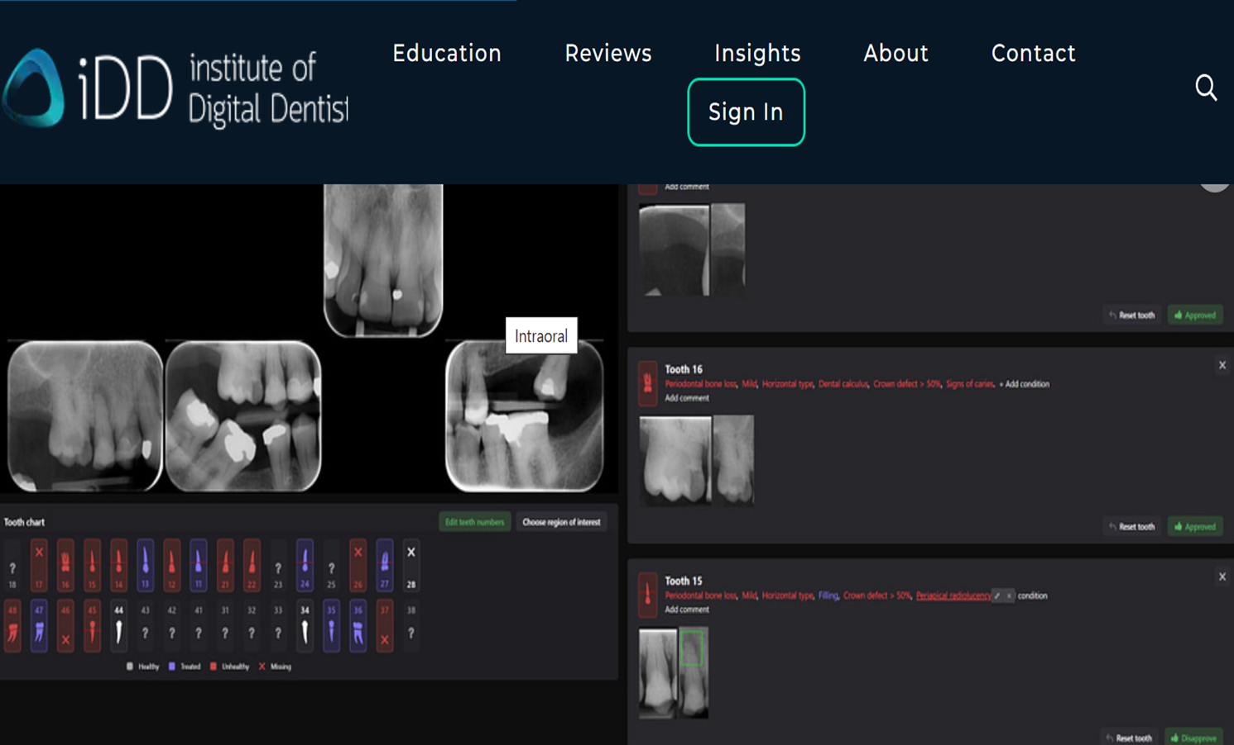

Slide 10

For teeth identification in panoramic radiographs with a clear view
Region detection and segmentation can also be considered complementary techniques.
However, when creating annotation data to prepare the training dataset, segmentation is needed to accurately trace the outline of the target, while region detection only encloses the target in a rough rectangle.

Slide 11
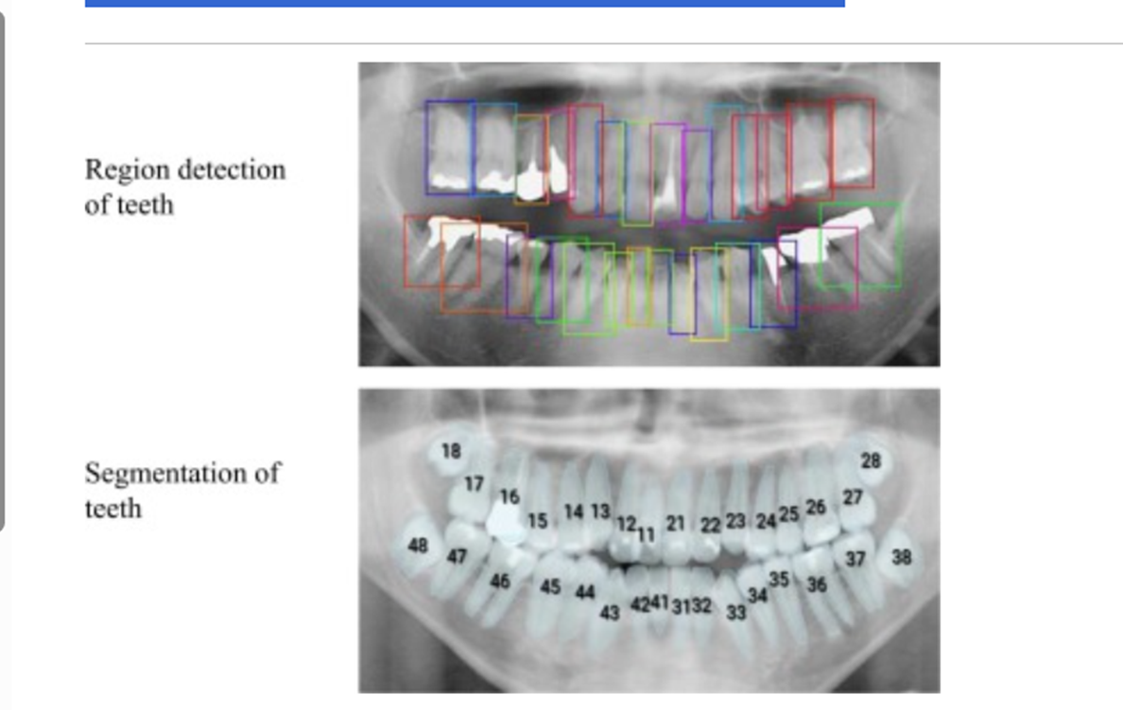
Automatically region detection and segmentation of teeth in the panoramic radiography:
Segmentation of teeth
Region detection of teeth

Slide 12
CBCT Segmentation
what is Segmentation?
It basically means taking the CBCT and delineating all the different 3D structures like bones, TMJ, Maxillary sinus and individual teeth, etc.
This is one feature that actually made Diagnocat very popular early on.
It was the only software that made CBCT segmentation easy.
Nowadays, there are several different companies and software that carry out segmentation, But Diagnocat was the first and is still arguably the best at it.

Slide 13
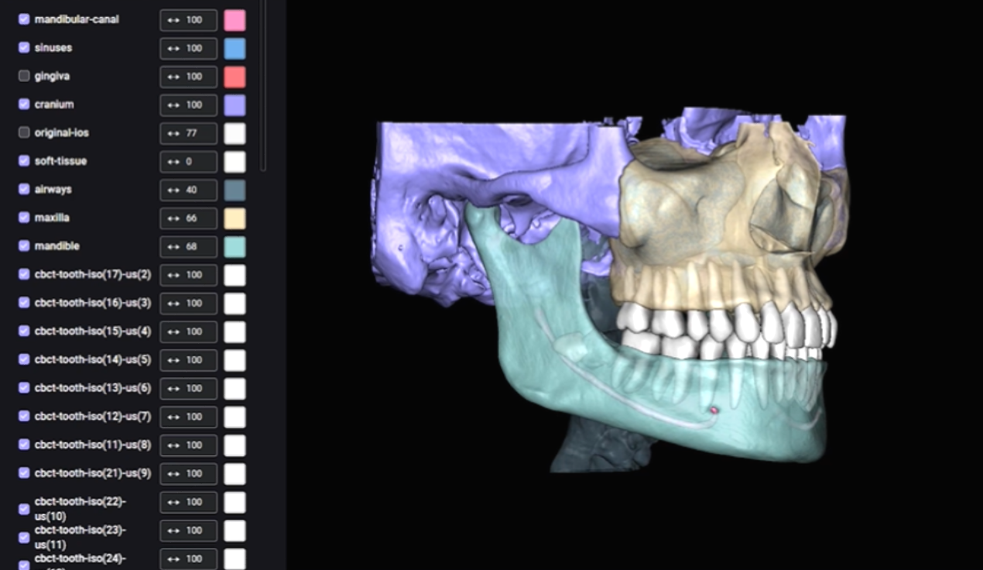

Slide 14


Slide 15

CBCT Segmentation
Diagnocat AI automatic segmentation feature transforms CBCT files into a 3D STL model.

Slide 16
Includes fully automated segmentation and generation of 3D STL models of various structures like soft tissue, teeth, maxillary sinus, inferior alveolar canal, incisive canal, mandible, maxilla, cranial base, and airways.
Generating 3D models with Diagnocat serves as an initial step for subsequent planning and modeling within specialized software or for 3D printing purposes.
Utilize the STL models for digital treatment planning, clinical case presentations, and engaging patients with effective communication, as visualizing the maxillofacial area significantly improves patient comprehension.

Slide 17

STL use cases
STL Orthodontist case 1
STL Orthodontist case 2
STL Surgeon case
STL Periodontal case

Slide 18
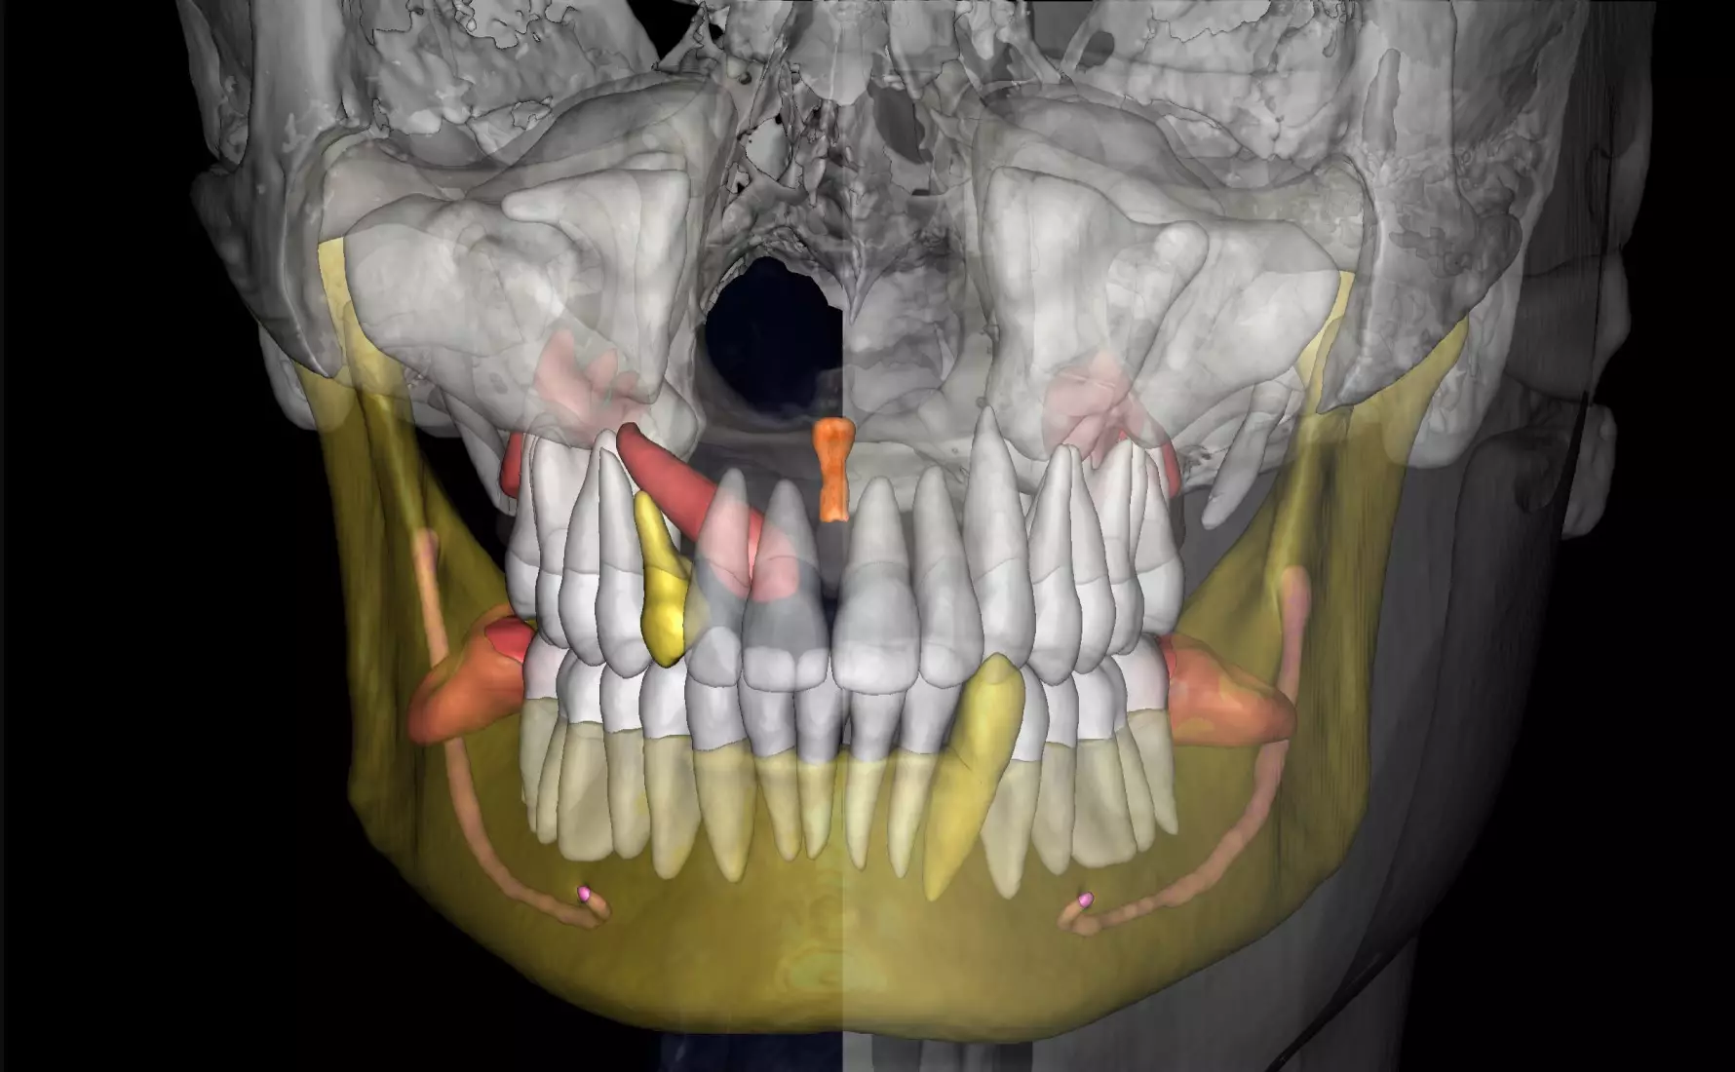
1. STL Orthodontist Case 1
Objective:
Implementing a comprehensive treatment plan and effective interaction between the clinician and the patient.
Challenge:
When discussing the clinical situation, the orthodontist uses plaster models of the jaws, which are often complicated to understand for the patient
Solution:
As an alternative to traditional jaw models, Diagnocat suggests using 3D segmentation, generated based on cone-beam computed tomography (CBCT). In doing so, the patient can see their own face, teeth and bone. The viewing program increases the transparency of the soft tissue and shows the patient the pathology clearly. A visual 3D model simplifies communication, helps the patient understand the problem, and helps to set the patient up for timely treatment.

Slide 19
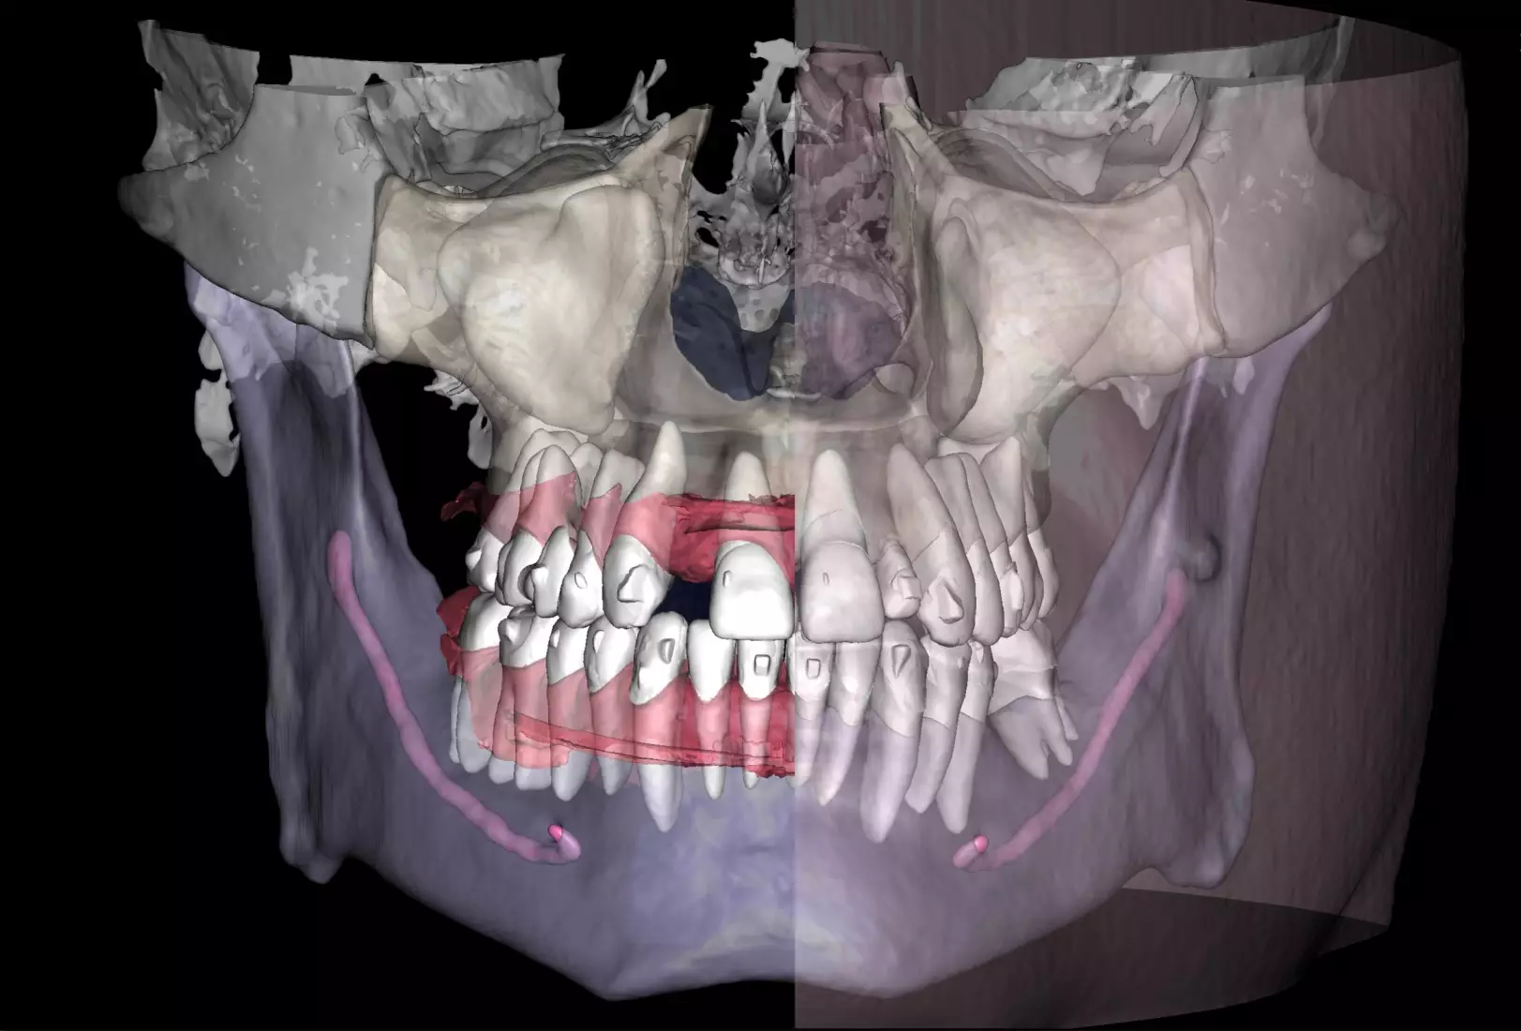
2. STL Orthodontist Case 2
Objective:
To reduce the amount of time taken to create a treatment plan for aligners.
Challenge:
When planning tooth movements, the orthodontist needs a significant amount of time to evaluate the clinical case and perform calculations to achieve the most functional and accurate final tooth position.
Solution:
Diagnocat's reports, based on CBCT and intraoral scans (STL files), help the clinician to quickly and accurately make decisions about treatment tactics and final tooth position, and to plan comprehensive treatment according to the individual needs of the patient.

Slide 20
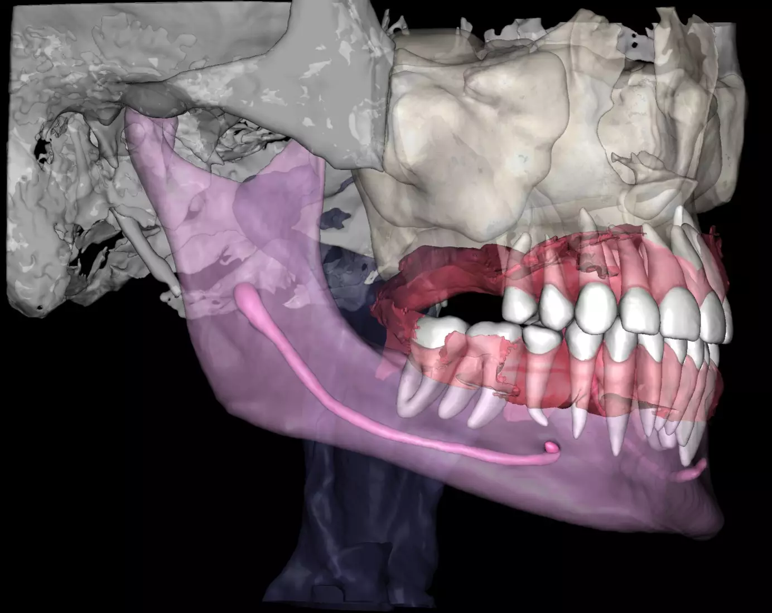
3. STL Surgeon Case
Objective:
To plan the implant placement with the use of a surgical guide.
Challenge:
Manual anatomy segmentation, which requires a lot of time and professionalism of the clinician, especially if the quality of CBCT is low. Human factor and inaccurate superimposition of CBCT and IOS, which leads to errors in the creation of the surgical template.
Solution:
Diagnocat automates CBCT segmentation, producing detailed 3D STL models. The process precisely segments full maxillofacial anatomy. With an intraoral scan, Diagnocat AI merges CBCT and IOS data for a unified model, widely used in digital dentistry treatment planning. The report is generated in just 5 minutes, saving your precious time.

Slide 21
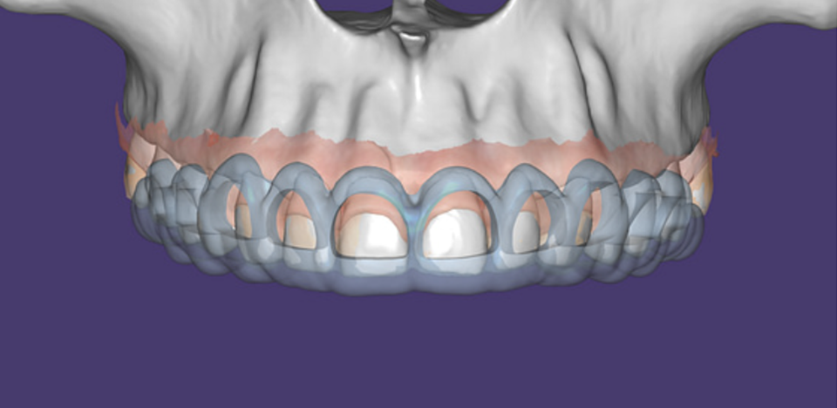
4. STL Priodontal case
The surgical crown lengthening guide was made with the aid of maxilla STL to visualize crestal bone level. Again thanks to CBCT segmentation by Diagnocat

Slide 22

Reports:
Orthodontic Report
Endodontic Report
Third Molar Report

Slide 23

1. Orthodontic Report:
Diagnocat is also capable of generating orthodontic reports. This requires a CBCT radiograph with a minimum field of view of (13 x 15 x) .
Diagnocat generates OPG and frontal and lateral cephalometric reconstructions from the CBCT data.

Slide 24

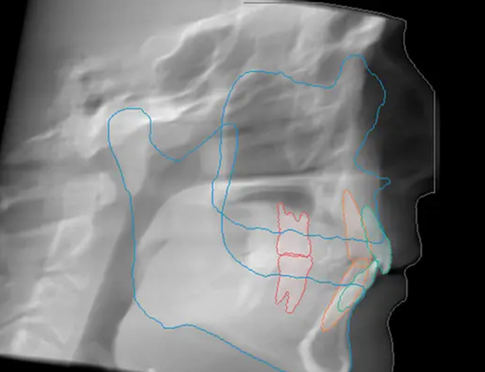
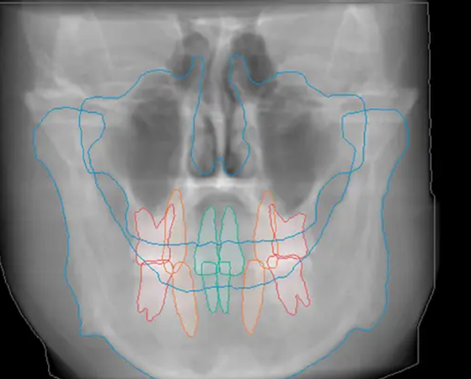
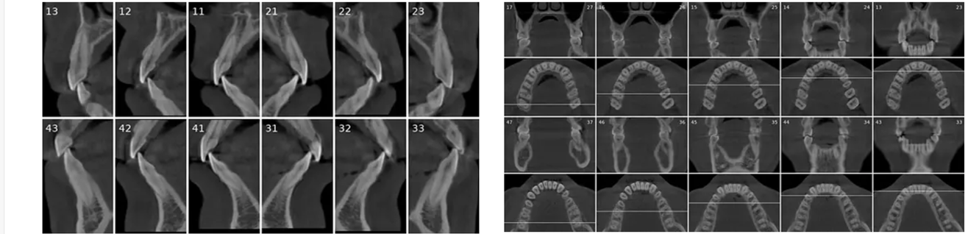
a. Tracings of the maxilla, mandible, central incisors, canines and molars. All automatically.
b. Cross-sectional and coronal views of teeth show torque and buccolingual relationships such as crossbite.

Slide 25
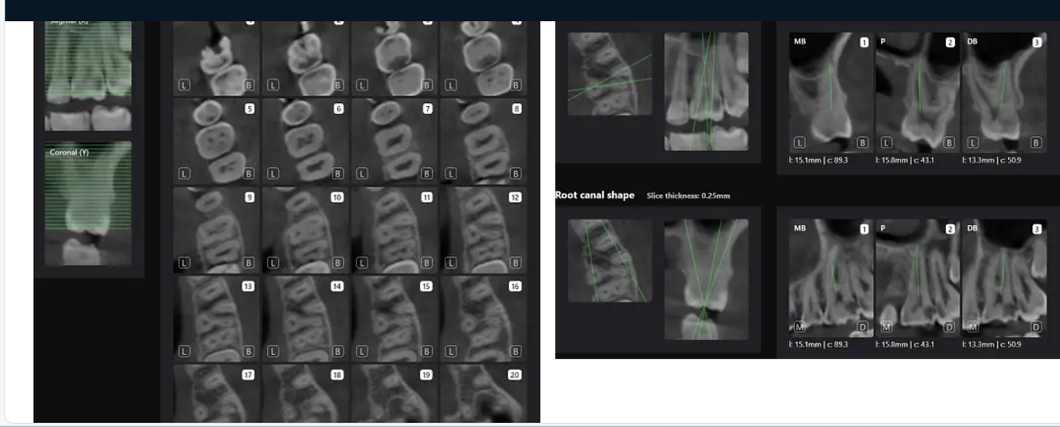
2. Endodontic Report
Tooth number is selected to analyze the root canal morphology within the CBCT radiograph

Slide 26
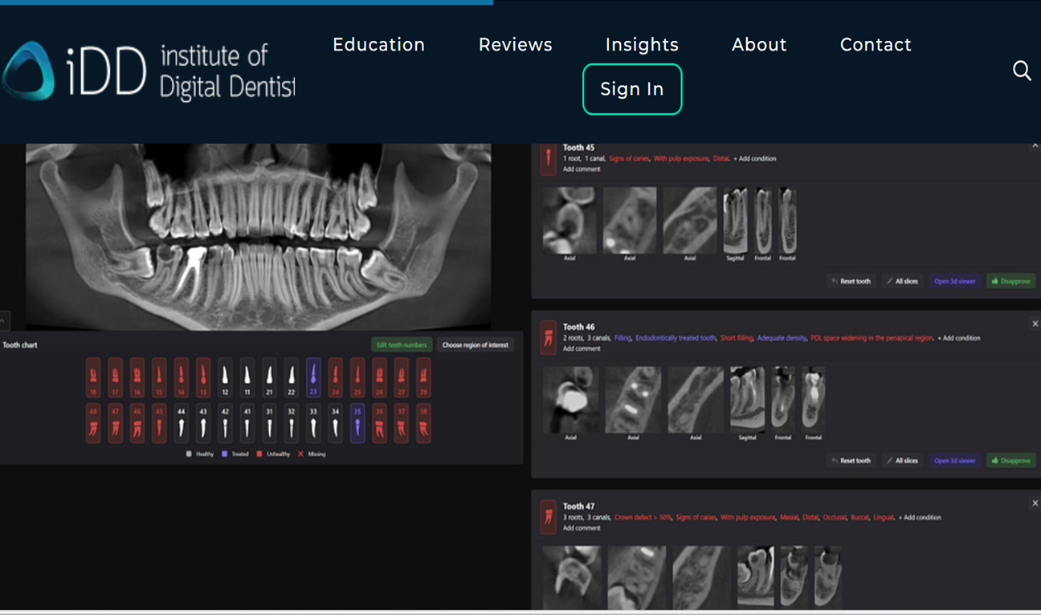

Slide 27
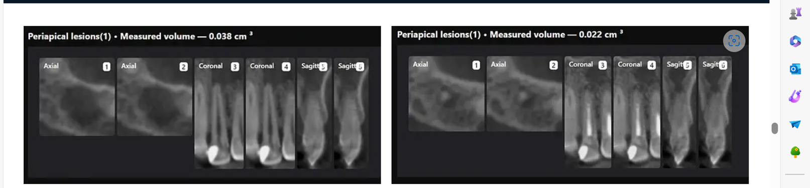
Measurement of periapical radiolucency volume is a unique advantage with 3D CBCT versus 2D PA. These are endodontic reports for tooth 12 which had a very large periapical radiolucency. The reports were done before and after a long-term calcium hydroxide dressing.

Slide 28

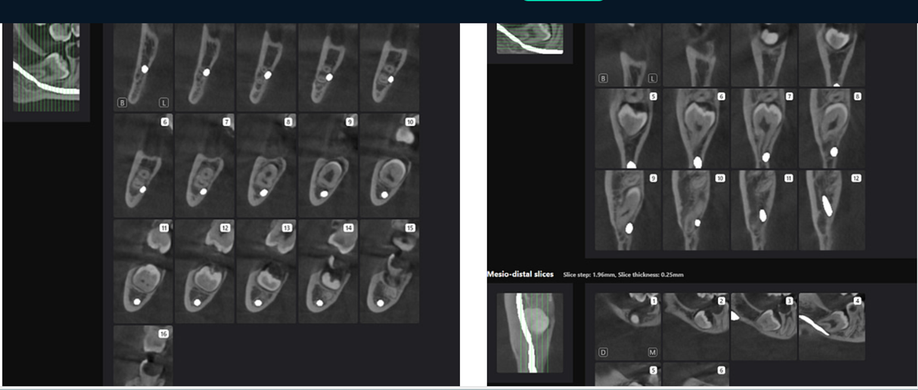
3. Third Molar Report:
A single-third molar is selected to evaluate for extraction
Generates slices in 3 directions and highlights the position of the inferior dental canal.

Slide 29

Areport is generated and outlines the health of every single tooth.
For each tooth, Diagnocat can identify 25 different possible findings for 2D images and more than 65 for 3D radiographs.
Each tooth report can be approved, and the dentist’s signature can be added to the overall report, which adds accountability to the report's contents.

Slide 30

Speed:
There is no point in using AI diagnostics if it takes longer than you to read an x-ray.
Generating a report using Diagnocat for a full mouth series of up to 24 2D radiographs takes less than a minute.
Generating a full report of a full-mouth CBCT 3D radiograph takes four to six minutes.
We are talking about going over every slice with a fine-tooth comb.
This has huge benefits, as a maxillofacial radiologist may take up to 40 minutes to fully report on a 3D CBCT radiograph.

Slide 31

Reducing errors/missed findings:
However, the company claims that based on their data, it has screening accuracy up to 90%.
Basically, it rarely misses, but you still have to check the report carefully.
Creation of Digital Patient:
The patient file in Diagnocat functions as cloud storage of photos, 2D and 3D radiographs, STLs, and documents.

Slide 32

Collaboration with colleagues and specialists
Thankfully, Diagnocat makes sharing easy. You can share the patient file with fellow Diagnocat users and colleagues who do not pay for Diagnocat services.
They can set up a Diagnocat account to view patient files shared with them. They can download the original files and view and download the Diagnocat reports.
However, they are not able to order new reports.

Slide 33

Conclusion
Undoubtedly, we will continue to see the rise of this technology in dentistry. Not just diagnosis, but segmentation, data collection and analysis, treatment planning and even in CAD/CAM. Being a dentist has never been more exciting.

Slide 34

Thank you!
Artificial Intelligence in Dental Imaging
By: Prof. Zainab Hasan AL Ghourbi

