Slide 1
Artificial Intelligence In Oral And Maxillofacial Pathology
Assistant lecturer : fatimah jalil ismael

Slide 2
Introduction
Artificial intelligence is transforming oral pathology by improving diagnostic accuracy and efficiency.
Key Benefits: Faster and more precise disease detection.
Key Challenges: Data limitations, ethical concerns, financial costs, and adaptation to existing workflows.

Slide 3
Artificial Intelligence in Oral Cancer Diagnosis
Artificial intelligence enhances early detection and diagnostic accuracy.
Techniques: Clinical imaging, whole slide imaging, cytology slides, and optical coherence tomography.

Slide 4
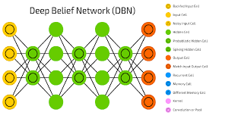
Artificial Intelligence in Intraoral Photography
Model: Deep Belief Networks.
Precision: Approximately 97.7 percent.
Challenges: Limited data availability and imbalance in sample classifications.

Slide 5
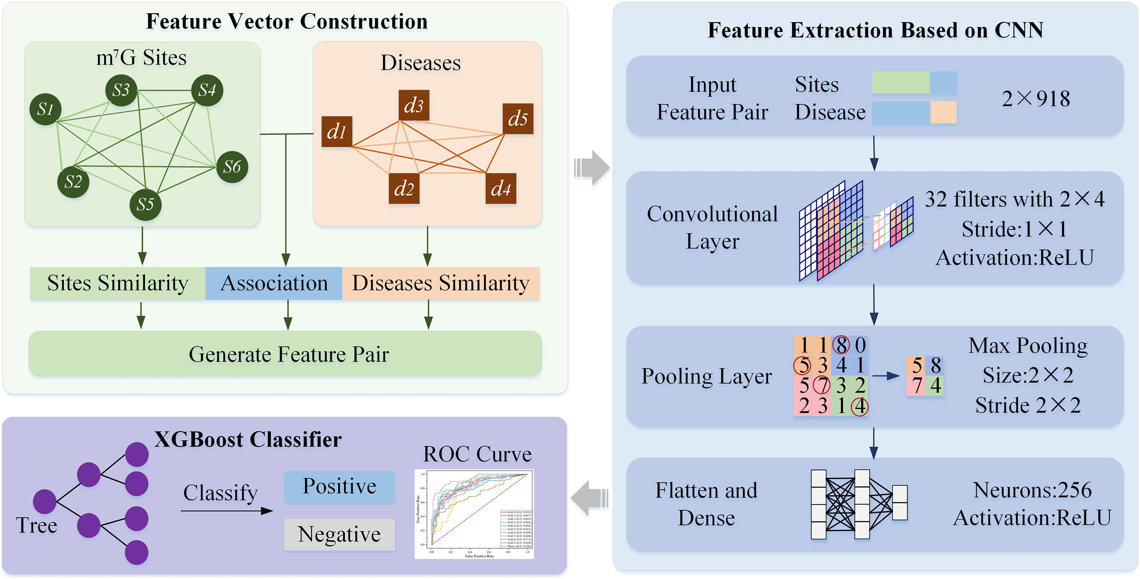
Artificial Intelligence in Pathological Slides
Model: Convolutional Neural Networks combined with Artificial Neural Networks and XGBoost.
Accuracy: 99.3 percent.
Challenges: Requires high-quality datasets and has issues with model transparency.

Slide 6
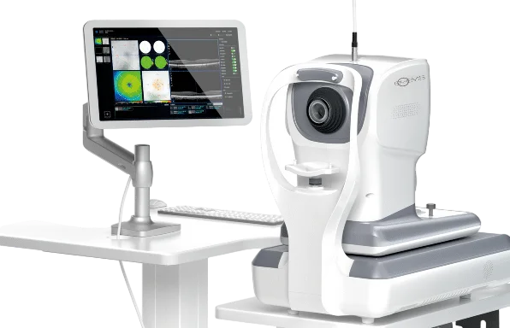
Artificial Intelligence in Noninvasive Screening
Cytology Slide Analysis: Automates evaluation, improving screening efficiency.
Optical Coherence Tomography with Artificial Intelligence: 91.6 percent accuracy for noninvasive cancer detection.
Challenges: Lower sensitivity for high-risk lesions and dependency on dataset quality.

Slide 7

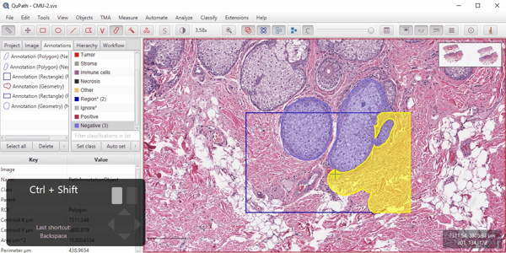
Artificial Intelligence in Workflow Optimization
Impetus: Artificial intelligence tool assisting in tumor detection.
QuPath: Digital pathology software improving biomarker analysis.
Natural Language Processing: Artificial intelligence-based scribes streamline clinical documentation.

Slide 8
Challenges in Artificial Intelligence Adoption
Data Limitations: Artificial intelligence requires large, diverse, high-quality datasets.
Generalization Issues: Models struggle to perform consistently across different patient populations.
Ethical and Legal Concerns: Compliance with patient privacy laws and medical regulations.
Financial Barriers: High implementation and maintenance costs.
Integration into Practice: Requires training and acceptance among pathologists.

Slide 9
Three-Dimensional Approaches in Histopathological Tissue Clearing System
CODA 3D reconstruction and labelling of serial histological sections

Slide 10
Three-Dimensional Approaches in Histopathological Tissue Clearing System
Three-dimensional microscopic approaches in histopathology display multiplex properties that present puzzling questions for specimens as related to their comprehensive volumetric information. This information includes
spatial distribution of molecules
three-dimensional co-localization
structural formation and whole data set that cannot be determined by two-dimensional section slides due to the inevitable loss of spatial information.

Slide 11
optical instruments
two-photon microscopy
high performance objectives with motorized correction collars
light scattering phenomenon that is deeply related to the refractive index mismatch between each cellular component and the surrounding medium

Slide 12
Tissue clearing
The first approach of tissue clearing was attempted by Spalteholz, a German anatomist , after realizing that contemporary histological methods were no longer effective for his new discoveries in macroscopic structures
purpose of tissue clearing:
Make the objects transparent without morphological denaturation which may cause misunderstanding of intact natural environment of tissue sample
Macromolecule-permeable structure for significantly improved immunolabeling
Reduced time consuming while simultaneously preserving its native molecule information without physical denaturation

Slide 13
Techniques
The clearing solution invented by Spalteholz was a crude mixture of organic solvents: methyl salicylate and benzyl benzoate, in the wintergreen oil
formalin fixation
pigment bleaching with hydrogen peroxide
gradient dehydration by serially increased ethanol concentration
incubation in the clearing solution

Slide 14
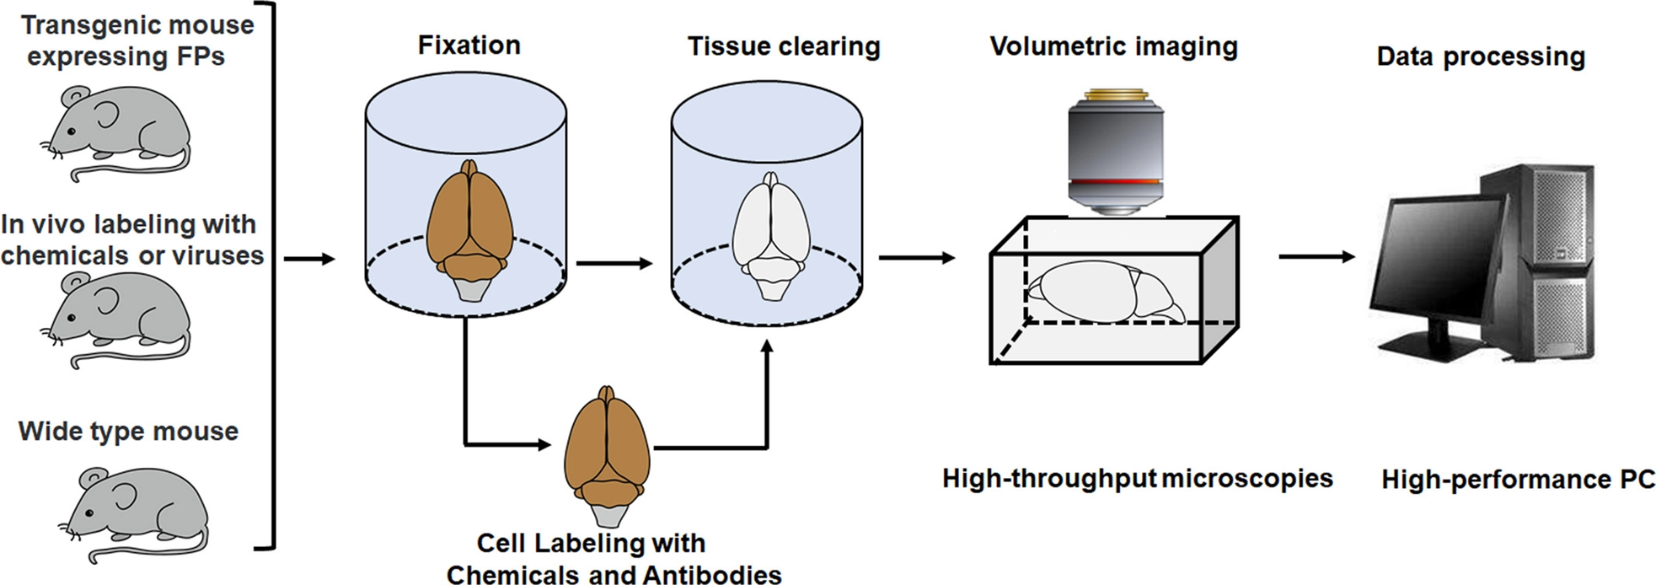

Slide 15
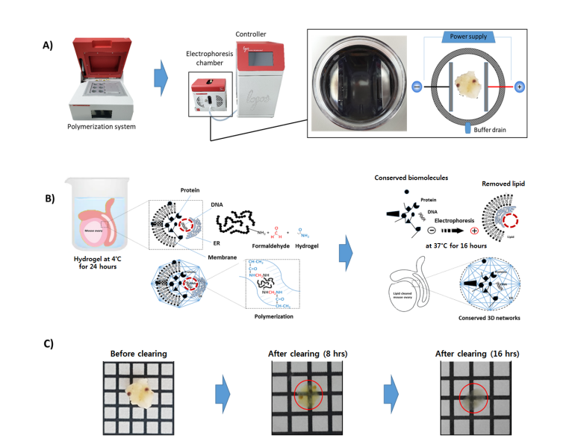
(A) A polymerization system accelerating hydrogel infusion
into the corner to corner of the sample tissue under
vacuum condition before electrophoretic delipidation.
A hydrogel polymerized tissue is ready for delipidation in
the electrophoresis chamber where lipid micelles are actively
removed along the electric field under the electric current around
1.0∼1.5 A at 37∼45°C consecutively,
for 16 hours in the case of mouse ovary.
(B) Formaldehyde in a fixed tissue is cross-linked with hydrogel.
Electrophoresis of the polymerized tissue allows charge dependent
lipid removal via SDS micelle.
Proteins and DNAs remain in the cleared tissue as conserved 3D networks.
(C) Before and after tissue clearing of mouse ovary

Slide 16
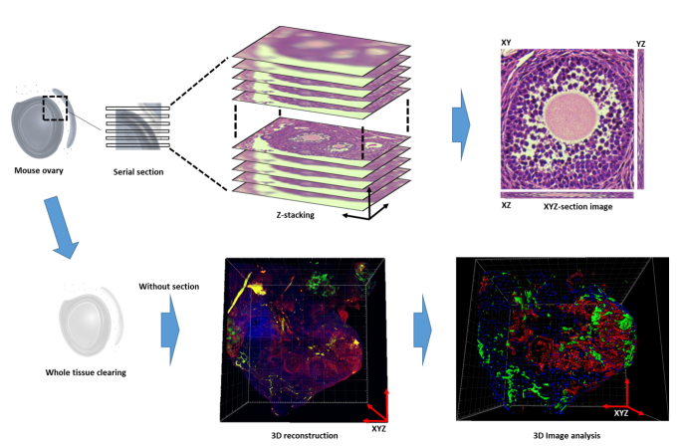
Immunoflourescence + confocal microscope

Slide 17
Clarity
CLARITY is the appropriate equipment-based tissue clearing method
extends higher compatibility with routine laboratory workflow in clinical pathology where a vast sample of tissue are daily conducted in a time-effort-money effective manner
medical technologists engaged in mostly prefer the automation system for fixation, hydrogel polymerization and lipid extraction that is related to increased productivity and efficiency in processing multiple tissue samples obtained simultaneously from patients

Slide 18
CODA 3D reconstruction and labelling of serial histological sections
CODA digitally reconstructs 3D tissues from scanned, serially sectioned H&E tissue sections using image registration techniques. The method incorporates deep learning semantic segmentation to label eight distinct tissue types of the human pancreas without incorporation of additional stains.
Using samples from a range of normal, precancerous, and invasive pancreatic cancer tissue,
Map in 3D modes of cancer invasion in the tumor microenvironment, and emphasize the need for further 3D quantification of biological systems.
single-cell analysis and is utilized here to quantify in 3D cellular content and spatial distributions amongst different non-neoplastic and neoplastic tissue types, information that is important in the design of early detection tests

Slide 19
Why CODA for pancreatic ductal adenocarcinoma?
inconsistent clearing and poor antibody penetration into the dense desmoplastic stroma that characterizes PDAC,
limits on the size of tissues that can be successfully cleared, hinder the power of tissue clearing techniques when applied to pancreatic cancer
The reconstruction of serial, hematoxylin and eosin (H&E) stained sections has also been implemented to study disease in 3D.
Though time consuming manual annotations or costly immunohistochemical (IHC) labeling or mass spectrometry has been introduced to identify biological components in 3D, the costs and time associated with labelling cellular and structural bodies in serial sections largely limits its applicability.

Slide 20
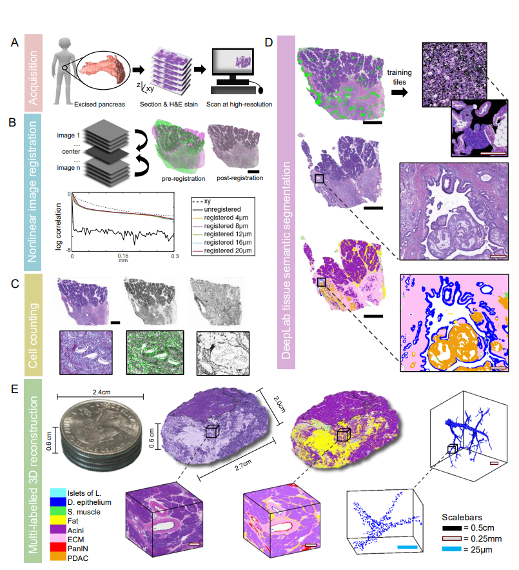
CODA. A Human pancreatic tissue is formalin fixed, paraffin embedded (FFPE), seriallysectioned, stained, and scanned at high resolution.
B Tissue images are registered to create a digital volume. Correlation of tissue image intensity in the xy dimension of single tissue sections is used as a reference for registration quality. Correlation of intensity in the z dimension in unregistered image stacks, and registered image stacks with different z-resolutions show that we maintain 99% registration quality with a z resolution of 12µm.
C Cells are identified using the hematoxylin channel of color deconvolved images. 2D serial cell counts are corrected using the in-situ measured nuclear diameter of cells in different tissue bodies.
D DeepLab deep learning semantic segmentation is created using manual annotations of tissue types which are randomly overlaid on large black tiles for training. Tissue images are then labelled to a resolution of 2µm.
E 3D reconstruction of >1000 serially sectioned pancreas tissue. 3D renderings are created at the cm, mm, and µm scale at both the tissue and single cell level.

Slide 21
At the end CODA is
improve our understanding of tumorogenesis.
We showed that CODA outperforms tissue clearing methods in its ability to create easily quantifiable tissue volumes, allowing quantification of deceptively simple concepts such as 3D cell count and density, vascular connectivity, tumor branching and morphology, and cm-scale tissue heterogeneity.
it is impossible to accurately assess the connectivity of branching ductal structures such as PanIN and IPMN (which are distinguished by size in 2D), as we have shown that complex glandular lumina can present as distinct objects separated by centimeters of tissue on single histological sections.
the heterogeneity of the pancreatic cancer environment dictates that it is impossible for single histological sections to accurately represent the complex milieu of cancer cell growth and corresponding cell death, desmoplastic tissue development, and immune cell invasion within tumor regions.
CODA is a powerful complement to previous tissue clearing methods and an upgrade to current serial sectioning 3D reconstruction methods as it designed with ease-of-quantifiability of these 3D concepts in mind.

Slide 22


