Slide 1
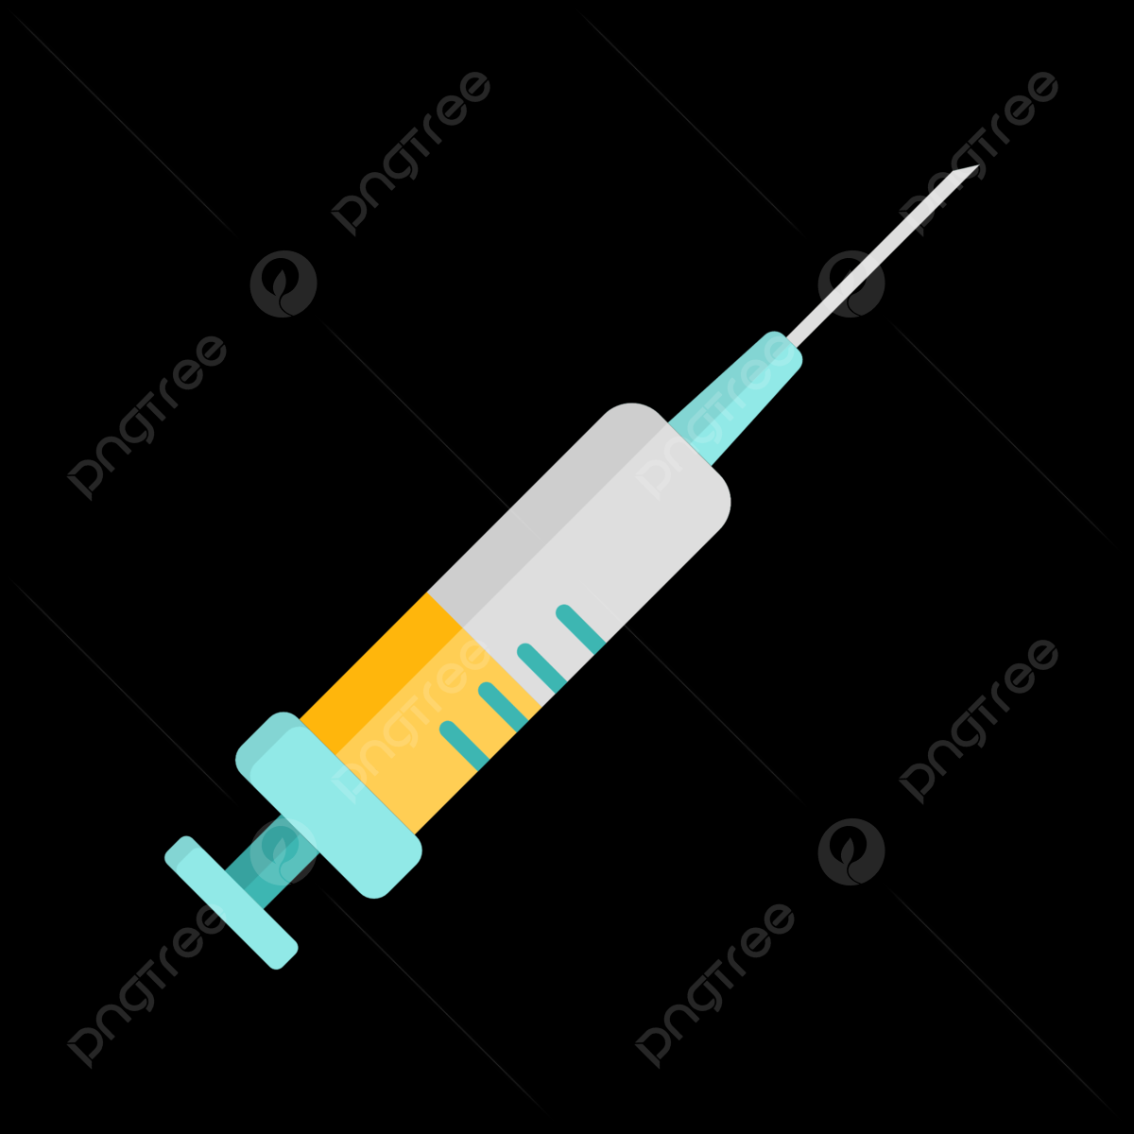
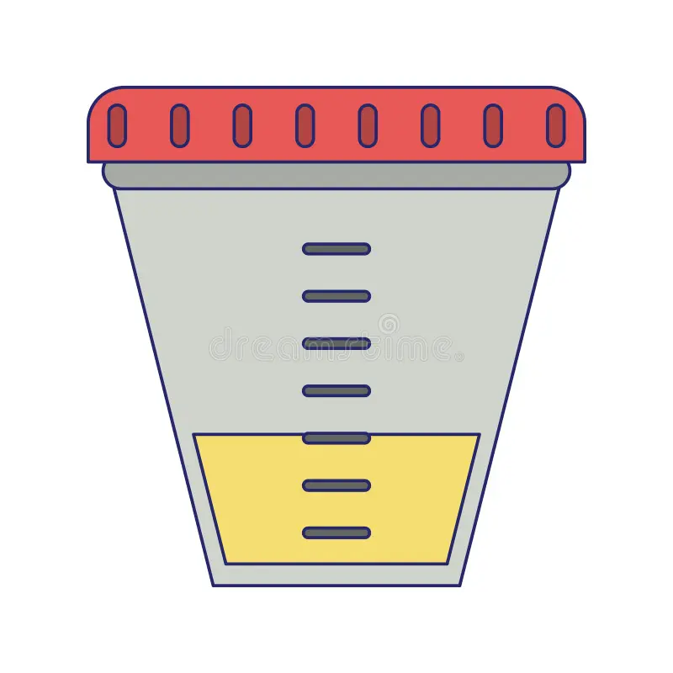

بعض التقنيات الفعالة لتحسين جمع العينات من مصادر البكتيرية مختلفة
A.T. Jwan Yassin Beerradha Alfaily

Slide 2
The probability sampling technique uses some sort of random selection. In this method, every individual of the population has an equal chance of being selected. The advantage of using probability sampling is that probability sampling gives us the best chance to draw a sample that is true representative of the population. To draw valid conclusions from your results, you have to carefully decide how you will select a sample that is representative of the group as a whole. This is called a sampling method. There are two primary types of sampling methods that you can use in your research:
Probability sampling involves random selection, allowing you to make strong statistical inferences about the whole group.
Non-probability sampling involves non-random selection based on convenience or other criteria, allowing you to easily collect data.

Slide 3
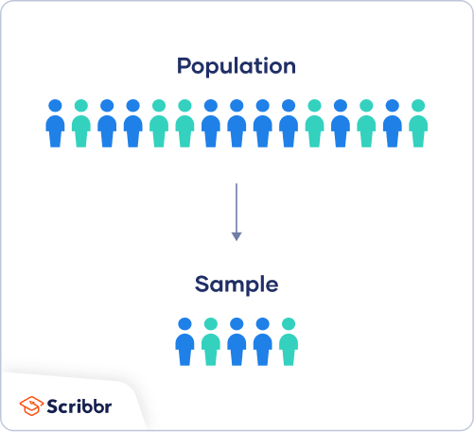
First, you need to understand the difference between a population and a sample, and identify the target population of your research.
The population is the entire group that
you want to draw conclusions about.
The sample is the specific group
of individuals that you will collect
data from.

Slide 4
1. Random Sampling
Random sampling is generally the best and simplest way to draw a sample from a population. With random sampling, every member of the population has an equal opportunity to be included in the sample, and pure chance is the only factor that determines who actually goes into the sample.
For example, we want to choose 200 patient at random from a hospital Here, we can give each patient in the database of the hospital a number between 1 and 500 and choose a random sample of 200 numbers using a random number generator.

Slide 5
2. Stratified Sampling
It is a procedure for selecting a sample that includes the individuals from identified subgroups in the proportion that they exist in the population. This method can be used to select equal numbers from each of the identified subgroups if comparisons between subgroups are important. It is useful only when you plan to subdivide the subjects for subsequent analysis to make various comparisons and decisions.
A good example of stratified sampling would be to divide the population into male and female or into young child and adult etc.
Or in to domestic and wild animals .

Slide 6
3. Cluster Sampling
Cluster sampling often is more convenient when the population is very large. It often isn’t possible to randomly select from the entire population but is more manageable when using clusters because of time, expense, and convenience. For example, a university has ten campuses across the country, each with nearly the same number of students. We can’t travel to every unit in order to gather the necessary data if we want to gather some information on facilities and other stuff. Therefore, we can choose three or four branches as clusters using random sampling. This can help the researcher cut down on travel, expense, time, etc.

Slide 7
4. Systematic Sampling
In systematic sampling, the first member of sample is chosen randomly, and the others are selected according to a predetermined sampling interval .The sampling interval is calculated by dividing the total population size by the desired sample size.
For example, a researcher wants to select a sample of 15 students from a total population of 150 students in a school. A researcher will randomly choose first student from the list and then will systematically choose every 10th student. Finally, A researcher will end up with a desired sample size.

Slide 8
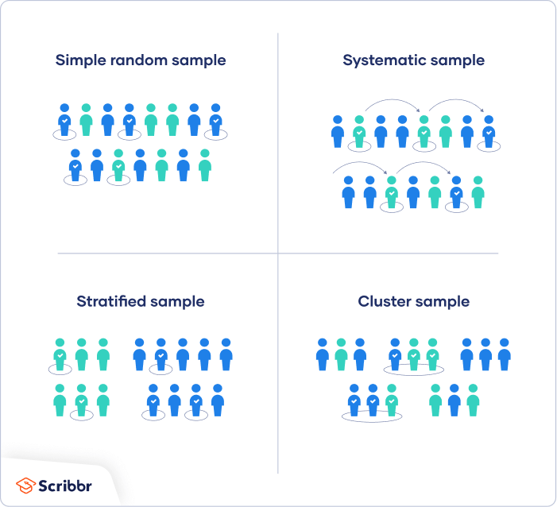

Slide 9
Sampling techniques
1- Manual sampling : physically collecting samples, often used in field research .
2- automated sampling : using instruments or devices to collect samples, common in laboratory settings.
3- Sequential sampling : collecting samples in a sequence, often used in quality control .

Slide 10
In medicine, sampling is the gathering of matter from the body to aid in the process of a medical diagnosis and/or evaluation of an indication for treatment, further medical tests or other procedures.Samples that can be obtained from the body include:
Blood
Urine
Saliva
Sputum
Feces
Semen
Other bodily fluids and tissues.

Slide 11
Blood sample
Blood samples are taken for various purposes, including medical tests and diagnosis. Here are some key points about blood samples:
A health care provider takes a blood sample from a vein in your arm using a small needle.
Blood tests analyze different cells and substances in the blood.
Common blood tests include CBC (complete blood cell count) and specific tests for glucose, cholesterol, and other components.
Blood samples can reveal important information about a person's health.

Slide 12
Techniques for Blood Sampling in Humans and Animals
Blood sampling techniques vary between humans and animals based on the purpose of the sample, the tools used, and the collection site. Here’s an overview of common techniques:
First: Blood Sampling Techniques in Humans
1. Venipuncture: Blood is drawn from a vein using a needle and syringe or a vacuum tube (Vacutainer).
Common sites: The median cubital vein in the arm or the dorsal hand veins. This technique is used for routine laboratory tests.
2. Capillary Sampling : A small puncture is made on the fingertip or heel (for infants) using a lancet or special device.
Used for glucose testing and simple blood analyses (HB, bilirubin).
3. Arterial Blood Sampling Blood is drawn from an artery, such as the radial artery. This method is used for arterial blood gas (ABG) analysis in critical cases.

Slide 13
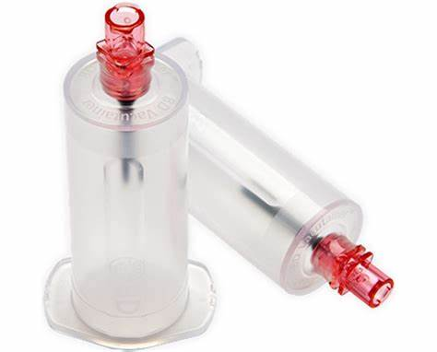

Slide 14
Gather the necessary equipment and tools, such as needles, tubes, syringes, tourniquet, alcohol pad, gauze, etc.
Ask the patient to expose one arm and place a tourniquet around it to make the veins more visible.
Locate a large and accessible vein and clean the site with alcohol pad or other disinfectant.
Insert a needle into the vein and attach the needed tubes or syringes to draw the required amount of blood.
Remove the tourniquet and the needle and press down on the site with gauze to stop bleeding.
Dispose of contaminated materials and needles in proper containers and label the blood samples.

Slide 15
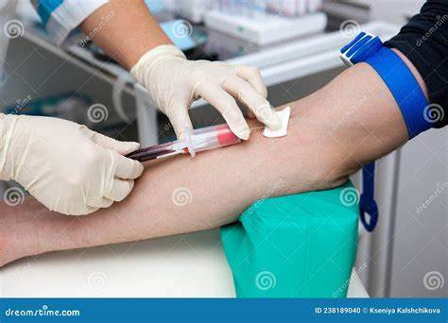

Slide 16
Second: Blood Sampling Techniques in Animals
The method of blood collection should be described in the protocol approved by the Institute animal ethics committee.
1.Venipuncture : Used in both large and small animals, with specific veins depending on the species, Dogs and Cats: Jugular vein, saphenous vein. Cattle and Horses: Jugular vein, coccygeal (tail) vein. Rodents: Tail vein or saphenous vein.
Capillary Sampling: Performed by puncturing the ear or limbs, commonly used in small animals like mice and piglets.
Arterial Sampling: Used in veterinary research or respiratory function monitoring.
Cardiac Puncture: Used in small animals (such as mice) under deep anesthesia to collect large blood volumes.Each technique depends on the type of animal, the required sample volume, and the purpose of the test.

Slide 17
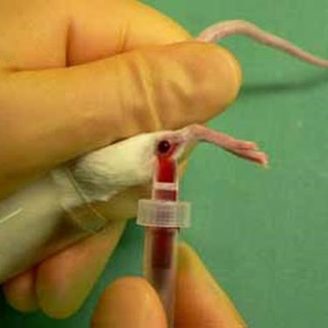
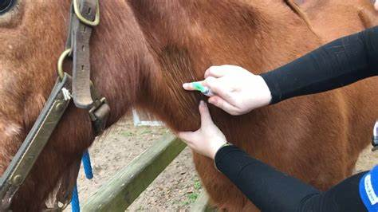
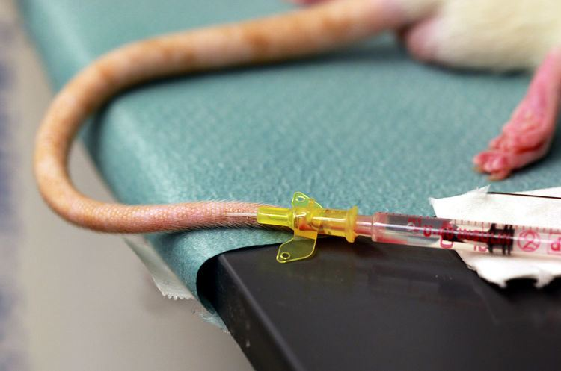

Slide 18
First: Urine Sample Collection Techniques in Humans
1. Random Urine Sample: Collected at any time without prior preparation. Used for general urine analysis (urinalysis).
2. First-Morning Urine Sample: Collected from the first urination after waking up, Used for pregnancy tests and some hormonal analyses.
3. Midstream Urine Sample (Clean Catch), The first portion of urine is discarded, and the sample is collected midstream, Used for bacterial infection testing to avoid contamination.
4. 24-Hour Urine Collection: All urine over 24 hours is collected in a special container. Used for kidney function tests and measuring certain chemicals in urine
5. Catheterized Urine Sample: A urinary catheter is used to collect urine directly from the bladder. Used when normal urination is difficult or for sterile samples.

Slide 19
Second: Urine Sample Collection Techniques in Animals
Free Catch Urine Collection: Urine is collected naturally while the animal urinates using a clean container. Used in dogs, cats, and cattle but may be subject to contamination.
Manual Bladder Expression: Gentle pressure is applied to the bladder to induce urination, often used in cats and small dogs.
Urinary Catheterization: A catheter is inserted through the urethra into the bladder for direct sample collection. Used in male dogs and cats, especially when a sterile sample is needed
Cystocentesis: A needle is inserted directly into the bladder through the abdominal wall to collect urine. Used for sterile samples, especially in cats and dogs.

Slide 20
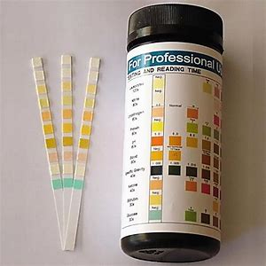

Slide 21
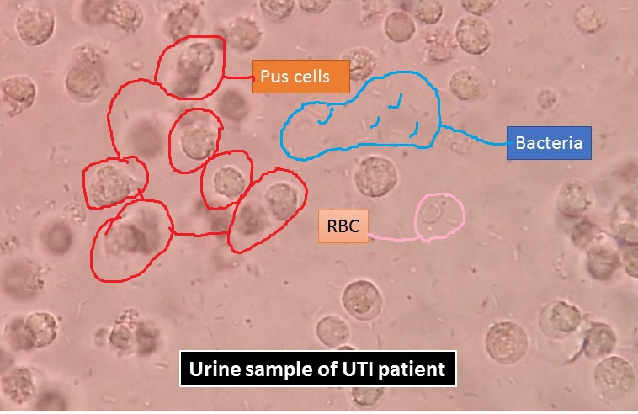

Slide 22
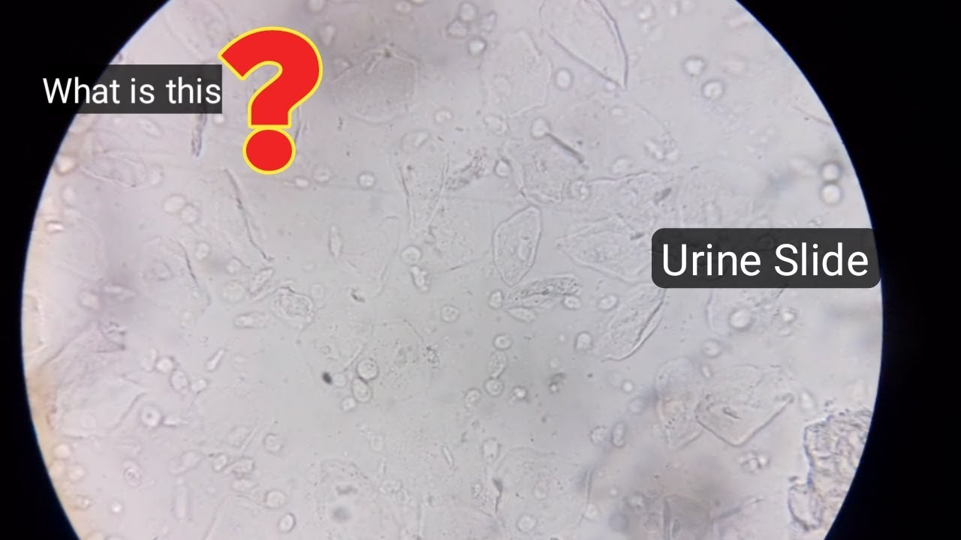

Slide 23
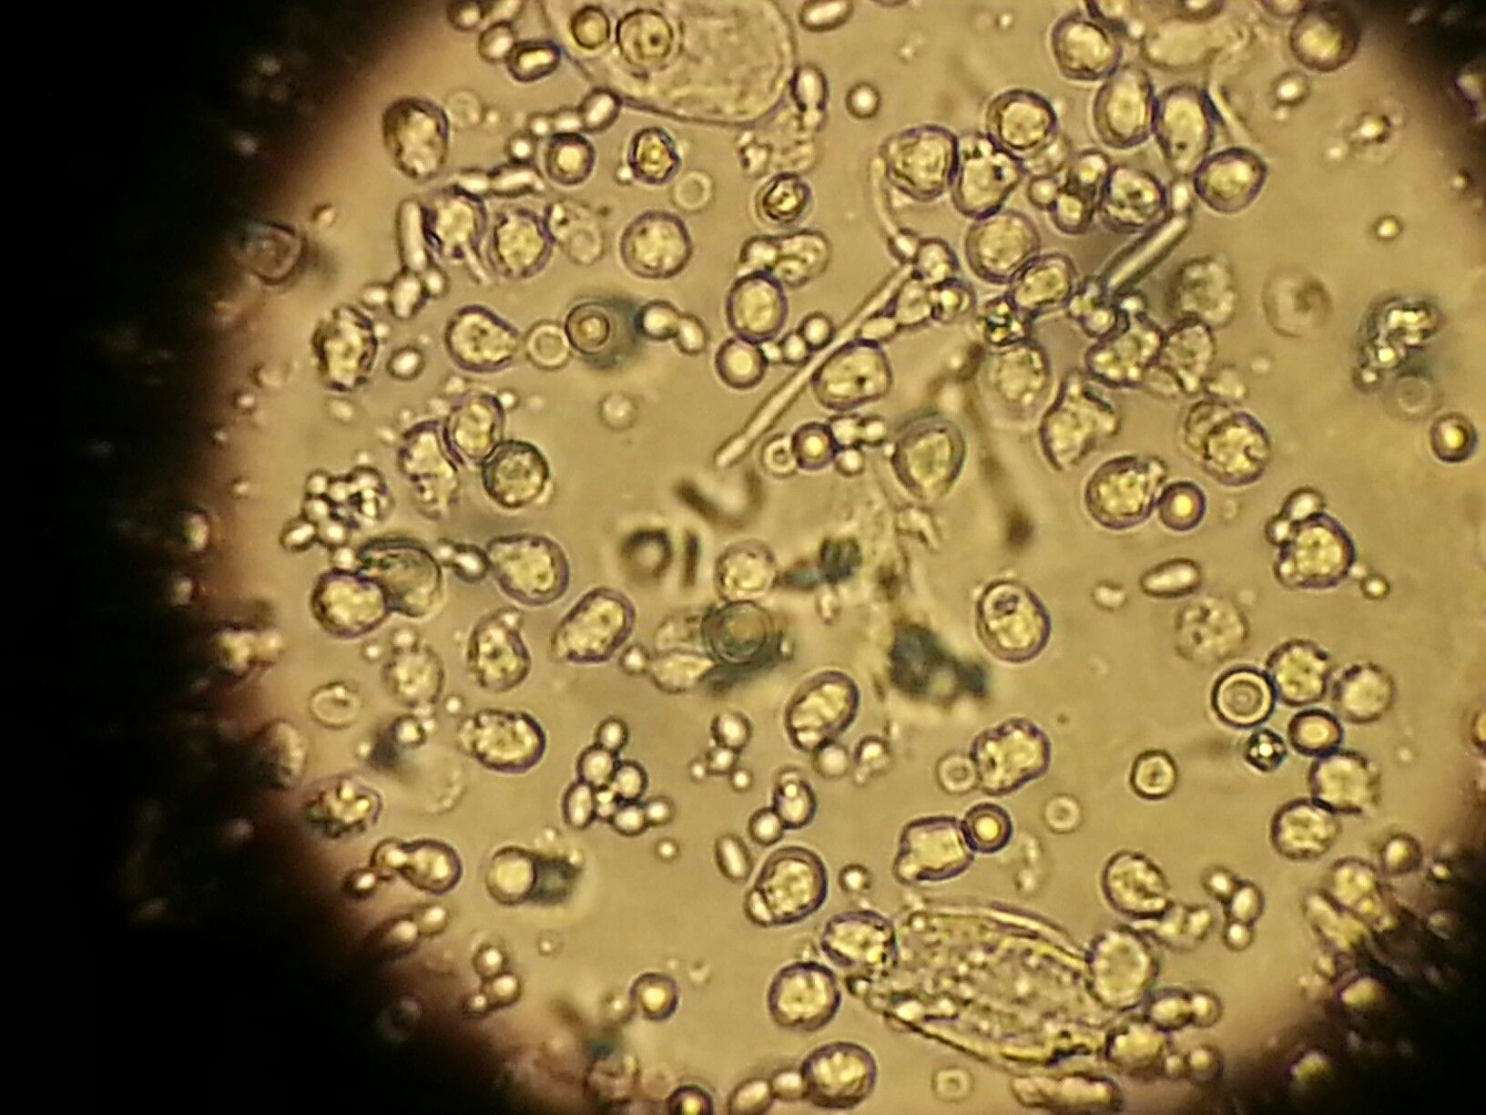

Slide 24
Third: Stool Sample Collection Techniques in Humans
1. Random Stool Sample: A small amount of stool is collected in a clean container, Used for parasite, bacterial testing.
2. Fecal Occult Blood Test (FOBT): A small sample is taken from different parts of the stool to test for hidden blood.
3. Timed Stool Collection (Over 3 Days): Multiple stool samples are collected to analyze fat content or certain chemicals.

Slide 25
Fourth: Stool Sample Collection Techniques in Animals
1. Free Catch Stool Collection: The stool is collected naturally after defecation in a clean container, Used in dogs, cats, cattle, and horses.
2. Rectal Swab or Extraction: A swab or gloved finger is inserted into the rectum to collect a direct sample, Used in animals that do not defecate easily or when a sterile sample is needed.

Slide 26
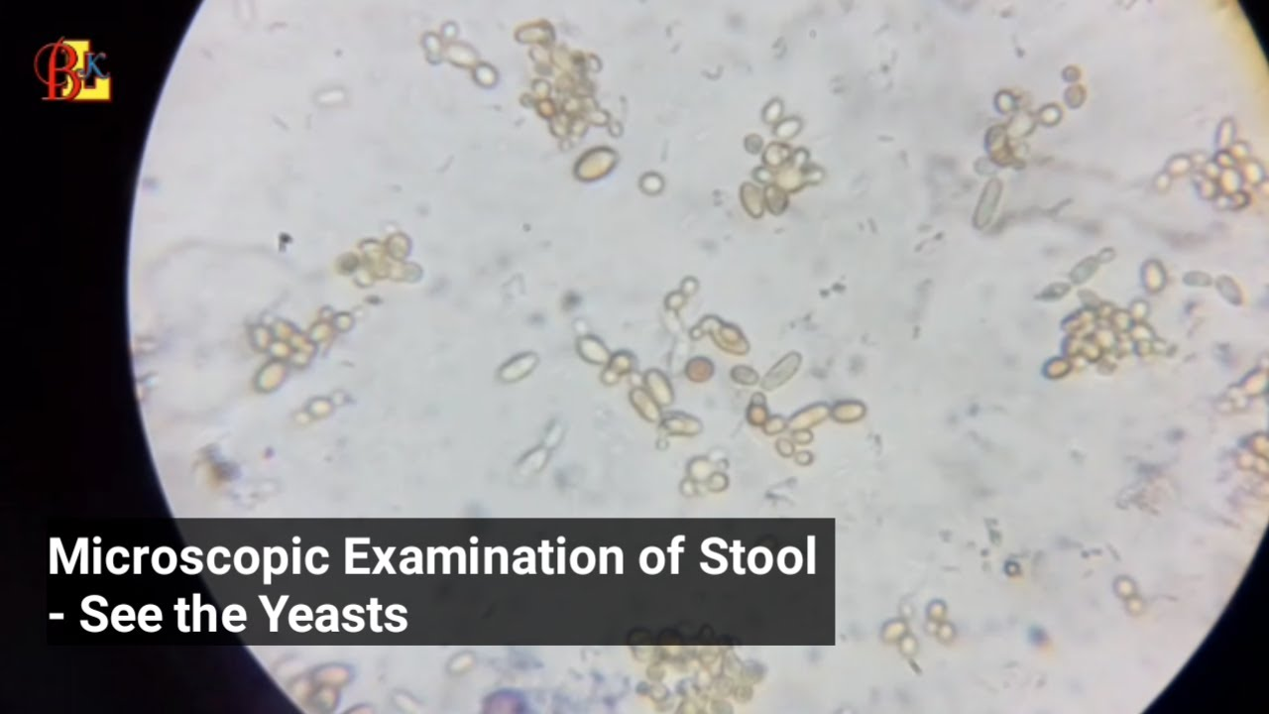

Slide 27
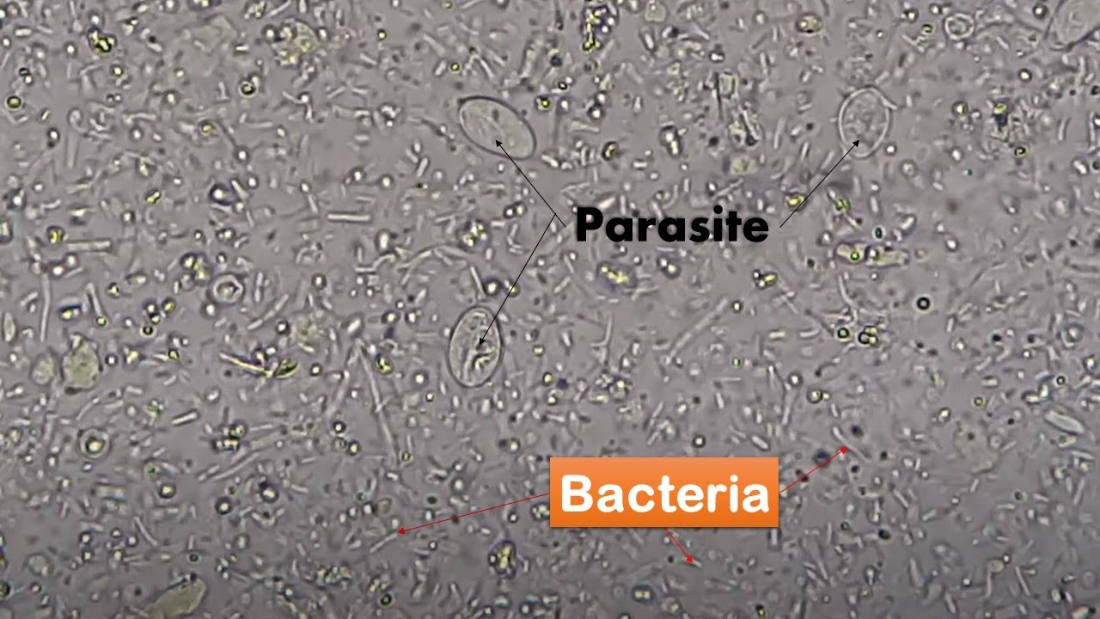

Slide 28


