Slide 1
Application of Antibiotics Discs
Assisst.Prof. Asmaa Hamoody
Lecturer Dr.Roua Jassium

Slide 2
Fast facts on antibiotics
Alexander Fleming discovered penicillin, the first
.natural antibiotic, in 1928
.Antibiotics cannot fight viral infections Fleming predicted the rise of antibiotic
.resistance Antibiotics either kill or slow the growth of bacteria.

Slide 3
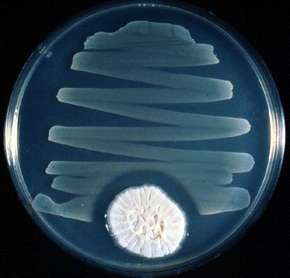
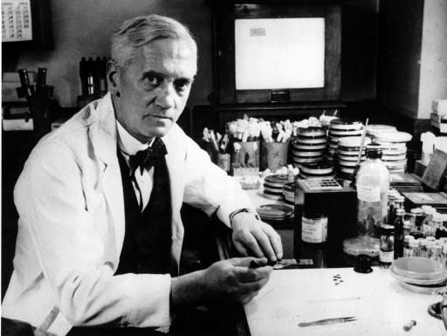
Fleming and Penicillin

Slide 4
The first antibiotic was penicillin. Penicillin-based antibiotics, such as ampicillin, amoxicillin, and penicillin G, are still available to treat a variety of infections and have been around for a long time.

Slide 5
What to know about antibiotics:
Antibiotics also known as antimicrobial are medications that destroy or slow down the growth of bacteria.
They include a range of powerful drugs and are used to treat diseases caused by bacteria. Antibiotics cannot treat viral infections, such as cold, flu, and most coughs.

Slide 6
Antibiotics are powerful medicines that fight certain infections and can save lives when used properly. They either stop bacteria from reproducing or destroy them.
Before bacteria can multiply and cause symptoms, the immune system can typically kill them.

Slide 7
Antibiotic/Antimicrobial
Antibiotic: Chemical produced by a microorganism that kills or inhibits the growth of another microorganism
Antimicrobial agent: Chemical that kills or inhibits the growth of microorganisms

Slide 8
Bacteriostatic vs bacteriocidal
Bacteriocidal | Bacteriostatic
Aminoglycosides | Chloramphenical
B-lactam antibiotics | Clindamycin
Vancomycin | Macrolides
Quinolones | Sulfonamides
Rifampicin | Tetracycline

Slide 9
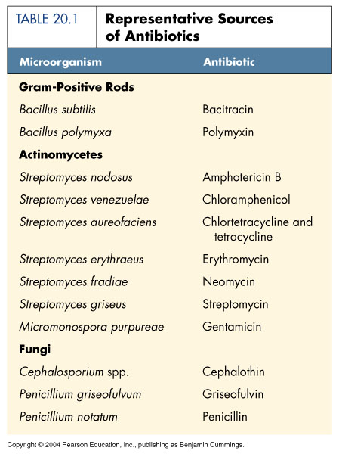
Microbial Sources of Antibiotics

Slide 10
Mechanisms of Antimicrobial Action
Bacteria have their own enzymes for
  Cell wall formation
  Protein synthesis
  DNA replication
  RNA synthesis
  Synthesis of essential metabolites

Slide 11
Mechanisms of Antimicrobial Action
Viruses use host enzymes inside host cells
Fungi and protozoa have own eukaryotic enzymes
The more similar the pathogen and host enzymes, the more side effects the antimicrobials will have

Slide 12
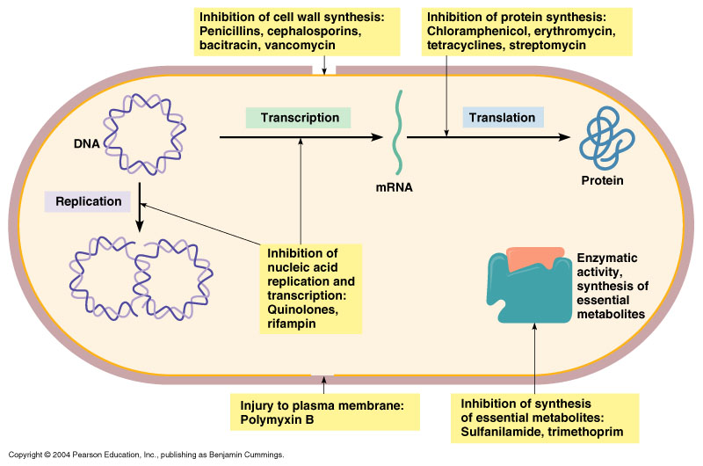
Modes of Antimicrobial Action

Slide 13
Antibacterial Antibiotics
Inhibitors of Cell Wall Synthesis
Penicillin (over 50 compounds)
  Share 4-sided ring (β lactam ring)
Natural penicillins
    Narrow range of action
    Susceptible to penicillinase (β lactamase)

Slide 14
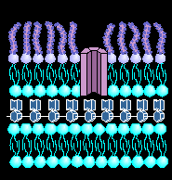
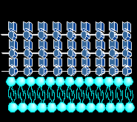
Prokaryotic Cell Walls

Slide 15
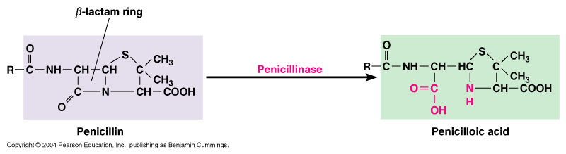
Penicillinase (β Lactamase)
Figure 20.8

Slide 16
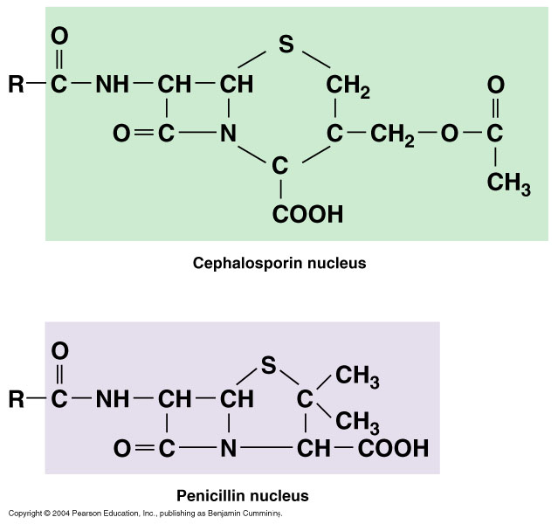
Other Inhibitors of Cell Wall Synthesis
Cephalosporins
  2nd, 3rd, and 4th generations more effective against gram-negatives
Figure 20.9

Slide 17
Other Inhibitors of Cell Wall Synthesis
Polypeptide antibiotics
  Bacitracin
    Topical application
    Against gram-positives
  Vancomycin
    Glycopeptide
    Important "last line" against antibiotic resistant S. aureus

Slide 18
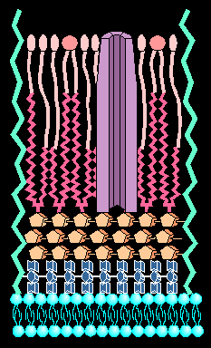
Other Inhibitors of Cell Wall Synthesis
Antibiotics effective against Mycobacteria: interfere with mycolic acid .

Slide 19
Inhibitors of Protein Synthesis
Broad spectrum, toxicity problems
Examples
  Chloramphenicol (bone marrow)
  Aminoglycosides: Streptomycin, neomycin, gentamycin (hearing, kidneys)
  Tetracyclines (Rickettsias & Chlamydia; GI tract)
  Macrolides: Erythromycin (gram +, used in children)

Slide 20
Inhibitors of Nucleic Acid Synthesis
Rifamycin
  Inhibits RNA synthesis
  Antituberculosis
  Ciprofloxacin
  Inhibits DNA
  Urinary tract infections

Slide 21
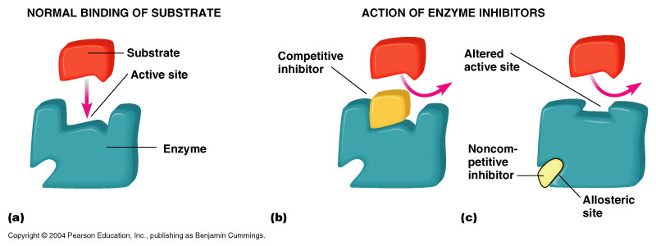
Competitive Inhibitors
  Sulfonamides (Sulfa drugs)
    Inhibit folic acid synthesis
    Broad spectrum
Figure 5.7

Slide 22
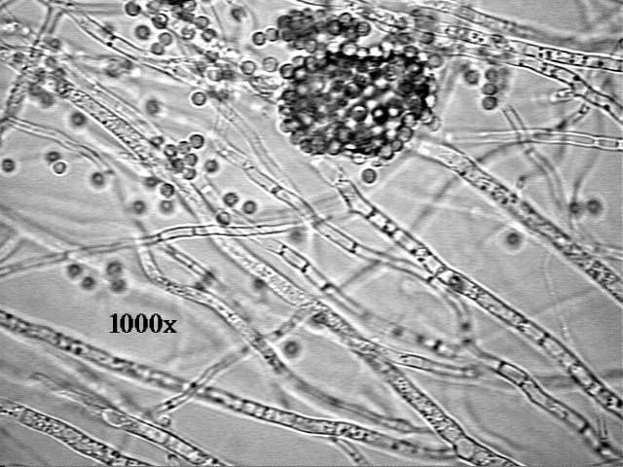
Antifungal Drugs
Fungi are eukaryotes
Have unique sterols in their cell walls
Pathogenic fungi are often outside the body

Slide 23
Antiviral Drugs
Viruses are composed of nucleic acid, protein capsid, and host membrane containing virus proteins
Viruses live inside host cells and use many host enzymes
Some viruses have unique enzymes for DNA/RNA synthesis or protein cutting in virus assembly
Figure 20.16a

Slide 24
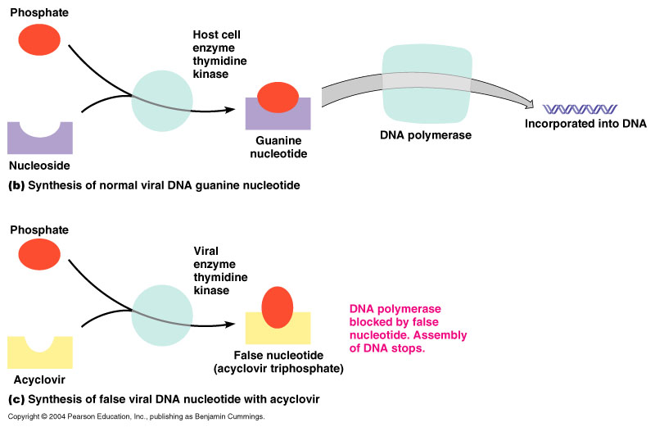
Analogs Block DNA Synthesis
Figure 20.16b, c

Slide 25
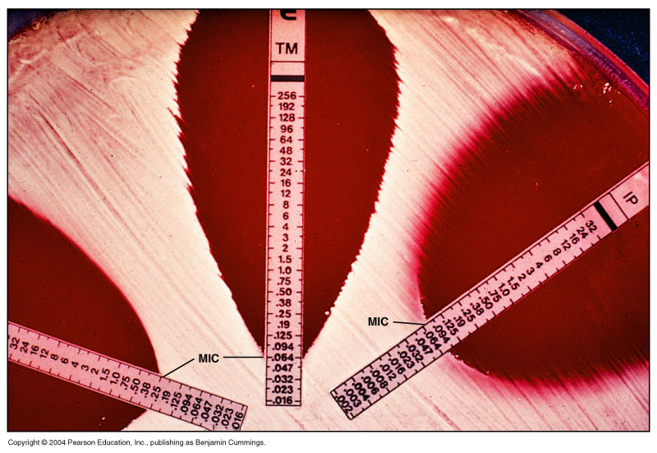
Measuring Antimicrobial Sensitivity

Slide 26
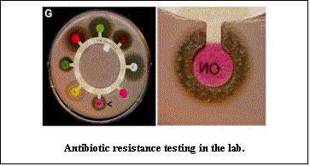
Measuring Antimicrobial Sensitivity: Disk Diffusion

Slide 27
Antimicrobial Resistance
Relative or complete lack of effect of antimicrobial against a susceptible microbe
Increase in MIC

Slide 28
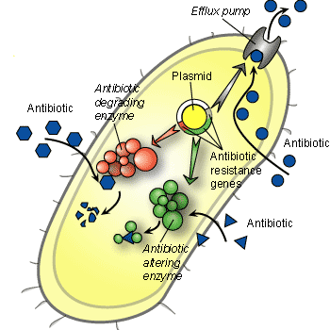
Mechanisms of Antibiotic Resistance
  Drug Enzymatic destruction of drug
  Prevention of penetration of drug
  Alteration of antibiotic or target site
  Rapid ejection of the

Slide 29
What Factors Promote Antimicrobial Resistance?
Exposure to sub-optimal levels of antimicrobial
Exposure to microbes carrying resistance genes

Slide 30
Consequences of Antimicrobial Resistance
Infections resistant to available antibiotics
Increased cost of treatment

Slide 31
Proposals to Combat Antimicrobial Resistance
Speed development of new antibiotics
Track resistance data nationwide
Restrict antimicrobial use
Direct observed dosing

Slide 32
Use more narrow spectrum antibiotics
Use antimicrobial cocktails

Slide 33
Thank you

