Slide 1
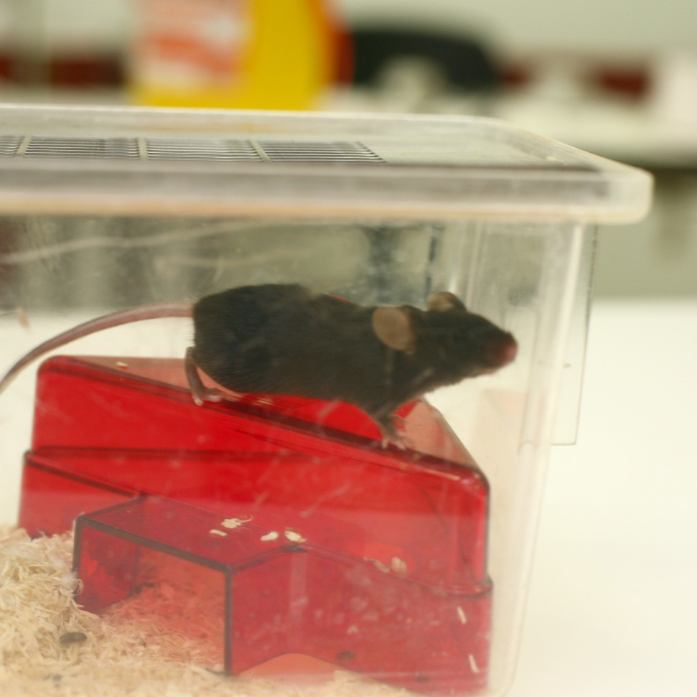
Laboratory Animals
and their uses
By
Assist. Prof. Dr Dhyaa Ab Abood Department of Microbiology
College of Veterinary Medicine University of Baghdad

Slide 2
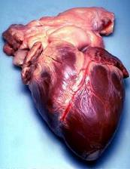
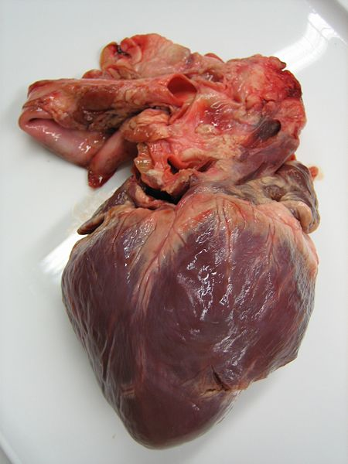
Why are animals used?
Animals use to understand how our body functions (physiology) and the diseases that affect us (pathological changes and pathogenesis).
Researchers must study living systems and the effects that diseases have on them – this often involves research that would not be ethical to carry out on humans, so animals are used.
Despite the difference between humans and animals, they have a very similar biology (they are anatomically similar). Even mice and men are around 99% genetically similar.
Notes:
Top image is a human heart, bottom image is a pig heart – note the similarities Images are Creative Commons from Wikipedia

Slide 3
2 .Animals can breed well under controlled environmental conditions.
3.Animals can serve as a model of biomedical research for various infectious and non-infectious conditions occurring in man and animals.
Examples:
Mice can be used as standard model for the study of Vitamin B12 deficiency.
Use of rats as standard model for the study of nutritional deficiency.
Use of guinea pigs for the study of Vitamin C deficiency.

Slide 4
Commonly used lab animals
orders & species
No. | Class or order | Species
1. | Rodents | Mouse, Rat, Guinea pig, Hamster and Ferret
2. | Lagomorphs | Rabbits
3. | Canine | Dog
4. | Felines | Cat
5. | Ovine | Sheep
6. | Caprine | Goat
7. | Avians | Fowl, Japanese quail, Pigeons etc.
8. | Amphibia | Frog
9. | Fish | Zebra fish
10. | Non-human primates | Monkeys
11. | Reptiles | Snakes and lizards

Slide 5
Animal Research and Alternatives

Slide 6
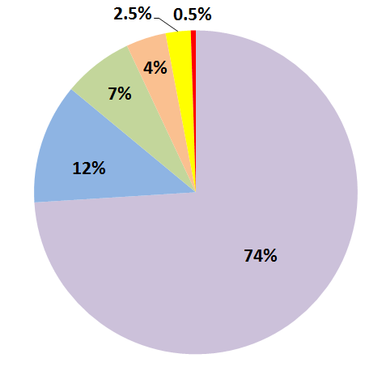
Which Percentage Applies To Which Animals?
Fish
Birds
Rats
Mice
Reptiles / Amphibians
Other Mammals
Notes:
Answers on next slide

Slide 7
Reptiles & Amphibians
Birds
Other Mammals
Rats
Fish
Mice
Notes:
Dogs and cats together account for under 0.5%, monkeys account for less than 0.1%

Slide 8
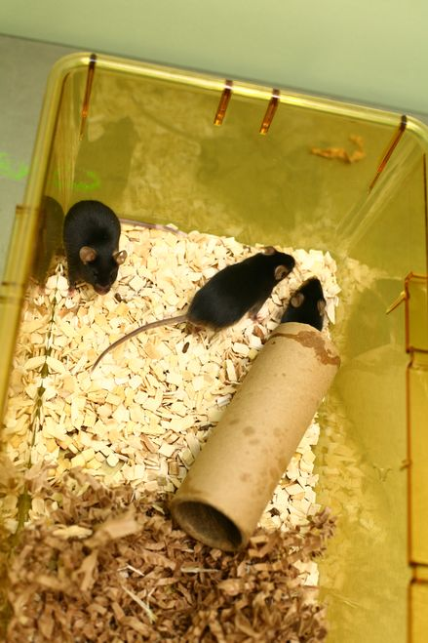
The 3Rs
The 3Rs are principles of prepared by scientist by scientists to improve animal welfare and scientific accuracy.
مبادئ الثلاثة للعلوم الجيدة التي وضعها العلماء لتحسين رعاية الحيوان والدقة العلمية.
Refinement :Finding ways of making animals’ lives better in labs, this can include toys for animals or better training for technicians
Reduction : Using as few animals to control as possible to get good results
Replacement: Using non-animal alternatives wherever they exist
Notes:
Stressed animals provide more variable results than non-stressed ones (just like humans), so keep stress levels low is important for scientific accuracy.
Refinement covers anything aimed at making the lives of animals within labs better e.g. training a monkey to stand and calmly take an injection so it doesn’t need to be restrained.

Slide 9
How select suitable animal species for my study
The most important factor in selection of species is used the most population in previous studies.
If there are no pervious study so initially mice, rats, guinea pigs, rabbits and hamsters should be used for screening.
The experiment should be continued if results are satisfactory.
If our results are satisfy on lab animals as (pilot study), then the experiment can be extended on dogs or non-human primates like monkey.
Note: When result of any experiment is to be projected on human being, serious consideration is to be given on selection of animals.
عندما يتم إسقاط نتيجة أي تجربة على البشر، يجب أن يؤخذ على محمل الجد اختيار الحيوانات

Slide 10
Classification of laboratory animals
On the basis of bacterial field, the laboratory animals can be classified into following three categories:
Conventional lab animals (CV-common class)
Germ Free lab animals (GF-high class)
Specific Pathogen Free lab animals (SPF-medium class)

Slide 11
Use of laboratory animals (field type of biomedical research)
Reproductive biology
To study the nutritional and vitamins deficiency
Diagnosis of bacterial and viral infections.
5. Tissue transplantation and cancer research.
6. Testing of drugs.
8. Effect of toxicity (LDF) .
9. To study the principles of genetics and breeding.
10. To test the pregnancy.
11. Production of anti-sera.
13. Assay of insulin and other hormones.

Slide 12
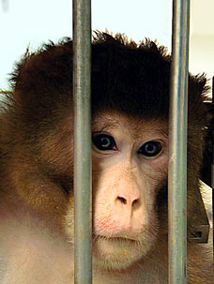
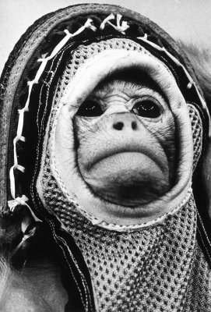
The Ethics of Animal Research
It is very important at application of medication or vaccination or induced infection, finally at killing of animals

Slide 13
End of study or experiment (Supervisors & students)
Initially the author do its experiment on group of animals as a pilot study levels to avoid any mistake could be happen, so there are anther animals group for continues study. With attention for training about anatomy of target organ.
Blood samples for plasma or serum should collected according to the guide of animal types before animal killing by prepare tests tubes, syringes centrifuge etc.
Animals should killing according to specific ethic certificate.
Body organs related with study should be examined grossly and photography insitu. A specific camera or measuring tools to measure weight, lengths or diameters I threw were pathological changes such as hypertrophy etc.
Harvested target organs should washed up with saline, dissecting the tubular organs to clean their lumen, while the paranchymatous organs should cutting into small specimens to ensure that the fixative solution fixed all tissue specimens and avoid autolysis.
When specimen collect an affected tissue should be cut with part of normal.
For histologic study the fixative solution should be equall 10 folds the volume of specimen

Slide 14
THANK YOU

