Slide 1
Cancer Vaccines:
By
Dr. Ammar Kadhim Jawad

Slide 2
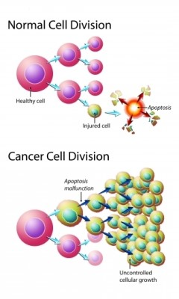
Introduction
Cancer is a group of disease
in which cells are aggressive
(grow and divide without
respect to normal limits)

Slide 3
Introduction
Vaccines have proven effective in preventing diseases caused by viruses and bacteria.
Cancer vaccines are a form of immunotherapy that can help the immune system to recognize and eliminate cancer cells “look like”

Slide 4
Vaccines (in Viruses and Bacteria vs in cancer)
Diseases caused by Viruses and Bacteria, vaccines work by exposing people to a weakened or inactivated version of the threat.
In the case of cancer, the situation is more complicated for several reasons:
Bacteria and Viruses, which appear foreign to our immune system, cancer cells more closely resemble our normal, healthy cells.
each individual’s tumor is in some sense unique and has its own distinguishing antigens.

Slide 5
Why Do We Need Cancer Vaccines?
Prevention of Virus-Linked Cancers
Boosting the Immune System Against Cancer
Targeted and Personalized Cancer Treatment
Reducing Cancer Recurrence
Fewer Side Effects Compared to Traditional Treatments
Potential to Work with Other Immunotherapies

Slide 6
Types of Cancer Vaccines
A. Preventive (Prophylactic) Vaccines
Work by preventing viral infections that can cause cancer
Examples:
HPV vaccine (Cervical cancer, Oropharyngeal cancer)
Hepatitis B vaccine (Liver cancer)

Slide 7
Types of Cancer Vaccines
B. Therapeutic (Treatment) Vaccines
These vaccines are designed to help the immune system fight existing cancers rather than prevent them.
The vaccine introduces tumor-specific antigens (TSA) to the immune system.
For examples: Sipuleucel-T (Provenge) – FDA-approved for prostate cancer

Slide 8
Types of Cancer Vaccines
C. Personalized Cancer Vaccines
These are referred to as neoantigens (“new antigens”), and they are expressed exclusively by tumor cells (as a result of mutations) and not by any of a patient’s healthy cells.
With neoantigen vaccines, therefore, it is conceivable that immune responses could be directed precisely against patients’ tumor cells while sparing their healthy cells from immune attack, thus possibly preventing side effects.
For examples: mRNA cancer vaccines – In development for personalized cancer treatment

Slide 9
How Cancer Vaccines Stimulate an Immune Response ?
Step 1: Antigen Introduction
Step 2: Antigen Presentation by Dendritic Cells
Step 3: Activation of T Cells
Step 4: B Cell and Antibody Response
Step 5: Memory Formation

Slide 10
Challenges and Limitations
Misdirected immune response where the immune system targets healthy cells that express the same target proteins.
Tumor heterogeneity (Different cancer cells within the same tumor).
Immune system suppression by cancer cells.
High cost & production challenges.

Slide 11
Conclusion
Cancer vaccines represent a paradigm shift in oncology, offering safer, more effective, and long-lasting cancer prevention and treatment strategies. As research advances, they will become a key component in the fight against cancer.

