Slide 1
Genetic Admixture Population Genetics
Farah Al-Saadi
MSc Genetic of Human diseases University College London UCL
Institute of Genetic Engineering and Biotechnology for Postgraduate Studies University of Baghdad
Farah.a@ige.uobaghdad.edu.iq

Slide 2
What is Genetic Admixture?
Individuals from two or more divergent genetic ancestries allowed for mating in one geographical location.
The resulted population will be decanted from multiple genetic sources which will be referred to as Admixed Population.

Slide 3
Population 1
Population 2
Admixed population of 1+2

Slide 4
Genetic Admixture of Latin America

Slide 5
First Genetic Ancestry – Asians

Slide 6
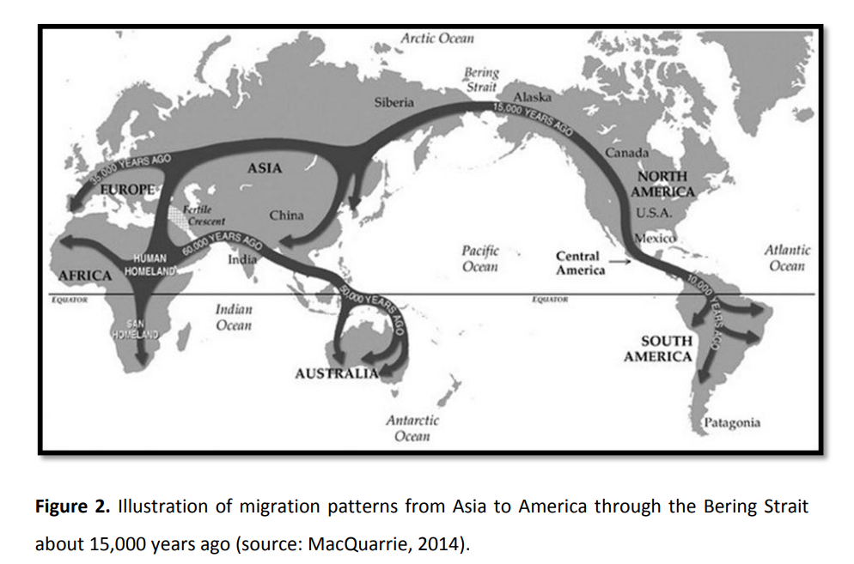

Slide 7
Second Genetic Ancestry – Europeans

Slide 8
Third Genetic Ancestry – Africans

Slide 9
Genetically Admixed population of Latin America

Slide 10
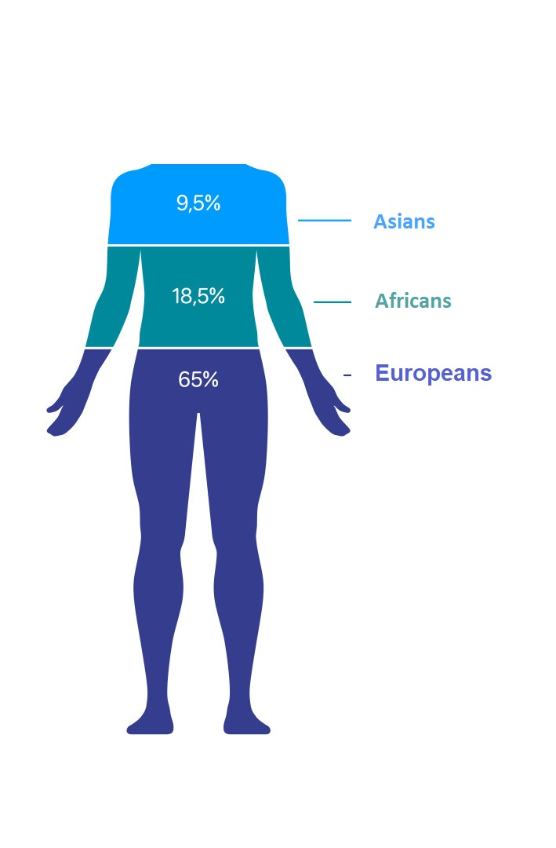
Individuals genetically compose of the 3 ancestries with different proportions

Slide 11
Impact of Admixture on genetic diversity
Admixture events can introduce new genetic variants and alleles into a population, increasing its overall genetic diversity and potentially leading to the emergence of novel phenotypes.
Admixture can have both beneficial and detrimental effects on a population, as it can introduce both advantageous and deleterious genetic variants.

Slide 12
Phenotypic diversity in Latin America
European decent – light skin/hair/eye color
African decent – Frizzy darker hair color

Slide 13
Disease risk in genetically admixed Latin America
European decent women – Lower risk of CHD
African decent women – Higher risk of diabetes

Slide 14
Admixed mapping
Ancestry Informative SNP
SNPs with largely different allele frequencies in populations.
Use Fixation index Fst: Proportion of genetic diversity due to allele frequency differences among populations.

Slide 15
European and East-Asian Allele Frequencies for the 8150 AIMs

Slide 16
Thank you

