Slide 1
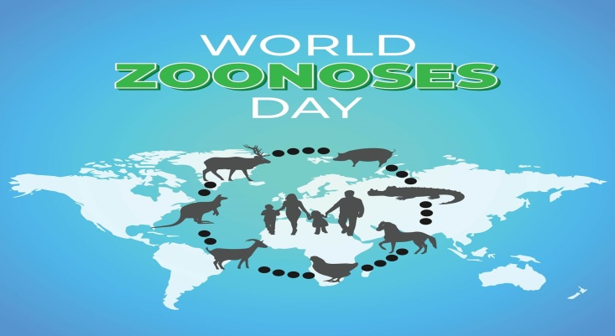
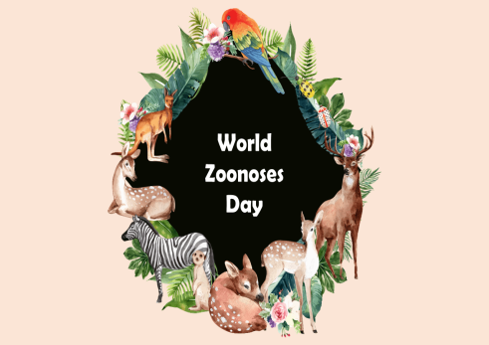
Zoonoses Challenging and increasing Global Disease Threats
Prof. Dr. Basima Qasim Hasan AL-Saadi
Wednsday,16/4/2025

Slide 2
Introduction
An emerging zoonosis is one that has recently been identified or evolved in recent past and still prevailing more in terms of its geographic, host, or vector ranges
Basic, applied and clinical studies are increasing in their number, rate of reporting, and breadth to address the multitude of biotic and abiotic factors that influence the emergence, epidemiology, diagnosis pathogenesis, treatment, control, and prevention of zoonoses.
1990, 105 manuscripts;
2000, 362 manuscripts;
2010, 973 manuscripts;
2015, 1738 manuscripts;
and, in 2020, 2779 manuscript.

Slide 3

Introduction
Zoonoses is a great public health concern and a direct human health hazard that may even lead to death.
Across the globe, the 13 most common zoonosis were most impactful on poor livestock workers in low- and middle-income countries and have caused an estimated 2.4 billion cases of illness and 2.7 million deaths in humans per year in addition to their negative effect on human health .Most of these diseases affect animal health and decrease livestock production
According to the World Health Organization (WHO), defines a zoonosis any disease or infection that is naturally transmissible from vertebrate animals to humans or from humans to animals. Among the human pathogens, about 61% are zoonotic in nature
The WHO states that there are over 200 currently known zoonosis.

Slide 4
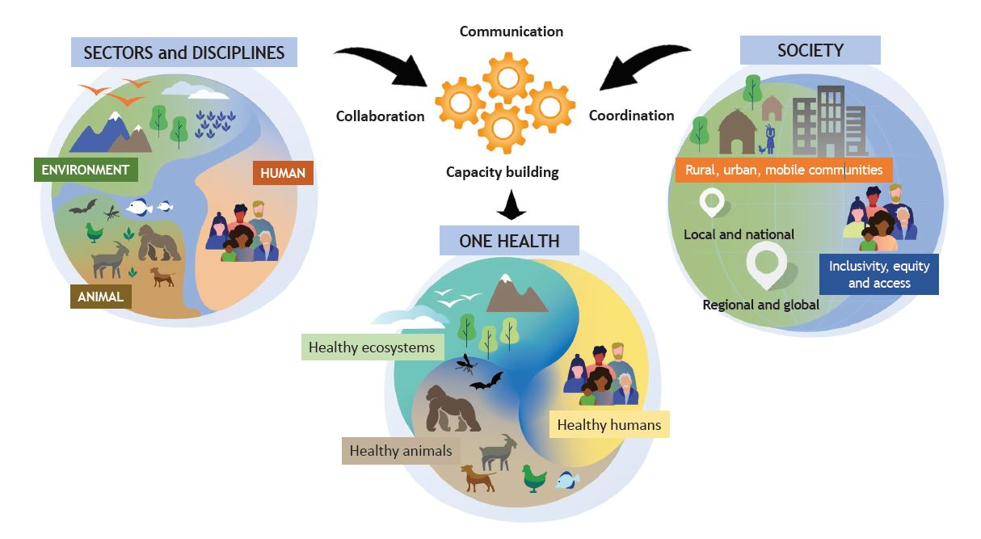
The Food and Agriculture Organization of the United Nations (FAO), the World Organisation for Animal Health (OIE), the United Nations Environment Programme (UNEP) and the World Health Organization (WHO) welcome the newly formed operational definition of One Health from their advisory panel, the One Health High Level Expert Panel (OHHLEP),
The four organizations are working together to mainstream One Health so that they are better prepared to prevent, predict, detect, and respond to global health threats and promote sustainable development.
The One Health definition developed by the OHHLEP states:One Health is an integrated, unifying approach that aims to sustainably balance and optimize the health of people, animals and ecosystems.

Slide 5
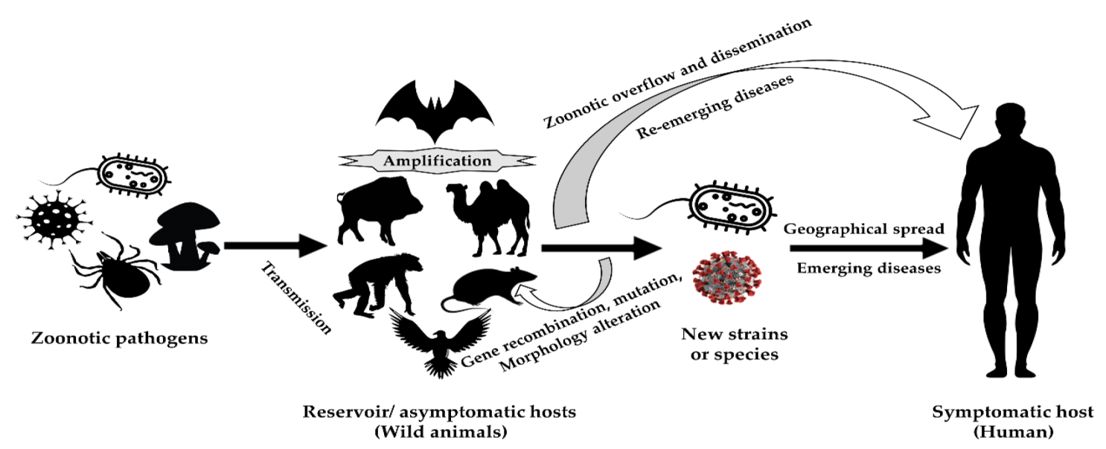
Factors affect zoonotic transmission
There are multiple factors which affect the transmission and occurrence of zoonotic infectious diseases from animal population to human beings. Furthermore, these factors also have significance in disease transmission within livestock.. First, the close contact between humans and livestock, particularly in intensive farming systems, increases the opportunities for disease transmission because livestock populations serve as reservoirs for zoonotic pathogens, even without apparent signs of disease. Second, genetic diversity within livestock populations affects disease susceptibility, with reduced diversity increasing the risk of disease emergence (Fig. 1).

Slide 6
Causes
Most of the infectious diseases affecting humans are of animal origin.
This diverse community of infectious diseases is not static due to the
ongoing and increasing frequency of newly discovered zoonotic pathogens, which are emerging during a time of unprecedented
global geoclimatic,
demographic,
socioeconomic,
and technological changes

Slide 7

Causes
Zoonotic diseases are caused by a wide range of pathogens. Based on etiology, zoonoses are classified into( according to (WHO):
bacterial zoonoses (such as anthrax, salmonellosis, tuberculosis, Lyme disease, brucellosis, and plague),
viral zoonoses (such as rabies, acquired immune deficiency syndrome- AIDS, Ebola, and avian influenza),
parasitic zoonoses (such as trichinosis, toxoplasmosis, trematodosis, giardiasis, malaria, and echinococcosis),
fungal zoonoses (such as ring worm), rickettsial zoonoses (Q-fever), chlamydial zoonoses (psittacosis),
mycoplasma zoonoses (Mycoplasma pneumoniae infection),
protozoal zoonoses, and diseases caused by acellular non-viral pathogenic agents (such as transmissible spongiform encephalopathies and mad cow disease)

Slide 8
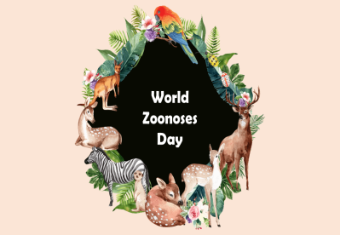

Risk Factors
Macro and micro geoclimatic variations, also represent major influences on the ecology of zoonotic diseases;
the distributions of arthropod vectors, vertebrate reservoirs, and human interactions;
habitat modification and land use change;
pathogen dynamics.
These environmental changes result in the movement of zoonotic pathogens into new geographic areas and the potential for decline in others where environmental conditions become less favorable due to the multiple factors required to maintain diverse enzootic cycles

Slide 9
A proactive approach
that is increasingly favored is to prevent the actual spillover of the zoonotic pathogen to humans from other vertebrate animal species and thus reduce disease and pandemic potential.
This approach requires:
active surveillance that is broad-ranging, international and ongoing;
deep molecular sequencing to analyze microbiomes and viromes of multiple
potential reservoir and vector species to identify existing and potential disease threats
3. The establishment of databases that are standardized in their methodology
and readily and easily accessible to stakeholders globally;
4 . and, the human capital, physical infrastructure, response capabilities, and financial support to maintain such global initiatives

Slide 10
The prevailing approach
relies upon the detection of zoonotic pathogen emergence as a result of human case onset.
The next steps include the
rapid development of effective, potentially novel, tools
And strategies to diagnose and treat emerging pathogens
and to quickly develop and administer vaccines to limit disease spread and protect vulnerable populations

Slide 11
Recommendations
Zoonotic diseases represent a serious public health concern. Many zoonoses are currently under control but there is gap in our knowledge about many diseases especially on the disease distribution, etiology, pathogen, host, vector biology, dynamics, transmission cycle, predisposing factors, and risk factors.
The equilibrium exists among the host, agent, and environment may be disturbed at any point due to various anthropogenic activities of increasing human population and natural activities to evoke emission of zoonoses.
With the existing knowledge we cannot accurately predict the time or the impact of the next pandemic of a zoonoses may occur.

Slide 12
Recommendations
Active and wider zoonoses surveillance and monitoring with advanced tools like satellite-based remote sensing system and molecular epidemiological tools.
Disease reporting and notification service. Giving priority to zoonoses and action team formation.
Available diagnostic facilities and skilled manpower. Cooperation at regional, national, subnational, and international levels.
One health-based approach comprising both veterinarians and medical doctors in addition to environmental experts and other professionals.
Ensuring adequate regular and emergency funding. Mass campaigning on public awareness on zoonoses.
More research on disease epidemiology, risk factors, pathogen virulence, host biology, and vector biology. Wildlife monitoring and wildlife protection

Slide 13
Future
to maintain diverse enzootic cycles
Further research is needed to closely identify knowledge gaps and to develop novel tools and strategies for the control and prevention of zoonotic diseases

