Slide 1
Geriatrics In Dentistry
Dr. Mohammed Ghalib B.D.S., M.Sc., in Preventive dentistry

Slide 2
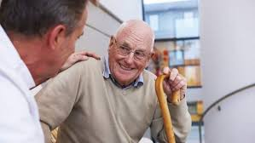
Geriatrics
Geriatrics: The branch of medicine concerned with the diagnosis, treatment and prevention of disease in older people and the problems specific to aging.
From the Greek "geron" meaning "old man" + "iatreia" meaning "the treatment of disease.".

Slide 3
Aging:
At the biological level, ageing results from the impact of the accumulation of a wide variety of molecular and cellular damage over time. This leads to a gradual decrease in physical and mental capacity, a growing risk of disease, and ultimately, death.

Slide 4
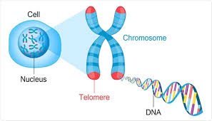

Slide 5
GERIATRIC PATIENT ASSESSMENT
The medical assessment of an older adult can be quite different and significantly more complicated than the medical workup of a younger patient:
First, older persons commonly present with both atypical symptoms and responses to illness.
Second, social and psychological factors can disguise classic disease presentations. Patients are able to mask a disease process, such as dementia, which can lead to physicians missing the diagnosis.

Slide 6
OSCAR is a multidimensional assessment tool for planning oral healthcare for the older patient, which has been developed by the American Academy of Oral Medicine.

Slide 7
Oral :Dentition, restorations, fixed and/or removable prostheses, periodontium, oral mucosa, salivary glands
Systemic: Medical problem list, medications, age-related changes, inter-professional communication

Slide 8
Capability: Ability to perform activity of daily living, caregivers, oral hygiene, transportation, mobility
Autonomy: Decision-making ability, consent to care, dependence on others for decisions
Reality: Financial limitation, life expectancy, prognosis, ability to maintain dental treatment, medical stability

Slide 9
Oral Health
Systemic Health

Slide 10
PHARMACOTHERAPEUTICS IN OLDER ADULTS
Due to increased exposure to medication, older adults are at an increased risk for drug-related complications. Problems such as drug–drug interactions, adverse drug reactions polypharmacy (use of multiple medications or use of more medications than appropriate).

Slide 11
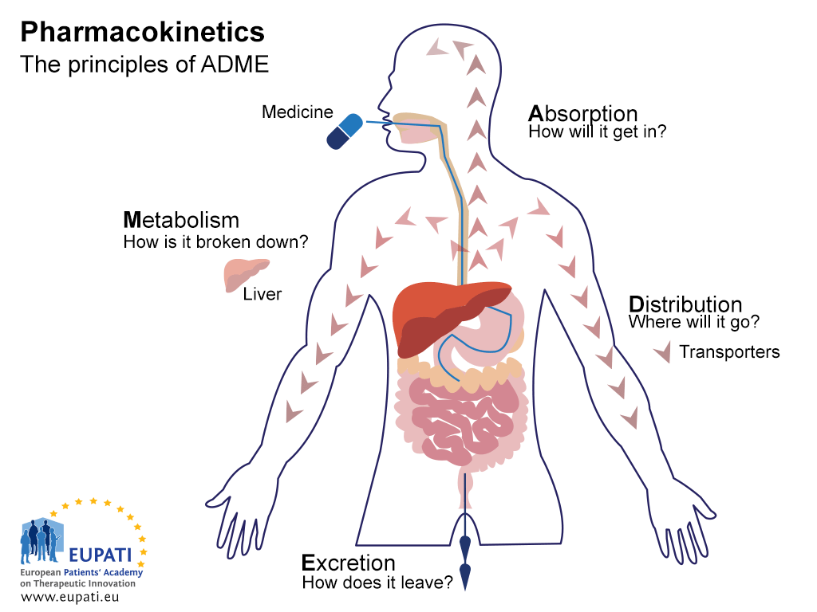
Pharmacokinetics
The pharmacokinetics of medications—the absorption, distribution, metabolism, and elimination—can be altered in an older patient due to the aging process.

Slide 12
Pharmacodynamics
The pharmacodynamics of medications—the drug’s action on the body—can also be affected by the aging process. As we age, multiple changes occur, such as changes in body composition (increased body fat, decreased lean muscle mass, anddecreased body water).

Slide 13
AGE-RELATED ORAL CHANGES

Slide 14
Oral Motor and Sensory Function
With aging:
Olfactory function declines.
Gustatory function declines.
Taste dysfunction may be attributed to: the normal aging process, primary defect in olfaction, upper respiratory infection, head injury, drug use, tooth loss and ill-fitting dentures or reduction in saliva production and idiopathic causes.

Slide 15
3) Alterations in mastication, swallowing, and oral muscular posture.
This muscle weakness can be exacerbated by various systemic diseases such as Parkinson disease, a history of head and neck cancer and its treatment, multiple sclerosis, and CVA.
choking and aspiration.
The dentist must be aware of these changes, especially when approaching restorative care.

Slide 16
Patients who have diminished food recognition and enjoyment as well as altered smell, taste mastication and swallowing function can therefore have significant effect on quality of life and malnutrition.
The dentist can play an important role in nutritional counseling to prevent malnutrition, dehydration, and diminished quality of life.

Slide 17
Dentition
The age-related changes to the dentition: Occlusion attrition, pulpal recession, fibrosis, and decreased cellularity are some of the more common changes seen—all of which may lead to diminished tooth sensitivity and reduced perception of painful stimuli.

Slide 18
In addition, recurrent coronal and root surface caries staining, chipping and cracking, and increased susceptibility to tooth fracture are common in older patients.

Slide 19
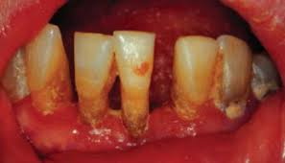
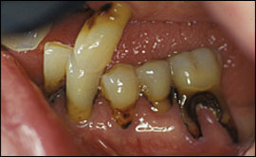

Slide 20
Oral Mucosa
Changes over time, including declining immunologic responsiveness, systemic disorders with the increased use of medications reapeted mucosal trauma, mucosal diseases, and salivary gland hypofunction.

Slide 21
Oral epithelium becomes thinner, less elastic, and atrophies.
In addition prone to oral lesions include trauma, lichen planus and lichenoid reactions, inflammatory processes such as epulis fissurata, candidiasis, vesiculo-bullous conditions such as pemphigoid, pemphigus, herpes, and finally premalignant and malignant lesions.

Slide 22
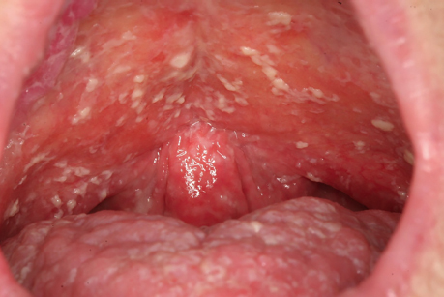
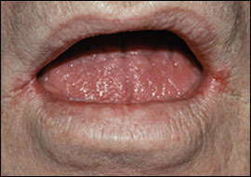
Thrush
Angular cheilitis

Slide 23
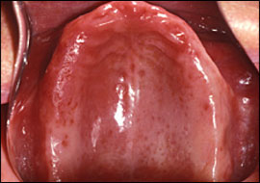
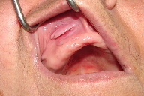
Denture stomatitis
Epulis fissuratum

Slide 24
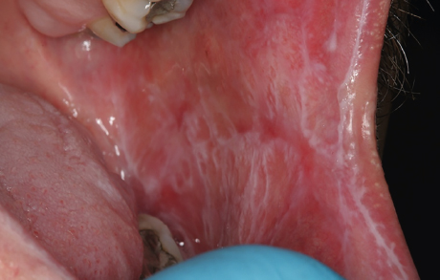
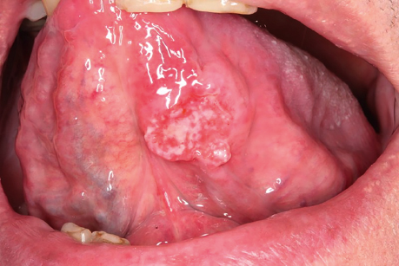
Reticular Lichen planus
Squamous cell carcinoma

Slide 25
SUMMARY
Oral and systemic diseases concurrently interact to produce a myriad of oropharyngeal disorders.
Thus, many older persons will experience oral mucosal, dental, periodontal and chemosensory, masticatory, salivary, and swallowing disorders. Most of these problems can be treated to diminish morbidity and mortality in this population.

Slide 26
Therefore, dentist must be able to identify, manage, and prevent these problems to enhance the quality of life of older adults.

Slide 27


