Slide 1
From Equations to Applications: The Role of Mathematics in Engineering Design
By: Dr. Zinah Abbas Abed

Slide 2
CONTENT
INTRODUCTION
EXAMPLES
INCREASING /DECREASING FUNCTIONS
FIRST DERIVATIVE TEST
SECOND DERIVATIVE TEST
APPROXIMATTION
TANGENTS AND NORMALS
MAXIMA AND MINIMA

Slide 3
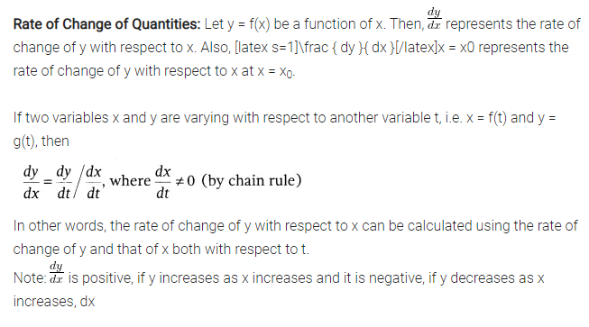
APPLICATIONS OF DERIVATIVES

Slide 4
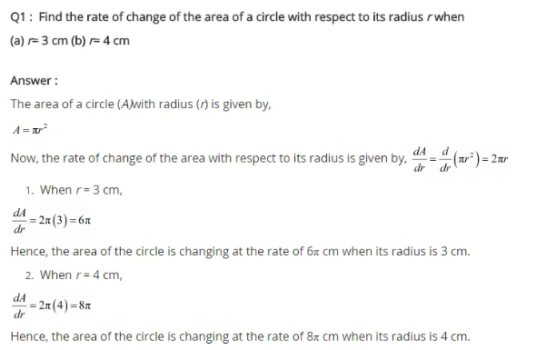

Slide 5
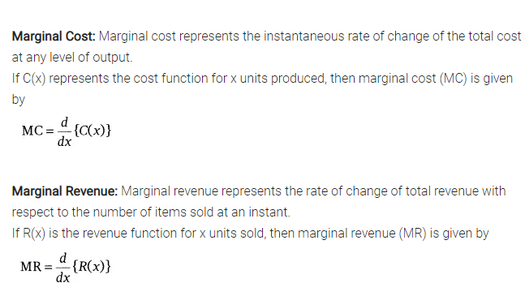
EXAMPLES

Slide 6
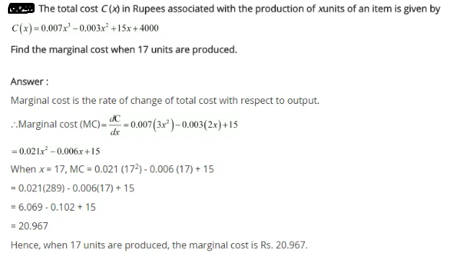

Slide 7
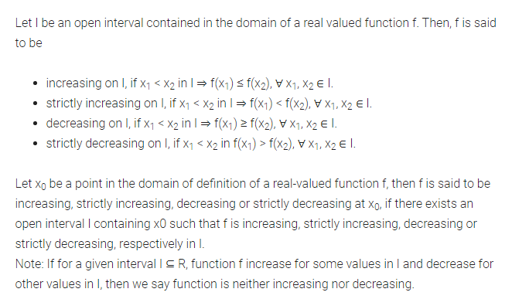
INCREASING /DECREASING FUNCTIONS

Slide 8
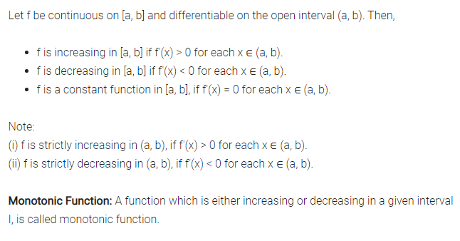
INCREASING /DECREASING FUNCTIONS

Slide 9
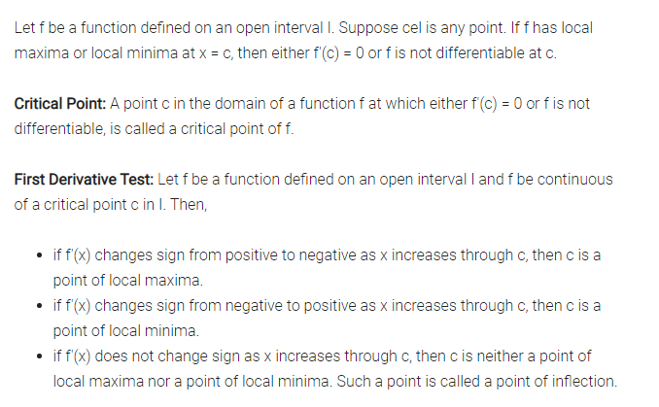
FIRST DERIVATIVE TEST

Slide 10
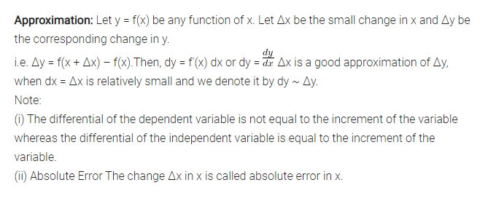
APPROXIMATTION

Slide 11
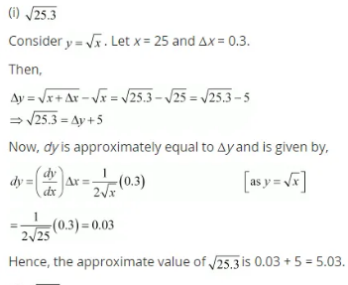
Finding the approximate value

Slide 12
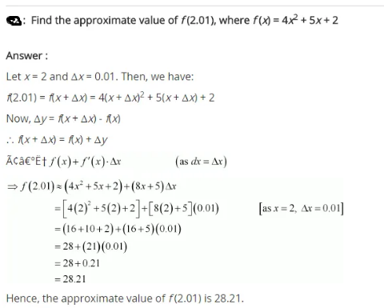

Slide 13
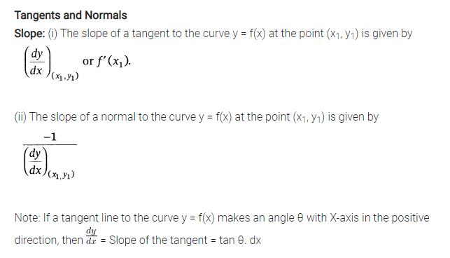
TANGENTS AND NORMALS

Slide 14
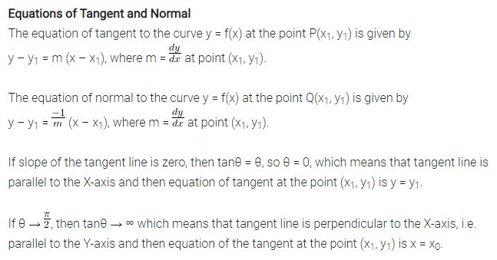
TANGENTS AND NORMALS

Slide 15
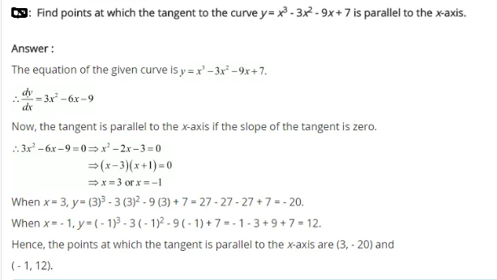

Slide 16
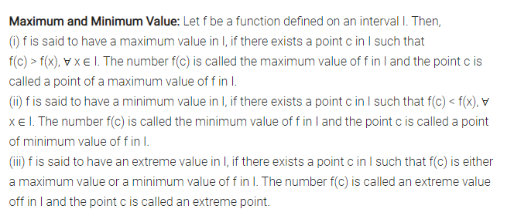
MAXIMA AND MINIMA

Slide 17
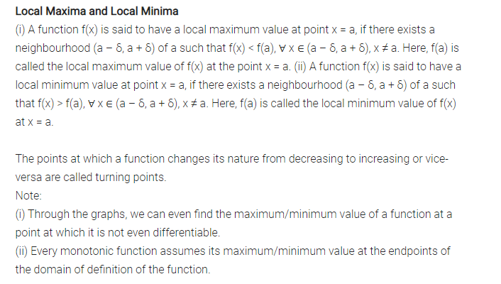
MAXIMA AND MINIMA

Slide 18
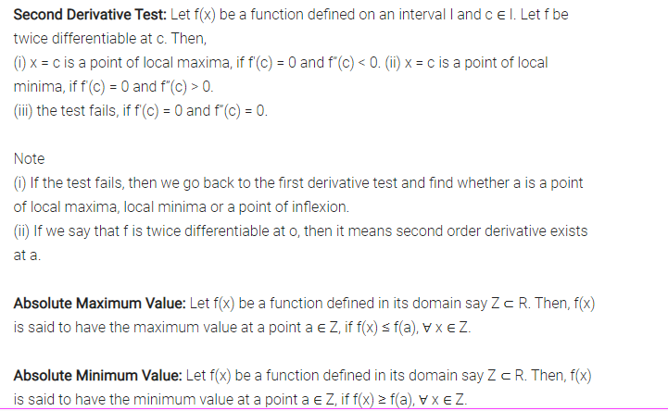
SECOND DERIVATIVE TEST

Slide 19
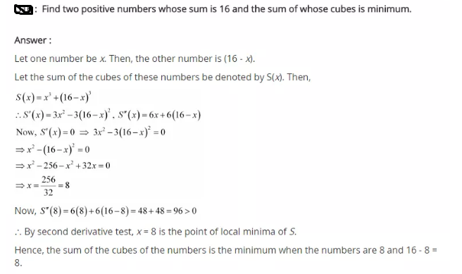

Slide 20
IMPORTANT FACTS
Absolute Minimum Value: Let f(x) be a function defined in its domain say Z ⊂ R. Then, f(x) is said to have the minimum value at a point a ∈ Z, if f(x) ≥ f(a), ∀ x ∈ Z.
Absolute Maximum Value: Let f(x) be a function defined in its domain say Z ⊂ R. Then, f(x) is said to have the maximum value at a point a ∈ Z, if f(x) ≤ f(a), ∀ x ∈ Z.
Every continuous function on a closed interval has a maximum and a minimum value.
Every continuous function defined in a closed interval has a maximum or a minimum value which lies either at the end points or at the solution of f'(x) = 0 or at the point, where the function is not differentiable.
Let f be a continuous function on an interval I = [a, b]. Then, f has the absolute maximum value and/attains it at least once in I. Also, f has the absolute minimum value and attains it at least once in I.

Slide 21
Thank you

