Slide 1

Challenges in Translating Engineering Terminology into Arabic
Prepared by: Raghad A. Ameer

Slide 2
Introduction
Translation of scientific and engineering terminology into Arabic involves overcoming various linguistic, cultural, and technical challenges.
Key challenges include the lack of direct equivalents, regional dialects, complex scientific concepts, and the evolving nature of new technologies.

Slide 3
Key terms
Translation is “the activity or process of changing the words of one language into the words in another language that have the same meaning.”
Transliteration is “the act or process of writing words using a different alphabet.”
Laser → ليزر
Internet → انترنت

Slide 4
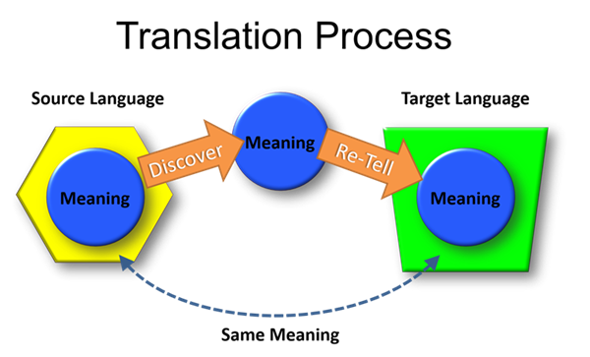

Slide 5
Challenge 1 - Lack of Direct Equivalents
Many scientific terms, especially in fields like technology, medicine, or environmental science, may not have direct counterparts in Arabic. Examples:
Torque:عزم الدوران Needs additional clarification for rotational force.
Elasticity: مرونة The concept of material elasticity in engineering might need further clarification, as it is often associated with both physics and material science.
Centrifugal Force:القوة الطرد المركزيNeeds clarity in dynamics.

Slide 6
Challenge 2 - Diverse Dialects and Standardization
Arabic is a language with many regional dialects, and while Modern Standard Arabic (MSA) is used for formal writing, regional variations may influence how terms are understood or used. The absence of a universally accepted Arabic terminology in some scientific fields can create confusion, especially if the translation is not standardized across countries.
Circuit: دائرة May differ in description across regions.
Generator: In some dialects, "مولد" is used, but in formal engineering terms, "مولد كهربائي" may be more precise.
Compressor:ضاغط in certain dialects may not fully convey the engineering context; "ضاغط هوائي" (air compressor) is more specific.

Slide 7
Challenge 3 - Complexity of Scientific Concepts
Some scientific concepts are highly specialized and may not have simple or concise translations. Translators need to balance accuracy with readability, making sure that the term conveys the exact meaning intended without oversimplifying the content.
Nanotechnology: تكنولوجيا النانو is used, but the depth of this interdisciplinary field involving molecular engineering may need further elaboration.
Reinforced Concrete: الخرسانة المسلحةUnderstanding of rebar placement and structural strength is necessary.
Artificial Intelligence:الذكاء الاصطناعي Subfields like machine learning may need specific terms.

Slide 8
Challenge 4 - Use of Latin and Greek Roots
Many scientific terms are derived from Latin or Greek, languages that have contributed significantly to scientific vocabulary worldwide. These roots can be difficult to translate directly into Arabic because of differences in grammatical structure, vocabulary, and phonetic systems. Translating such terms often requires adding descriptive explanations or coining new terms.
Hydraulic: هيدروليكي Derived from Greek; complex systems require explanation.
Electromagnetic: كهرومغناطيسي Greek term requiring further understanding of electric and magnetic field interactions.
Thermodynamics: الديناميكا الحرارية Requires explanation of concepts like entropy and heat.
Quantum: كمومي Requires understanding of quantum mechanics in material and electrical engineering.

Slide 9
Challenge 5 - Cultural Context and Interpretations
Scientific knowledge often reflects specific cultural or historical contexts. For example, scientific theories developed in Western contexts may have different interpretations or connotations when translated into Arabic. Cultural sensitivities, religious beliefs, or historical views may also shape how certain terms are understood or accepted in the Arab world.
Risk Assessment: تقييم المخاطر Different safety practices across regions.
Reinforced Concrete: الخرسانة المسلحة Cultural differences in construction practices.
Renewable Energy: الطاقة المتجددة Regional infrastructure impacts understanding and application.

Slide 10
Challenge 6 - Evolving Language
As science evolves, new concepts, technologies, and discoveries emerge rapidly, outpacing the development of corresponding Arabic terms. As a result, translators often have to rely on transliterations (using the original English word or a close approximation), which may not be immediately understandable to Arabic-speaking audiences.
3D Printing: الطباعة ثلاثية الأبعاد Newer printing methods may lack Arabic-specific terms.
Robotics: الروبوتات Rapidly evolving field, requiring new terms.
Smart Grid: الشبكة الذكية Technical aspects may need further explanation.
Internet of Things (IoT): إنترنت الأشياء Complex applications require additional context.

Slide 11
Influence of English as a Dominant Language
The overwhelming influence of English in the global scientific community can lead to the incorporation of English terms directly into Arabic, resulting in "Anglicization" and potentially complicating understanding for Arabic-speaking audiences, especially those not familiar with the English terms.
Source (English): "The software's user interface (UI) allows easy manipulation of 3D models.“
Arabic Arabic Translation:
“تسمح واجهة المستخدم للبرنامج ((UI بالتلاعب بسهولة بالنماذج ثلاثية الأبعاد”
While this translation might be accurate, the use of "UI" in its English form might leave some readers confused.
The term “ " واجهة المستخدم could be used instead to avoid Anglicization, though some technical audiences might still prefer the English acronym.

Slide 12
Thank you

