Slide 1
Genetic Modification
Food
Dr. Duaa khalid

Slide 2

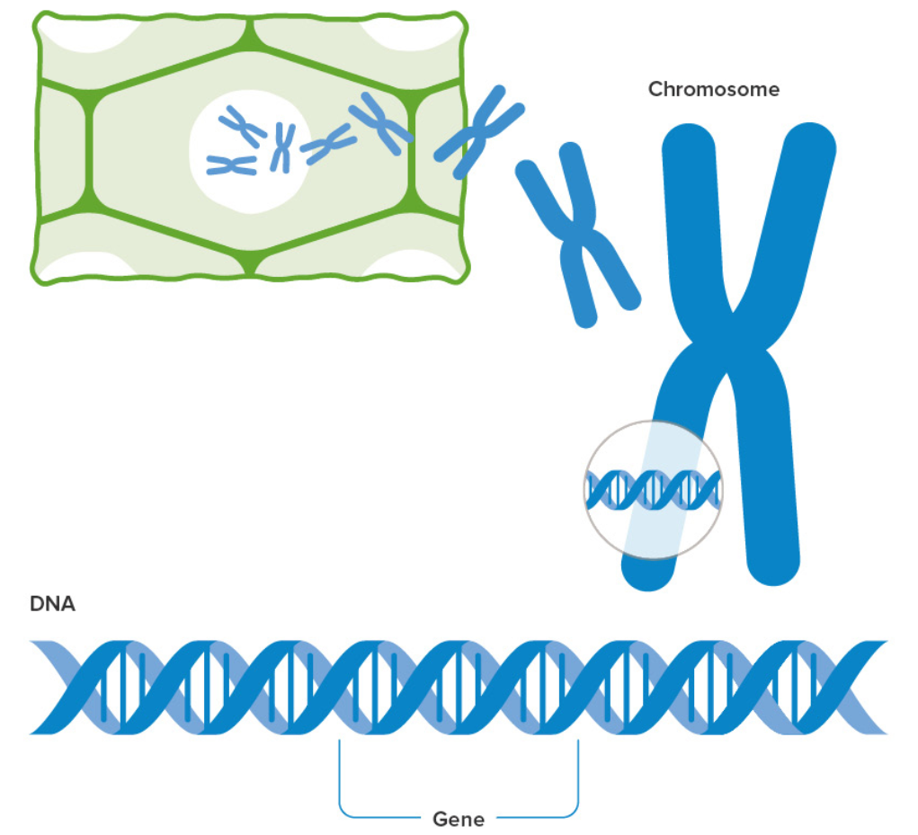
Genetic material
Genetic material is the hereditary substance in the cell. It carries all information specific to an organism. It is known as DNA (deoxyribonucleic acid) or RNA (ribonucleic acid).
The cytoplasm of prokaryotes such as bacteria contains DNA. In eukaryotes such as plants and animals, DNA is found in the nucleus of the cell (nuclear DNA) and to a lesser extent in the extranuclear sites, such as mitochondria (containing mtDNA) and chloroplast (containing cpDNA).

Slide 3

Genetic modification
Genetic modification is a technique to change the characteristics of a plant, animal or microorganism by transferring a piece of DNA from one organism to a different organism.
This is done through targeted removal of the desired genes from the DNA of one organism and adding them to the other organism.

Slide 4
Types of genetic modification
Selecting breeding
Selective breeding, also known as artificial selection, is the process of deliberately choosing and mating organisms with desirable traits to produce offspring with those traits. This practice has been used for thousands of years in agriculture and animal husbandry to improve the quality of crops and livestock.
Selective breeding involves identifying individuals with desirable traits, such as high yield, disease resistance, or desirable physical characteristics, and then breeding them with other individuals that also possess those traits. Over time, this can lead to the development of new breeds or varieties that are better adapted to specific environments or have enhanced qualities.

Slide 5
Steps of genetic modification
Choose the plants or animals from your existing stock that have the feature you want.
Breed these with each other.
Choose the best of the offspring and breed these together.
Continue this process over several generations and eventually, all the offspring have the features that you are looking for.

Slide 6
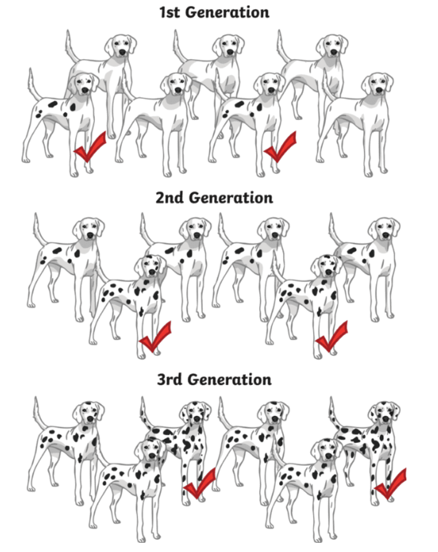

Slide 7

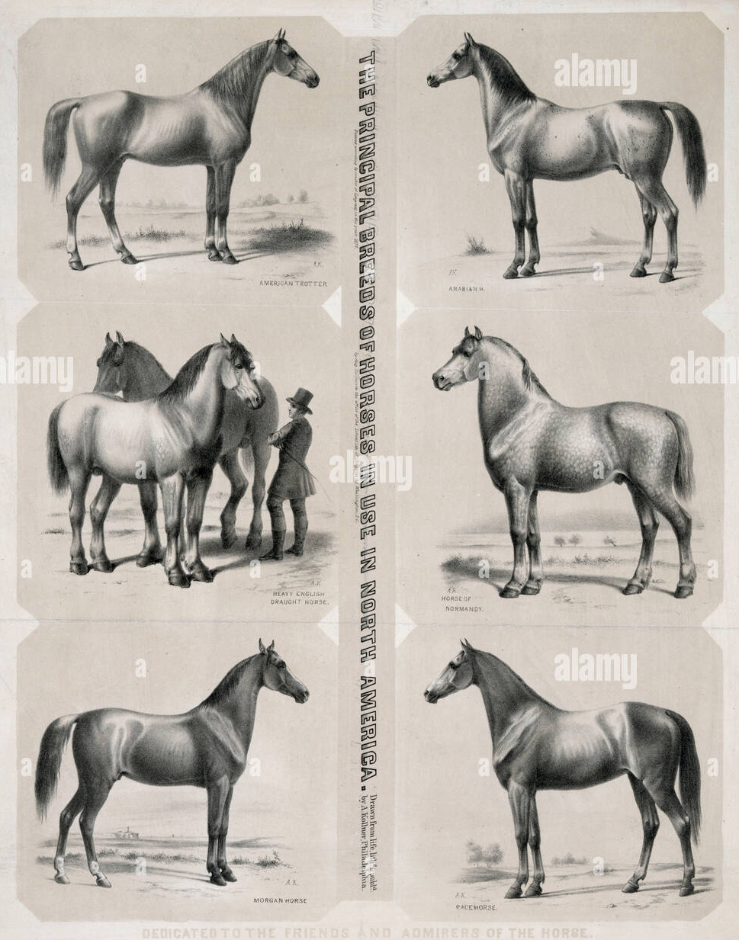
Examples of genetic modification
Horse Breeding
Horses have been selectively bred across many generations to produce variation according to a targeted function
Race horses have been bred for speed and hence are typically leaner, lighter, taller and quicker
Draft horses have been bred for power and endurance and hence are sturdier and stockier. (Thoroughbred horses)

Slide 8
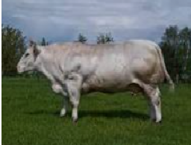
Examples of genetic modification
Cow Breeding
Cows have been selectively bred across many generations to produce offspring with improved milk production
Farmers have also targeted the breeding a cows with a mutation resulting in increased muscle mass
The resulting stock of cattle (termed Belgian Blue) have excessive bulk and produce more edible lean meat.
beef cattle from Belgium and England cow

Slide 9
Dog Breeding
Dog breeds show an enormous amount of variety due to the targeted selection of particular traits by man.
Hunting dogs (e.g. beagles) were typically bred to be smaller in stature so as to enter fox holes.
Herding dogs (e.g. sheep dogs) were bred for heightened intelligence in order to follow herding commands
Racing dogs (e.g. greyhounds) were specifically bred to be sleek and fast.
Toy dogs (e.g. chihuahuas) were selectively bred for their dimunitive size.

Slide 10
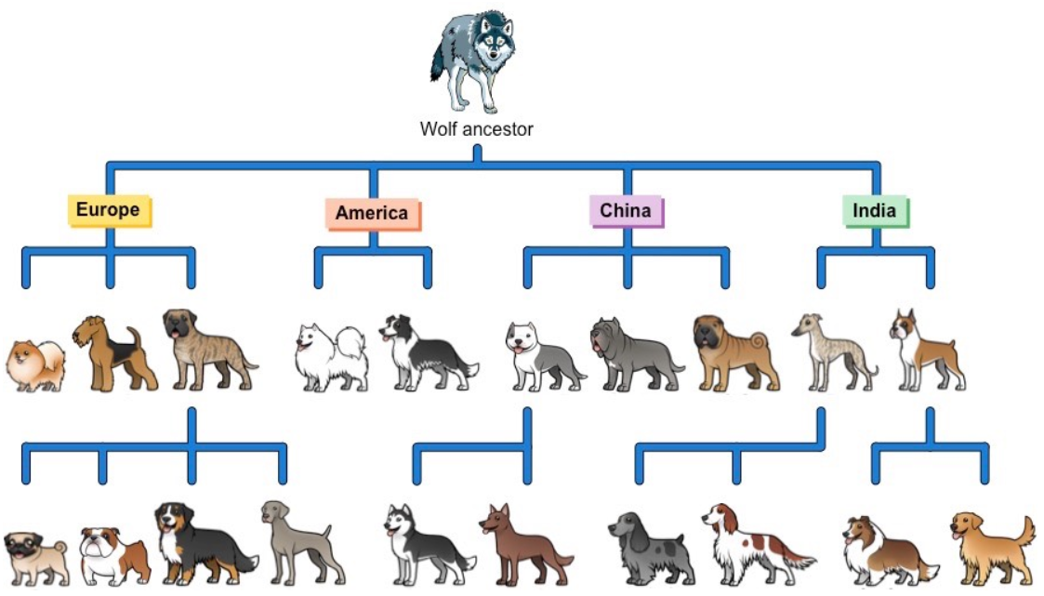

Slide 11
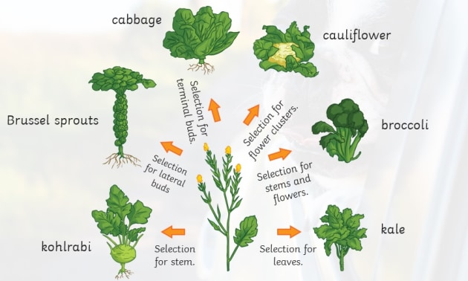
Brassica plant
From the original brassica plant, people have selected for certain traits to create lots of different foods that we can eat. From kohlrabi to cauliflower, broccoli to kale, these tasty vegetables are all the outcome of selective breeding in plants.

Slide 12
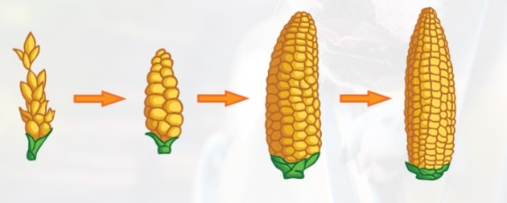
Corn
Corn is a vital crop in many parts of the world. Selection of corn has been taking place for over 10.000 years! Yield has been increased by selecting for more kernels. There are also varieties of corn that are able to survive in harsh climates: this is important in our changing world.

Slide 13
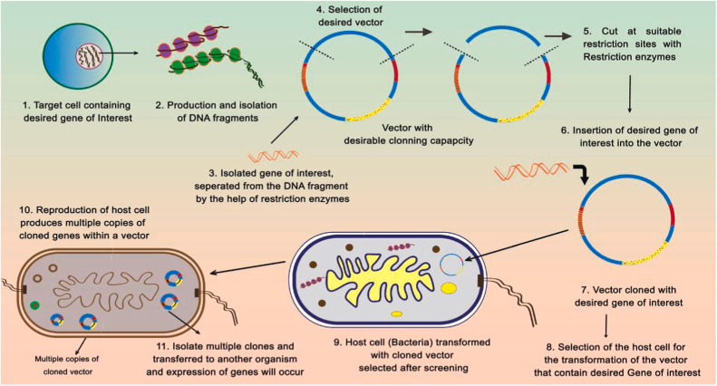
Genetic engineering
Genetic engineering is the manipulation of an organism's genetic material to alter its traits or characteristics. This can involve adding, deleting, or changing specific genes or segments of DNA to produce desired traits or outcomes.

Slide 14
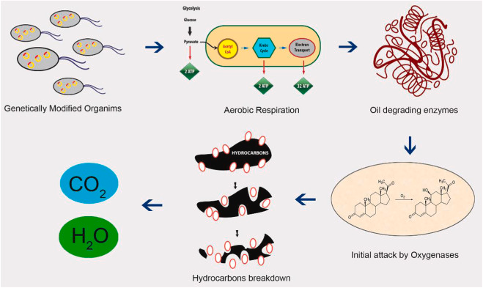
Genetically modified organisms (GMOs)
Bioremediation: Genetic engineering can be used to create microorganisms that can break down or detoxify pollutants in industrial waste. These genetically modified microorganisms can be used to clean up contaminated soil and water.
GEMs, or genetically engineered microorganisms, are gaining popularity in the area of bioremediation as a result of recent technical developments. GEMs are sought for because of their genetic material, which may be altered to include desired genes.

Slide 15
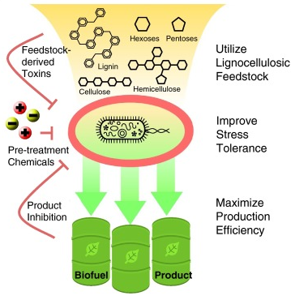
Genetically modified organisms (GMOs)
Biofuel production: Genetic engineering can be used to create microorganisms that can produce biofuels such as ethanol, butanol, and biodiesel. These microorganisms can convert agricultural waste and other renewable resources into biofuels.

Slide 16
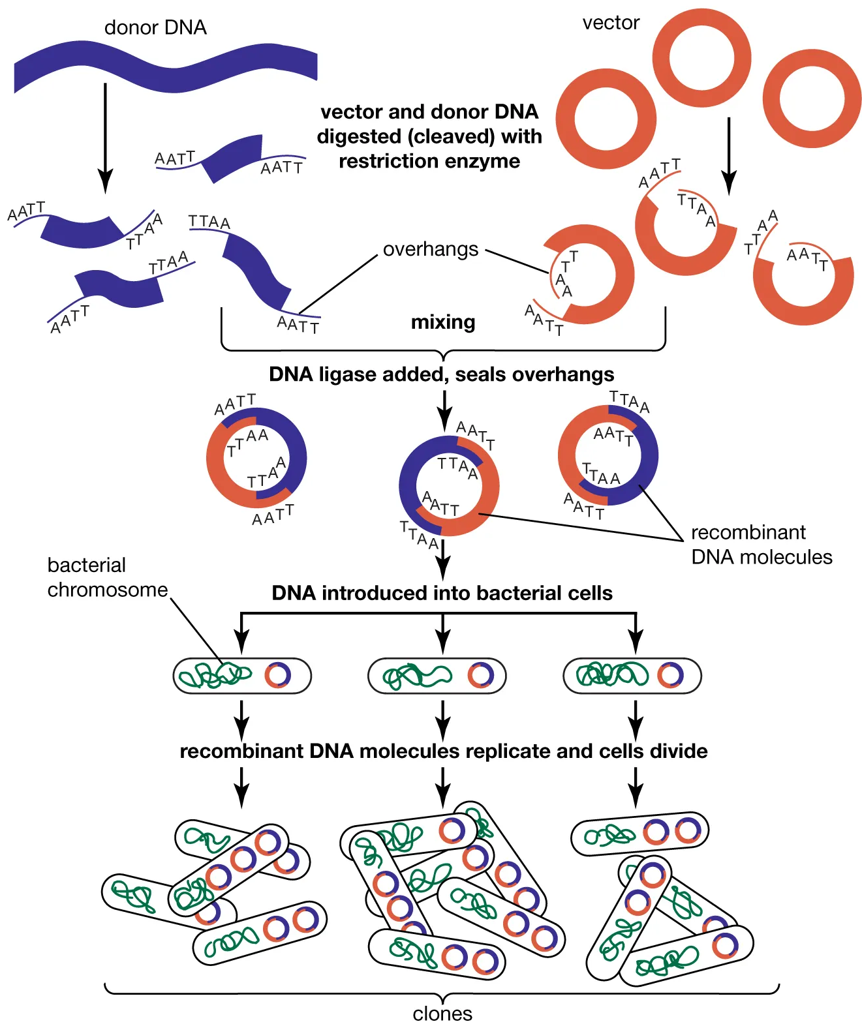
Genetically modified organisms (GMOs)
Enzyme production: Genetic engineering can be used to produce enzymes that are used in various industrial processes such as food processing, textile manufacturing, and paper production. These enzymes can be optimized for specific industrial applications, making them more efficient and cost-effective.

Slide 17
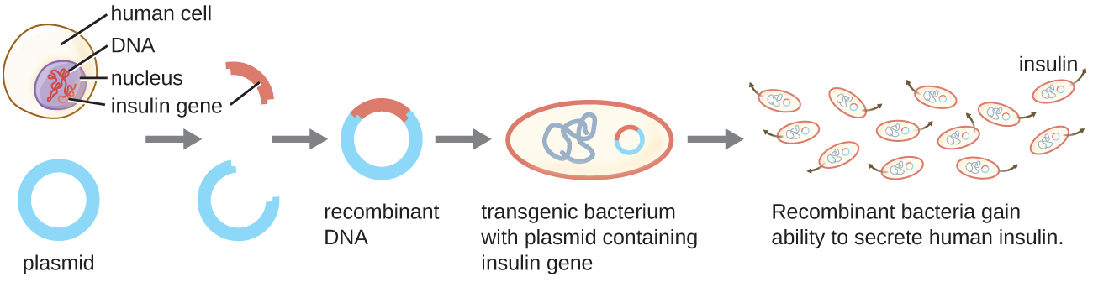
Genetically modified organisms (GMOs)
Pharmaceutical production: Genetic engineering can be used to produce proteins and other molecules that are used in the production of pharmaceuticals. These genetically modified organisms can be used to produce high-value drugs and other pharmaceutical products.

Slide 18
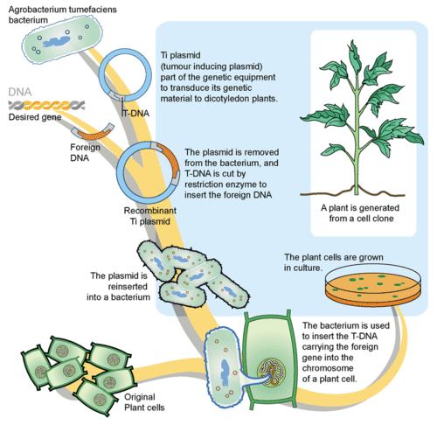
Genetically modified organisms (GMOs)
Agricultural biotechnology: Genetic engineering can be used to create crops that are resistant to pests and diseases, have improved yields, and can grow in harsh environmental conditions. These genetically modified crops can help meet the growing demand for food and can be used to produce biofuels and other industrial products.

Slide 19
Genetically modified organisms (GMOs)
Industrial fermentation: Genetic engineering can be used to create microorganisms that can ferment sugars into various products such as organic acids, amino acids, and vitamins. These products can be used in various industrial applications such as food and beverage production, pharmaceuticals, and cosmetics.

Slide 20
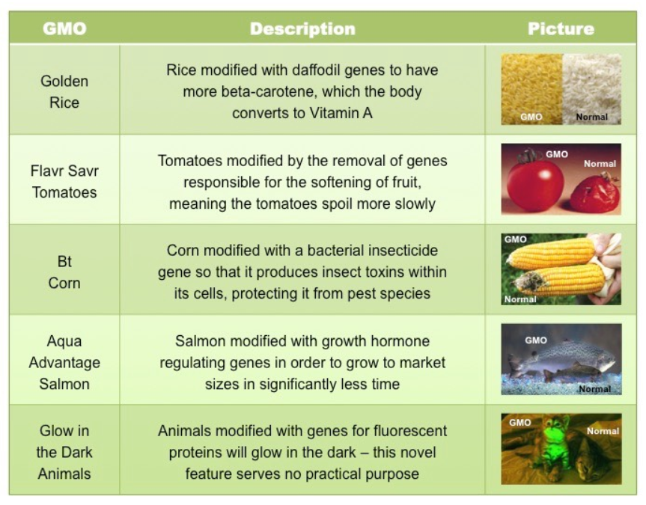
Genetically Modified Food (GMF)

Slide 21
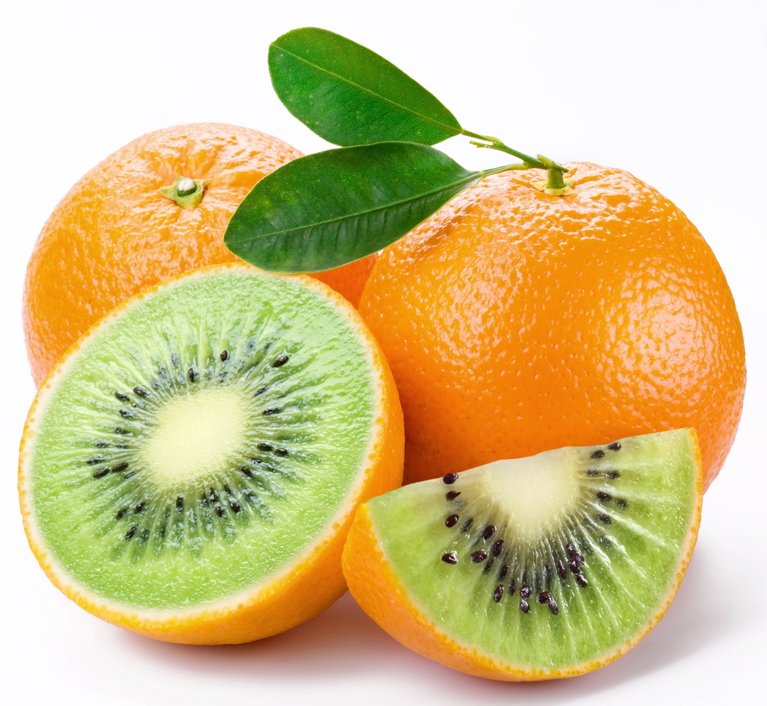

Slide 22
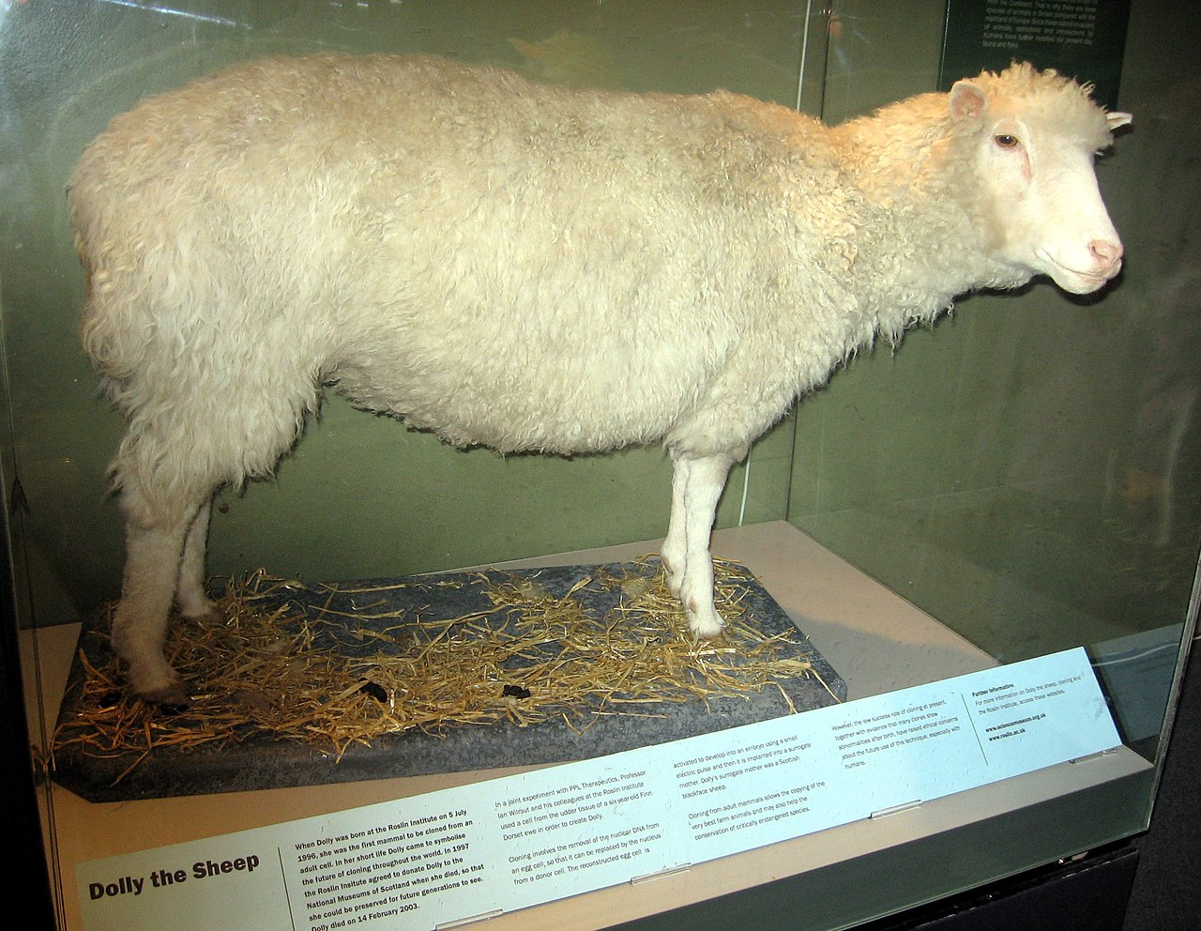

Slide 23
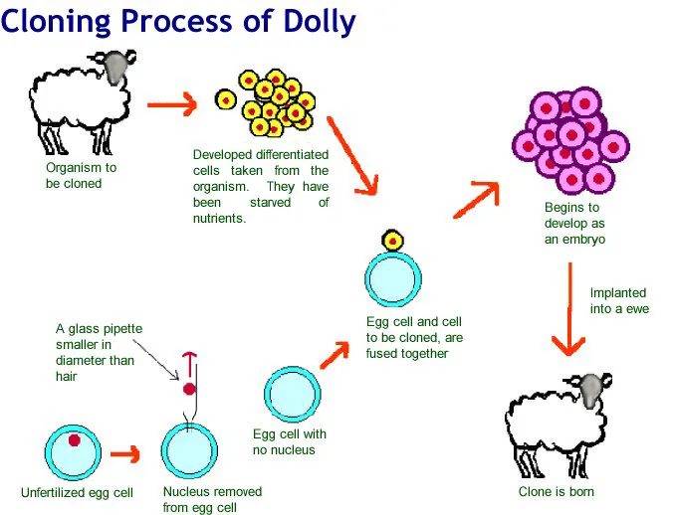

Slide 24


