Slide 1
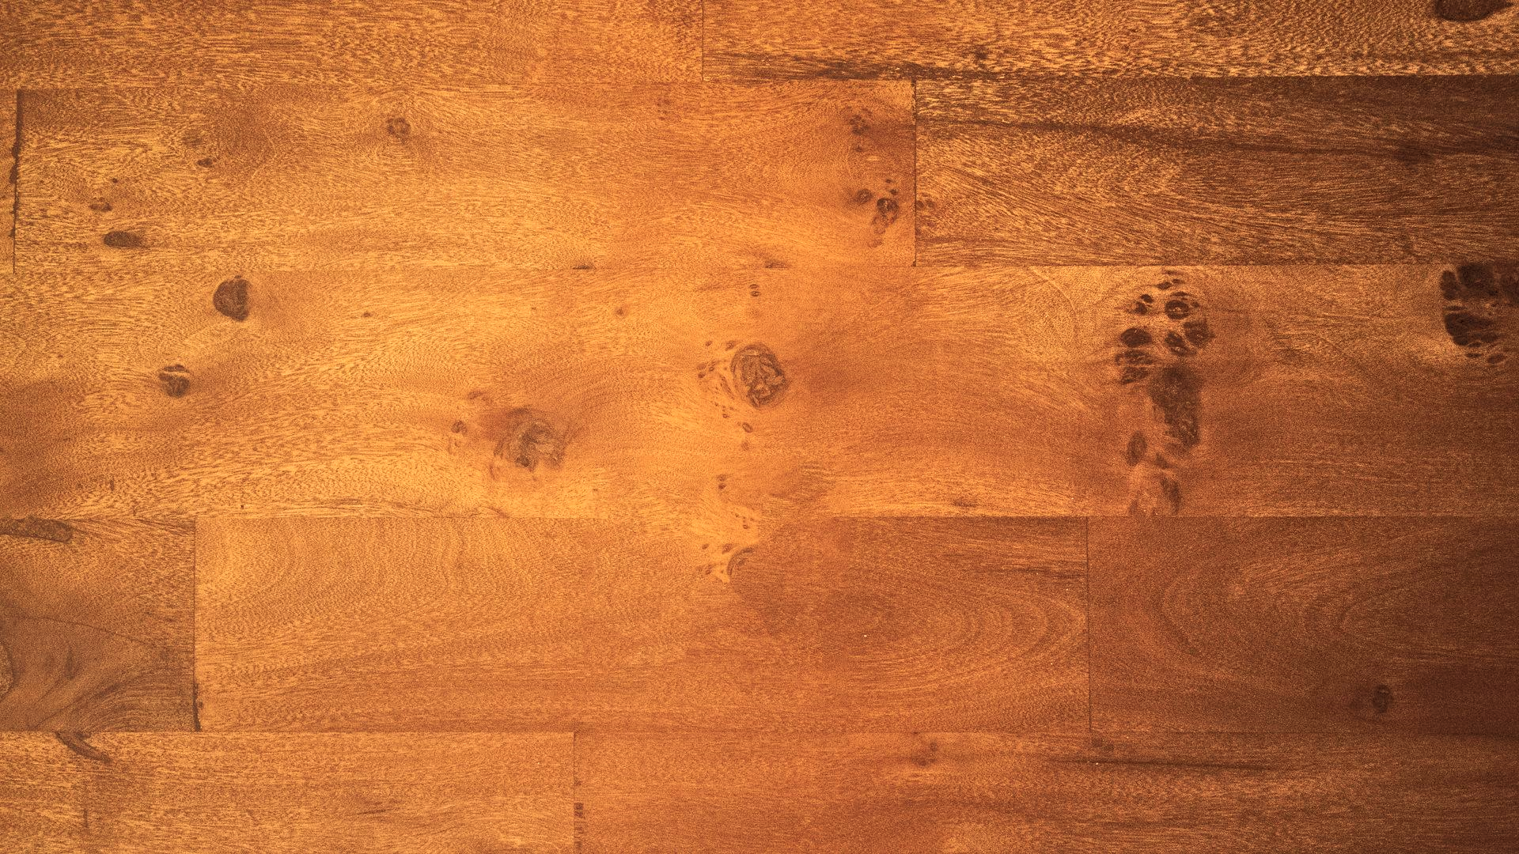

Republic of Iraq
Ministry of Higher Education
and Scientific Research
University of Baghdad
College of Veterinary Medicine
Pathological investigation of the main skin lesion in dogs

Slide 2
Introduction
skin is the first line of defense mechanism according to many sources the skin accounts for around 15–25 percent of an animal's total body weight, depending on its species and age., Skin produces vitamin D regulates temperature, regulates immunity, senses touch and keeps biochemical homeostasis in check, among its many important roles . Skin is a common site for mechanical, bacterial, viral and fungal infections. The skin and coat are also susceptible to a wide range of allergy and hormonal disorders. One of the most common and challenging conditions to treat in veterinary facilities, particularly for dogs is dermatologic issues, which account for 30–70% of all owner complaints . The poor dog may have a terrible time and the vet. and owner may find it frustrating. a large majority of dogs caseload consists of skin disorders . When the skin's protective system or its function is disrupted, infections may develop. Clinical symptoms may arise from an overgrowth of non-specific bacterial, fungal and parasite flora due to a nonspecific deficiency in innate, humoral or cellular immunity.

Slide 3
The majority of bacterial skin infections in dogs are caused by superficial pyodermas. These infections may manifest as pustules on the skin (impetigo) or in the hair follicles (bacterial folliculitis). reported that the majority of canine cases of pyoderma are caused by superficial bacterial folliculitis. Usually, most of Gram-positive or Gram-negative infections are caused by the normal resident microflora of the skin, mucous membranes and gastrointestinal tract. Cases of otitis, respiratory, urinary and dermatological infections in pets involve principally both groups of bacteria. Pyoderma and otitis externa can affect dogs of any age or gender and are usually caused by Staphylococcus spp. Other bacteria commonly associated with otitis include Pseudomonas aeruginosa, Escherichia coli.

Slide 4
E. coli, Streptococcus spp., Proteus mirabilis, Enterococcus spp. and Corynebacterium spp. Particularly, the opportunistic Gram-positive bacterium, skin commensal or pathogen, Staphylococcus pseudintermedius (S. pseudintermedius) is considered the main causative agent of skin and ear infections in small animals. Even though Gram-negative bacteria, such as E. coli and Pseudomonas aeruginosa are prevalent as bacterial agents of canine and feline urinary tract infections. they are increasingly reported to be responsible for secondary skin infections, not only in humans . but also in small animals. Superficial mycoses of the skin are fungal infections that affect mostly the superficial layers of the skin, hairs and any other skin appendages, such as claws in carnivores .

Slide 5
Dermatophytosis and Aspergillus spp. infections represent the superficial mycoses with greatest impact in dogs. The causative agent's dermatophytes respectively are placed in distant branches of the fungal tree of life and are likely to have evolved independently to adapt to survival and development within a cutaneous ecosystem. In dogs the most prevalent dermatophyte species, Microsporum Canis and trichophyton Verrucosum are true fungal when in contact with the skin, they infect stratum corneum and hairs causing cutaneous lesions. Dermatophytes are also significant due to their zoonotic potential and the concern of companion animals owners confronted with severe and chronic inflammatory skin diseases. Dog skin parasites mostly ticks, fleas, round worms, lice, mite the affected skin is red and partially or completely hairless with pus, crusts or ulcer.

Slide 6
The term tumor denotes an anomalous expansion within the body. Canine tumors encompass a spectrum of growths, from non-threatening skin enlargements to aggressive, infiltrative growths in various body regions, including internal organs. While not all tumors prompt immediate alarm, numerous tumors will persist in enlarging unless they are surgically removed, and some have the potential to spread, or metastasize. The spread of tumors, or metastasis, is a key factor in determining a graver prognosis, underscoring the importance of preemptively excising such growths to maintain the wellness of pets. tumor are groups of abnormal cells that form lumps or growth depending on whether they are cancerous (malignant) non-cancerous (benign) or precancerous. Mostly in dog's melanoma, dermatofibroma and lymphoma.

Slide 7
200 dogs different age, sex and breed from Iraq governorates (Baghdad, Erbil, Anbar, Sulaymaniyah)
ecto parasite
examination
Dermatophyte Test Agar
D.T.M Agar Base
100 skin sample suspected infected
Fungus examination
Cultured media
lactophenol cotton blue stain
take biopsy by biopsy punch
blood base agar
nutrient agar
MacConky agar
pathological
examination
Bacterial examination
cultured media
VAITEK SYSTEM
H&E stain
PAS stain

Slide 8
Results

Slide 9
Table 1: Bacterial isolation from dog skin: the No. of dogs which examined (200),
100 of them were pathogenic bacterial infected.
% | No. of isolation | Types of bacterial isolation
50 | 50 | Staphylococcus pseudintermedius
20 | 20 | proteus mirabilis
20 | 20 | pseudomonas aeruginosa
10 | 10 | Escherichia coli

Slide 10
Table 2: Fungal isolation from dog skin: the No. of dogs which examined (200),
100 of them were pathogenic fungal infected.
% | No. of isolation | Types of fungal isolation
60 | 60 | Aspergillus niger
30 | 30 | Trichophyton Verrucosum
10 | 10 | Alternaria spp.

Slide 11
Table 3: (20) samples isolation from dog skin.
Species of dog | Grossly appearance | Microscopic appearance
K9 dogs | 6 samples cauliflower-like appearance nodules with ulcered skin | Multinodular concentric lamination of keratin (cancer pearls) with market stromal fibroma. Tumor cells large, polyhedral and similar to cells of stratum spinosum of epidermis, the cell is immature and mor hyperchromatic.
Ornamental dogs | 4 samples cauliflower-like appearance with ulcered skin and allopecia fig (6) | infected hyperkeratosis with necrotic debris, acanthosis of dermis layer, concentration multinodular lamination of keratin (cancer pearls), mononuclear cells infiltration in the dermis and muscular layer
Stray dogs | 6 samples of papilloma on forelimbs fig (7) | hyperkeratosis and acanthosis of epidermal layer papilloma like of epidermis layer, hyperplasia of hair follicle with mononuclear cells surrounds the follicles
 | 4 samples with enlarged nodules (0.5-1cm) on limbs dermatofibroma fig (10) | ulceration of necrotic epidermic and dermis layer with necrotic debris and inflammatory cells, infected granulation tissue in dermis layer, congested blood vessels

Slide 12
Table 4: clinical signs and gross lesion of pathogenic bacterial, fungal and parasites with tumors in K9, ornamental and stray dog.
Dog species | Clinical signs & gross lesion | Types of pathogenic bacteria | Types of pathogenic fungal | Types of parasite | tumors
K9 dog | Skin allopecia fig (4) Skin ulcer on flank fig (4) Cauliflower-like appearance with ulcer skin | pseudomonas aeruginosa | Aspergillus niger | - | Squamous cell carcinoma
ornamental dog | Cauliflower-like appearance nodules with ulcer skin | - | Alternaria spp. | - | Squamous cell carcinoma fig (6)
Stray dog | Skin allopecia Odematous necrotic skin fig (5) Papilloma on the limb’s fig (7) Large skin ulcer on dermis and epidermis Complete neck ulcer and allopecia fig (9) Elevated nodule (0.5-1cm) on limb fig (10) | - Staphylococcus pseudintermedius Escherichia coli Staphylococcus pseudintermedius Staphylococcus pseudintermedius Proteus mirabilis | Trichophyton Verrucosum Aspergillus niger - Aspergillus niger Aspergillus niger |  | Papilloma fig (7) Dermatofibroma

Slide 13
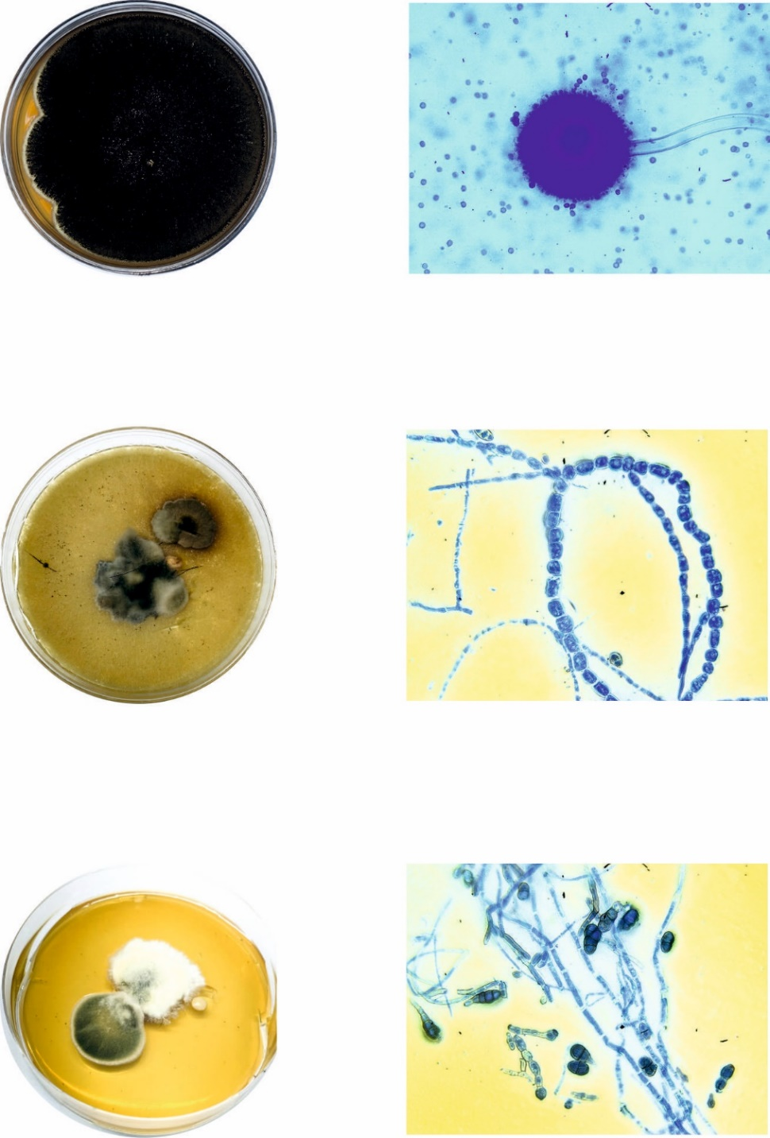
Fungal isolation:
Fig (2) Aspergillus niger Fig (3) Aspergillus niger
Black growth (Lactophenol blue stain, 40x)
Fig (4) trichophyton Verrucosum Fig (5) trichophyton Verrucosum
Irregular growth (Lactophenol blue stain, 40x)
Fig (6) Alternaria spp. Fig (7) Alternaria spp.
(Lactophenol blue stain, 40x)

Slide 14
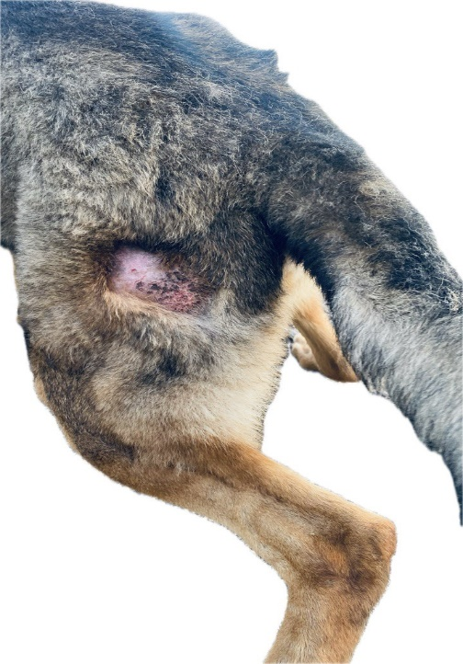
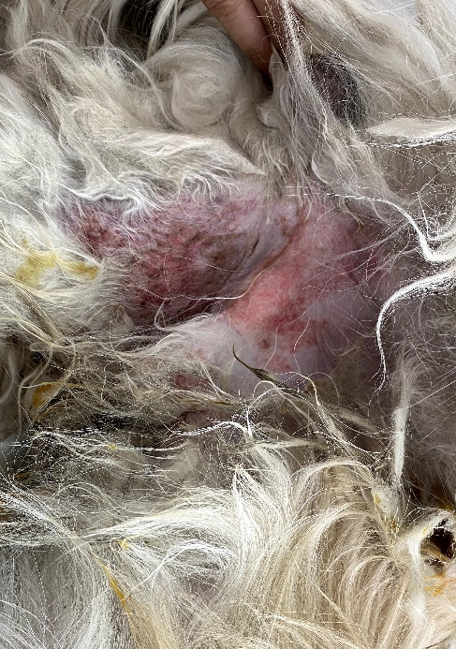
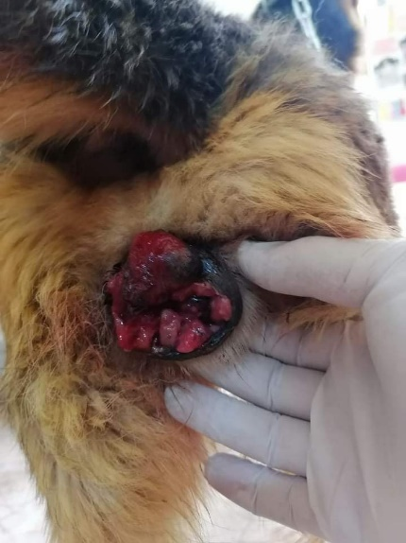
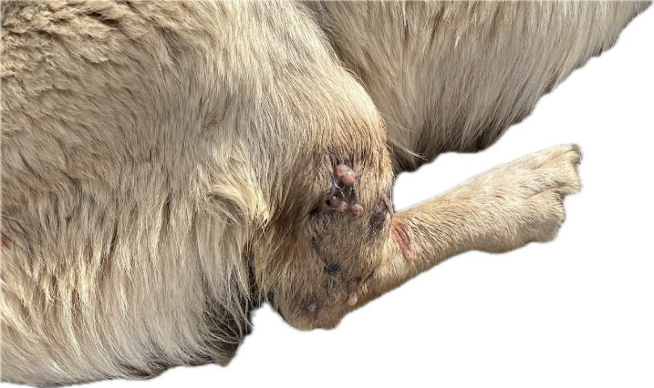
4
5
7
8
Figure4: Gross section in k9 dog skin allopecia with skin ulcer on the flank of dog isolation from skin lesion (Aspergillus niger - pseudomonas aeruginosa). Figure5: in stray dog skin Allopecia with large area of red edematous necrotic skin isolation from skin lesion (Trichophyton Verrucosum - Staphylococcus pseudintermedius). Figure6: in ornamental dog skin multiple red necrotic irregular Cauliflower-like appearance nodules pedunculate with ulcerated surface and secondary infected a raised on the fore-limb (squamous cell carcinoma with fungal Alternaria spp.). Figure7: in stray dog skin multiple irregular firm necrotic nodules on the fore-limb (papilloma) isolation from skin lesion (Aspergillus niger - Escherichia coli).

Slide 15
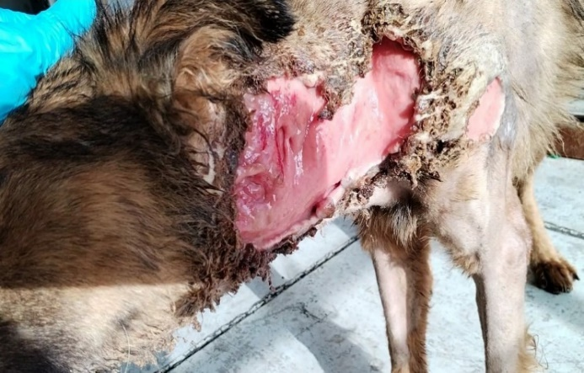
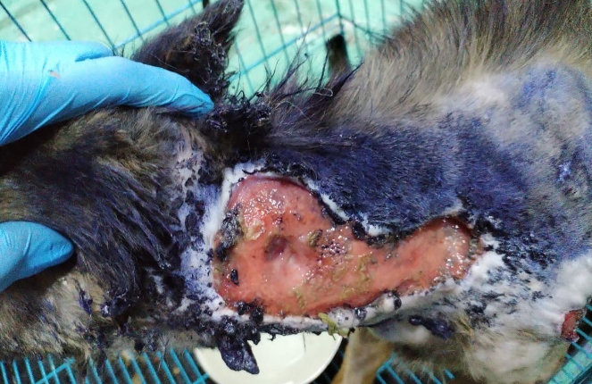
8
10
11
Figure8: in stray dog skin sever allopecia with a pendulous abdomen with large skin ulcer (dermis and epidermis) with irregular large leg ulcer isolation from skin lesion (Aspergillus niger - Staphylococcus pseudintermedius). Figure9: in stray dog skin Complete ulcer in the neck skin with allopecia (Aspergillus niger - Staphylococcus pseudintermedius). Figure10: in stray dog skin Elevated well - circumscribed firm nodule round to avoid about 0.5-1cm present on for limb with necrotic surface isolation from skin lesion (Aspergillus niger - proteus mirabilis)

Slide 16
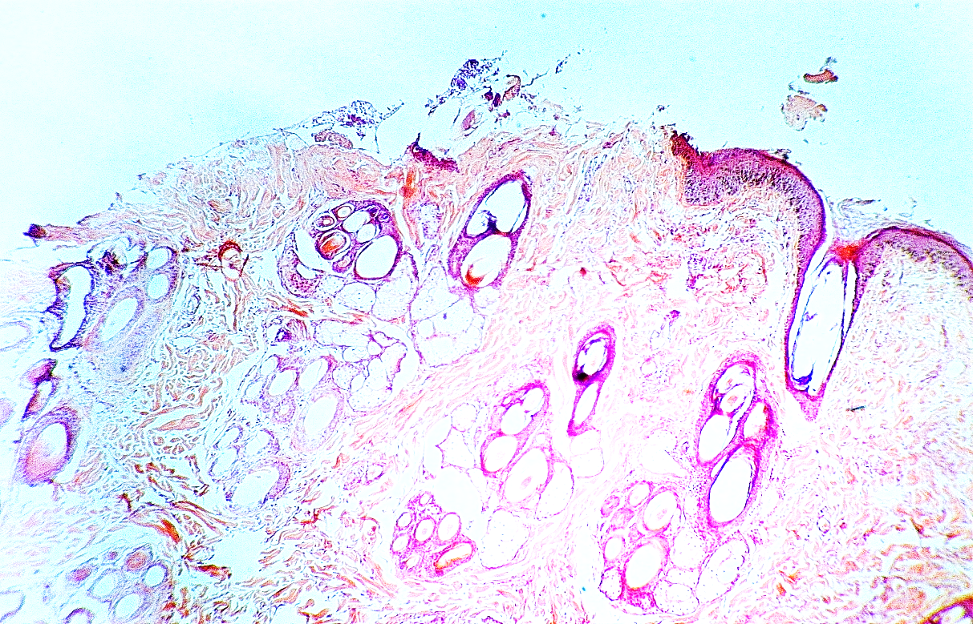

B
A
Figure 11: Microscopic section in k9 dog skin: A: infected epidermal layer ulcer with necrotic debris B: hyperplasia of sebaceous gland with mononuclear inflammatory cells surrounded the glands (H&E stain, 200×).

Slide 17
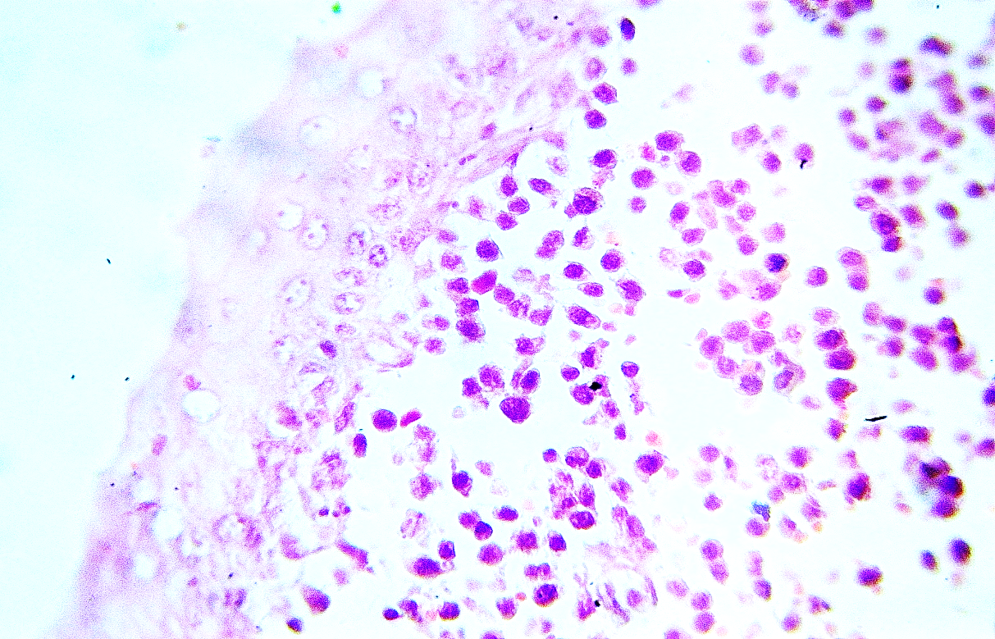
B
A
C
Figure 12: Microscopic section in k9 dog skin: A: epidermal acanthosis B: apoptotic cells C: mononuclear cells infiltration in dermis layer mostly macrophages (H&E stain, 400×).

Slide 18
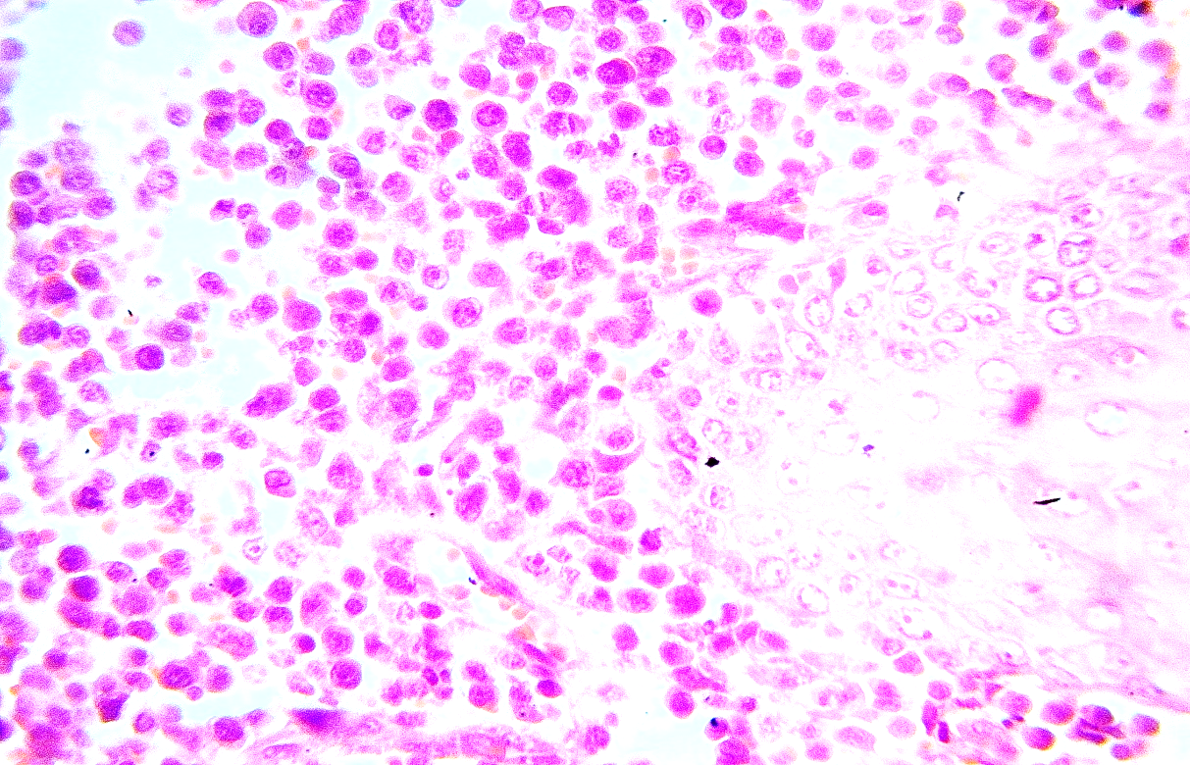
B
A
Figure 13: microscopic section in stray dog skin: A: Sever acanthosis of epidermal layer with apoptosis B: sever mononuclear cells infiltration in dermal layer (H&E stain, 400×).

Slide 19
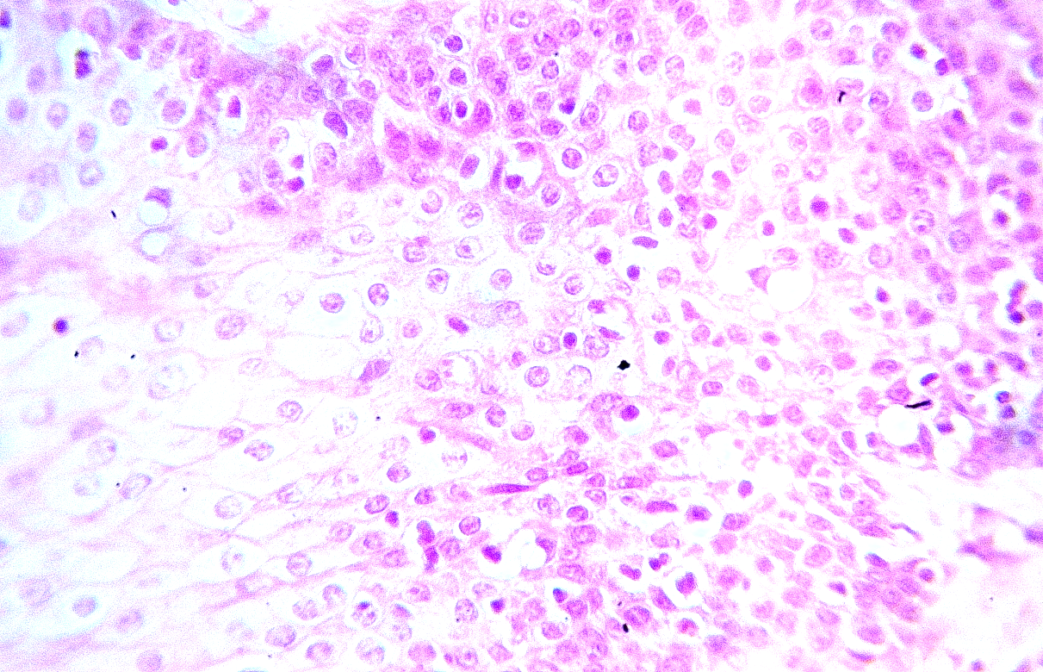
Figure 14: Microscopic section in stray dog skin: Acanthosis of epidermis layer with vacuolar degeneration and apoptosis star (H&E stain, 400×).

Slide 20
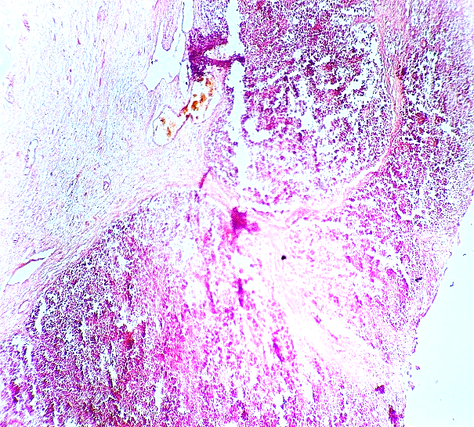
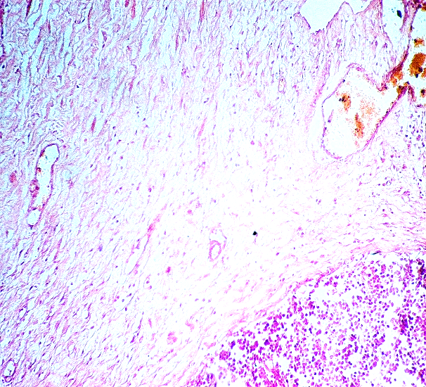
D
C
B
C
A
D
Figure 15: microscopic section in stray dog skin: A: complete ulceration of epidermal layer with necrotic debris, polymorphic& mononuclear cells Infiltration. B: dermis layer consists multiple rounded abscess with necrotic debris C: Congested blood vessel D: granulation tissue consists fibroblast and angioblast (H&E stain, 100×,400×).

Slide 21
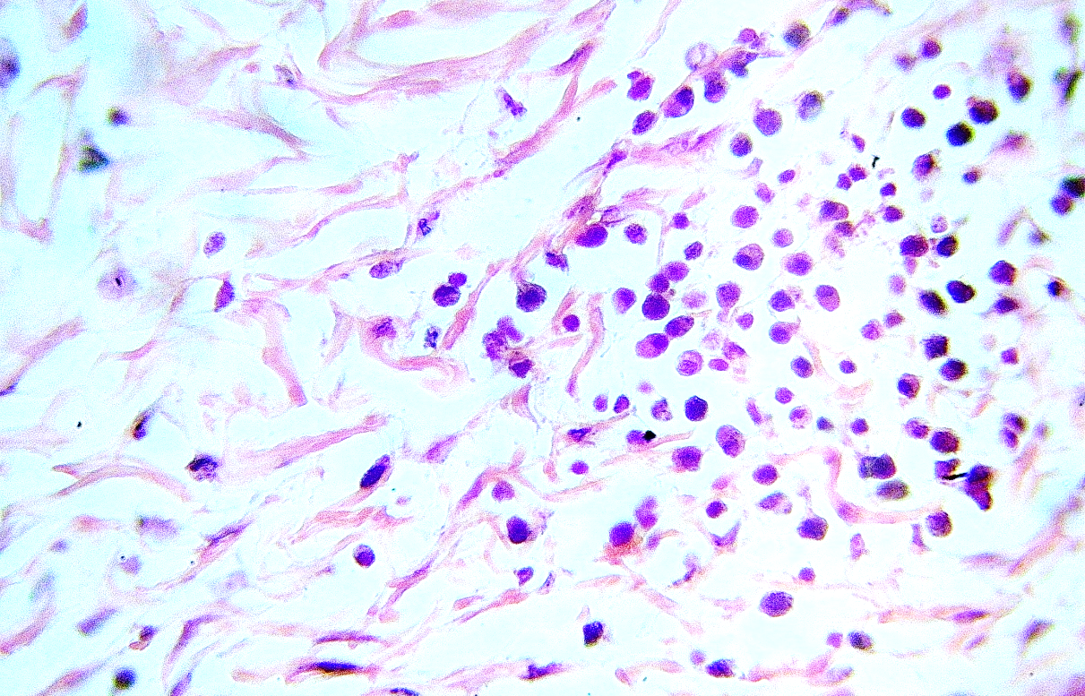
Figure 16: microscopic section in k9 dog skin: Sever mononuclear inflammatory cell infiltrated in dermis layer (H&E stain, 400×).

Slide 22
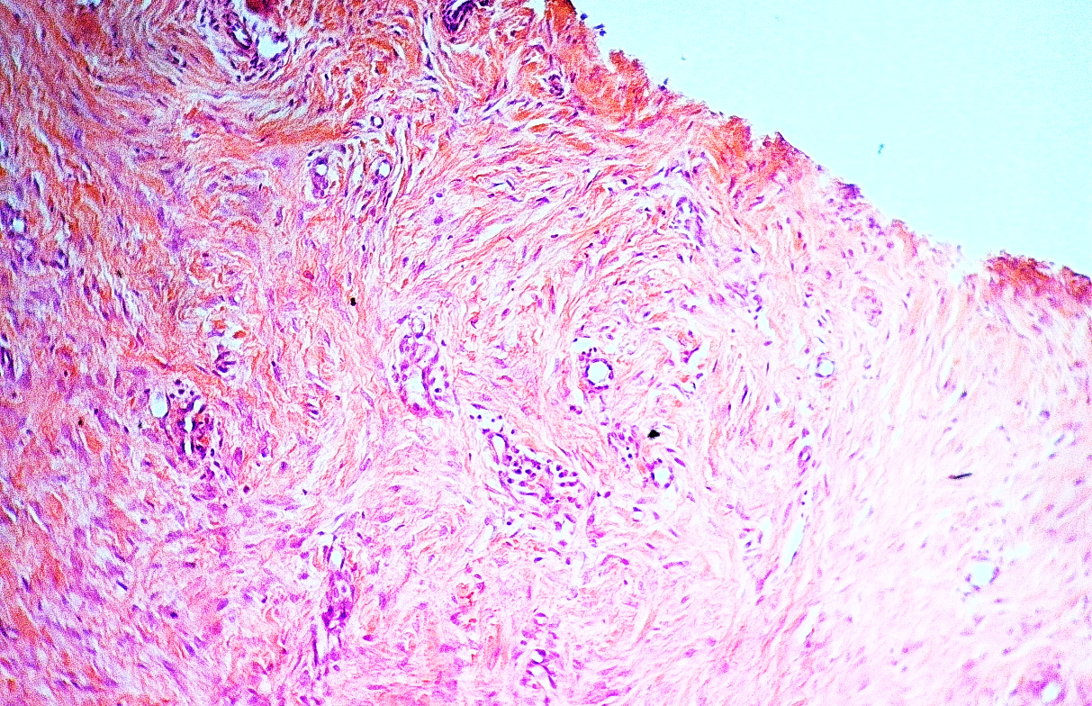
A
B
C
Figure 17: A: microscopic section in stray dog skin complete ulcer of epidermis layer B: fibroma consist whorls and interlacing bundles fibroblast and collagen fibers, the tumor cells have large pale elongated nuclei with variable degrees of vascularization C: infected fibrous tissue with mononuclear cells and newly blood vessels surrounded by mononuclear cells (H&E stain, 200×).

Slide 23
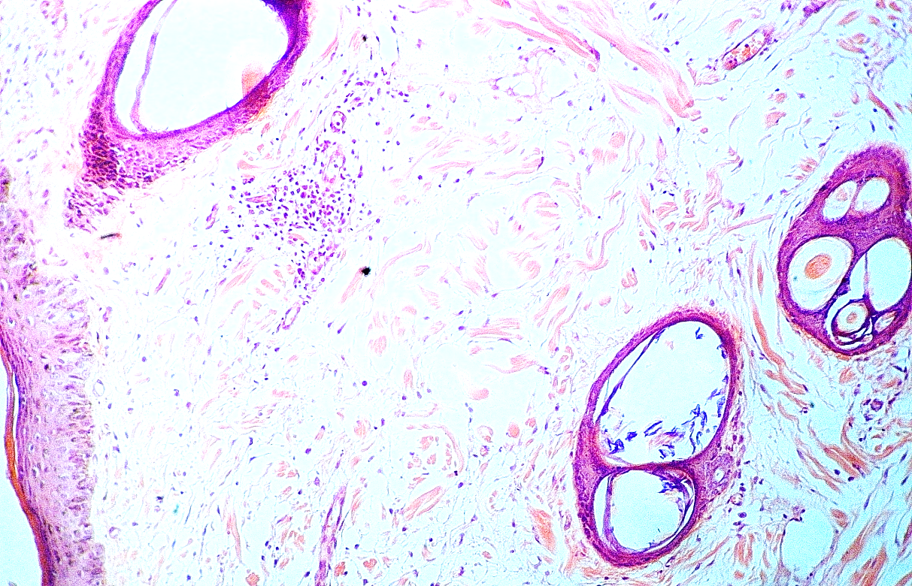
A
B
A
Figure 18: Microscopic section in k9 dog skin: A: cystic dilation of hair follicles surrounded by mononuclear inflammatory cells B: dermal lymphocytic aggregation (H&E stain, 200×).

Slide 24
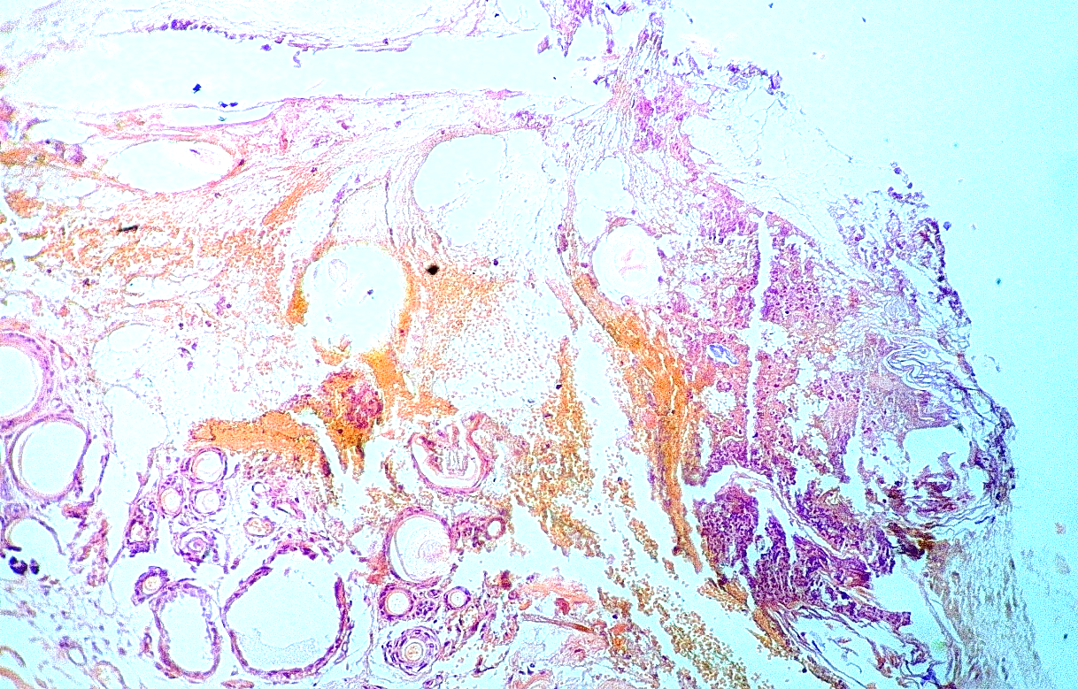
A
B
C
Figure 19: Microscopic section in stray dog skin: A: complete ulcer of epidermal layer with sever necrosis and inflammatory cells B: extensive dermal hemorrhage C: necrotic all glands and surrounded by mononuclear cells (H&E stain, 200×).

Slide 25
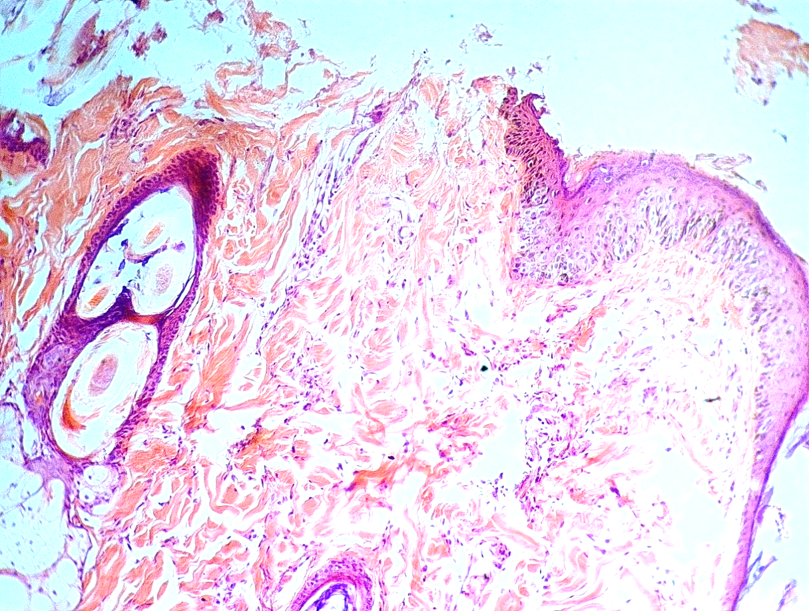
A
B
C
D
Figure 20: Microscopic section in K9 dog skin: A: epidermal ulcer B: mononuclear cells infiltration in dermis layer C: hyperplasia hair follicles with mononuclear inflammatory cells surrounded the hair follicles D: hyperplasia of Sebaceous gland (H&E stain, 200×).

Slide 26
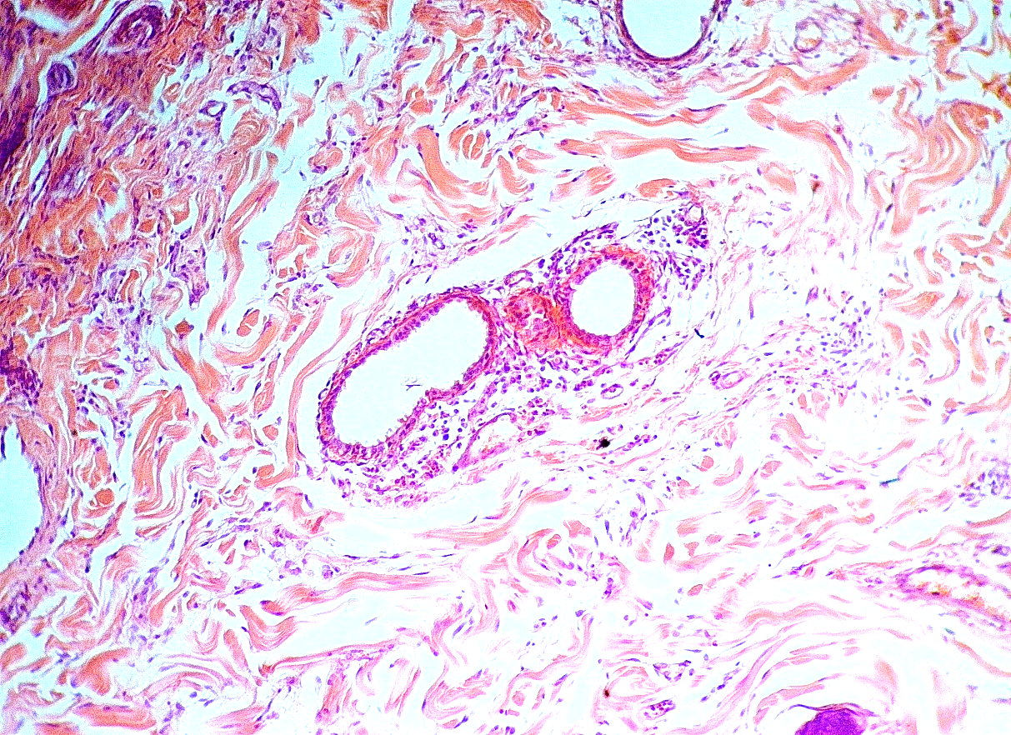
B
A
Figure 21: Microscopic Section in K9 dog skin: A: dilated blood vessels surrounded by mononuclear cells in dermis layer B: mononuclear cells mostly lymphocytes Infiltrated in dermis layer (H&E stain, 200×).

Slide 27
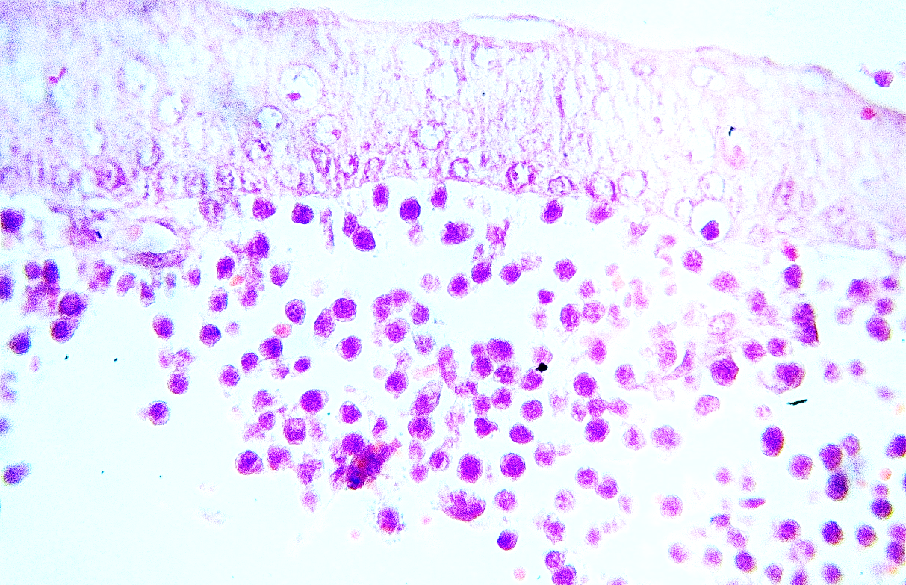
A
B
Figure 22: Microscopic section in k9 dog skin: A: acanthosis of epidermal layer with vacuolar degeneration B: apoptotic cells and mononuclear cells infiltration in dermal layer (H&E stain, 400×).

Slide 28
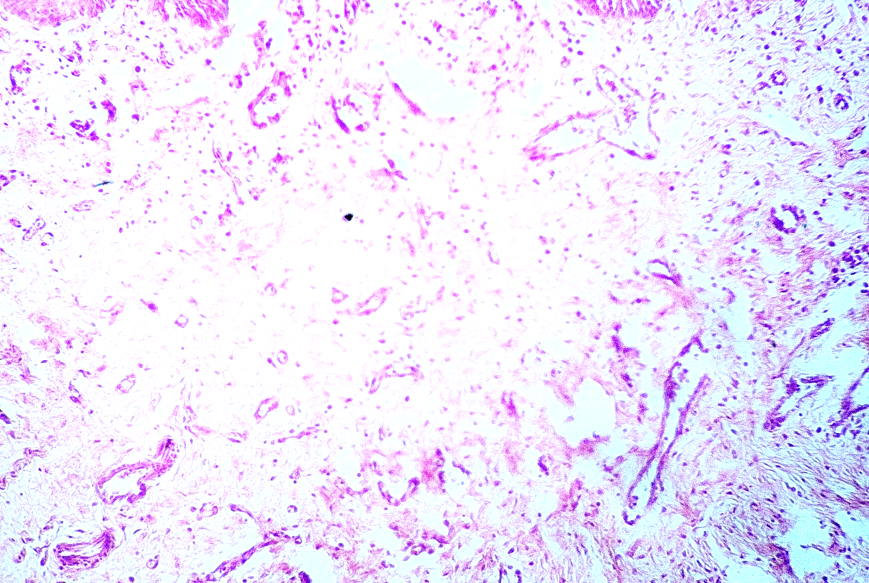
A
B
Figure 23: Microscopic section in stray dog skin: A: infected granulation tissue with mono and polymorphic inflammatory cells, B: angioblast and fibroblast (H&E stain, 200×).

Slide 29
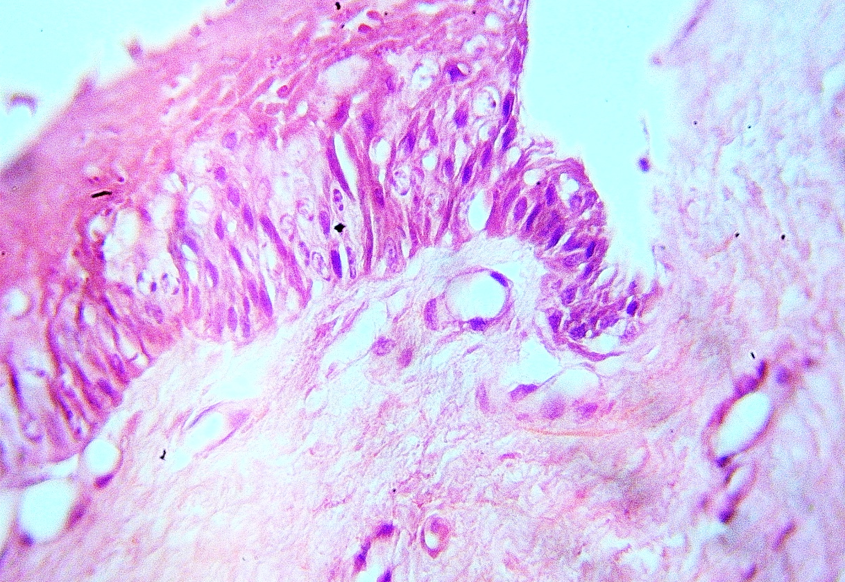
A
B
C
Figure 24: Microscopic section in k9 dog skin: A: epidermal ulcer B: epidermal acanthosis with vacuolar degeneration C: newly granulation tissue (H&E stain, 400×).

Slide 30
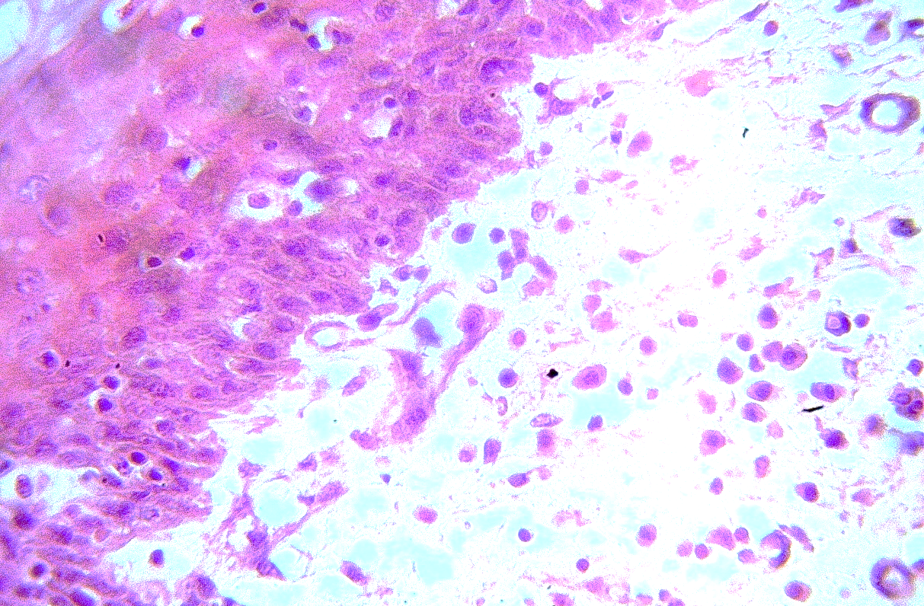
A
B
Figure 25: Microscopic section in k9 dog skin: A: acanthosis with several deeply eosinophilic, shrunken apoptosis cell with pyknotic nuclei in the basal and spinous layers B: dermis layer odema with mononuclear cells infiltration (H&E stain, 400×).

Slide 31
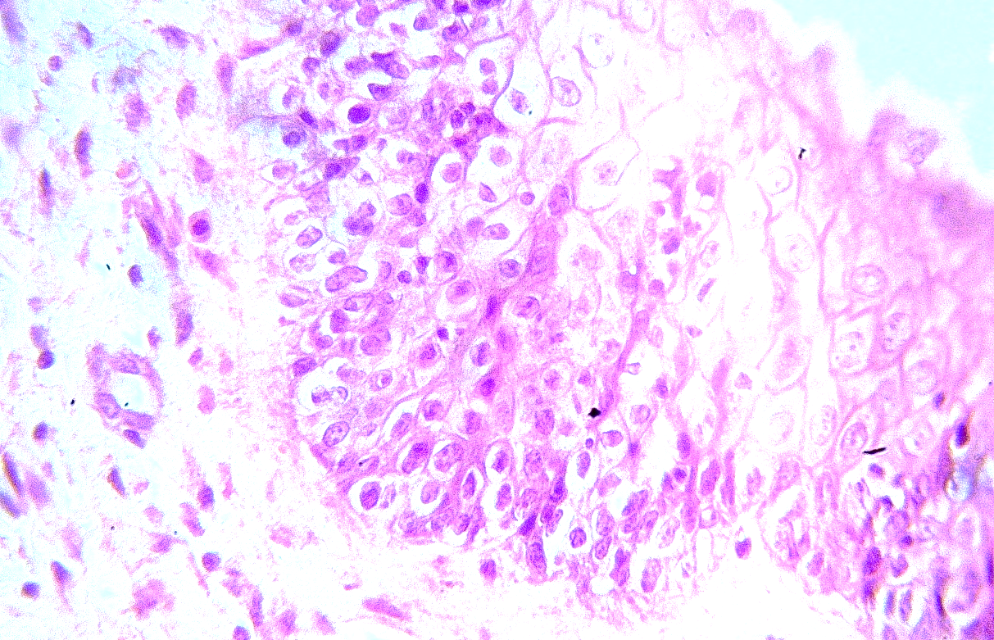
B
A
Figure 26: Microscopic section in stray dog skin: A: acanthosis increased thickness of stratum referred as acanthosis with vacuolar degeneration B: dermal layer with infected granulation tissue (H&E stain, 400×).

Slide 32
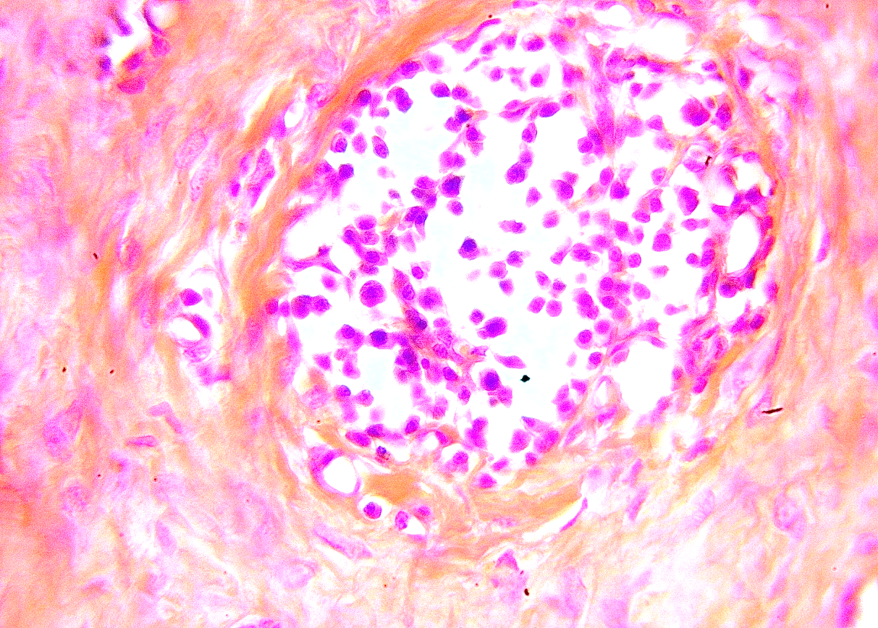
A
B
Figure 27: Microscopic section in stray dog skin: A: necrotic abscess contains large number of macrophage and lymphocyte, degenerate polymorphs cells and debris in the dermis layer B: thick collagen fiber in dermis with mononuclear cell infiltration (H&E stain, 400×).

Slide 33
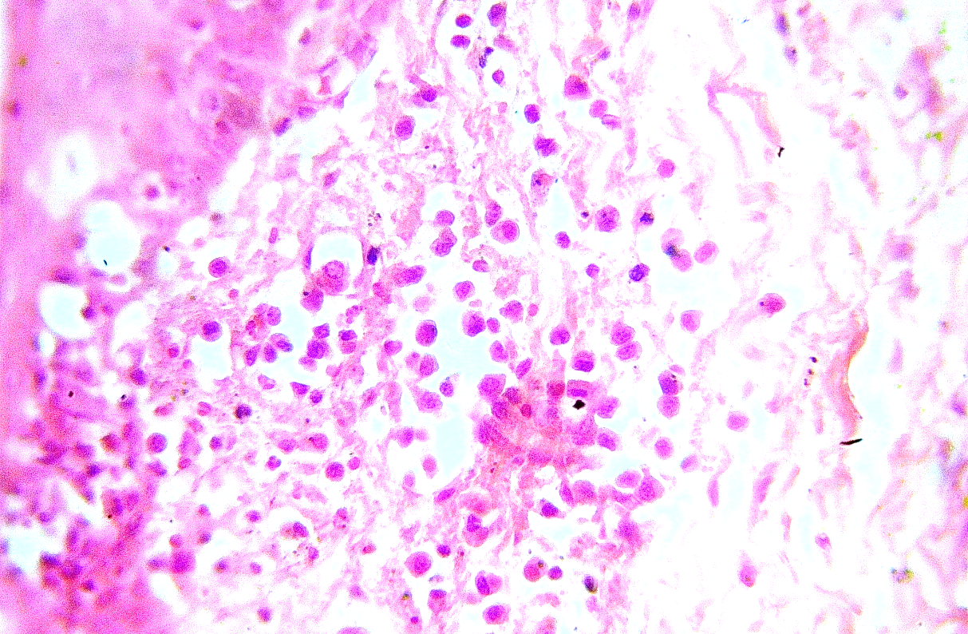
A
C
B
Figure 28: Microscopic section in k9 dog skin: A: vacuolar necrotic cells in epidermis B: necrotic cavity with mononuclear cells infiltration C: odema (H&E stain, 400×).

Slide 34
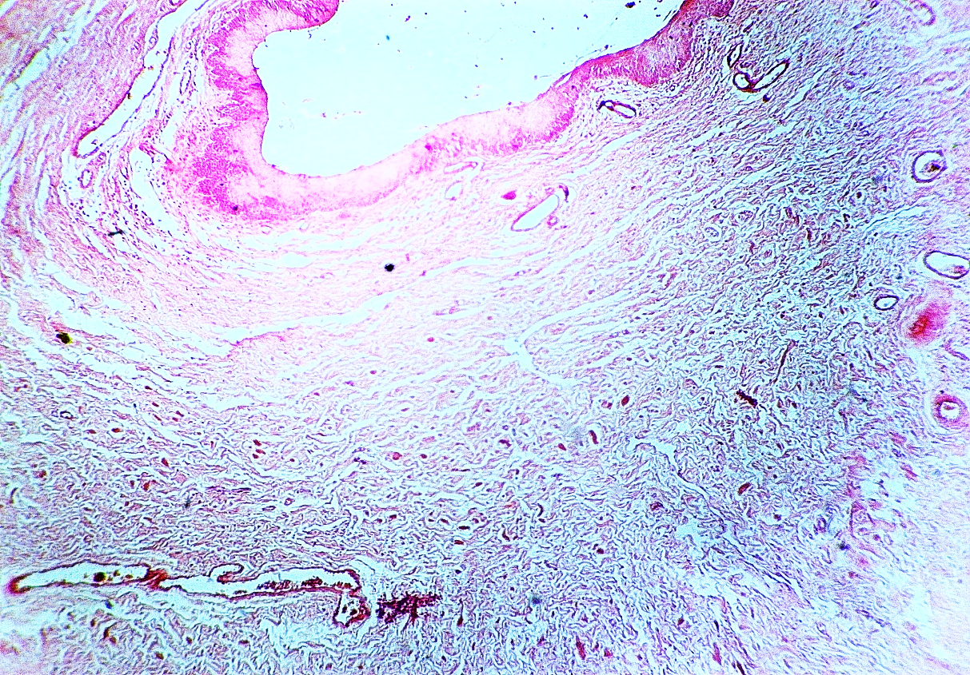
A
B
Figure 29: Microscopic section in k9 dog skin: A: infected epidermal with inflammatory cells B: granulation tissue in dermis C: congested and dilated blood vessels (H&E stain, 200×).
C

Slide 35
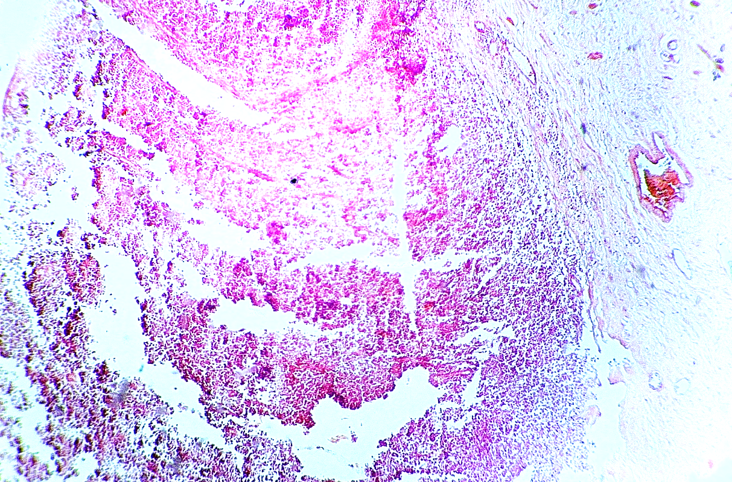
B
C
A
Figure 30: Microscopic section in stray dog skin: A: ulceration of necrotic epidermic and dermis layer with necrotic debris and inflammatory cells B: infected granulation tissue in dermis layer C: congested blood vessels (H&E stain, 200×).

Slide 36
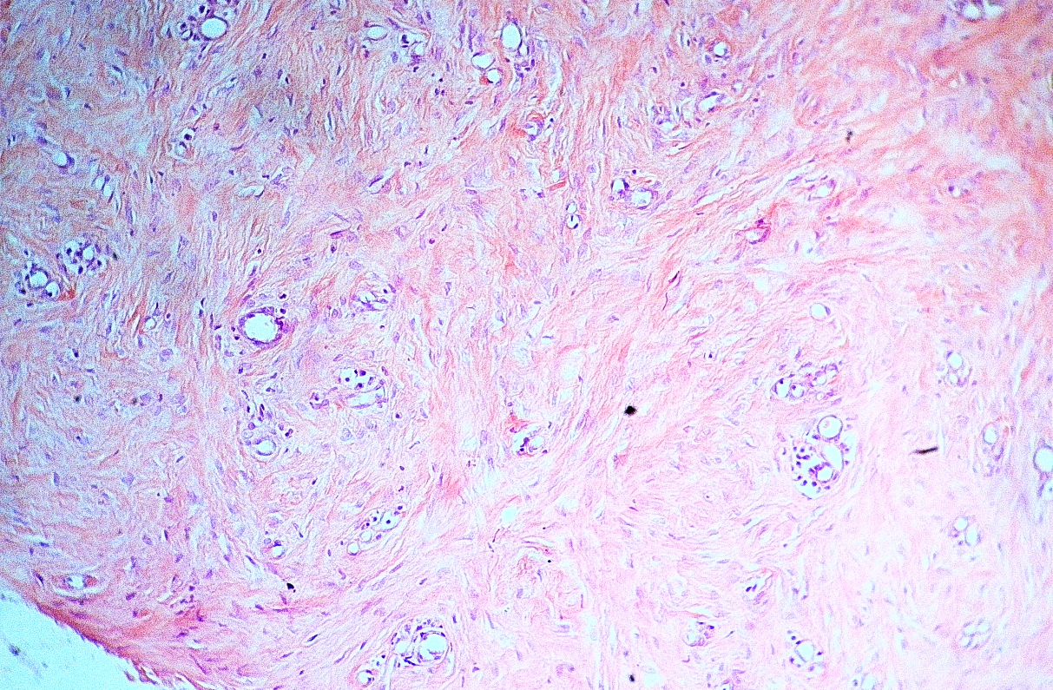
B
A
Figure 31: Microscopic section in stray dog skin: A: dermatofibroma curved bundles of cells and fibromas tissue which form a well-developed (basket - wave) pattern interlacing strand of collagenous fibrous tissue with stellate fibroblast spindle -shaped nuclei, many vacuolated cells are present B: newly blood vessel surround by mononuclear cells (H&E stain, 200×).

Slide 37
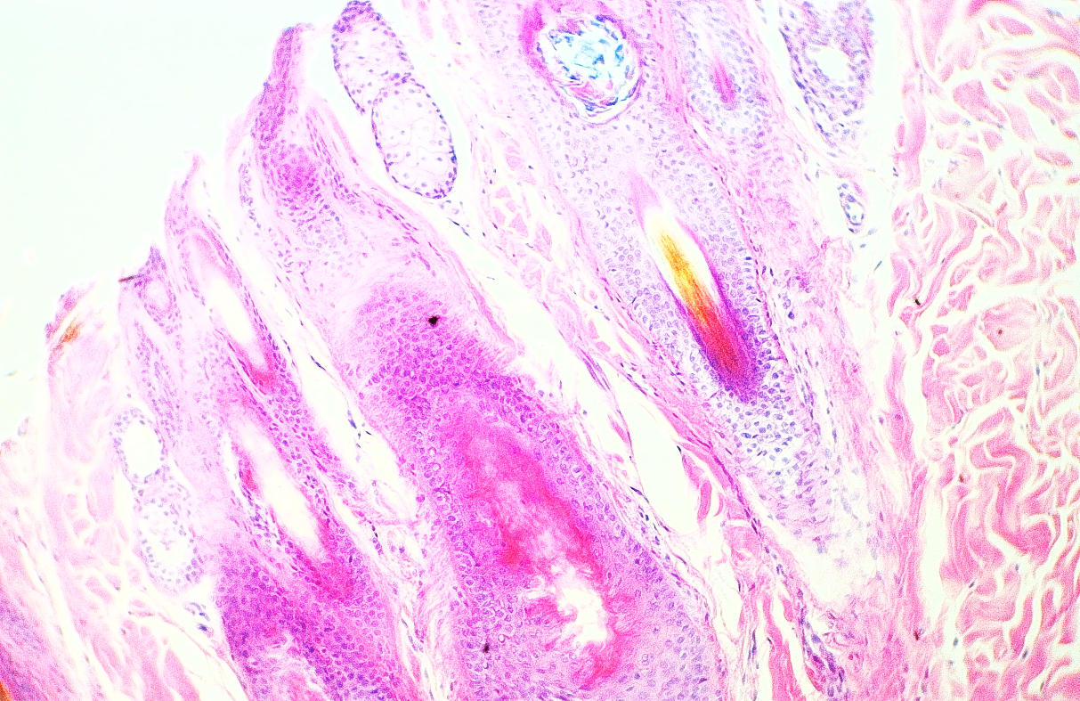
A
B
Figure 32: Microscopic section in k9 dog skin: A: hyperkeratosis and acanthosis of epidermal layer papilloma like of epidermis layer B: hyperplasia of hair follicle with mononuclear cells surrounds the follicles of epidermal layer (H&E stain, 200×).

Slide 38
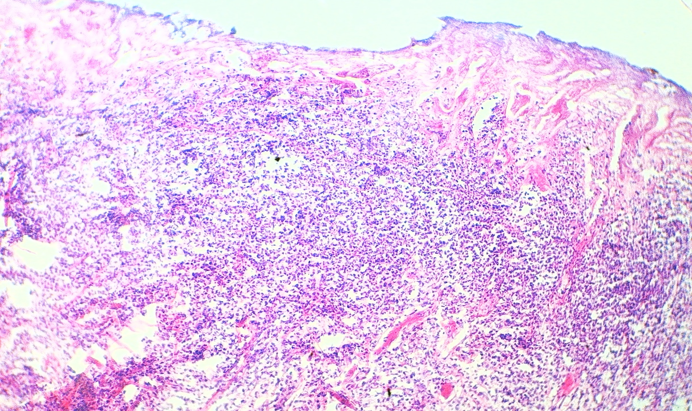
A
B
C
Figure 33: Microscopic section in stray dog skin A: sloughing and ulcer in epidermis layer B: sever dermal infiltration with mono and polymorphic inflammatory cells C: congested blood vessels (H&E stain, 200×).

Slide 39
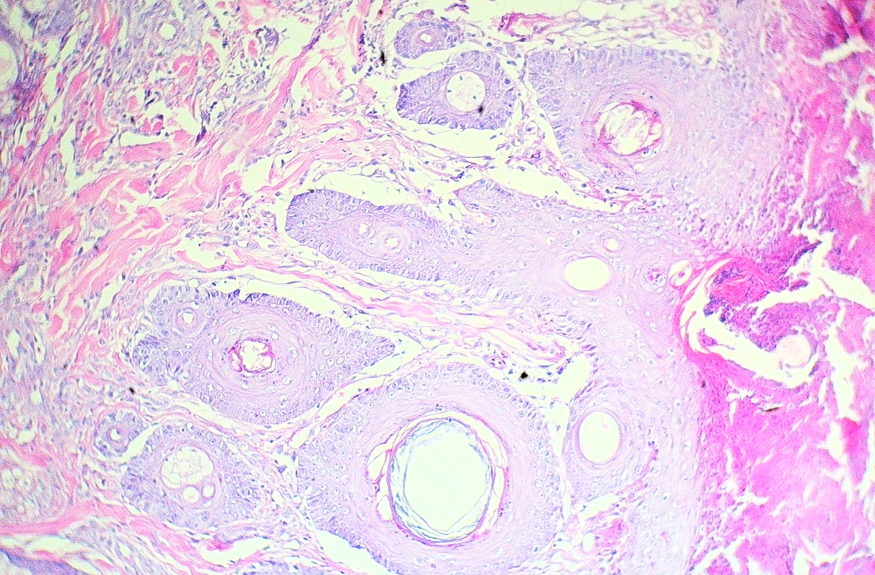
D
C
B
A
Figure 34: Microscopic section in ornamental dog skin: A: infected hyperkeratosis with necrotic debris B: acanthosis of dermis layer C: concentration multinodular lamination of keratin (cancer pearls) squamous cell carcinoma with large polyhedral cells D: mononuclear cells infiltration in the dermis and muscular layer (H&E stain, 200×).

Slide 40
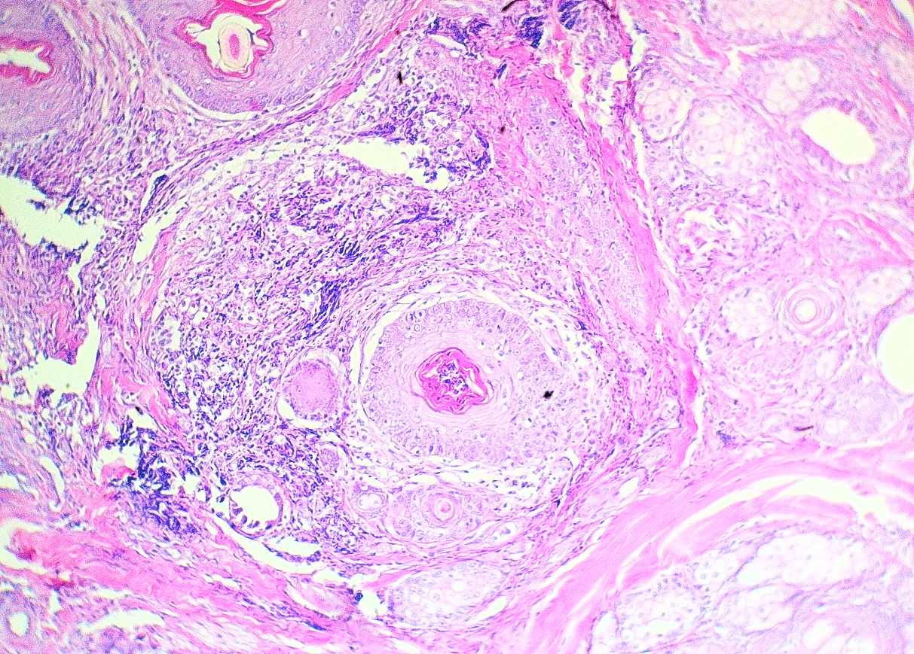
A
F
B
E
A
C
D
G
Figure 36: Microscopic section in k9 dog skin: A: multinodular concentric lamination of keratin (cancer pearls) B: marked stromal fibrous C: the tumor cells are large & polyhedral and similar to cells of stratum spinosum of epidermis D: the cell is immature & more hyperchromatic E: sever mononuclear cells infiltration F: necrosis area G: hyperplasia of sebaceous gland (H&E stain, 200×).

Slide 41
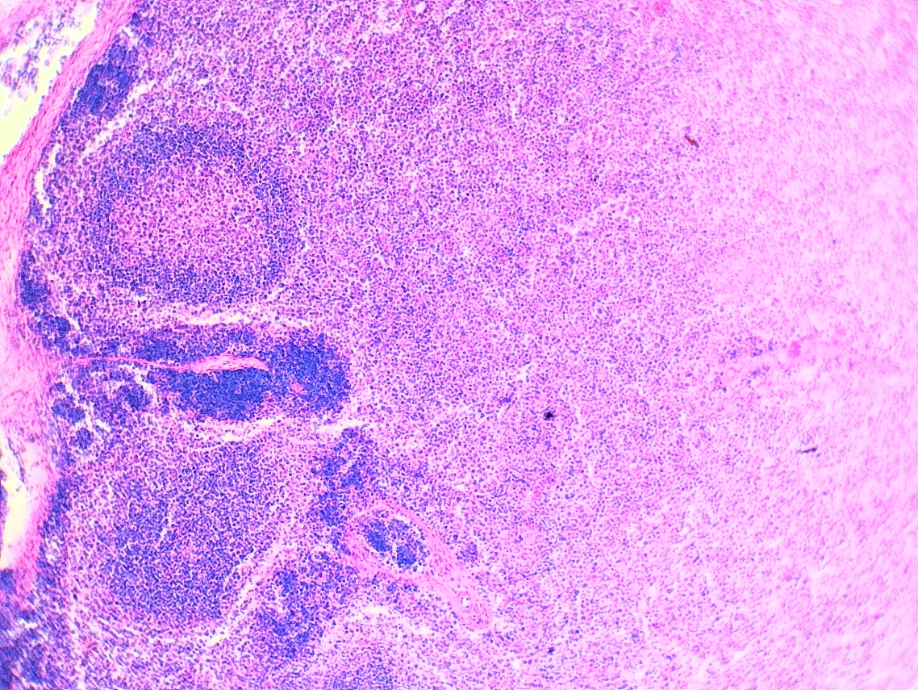
B
A
B
C
Figure 37: Microscopic section in stray dog skin: A: multiple infected granuloma consist center necrosis and surrounded by mononuclear cells B: all layer's epidermis and dermis heavily infected with mononuclear cells C: necrotic hair follicle with heavily mononuclear cells surrounded the follicles (H&E stain, 200×).

Slide 42
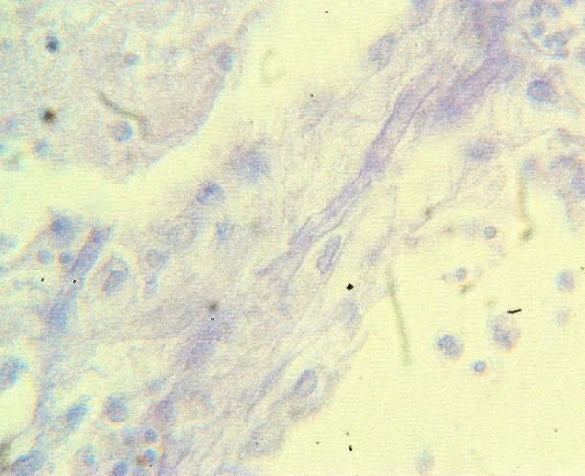
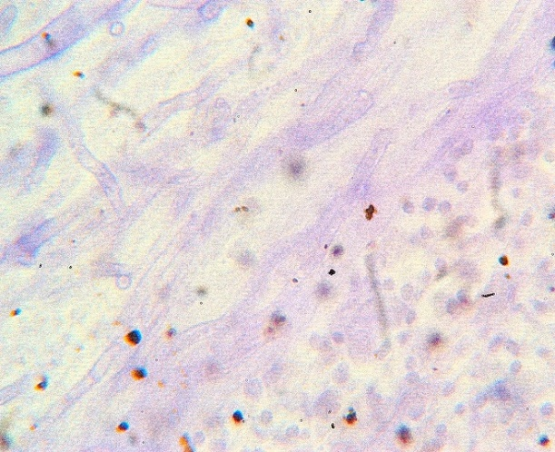
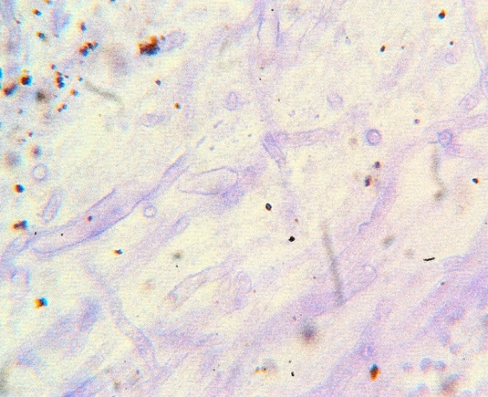
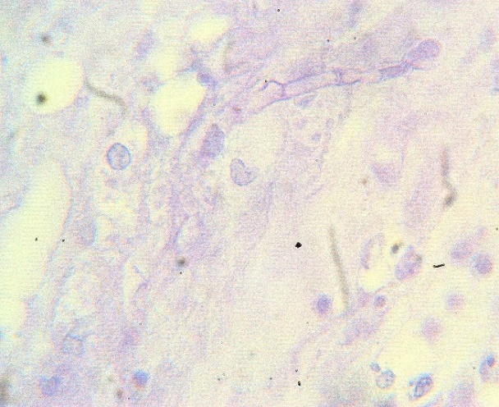
Figure 38: Microscopic section in stray dog skin: Showed Aspergillus niger Hyphae (septate) (PAS stain, 200×).

Slide 43
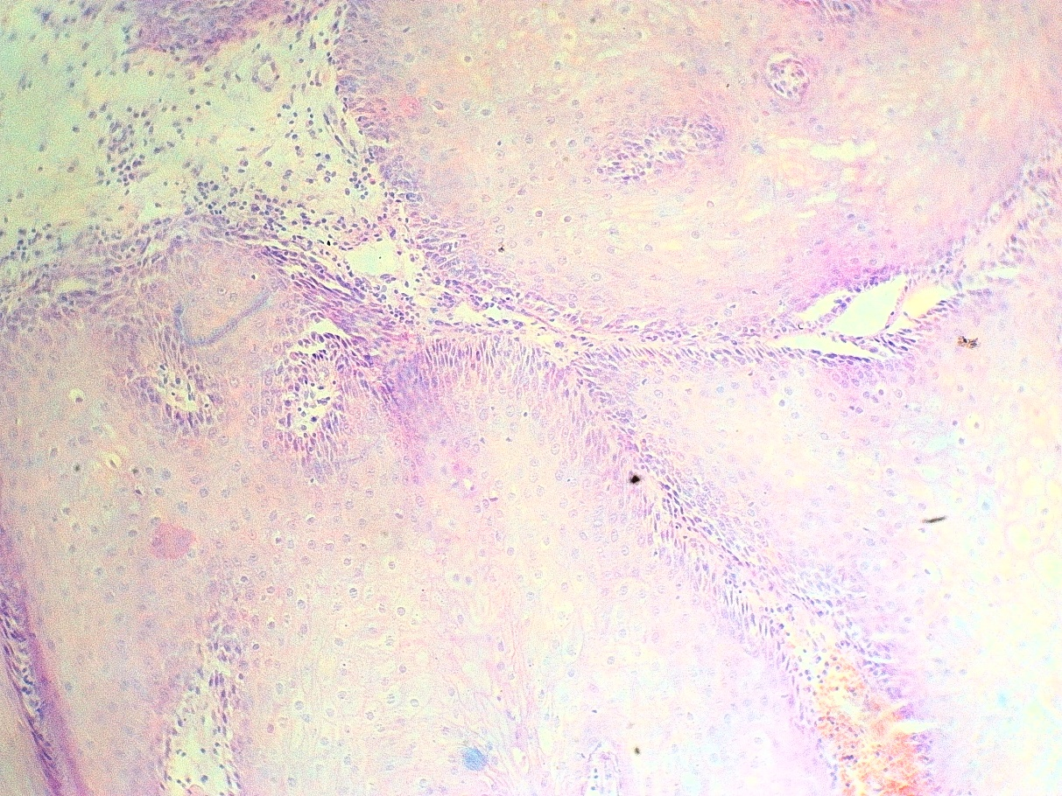
A
A
B
Figure 39: Microscopic section in stray dog skin: A: sever acanthosis and infected epidermal B: hemorrhage (H&E stain, 200×).

Slide 44
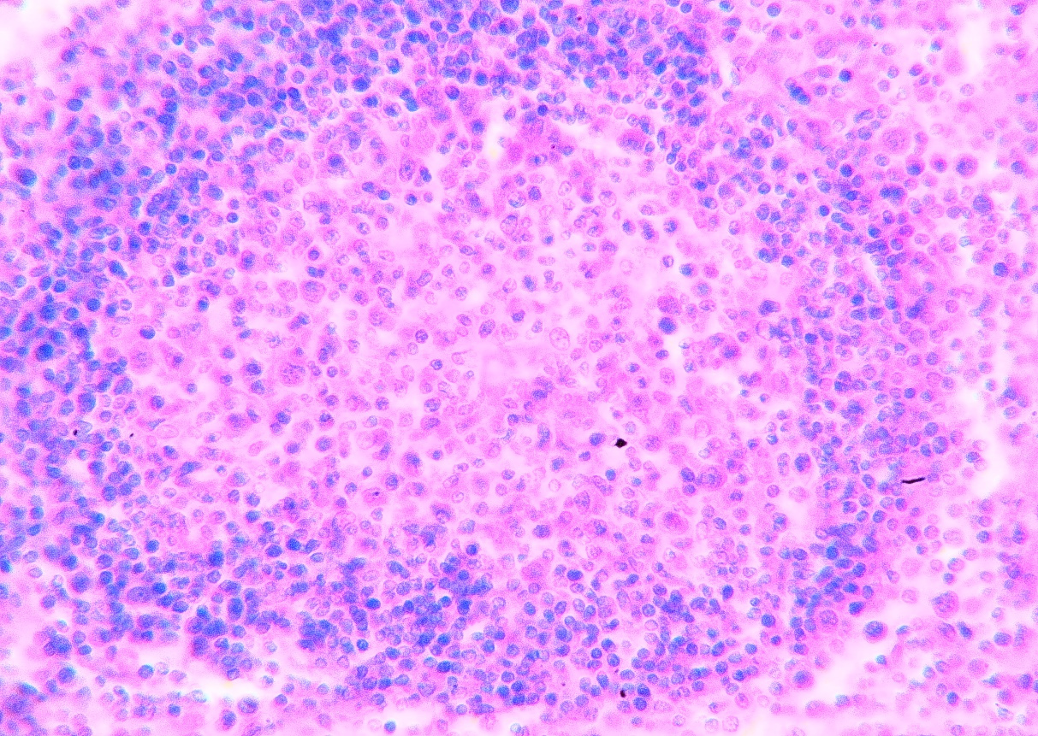
C
B
A
Figure 40: Microscopic section in k9 dog skin: A: granuloma consist of center necrosis B: mononuclear cells and polymorphic cells infiltration C: eosinophilic cells in the dermis (H&E stain, 200×).

Slide 45
1. Skin dog's lesion reported pathogen bacterial infection mostly secondary infection Staphylococcus Pseudintermedius. 2. Skin dog's lesion reported pathogen fungal infection mostly secondary infection Aspergillus niger. 3. Skin dog's tumors reported dermatofibroma squamous cell carcinoma and papilloma. 4. Bacterial and fungal infection cause lesion in dogs skin mostly abscess, dermatitis, granuloma with skin fungal hyphae.
Conclusion

Slide 46
1. Study in details virulence of the most pathogenic infection (bacterial and fungal). 2. Study the causes of skin tumor. 3. Select the most important drugs for skin infection. 4. Study in details the causes of dog's skin dermatitis.
Recommendation

Slide 47
Thankyou

