Slide 1
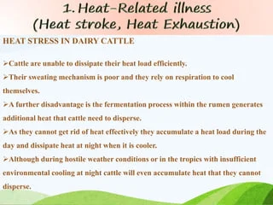

Slide 2
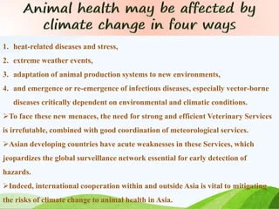

Slide 3
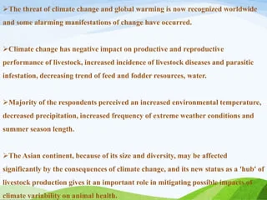

Slide 4
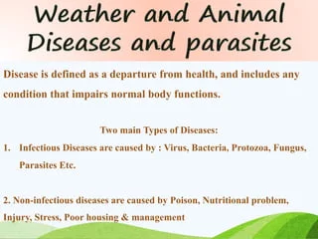

Slide 5
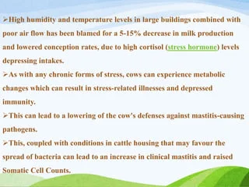

Slide 6
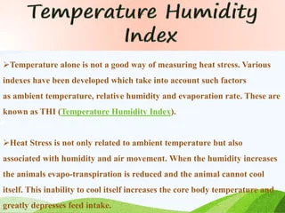

Slide 7
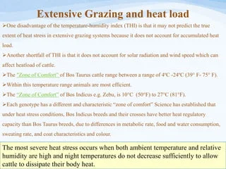

Slide 8
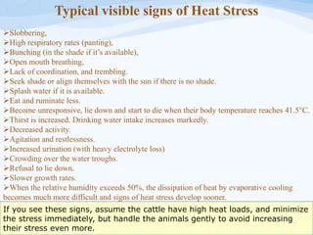

Slide 9
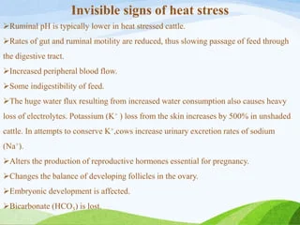

Slide 10
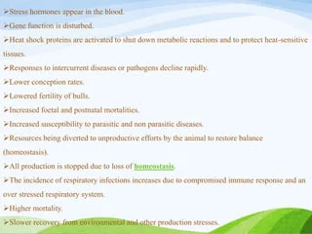

Slide 11
The effect of climate change on animal health may be either direct or indirect (Figure 1) and may be due primarily to changes in environmental conditions, which include air temperature, relative humidity, precipitation, and frequency and magnitude of extreme events (i.e., heat waves, severe droughts, extreme precipitation events, and coastal floods). (Forastiere, 2010).

Slide 12
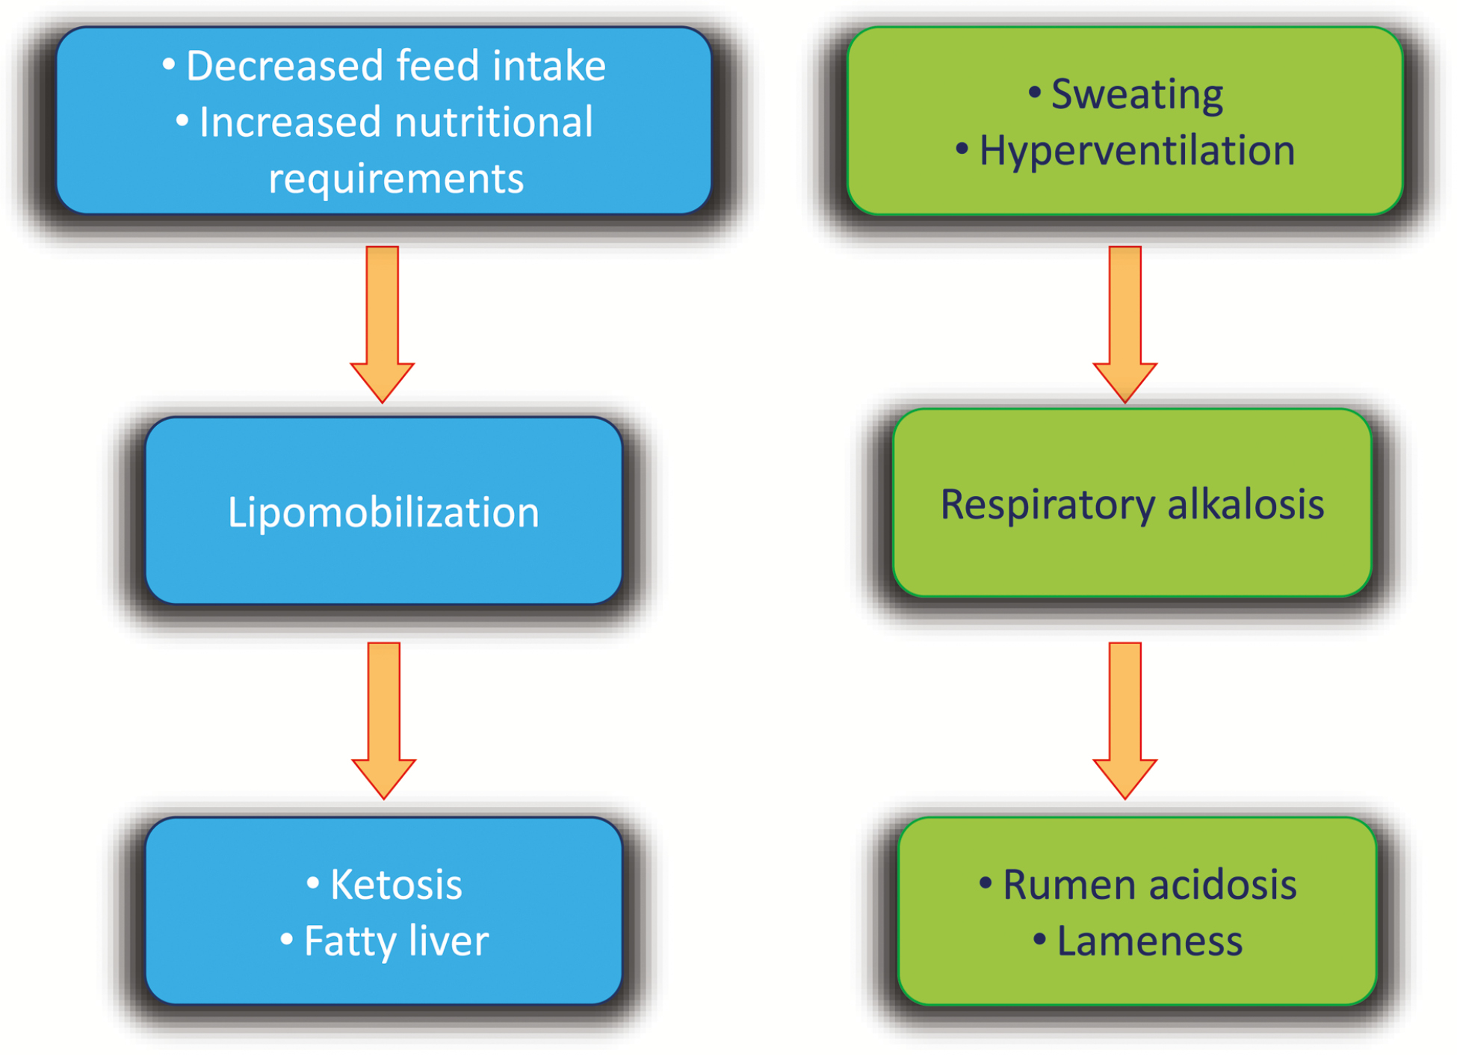

Slide 13
Although this article focuses on the effects of environmental factors, it should be noted that factors leading to the effects of climate change on health are extremely complex, involving not only environmental forces, but also ecological and social aspects, economical interests, and individual and community behaviors

Slide 14
Direct Effects
The direct effects of climate change on health may be due primarily to increased temperatures and frequency and intensity of heat waves (Gaughan et al., 2009). These effects are mediated by induction of heat stress conditions. Depending on its intensity and duration, heat stress may negatively affect livestock health by causing metabolic alterations, oxidative stress, immune suppression, and death (Figure 2).

Slide 15
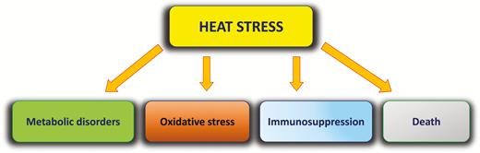

Slide 16
Metabolic Disorders
Homeothermic animals respond to high temperatures by increasing heat loss and reducing heat production in their attempt to avoid increased body temperature (hyperthermia). Such responses include an increase in respiratory and sweating rates and a decrease in feed intake. These physiological events may provide a significant contribution to explain the occurrence of metabolic disorders in heat-stressed animals (Figure 3).

Slide 17
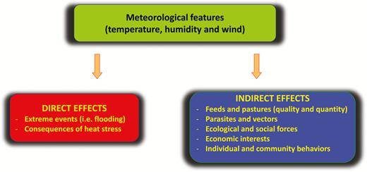

Slide 18
Oxidative Stress
In farm animals, oxidative stress may be involved in several pathological conditions, including conditions that are relevant for animal production and the general welfare of individuals Oxidative stress results from an imbalance between oxidant and antioxidant molecules and may depend on the excess of oxidant and/or lack of antioxidant substances (Figure 4). In the last 10 to 15 yr, the involvement of heat stress in inducing oxidative stress in farm animals has received increasing interest The total antioxidant status concentrations in serum of heifers were lower in the summer than in the winter in peri- and postpartum periods In mid-lactating cows, plasma values of reactive oxygen metabolite substances were increased during summer. Total carotenes and vitamin E were decreased during summer. Increased oxidant and decreased antioxidant molecules in blood during the hot summer season have been reported both in dairy and buffalo cows. Finally, heat stress has been associated with an increase of antioxidant enzyme activities (e.g., superoxide dismutase, catalase, and glutathione peroxidase), which has been interpreted as an adaptation response to increased levels of reactive oxygen species.

Slide 19
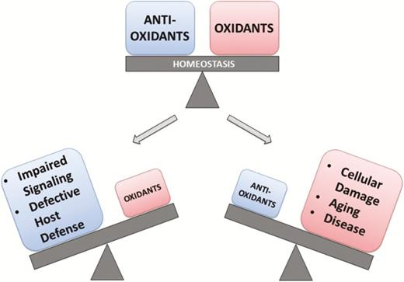

Slide 20
Immune Suppression
The immune system has evolved as a complex of mechanisms to protect the host from invasion by pathogenic organisms. A number of factors may affect the proper functioning of the immune system Several studies reported that heat stress may impair the function of the immune system in food-producing animals. Effects of heat stress on immune function are not always straightforward and may depend on the species, breed, genotype, age, social status, acclimation level, and intensity and duration of the exposure to the unfavorable conditions.
Immune suppression facilitates the occurrence of infections, which impairs reproductive efficiency,

Slide 21
Death
A series of studies have described a greater risk of mortality during the hottest months and an increased death rate during extreme weather events .High temperatures may cause heat stroke, heat exhaustion, heat syncope, heat cramps, and ultimately organ dysfunction. These heat-induced complications occur when the body temperature rises 3 to 4 °C above normal.
In an Indian study, reported an increase of mortality in Mecheri sheep during summer season. Another series of studies on the effects of temperatures on mortality in farm animals described an increase of deaths during extreme weather events. It was also reported that during the severe and prolonged heat waves which occurred in Europe during summer 2003, over 35,000 people and thousands of pigs, poultry, and rabbits died in the French regions of Brittany and Pays-de-la-Loire

Slide 22
Finally, other examples of how climate change may affect animal health are provided from parasitic diseases. In this context, gastrointestinal nematodes are important parasites of livestock, causing mortality and morbidity. Because a significant part of the life cycle of these parasites is completed outside of the host, their survival and development are susceptible to climate change..

