Slide 1
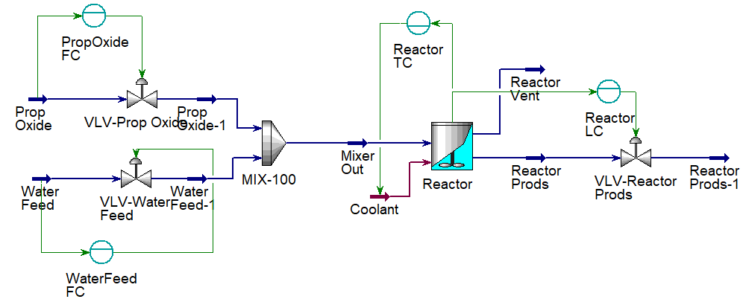

Simulation of Process control Aspen HYSYS
Assist Prof Dr. Khalid W. Hameed
Lect. Osama F Saeed
Lect. Noor Q. Jaber
Al-Khwarizmi College of Eng.
University of Baghdad

Slide 2
What is the Aspen HYSYS
Aspen HYSYS is a Simulation and process plant Design Software.
It is designed by Canadian company Hyprotech, founded by researchers from the University of Calgary, HYSYS V1.1 published in 1996. In May 2002, AspenTech acquired and modified Hyprotech, including HYSYS (Hyprotech Systems).
Specialized software for Chemical Engineering.

Slide 3
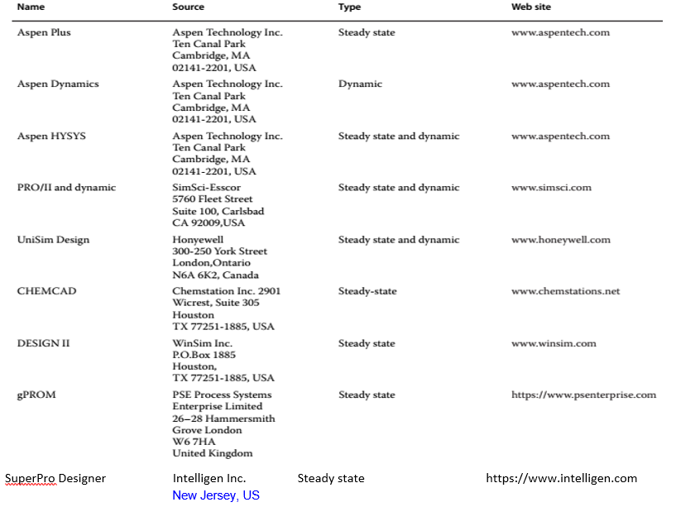
Most of known process simulators

Slide 4
Advantages of the Software:
Contains the physical and thermodynamical properties of hundreds of chemicals.
Performance the Material and Energy balance as well as unit conversion.
Performance the Design Calculations.
Perfect for analytical/numerical minds (How the process would behave under different conditions) e.g. Case steady research, or Using Stream Analysis → Property Table
Stream Analysis → Envelope

Slide 5
Advantages of Software (continue)
Execute the dynamics and control process as well as steady state.
Performance the Economic Evaluation.
Obtain a report of all details of plant.
Eliminate of Routine and Saving of time. i.e. Make easer/ faster work as well as accuracy of results.
The software can present a virtual lab
It can be applied the operating conditions by software firstly, then in the practical field to avoid the errors and to obtain the optimum conditions.
Excellent for your curriculum as an engineer.

Slide 6
Dynamic State Simulation
By means of dynamic simulation, it is possible to monitor the behavior of the main process variables when subjected to disturbances typical of an industrial plant operation.
Enhancing Efficiency and Precision in Chemical Process Engineering.
Enables dynamic modeling to predict system behavior under various conditions.
Supports operational efficiency and safety analysis.

Slide 7
شكراً

