Slide 1
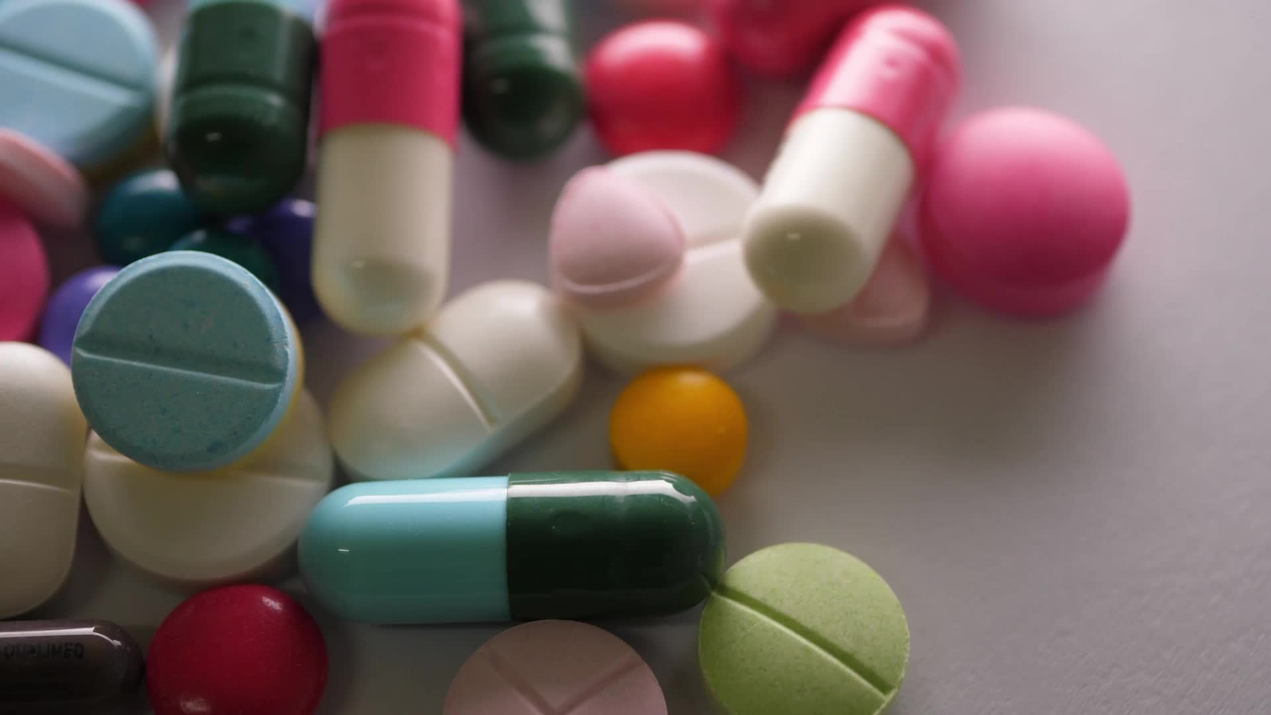
Phage Therapy as an Alternative to Antibiotic Efficacy and Safety in Clinical applications
Dr. Ali Al-Fendi
Institute of Genetic Engineering and Biotechnology for Postgraduate Studies/University of Baghdad

Slide 2
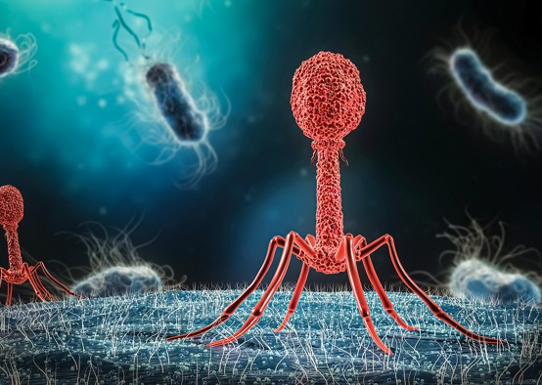
The Antibiotic Resistance Crisis
Drug resistance occurs when microorganisms (like bacteria, fungi, viruses, and parasites) evolve to survive exposure to drugs designed to kill them. This renders infections increasingly difficult, and sometimes impossible, to treat.
Global Impact: Drug resistance is a worldwide crisis affecting both developed and developing nations.
Mortality: The World Health Organization (WHO) estimates that drug-resistant infections cause at least 700,000 deaths annually, with projections of 10 million deaths per year by 2050 if the problem is not addressed.
Economic Burden: Drug-resistant infections lead to longer hospital stays, increased healthcare costs, and lost productivity.

Slide 3
Mechanisms of Drug Resistance
Enzymatic Inactivation: Microorganisms produce enzymes that break down or modify drugs, rendering them ineffective.
Efflux Pumps: Microorganisms develop pumps that actively expel drugs from their cells, reducing their concentration at the target site.
Target Modification: Microorganisms alter the target sites where drugs bind, preventing the drugs from working.
Reduced Permeability: Microorganisms decrease the permeability of their cell membranes, preventing drugs from entering.

Slide 4
Factors Contributing to Drug Resistance
Overuse and Misuse of Antimicrobials.
Poor Infection Control Practices.
Lack of New Drug Development

Slide 5
Consequences of Drug Resistance
treatment Failures
Increased Healthcare Costs
Limitations on Medical Procedures

Slide 6
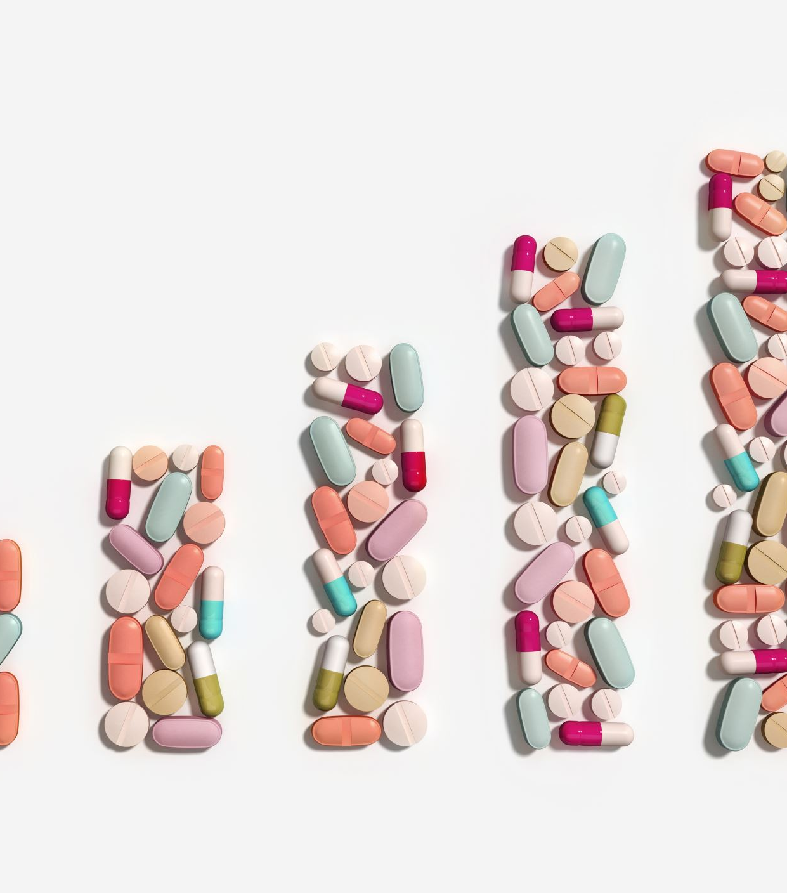
Antibiotic Resistance and the Promise of Phage Therapy
The rapid evolution and spread of AR necessitate the development of novel therapies.
Phage therapy has re-emerged as a promising alternative due to the growing AMR crisis.
While other alternatives exist, phage therapy stands out for its targeted approach, minimizing harm to beneficial bacteria.

Slide 7
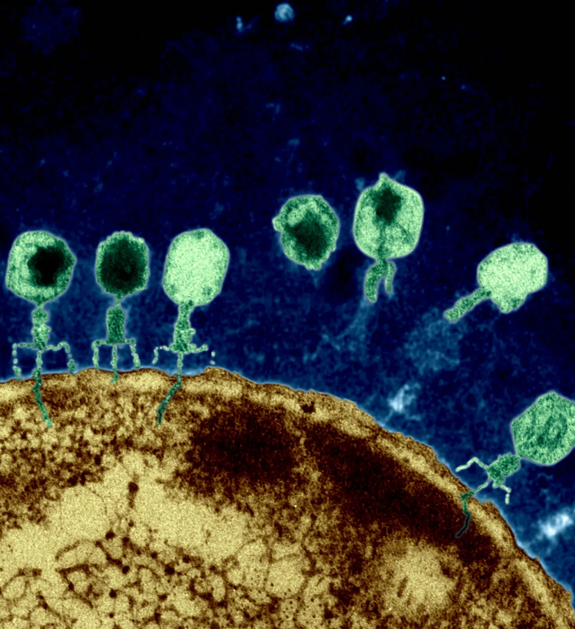
What are Bacteriophages?
Bacteriophages (or simply "phages") are viruses that specifically infect and destroy bacteria. They are nature's own bacterial predators.
Phages are incredibly abundant in the environment – they are found wherever bacteria exist (soil, water, even within the human body).
Phages come in a wide variety of shapes and sizes. Some have complex structures, while others are simpler.
Phages are highly specific, often targeting only a narrow range of bacterial strains. This is a key advantage for therapy.

Slide 8
History of Phage Therapy: From Discovery to Resurgence
The bacteriolytic activity of phages was recognized as early as 1896.
In 1917, d'Herelle observed phages' activity against Shigella and pioneered phage therapy for various infections.
Early Challenges: Between 1930-1940, phage therapy faced setbacks in the US due to inconsistent quality and poor stability of phage preparations.
Modern Resurgence: The rise of antibiotic resistance has spurred renewed interest and research in phage therapy.

Slide 9
MECHANISM OF PHAGE ACTION

Slide 10
Advantages of Phage Therapy: A Powerful Arsenal Against Bacterial Infections
Targeted Precision: The Power of Specificity: Phages exhibit remarkable specificity, often targeting only a single strain or a very narrow range of bacterial strains. This precision is a double-edged sword: it requires careful identification of the causative bacteria, but it also provides significant advantages.
Preservation of Microbiota
Reduced Collateral Damage
Personalized Treatment Potential

Slide 11
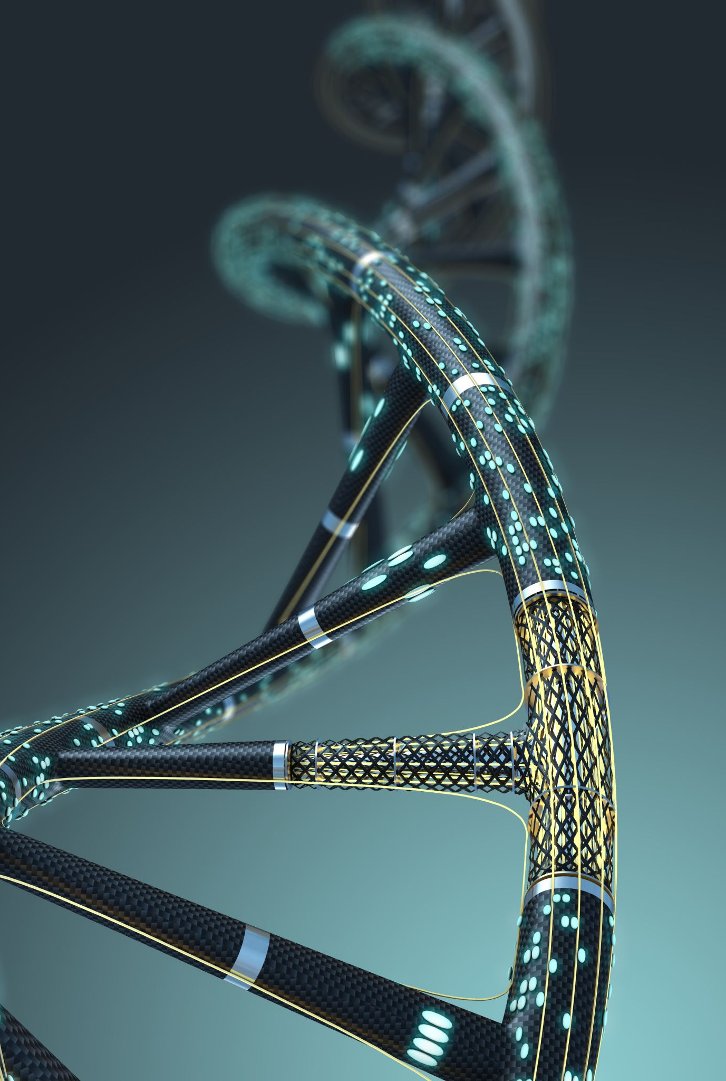
A Moving Target: Managing Phage Resistance
Mechanisms of Phage Resistance: Bacteria can develop resistance through mechanisms like modifying phage receptors on their surface, producing enzymes that degrade phage DNA, or using CRISPR-Cas systems to target phage DNA.
Overcoming Resistance:
Phage Cocktails
Sequential Phage Therapy
Engineered Phages

Slide 12
Safety First: A Generally Well-Tolerated Therapy
Minimal Toxicity.
Endotoxin Release.
Immune Response.

Slide 13
Clinical Applications of Phage Therapy
SKIN AND SOFT-TISSUE INFECTIONS

Slide 14
Clinical Applications of Phage Therapy
RESPIRATORY TRACT INFECTIONS

Slide 15
Clinical Applications of Phage Therapy
Urinary Tract Infections (UTIs): The ELIMINATE trial, one of the largest phage therapy studies to date, is testing the effectiveness of bacteriophages in treating UTIs caused by antibiotic-resistant Escherichia coli.
Cystic Fibrosis: A clinical trial supported by the National Institutes of Health (NIH) is evaluating the safety and efficacy of bacteriophage therapy in adults with cystic fibrosis who have lung infections caused by Pseudomonas aeruginosa.
Skin Infections: Several clinical trials have demonstrated the safety and varying degrees of efficacy of phage therapy in treating skin infections, with nearly 100% success in some cases and no reported side effects.

Slide 16
Phage–Antibiotic Synergy (PAS)
Phage–Antibiotic Therapy as a Promising Strategy to Combat Multidrug-Resistant Infections and to Enhance Antimicrobial Efficiency
Advanced Drug Delivery Group, Faculty of Medicine and Health, School of Pharmacy, The University of Sydney. (2022).

Slide 17
Challenges and Limitations: Overcoming Hurdles in Phage Therapy Implementation
The Specificity Challenge: Narrow Host Range:
Rapid Diagnostics
"Phage Hunting“
Personalized Medicine Complexity

Slide 18
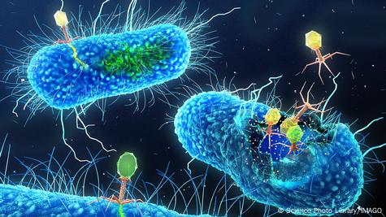
Challenges and Limitations: Overcoming Hurdles in Phage Therapy Implementation
The Evolving Target: Phage Resistance:
Phage Cocktails
Engineered Phages
"Phage Banks" and Ongoing Research

Slide 19
Challenges and Limitations: Overcoming Hurdles in Phage Therapy Implementation
Production and Standardization: Manufacturing Challenges:
Large-Scale Production
Purification and Quality Control
Standardization
Stability and Storage

Slide 20
Challenges and Limitations: Overcoming Hurdles in Phage Therapy Implementation
Other Considerations
Clinical Trial Design
Cost
Administration

Slide 21
CONCLUSION
Phage therapy offers significant therapeutic potential, especially given the growing problem of antibiotic resistance.
Phage therapy has demonstrated a promising safety profile and good patient tolerance.
Developing and implementing phage therapy requires substantial time, resources, and commitment.
Correct administration of phage therapy is crucial for its success.
Phage therapy, while promising, is not a "magic bullet" and should be considered one tool among many in the fight against bacterial infections.

Slide 22
Thank You!
Any Questions?

