Slide 1


قارض الزغبة طويلة الأذن وأهمية هذا النوع في البيئة العراقية Large eared Dormouse Eliomys melanurus and it`s importance in Iraqi environment By M.Sc. Yasameen S. Hasan

Slide 2
You can see me

Slide 3
Abstract
Eliomys melanurus is a species of family Gliridae belongs to order Rodentia. It is found in Egypt, Iraq, Jordan, Lebanon, Libya, Saudi Arabia, Syria and Turkey. Its natural habitats are temperate forests, subtropical or tropical dry shrubland, Mediterranean-type shrubby vegetation, rocky areas and gardens.
It is important to enrich our information about Rodentia because of its importance role in ecosystem and some of them considered as indicator of environmental pollution, using in scientific experimental studies, some species listed as near threatened.

Slide 4
Aims of this workshop
Introduction of this species and first record in the world.
Distribution and conservation.
Description and anatomical characteristics
Activity and Feeding
Importance in Iraqi environment
Recommendation for prospective research

Slide 5
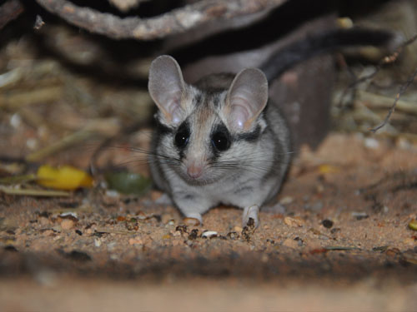
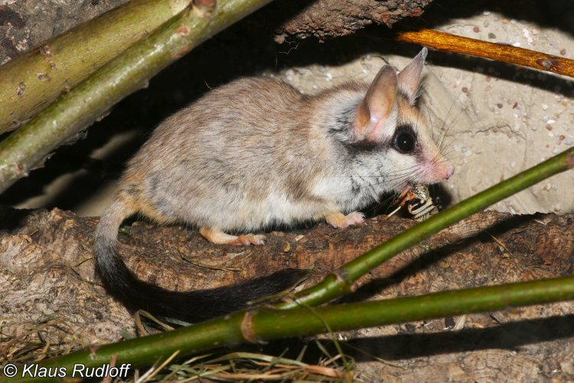
Introduction

Slide 6
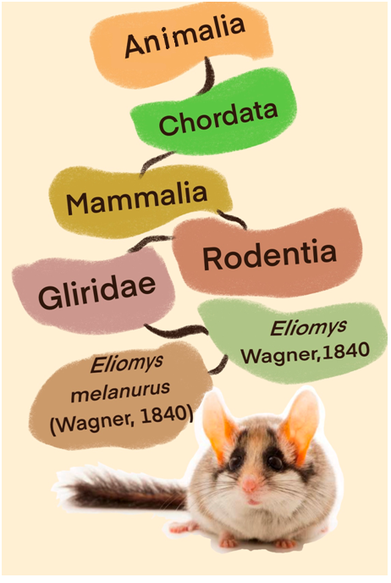
Introduction
Iraqi environment is enriched with diverse mammalians especially order of Rodentia (rodents) which is the largest order among the mammals (Hatt, 1959).
Eliomys melanurus was described at first time by Wagner in 1839 who placed it in genus Myoxus. Wagner description based on two specimens collected by Hofrath Von Schubert during an expedition to Egypt and Palestine in 1836/ 1837.
But in Iraqi environment has been recorded at the first time by Adam Nadachowski and others in 1977 in an owls pellets about 90 km at southwest of Mosul northwest of Iraq.

Slide 7
Distribution
Under genus of Eliomys there are three distinguishable species including , E. quercinus which is living in Europe, E. melanurus distributed in southern of Turkey, middle east (Sinai of Iraq) and in eastern north of Africa, while the last species is E. munbyanus living in western north of Africa (Table 1).
Between 2013 and 2014 Al-Sheikhly O.F. and others recorded Eliomys melanurus (Gliridae, Rodentia) in their research “checklist of mammals of Iraq (Chordata, Mammalia)” they mentioned its distribution restricted to rocky steppe of north western Iraq (Al-Sheikhly O.F. et al, 2015)
In 2020, Montazer Kamel recorded rare species restricted to the dry steppes of northwestern Iraq in his research “Updated checklist of Rodents of Iraq (Rodentia)”
As shown in figure 1.

Slide 8
Distribution
Table 1. shows distribution of Eliomys species around the world
Eliomys | Distribution
melanurus | Southern of turkey; middle east (Sinai of Iraq), eastern north of Africa
quercinus | Western Europe east to the Urals, Mediterranean islands
munbyanus | Western north Africa (Holden 2005)

Slide 9
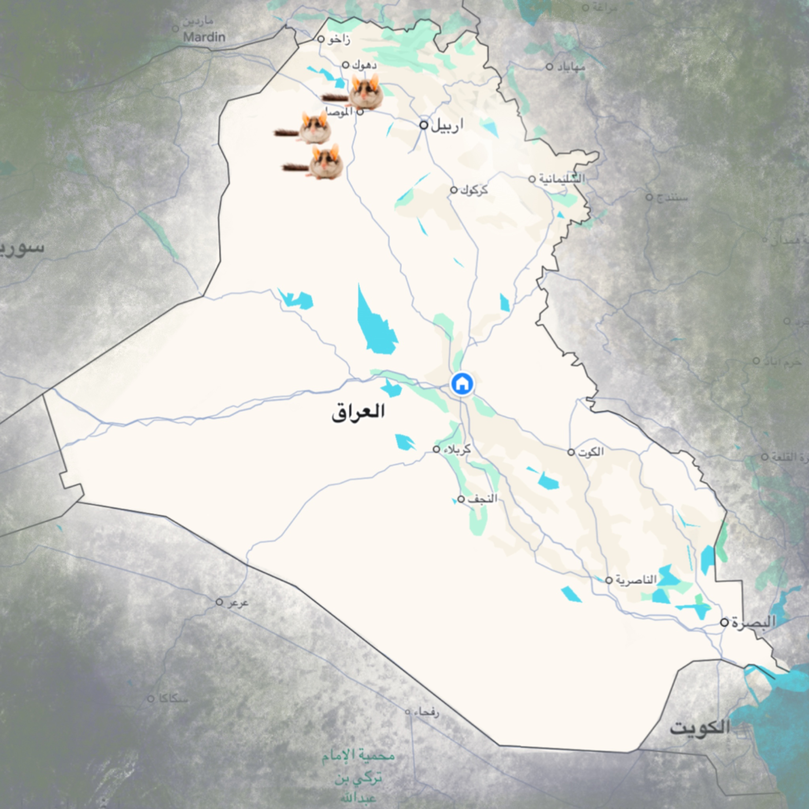
Distribution
Figure 1. Distribution of rare species in Iraq reported by Montzar Kamel in 2020.

Slide 10
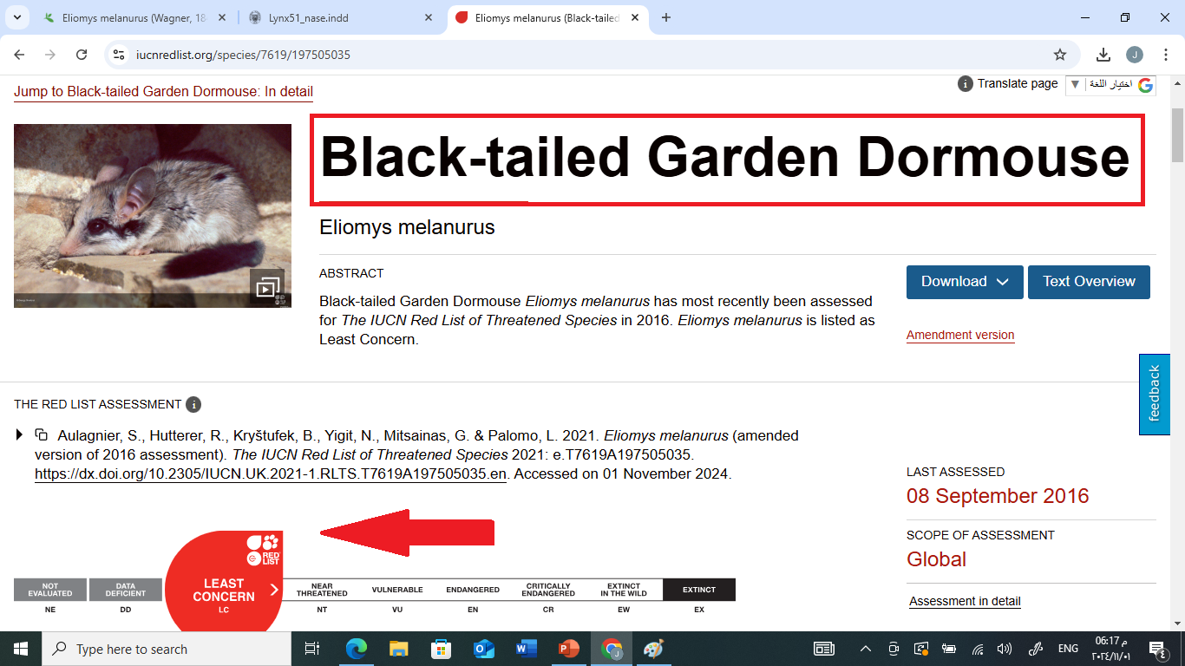
Distribution
Conservation:Black-tailed Garden Dormouse or large eared Eliomys melanurus has most recently been assessed for The IUCN Red List of Threatened Species in 2016. Is listed as Least Concern.

Slide 11
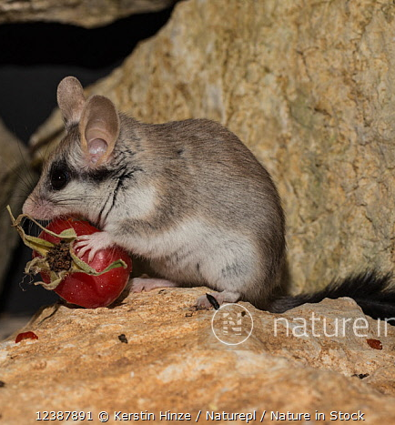
Description and anatomical characteristics
This genus of Eliomys has medium body sized characterized by large eyes with external noticeable striking color pattern on its face which is dark-masked shape extends from the ends of eyes posteriorly under the ears which contrasts on the cheeks with pale. Large brown oval- shaped ears, black long tail (ca 95% of HB) contrasting the color at the end. Hairs of the tail at the base is shorter (3-4mm) and longer at tip (up to 23 mm).

Slide 12
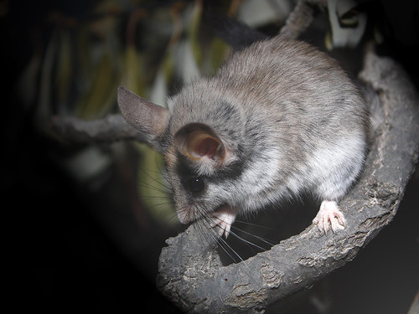
Description and Anatomical characteristics
Fore feet have four digits while hind feet white and have five digits the soles are naked. Skull long (35.9 mm) with very large tympanic bullae and long rostrum (15.6 mm). Zygomatic arches very delicate. Slender mandible with large perforations of the angular processes, having a distinctive secondary projection on the lower margin. Crowns of cheek teeth distinctively concave as shown in figure (2).

Slide 13
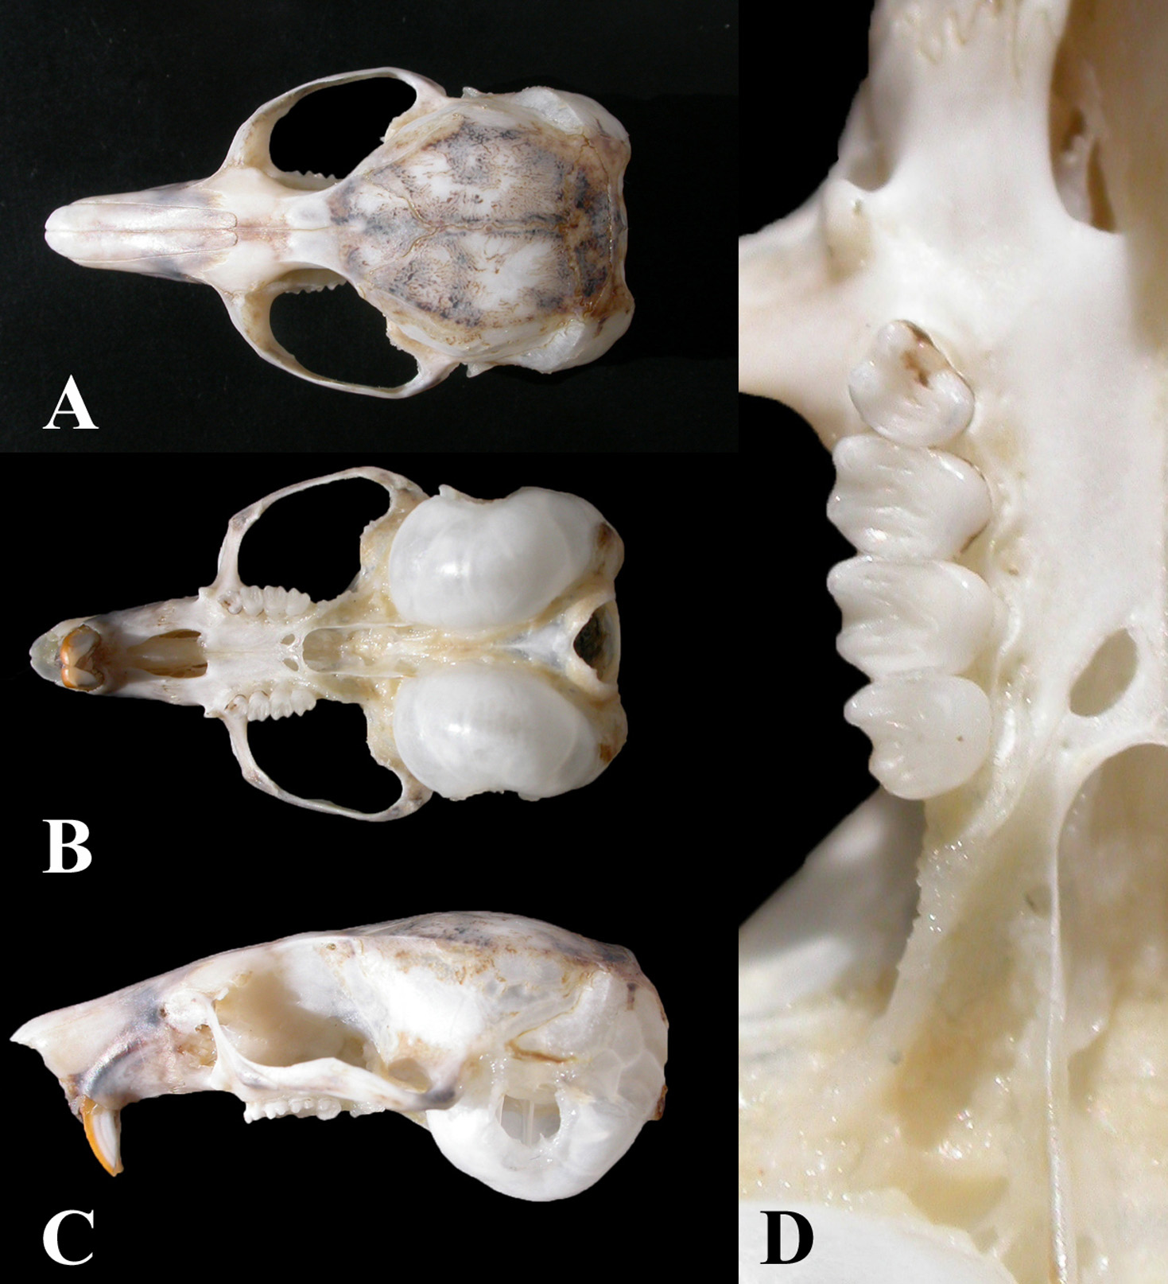
Anatomical characteristic of E. melanurus
FIGURE 2. A.Dorsal, B. Ventral, C. Lateral views of the skull, and D. Maxillary teeth for Eliomys melanurus.
© Amr, Zuhair S.;Abu, Mohammad A.;Qumsiyeh, Mazin;Eid, Ehab

Slide 14
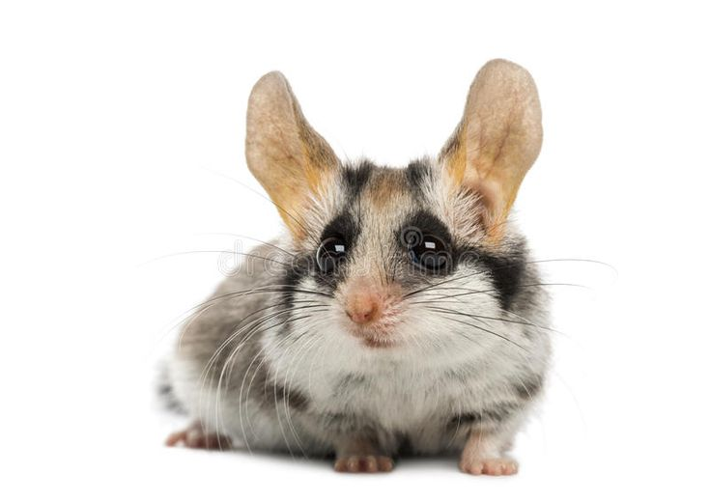
Measurement of the body
HB 128.0 (111 – 144) mm, n = 10
T: 122.0 (100 – 136) mm, n = 10
HF: 26.7 (26 – 27) mm, n =10
E: 27 (26 – 29) mm, n = 10
WT: 51.8 (38.4 – 63.0) g, n= 16
GLS: 35.9 (34.2 – 37.0) mm, n = 7
GWS: 20.9 (19.8 – 22.0) mm, n = 7
P- M: 5.3 mm, n = 8**
Libya (Kahmann & Thomas 1981)
* Western Mediterranean Coastal Desert, Egypt (Osborn & Helmy)

Slide 15
Activity and Feeding
Overall, locomotor activity patterns of the Asian garden (large eared) dormouse largely resemble those of other species of dormice. However, Asian garden dormice spent long periods of time inactive both during light and darkness, when exposed to an ambient temperature of 10 °C, which may be related to the dramatic and sudden change in temperature. This period of inactivity may reflect a bout of torpor or the entering into a state of hibernation (Alagaili A.N. et al 2014).

Slide 16
Activity and Feeding
The Black-tailed Garden Dormouse is omnivorous, predominantly insectivorous and carnivorous. Stomach contents have included insects and other invertebrates such as snails and centipedes; small vertebrates such as small mammals and a fan-fingered gecko (Ptyodactylus) have also been recorded. Two individuals caged together entered torpor or “partial hibernation,” during which time one of the individuals preyed on the other and consumed the entire animal except for tail, hindfeet, and cranium; brain was also consumed.

Slide 17
Importance in Iraqi environment
Rodents represent a very diverse and rich group as they play an active role in maintaining ecosystems. In addition, they harbor many pathogens which makes them very important from a public health perspective (Dahmana et al. 2020).
It is important to regularly update the list of the living rodent species occurring in Iraq since most of these rodents are of medical importance as they are capable of transmitting dangerous diseases to humans. In addition, rodents can be good indicators of local biodiversity as a result of their specialization to specific types of ecosystems and their low distribution ability (Bryja et al. 2019).

Slide 18
Recommendation for prospective studies
There is rare study about E. melanurus in Iraq, so we need more information about this species, external or internal parasite, life cycle, importance as benefitive or detrimental animal and considering as important part of Iraqi ecosystem.
In Iraqi natural history museum which is opened in 1946, in all mammalians accession we have not seen any related accession to Genus Eliomys also as a Myoxus (Wagner 1840), so we need an preserved specimen for the benefit of the public so they are available for study, education, and enjoyment.

Slide 19
Thanks for your listening

