Slide 1
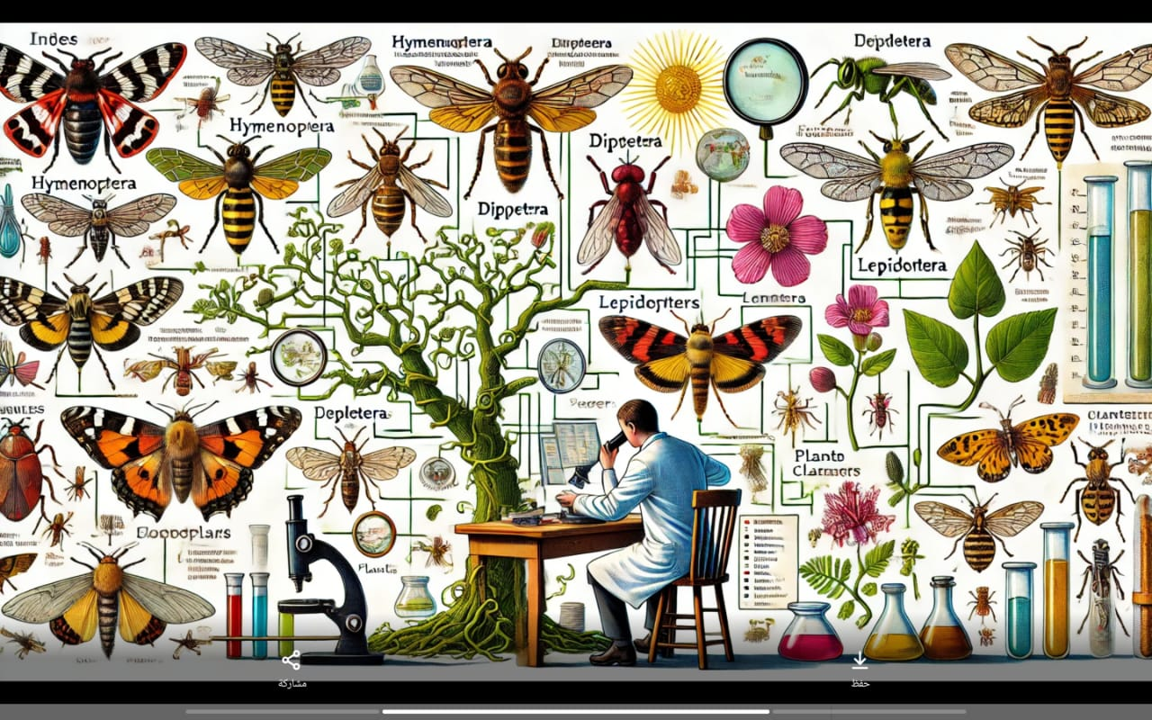


The mechanism for confirming and registering new species for science
الية تأكيد وتسجيل الانواع الجديدة للعلم
أ.د رزاق شعلان عكل
أ.م.د هناء هاني عبدالجسين
م.م شذى عبداللطيف

Slide 2
The mechanism for confirming and registering new species for science
الية تأكيد وتسجيل الانواع الجديدة للعلم
أ.د رزاق شعلان عكل
أ.م.د هناء هاني عبدالجسين
م.م شذى عبداللطيف

Slide 3
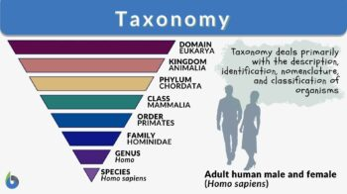
Introduction:
"Without taxonomy to give shape to the bricks, and systematics to tell us how to put them together, the house of biological science is a meaningless jumble".
بدون علم التصنيف الذي يعطي شكل الهيكل الرئيسي، علم النظم التي تخبرنا بكيفية تجميعها معًا، فإن بيت العلوم البيولوجية يصبح مجرد فوضى لا معنى لها.

Slide 4
Taxonomy is the science of discovering, naming, describing, diagnosing, documenting, recognizing, identifying, and classifying different kinds of organisms (Mayr 1969, Mayr and Ashlock 1991).
It is often viewed as a subset of systematics, which is the science that seeks to explore relationships between species in an evolutionary context by providing the framework into which species are classified—a categorical arrangement that gives order to the nature and patterns of variation of life on Earth. Taxonomy provides the international language for scientific communication, establishing clear, universal, and unambiguous terms of reference. It underpins all fields in the biological sciences, laying the foundation for ecology, evolutionary biology, conservation biology, biosecurity, primary industry (agriculture, aquaculture, and fisheries), medicine, and public health, all of which depend on a robust taxonomy.

Slide 5
Speciation
Phylectic evolution
Branching evolution

Slide 6
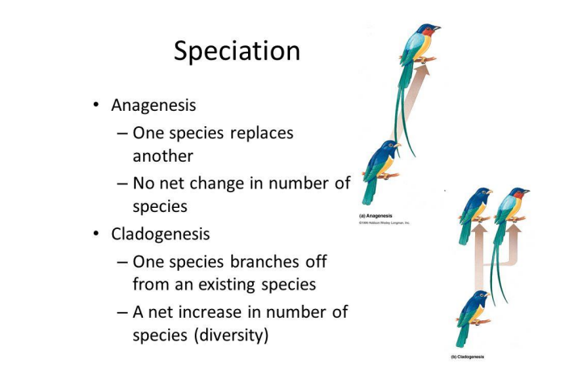

Slide 7
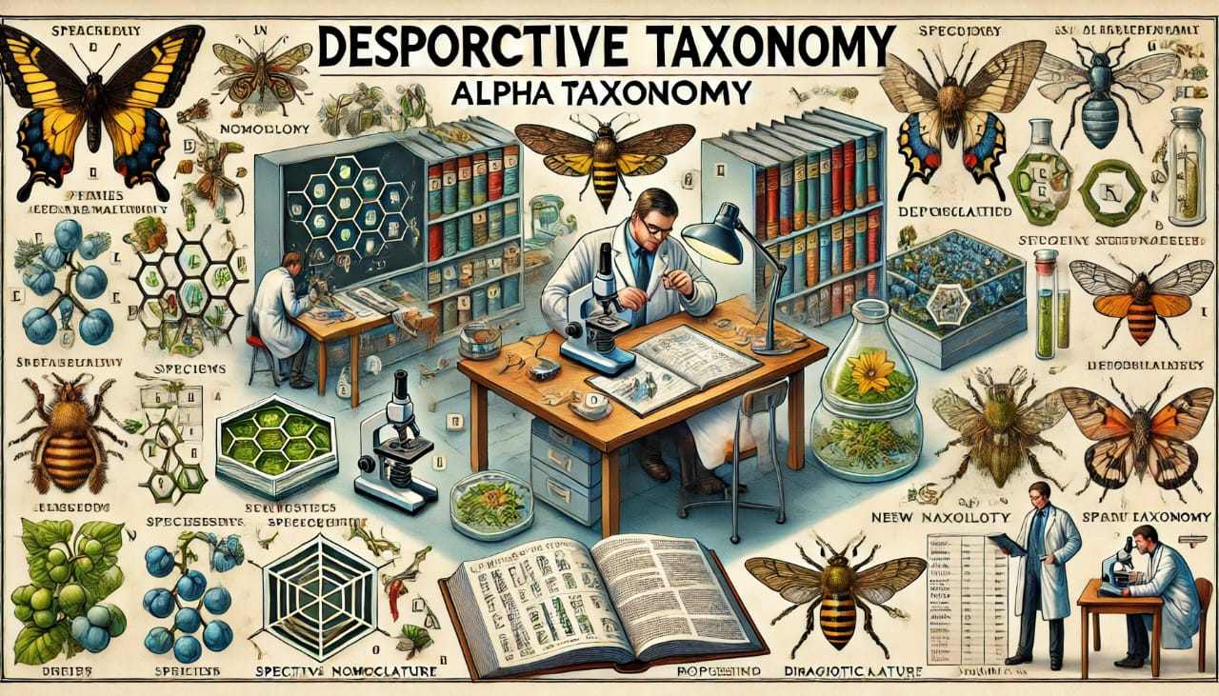
How is a new species described?

Slide 8

Step 1: Collect specimens
Taxonomy is fundamentally based on specimen collecting. With very few exceptions, a dead specimen (or specimens) is required to allow taxonomists to make a sufficiently detailed study to be absolutely sure a prospective new species is indeed actually new, and to ensure a physical example of that species is available to the scientific community for future examination. Amongst other things, this acts as reference material, which allows scientists to compare the specimen against future collections, and thus help establish if other specimens may be representative of new species as well. New species descriptions require a single ‘type’ individual on which the description is based (called holotype), and often several additional specimens showing variation in the species (paratypes).

Slide 9

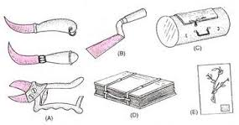

Slide 10
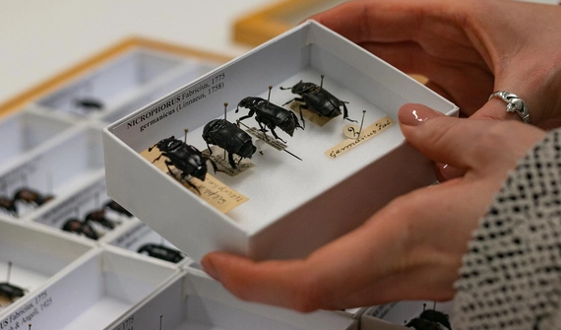
Step 2: Get specimens to a lab environment.
Getting freshly collected specimens from the field to a setting where they can be carefully prepared, examined, and stored is a key step in the species description process.

Slide 11
Step 3: Examine specimens and make sure they are new.
Once held in laboratory conditions, a taxonomist can then begin the process of determining whether a species is new to science or not. This is a meticulous procedure that is often the longest part of the species description process, and typically the most difficult. It involves careful comparative analysis with specimens of closely related species, often supplemented with lab-based molecular phylogenetic analysis. In many cases, specialists from other institutions are consulted, and the taxonomist may need to request specimens on loan from other institutional collections for comparative analysis. Where appropriate, the taxonomist may also examine field-based data which can be suggestive of a species taxonomic status; for example, vocalization patterns in birds. It is this part of the process that requires the highest level of specialist skill – knowing what is ‘normal’ in a group of organisms, and how a specimen varies from this norm to the extent that it can be classified as a ‘new’ requires highly refined expertise. Sadly, such taxonomic skills are in decline for many taxa, and experts that are able to identify new species with certainty are becoming an increasingly rare resource. For example, only a handful of taxonomists are alive that have sufficient expertise to work on the Laboulbeniales — a group of microscopic insect-parasitizing fungi.

Slide 12
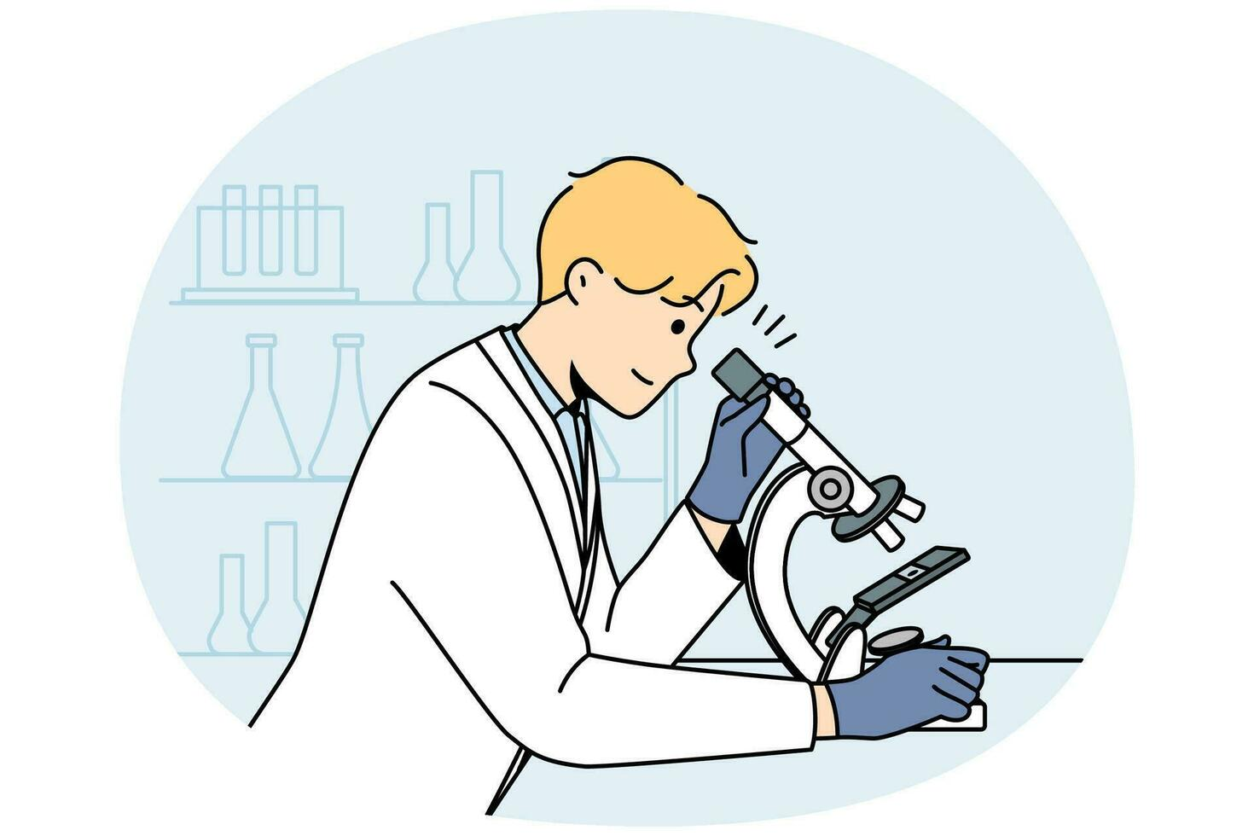

Slide 13
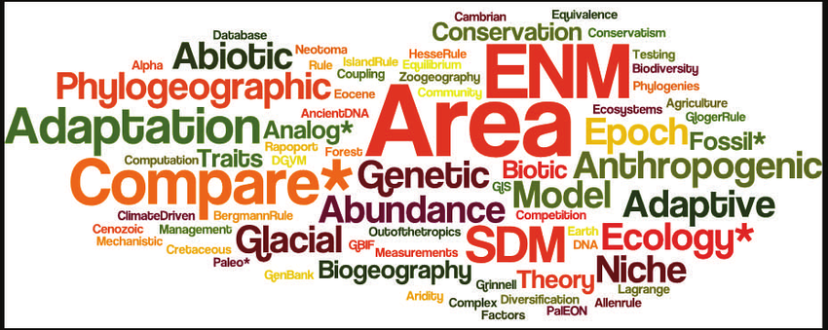
Step 4: Name the taxon
Once a specimen is recognized as a new species, it must be given a name! There are a huge range of naming possibilities open to taxonomists – species have been named after celebrities and catch-phrases, however, the taxonomists are generally encouraged to choose names which reflect the geography, ecology, or morphology of the species being described.

Slide 14
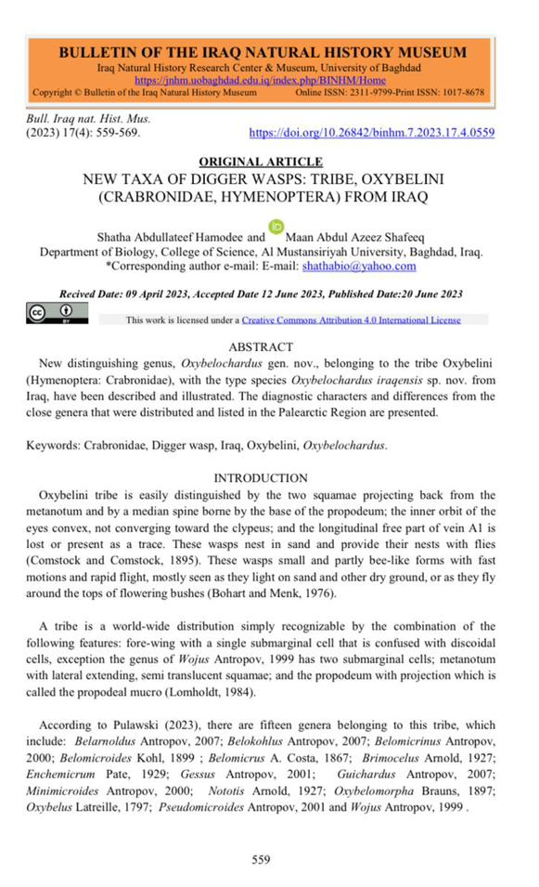
NEW TAXA OF DIGGER WASPS: TRIBE, OXYBELINI (CRABRONIDAE, HYMENOPTERA) FROM IRAQ

Slide 15
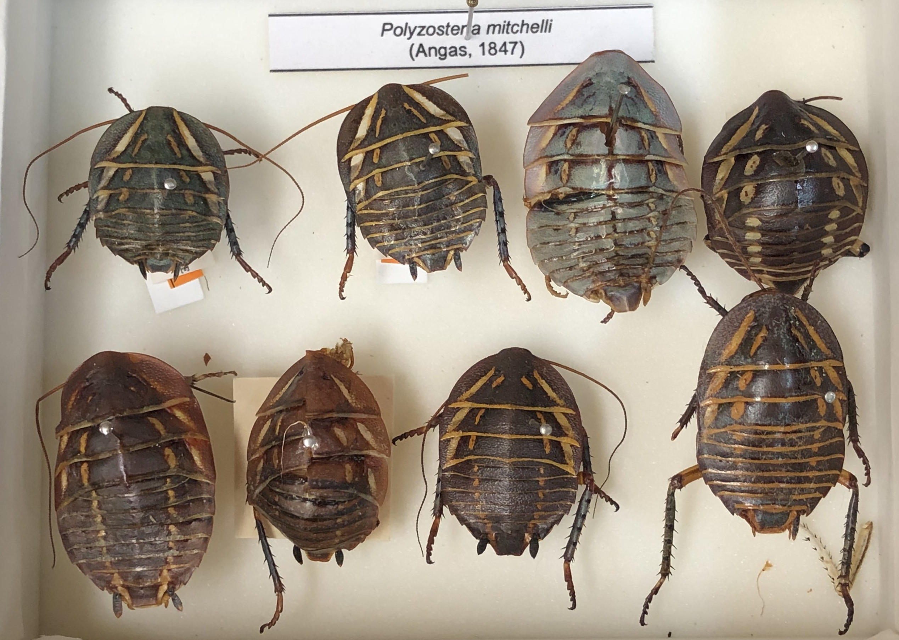
Step 5: Deposit the new taxon in a collection.
Once described, the specimens now representing a new species for science must be lodged in an internationally recognized collection. These can be insect and mammal collections "for example" as part of natural history museums or herbaria for plants and fungi.
There are several reasons why such collections play a central role in taxonomy

Slide 16
Firstly, these collections represent a secure depository where specimens can be kept in appropriate storage for centuries. Scientists today regularly need to consult specimens that are hundreds of years old in order to characterize their morphology according to today’s standards (and use them for genetics work – DNA has been successfully extracted from specimens dating back to the 18th century!). Secondly, institutional collections represent concentrations of taxonomic expertise. For many organisms there are only a handful of experts skilled enough to be able to make accurate judgements about whether a species in that organism group is new or not, and many of these taxonomists work at (or are affiliated with) a museum or similar specimen-storing institute. Thirdly, concentrating many specimens of similar organisms together (as in a museum collection) makes it much easier for taxonomists to compare a prospective new species against existing species in the same group, as this means they only have to examine material from a limited number of collections rather than chase down scattered specimens held by individuals who could be all over the World! The Natural History Museum in London, for example, curates over 35 million biological specimens, and thus can sometimes act as a “one-stop shop” for taxonomists looking for comparative material to base a new species description on. Similarly, the Harvard University Herbaria is among the most important collections around the world for plants and fungi with 5.5 million specimens.

Slide 17
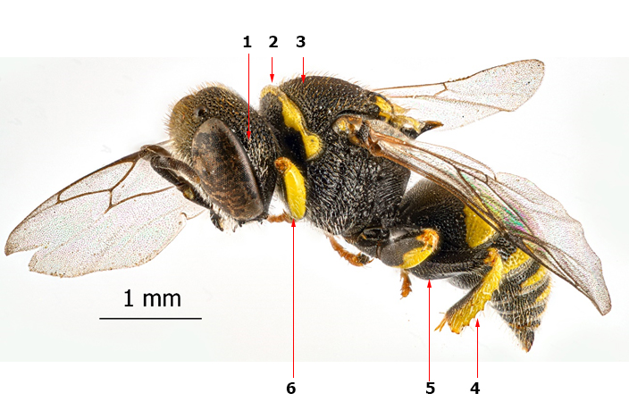
Three specimens of them are deposited in Iraq Natural History Research Center and Museum –University of Baghdad under the museum number (HYC.1.023).

Slide 18
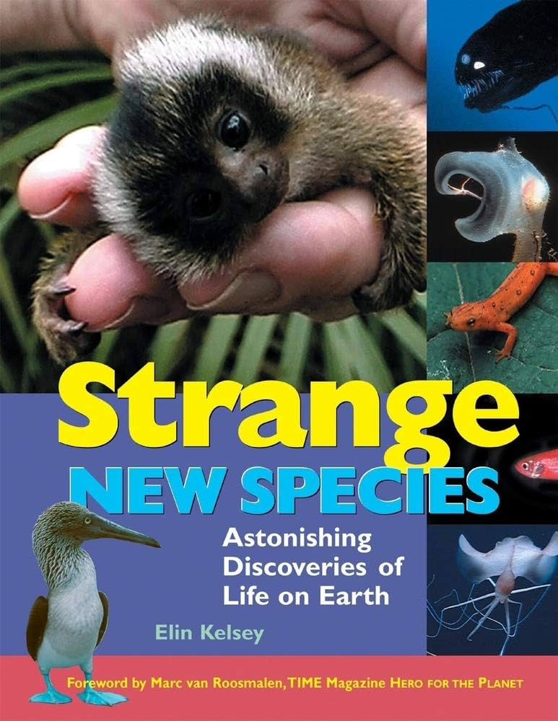
Step 6: Describe and publish the new species.
When a taxonomist has compiled sufficient evidence to be absolutely certain a specimen represents a new species to science, they can write their findings up in a publication – typically a peer-reviewed journal, although other suitable outlets exist, such as specialist textbooks. The ‘description’ section of taxonomy articles tends to be fairly standardized; requiring commentary on a specific set of criteria that prove a species is new.
This writing process (and subsequent reviews and corrections) can also be very time consuming. A wide variety of journals can be used as outlets for new species descriptions, including taxonomic “mega-journals” like ‘Zootaxa’, ‘Phytotaxa’ or ‘MycoKeys’ (which publish descriptions for any animal, plant or fungal species, respectively), or specialist journals that focus on very particular taxonomic groups (e.g. ‘The American Fern Journal’ or ‘The Coleopterists Bulletin’).

Slide 19
The main difference between "new species" and "new records"
New Species
- A new species refers to a distinct type of organism that is identified and classified as a species for the first time.
- Discovering a new species typically involves finding individuals with unique characteristics that differentiate them from known species.
- The process of identifying a new species often involves detailed scientific analysis, including genetic, morphological, and ecological studies.
- Discovering a new species contributes to our understanding of biodiversity and evolution.
New Records
- New records refer to instances where a species is documented in a location where it has not been previously recorded.
- This could involve the first documented occurrence of a species in a specific geographic area, habitat, or ecosystem.
- Finding new records can result from increased survey efforts, improved detection methods, or changes in the distribution of species due to environmental factors or human activities.
- New records provide valuable information about species distributions, population dynamics, and environmental changes.

Slide 20
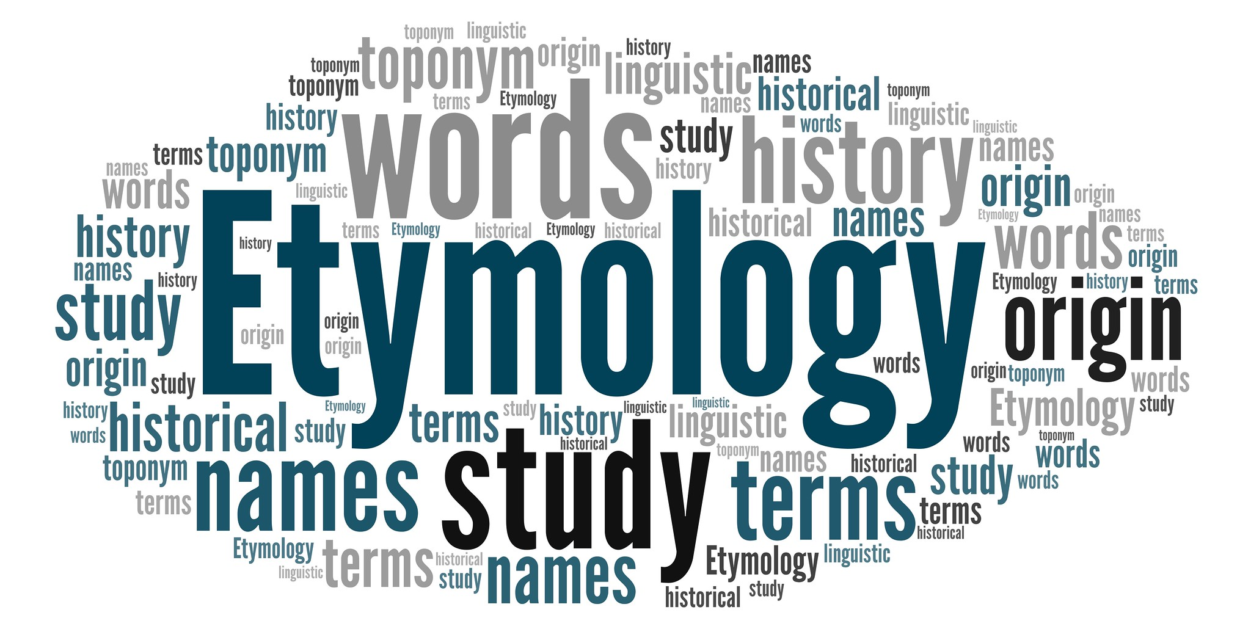
Etymology
Etymology, aspect and length of nomina. This point is rarely discussed in taxonomic papers and books, because most taxonomists consider themselves as the creators, and often the “owners”, of the new nomina they publish, and demand in fact “full freedom” for the aspect and length of these nomina, feeling very “shocked” if someone questions their choice. However, the nomina they publish are not only for their personal pleasure and use, but must be at the service of a discipline (taxonomy), of a community (taxonomists) and in fact of all users of scientific nomina, which in some cases (laymen, farmers, lawyers, custom officers, etc.) are very far from biology. Some guidelines at least, if not rules, should exist regarding the characteristics of new nomina.

Slide 21
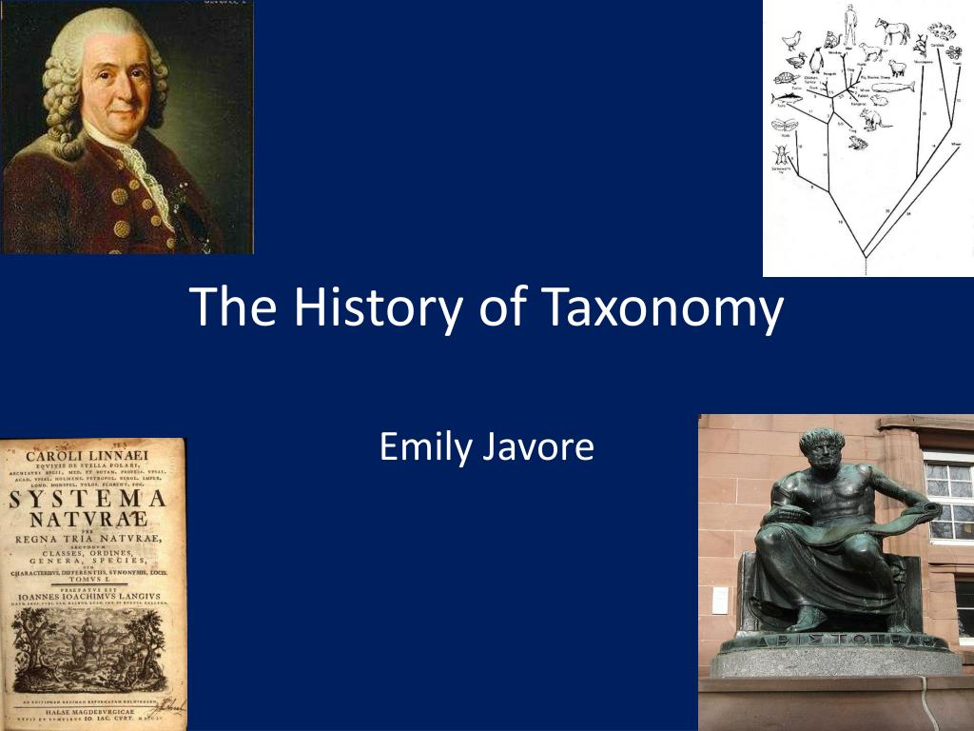
Form and function
In the history of taxonomy, the most common animal names are probably those reflecting species morphology, habitat and sometimes even behaviour. Names referring to morphological features can be further divided into several subcategories such as size – one of the largest beetles ever described is Titanus giganteus (Linnaeus 1771). A name may also reflect the colour of the animal (the black garden ant Lasius niger) or a specific pattern present on the body of the described taxon, like zigzags, dots or stripes (the cowry Cypraea ziczac (Linnaeus 1758).

Slide 22
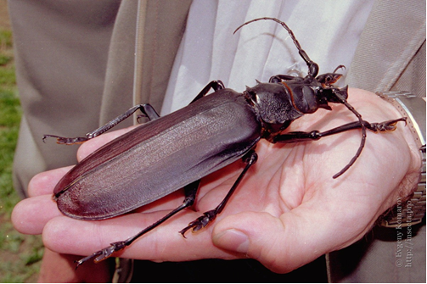
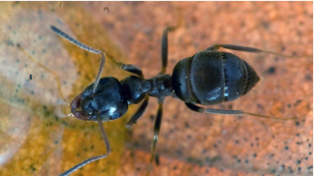
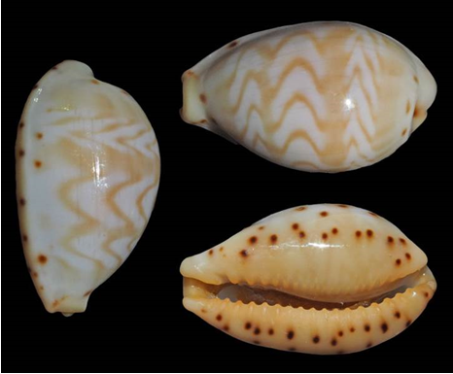

Slide 23
You name the place and I will be there
Knowledge about the distribution of species is very important for the understanding of their biology and ecology. No wonder that there is a series of species named after their type locality or range. The name may point directly the place where the animal was found e.g.,
Sphex zubaidiyacus Augul, 2013 –Hymenoptera
Ammophila duhokensis Augul, Abdoul-Rassoul & Kaddou, 2013- Hymenoptera
Cercotmetus asiaticus Amyot & Serville, 1843 – Hemiptera

Slide 24
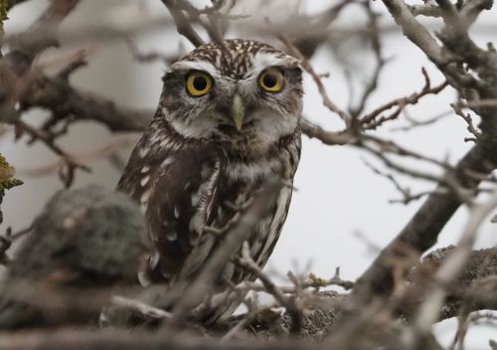
Gods and demons:
Little Owl Athene noctua (Scopoli, 1769)- Aves, to the Greek goddess Athena. In this case it is easy to track the association between the species and its mythic archetype as both Athena and owls are symbols of wisdom; moreover the Little Owl was sacred to Athena.

Slide 25
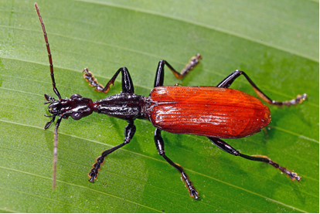
Monsters and cryptids
Legendary or mythical animals can be found in civilizations from various regions of the world and taxonomists find inspirations from them and the related field of cryptozoology. One of the best known is the myth of the Yeti – a mysterious anthropoid cryptid inhabiting the Himalayan Mountains; a carabid beetle was named Agra yeti (Erwin 1982) because of its big feet.
Host name of the species:
Empoasca fabae (Harris, 1841)
Oryzaephilus Ganglbauer, 1899

Slide 26
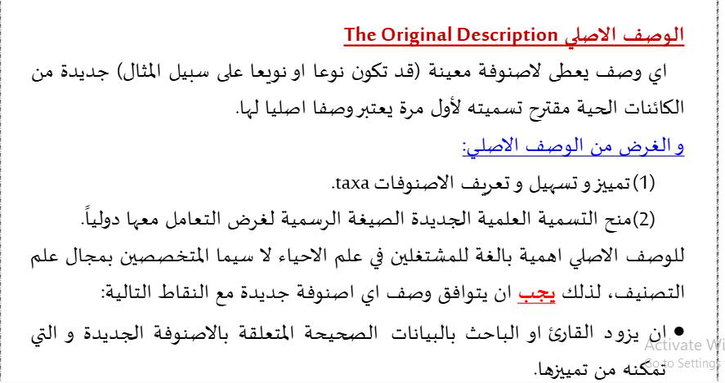

Slide 27
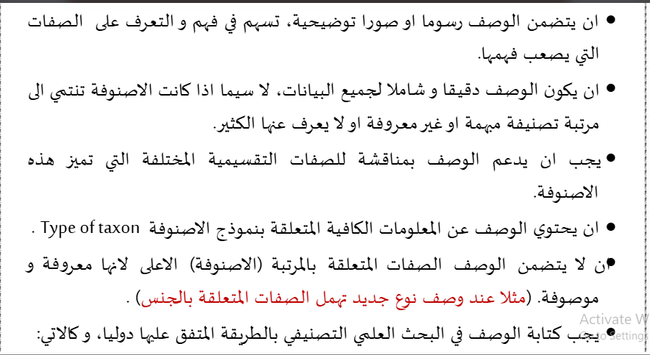

Slide 28
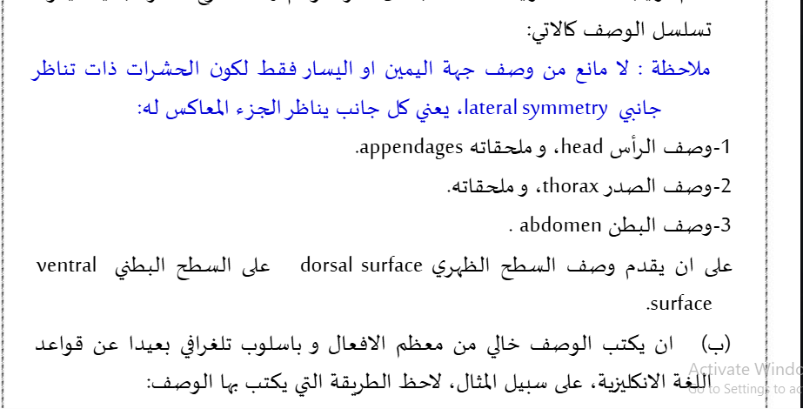

Slide 29
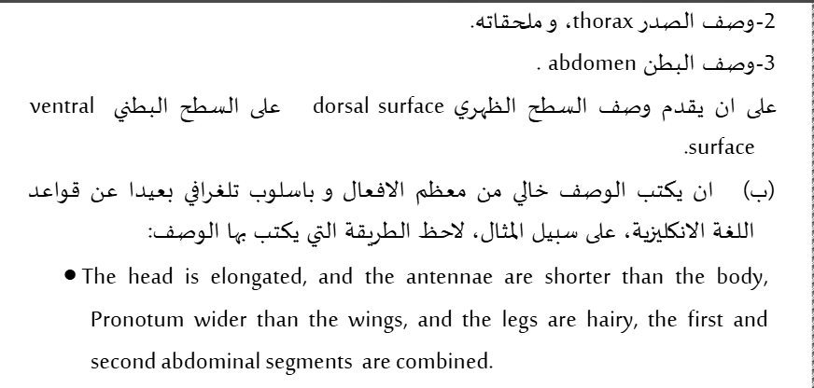

Slide 30
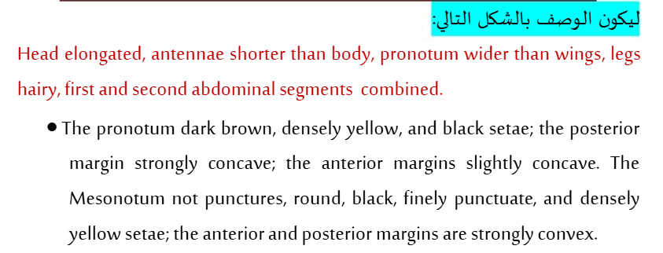
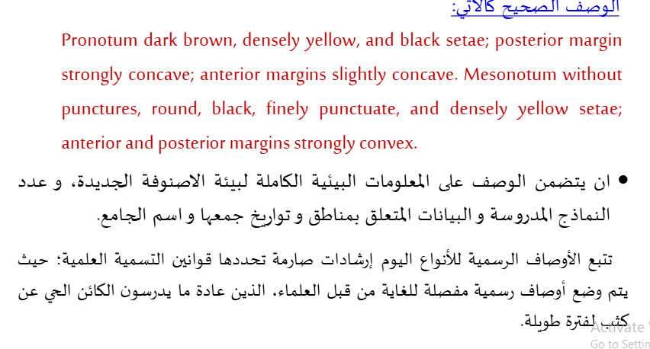

Slide 31
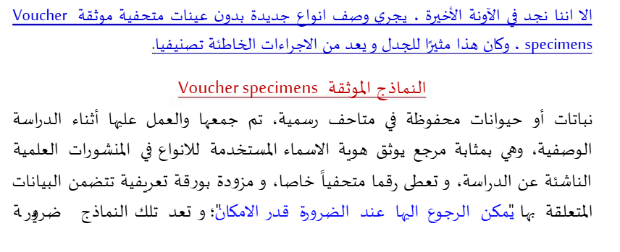

Slide 32
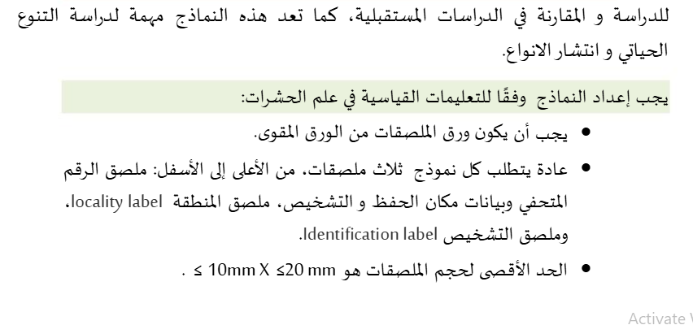

Slide 33
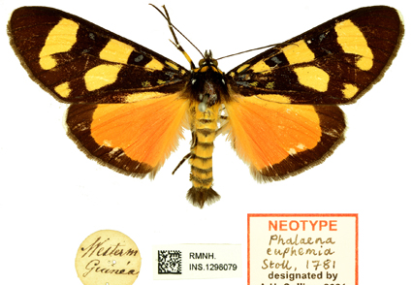
نوع من الأنواع
The Type:
النموذج المثالي: Primary types
النموذج الاصلي الاوحدHolotype
، نموذج القرين المثاليAllotype
، نموذج الرفيق المثاليParatype،
النضير Syntype
النموذج المثالي المنتخب Lecotype
النموذج الحديث المثاليNeotype
النموذج المثالي المشروحPlesiotype

Slide 34
التوصيات
1-ضرورة ايداع العينات التي تسجل لاول مرة للعلم وللمجموعة العراقية في المتاحف.
2-إجراء المزيد من التحريات في مناطق العراق المختلفة وإمكانية الحصول على انواع جديدة مسجل للعراق أو انواع جديدة للعلم.
3-نوصي بإجراء دراسات تصنيفية على المستوى الجزيئي لاستكمال الدراسات المورفولوجية وتسجيل الأنواع العراقية في بنك الجينات.
4-إجراء دراسات بيئية وبيولوجية على الأنواع المنتشرة في العراق.

Slide 35


