Slide 1
Possible Protective Effects of Tirzepatide on Polycystic Ovary Syndrome in Female Rats Model induced by Testosterone Propionate in Comparison to Metformin
By
Noor Zaher
MSD student
Department of pharmacology and Toxicology

Slide 2
Introduction
Polycystic ovarian syndrome (PCOS) is the most common endocrine disorder
among women of reproductive age. The metabolic inefficiency linked to this
syndrome increases the risk of developing type 2 diabetes (T2D), endometrial
cancer, and cardiovascular disease. Tirzepatide a novel dual glucose-dependent
insulinotropic polypeptide (GIP) and glucagon-like peptide-1 (GLP-1) receptor
agonist, has shown significant efficacy in improving glycemic control and
reducing body weight.Given the strong association between insulin resistance,
obesity, and polycystic ovary syndrome (PCOS), tirzepatide may offer therapeutic
advantages beyond current treatment options such as metformin.

Slide 3
Aim of the study
our study aimed to evaluate the possible protective effects of Tirzepatide against testosterone propionate induced PCOS in rats.

Slide 4
Study design
Rats were randomly assigned to five groups (n = 6);
the control group received propylene glycol (0.5 ml oral gavage) daily for 14 days .
Induction group received TP (1 mL/kg/day) for 30 days .
The low and high dose Treatment groups received Tirezpatide (0.88 and 1.32mg/kg/weak, respectively; subcutaneous) for 14 days following the induction of PCOS.
Group V was administered metformin at a dosage of 300 mg/kg/day.

Slide 5
All treatments were administered on a defined schedule, and doses were prepared fresh to ensure stability .During the treatment period, rats were observed daily for general health, and body weights were recorded weakly to monitor health status. Any adverse effects or mortalities were recorded; however, no unexpected deaths occurred outside of study termination plan.
On the day fourty five, the rats were fasted overnight to standardize biochemical measurements, and then anesthetized for sample collection. The animal were anesthesized to ensure a surgical plane of anesthesia for painless procedures.Once deeply anesthetized (confirmed by absence of response to toe pinch), blood samples were collected by cardiac puncture using a sterile syringe.

Slide 6
Approximately 3–5 mL of blood was obtained from each rat and allowed to clot in plain (anticoagulant-free) tubes .The clotted blood was centrifuged at 3000-4000 rpm for 10 min at room temperature to separate the serum and stored at –80°C for further analysis. Immediately after euthanasia, the ovary was harvested and washed in cold PBS for biochemical, molecular, and histological analyses.

Slide 7
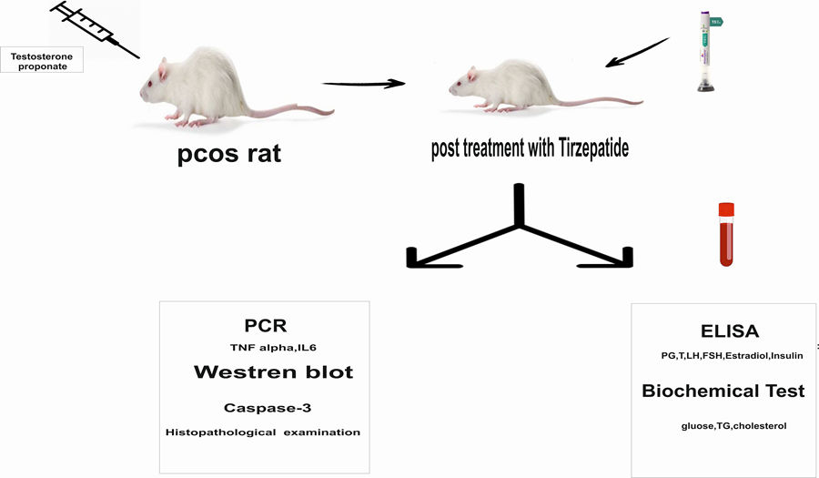

Slide 8
Result / Hormonal effect
The hormonal effect on (gonadotropin and steroid hormones) was significant, especially with the higher dose of tirzepatide, as the hormone levels returned to normal levels after the treatment .

Slide 9
Metabolic effect
Treatment with Tirzepatide at both doses as well as with metformin (300 mg/kg), resulted in marked reductions in serum cholesterol, glucose, insulin levels, and body weight .
Significant decrease occurred with higher dose of tirzepatide (1.32mg).

Slide 10
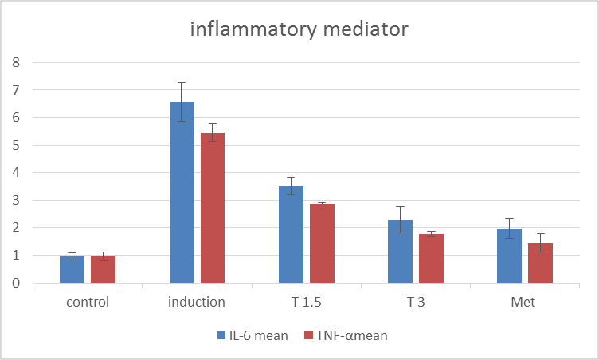
Modulation of Inflammatory Markers

Slide 11
conclusion
This study underscores the prospective therapeutic efficacy of Tirzepatide in the treatment of Polycystic Ovary Syndrome (PCOS), a complex endocrine condition marked by hyperandrogenism, insulin resistance, and anovulation. Tirzepatide addresses various pathophysiological pathways, including insulin resistance, hyperinsulinemia, dyslipidemia, hormonal imbalance, and chronic low-grade inflammation, providing a holistic strategy that may exceed the efficacy of conventional treatments like metformin. Our results indicate that Tirzepatide markedly reduces serum testosterone, enhances LH/FSH ratios, elevates estradiol levels, and reinstates ovulatory function, especially at elevated doses. Furthermore, its metabolic advantages, including enhanced lipid profiles, weight reduction.

Slide 12


