Slide 1


The Relationship between Iron Deficiency Anemia and Glycosylated Hemoglobin in Diabetes Patients
Presented by : Zainab Hilal

Slide 2
Iron's Role in Hemoglobin
Hemoglobin Structure & Iron
Hemoglobin is a metalloprotein in red blood cells, primarily transporting oxygen. It comprises four globin chains, each binding a heme group. The heme group, a porphyrin ring, centrally coordinates a ferrous iron (Fe2+) ion, which reversibly binds oxygen. This iron atom is crucial for oxygen affinity and transport.
Iron, Pancreatic β-Cells, and Diabetes
Iron plays a critical role in pancreatic islet beta-cell function and insulin synthesis. Dysregulation of iron metabolism can impair beta-cell mass and insulin secretion, contributing to insulin resistance. Both iron deficiency and overload are implicated in the pathogenesis and progression of diabetes mellitus.

Slide 3
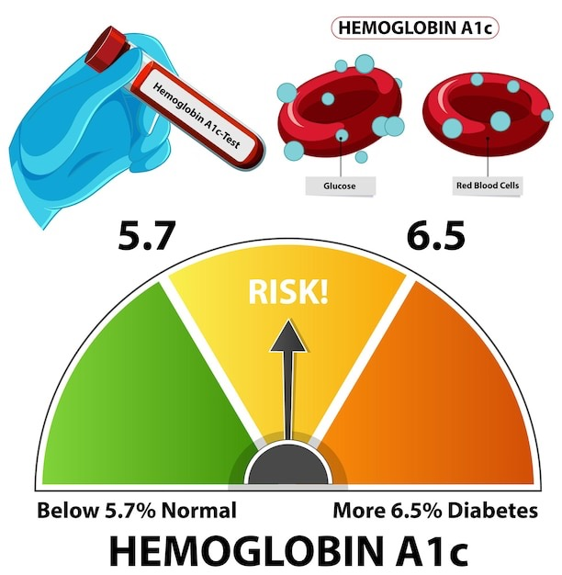
Glycosylated Hemoglobin (HbA1c)
What is HbA1c?
HbA1c is hemoglobin with glucose attached via non-enzymatic glycation of N-terminal valine in the beta chain.
How it Forms
Glucose in serum irreversibly binds to hemoglobin within red blood cells, reflecting average blood glucose levels.
Clinical Significance
HbA1c provides a 2-3 month glycemic control average, crucial for diabetes diagnosis and management.

Slide 4
HbA1c: A Diagnostic Benchmark
1
2
3
s: Indicator Identified
ADA Approves "Gold Standard"
Reflects Average Glucose
Glycosylated hemoglobin recognized for monitoring long-term glucose control in diabetes patients.
American Diabetes Association (ADA) endorsed HbA1c for diagnosis and management.
Measures average blood glucose levels over the preceding 2-3 months effectively.

Slide 5
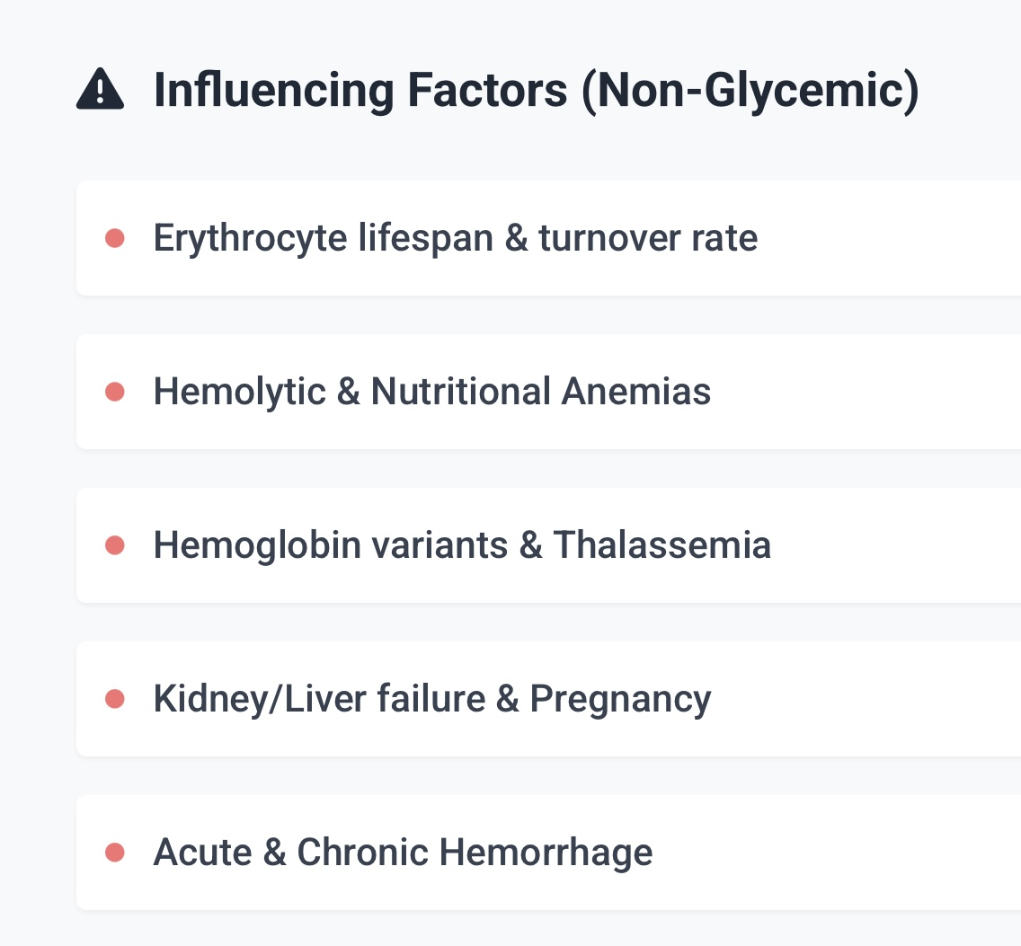

Slide 6
Unmasking the Silent Comorbidity: Anemia in Diabetic Patients
Prevalence
Overlapping Symptoms
Clinical Impact
The coexistence of diabetes and anemia is an increasingly recognized clinical entity, significantly impacting patient well-being. Anemia affects a substantial proportion of diabetic individuals, with prevalence rates ranging from 14% to 45% across diverse ethnic groups globally.
A critical diagnostic challenge arises from the shared symptomatology of diabetes and anemia, including numbness or coldness in the extremities, pale skin, and shortness of breath. These overlapping signs frequently contribute to the underdiagnosis of anemia in diabetic patients.
Anemia is not merely a secondary condition; it negatively affects clinical outcomes, exacerbates fatigue, and significantly diminishes the overall quality of life for individuals with diabetes.
Early detection and proactive management of anemia are therefore indispensable strategies to mitigate its detrimental effects and improve long-term patient outcomes.

Slide 7
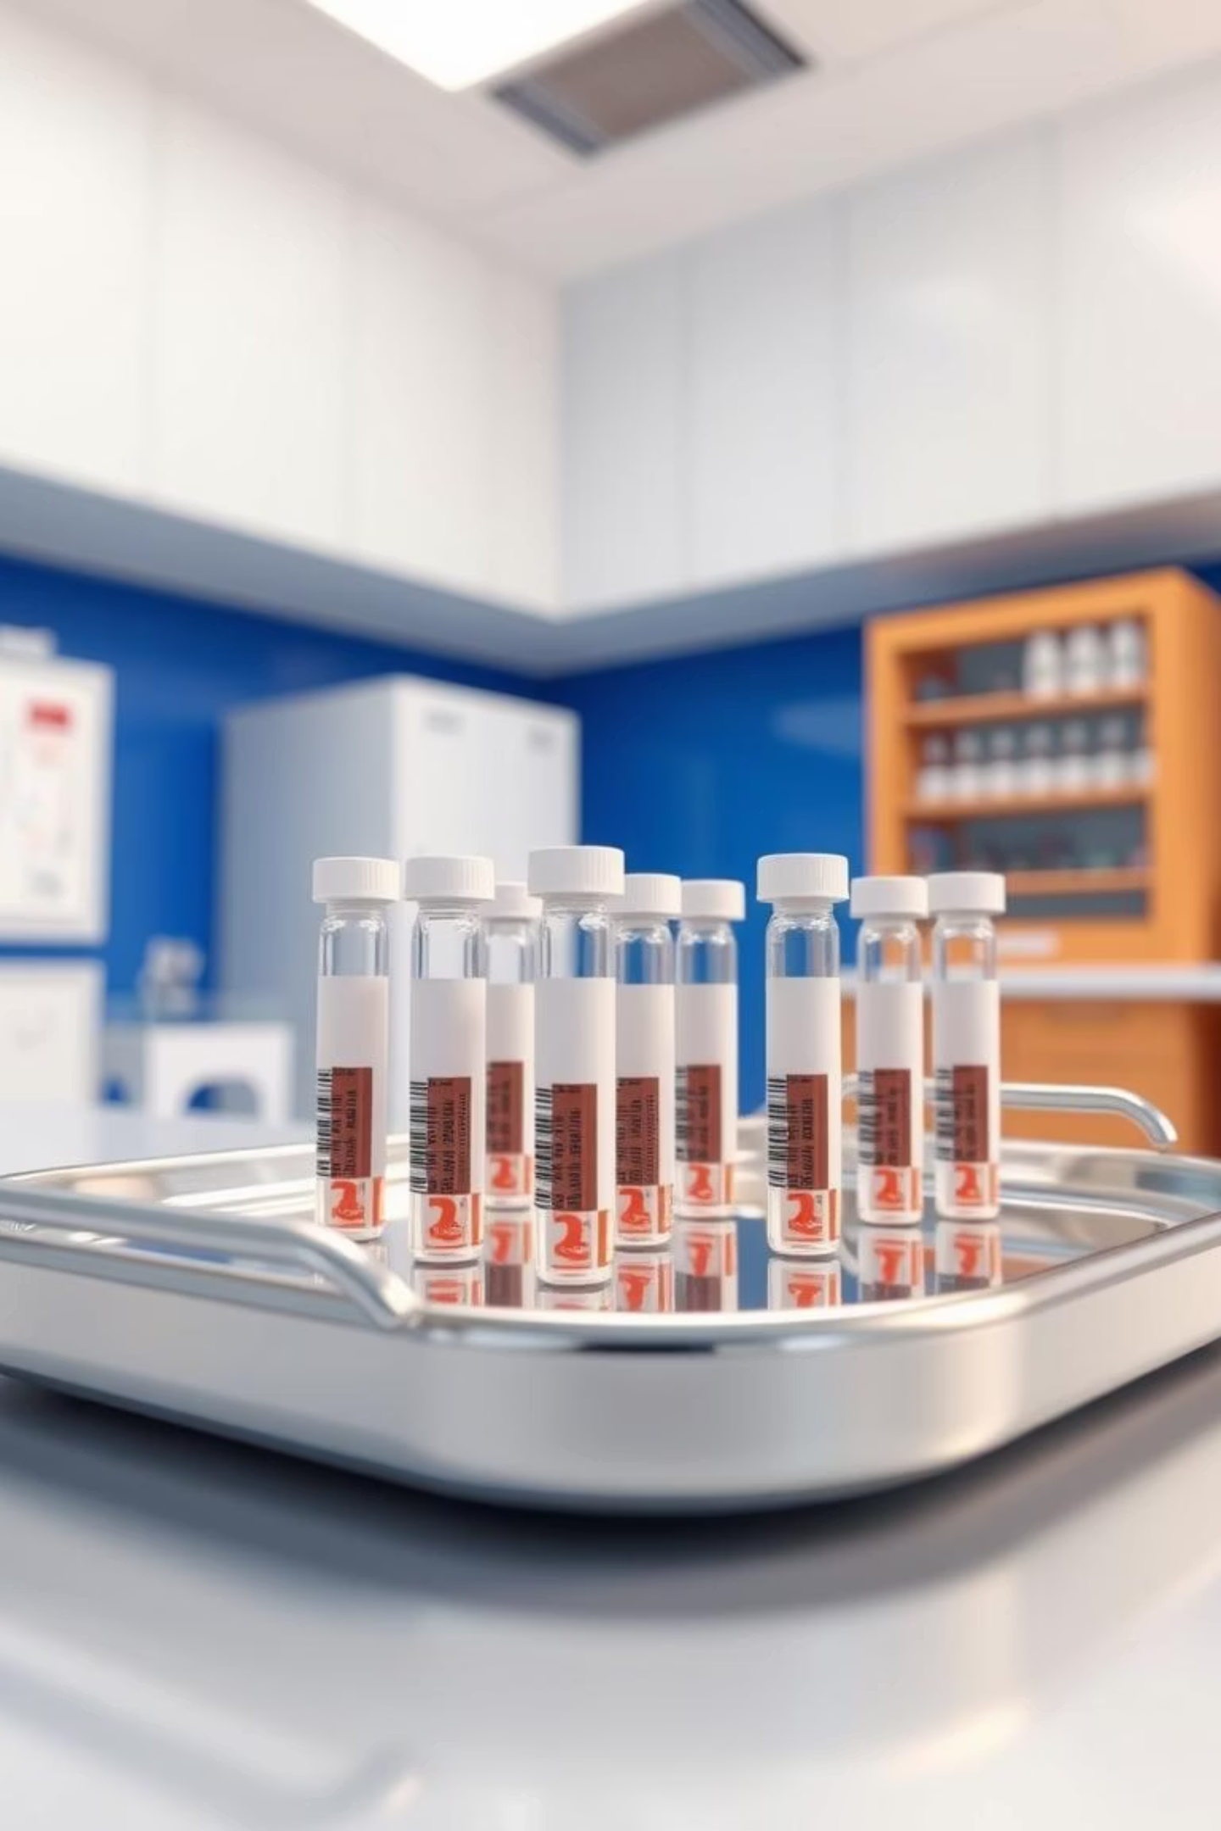
Iron-Deficiency Anemia and HbA1c Levels
.
Individuals with impaired iron metabolism may develop iron-deficiency anemia (IDA),
Iron deficiency anemia (IDA) is a critical factor influencing HbA1c levels. The first correlation study by Horton and Huisman in 1965 highlighted this link. Subsequent research has consistently shown a direct proportionality between IDA severity and its effect on HbA1c.
This means that caution is essential when diagnosing prediabetes or DM in patients with IDA, especially when their HbA1c levels are near the diagnostic threshold. Undiagnosed IDA can lead to misdiagnosis of DM if HbA1c testing is used in isolation.

Slide 8
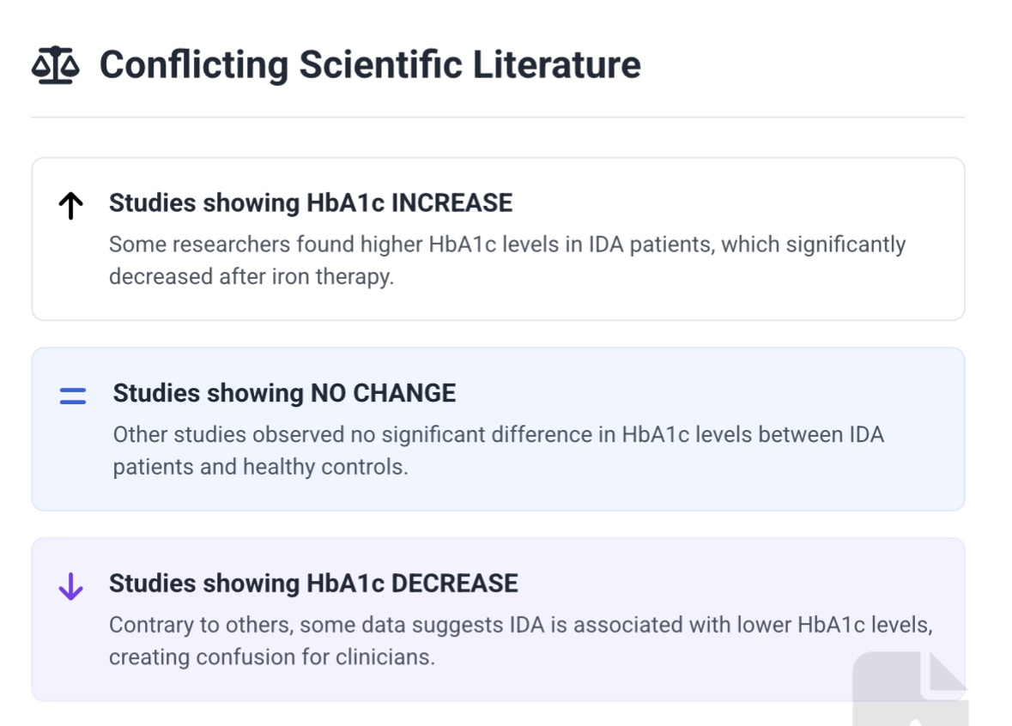

Slide 9
IDA's Influence on Glycemic Status
Iron deficiency anemia (IDA) significantly impacts glycemic status by falsely elevating HbA1c levels. This occurs due to increased erythrocyte lifespan or altered hemoglobin glycation kinetics.

Slide 10



Mechanisms Behind IDA's Influence on HbA1c
Hb Backbone Modification
Delayed Turnover
Longer RBC Lifespan
Iron deficiency may alter Hb structure, increasing glycation sites. This structural change enhances glucose binding affinity.
Reduced erythropoiesis in IDA slows the replacement of glycated Hb. Older Hb molecules accumulate, leading to higher HbA1c.
IDA can extend red blood cell survival time. Longer circulation means more exposure to glucose, increasing glycation.
Previous epidemiological studies have linked IDA-associated hemoglobin depletion with elevated HbA1c. These mechanisms collectively predispose the hemoglobin molecule to a higher rate of glycation, even at constant glucose levels.

Slide 11
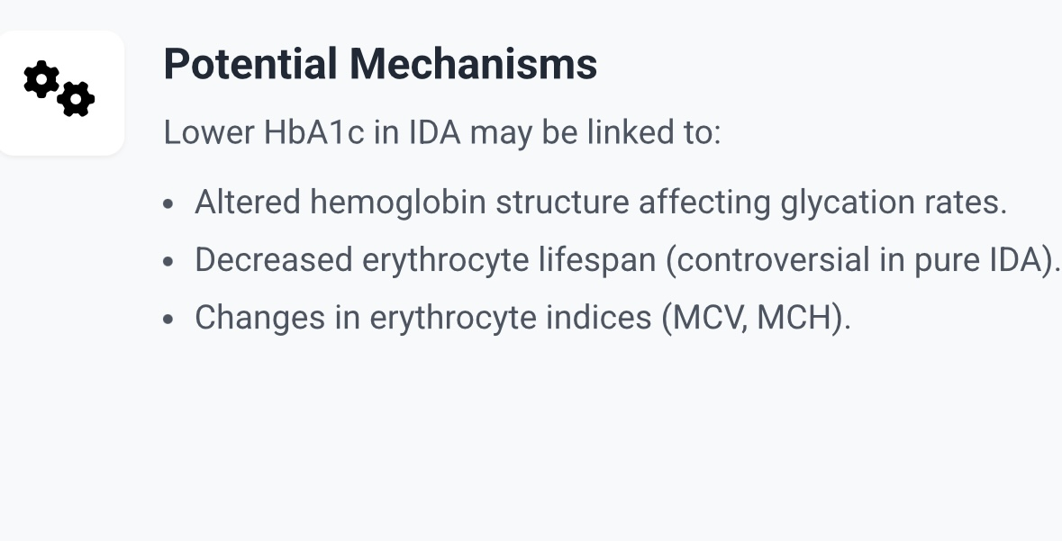

Slide 12
IDA Severity & HbA1c Impact
Diagnostic Caution & Thresholds
IDA affects HbA1c results and this effect is dependent on anaemia degree. These upward changes are statistically significant but they may be not clinically relevant when the overall variability of the HbA1c test is considered. The presence of slight anaemia is likely to have a minor effect on HbA1c levels favouring its use to diagnose diabetes in patients with mild anaemia.
Clinicians must exercise extreme caution when diagnosing prediabetes or diabetes in patients with IDA. Relying solely on HbA1c in such cases risks misdiagnosis and delayed intervention. Consider additional glycemic markers.

Slide 13

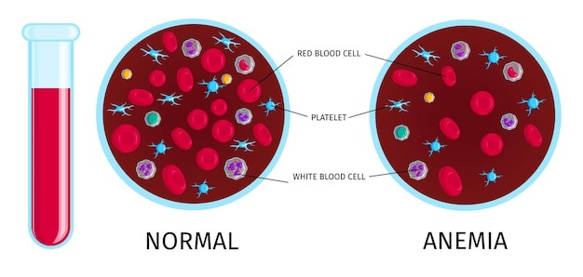
Normal blood (left) vs. anemic blood (right) composition.
Comprehensive Patient Assessment
Accurate HbA1c interpretation necessitates assessing hematological factors and IDA risk. This ensures precise diagnosis and effective management of both diabetes and anemia.

Slide 14
Clinical Implications for Management
Accurate HbA1c Interpretation
Optimized Diabetes Treatment
Improved Patient Outcomes
Iron deficiency anemia (IDA) can falsely elevate HbA1c. This necessitates screening for IDA to prevent misdiagnosis of glycemic control.
Correcting IDA can impact HbA1c values, requiring careful re-evaluation of diabetes therapies. This ensures appropriate and effective treatment strategies.
Addressing IDA alongside diabetes management enhances overall health. This holistic approach leads to better long-term glycemic control and reduced complications.

Slide 15
One study done by Saida Fuad Shnaigat, Baha’a M. Abu Salma, Jerash University, Jerash, Jordan, investigate the relationship between iron
metabolism indicators such as ferritin and transferrin levels and glycosylated
The study employed Pearson correlation coefficients and a multiple linear regression model to quantify the relationships between HbA1c and key iron metabolism indicators, as well as fasting blood sugar.
1
2
Positive Correlation with Ferritin
Positive Correlation with FBS
A significant positive correlation was found between HbA1c and ferritin (Pearson r = 0.33, p=0.001), indicating that higher iron stores are associated with higher HbA1c levels.
HbA1c also showed a strong positive correlation with Fasting Blood Sugar (FBS) (Pearson r = 0.40, p=0.001), as expected for glycemic control.
3
4
Inverse Relationship with Transferrin
Inverse Relationship with MCV
An inverse relationship was observed between HbA1c and transferrin (Pearson r = 0.33, p=0.01), suggesting that higher iron transport capacity is linked to lower HbA1c.
Similarly, HbA1c had an inverse relationship with Mean Corpuscular Volume (MCV) (Pearson r = 0.37, p=0.001), implying that smaller red blood cell size correlates with higher HbA1c.
The multiple linear regression model explained 76% of the variance in HbA1c, confirming the significant influence of these independent variables.

Slide 16


Implications of Iron Status on HbA1c Interpretation
The study's findings underscore the critical need to consider iron status when interpreting HbA1c levels in diabetic patients. Abnormal iron metabolism can significantly influence HbA1c readings, potentially leading to misdiagnosis and suboptimal diabetes management.
Risk of Misclassification
Iron deficiency anemia (IDA) can lead to an overestimation of HbA1c, potentially classifying a patient as having poorer glycemic control than they actually do, or vice versa.
Impact on Treatment
Inaccurate HbA1c readings can result in inappropriate treatment adjustments, leading to either overtreatment or undertreatment of diabetes.
Pancreatic Beta-Cell Damage
Excessive iron load can damage pancreatic beta cells, promoting insulin resistance and contributing to the development of type 2 diabetes.
Red Blood Cell Survival
In chronic IDA, prolonged red blood cell survival in circulation can lead to higher HbA1c readings, as there is more time for hemoglobin to become glycated.

Slide 17



Ferritin, Inflammation, and Diabetes Risk
The positive relationship between HbA1c and ferritin levels observed in this study aligns with previous research suggesting that elevated serum ferritin, often an acute-phase reactant, plays a role in insulin resistance and type 2 diabetes development.
Inflammation Link
Increased Diabetes Risk
Iron Overload
Serum ferritin rises during inflammation, which can impair insulin release and glucose metabolism, contributing to higher HbA1c values.
Elevated serum ferritin levels have been consistently linked to a higher risk of developing type 2 diabetes in various populations.
Studies indicate that excess body iron can contribute to the pathogenesis of insulin resistance and the development of type 2 diabetes.
These findings emphasize the importance of considering ferritin levels not just as an indicator of iron stores, but also as a potential marker for metabolic dysfunction and diabetes risk.

Slide 18
Conclusion and Future Directions
This study confirms the significant impact of iron deficiency anemia on HbA1c levels and highlights the necessity of considering iron status in diabetes management. Correcting IDA before making diagnostic or therapeutic decisions based solely on HbA1c is crucial.
1
2
Adjusting HbA1c
Optimizing Metabolic Control
Appropriate methods to adjust HbA1c in the presence of anemia are needed to improve diabetes monitoring and prevent complications.
Demonstrating how iron deficiency disrupts glucose homeostasis can lead to opportunities for optimizing metabolic control through iron repletion.
3
4
Ferritin Level Adjustment
Future Research
Diabetic patients' treatment plans should incorporate ferritin level adjustment, especially in those with anemia, to help reduce HbA1c levels.
As an observational study, causality cannot be determined. Prospective and clinical studies are required to further elucidate the complex relationships between HbA1c, ferritin, transferrin, and MCV.
The study's strength lies in comparing diabetes, prediabetes, and non-diabetes groups across varying ages.

Slide 19
The Critical Impact of Anemia on Blood Glucose Monitoring
Low Haemoglobin & Haematocrit (HCT)
1
Anemia, characterised by reduced haemoglobin and haematocrit levels, can profoundly compromise the accuracy of self-monitoring blood glucose (SMBG) systems.
Hyperglycaemia Risk
2
High HCT levels, conversely, can lead to artificially low glucose readings, significantly increasing the risk of undetected hyperglycaemia.
Hypoglycaemia Risk
3
When HCT is low, some SMBG devices may display glucose readings that are falsely elevated, potentially leading to excessive insulin administration and dangerous hypoglycaemic episodes.
Device Variability
4
SMBG devices exhibit varying degrees of sensitivity to HCT fluctuations. While some are only accurate within a narrow HCT range (approximately 30–55%), others maintain reliability even at very low HCT levels.
Given that anemia and HCT values can differ significantly among patient populations, it is paramount to ensure that individuals, especially those with diabetes, utilise a glucose monitor precisely calibrated for safe and accurate readings in their specific haematological context.

Slide 20


