Slide 1
Nanomicelles
Presented by
Ahmed Ibrahim Ahmed

Slide 2
Nanomicelles
Micelles are amphiphilic colloidal structures having a particle diameter ranging from 5 to 100 nm, as shown in figure (1). Micelles are molecules having two regions of different affinities for water. The amphiphilic molecules forming micelles associate at certain temperatures and concentrations.

Slide 3
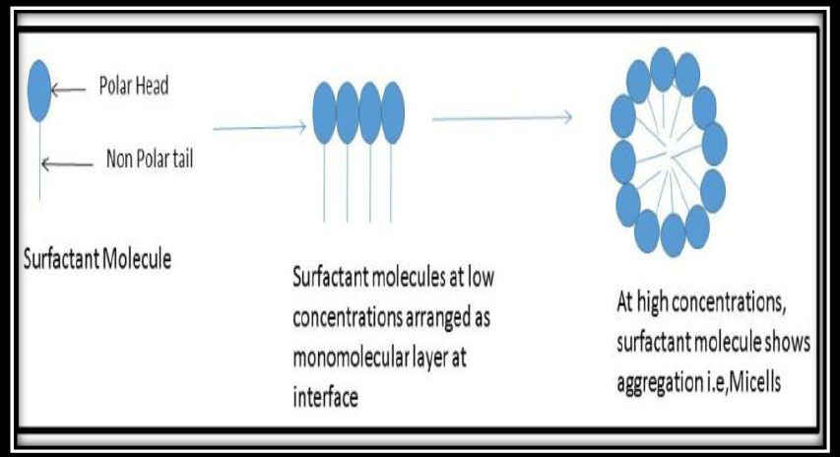
Figure (1): structure of nanomicelles(1).

Slide 4
The critical micelle concentration is the concentration at which aggregation begins and the micelles are formed as shown in figure (2). The number of monomer molecules forming a micelle is known as the aggregation number of the micelle. The aggregation of the amphiphilic molecules leading to the formation of micelles occurs due to the removal of the hydrophobic fragments of the micelles from the aqueous environment and the formation of hydrogen bonds in water .

Slide 5
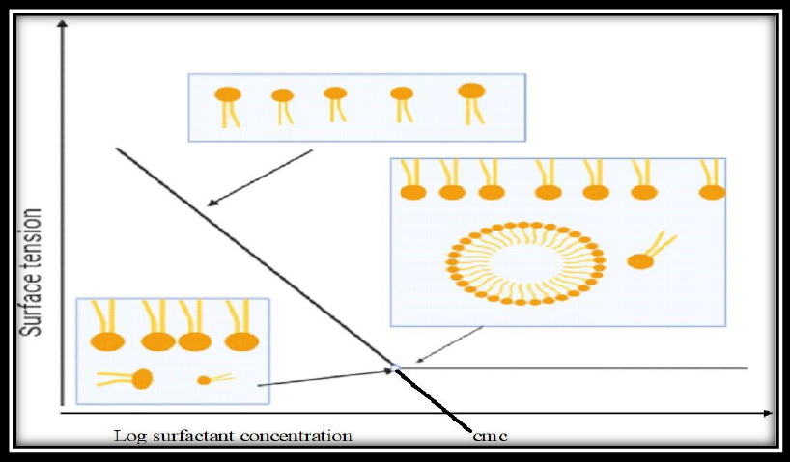
Figure (2): Critical Micelles Concentration(2).

Slide 6
Nanomicelles are used with main purpose is to solubilize hydrophobic compound(1) due to having lipophilic portion of monomer.
Inner core of monomer prevent the compound from degradation(1).
Outer core of nanomicelles is hydrophilic that modulate the pharmacokinetic properties of drug compound due to increasing solubility(3).

Slide 7
Advantages of nanomicelles
1. Nanomicelles formulation prevents the drug from harsh environment so, reduces the Chances of drug degradation(2).
2. It is suitable carrier for delivery of hydrophobic drugs(2).
3. In transdermal drug delivery drug passes through coenocytes along
with keratinous fibers in stratum cornea so, lipophilic drug having
tendency to passed through it, so also suitable for transdermal drug
delivery(4).
4. Risk of adverse effects is low(4).
5. There is no irritation or reduces irritation(4).
6. Ocular and transdermal bioavailability is high through nanomicelles carrier(4).

Slide 8
Limitations
Nanomicelles are useful in various aspects but also have limitations,
such as if micelles get diluted and given intravenously, equilibrium shifts towards an unlimber state that leads to dissociation. However, this problem is overcome by cross-linking the micelles through covalent cross-linking. There are also various challenges in scaling up formulations from a lab scale to a large scale that must be addressed(2).

Slide 9
Types of nanomicelles
A. Surfactants are amphiphilic molecules which having hydrophilic head and hydrophobic tail.
The head of surfactant molecules have charge
which may either anionic or cationic, dipolar or zwitterionic, or non-charged / nonionic. Anionic surfactants: sodium dodecyl sulfate (SDS),
Cationic surfactant: dodecyltrimethylammonium bromide (DTAB).

Slide 10
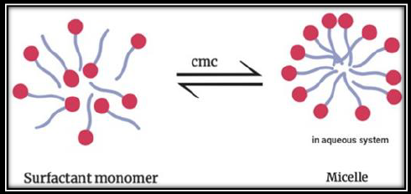
At lower concentration surfactant adsorb on
the surface or interfaces that will change by reducing the surface or interfacial energy.
Above the critical micelle concentration (CMC) surfactant will form micelles as shown in figure (3).
Figure (3): CMC of surfactant monomer to nanomicelles(2).

Slide 11
B. polymeric Nanomicelles
Conjugation of micelles with polymers is used for incorporating lipophilic drugs.
Block copolymer, as can be seen in Figure (4), has an amphiphilic nature and consists of two distinct regions of hydrophilic and hydrophobic
segments.

Slide 12
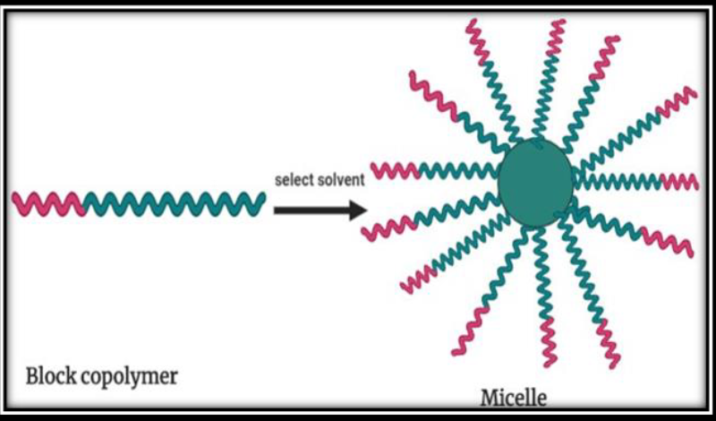
Figure (4): Block copolymer with micelle.

Slide 13
Polymeric micelles are the most useful technique to prepare sustained release micelles.
Polymers having very low CMC (< 0. 1 μg/ml) is used for enhance the circulation time before the micelle degrades.
If the polymer or surfactant has a CMC lower than 0. 1 μg/ml, concentrations as low as 5mg/ml may be used to prepare a micelle formulation in order to counter the dilution effects in the blood.

Slide 14
Polymeric micelles have long circulating characteristics and significant tumor accumulation which provide an important use in tumor targeting . In contrast with the surfactant micelles, polymeric micelles are usually more stable, have a lower critical micelle concentration (CMC), a slower dissociation rate and achieving high drug accumulation at the target

Slide 15
Micellization
Amphiphilic block copolymer shows various behavior in aqueous media and in organic solvents. When an amphiphilic block copolymer is dissolved in aqueous that is a thermodynamically good solvent for hydrophilic block portion and a precipitant for the lipophilic block portion, the block copolymer chains spontaneously assemble into polymeric micelles.

Slide 16
Mechanism of micellization
In the process of micellization, self-association of monomers will occur due to the decrease in surface free energy of the system, as the concentration of surfactant increases, the micellization process gets started, as shown in figure (5). A decrease in surface free energy is promoted by the removal of hydrophobic fragments from the aqueous environment and the formation of micelles with hydrophilic segments that interact with the surrounding aqueous system(5).

Slide 17
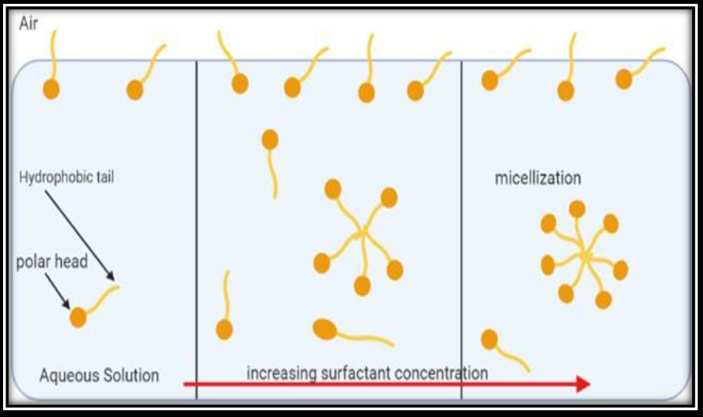
Figure (5): Micellization occurs head and tail oriented according to
outer aqueous system.

Slide 18
Method of preparation of nanomicelles
Direct dissolution method
Dialysis method
Solvent Evaporation Method
Lyophilization method
Oil In Water Emulsion (O / W)

Slide 19
Direct dissolution method
This is used for dissolving the polymer with the drug in aqueous solvent media. These polymers have high water solubility.
It requires heating of the aqueous medium to reach micellization through dehydration of the core-forming part (6).
In this method process steps as shown in figure (6).

Slide 20
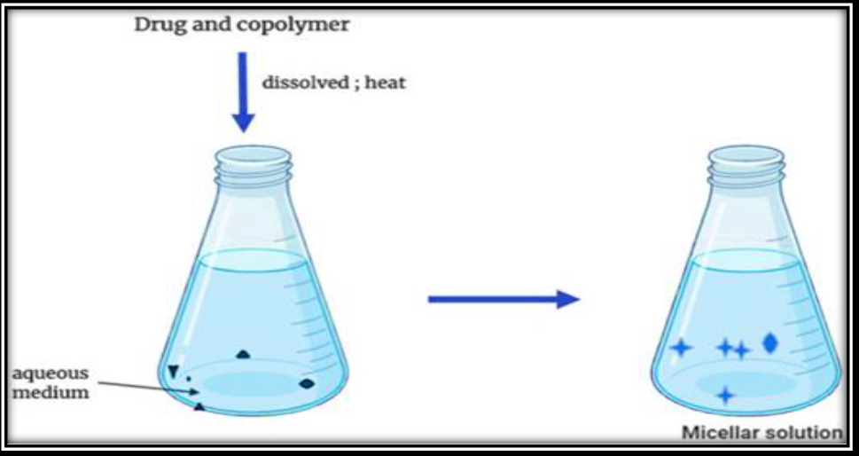
Figure (6): Direct Dissolution Method

Slide 21
Dialysis method
In this method, micelles are prepared from amphiphilic copolymers, which have a low solubility. This method is also used for drug loading in copolymers that require common organic solvents such as dimethylsulfoxide
(DMSO), N-dimethylformamide (DMF)….

Slide 22
While using water-miscible organic solvent, the copolymer can be dialyzed against aqueous medium (water) to generate micelles because of the slow removal rate of organic solvent as shown in figure (7).

Slide 23
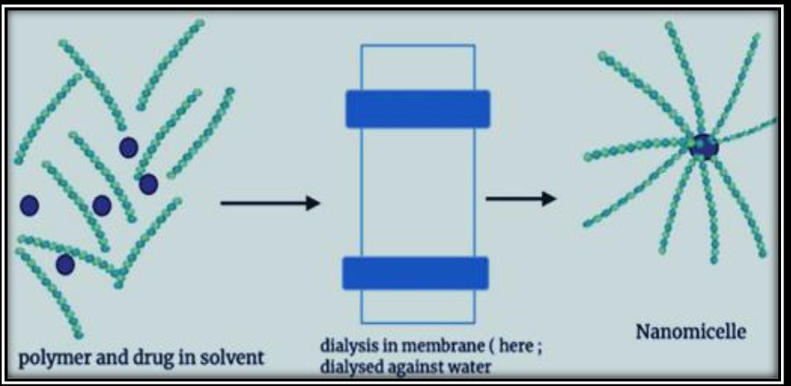
Figure (7): Dialysis method.

Slide 24
Solvent Evaporation Method
Block copolymer and drug (active agent) are dissolved in common solvent or mixture of two miscible solvent. Drug – copolymer film is formed upon stirring and drying the mixture. When the film is reconstituted with warm water or buffer; micelles are formed(7).

Slide 25
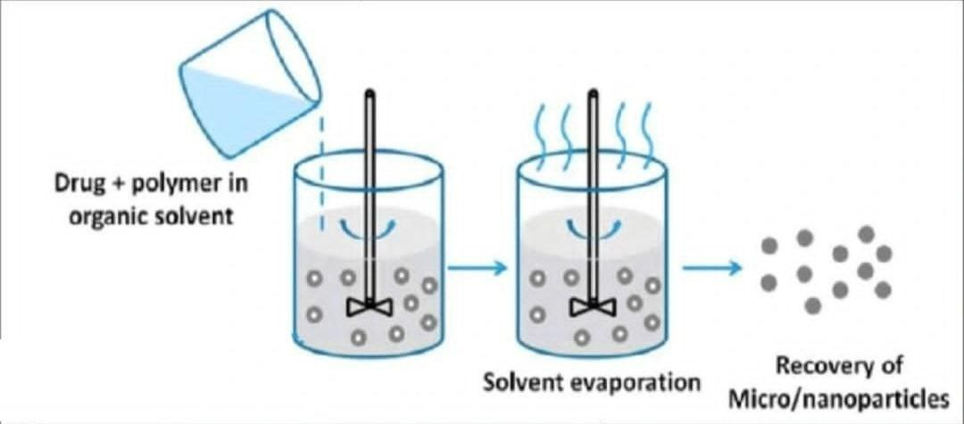
Figure (8): Solvent Evaporation Method.

Slide 26
Lyophilization method
This method is also known is “FREEZE DRYING” process. This method is one step process method. Lyophilization method involves dissolution of both copolymer and the drug mixture of aqueous and organic solvent. To get drug loaded mixture above mixture is reconstituted see figure (9). Micelles which are produce by this method they have enough shelf life along with high water dispersibility.

Slide 27
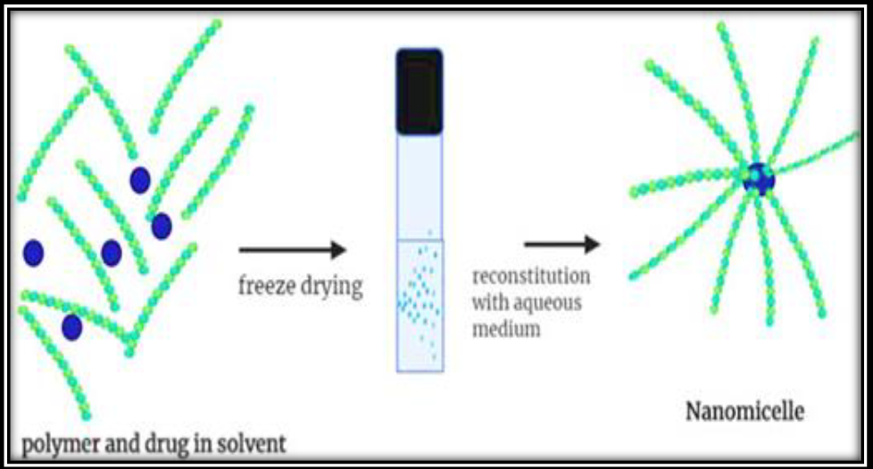
Figure (9): Lyophilization Method.

Slide 28
Oil In Water Emulsion (O / W)
Physical entrapment of lipophilic drug is also obtained by oil in water (O/W) emulsion. Here, non-water-miscible organic solvent is used such as dichloromethane, ethyl acetate. Nanomicelles preparation by oil/water emulsion Mixture contain copolymer / drug / volatile – non water miscible solvent is adding rapidly along with stirring with or without surfactant see figure (10).

Slide 29
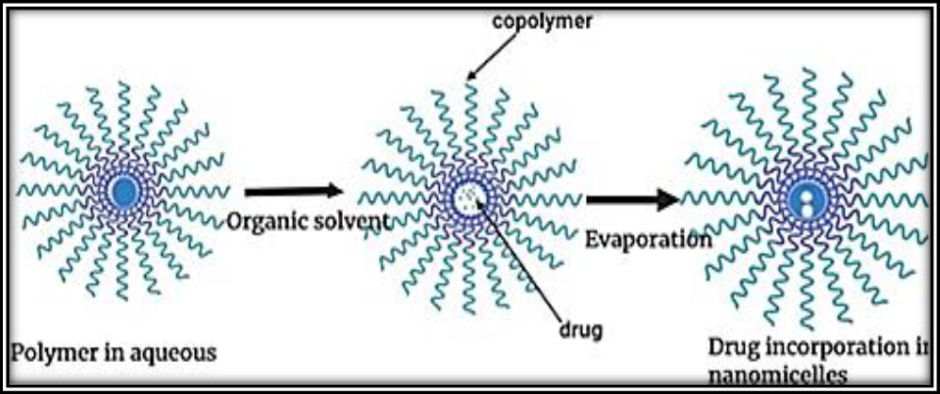
Figure (10): Oil in Water Emulsion method

Slide 30
Applications of nanomicelles
1. Enhancing solubility
2. Formulations of antifungal agents
3. Passive targeting
4. Ocular drug delivery

Slide 31
Enhancing solubility
Nanomicelles show excellent ability to load a large number of hydrophobic drugs.
Low solubility limits the drug dissolution rate and results in erratic absorption patterns.
The micelles’ inner hydrophobic core could entrap hydrophobic drug molecules and a hydrophilic outer shell layer extends outwards to maintain the water solubility.

Slide 32
Formulations of antifungal agents
Drug is successively incorporated into various types of polymers and formulate the nanomicelles which will improve the solubility and permeability. Their toxicity is low and have a more bioavailability.

Slide 33
Passive targeting
In anticancer formulation for tumor chemotherapy, polymeric nanomicelles are used for passive targeting ,Polymeric micelles are being used for anticancer because of having low chances of adverse effects and selectively concentrate at cancer cells or tissues.

Slide 34
Ocular drug delivery
Eyes have complex anatomy and physiology that restrict drug entry at the desired or targeted site.
Nanomicelles are used to deliver intraocularly for improvement of corneal permeability and also to increase ocular bioavailability.

Slide 35
References
1. Vadlapudi AD, Mitra AK. Nanomicelles: an emerging platform for drug delivery to the eye. Therapeutic delivery. 2013;4(1):1-3 .
2. Patel M, Solanki A, Nasit M. Comprehensive Review On Nanomicelles Drug Delivery System. The Journal of Pharmaceutical Sciences and
Medicinal Research. 2021;001 .

Slide 36
References
3. Mallya P, DV G, Mahendran B, Bhavya M, Jain V. INTERNATIONAL JOURNAL OF RESEARCH IN PHARMACEUTICAL SCIENCES. 2020 .
4. Kunjumon S, Krishnakumar K, Nair S.Nanomicelles Formulation: In Vitro Anti-Fungal Study. Int J Pharm Sci Rev Res. 2020;62:78-81.

Slide 37
References
5. Imran M, Shah MR. Amphiphilic block copolymers–based micelles for drug delivery. Design and Development of New Nanocarriers: Elsevier; 2018. p. 365-400 .
6. Liu J, Lee H, Allen C. Formulation of drugs in block copolymer micelles: drug loading and release. Current pharmaceutical design. 2006;12(36):4685-701 .

Slide 38
References
7. Su M, Su Z. Effects of Solvent Evaporation Rate and Poly (acrylic acid) on Formation of Poly (ethylene oxide)-block-polystyrene Micelles from Emulsion. Macromolecules. 2014;47(4):1428-32 .

