Slide 1


تقيم كلية الصيدلة /جامعة بغداد
وحدة الشؤون العلمية الحلقة النقاشية الموسومة
The advance in the management of type 1 diabetes
نور كاظم محمد جواد
طالبة الدكتوراه /فرع الصيدلة السريرية
يوم الخميس المصادف 27-2-2025
الساعة: التاسعة والنصف
قاعة البيروني

Slide 2
Introduction
Type 1 diabetes mellitus (T1DM) is the most common autoimmune chronic disease in young patients.
It is caused by autoimmune destruction of pancreatic B-cells
Complications associated with diabetes are life-threatening and the current standard of care for T1DM still life-long insulin injections.

Slide 3
Treatment Options for Type 1 Diabetes
Currently, no real cure exists for diabetes, and daily insulin injections remain the standard of care for patients with T1DM.
Since the discovery of insulin more than 100 years ago, vast advances in treatments have improved care for many people with type 1 diabetes.
Ideally, a viable treatment for T1DM would
restore both insulin production and secretion regulation by glucose.

Slide 4
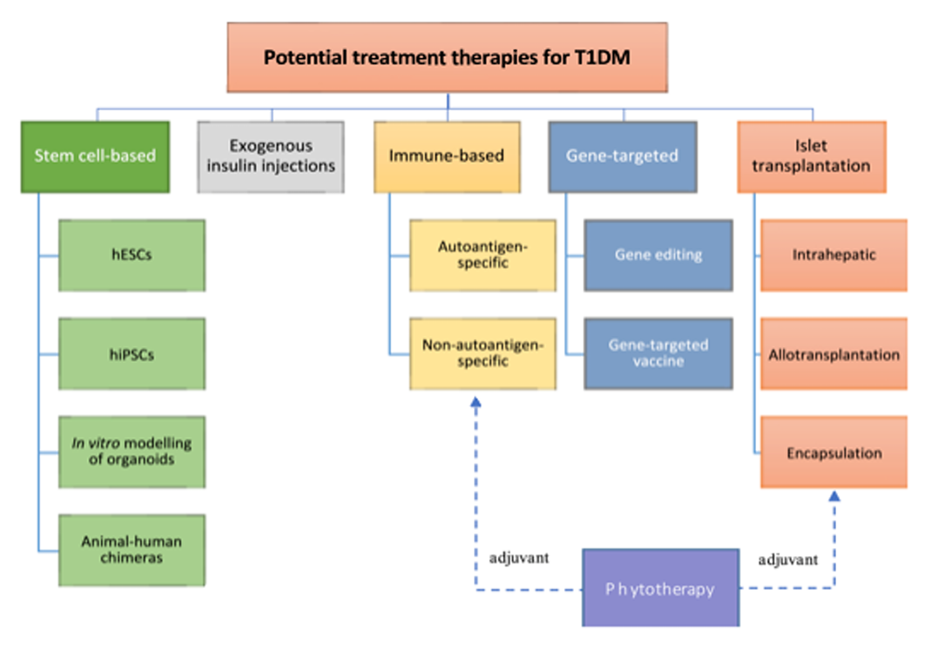

Slide 5
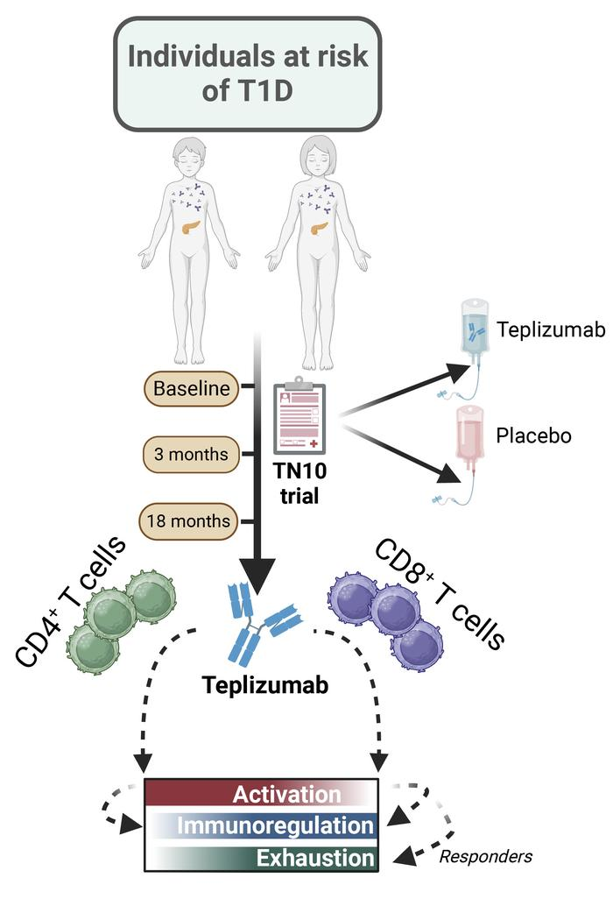
Type 1 Diabetes Prevention
Immunotherapy for β cell preservation
Teplizumab is a humanized monoclonal antibody against the CD3 molecule on T cells.
It is thought to modify CD8 positive T lymphocytes, key effector cells that mediate β cell death and preserves regulatory T cells.

Slide 6
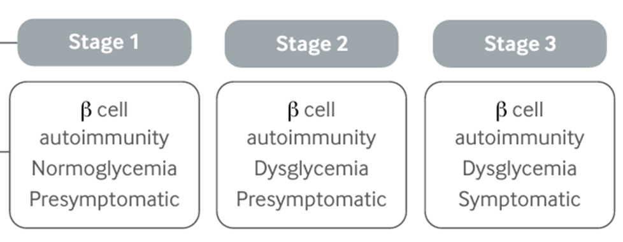
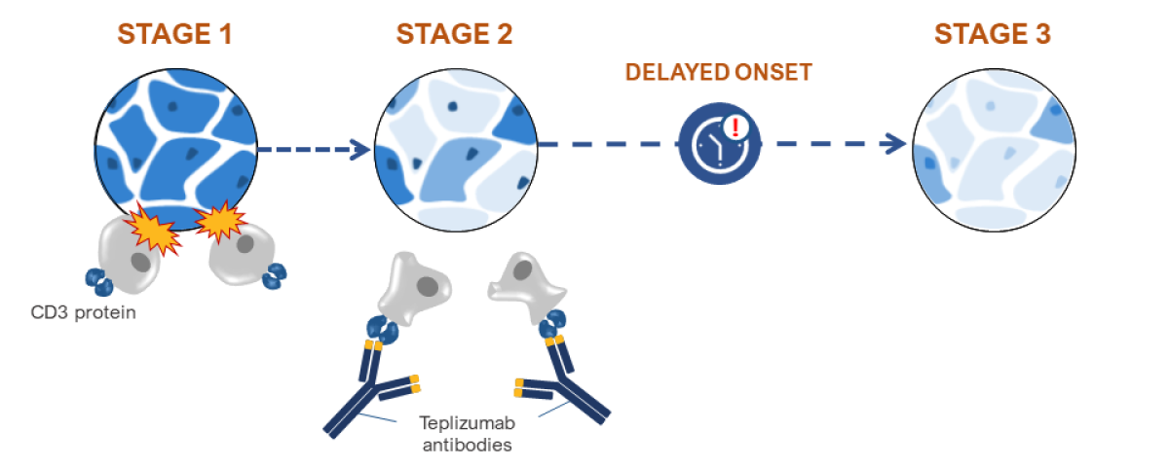
Teplizumab

Slide 7
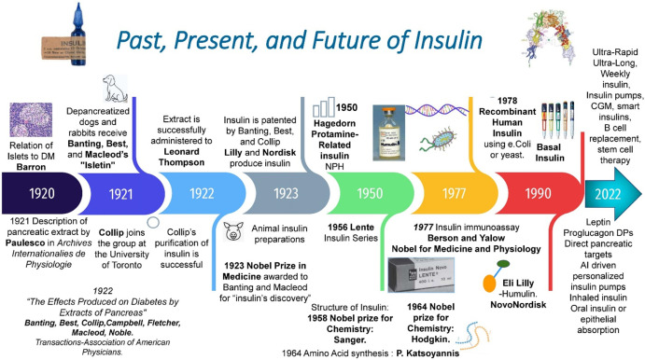
Insulin Therapy

Slide 8
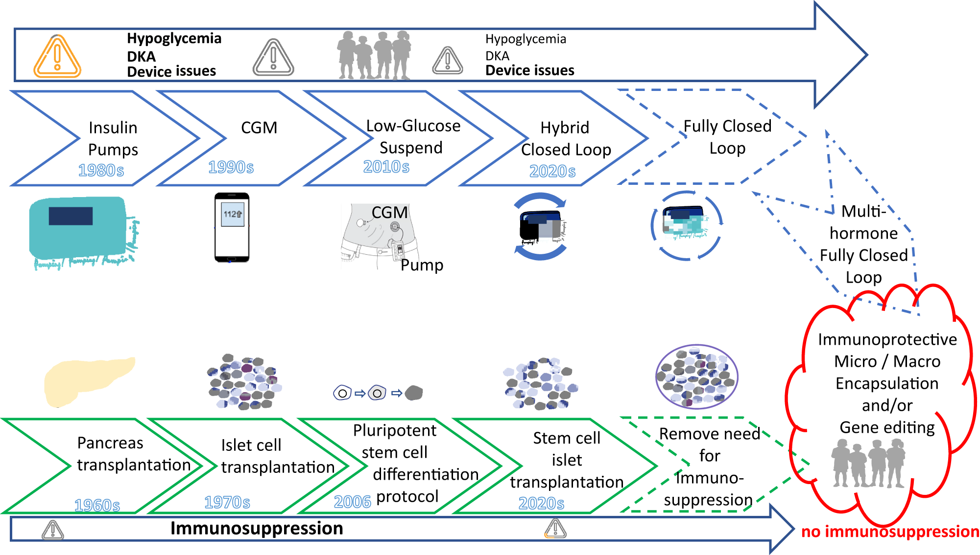

Slide 9
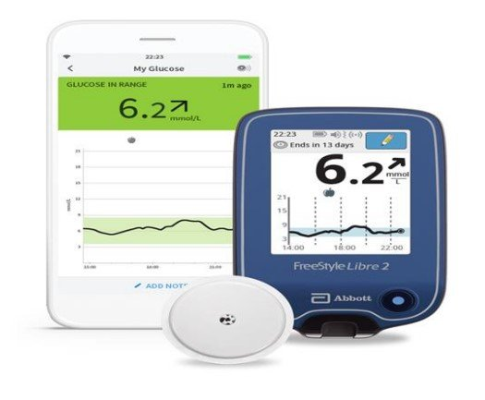
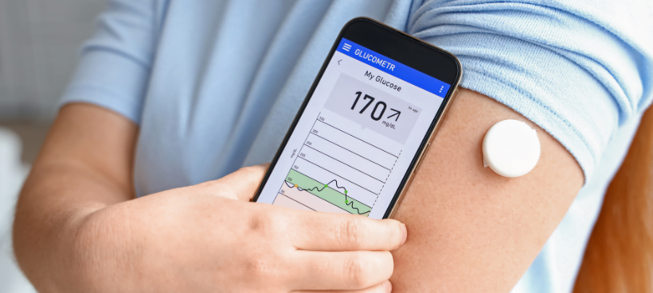
Advance in Insulin Therapy
Advances in monitoring
Continuous glucose monitoring (CGM):sensors uses interstitial fluid glucose concentrations to estimate blood glucose.
Two types of CGM are available.
Real time CGM: provides a continuous stream of glucose data to a receiver, mobile application, smart-watch, or pump.
Intermittently scanned CGM: needs to be scanned by a reader device or smartphone.

Slide 10
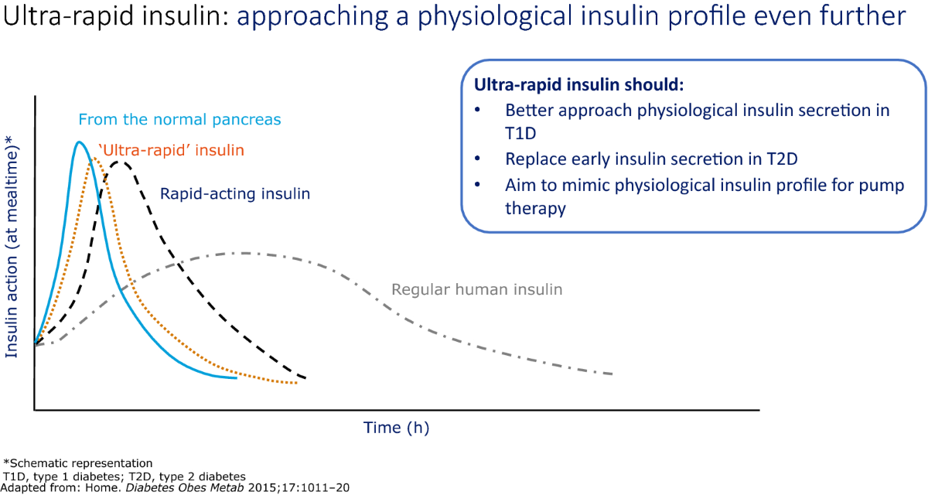
Ultra-rapid acting insulin

Slide 11

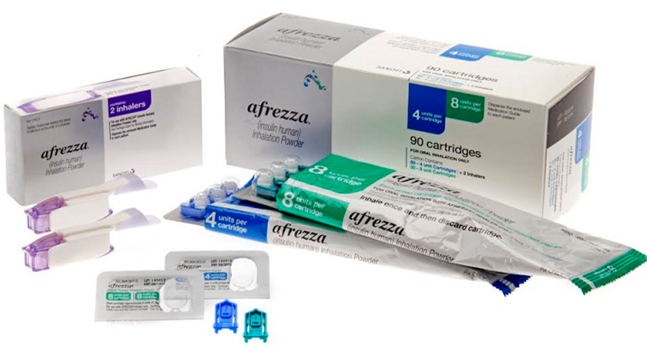
Inhaled Insulin

Slide 12
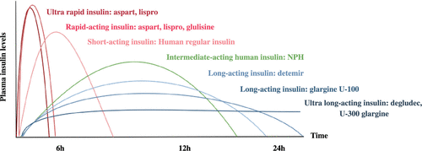

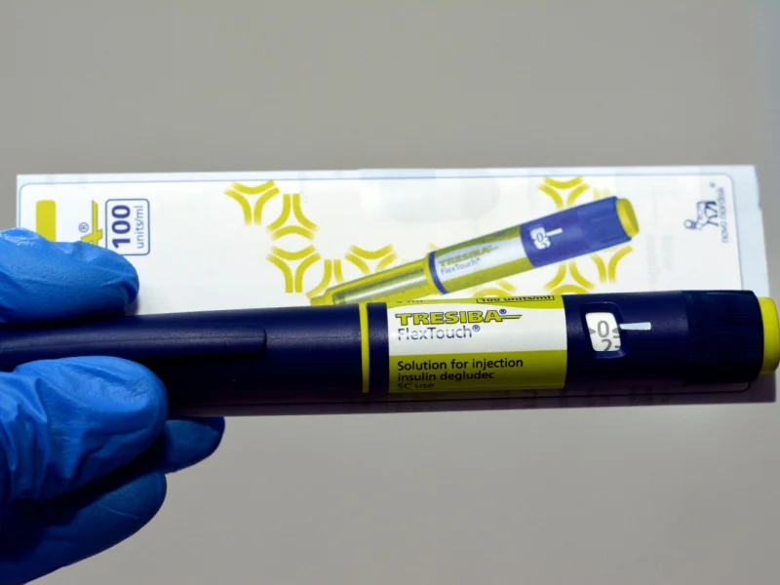
Ultra-long acting insulin

Slide 13
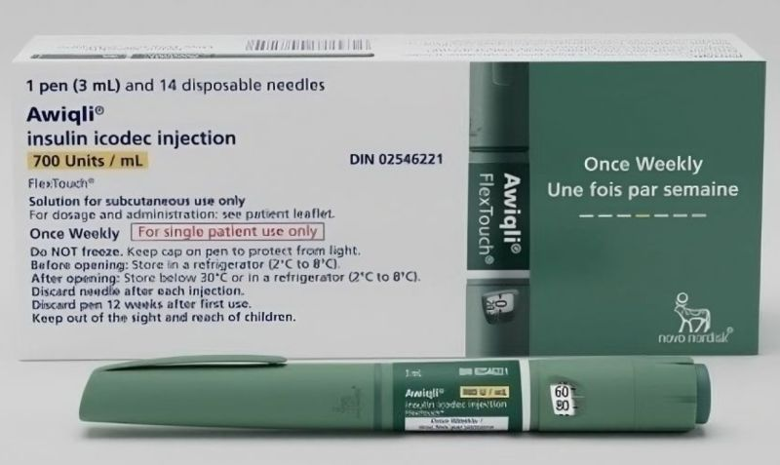
Once weekly insulin
An FDA committee voted against recommending insulin icodec to improve glycemic control in type 1 diabetes.
Concerns over hypoglycemia risk and lack of data on risk mitigation were discussed.

Slide 14
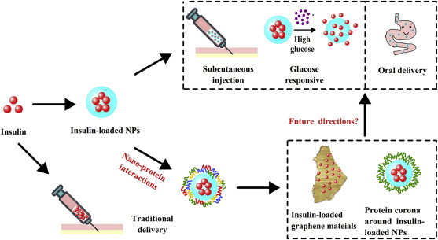
Nanoparticle Technology

Slide 15
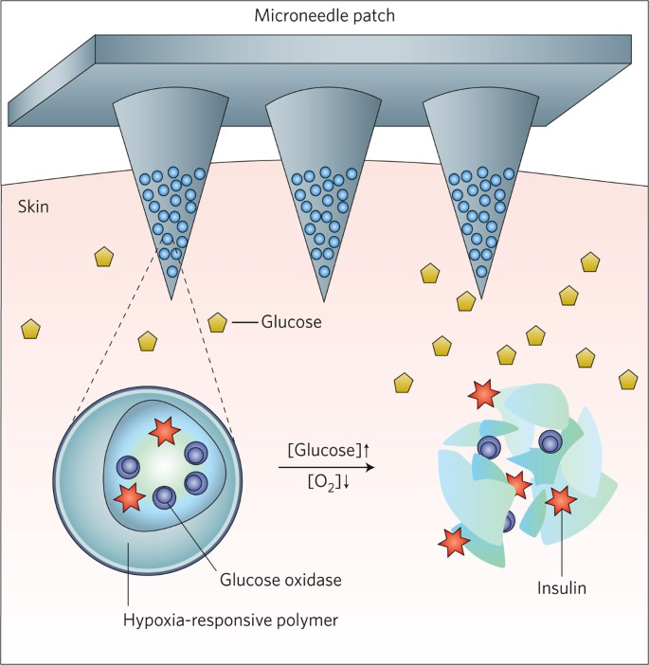
Development of Glucose-Responsive “Smart” Insulin Systems
Glucose-sensitive modifications of existing clinical analogs, and newly-developed hypoxia-sensitive polymer matrices.

Slide 16
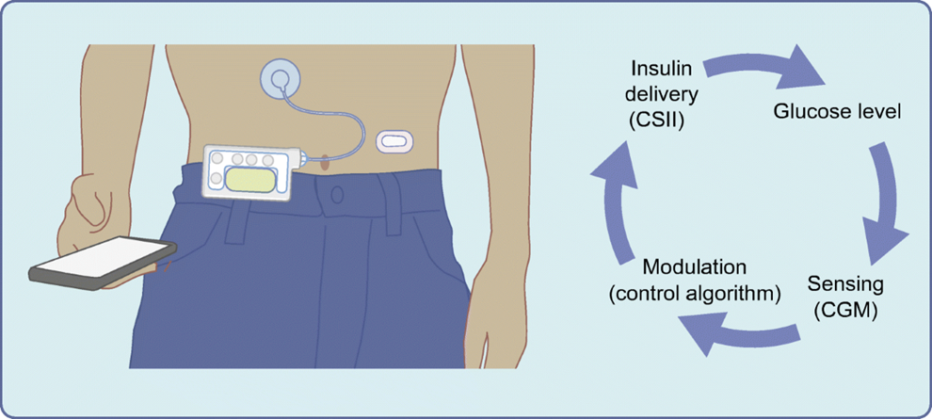
Hybrid closed-loop systems (HCL)
Recommended for
1-Adults type 1 diabetes who HbA1c of 7.5% or higher, or have disabling hypoglycaemia, despite best possible management with insulin pump and or CGM.
2-Children and young people (under 18 years old) living with type 1 diabetes
3- Pregnant or planning to become pregnant.

Slide 17
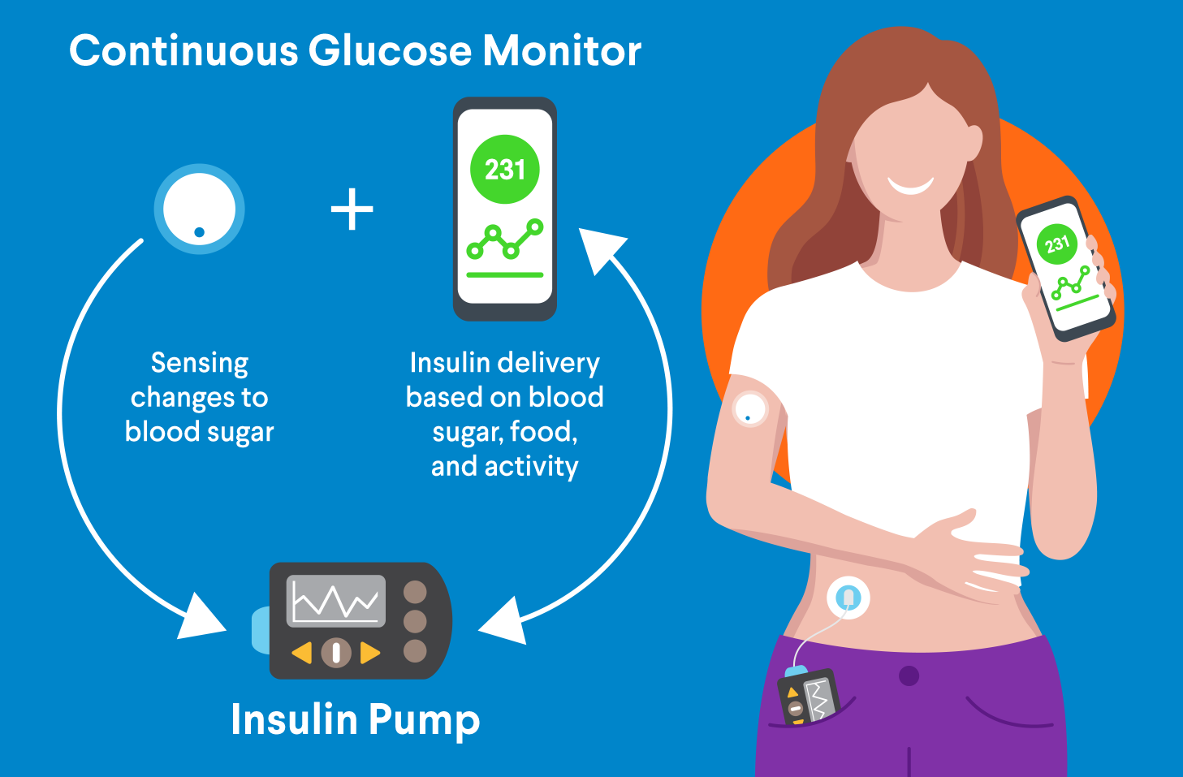

Slide 18
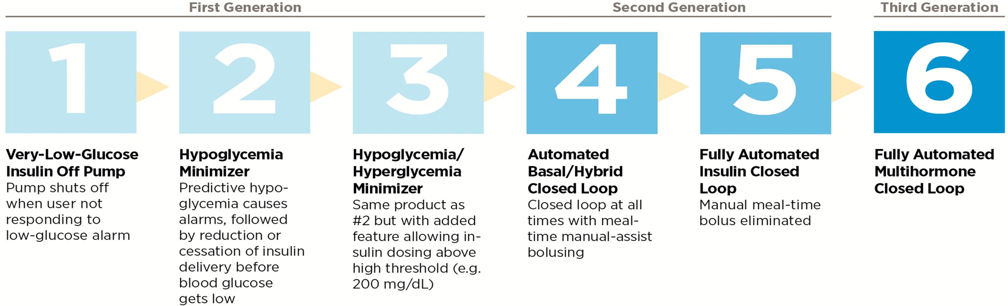
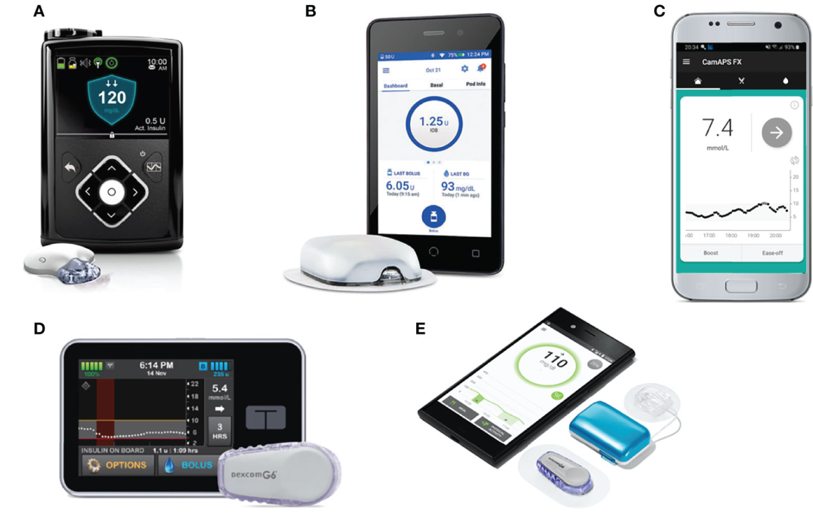
A

Slide 19
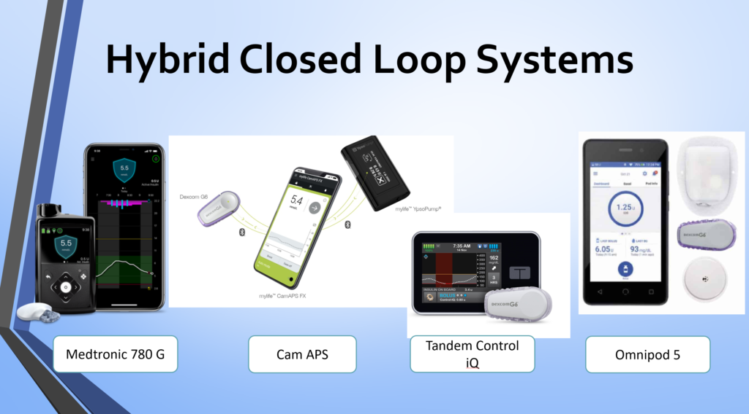
Automated Insulin Delivery (AID) Systems

Slide 20
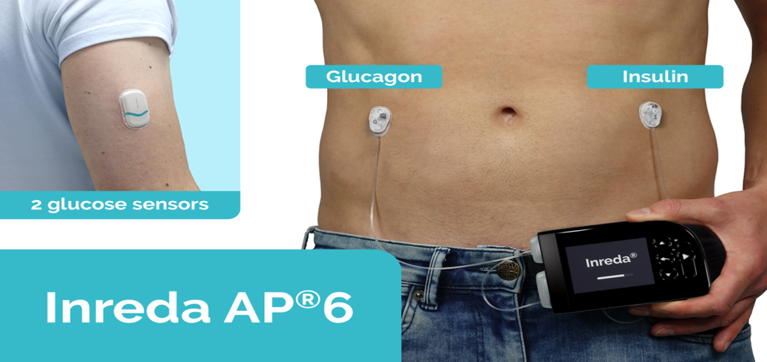
Bihormonal fully closed-loop (FCL) systems
This system combined use of insulin and glucagon allows the system to closely mimic physiological blood glucose regulation, assisted by counter regulation in case of impending hypoglycaemia.
Notes:
Bihormonal fully closed-loop system for the treatment of type 1 diabetes: a real-world multicentre, prospective, single-arm trial in the Netherlands
van Bon, A C et al.
The Lancet Digital Health, Volume 6, Issue 4, e272 - e280

Slide 21
Bihormonal fully closed-loop (FCL) systems
This system is completely reactive, responding to current sensor readings and the change in glucose concentrations over time.
The short-term performance and safety of this bihormonal FCL system were tested in controlled trials and EU approval was obtained in 2020

Slide 22
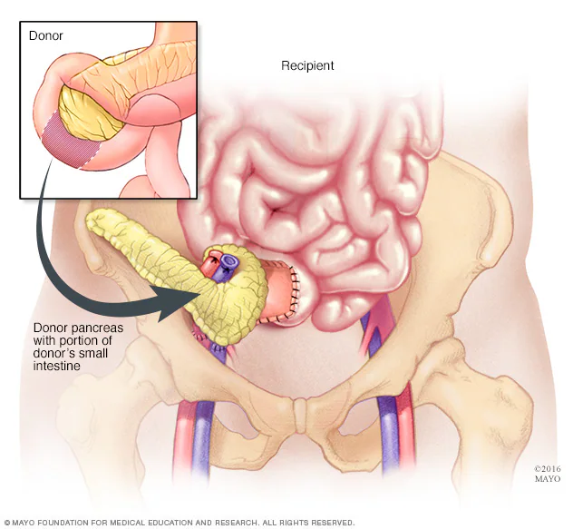
β cell replacement therapies
Pancreatic-cell replacement offers the potential for physiological glycemic control, avoiding hypo and hyperglycemic episodes.
1-Pancreas transplantation
Whole pancreas transplantation
is not preferred because
surgically, it is an aggressive
and invasive procedure associated
with comorbidities

Slide 23
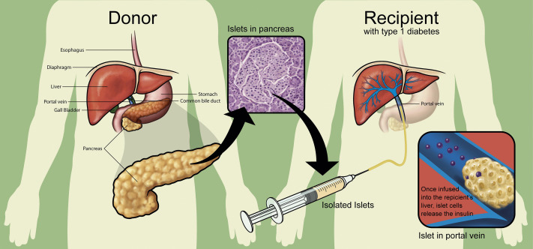
β cell replacement therapies
2. Islet transplantation
It considered a relatively safe procedure with less associated comorbidities, making it an attractive therapeutic option for T1DM
There are many challenges such as limited islet availability, extensive islet apoptosis, and poor islet vascular engraftment.

Slide 24
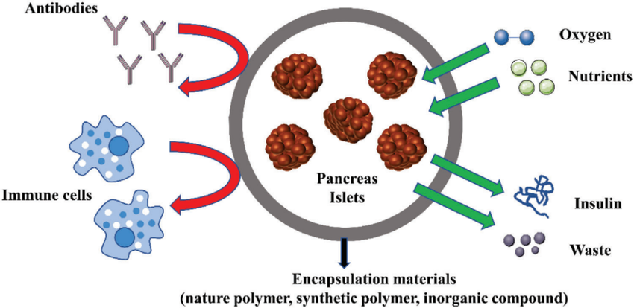
Islet encapsulation
Encapsulation protect islet cell from immune attacks, allows passive diffusion of glucose, insulin, oxygen, and other nutrient exchange, while preventing direct contact with immune cells, so eliminate need for immunosuppressant drugs.

Slide 25
Stem cell based therapy
Stem cells can provide a limitless source of insulin producing-cell and solve the problem of limited availability of suitable donors.
Its promise of playing a key role in future islet transplantation techniques by enhancing their survival and function.

Slide 26

Human embryonic stem cells (hESCs)
Pluripotent cells that differentiate into somatic cells in a developing embryo.
Potentially hESCs could be used to generate new-cells for allogenic transplantation purposes of T1DM patients.
However, ethical because hESCs cells are derived from 5–7-day old blastocysts and its collection involves the destruction of human embryos.

Slide 27
Human Induced Pluripotent Stem Cells (hiPSCs)
This cells can differentiated to unlimited number of functioning beta cells for autologous islet transplantation in T1DM patients without immune rejection.
Although promising, generating-cells from hiPSCs is a complex, costly procedure, and susceptible to teratoma formation.

Slide 28
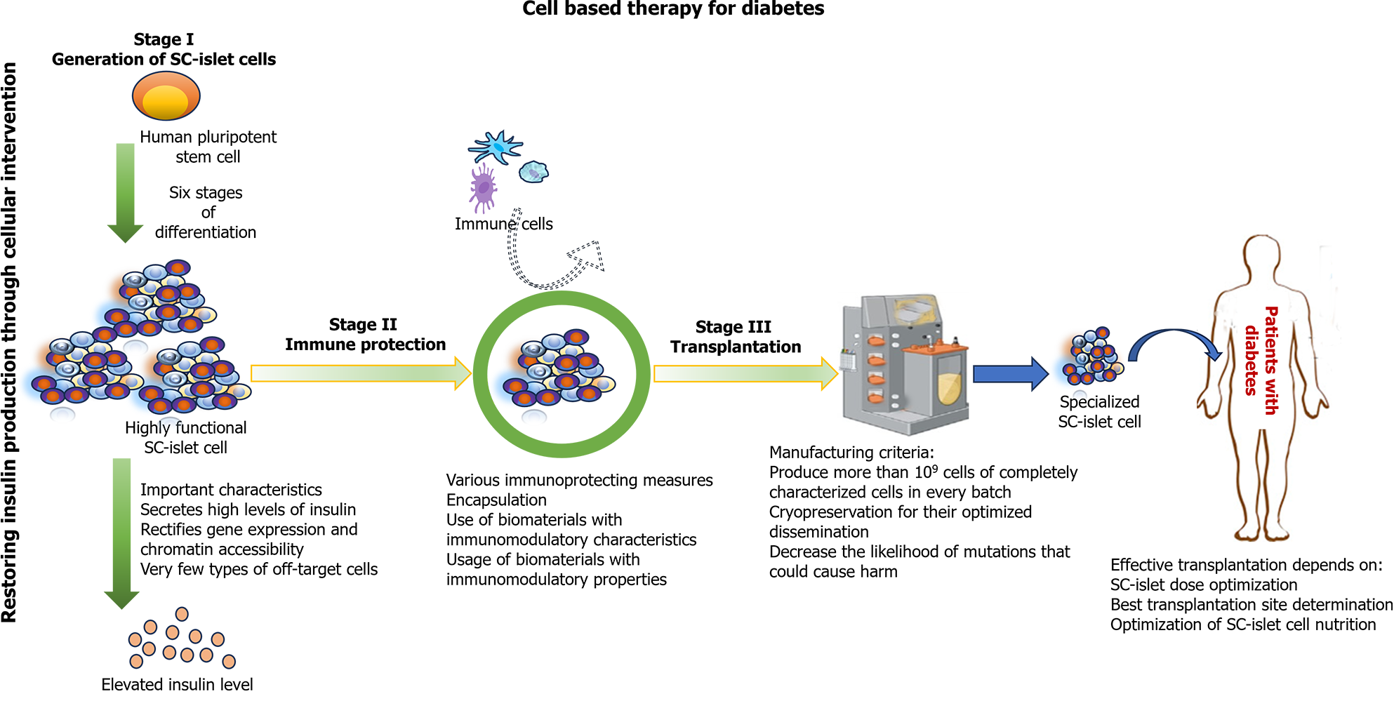

Slide 29
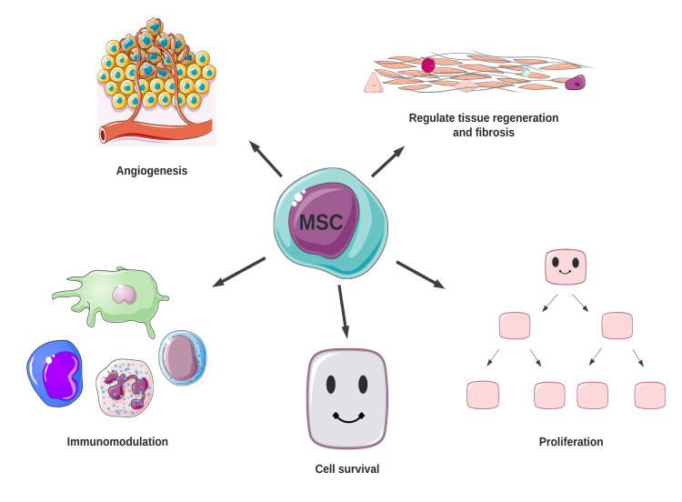
Mesenchymal Stem Cells (MSCs)
MSCs used as adjuvants in islet transplantation that enhance islet vascularization and engraftment by stabilizing the vascular network around the graft. And also promote the growth and functionality of neighbor cells.

Slide 30
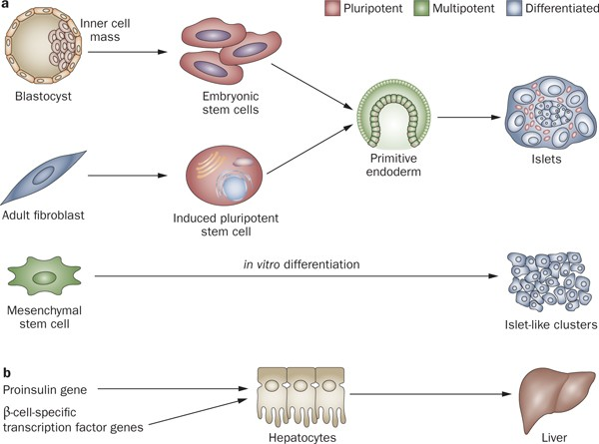
Stem cell and gene therapies for diabetes mellitus

Slide 31
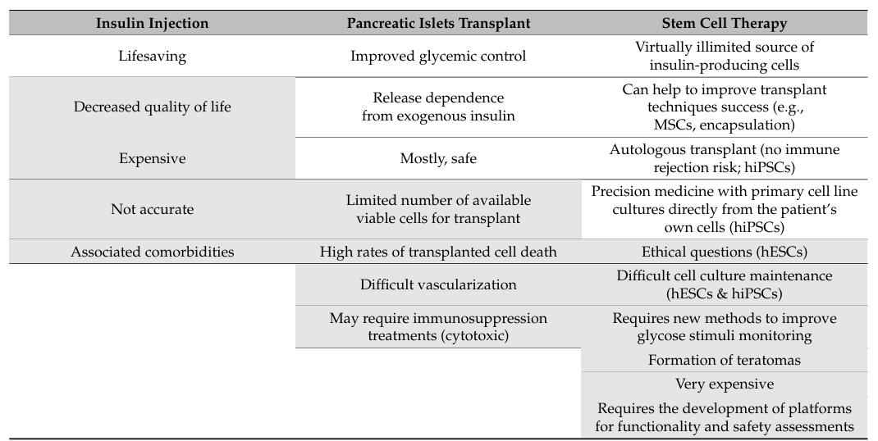

Slide 32
References
Subramanian S, Khan F, Hirsch IB. New advances in type 1 diabetes. Bmj. 2024 Jan 26;384.
Templer S. Closed-loop insulin delivery systems: past, present, and future directions. Frontiers in Endocrinology. 2022 Jun 6;13:919942.
Rodrigues Oliveira SM, Rebocho A, Ahmadpour E, Nissapatorn V, de Lourdes Pereira M. Type 1 diabetes mellitus: A review on advances and challenges in creating insulin producing devices. Micromachines. 2023 Jan 6;14(1):151.
van Bon AC, Blauw H, Jansen TJ,et al. Bihormonal fully closed-loop system for the treatment of type 1 diabetes: a real-world multicentre, prospective, single-arm trial in the Netherlands. The Lancet Digital Health. 2024 Apr 1;6(4):e272-80.

Slide 33


