Slide 1
برعاية السيد عميد كلية الطب البيطري المحترم
يسر وحدة التعليم المستمر وبالتعاون مع فرع الامراض وامراض الدواجن
اقامة محاظرة علمية بعنوان
(Chitosan role coated silver nanoparticles)
المحاضرون
أ.م.د. زينب جمال محمد جواد
تاريخ الانعقاد 2024/4/28

Slide 2
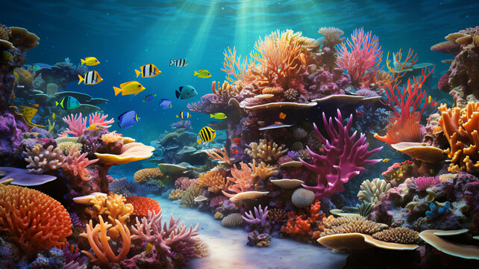
The Medical Uses of Chitosan
Assit.Prof.Dr.Zainab Jamal Mohammed Jawad

Slide 3
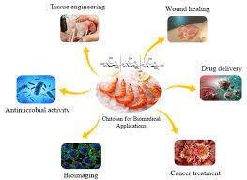
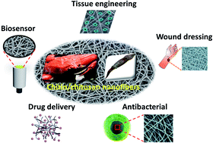
Introduction formula sourses uses of chitosan The purification process Applications Conclusions

Slide 4
Introduction
Chitosan (CS) is a linear polysaccharide which is achieved by deacetylation of chitin, which is the second most plentiful compound in nature, after cellulose. It is a linear copolymer of β-(1 → 4)-linked 2-acetamido-2-deoxy-β-d-glucopyranose and 2-amino-2-deoxy-β-d-glucopyranose. It has valued properties such as biocompatibility, biodegradability, hydrophilicity, nontoxicity, high bioavailability, simplicity of modification, favorable permselectivity of water, outstanding chemical resistance, capability to form films, gels, nanoparticles, microparticles and beads as well as affinity to metals, proteins and dyes.

Slide 5
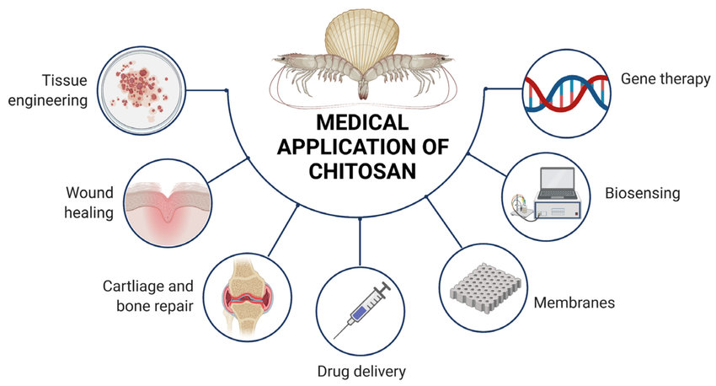
The biodegradable CS is broken down in the human body to safe compounds (amino sugars) which are easily absorbed. At present, CS and its derivatives are broadly investigated in numerous pharmaceutical and medical applications including drug/gene delivery, wound dressings, implants, contact lenses, tissue engineering and cell encapsulation. Besides, CS has several OH and NH₂ functional groups which allow protein binding.

Slide 6
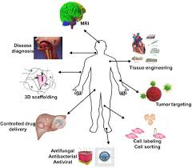
Sources of chitosan:
It is derived from the exoskeleton of insects and marine crustaceans. Often, it is insoluble in common solvents that limit its applications but its deacetylated product, named chitosan is found to be soluble in protonated aqueous medium and used widely in various biomedical fields.

Slide 7
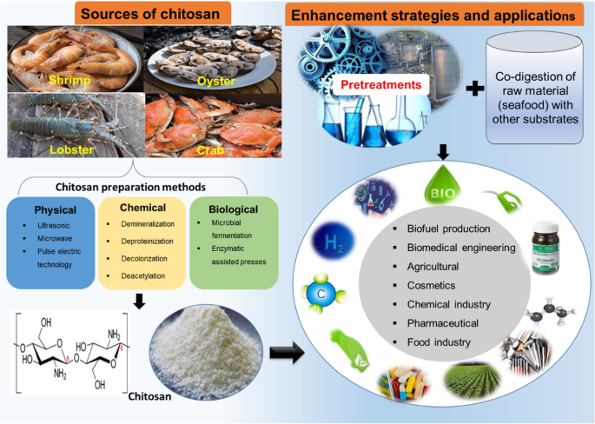

Slide 8
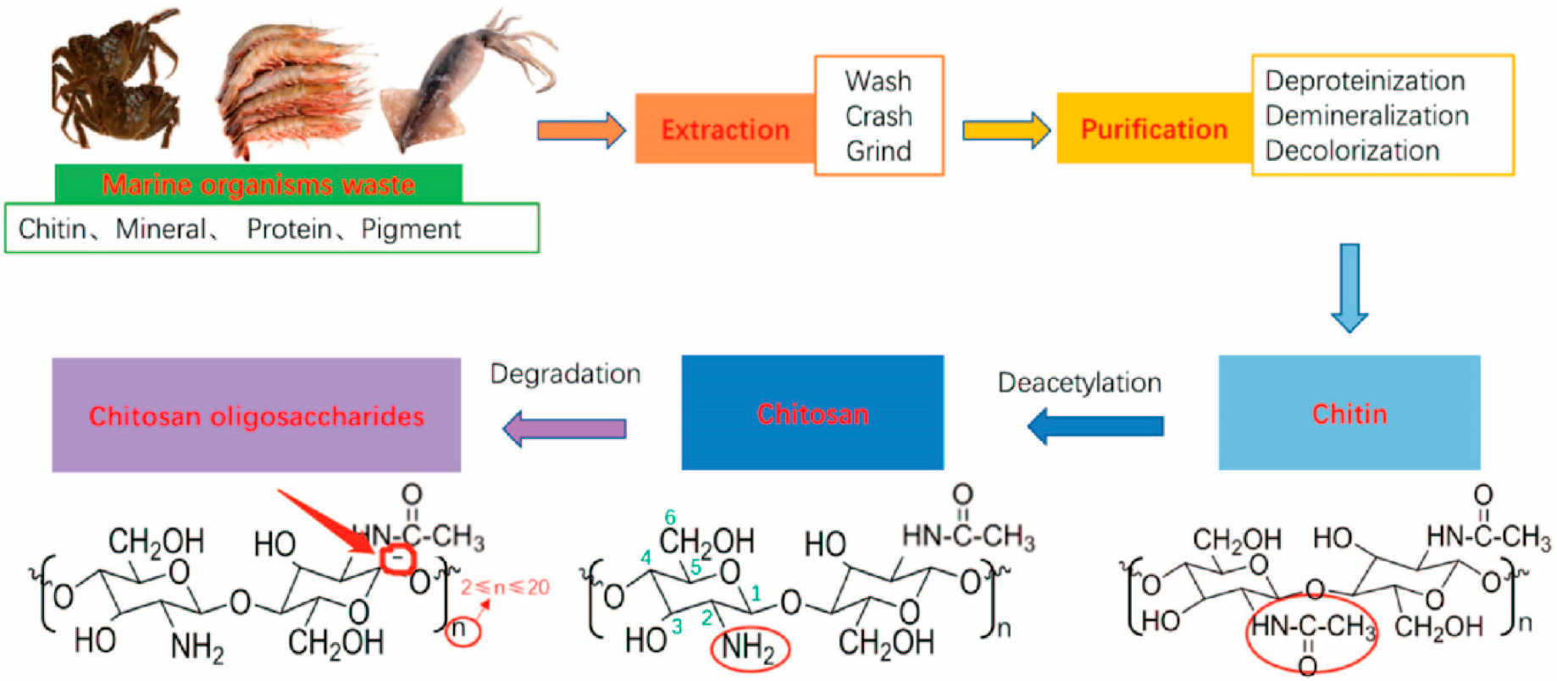
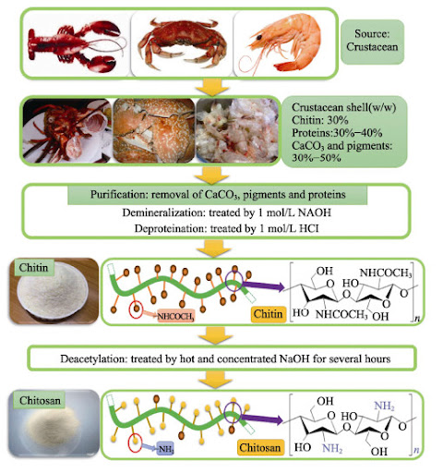

Slide 9
The purification process
It is easier for shrimp shells which are thinner. Usually, shells of the same size and species are grouped, then cleaned, dried and ground into small shell pieces . There is no standard purification method as different chitin sources require different treatments due to the variety in their structures. Conventionally, the protocol is divided into demineralization, deproteinization and decolorization steps which can be carried out using chemical or biological (enzymatic treatment or fermentation) treatments. The end-products need to be highly purified if they are to be used for biomedical or pharmaceutical purposes, as residual proteins, minerals or pigments can cause serious side effects. Conversion of chitin to chitosan can be achieved by enzymatic or chemical deacetylation.

Slide 11
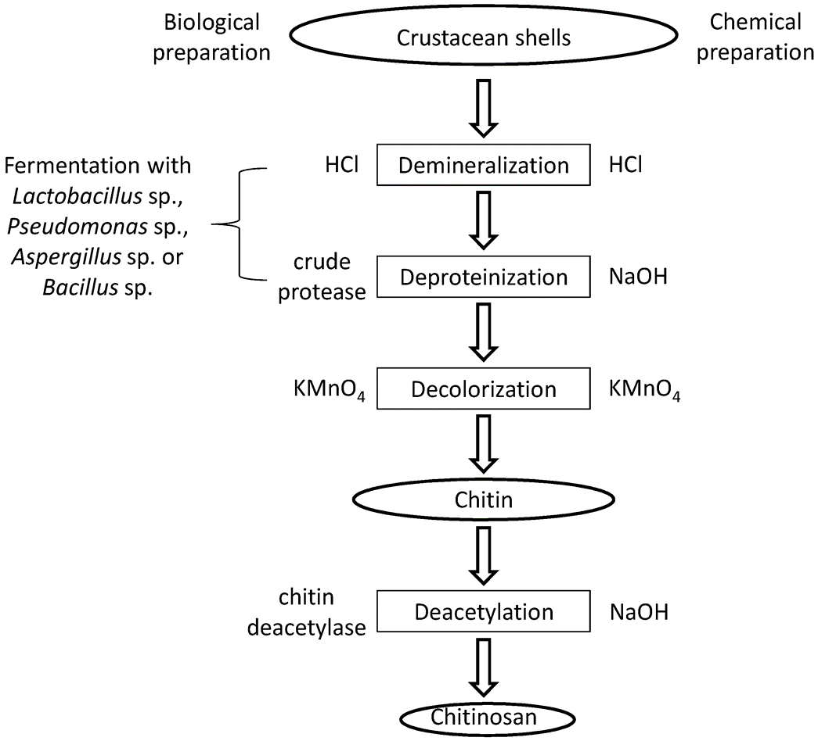

Slide 12
Applications
Tissue Engineering: Tissue engineering describes the use of a combination of cells, engineering materials, and suitable biochemical factors to improve or replace biological functions.
Drug Delivery System: Chitosan has been widely used in pharmaceutical industry in drug delivery systems in different forms, like tablets, microspheres, micelles, vaccines, nucleic acids, hydrogels, nanoparticles and conjugates
Wound Healing : Chitosan and its derivatives exhibit biodegradable, biocompatible, antimicrobial activity and low immunogenicity which are advantageous for development as biomaterials for wound healing
Water Treatment: Chitosan is regarded as one of the most efficient materials for adsorption of pollutants in water treatment systems.
Obesity Treatment: Chitosan is marketed as a dietary supplement or nutraceutical for lowering serum cholesterol and controlling obesity
Cardiovascular Diseases Treatment: Administration of chitosan-oligosaccharides by gastric gavage to apolipoprotein E deficient mice (apoE-/-) fed a high fat diet for 12 weeks lowered triglyceride and cholesterol levels in non-high density lipoprotein fractions, undermined atherosclerosis, increased atherosclerotic plaque stability, upregulated hepatic expression of low density lipoprotein receptor, scavenger receptor BI and also the expression of macrophage scavenger receptor BI and ATP binding cassette transporter A1.

Slide 13
Food Industry :The use of electrospun chitosan fibers for wrapping during dry-aging of beef for up to three weeks yielded better results with regard to decrease of counts of microorganisms, molds and, yeasts, yield, lighter appearance, and less muscle denaturation in comparison with traditional dry-ageing
Gene Silencing in Disease Vector Mosquito Larvae: Chitosan/interfering RNA nanoparticles mixed with food and consumed by larvae of Aedes aegypti (vector of the dengue and yellow fever) and Anopheles gambiae (vector of the primary African malaria vector) represented a methodology that can be applied to many insects and pests
Dry Mouth Syndrome Treatment: Chitosan-thioglycolic-mercaptonicotinamide conjugates, which were non-toxic against Caco-2 cells and synthesized by the oxidative S-S coupling of chitosan-thioglycolic acid with 6-mercaptonicotinamide, manifested improved swelling and cohesive characteristics compared with unmodified chitosan and were promising for therapy of dry mouth syndrome in which lubrication and mucoadhesiveness of the mucosa are wanting
Mucosal Immunity Enhancer :Nasal administration of Bacillus anthracis protective antigen adsorbed on chitosan -C48/80 nanoparticles into mice produced elevated serum titers of antibodies against protective antigen and a more balanced Th1/Th2 pattern compared with C48/80 in solution or chitosan/alginate -C48/80 nanoparticles
Treatment of Age-Related Diseases :The pathophysiological roles played by oxidative stress, oxidation of low density lipoprotein, increase of tissue stiffness, conformational changes of protein, aging-associated and chronic inflammation have been reviewed.

Slide 14
Conclusions
Chitosan is a biodegradable and inexpensive polymer which has numerous applications in biomedical as well as pharmaceutical industries. A large amount of research work has been done on chitosan and its derivatives for the purpose of tissue engineering, drug delivery, wound healing, water treatment, antitumor and antimicrobial effects. Chitosan demonstrated antitumor activity in terms of as a therapeutic agent and as a drug carrier.
As a therapeutic agent, it has been suggested that the antitumor activity related to their ability to induce cytokines production through increased T-cell proliferation.
As a drug carrier, chitosan and its products improve drug absorption, stabilize drug constituents for drug targeting in addition to drug release enhancement.

Slide 15
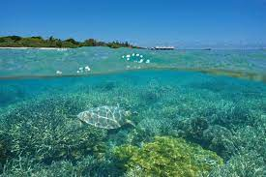
Thanks for your listing

