Slide 1
برعاية السيد عميد كلية الطب البيطري المحترم
يسر وحدة التعليم المستمر وبالتعاون مع فرع الامراض وامراض الدواجن
اقامة محاظرة علمية الموسومة
(Sodium cyanide hazards to birds and wildlife)
المحاضر
د. رغد ناظم محمد
تاريخ الانعقاد 2024/4/4

Slide 2
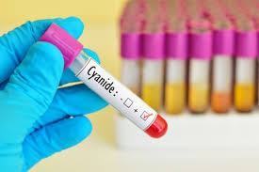
Sodium Cyanide Hazards to birds and wildlife
Speaker Raghad N. AL-Saadi

Slide 3
Outlines
Introduction Chemical compound Using Na CN
The Baia Mare Gold Mine

Slide 4
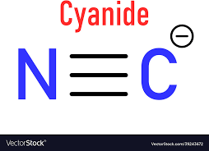
Cyanide
Chemical compound
In chemistry, a cyanide is a chemical compound that contains a C≡N functional group. This group, known as the cyano group, consists of a carbon atom triple-bonded to a nitrogen atom. In inorganic cyanides, the cyanide group is present as the cyanide anion ⁻C≡N. This anion is extremely poisonous. Wikipedia
Formula: CN−
Molar mass: 26.02 g/mol

Slide 5
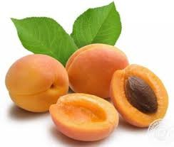
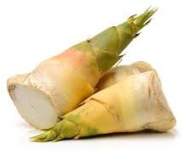
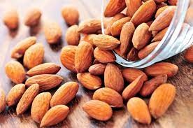
Cyanides in the environment
Low levels of cyanides are found in nature and in products we commonly eat and use. Cyanides can be produced by certain bacteria, fungi and algae. Cyanides are also found in cigarette smoke, in vehicle exhaust, and in foods such as spinach, bamboo shoots, almonds, lima beans, fruit pits and tapioca.

Slide 6
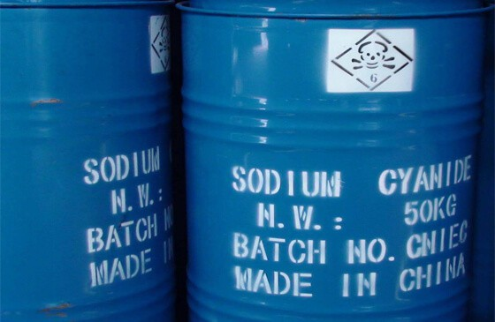
Using Na CN
A process called “Cyanidation”, or cyanide leaching, has been the dominant gold extraction technology since the 1970s. In this process sodium cyanide, in a dilute solution of ranging from 100 ppm to 500 ppm or 0.01% to 0.05% cyanide, is used to selectively dissolve gold from ore.

Slide 7
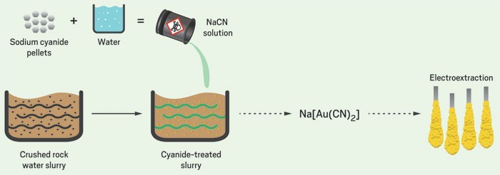
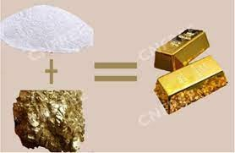
A sodium cyanide solution is commonly used to leach gold from ore. There are two types of leaching: Heap leaching: In the open, cyanide solution is sprayed over huge heaps of crushed ore spread atop giant collection pads. The cyanide dissolves the gold from the ore into the solution as it trickles through the heap.

Slide 8
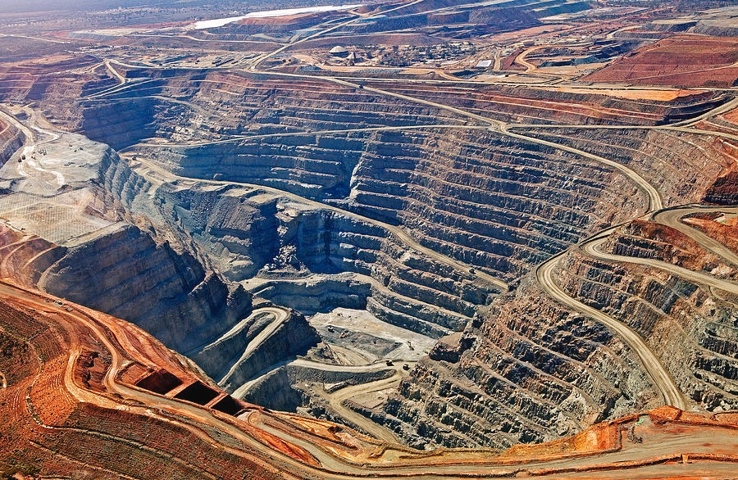

Slide 9
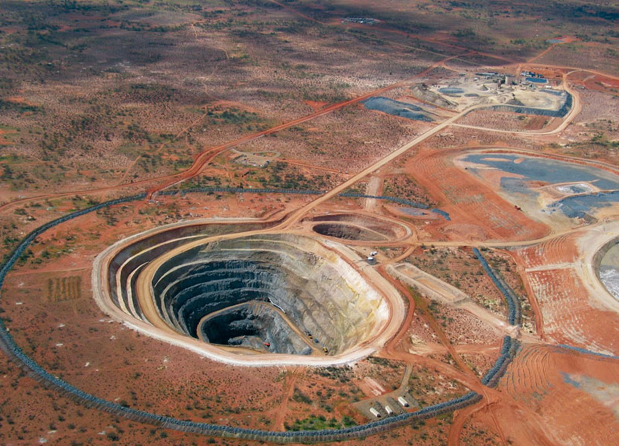

Slide 10
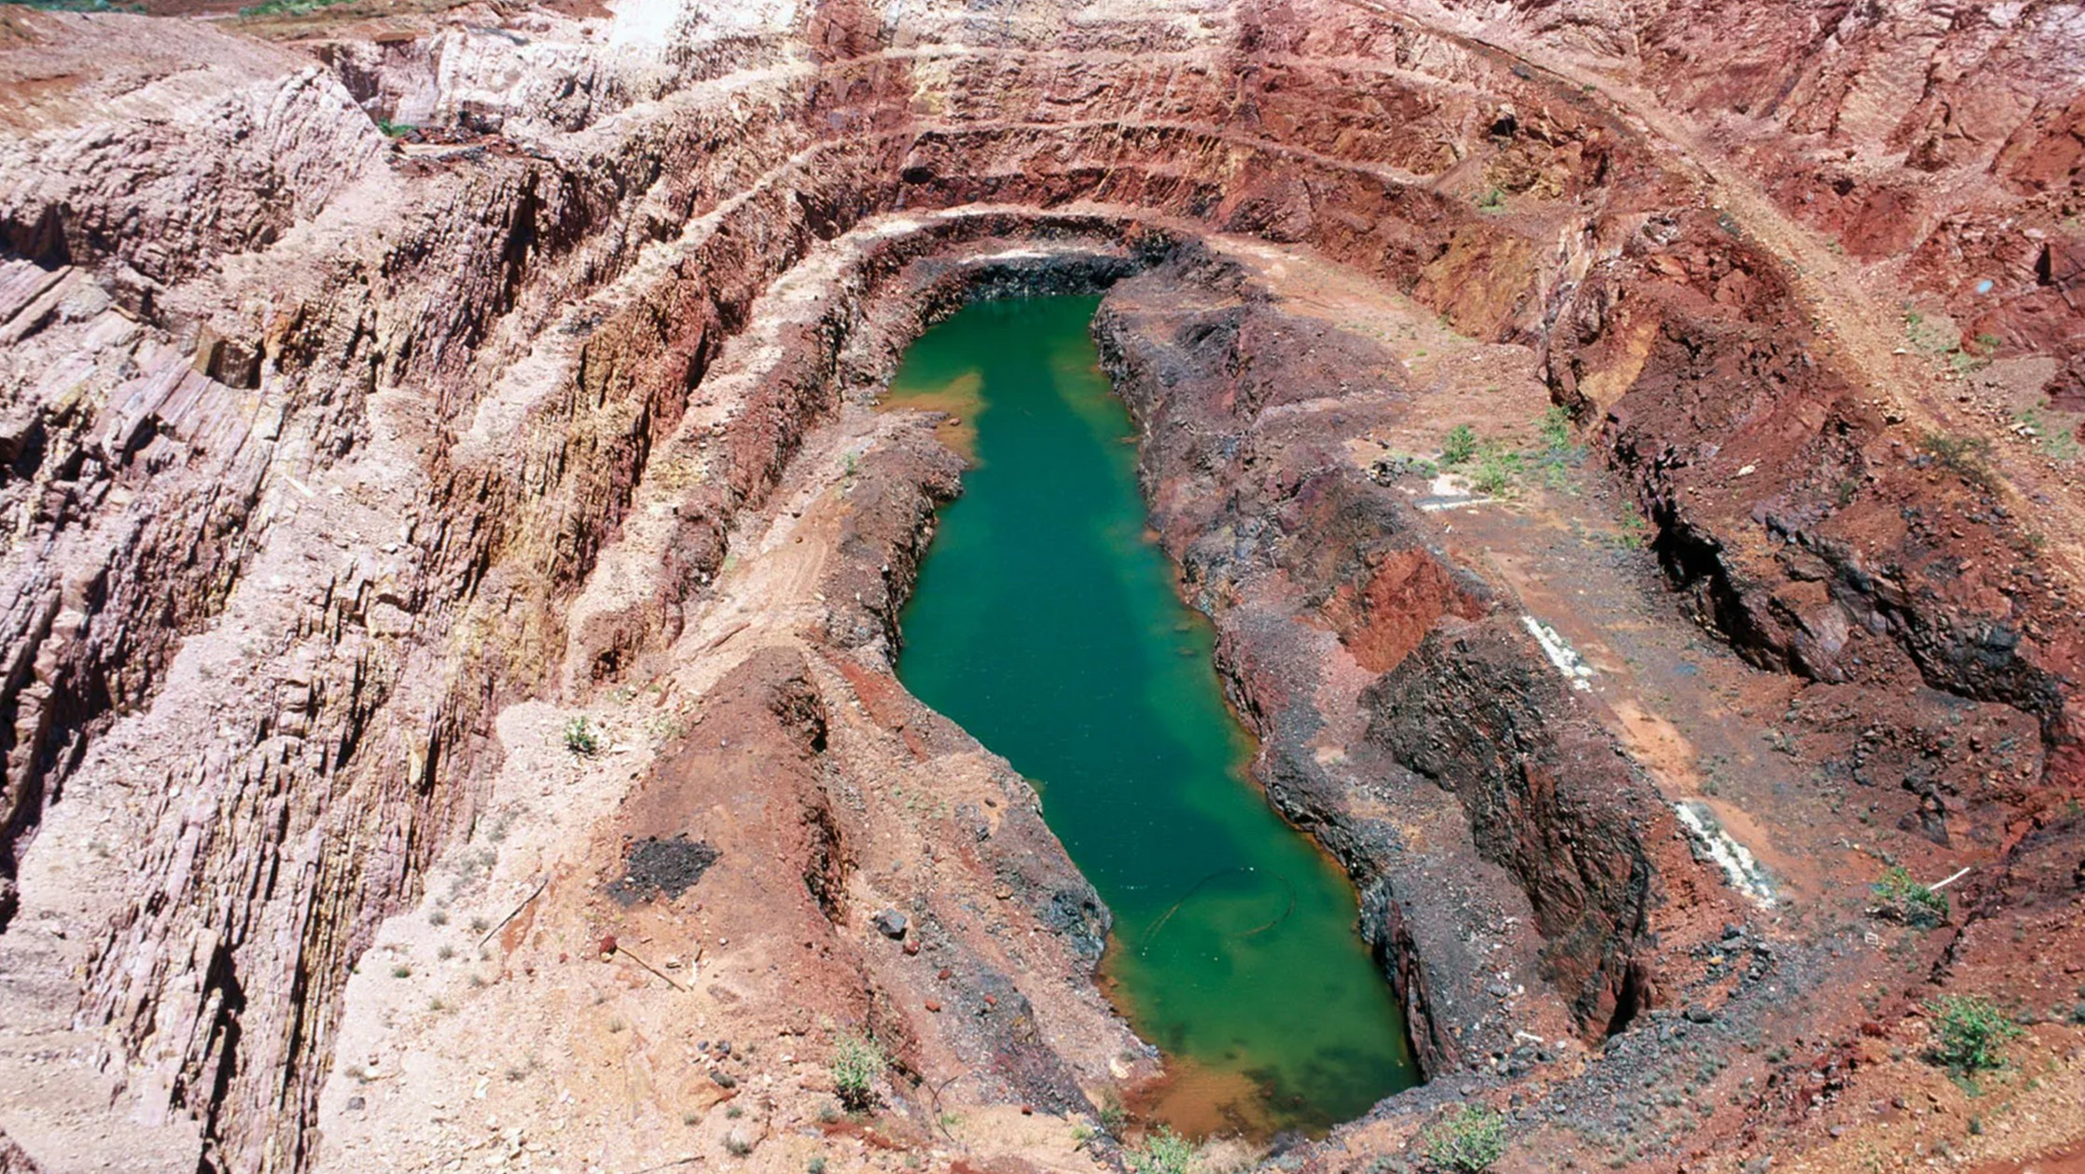

Slide 11
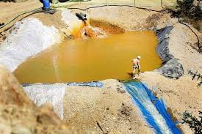
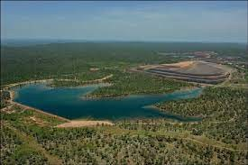
Cyanide in gold production
Since the 1960s when 'cyanide heap leaching' was introduced to the mining process, the toxic impact of gold mining has rocketed. The process involves pouring a cyanide solution over crushed ore. The cyanide solution percolates, dissolves the gold and carries it to solution ponds. This technique requires the use of large quantities of highly toxic cyanide. The cyanide solution is either reused, stored in a dam or directly discharged into rivers or the sea. Toxic heavy metals and metalloids, such as arsenic, occur frequently in ores and can be released with crushing and leaching.

Slide 12
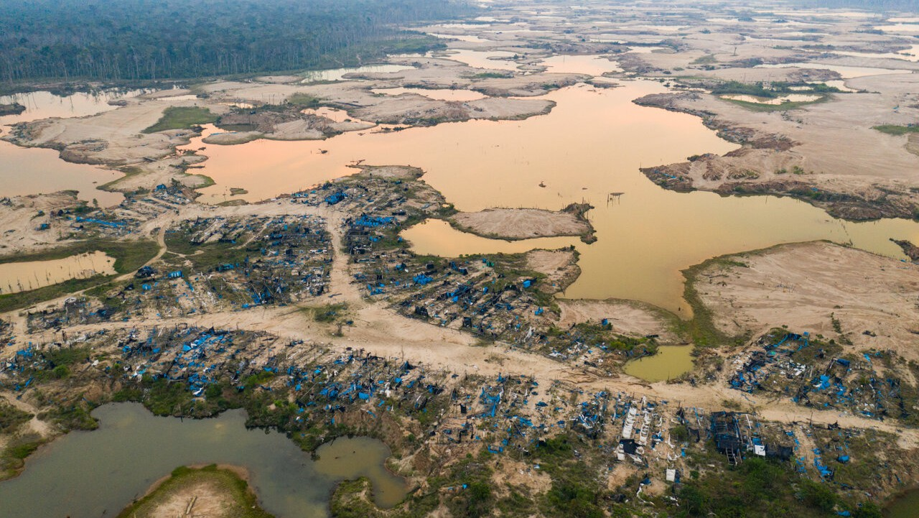

Slide 13
Typical cyanide-leach gold wastes are quite complicated chemically, containing
fluids with high concentrations of sediments; cyanide and breakdown compounds (such as free cyanides, metal-cyanide complexes, cyanates, thiocyanates, ammonia, possibly organic- cyanide compounds, cyanogen, cyanogen chloride, and chloramines); numerous metals (for example, arsenic, cadmium, cobalt, copper, iron, lead, manganese, nickel, selenium, silver, mercury, molybdenum, vanadium, zinc); non-metals (sulfates, chlorides, fluorides, nitrates, and carbonates.

Slide 14
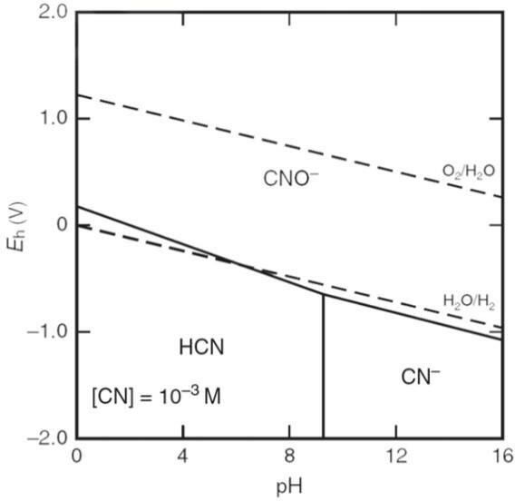

Slide 15
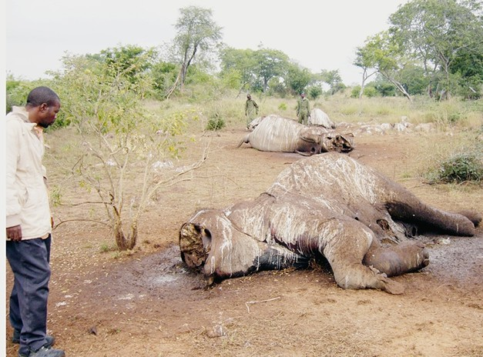
Wildlife deaths associated with cyanide-bearing tailings dams are a significant environmental issue that has affected the gold mining industries for many years and still characterized by little knowledge about how to measure, monitoring, reduce or eliminate those deaths.

Slide 16
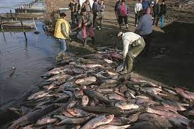
The Baia Mare Gold Mine Cyanide Spill: Causes, Impacts and Liability
On January 30th 2000, the dam containing toxic waste material from the Baia Mare Aurul gold mine in North Western Romania burst and released 100,000 cubic meters of waste water, heavily contaminated with cyanide, into the Lapus and Somes tributaries of the river Tisza, one of the biggest in Hungary.

Slide 17
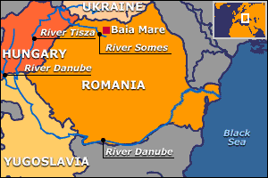
The cyanide was carried in the water by the river systems to other countries.

Slide 18
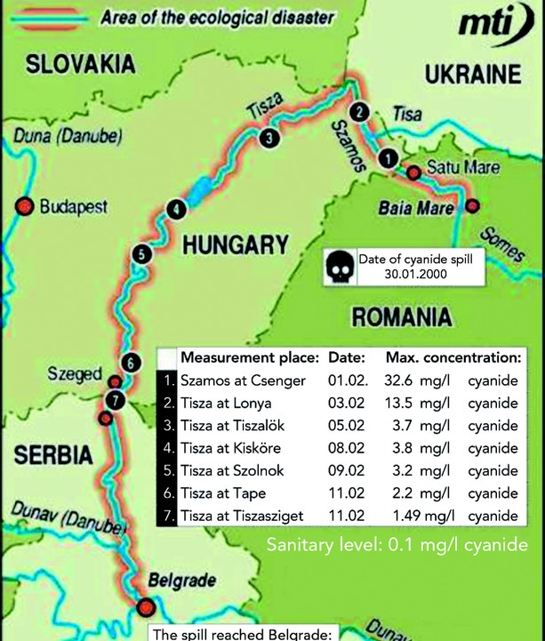
Cyanide is highly toxic, and is lethal to humans and other species even in very small doses. The cyanide contaminated water has now been carried to the river Danube which flows through Serbia, Bulgaria and Romania.

Slide 19
The Hungarian Ministry for the Environment, stated on February 14th that: "Besides the ecological damage, the cyanide pollution in the river Tisza meant also significant threat to the human health, because in the upper part of the Tisza the cyanide concentration was 100 times more than the limit value for drinking water.“
After the spill, the Someș had cyanide concentrations of over 700 times the permitted levels. The Someș flows into the Tisza, Hungary's second largest river, which then flows into the Danube. The spill contaminated the drinking supplies of over 2.5 million Hungarians.

Slide 20
Reasons for the incident are still under investigation. It is clear that questions about the dam's safety have been raised in the recent past, despite claims by the Romanian Government that: "unusual meteorological conditions caused the dam to burst. High temperatures, never recorded before during the last century, caused a quick thaw which provoked a big discharge of water into the dam". (Foreign Affairs Minister for the Environment, El Pais, 10/2/00)

Slide 21
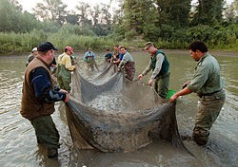
To date, little is known about the long term environmental impacts of the incident. However, toxic and bio-accumulative substances, such as heavy metals, are common in wastes from mining activities.

Slide 22
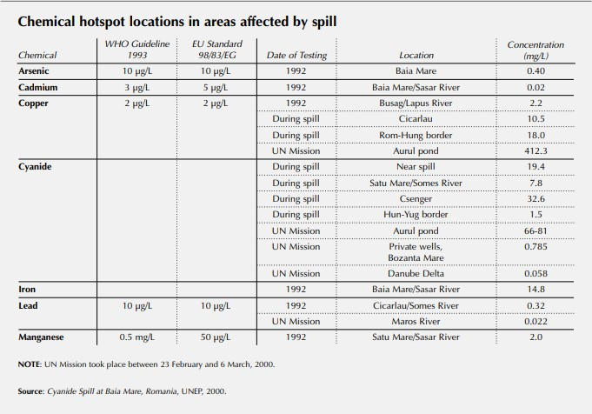

Slide 23
When such complex fluids spill into a biologically productive river, it is not usually possible to determine precisely which components have caused the toxic responses. In Romania, the news media and regulators focused their attention on the cyanide content of the spilled mining wastes. They tended to neglect the toxic impacts of the sediments, metals, elevated pH, and other chemical constituents. Thus, the data that have been made public are inadequate to make detailed toxicity conclusions.

Slide 24
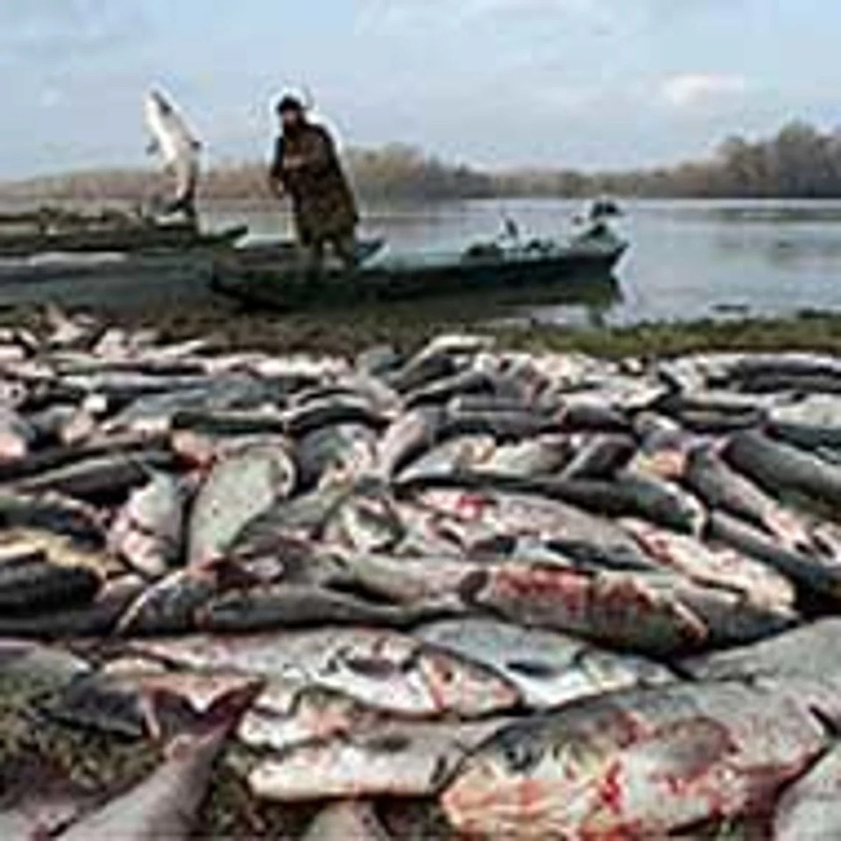
The publicly available data from the Romanian spill reported only total cyanide, and selected determinations of copper, manganese, iron, lead, and zinc--- for river samples.
No detailed analyses of the actual gold- process waste liquids were made public. No field measurements (temperature, specific conductance, or pH) were reported. Such measurements are, in some ways, the most useful data for understanding such a spill.

Slide 25
International Cyanide Management Code (ICMC); [ICMC The International Cyanide Management Institute. International cyanide management code, the international cyanide management institute 2005
Cyanide intake and bird-deaths is not linear, and that relationship is characterized by a threshold at approximately 50 mg weak-acid- dissociable cyanide (WADCN) per litre of tailings waste (50 mg/L); and

Slide 26
However, operator's certification under the ICMC is difficult because of the limited data and potentially serious under-estimation of the death counts. This is due to observational skill and monitoring frequency, the small size of the carcasses, large extent of tailings facilities, carcasses loss by; entombment in tailings, sink, or taken by scavenging wildlife.

