Slide 1
الاورام اسبابها ووصفها النسيجي
اعداد
د.انعام بدر فالح

Slide 2
What is animal tumor? Neoplasia is the uncontrolled, abnormal growth of cells or tissues in the body, and the abnormal growth itself is called a neoplasm or tumor. It can be benign or malignant. Benign neoplasms tend to grow slowly; displace, but do not tend to invade, the surrounding body tissues; and do not spread throughout the body.

Slide 3
Malignant tumors are cancerous and can spread cancer cells throughout one's body through the blood or lymphatic system, a process known as metastasis.
Tumors can affect bones, skin, tissue, organs and glands. Many tumors are not cancer (they're benign). But they still may need treatment. Cancerous, or malignant, tumors can be life-threatening and require cancer treatment. Any species can develop cancer, but some are more at risk than others.
Chemicals, solar radiation, and viruses are just some of the things that can cause skin tumors in animals.

Slide 4
What is a tumor and how does it function?
When cells grow old or become damaged, they die, and new cells take their place. Sometimes this orderly process breaks down, and abnormal or damaged cells grow and multiply when they shouldn't. These cells may form tumors, which are lumps of tissue. Tumors can be cancerous or not cancerous (benign).

Slide 5
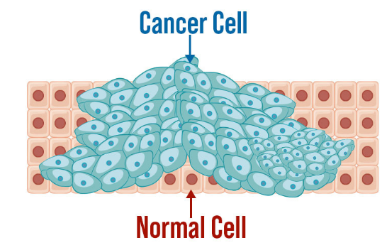
Why do animals get tumors?
Because healthy cells divide and reproduce continuously, veterinary cancer specialists (oncologists) speculate that as an animal ages it becomes more and more likely that a cell will divide incorrectly, not be repaired correctly, and end up with a mutation. Such a mutation could, in turn, lead to cancer.

Slide 6
How Does Cancer Develop?
Since genes that determine how our cells behave, particularly how they grow and divide, are altered, cancer is a genetic disease.
Cancer-causing genetic alterations can occur because:
Of mistakes that happen when cells divide.
Of DNA deterioration brought on by unfavorable environmental elements like the chemicals in tobacco smoke and the sun’s ultraviolet rays(physical & chemical carcinogens)
Also Biological cancer-causing substances such as parasites, viruses, and bacteria

Slide 7
What are the main features of tumor growth?
The malignant cell is characterized by: acceleration of the cell cycle; genomic alterations; invasive growth; increased cell mobility; chemotaxis; changes in the cellular surface; secretion of lytic factors, etc.
The first step to make cancer diagnosis is to recognize whether or not the specimen contains a lesion and then to determine whether the lesion is neoplastic or non-neoplastic.
The final step is to classify the type of tumor based on the cellular differentiation and gross and microscopic growth pattern based on the light microscopic examination of hematoxylin and eosin stained slides.
For the correct identification of the tumor, immunostaining, molecular diagnostic tools, or possibly electron microscopic evaluation may be required.

Slide 8
How can you distinguish benign and malignant in terms of histopathology?
A benign tumor is well differentiated, grows slowly, shows expansile growth with encapsulation and does not metastasize. In contrast, a malignant tumor is often poorly differentiated, grows rapidly with many mitoses, shows invasive growth with no capsule and frequently metastasizes.
The differences between benign and malignant tumors include; (1) differentiation, (2) growth rate, (3) growth pattern, and (4) metastasis

Slide 9
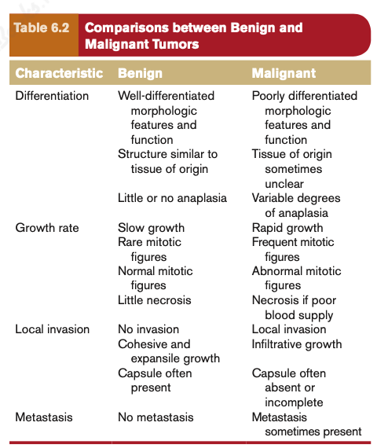

Slide 10
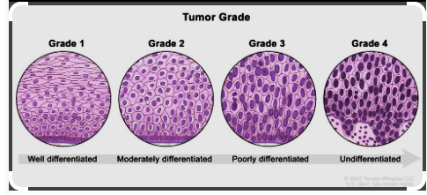
What is the most important microscopic feature for the diagnosis of malignancy?
In general, malignant tumors show high cellularity, tumor necrosis and nuclear alterations
The most important feature of malignant cells is polymorphism, which is seen in the various changes of the cytoplasm and cell nucleus. The cells of a malignant neoplasm frequently show a size that differs from normal. In addition, the cells almost invariably possess a large nucleus, having an irregular size and shape(a nuclear polymorphism), the nucleoli are prominent, the cytoplasm is scarce and intensely colored or, on the contrary, is pale..
After making a diagnosis of malignancy, one should then consider the relevant prognostic factors. The 2 well-known prognostic factors include stage and grade. Therefore, information for regarding stage and grade should be included in the pathology report.

Slide 11
Stage of Cancer
Five phases are typical for malignancies. The size and location of the tumor are two of the many variables that affect the stage:
Stage 0: carcinoma in situ, abnormal cells growing in their normal place ("in situ" from Latin for "in its place").
Stage I: cancers are localized to one part of the body. Stage I cancer can be surgically removed if small enough.
Stage II: cancers are locally advanced. Stage II cancer can be treated by chemotherapy, radiation, or surgery.
Stage III: cancers are also locally advanced. Whether a cancer is designated as Stage II or Stage III can depend on the specific type of cancer; for example, in Hodgkin's Disease, Stage II indicates affected lymph nodes on only one side of the diaphragm, whereas Stage III indicates affected lymph nodes above and below the diaphragm. The specific criteria for Stages II and III therefore differ according to diagnosis. Stage III can be treated by chemotherapy, radiation, or surgery.

Slide 12
Stage IV: cancers have often metastasized, or spread to other organs or throughout the body. Stage IV cancer can be treated by chemotherapy, radiation, or surgery. Despite treatment, a patient's mortality rate can be significantly higher with Stage IV cancer, e.g., the cancer can progress to become terminal.

Slide 13
What are the main differences between epithelial tumors and mesenchymal tumors?
The main differences between epithelial tumors and mesenchymal tumors include: (1) The tumor cells in epithelial tumors are oval-round to polygonal, but in mesenchymal tumors, the tumor cells are in general spindle-shaped; (2) Epithelial tumors generally form tumor cell nests, but mesenchymal tumors are arranged diffusely in sheets, without forming tumor cell nests; (3) In epithelial tumors, desmoplastic stroma is well formed in between tumor cell nests, but in mesenchymal tumors there is no desmoplastic stroma; and lastly, (4) feeding vessels open in the stroma in epithelial tumors but open directly between tumor cells in mesenchymal tumors.

Slide 14
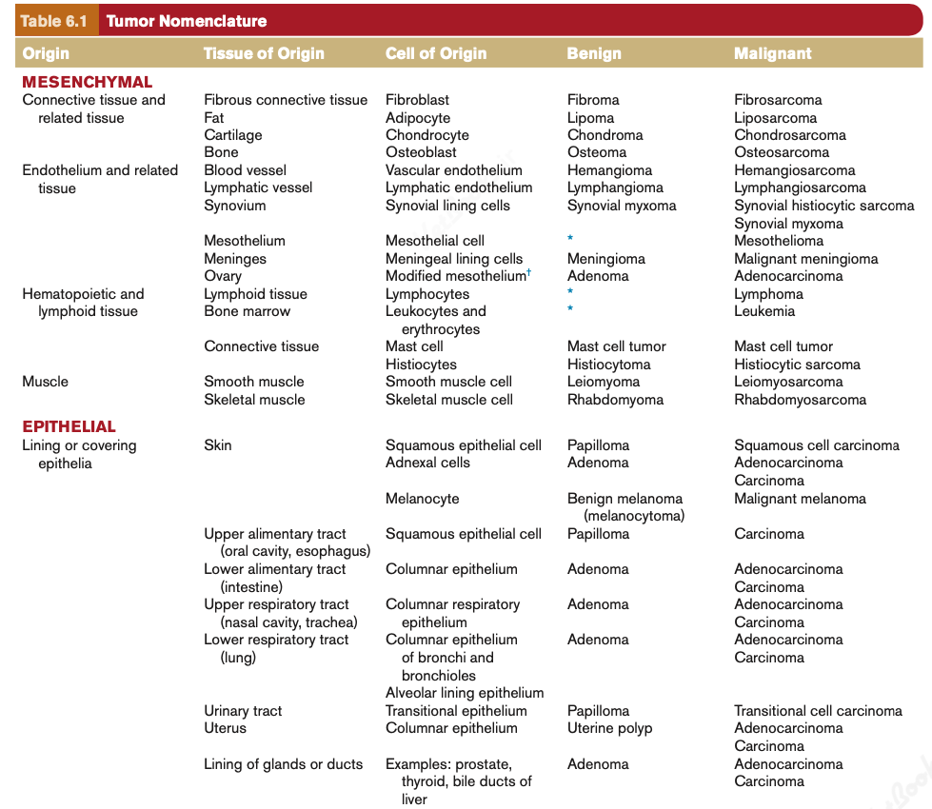

Slide 15
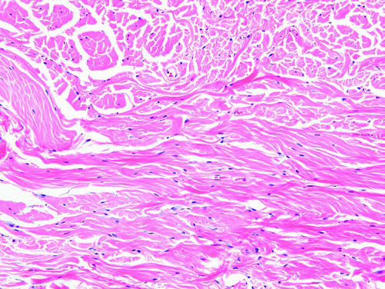
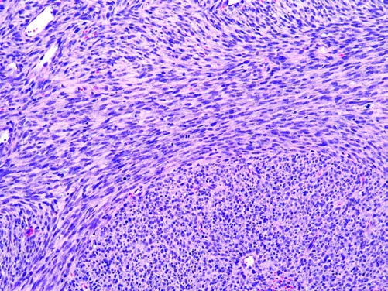
omparison of Benign and Malignant Tumors of Fibroblast Origin. A, Fibroma, subcutis, dog. The benign fibroma is composed primarily of mature collagenous connective tissue with relatively few neoplastic fibroblasts that are indistinguishable from normal fibroblasts. Hematoxylin and eosin (H&E) stain. B, Fibrosarcoma, subcutis, dog. The fibrosarcoma is composed of densely packed, large fibroblasts with plump elongate nuclei and moderate amounts of eosinophilic cytoplasm arranged in interlacing bundles; mature collagen is sparse to absent. H&E stain. (Courtesy College of Veterinary Medicine, University of Tennessee.)

Slide 16
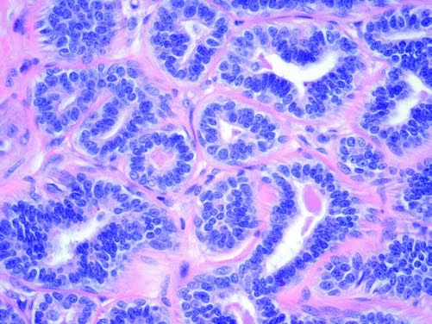
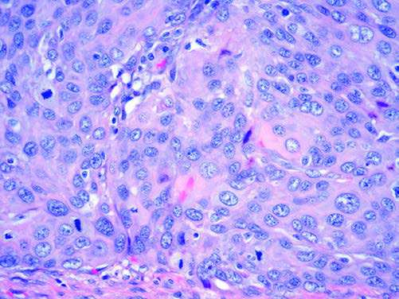
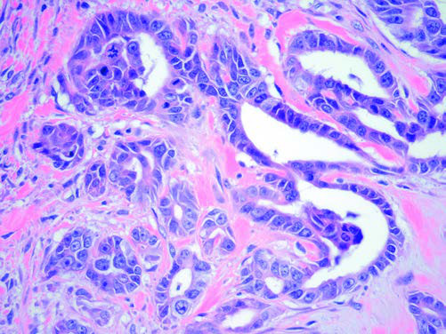
omparison of an Adenoma (A), Solid Carcinoma (B), and an Adenocarcinoma (C). A, Adenoma, mammary gland dog. Adenomas are be- nign tumors arising from glandular tissue. Note the well-formed tubules and acini lined by a single layer of uniformly sized cuboidal epithelial cells. B, Squamous cell carcinoma, tonsil, dog. Carcinomas are microscopically characterized by neoplastic epithelial cells forming solid sheets, nests, or cords of neoplastic epithelial cells. Note the variation in nuclear size (pleomorphism) and the frequent mitotic figures (arrows). C, Adenocarcinoma, apocrine, dog. Adenocarcinomas have tubular or acinar structures, indicating a glandular tissue of origin, that are lined by the pleo- morphic neoplastic epithelial cells. Mitotic figures (arrow) may be numerous in adenocarcinomas. Given overlapping microscopic features across benign and ma- lignant tumors, tumor diagnosis also takes into consideration gross and microscopic patterns of tumor growth and invasion (if present), clinical and biological behavior of the tumor, and other factors

Slide 17
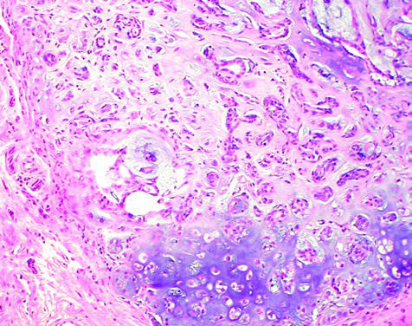
Mixed Mammary Tumor, Mammary Gland, Dog. Mixed mammary tumors of dogs contain structures formed both by epithelial cells (arrows) and by mesenchymal cells, such as cartilage (bluish-purple area de- marcated by arrowheads) and bone. Hematoxylin and eosin (H&E) stain. (Courtesy College of Veterinary Medicine, The Ohio State University.)
ESSENTIAL CONCEPT 6.1 Tumor Characteristics
Tumors may arise from virtually any tissue in the body. Benign tu- mors are expansile masses and may compress but do not invade surrounding tissue and do not spread to other sites in the body. In contrast, malignant tumors are locally invasive and have the po- tential to metastasize (spread) to distant sites. Characteristics of malignant tumors include the following:
1. Loss of differentiation as indicated by morphologic variability in tumor cells, abnormal tissue architecture, and loss of specialized cell function
2. Unlimited proliferative potential resulting from continuous cell division and resistance to cell death
Clinically, the tumor grade (degree of differentiation) and stage (extent of spread) are used to establish prognosis and guide treat- ment options.

Slide 18
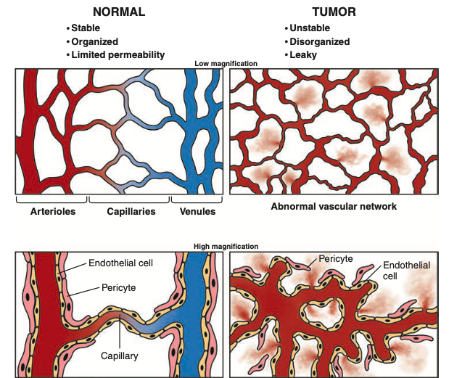
Tumor Angiogenesis. Compared with normal vessels (left panels), tumor vessels are tortuous and irregularly shaped (right panels). Arterioles, capil- laries, and venules are clearly distinguishable in normal vasculature. In tumors, vessels are disorganized, irregularly shaped, and distinction between arteries, capillaries, and venules is not always possible. In contrast to the stable vascular network of normal tissue, the networks formed by tumor vessels are unstable and leaky. Thus, both the structure and function of tumor vasculature are abnormal.

