Slide 1
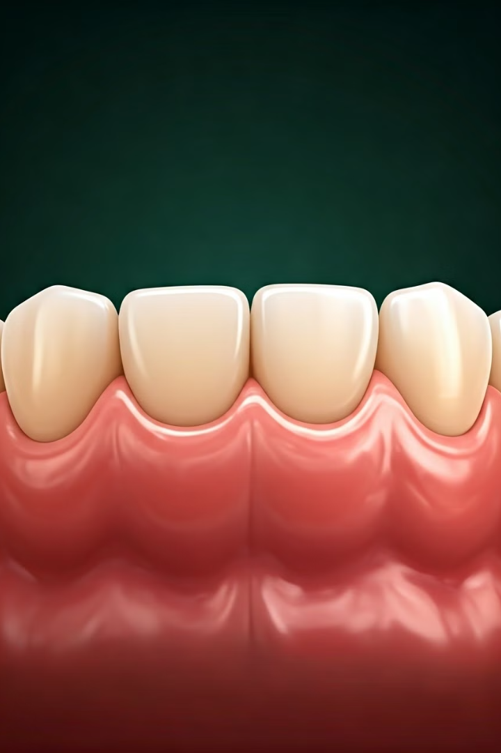
Advances in Periodontology
Periodontology, the study of the structures supporting the teeth, has seen remarkable advancements in recent years. These innovations have transformed the way dental professionals diagnose, treat, and manage periodontal diseases, leading to improved patient outcomes and oral health.

Slide 2
Understanding the Oral Microbiome
1
Microbial Diversity
2
Microbial Balance
Research has revealed the complex ecosystem of microorganisms that reside in the human oral cavity, known as the oral microbiome.
Maintaining a healthy balance of these microbes is crucial for preventing the onset of periodontal diseases.
3
Targeted Therapies
Advancements in understanding the oral microbiome have enabled the development of more targeted and effective treatment strategies.

Slide 3
Innovative Diagnostic Technologies
Advanced Imaging
Genetic Screening
Biomarker Analysis
New imaging techniques, such as cone-beam computed tomography (CBCT), provide detailed, three-dimensional views of the oral structures.
Genetic testing can identify individuals at higher risk for developing periodontal diseases, enabling early intervention and preventive measures.
Analyzing specific biomarkers in saliva or gingival crevicular fluid can aid in the early detection of periodontal conditions.

Slide 4
Novel Regenerative Therapies
Tissue Engineering
Advancements in tissue engineering have led to the development of biomimetic materials that can promote the regeneration of lost periodontal structures.
Growth Factors
The strategic application of growth factors can stimulate the body's natural healing and regenerative processes in the oral cavity.
1
2
3
Stem Cell Therapy
The use of stem cells, either from the patient or donated sources, has shown promising results in regenerating periodontal tissues.

Slide 5
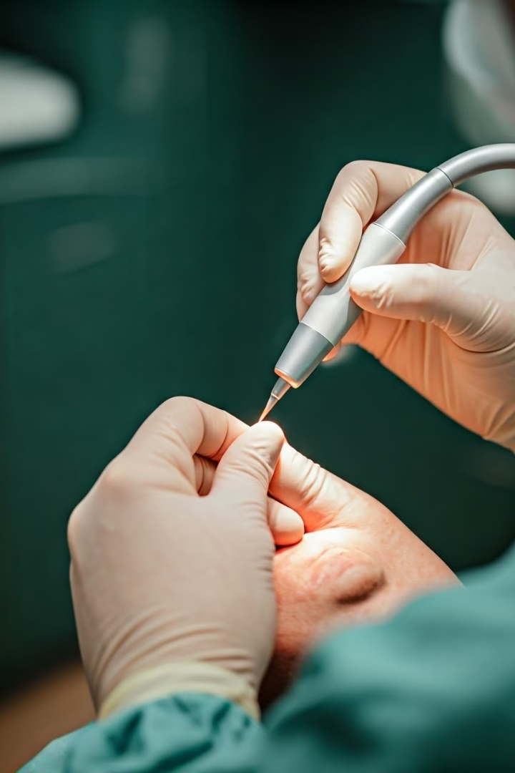
Minimally Invasive Surgical Techniques
Laser-Assisted Procedures
Microsurgical Methods
Advancements in laser technology have enabled more precise and less invasive surgical approaches, reducing patient discomfort and recovery time.
The use of microscopes and specialized instruments has enhanced the accuracy and effectiveness of periodontal surgical interventions.
Endoscopic Techniques
Computer-Guided Surgeries
Endoscopic procedures allow dental professionals to visually inspect and treat periodontal conditions with minimal trauma to the patient.
Advanced computer-aided planning and navigation systems have improved the precision and predictability of periodontal surgical outcomes.

Slide 6
Precision-Guided Antibiotic Treatments
Microbiome Analysis
Genetic Profiling
Detailed analysis of the patient's unique oral microbiome guides the selection of targeted antimicrobial therapies.
Genetic testing can identify specific bacterial strains and their antibiotic susceptibility, enabling personalized antibiotic prescriptions.
Controlled Release
Antimicrobial Stewardship
Novel delivery systems, such as local drug-delivery devices, ensure the precise and sustained release of antimicrobials.
Antibiotic use is carefully monitored and optimized to prevent the development of resistant bacterial strains.

Slide 7
The Role of Nutrition in Periodontal Health
Antioxidants
Anti-Inflammatory Nutrients
Bone-Supporting Minerals
Dietary antioxidants, such as vitamins C and E, can help reduce inflammation and oxidative stress in the gums.
Omega-3 fatty acids and polyphenols have been shown to modulate the inflammatory response in periodontal tissues.
Adequate intake of calcium, phosphorus, and vitamin D is crucial for maintaining strong alveolar bone supporting the teeth.

Slide 8
Future Trends and Implications
1
Personalized Dentistry
Advancements in genomics and data analytics will enable the development of tailored prevention and treatment strategies for each patient.
2
Digital Transformation
Increased integration of digital technologies, such as artificial intelligence and teledentistry, will revolutionize the delivery of periodontal care.
3
Holistic Approach
The recognition of the bidirectional relationship between oral and overall health will drive a more comprehensive, integrated approach to patient care.

