Slide 1
The Crucial Role of Enzymes in ELISA
Enzymes are the driving force behind the Enzyme-Linked Immunosorbent Assay (ELISA), a powerful diagnostic tool used to detect and quantify a wide range of biomolecules. Their unique catalytic properties are essential for the sensitivity and reliability of ELISA testing.

Slide 2
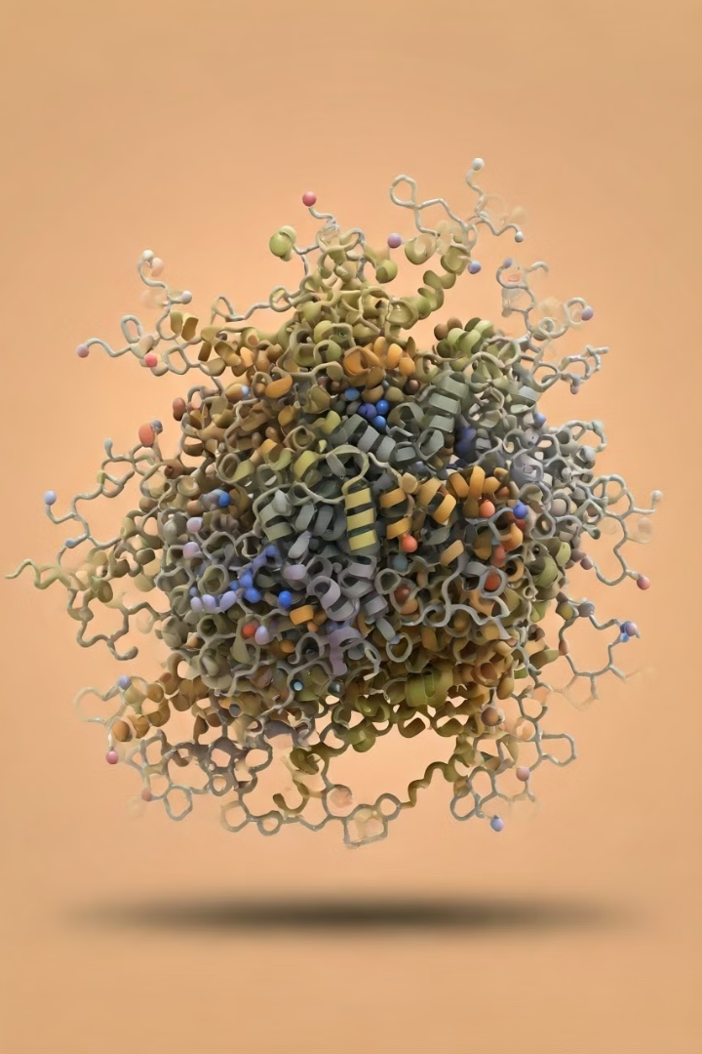
What are Enzymes?
1
Biological Catalysts
2
Versatile and Efficient
Enzymes are specialized proteins that accelerate chemical reactions in living organisms without being consumed themselves.
They can increase the rate of reactions by millions of times, making them essential for biological processes.
3
Highly Specific
Enzymes have a unique 3D structure that allows them to bind and catalyze specific substrates.

Slide 3
Function of Enzymes in ELISA
Catalyzing Reactions
Amplifying Signals
Quantitative Measurement
Enzymes accelerate the chemical reactions that produce a detectable signal in ELISA, such as color changes or luminescence.
Enzyme-based detection can generate a much stronger signal compared to direct labeling, improving the assay's sensitivity.
The enzyme's catalytic rate can be used to quantify the amount of target analyte in the sample.

Slide 4
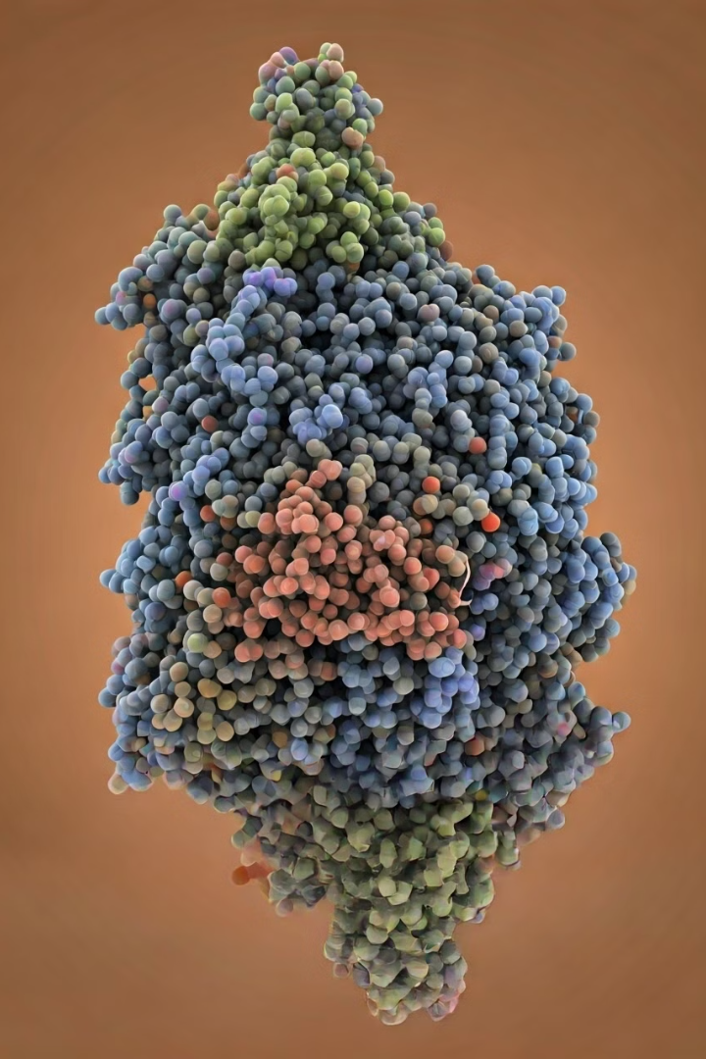
Enzyme-Substrate Interactions
1
Binding
The enzyme's active site binds the specific substrate, forming an enzyme-substrate complex.
2
Catalysis
The enzyme lowers the activation energy, allowing the reaction to proceed rapidly.
3
Release
After the reaction, the enzyme releases the products and is ready to catalyze another reaction.

Slide 5
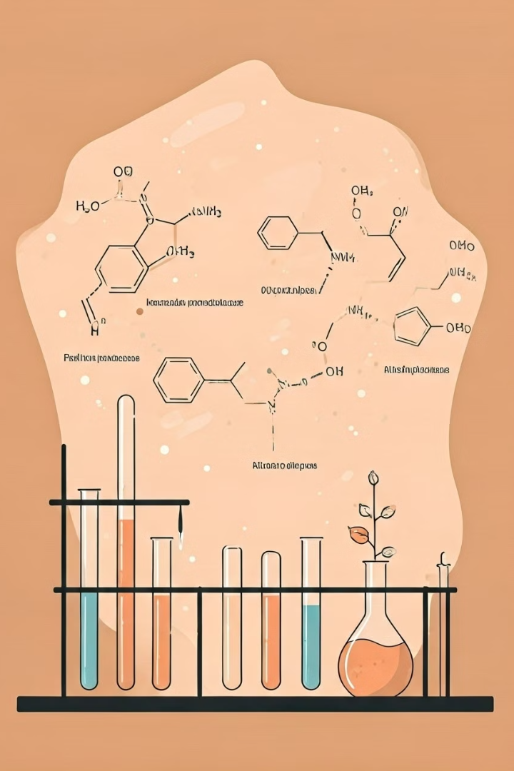
Types of Enzymes Used in ELISA
Horseradish Peroxidase (HRP)
Alkaline Phosphatase (AP)
Catalyzes the hydrolysis of phosphate groups, generating a colored or fluorescent signal.
A widely used enzyme that catalyzes the oxidation of a chromogenic substrate, producing a colored product.
Beta-Galactosidase
Luciferase
Cleaves a colorless substrate to produce a colored product, useful for enzyme-based detection.
Catalyzes a bioluminescent reaction, emitting light that can be detected and quantified.

Slide 6
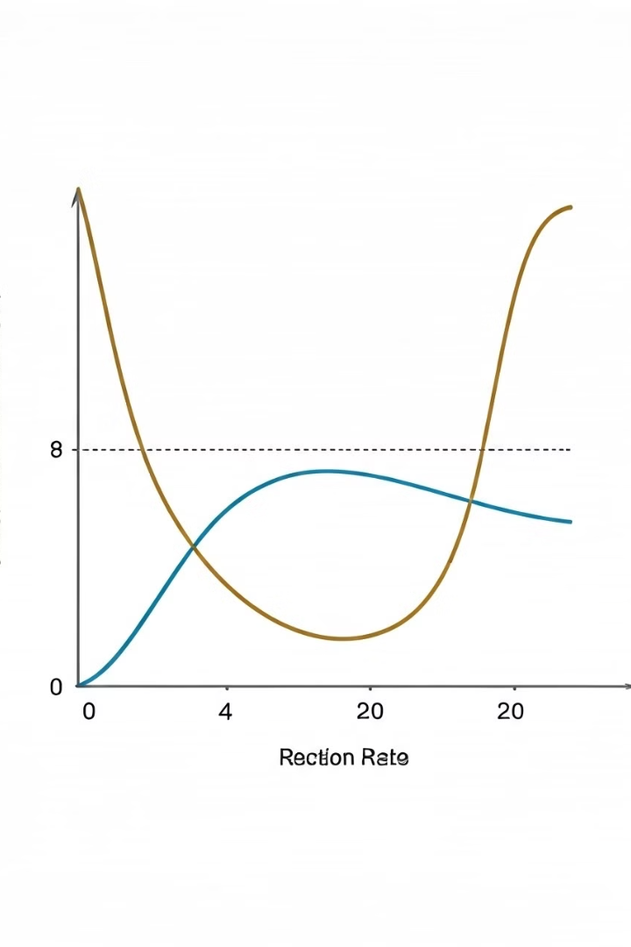
Enzyme Kinetics in ELISA
Substrate Binding
The enzyme binds to the substrate, forming an enzyme-substrate complex.
Catalysis
The enzyme lowers the activation energy, facilitating the conversion of substrate to product.
Product Release
The enzyme releases the product, allowing it to be detected and quantified.

Slide 7
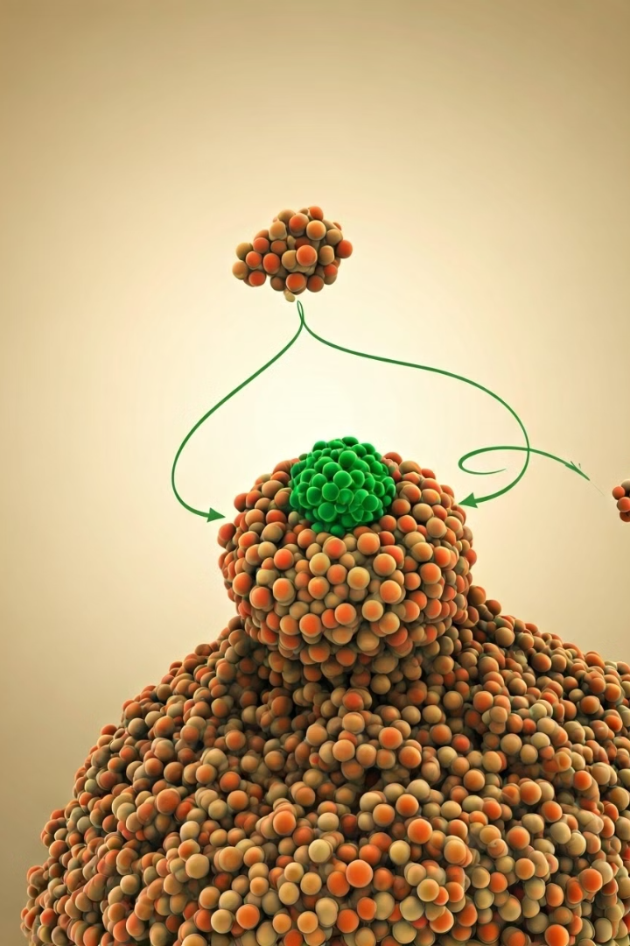
Enzyme Amplification in ELISA
1
Enzyme Binding
The enzyme binds to the target analyte, forming an immune complex.
2
Catalytic Turnover
The enzyme rapidly converts multiple substrate molecules, generating a strong signal.
3
Signal Amplification
The amplified signal allows for the sensitive and quantitative detection of the target analyte.

Slide 8
Advantages of Enzyme-Based Detection in ELISA
Improved Sensitivity
Quantitative Measurements
Enzyme amplification enables the detection of even trace amounts of target analytes.
The enzyme's catalytic rate can be used to accurately quantify the amount of target in the sample.
Versatile Applications
Cost-Effective
Enzymes can be used to detect a wide range of biomolecules, from proteins to small molecules.
Enzyme-based ELISA kits are generally more affordable compared to alternative detection methods.

Slide 9
Challenges and Limitations of Enzyme Use in ELISA
Enzyme Stability
Potential Interference
Optimization Challenges
Enzymes can be sensitive to environmental factors, such as temperature, pH, and the presence of inhibitors.
Certain substances in the sample can interfere with the enzyme's activity, leading to false results.
Careful optimization of enzyme concentration, substrate, and other assay conditions is crucial for reliable results.

Slide 10
Future Advancements in Enzyme-Linked Immunoassays
1
Improved Enzyme Engineering
Advances in protein engineering may lead to more stable, sensitive, and selective enzymes for ELISA.
2
Automated ELISA Systems
Robotics and integrated platforms can streamline ELISA workflows, improving efficiency and reducing human error.
3
Integrated Biosensors
The integration of enzymes with advanced biosensors may enable rapid, portable, and point-of-care ELISA testing.

