Slide 1
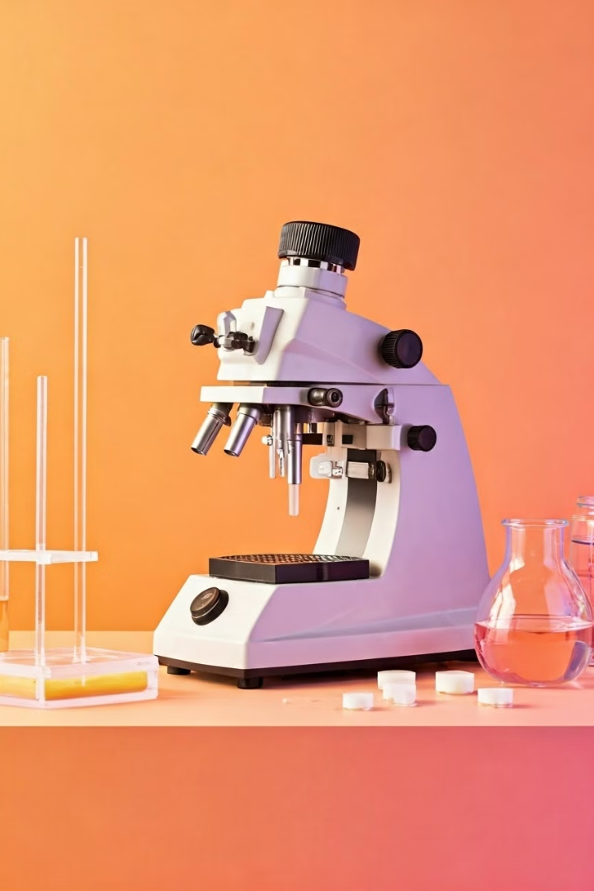
Decontamination Methods in Microbiology Laboratory
Maintaining a safe and sterile environment is critical in microbiology laboratories. This presentation will explore the key decontamination methods used to eliminate harmful microorganisms and ensure sample integrity.

Slide 2
Introduction to Decontamination
1
Eliminating Contaminants
2
Safeguarding Samples
3
Protecting Researchers
Decontamination involves the destruction or removal of microorganisms that could compromise research or endanger personnel.
Proper decontamination ensures microbiology samples remain free from unwanted microbes that could interfere with analysis.
Decontamination practices minimize the risk of exposure to pathogenic organisms for laboratory staff.

Slide 3
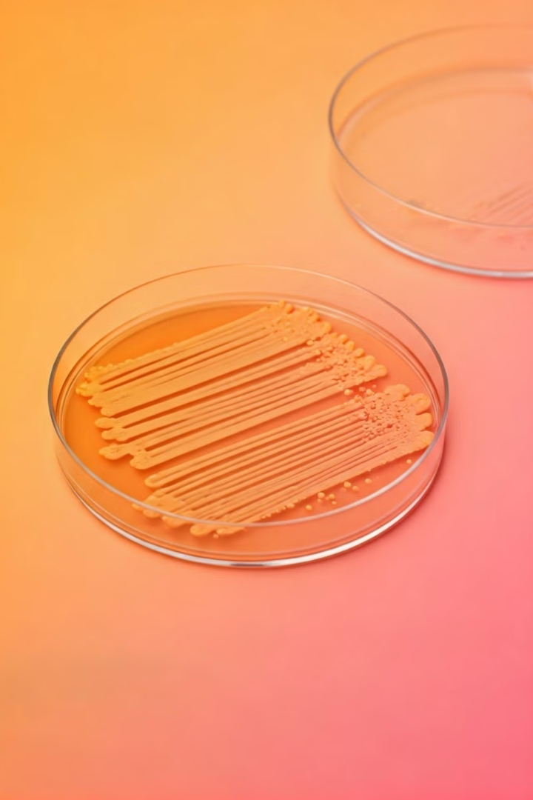
Importance of Decontamination in Microbiology
Sample Integrity
Personnel Safety
Contamination can compromise the accuracy and validity of microbiology research and testing.
Exposure to hazardous microbes poses serious health risks to laboratory staff if proper decontamination is not maintained.
Regulatory Compliance
Decontamination is required by regulatory bodies to ensure microbiology labs meet safety and quality standards.

Slide 4
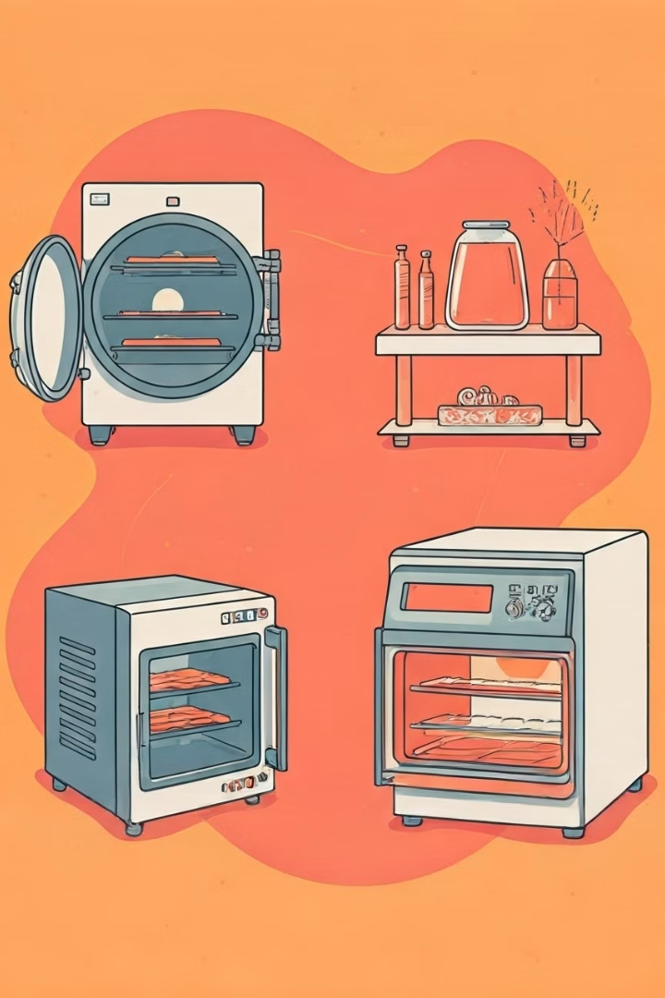
Physical Decontamination Methods
1
Autoclaving
High-pressure steam sterilization to eliminate microbes and spores.
2
Dry Heat
Exposure to high temperatures to destroy microorganisms through oxidation and protein denaturation.
3
Filtration
Passing liquids or gases through membranes to remove contaminants and microbes.

Slide 5
Autoclaving
Process
Applications
Verification
Exposing materials to high-pressure steam at 121°C (250°F) for 15-30 minutes to kill all microbes.
Commonly used to sterilize glassware, media, instruments, and waste prior to disposal.
Monitoring with chemical and biological indicators to ensure proper sterilization occurred.

Slide 6
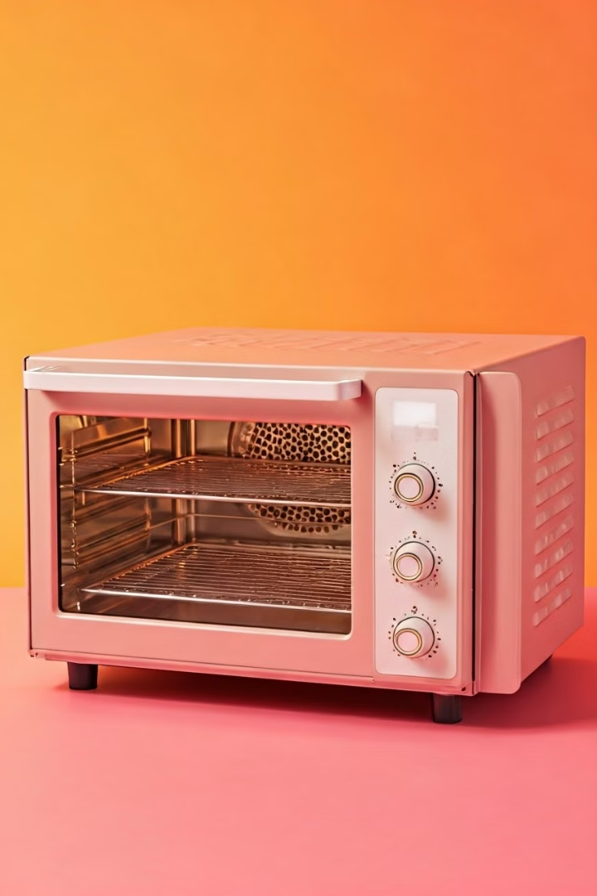
Dry Heat Sterilization
1
Principles
2
Advantages
Exposing materials to high temperatures (160-320°C) to destroy microorganisms through oxidation.
Effective against resistant spores and does not leave behind chemical residues.
3
Limitations
Longer processing times and cannot be used on heat-sensitive materials.

Slide 7
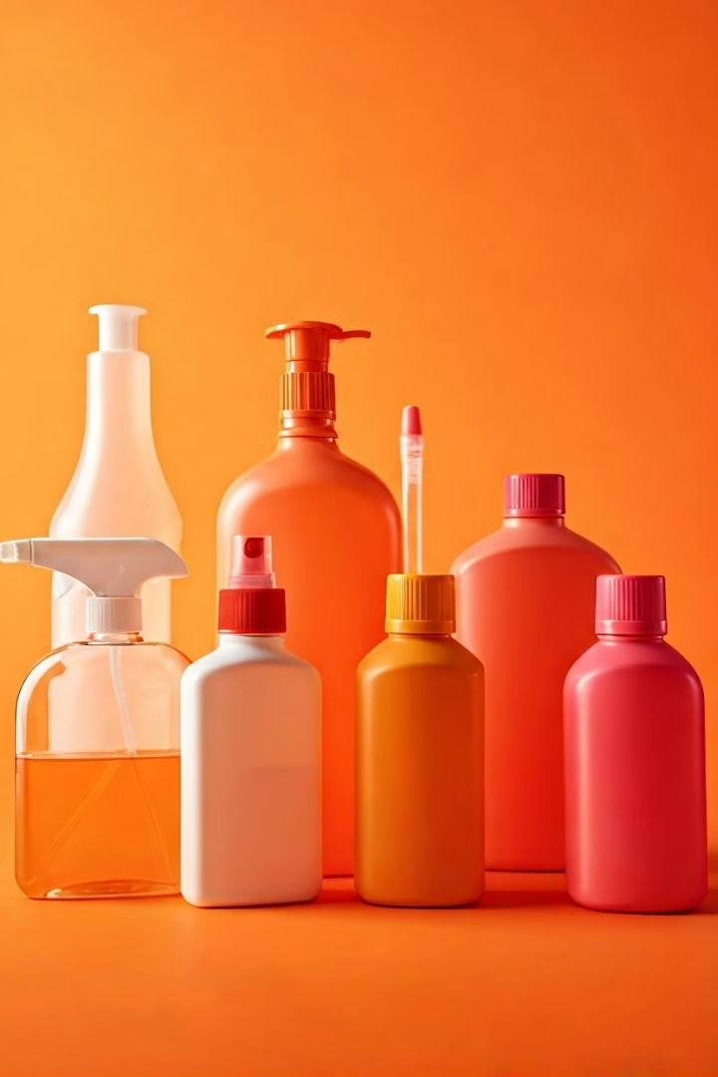
Chemical Decontamination Methods
1
Disinfectants
Chemical agents that kill or inactivate microorganisms on surfaces and equipment.
2
Antiseptics
Antimicrobial substances applied to living tissue to prevent infection and promote healing.
3
Validation
Ensuring the effectiveness of chemical methods through testing and monitoring.

Slide 8
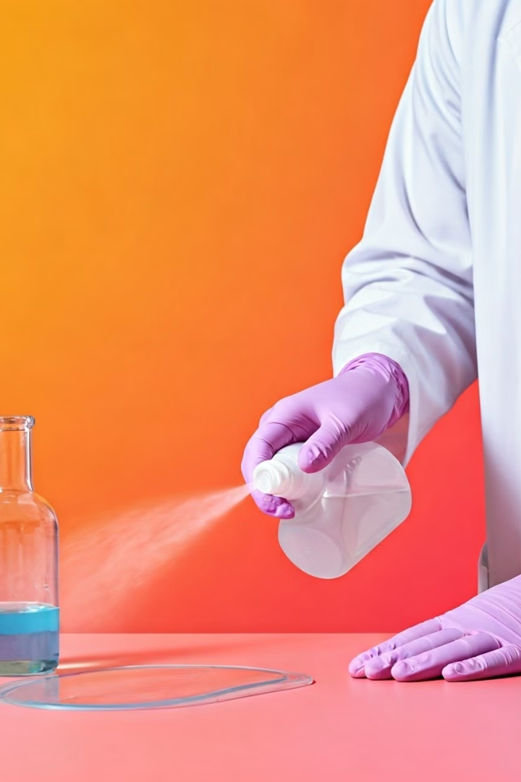
Disinfectants and Antiseptics
Alcohols
Chlorine
Denature proteins and disrupt cell membranes of microbes.
Oxidizing agent that damages microbial DNA and proteins.
Surfactants
Temperature
Reduce surface tension to physically remove microorganisms.
Heat and cold can inactivate or kill a wide range of microbes.

Slide 9
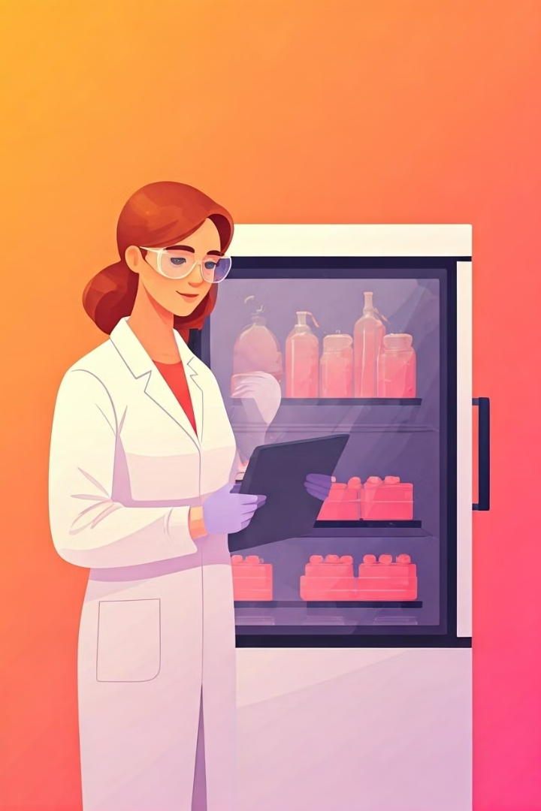
Validation and Monitoring
Validation
Ensuring decontamination methods effectively eliminate target microorganisms.
Routine Monitoring
Ongoing testing and record-keeping to verify continued effectiveness.
Corrective Action
Addressing any issues or failures in the decontamination process.

Slide 10
Conclusion and Best Practices
Comprehensive Approach
Rigorous Training
Ensuring all laboratory personnel are knowledgeable about proper decontamination techniques.
Combining physical, chemical, and monitoring methods for robust decontamination.
Continuous Improvement
Regularly reviewing and updating decontamination protocols to address emerging needs.

