Slide 1
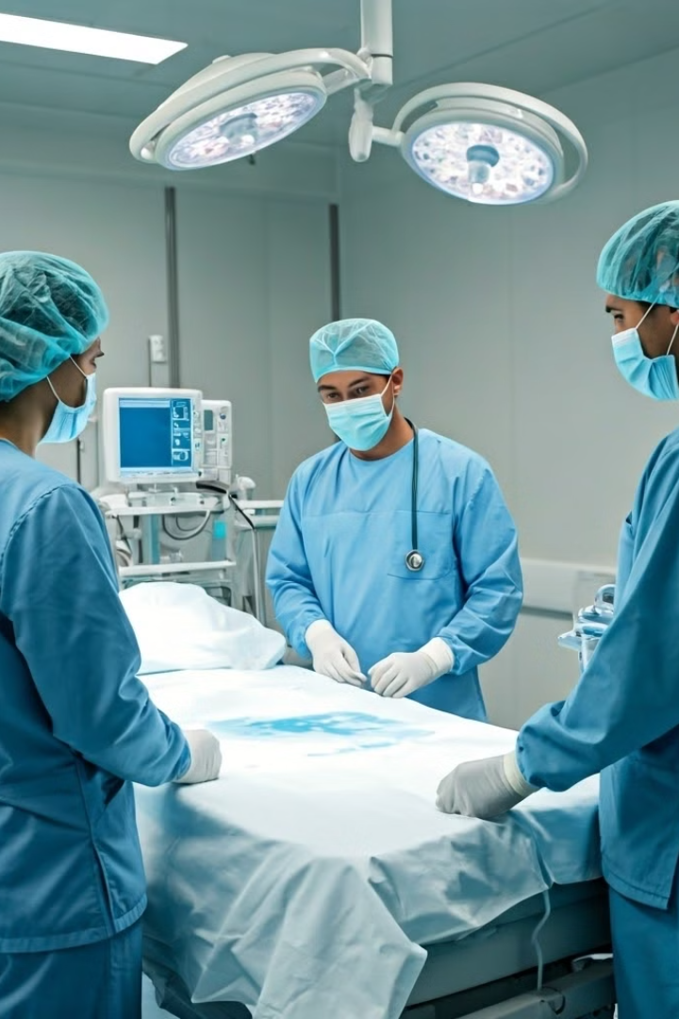
Infection Control for Medical Staff
Effective infection control is crucial for protecting the health and safety of medical professionals and their patients. This presentation will cover the essential protocols and best practices to prevent the spread of infectious diseases in healthcare settings.

Slide 2
Importance of Infection Control
1
Patient Safety
2
Reduced Costs
Infection control minimizes the risk of patients contracting illnesses during medical treatment.
Preventing healthcare-associated infections saves hospitals significant time and money.
3
Compliance
Adhering to infection control guidelines is necessary to meet regulatory requirements.

Slide 3
Hand Hygiene Protocols
1
Handwashing
Use soap and water for at least 20 seconds, focusing on all surfaces of the hands.
2
Hand Sanitizer
Apply alcohol-based hand rub, ensuring complete coverage of all hand surfaces.
3
Timing
Perform hand hygiene before and after patient contact, after touching contaminated items, and at other critical moments.

Slide 4
Proper Use of Personal Protective Equipment (PPE)
Gowns
Gloves
Masks & Face Shields
Wear impermeable gowns to protect against splashes and contamination.
Change gloves between patients and when visibly soiled or damaged.
Use appropriate masks and face shields to prevent exposure to airborne pathogens.

Slide 5
Disinfection and Sterilization of Medical Equipment
Cleaning
Disinfection
Sterilization
Remove visible dirt and debris from instruments and surfaces before disinfection or sterilization.
Use EPA-approved disinfectants to kill pathogens on non-critical equipment and surfaces.
Ensure critical equipment is properly sterilized using methods like autoclaving or gas sterilization.

Slide 6
Handling and Disposal of Contaminated Waste
Segregation
Containment
Disposal
Separate contaminated waste from general waste for proper disposal.
Use leak-proof, puncture-resistant containers for transporting contaminated waste.
Follow local regulations for the safe and environmentally-friendly disposal of contaminated waste.

Slide 7
Preventing the Spread of Airborne Pathogens
Engineering Controls
Implement HVAC systems and negative pressure rooms to limit airborne transmission.
Administrative Controls
Establish policies for patient isolation, visitor restrictions, and staff cohorting.
Personal Protective Equipment
Use N95 respirators or higher-level masks to protect against airborne pathogens.

Slide 8
Isolation Procedures for Infected Patients
Contact Precautions
Droplet Precautions
Airborne Precautions
Implement contact precautions for pathogens transmitted through direct or indirect contact.
Use droplet precautions for pathogens spread through large respiratory droplets.
Employ airborne precautions for pathogens that can remain suspended in the air.

Slide 9
Monitoring and Reporting of Infectious Outbreaks
1
Surveillance
Continuously monitor for signs of infectious disease outbreaks within the healthcare facility.
2
Reporting
Promptly report any suspected outbreaks to public health authorities for further investigation.
3
Response
Implement appropriate control measures and work with experts to contain the outbreak.

Slide 10
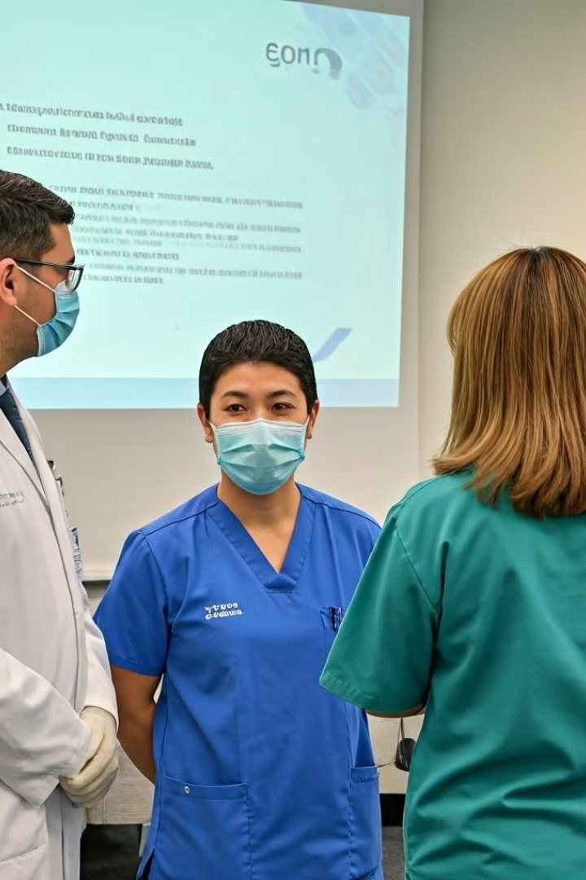
Continuous Training and Education for Medical Staff
Onboarding
Ongoing Education
Provide comprehensive infection control training for all new hires and staff.
Regularly update staff on the latest infection control guidelines and best practices.
Competency Assessments
Evaluate staff proficiency in infection control procedures and provide additional support as needed.

