Slide 1
Clinical Case Presentation
Welcome to this clinical case presentation. We'll explore a complex patient case, discussing history, examination findings, diagnosis, and treatment. This presentation will provide valuable insights into medical decision-making and patient care.

Slide 2
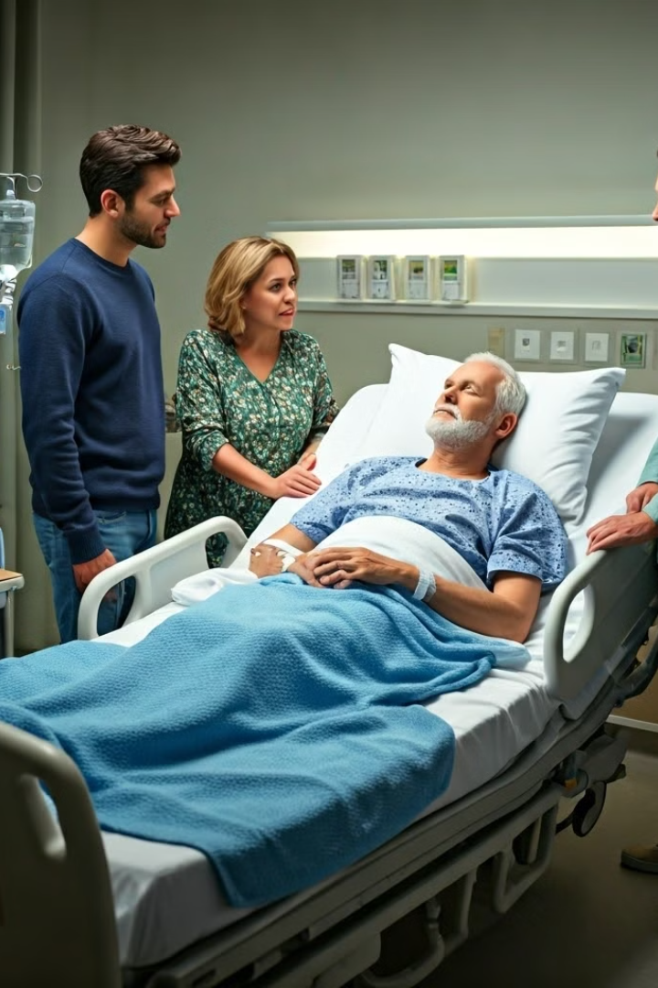
Introduction
1
Patient Admission
68-year-old male admitted with severe abdominal pain and fever. Symptoms began three days ago, progressively worsening.
2
Initial Assessment
Emergency department evaluation revealed signs of acute distress. Patient appeared pale and diaphoretic.
3
Preliminary Diagnosis
Suspected acute cholecystitis based on presenting symptoms. Further tests ordered to confirm diagnosis.

Slide 3
Patient History
1
Medical Background
2
Social History
History of hypertension and type 2 diabetes. No prior surgeries or hospitalizations.
Non-smoker, occasional alcohol consumption. Retired teacher living with spouse.
3
Family History
Father had coronary artery disease. Mother diagnosed with breast cancer at 65.

Slide 4
Physical Examination Findings
Vital Signs
Abdominal Exam
Other Findings
Temperature: 38.5°C
Tenderness in right upper quadrant
No jaundice observed
Blood Pressure: 140/90 mmHg
Positive Murphy's sign
Clear lung sounds
Heart Rate: 98 bpm
Mild distension noted
Regular heart rhythm

Slide 5
Diagnostic Tests and Results
Blood Tests
Imaging Studies
Additional Tests
Elevated white blood cell count: 15,000/µL. C-reactive protein: 80 mg/L. Liver function tests mildly elevated.
Abdominal ultrasound revealed gallbladder wall thickening and presence of gallstones. No biliary duct dilation observed.
ECG showed normal sinus rhythm. Chest X-ray unremarkable. Urine analysis within normal limits.

Slide 6
Differential Diagnosis
Acute Cholecystitis
Acute Pancreatitis
Primary consideration based on symptoms, physical exam, and ultrasound findings.
Considered due to abdominal pain, but less likely given normal lipase levels.
Peptic Ulcer Disease
Acute Hepatitis
Possible, but location of pain and ultrasound findings favor cholecystitis.
Less likely due to absence of jaundice and only mildly elevated liver enzymes.

Slide 7
Final Diagnosis
Diagnosis
Etiology
Severity
Acute Cholecystitis confirmed based on clinical presentation, laboratory findings, and imaging studies.
Caused by gallstone obstruction of the cystic duct, leading to gallbladder inflammation.
Moderate severity, requiring prompt intervention to prevent complications such as perforation or sepsis.

Slide 8
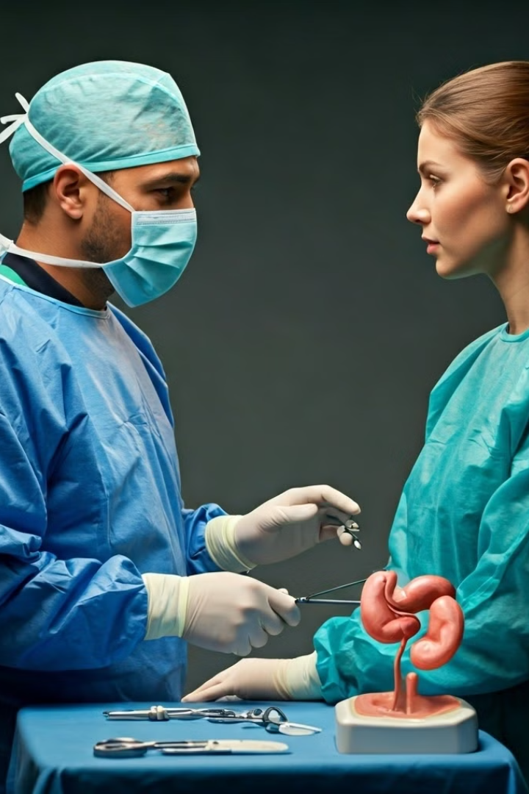
Treatment Plan
Initial Management
IV antibiotics initiated. NPO status maintained. Pain management with IV analgesics.
Surgical Intervention
Laparoscopic cholecystectomy scheduled within 24 hours of admission.
Post-operative Care
Early mobilization encouraged. Diet advanced as tolerated. Continued pain management and antibiotics.
Discharge Planning
Patient education on diet modifications and wound care. Follow-up appointment scheduled.

Slide 9
Patient Outcome
1
Surgical Procedure
Laparoscopic cholecystectomy performed without complications. Operative time: 75 minutes.
2
Post-operative Course
Patient recovered well. Pain controlled with oral medications. Diet advanced successfully.
3
Discharge
Patient discharged on post-operative day 2. Provided with follow-up instructions and medication list.

Slide 10
Discussion
1
Key Learning Points
2
Future Considerations
Importance of prompt diagnosis and treatment in acute cholecystitis. Role of imaging in confirming diagnosis.
Patient advised on lifestyle modifications to prevent future gallstone formation. Regular follow-ups recommended.
3
Team Reflection
Successful multidisciplinary approach highlighted. Emphasis on clear communication between departments for optimal patient care.

