Slide 1
Genetic Role in Craniofacial Anomalies
Craniofacial anomalies are a group of birth defects that affect the development of the head, face, and skull. Genetic factors play a crucial role in the etiology of these conditions, influencing the intricate processes of embryonic growth and tissue formation.

Slide 2
Anatomy of the Craniofacial Region
Cranium
Facial Bones
Soft Tissues
The upper portion of the skull, composed of the frontal, parietal, temporal, and occipital bones.
The bones that make up the face, including the maxilla, mandible, nasal, and zygomatic bones.
The muscles, skin, and connective tissues that shape the external features of the face.

Slide 3
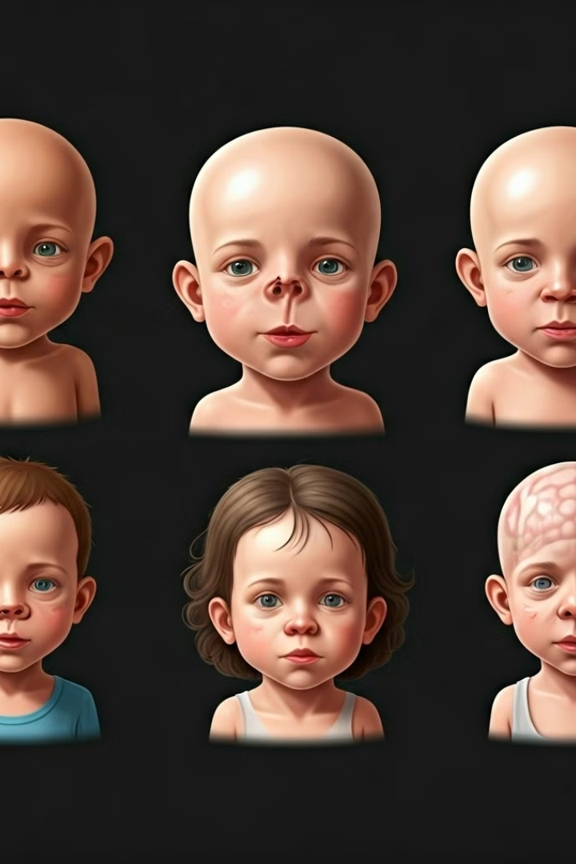
Types of Craniofacial Anomalies
Cleft Lip/Palate
Craniosynostosis
A common anomaly where the lip and/or palate fail to fuse properly during development.
Premature fusion of one or more cranial sutures, leading to an abnormal skull shape.
Microcephaly
Macrocephaly
A condition where the head and brain are significantly smaller than normal.
An abnormally large head, often caused by excess fluid or brain overgrowth.

Slide 4
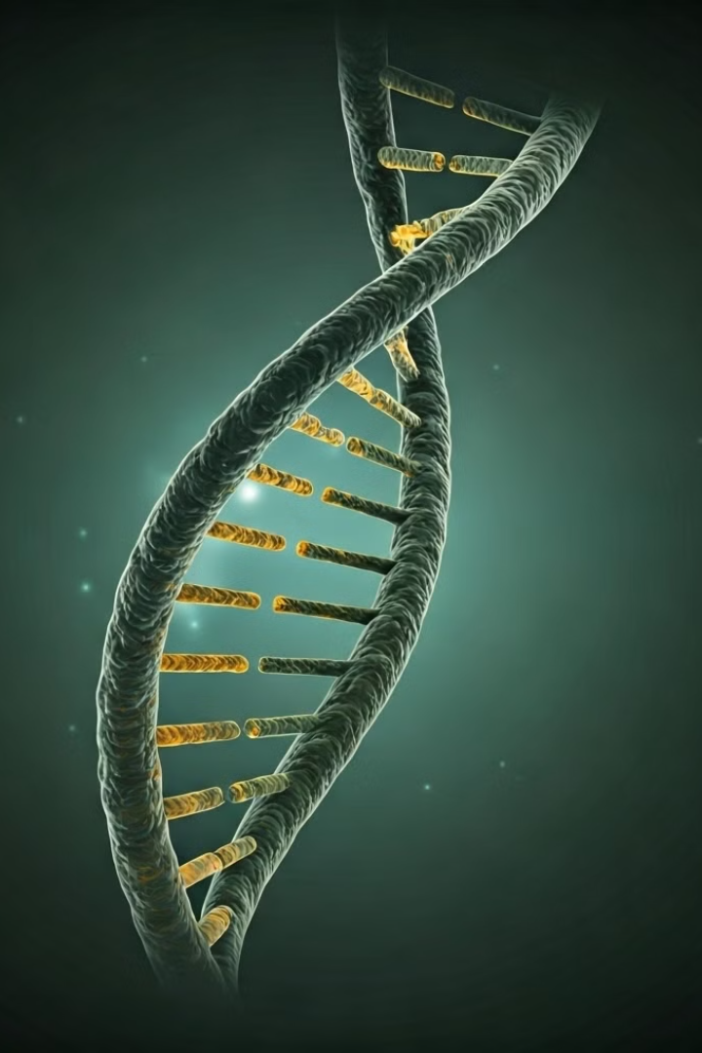
The Role of Genetics in Craniofacial Anomalies
1
Genetic Factors
2
Complex Inheritance
Mutations in genes involved in craniofacial development can lead to various anomalies.
Most craniofacial anomalies have a multifactorial inheritance pattern, involving multiple genes and environmental factors.
3
Syndromic Conditions
Certain genetic syndromes, such as Apert and Crouzon syndromes, are associated with craniofacial abnormalities.

Slide 5
Inheritance Patterns in Craniofacial Anomalies
X-Linked
Autosomal Dominant
The mutation is located on the X chromosome, leading to gender-specific inheritance patterns.
A single mutated gene from either parent can cause the condition.
1
2
3
Autosomal Recessive
Two mutated genes, one from each parent, are required for the condition to manifest.

Slide 6
Genetic Mutations Linked to Craniofacial Anomalies
TWIST1
MSX1
FGFR2
TP63
Involved in craniosynostosis.
Linked to cleft lip and palate.
Associated with Apert syndrome.
Involved in various craniofacial malformations.

Slide 7
Diagnostic Tools in Genetic Evaluation
Genetic Testing
Imaging Techniques
Counseling
DNA analysis, including sequencing and chromosomal microarray, to identify genetic mutations.
Radiographic, CT, and MRI scans to assess craniofacial structure and development.
Genetic counseling to provide guidance on inheritance patterns and recurrence risks.

Slide 8
Multidisciplinary Approach to Treatment
Plastic Surgery
Speech Therapy
Dental Care
Corrective procedures to address structural abnormalities and improve appearance.
Improving speech, swallowing, and communication skills for those with cleft lip/palate.
Orthodontic treatment and dental interventions to address bite and alignment issues.

Slide 9
The Importance of Early Intervention
1
Developmental Milestones
2
Psychological Well-being
3
Multidisciplinary Care
Early treatment can help ensure proper growth and development of the face and skull.
Timely interventions can improve self-esteem and social integration for affected individuals.
A coordinated approach involving various specialists is crucial for optimal outcomes.

Slide 10
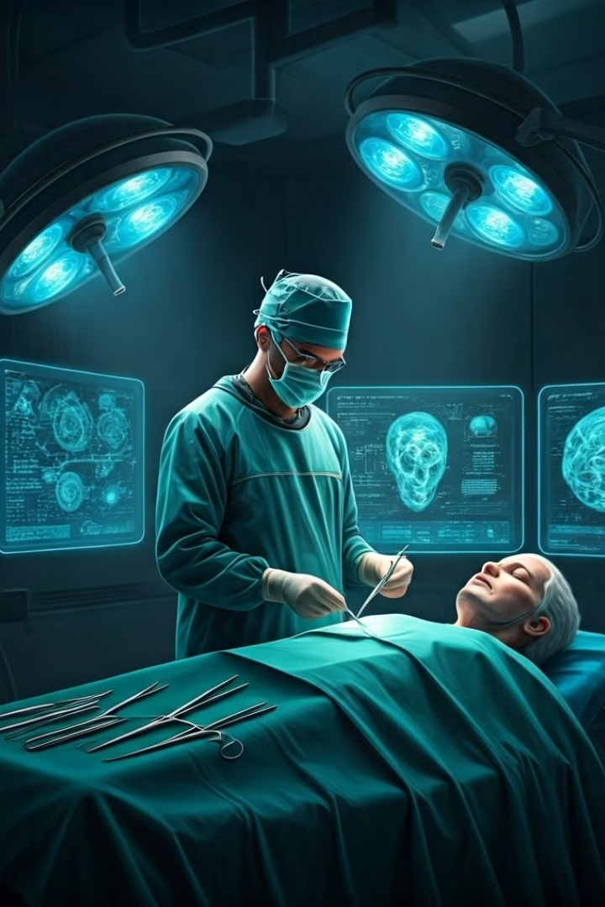
Future Directions in Craniofacial Genetics
Gene Therapy
Personalized Medicine
Potential to correct genetic defects and prevent the development of craniofacial anomalies.
Tailored treatments based on an individual's unique genetic profile and medical history.
Prenatal Diagnosis
Collaborative Research
Advances in imaging and genetic testing to detect craniofacial anomalies during pregnancy.
Interdisciplinary efforts to further understand the genetic basis of craniofacial development.

