Slide 1

Data Analysis
أ.م.د. رشـــا حسين علي- أ.م.د.رحاب حسين علي
كلية التربية للبنات – قسم الحاسوب
كلية التربية للبنات – قسم رياض الاطفال

Slide 2
Introduction to Data Analysis
What is Data Analysis?
Why is it Important?
Data analysis involves the process of examining raw data, cleaning and organizing it, and extracting meaningful insights and patterns.
Data analysis helps us understand trends, make informed decisions, and improve outcomes in various fields, from business to science.

Slide 3
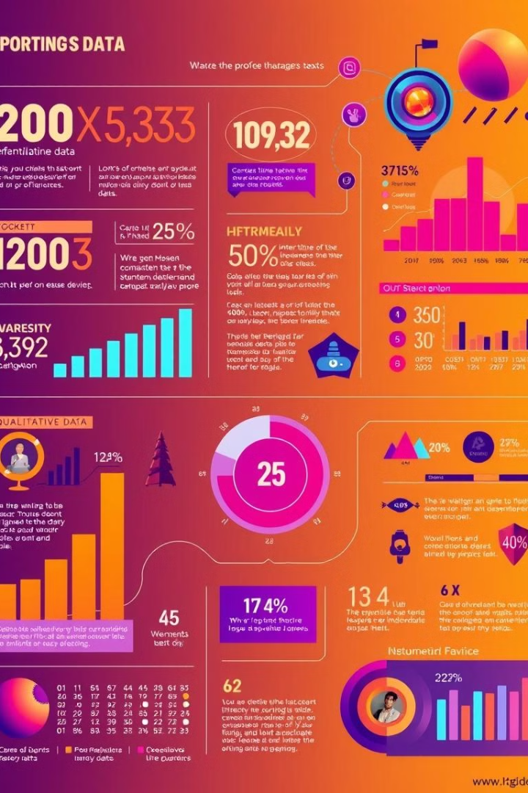
Types of Data: Quantitative vs. Qualitative
Quantitative Data
Qualitative Data
Numerical data that can be measured and counted. Examples include sales figures, age, and temperature.
Descriptive data that provides insights into opinions, beliefs, and experiences. Examples include customer feedback, surveys, and interviews.

Slide 4
Tools and Techniques
• Data Visualization: Tableau, Power BI
• Programming: Python, R
• Statistical Analysis: SPSS, Excel
• Machine Learning: Scikit-learn, TensorFlow
• Big Data Tools: Hadoop, Spark

Slide 5
Applications of Data Analysis
✔ Healthcare: Predicting patient outcomes.
✔ Finance: Fraud detection and risk modeling.
✔ Technology: Improving user experiences.
✔ Education: Personalized learning experiences.

Slide 6
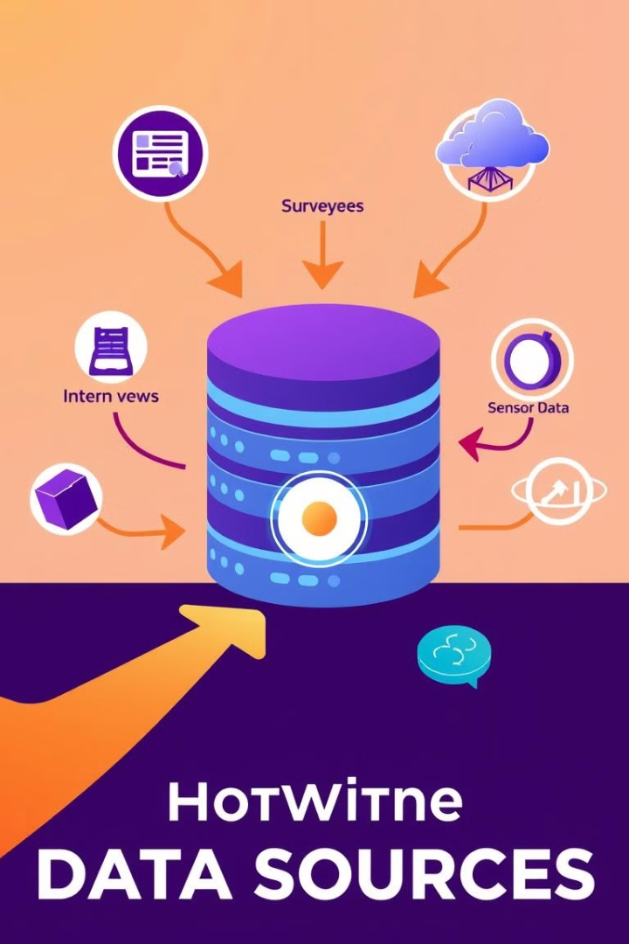
Data Collection and Sampling Techniques
Surveys
Interviews
Gathering structured data through questionnaires or online forms.
Collecting in-depth qualitative data through conversations.
Observations
Experiments
Recording and analyzing data through direct observation of events or behaviors.
Conducting controlled tests to gather data on specific variables.

Slide 7




Data Cleaning and Preprocessing
Handling Missing Values
Replacing or removing missing data points using various methods.
Data Transformation
Converting data into a consistent format to ensure accurate analysis.
Outlier Detection
Identifying and addressing extreme data points that may skew results.

Slide 8



Exploratory Data Analysis (EDA)
Summarize Data
1
Calculate descriptive statistics, such as mean, median, and mode.
Identify Patterns
2
Look for trends, relationships, and outliers in the data.
Visualize Relationships
3
Create charts and graphs to understand the data visually.

Slide 9

Statistical Analysis Methods
1
Regression Analysis
Examining the relationship between variables to predict outcomes.
2
Hypothesis Testing
Testing a specific claim about a population based on sample data.
3
ANOVA
Comparing the means of different groups to determine significant differences.

Slide 10
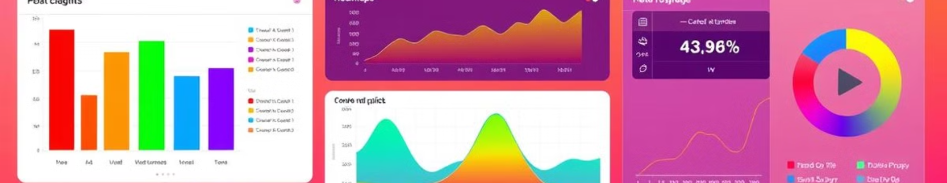




Data Visualization Techniques
Bar Charts
Line Graphs
Scatter Plots
Heatmaps
Comparing categorical data using bars of different heights.
Showing trends over time or across different categories.
Visualizing the relationship between two numerical variables.
Representing data in a grid with color intensity indicating values.

Slide 11

Thank you

