Slide 1
Boosting memory and creativity
Presented by
Lecturer/ Ahmed Amer
College of Physical Education and Sports Science
Baghdad university

Slide 2
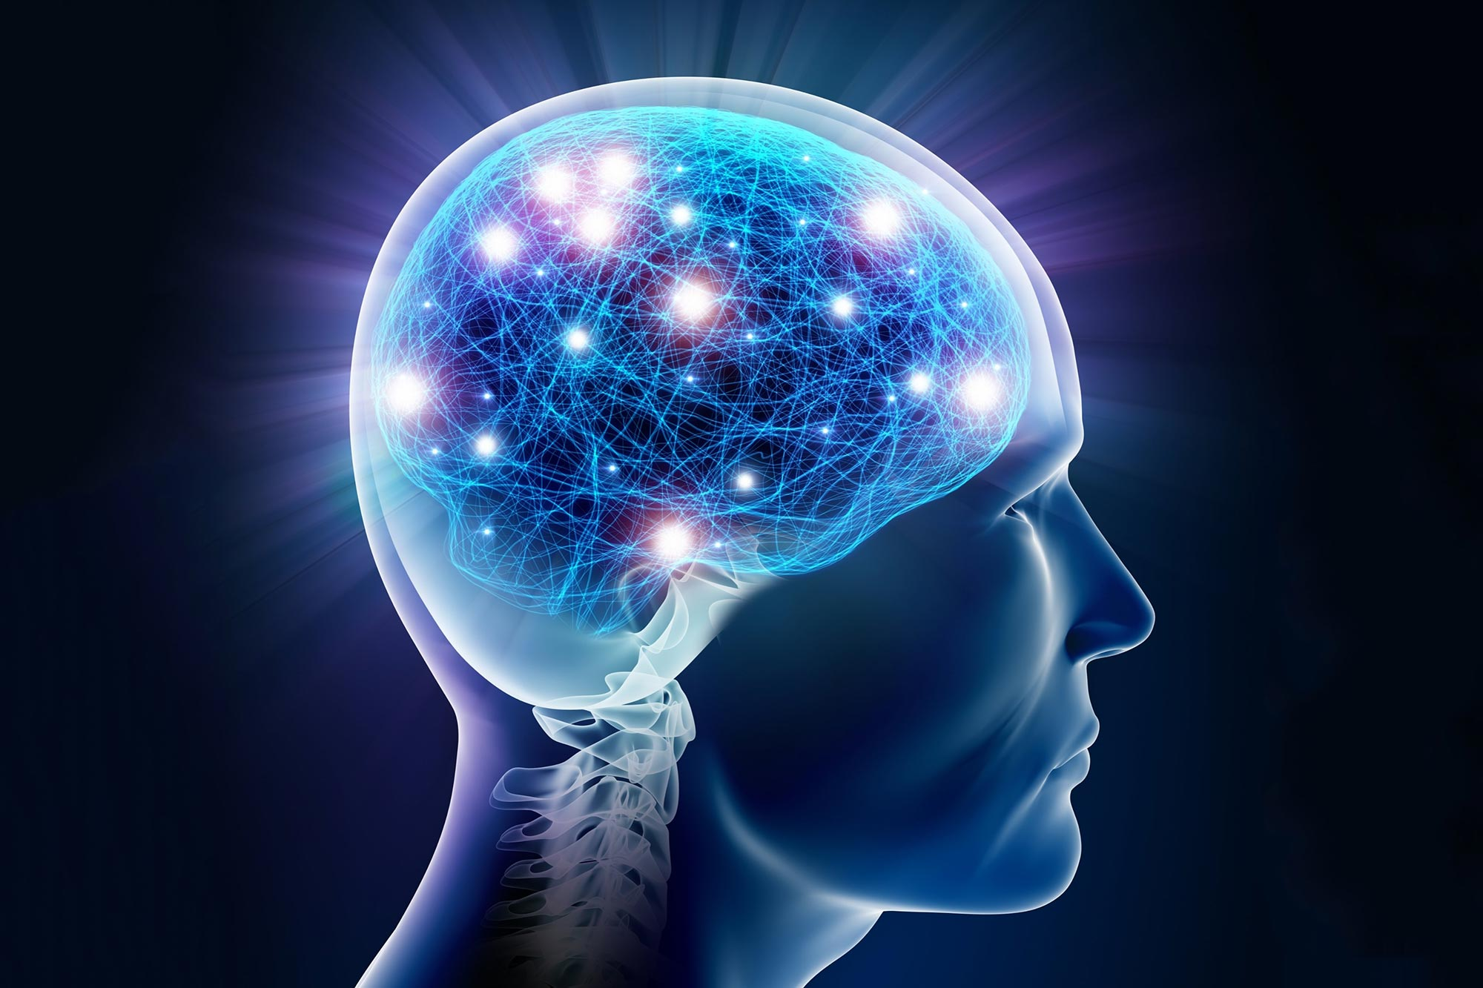
Those who cannot remember the past are condemned to repeat it.
– George Santayana

Slide 3
introduction
Neuroscience is still in its infancy, but its investigations are showing to be highly influential in many fields. Some of its topics, however, have been discussed for centuries. Memory is one of them, having been studied in philosophy, psychology and biology.
Among the different themes studied by neuroscience, memory is arguably one of the main topics since the creation of this field

Slide 4
What is memory
Our memory is concerned with meaning, not data, and this implies an emphasis on creation, rather than storage.
memory is “based on the construction of meaning, an interpretation of the outside world that relies on selecting a minimum of information and making abstractions – while discarding a multitude of detail”

Slide 5
What is memory
Memory, is not always or only a reproduction of past experiences or a simple connection between two discrete moments of consciousness.
It is also a way of weaving the facts about ourselves and our histories into a coherent and intelligible story, expressive of the overall contours of our characters and our lives; our autobiographical memory is, that is, more like a biography than a photo album

Slide 6
We, as teachers can be so caught up in the task of instruction that we may forget the most essential issue of all: insuring adequate memory of the materials presented. Teachers present students with a seemingly endless supply of information, skills and concepts but this material is only truly learned if it can be efficiently recalled by the student when needed. Therefore, choosing methods to enhance memory and efficient recall is possibly the most critical aspect of your instructional design.

Slide 7
teaching with a content-based approach does not support memorization. According to Sharma, Bhosle, & Chaudhary (2012), 75% of all information processed in human brain is from visual communication because the human brain processes images 60,000 times faster than texts, and 90 percent of information transmitted to the brain is visuals (Eisenberg, 2014), which facilitates better memorization of content.
Visual communication is considered as an effective teaching approach to convert a content-based or text-based course into a visual-based one in order to make memorization easier and generate better learning performance. It is the communication of information through the visual display of information
The fundamental goal of visual communication is to produce the best possible picture at the lowest data rate (Huck, Fales & Rahman, 1997) because visual communication communicates and displays information in a format that enables people to clearly see information and understand what they see (Few, 2006).

Slide 8
There are many benefits of visual communication. According to Freeman (2019), visual communication can communicate information faster and better through its visual elements because it helps process visual information with less language barriers as compared to a paragraph of text, stimulates interest from viewers with their visual elements, generates easy to understanding information, and provides the ease of remembering and retaining the information (Choudhary, 2019; Dimension Data, 2013; Lankow, Ritchie & Crooks, 2012; Alfi, 2011).
Also, there is various evidence from current research studies indicating that communication that has a visual component can be far more effective than communication that does not ((Hewlett- Packard Development Company, 2004

Slide 9
Example try to memorize the following
Rabbit
Chair
Fox
Dinner
Tie
Blue
Cup

Slide 10

This Photo by Unknown Author is licensed under CC BY

Slide 11
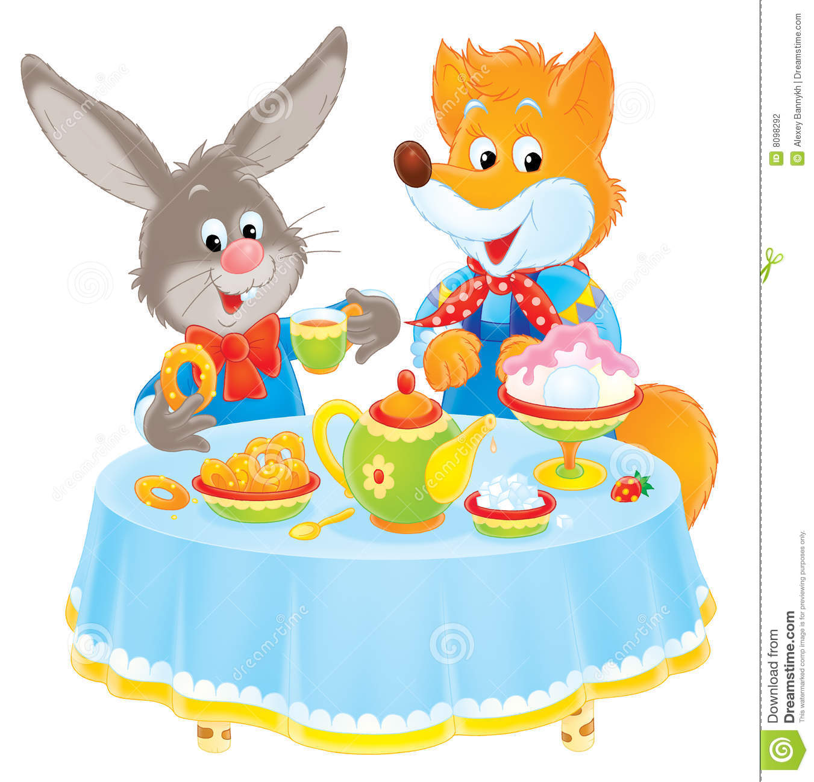
It is easier to remember when put in a picture

Slide 12
Modern bio-medical memory enhancement has been a major scientific goal in the last decades, in great part because of dementia related diseases, but also as a way to enhance ourselves cognitively.
Techniques to treat post-traumatic stress disorder (PTSD) by erasing or weakening specific memories have also been quite important.
It would be simply impossible to give a comprehensive account of all the different types of memory enhancers. These new enhancements can be technological, genetic , or pharmacological

Slide 13
Defining Memory and Targeting Phases for Memory Enhancement
Stages of Memory Formation and Storage
memory consists of multiple stages, including acquisition/ encoding, working memory/short-term memory, long-term memory/consolidation, memory retrieval, and reconsolidation

Slide 14
Types of Memories and Memory Systems
Memories can be classified not only in a temporal manner, but also according to their type and function, as well as by which brain regions underlie their formation and processing
Importantly, these memory systems are not separated in nature, acting alone and on one type of memory, but rather, they coexist and often interact.

Slide 15
Mechanisms of Memory Enhancement
1. Gene Expression: The CREB-C/EBP Pathway
One of the first mechanisms identified as critical for long-term memory consolidation (both explicit and implicit) is the requirement for de novo protein and RNA synthesis

Slide 16
2. Synaptic Remodeling
Long-term memory formation is critically associated with synaptic remodeling, including the growth or pruning of synapses, as well as altered synaptic efficacy.
These changes occur through a number of local regulations, including mRNA translation, protein degradation, remodeling of cytoskeleton, and receptor trafficking into and out of the synapse.

Slide 17
3. Neuromodulation
Neuromodulators, which alter cellular and synaptic properties via widespread projections have a well-known role in memory function and many modulation pathways have been targeted for memory enhancement.
One neuromodulator with a well-known effect on cognition is dopamine.

Slide 18
4. Endogenous Substances
The effects on memory enhancement discussed above are mainly the results of pharmacological manipulations with synthetic compounds, especially for those used in clinical studies, as is the case with Ampakines, D-Cylcoserine, and Donepezil. However, a number of endogenous substances, primarily those that are key players in metabolic processes (ie. glucose and insulin), have been known to have a direct memory enhancing effect for quite some time.

Slide 19
Behavioral Methods
In addition to pharmacological approaches, there are a number of behavioral manipulations that have been found to be effective in promoting memory enhancement. First, repetition has long been known to enhance memory performance, and it has been consistently shown that repeated training trials and/or learning events are associated with better memory. This method is one that is employed during everyday learning, and is also known to have benefits for cognitive disorders such as dementia

Slide 20
COMPOSE
is an acronym designed to summarize the critical teaching skills which improve student memory of information taught. By addressing the elements of COMPOSE, teachers can maximize the likelihood that the information they teach will be stored in a manner which will optimize the likelihood of efficient recall for later application and exploration. COMPOSE stands for Connections, Odds of Success, Meaningfulness of the Materials, Practice, Organizational Clarity, Strategies, and Emotional Impact

Slide 21
COMPOSE
C: Connections One simple method for connecting new information to known information is through elaboration to activate prior knowledge before any presentation of new information
O: Odds of success Segmenting Tasks: Presenting tasks in shorter segments (fewer items appear less daunting than larger numbers of items to complete)
M: Meaningfulness, value In general, we forget the meaningless…and retain the meaningful. Rebecca Rupp
P: Practice, repetition We're creating those memories that will last. You remember the things that you did, not the thing that you learned. Susan Hilyer
O: Organizational clarity Simplicity, clarity, singleness: These are the attributes that give our lives power and vividness and joy as they are also the marks of great art. Richard Holloway
S: Strategies Strategies are techniques you can use to organize or practice materials for learning or memory.
E: Emotional impact What we learn with pleasure we never forget. Alfred Mercier

Slide 22
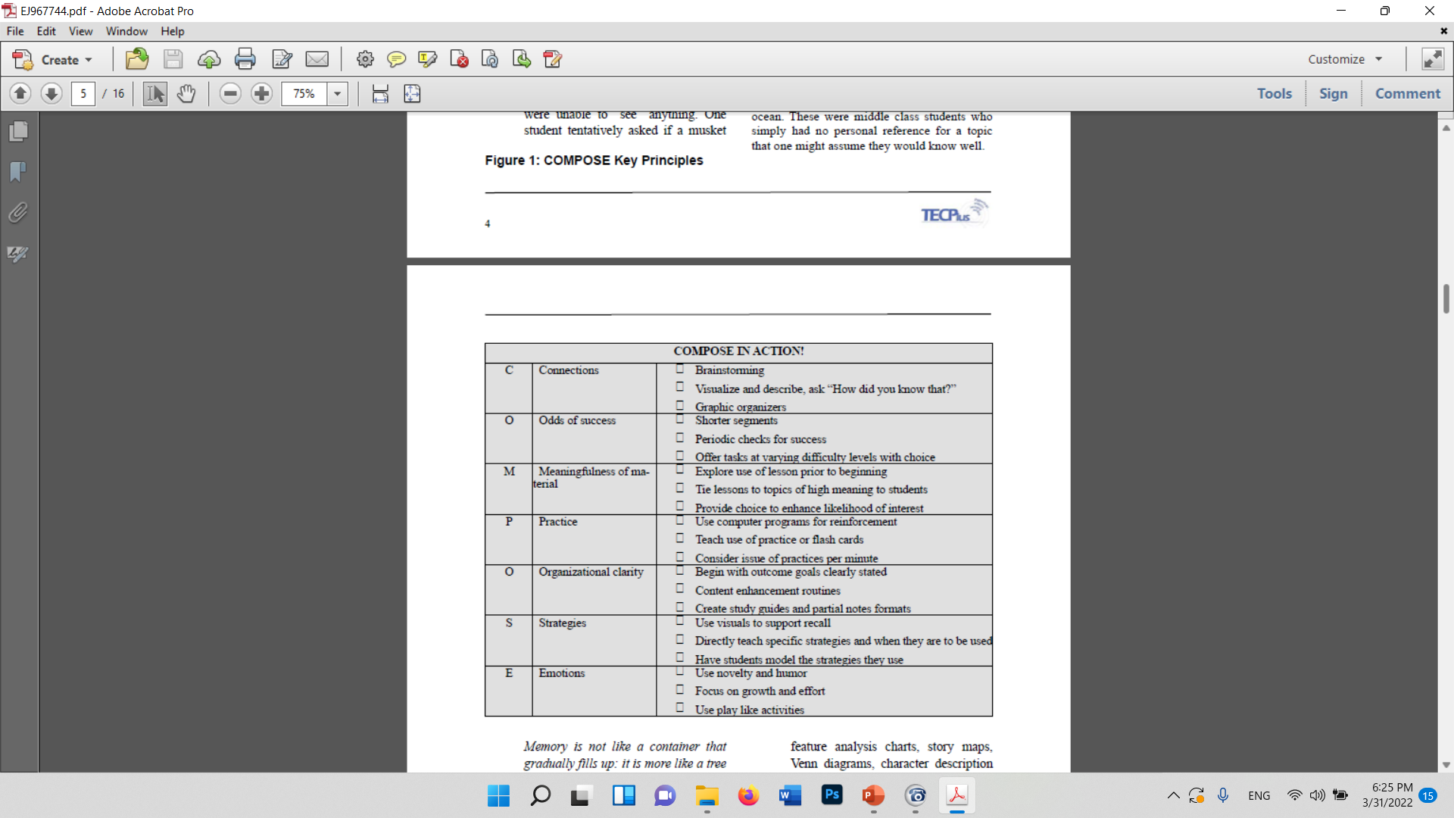

Slide 23
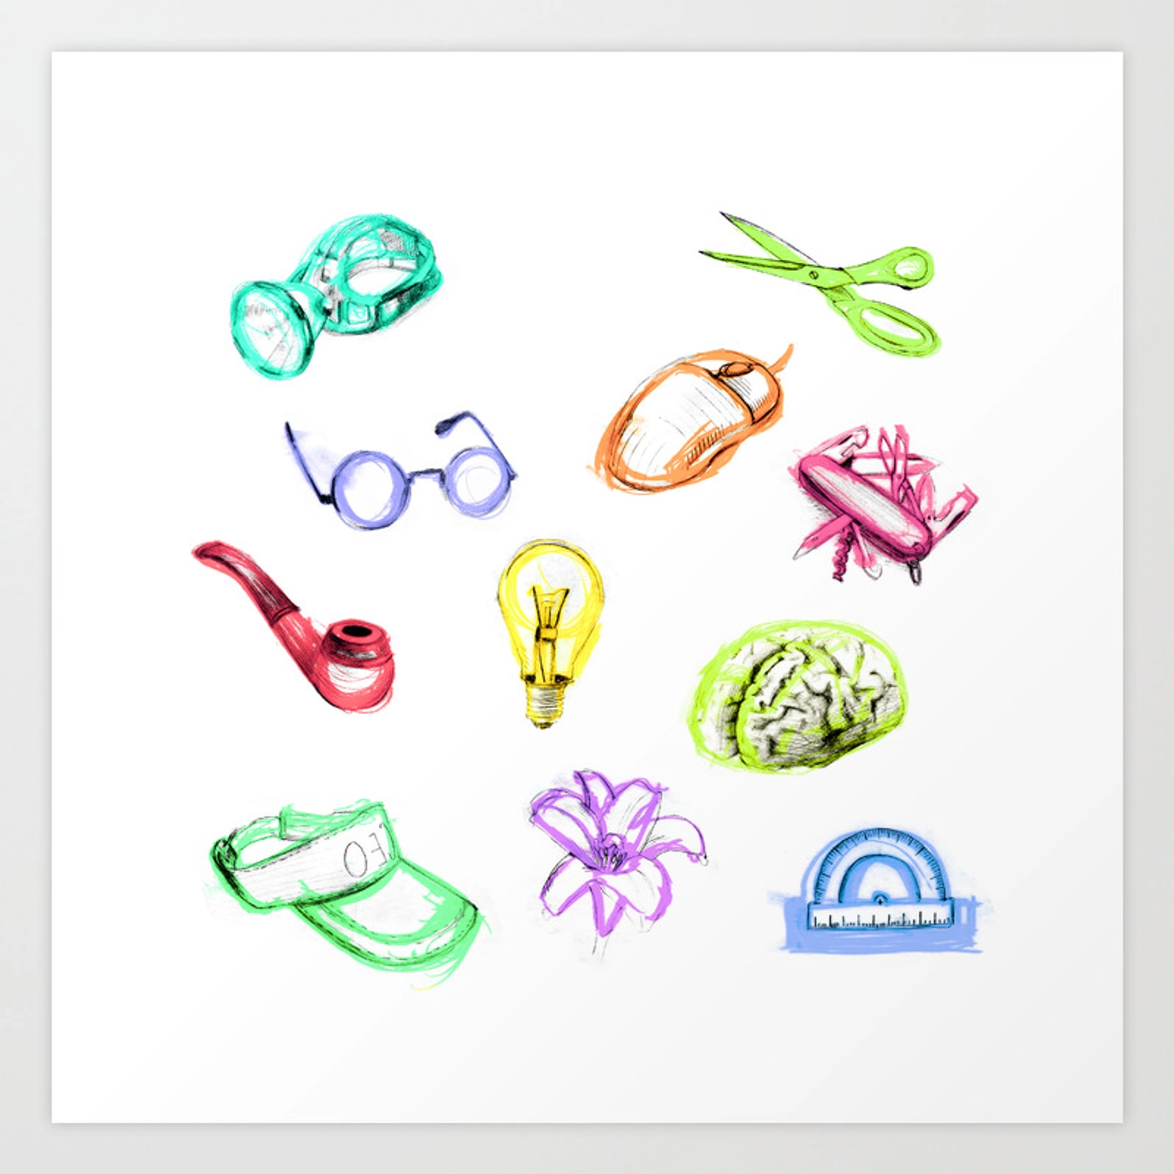
Example

Slide 25
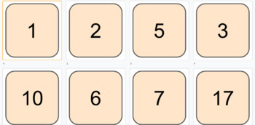
Another example

Slide 27

This Photo by Unknown Author is licensed under CC BY-SA-NC

