Slide 1

Occlusion & TMJ Disorder ,is it emergency
Prof Dr Fawaz. Aswad
College of dentistry
University of baghdad

Slide 2
Why we study this subject ?
Now that there is a universal acceptance of the need for continuing education, it may be more realistic to consider a comprehensive study of the articulatory system as the first mandatory element of a post graduate dental education. But the articulatory system is the biomechanical environment in which dentists provide treatment

Slide 3
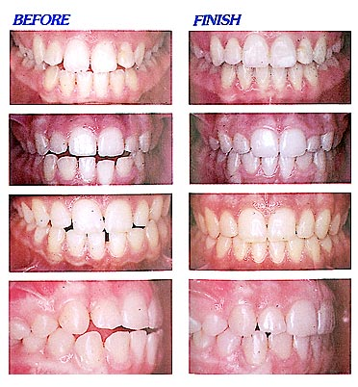
Q / What Occlusion is ?
Q / What is Mal Occlusion ?

Slide 4
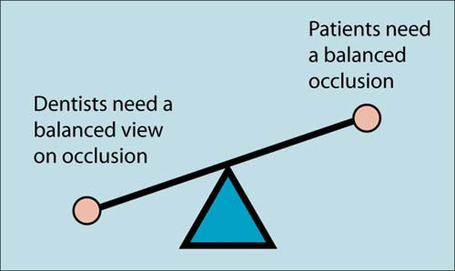
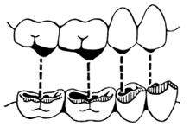

Slide 5
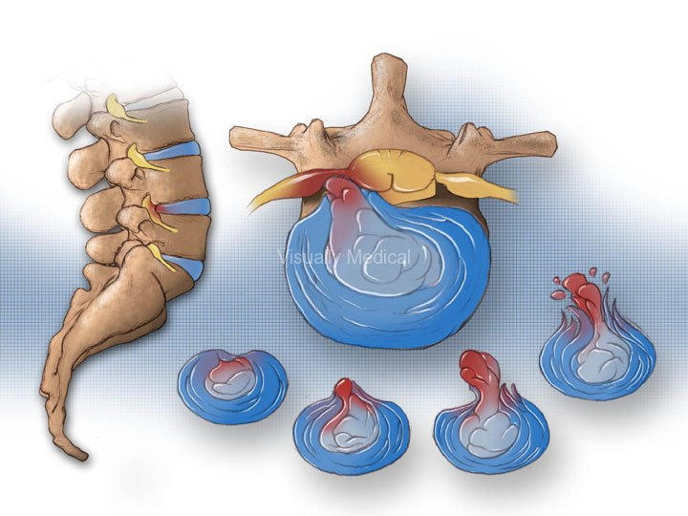
Q / Why occlusion is important ?
TMJ Disorder
Poor Posture
Excessive earwax
Speed defect
Prolapsed of Lumbar disc
Negative influence on the Craniosacral mechanism
Look of beauty
Reduced Strength in Deltoid and rectus femoralis muscles

Slide 6
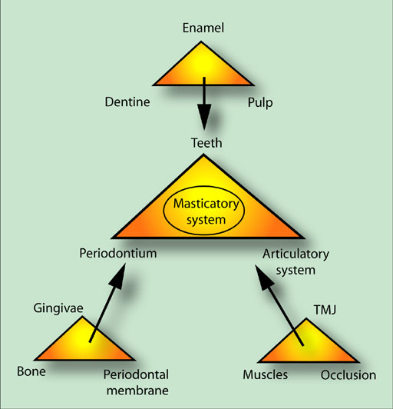
The Masticatory System

Slide 7
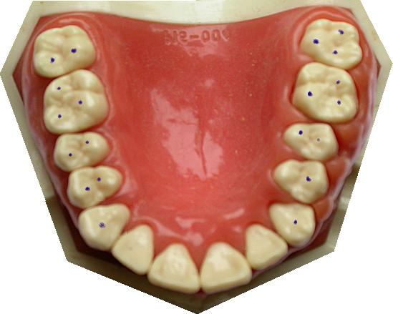
How to analysis the occlusion ?
Static occlusion .
Does the Centric occlusion occur in centric relation ?

Slide 8
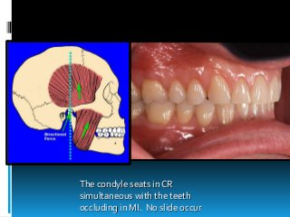

Slide 9
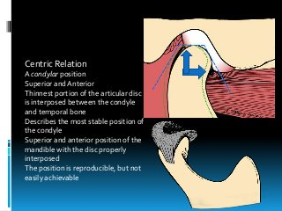

Slide 10
THE OCCLUSION CONDITION SHOULD BE CONSIDRED BOTH
DYNAMIC OCCULSION which affected the TMJ through the orthopedic stability of the mandible as it load against the cranium, therefore the acute changes in the occlusion can influence mandibular function thus lead the TMJ symptoms
Also the force applied on individual teeth are minimized when the condyles in the most anteriosuperior position in the fosa

Slide 11
Also the occlusion force will be affected in orthopedic stability
This stability exist when the teeth in harmony with the musculoskeletal stability of the condyle in the fossa
If the above mention stability occur so the functional forces can be applied to the teeth and joint without tissue injury

Slide 12
If that not happened what is going to occur ?
That’s mean the orthopedic stability exist and the teeth are not in occlusion the condyle maintained in position by the elevator muscle and this lead to the teeth to be brought into contact only ,and this represent a very instable occlusion position but the condyle remain in a stable position
Here the patient either have a stable joint position and only occlude on one teeth or try to bring the static occlusion position and this compromise the joint stability

Slide 13
What is going to happened if the loading occur and the joint is not in a stable relation ?
Here there will unusual movement in order to gain a stability this movement although small translators shift between disc and the condyle and lead to strain to the discal ligaments then elongation of the discal ligaments and thinning of the disc

Slide 14
What's these translatory movement caused ?
It may caused a minimum damage to the different element of the masticatory system ,this parafunction muscle activite by different mechanism like bruxism ,clenching
All the above mention notes still arise a question whether change in the occlusion will affected the TMJ

Slide 15
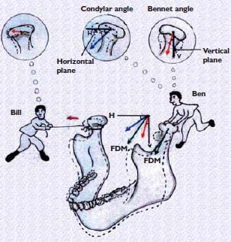
Dynamic Occlusion
Muscle & Mastication
Two Guidance System

Slide 16
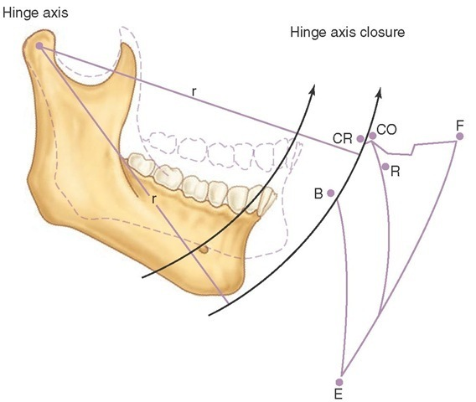

Slide 17
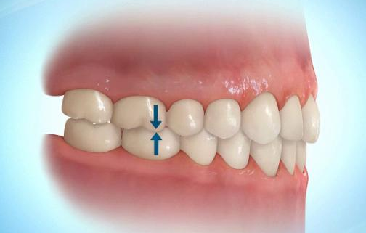
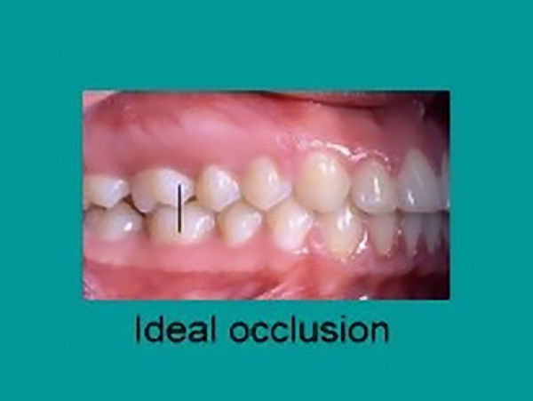
When we have an Ideal Occlusion?
- CO = CR
- When the Manidubular moves there is immediate and lasting post Disclusion Ant guidance on front

Slide 18
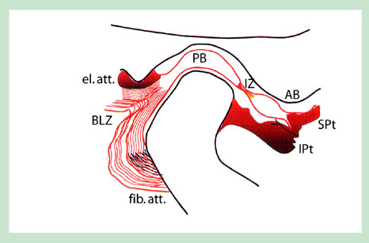
Functional anatomy of the temporomandibular joint
Anatomy Centric relation
Conceptual
Geometrical

Slide 19
'Does Centric Occlusion Occur in Centric Relation?' This is an essential question
Another aspect of the static occlusion is the presence or absence of 'freedom in centric', this is also known as 'long centric'.
As previously stated the word centric is an adjective and so strictly it should never be used without a defining noun. So this long established term would better read: Freedom in centric occlusion or long centric occlusion. Freedom in centric occlusion occurs when the mandible is able to move anteriorly for a short distance in the same horizontal and sagittal plane while maintaining tooth contact (Alternatively there will be no freedom in centric occlusion if either the front teeth or the posterior occlusion do not allow this horizontal movement

Slide 20
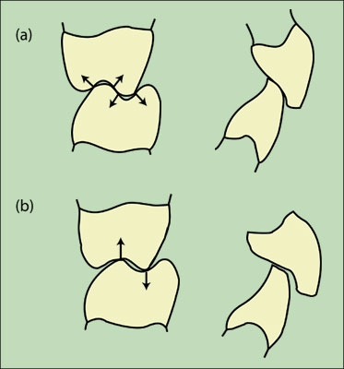

Slide 21
It is of paramount importance to appreciate that the term 'ideal occlusion' means something quite different from the term 'correct occlusion
'. To state that an occlusion is correct or wrong betrays a mechanistic approach to the subject. Patients are not machines and an occlusion can only be judged on the reaction that it produces in the tissues of the system in which it inter-reacts. That reaction will be infinitely variable between individuals and will in some contexts (ie TMD pain) vary within an individual with time.
Guidelines of Good Occlusal Practice should be established because they offer the most prudent way in which to provide

Slide 22
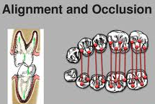
The importance of ideal occlusion Concept :
Pretreatment examination and records.
Treatment of TMJ & PDS
Confirmative versus reorganized approach

Slide 23
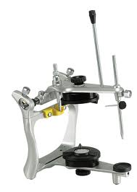
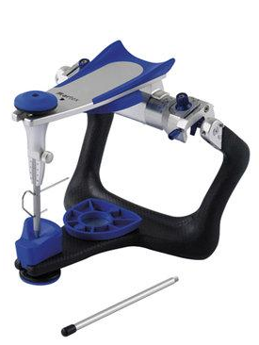
Q / What are the factors determine a patient’s reaction to an occlusion ?
The resistance of the tissue and / or restoration
The magnitude of force being applied
The frequency of force being applied
The Direction of force being applied
The number of Contacts transmitting that force

Slide 24
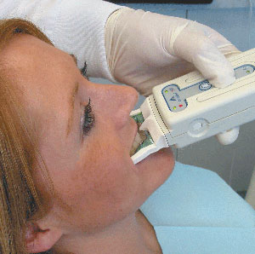
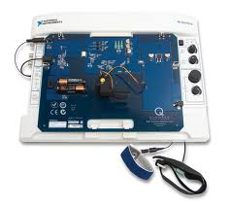
The Three most important factors that effect a patient’s occlusion :
Teeth
TMJ
Neuromuscular system

Slide 25


Extremely sorry for yr headaches

