Slide 1




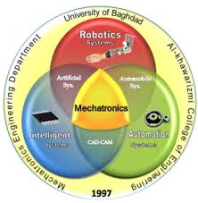
The Importance of Using Google Scholar and Scopus
Dr. Ayhem Tariq Al- Nuaimi
April, 01, 2024

Slide 2
PRESENTATION OUTLINE
Google VS Google Scholar
Definition of Google Scholar
How To Use Google Scholar
Metrics, H-Index, i10-Index, i20-Index
Definition of Scopus
How To Use Scopus
Conclusions & Advices

Slide 3
Google VS Google Scholar
Google
Anything it can find on the web, Web sites, blogs, images, videos, podcasts, PDFs, spreadsheets, presentations, discussions.
Sometimes includes articles from Scholar at the top of the results
Google Scholar
Research information, patents, legislation from known publishers.
Open access.
Author self archived repositories (may NOT be included in Scholar)
Institutional repositories.
Anything that is structured like an academic paper.
Separate from main Google .

Slide 4
Definition of Google Scholar
Is a search engine that searches for scholarly literature.
Can search across many disciplines.
Launched in 2004.
Not all articles will have free full text.
Some articles are linked to library resources if you work on campus.

Slide 5

How to open google scholar account?
No worry, if you have Gmail account
http://scholar.google.com
If not, simply Sign Up for Gmail/Google account
Single account sufficient for all google apps
Pricing Options: Free access via any Web browser.

Slide 6
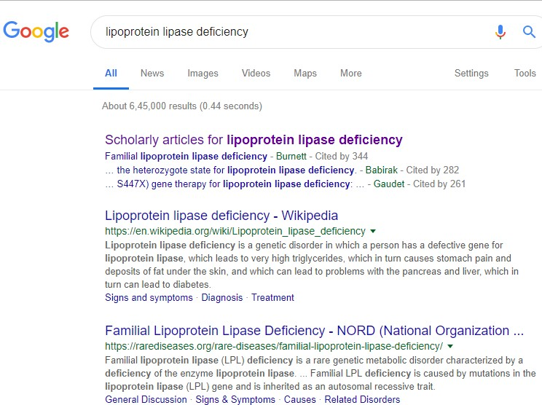
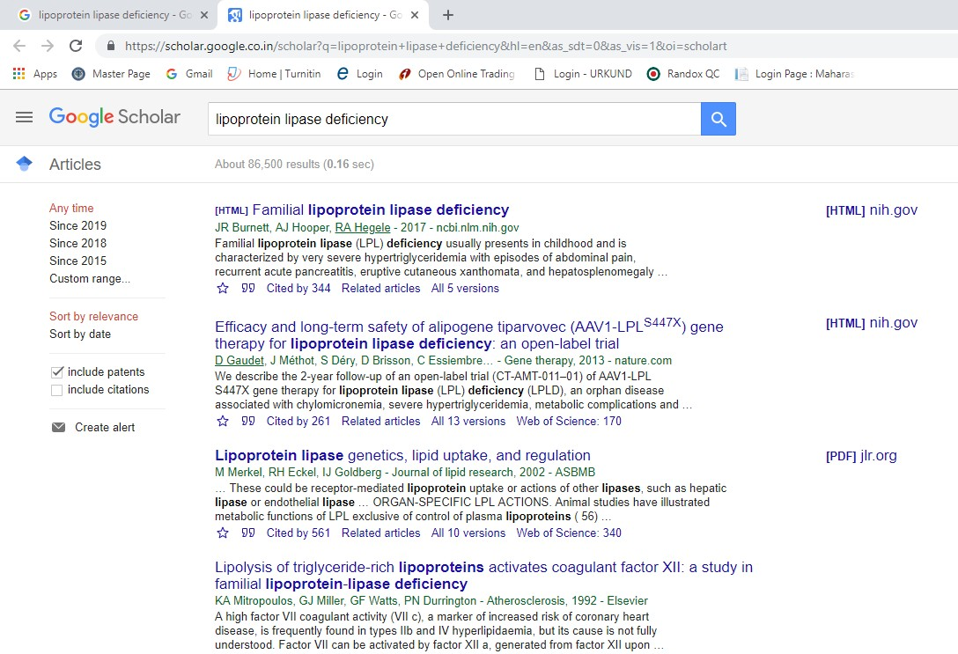
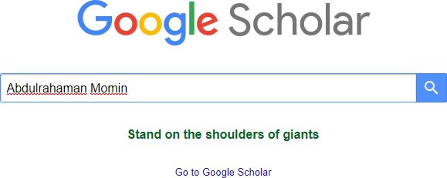

Slide 7
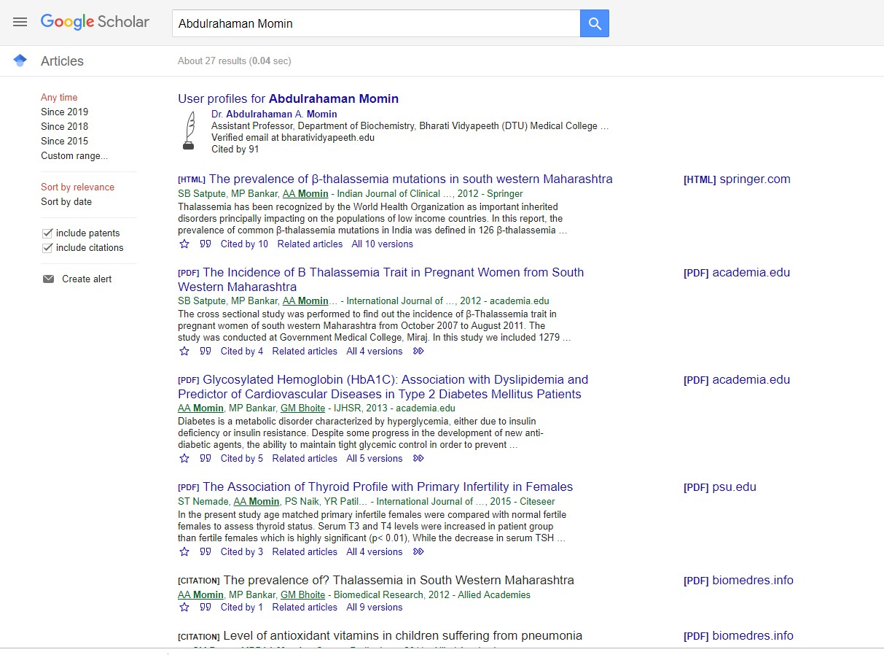
Title & Authors
Articles related to your paper
Cite the article (Next page)
Save to “My library” previously only found
Versions of your article
in CiteSeer, Scopus,
and Web of Science.

Slide 8
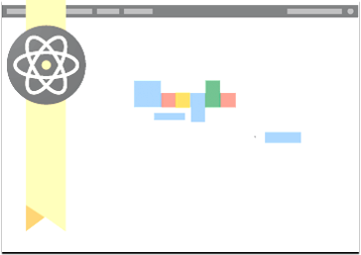
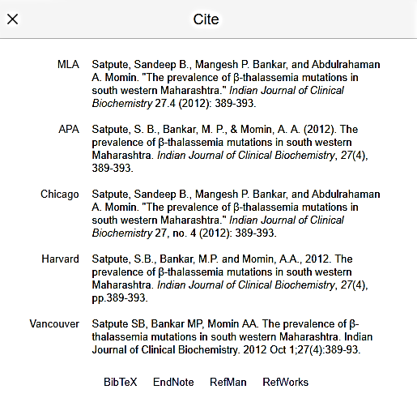

Slide 9
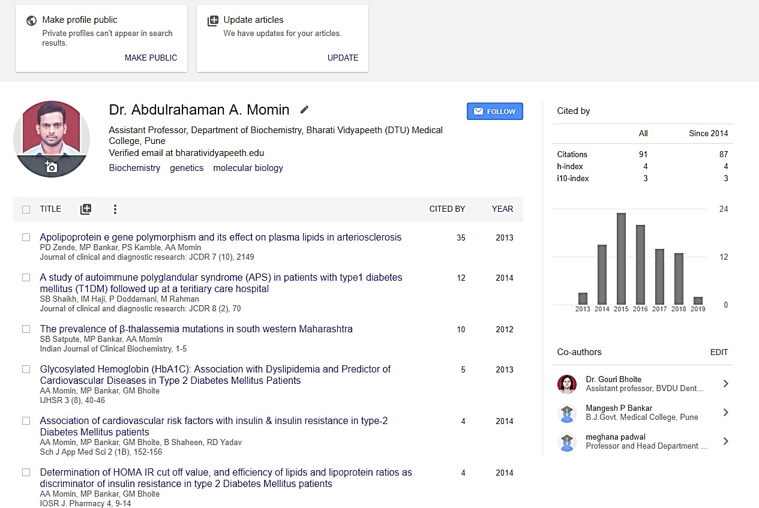

Appear in Google Scholar results when
Your citation metrics are computed and updated automatically as Google Scholar finds new citations to your work on the web.
people search for your name

Slide 10
How do I see the citation graph for one of my articles?

Slide 11
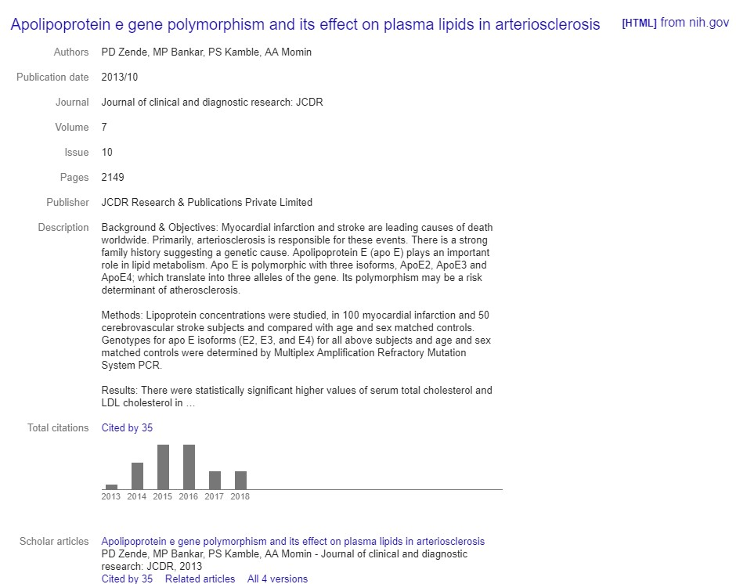

Slide 12
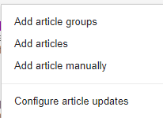
How to add article manually?
You can add groups of related articles
You can choose to have your list of articles updated automatically or review the updates yourself, or to manually update your articles at any time.

Slide 13
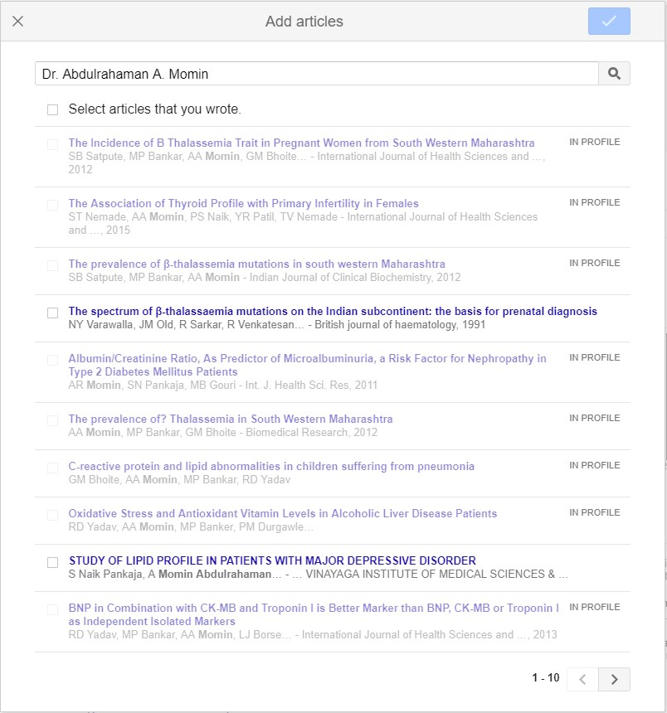
How to add article manually?

Slide 14
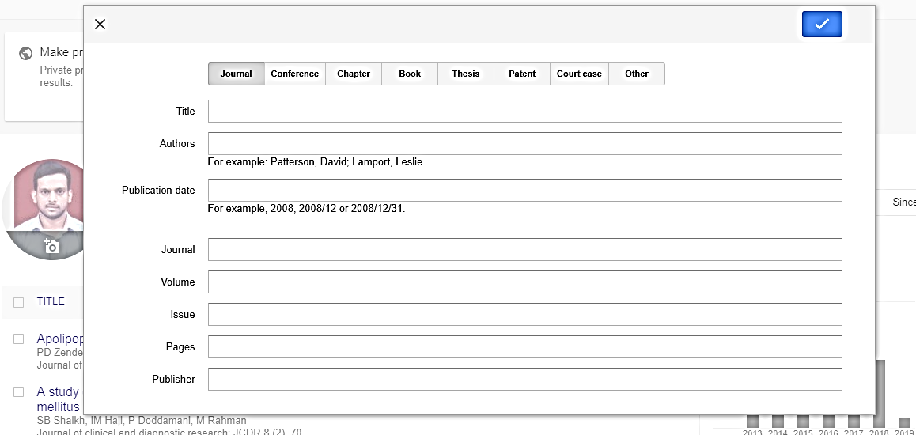
How to add article manually?
Apolipoprotein e gene polymorphism and its effect on plasma lipids in arteriosclerosis
PD Zende, MP Bankar, PS Kamble, AA Momin
2013/10
Journal of Clinical and Diagnostic research 7
10
2149-2152
JCDR Research & Publications Private Limited

Slide 15

Metrics
Google Scholar Metrics provide an easy way for authors to quickly gauge the visibility and influence of recent articles in scholarly publications.
Scholar Metrics summarize recent citations to many publications, to help authors as they consider where to publish their new research.
Google Scholar automatically calculates and displays the individual's total citation count, h-index, and i10-index.
You can also explore publications in research areas of your Interest.
Metrics feature now supports viewing the impact of the academic journals, and whole fields of science, via "metrics" button.

Slide 16
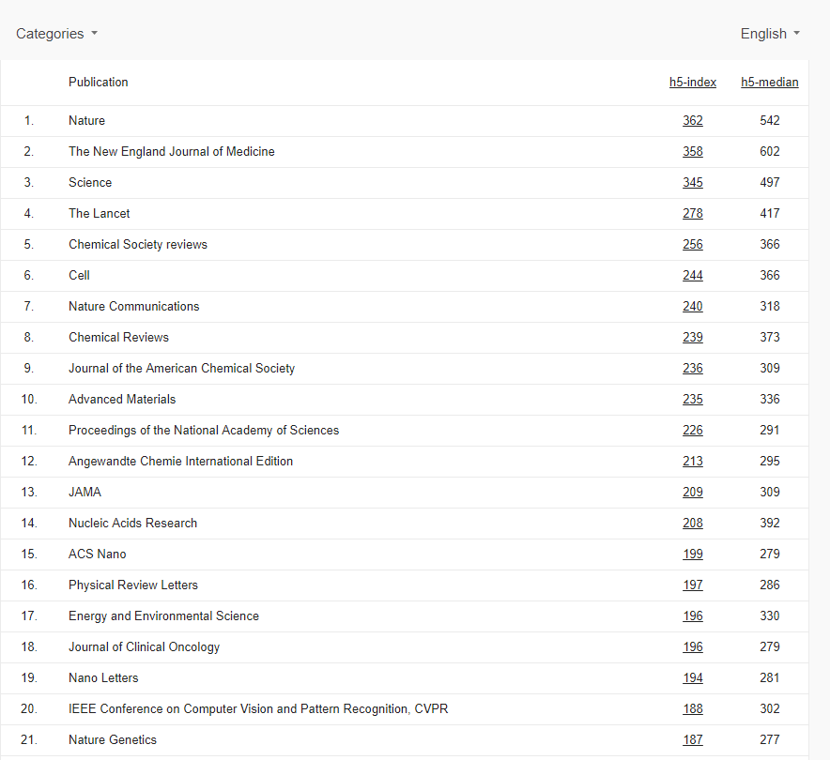
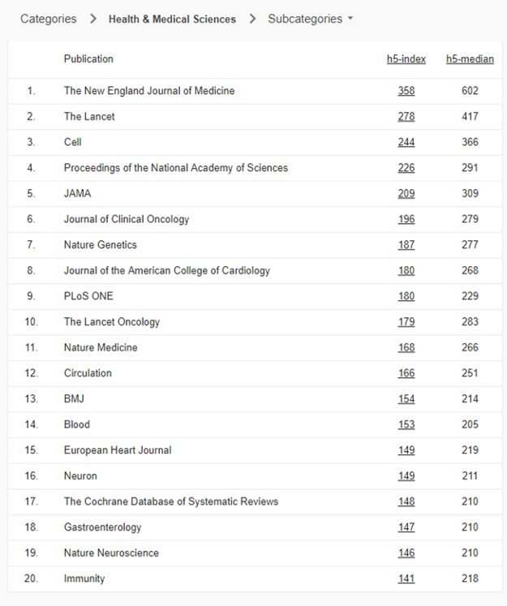
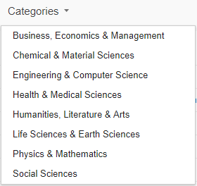
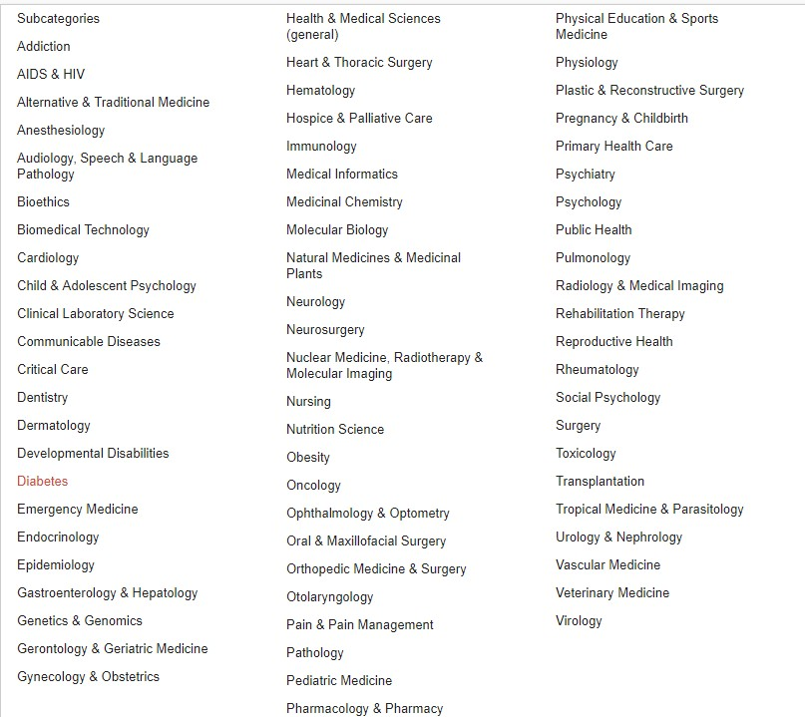
This reveals the top journals in a field of interest, and the articles generating these journal's impact can also be accessed.
To get started, you can browse the top 100 publications in several
languages, ordered by their five-year h-index and h-median metrics.

Slide 17
H-Index
The index was suggested in 2005 by Jorge E. Hirsch, a physicist and is sometimes called the Hirsch index or Hirsch number.
The h-index is an author-level metric that attempts to measure both the productivity and citation.
The index is based on the set of the scientist's most cited papers and the number of citations that they have received in other publications.
The index can also be applied to the productivity and impact of a scholarly journal as well as a group of scientists, such as a department or university or country.

Slide 18
Example
This author’s h index is highlighted by the red circle. This represents the point where
at least h number of papers have been cited at least h times each. In this example, the
h-index is 15. That is, 15 papers have been published by this author which themselves
have each been cited at least 15 times.

Slide 19
i10-index
The i10-index is the newest in the line of journal metrics and was introduced by Google Scholar in 2011.
It is a simple and straightforward indexing measure found by tallying a scholar’s total number of published papers with at least 10 citations.
i20-index
i20-index The i20-index, proposed in this editorial note, is obtained by tallying a scholar’s total number of published papers with at least 20 citations

Slide 20
Alternatives to Google Scholar
Web of Knowledge (Web of science)
Scopus
SOLO
Subject specialised federated searches e.g PubMed, Scirus for scientific information.

Slide 21
Definition of Scopus?
“Scopus is the largest abstract and citation database of peer-reviewed literature and quality web sources with smart tools to track, analyze and visualize research”.
It is an Elsevier database launched in 2004. Scopus covers.
Approximately 36,377 journals (22,794 active journals and 13,583 inactive journals).
All journals covered by the Scopus database are reviewed for sufficiently high quality every year.
Notes:
+1,000+ Open Access journals
+500 Conference Proceedings
400M web pages
21M patents
Repositories
Digital Archives

Slide 22
Definition of Scopus?
240 million scholarly
Web items, E-prints,
theses, dissertations,
13 M patents
Focused
web
information
15,100 titles
STM &
Social
sciences
World’s Largest Abstract & Citation Database
Academic
library
sources
4,000 publishers
15% Elsevier sources
85% other publishers
Fastest route to FullText

Slide 23
Scopus Coverage
15,100 Unique Titles
5,900
4,500
2,500
2,700
Life & Health
(100% Medline)
Chemistry
Physics
Engineering
Biological
Agricultural
Environmental
Social Sciences
Psychology
Economics

Slide 24
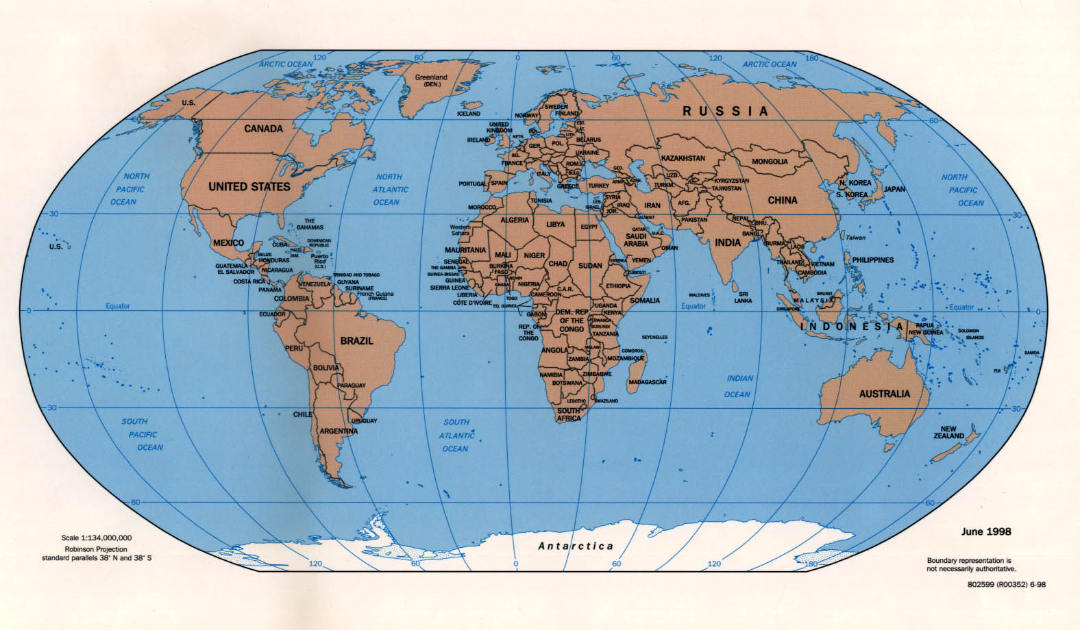
International distribution of titles
6872
806
5336
1390
189
198
251

Slide 25
Geographical Spread of Scopus Content

Slide 26
The Front Page of Scopus

Slide 27
How To Use Scopus?

Slide 34
Top Iraqi Universities Published in Scopus

Slide 35
Examples of Scientific Social Networks
http://www.researchgate.net/
http://www.mendeley.com/
http://www.linkedin.com
http://www.academia.edu/
https://orcid.org/
https://www.mysciencework.com/#world-scientific-community
http://www.scholaruniverse.com/

Slide 36
Conclusions
The increasing availability of online information resources and open access journals will place Google Scholar at the fingertips of most working scholars.
Improvements in the Google Scholar system will increase its use by those already familiar with it and gain it new users.

Slide 37
Advices
Necessity of writing affiliation to Iraqi governmental or private institutions in the correct manner.
It is necessary to write the name of the researcher in his / her research and to apply this to all research.
H-Index is your identity in the research community. must take care of

Slide 38

THANKS FOR YOUR ATTENTION

