Slide 1
Purpose of a Surgical Guide
Surgical guides are essential tools that help surgeons plan and execute complex procedures with unparalleled precision and accuracy. They serve as a roadmap, ensuring that the surgery is performed according to the optimal plan, minimizing risks and improving patient outcomes.
AF

Slide 2
What is a Surgical Guide?
1
Patient-Specific
2
Precise Positioning
Surgical guides are custom-designed based on the patient's unique anatomy, ensuring a perfect fit and optimal surgical results.
They provide a template for the surgeon to accurately position and orient surgical instruments, implants, or other devices during the procedure.
3
Streamlined Workflow
Surgical guides simplify complex procedures, reducing the time and effort required to complete the surgery.

Slide 3
Benefits of Using a Surgical Guide
Improved Accuracy
Reduced Surgical Time
Minimized Complications
Surgical guides enhance the precision of surgical interventions, ensuring that the intended targets are accurately reached.
By streamlining the surgical workflow, guides can significantly reduce the duration of the procedure, minimizing patient exposure and risks.
The enhanced precision and efficiency provided by surgical guides can help reduce the risk of surgical complications and improve patient outcomes.

Slide 4
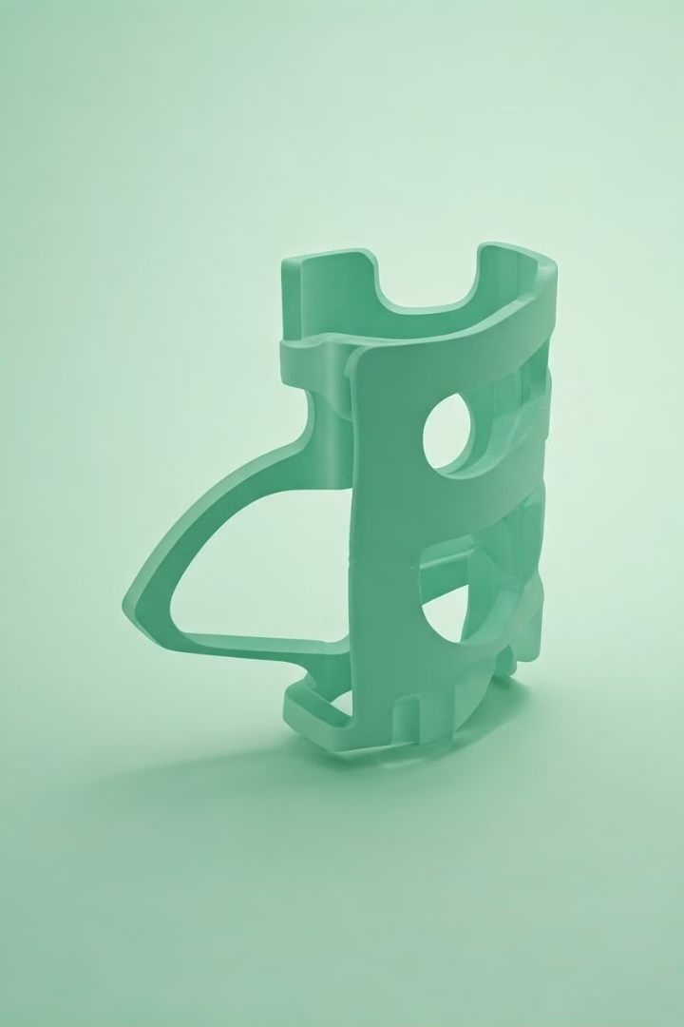
Improved Accuracy and Precision
1
Precise Placement
Surgical guides ensure that surgical instruments, implants, or other devices are positioned exactly as planned, reducing the risk of errors.
2
Anatomical Alignment
By aligning the guide with the patient's unique anatomy, surgeons can achieve optimal results, ensuring the best fit and functionality.
3
Customized Fit
Surgical guides are tailored to the individual patient, providing a perfect fit and eliminating the need for extensive intraoperative adjustments.

Slide 5
Reduced Surgical Time
1
Streamlined Procedures
2
Fewer Adjustments
With the precise placement and alignment provided by the guide, surgeons can minimize the need for intraoperative adjustments, further reducing surgical duration.
Surgical guides simplify complex procedures, allowing surgeons to work more efficiently and reducing the overall time required for the surgery.
3
Optimized Workflow
Surgical guides integrate seamlessly into the surgical workflow, enabling a more streamlined and organized approach to the procedure.

Slide 6
Minimized Risk of Complications
Reduced Tissue Trauma
Improved Implant Placement
The precision of surgical guides helps minimize the amount of tissue manipulation and disruption, lowering the risk of complications such as infection or delayed healing.
Accurate positioning of implants or other devices using surgical guides can reduce the likelihood of complications like implant failure or misalignment.
Enhanced Safety
Faster Recovery
Surgical guides enhance the overall safety of the procedure, protecting critical structures and minimizing the potential for adverse events during the surgery.
By reducing complications and minimizing tissue damage, surgical guides can contribute to a faster and more uneventful recovery for the patient.

Slide 7
Components of a Surgical Guide
Anatomical Model
Targeting Markers
The guide is designed based on a detailed 3D model of the patient's anatomy, ensuring a perfect fit.
Precise alignment markers help the surgeon accurately position the guide and surgical instruments.
Drill Guides
Durable Material
Integrated drill guides ensure that any necessary drilling or cutting is performed at the correct angle and depth.
Surgical guides are typically made from high-strength, biocompatible materials to withstand the demands of the surgical environment.

Slide 8
Designing an Effective Surgical Guide
Comprehensive Planning
Detailed pre-operative planning, including imaging and 3D modeling, is crucial for designing an effective surgical guide.
Iterative Design
The guide may undergo multiple design iterations to ensure optimal fit, functionality, and ease of use.
Quality Assurance
Thorough testing and validation of the surgical guide are essential to guarantee its performance and safety.

Slide 9
Implementing the Surgical Guide
Preoperative Preparation
The surgical guide is sterilized and integrated into the pre-surgical workflow, ensuring smooth implementation.
Intraoperative Utilization
The surgeon precisely aligns and secures the guide, using it as a reference throughout the procedure.
Postoperative Evaluation
The surgical outcome is assessed, and the guide's effectiveness is evaluated to inform future improvements.

