Slide 1
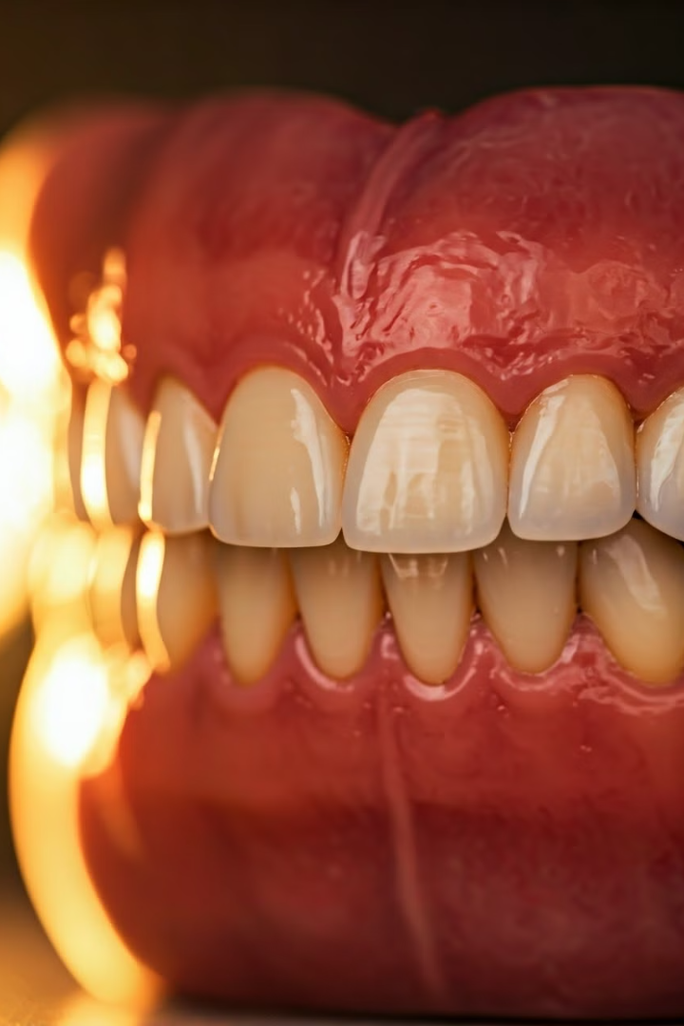

Final Adjustments: Ensuring Proper Fit and Function
After the prosthesis is fabricated, final adjustments are made to ensure it fits comfortably and functions properly before being placed in the patient's mouth. This critical step ensures the prosthesis meets the patient's unique needs.

Slide 2

Introduction to Prosthetic Adjustments
1
Personalized Fit
2
Functional Testing
Each patient's oral anatomy is unique, requiring customized adjustments to the prosthesis.
The prosthesis must be tested for proper occlusion, stability, and phonetic function.
3
Aesthetic Considerations
Adjustments may be made to improve the natural appearance of the prosthesis.

Slide 3
Evaluating the Fit of the Prosthesis
Bite Evaluation
Tissue Adaptation
Retention and Stability
Assess the patient's bite and ensure the prosthesis aligns properly with the natural teeth.
Check for any areas of the prosthesis that may be putting undue pressure on the gums or soft tissues.
Ensure the prosthesis is securely held in place without excessive movement or rocking.

Slide 4
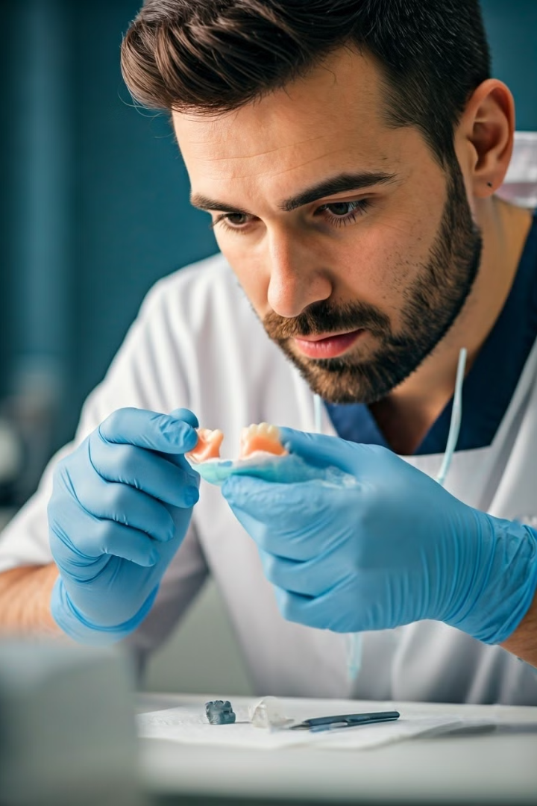
Identifying Areas Requiring Adjustment
High Spots
Improperly Fitting Edges
Identify any areas of the prosthesis that are making premature contact with the natural teeth or soft tissues.
Check for any sharp or irritating edges that may be causing discomfort for the patient.
Inadequate Occlusion
Aesthetic Concerns
Ensure the prosthesis is making proper, even contact with the opposing teeth.
Note any areas that could be improved to enhance the natural appearance of the prosthesis.

Slide 5

Techniques for Adjusting the Prosthesis
Grinding
Rebasing
Carefully removing excess material to address high spots or improper fit.
Modifying the base of the prosthesis to improve retention and stability.
1
2
3
Polishing
Smoothing and refining the surface of the prosthesis for comfort and aesthetics.

Slide 6
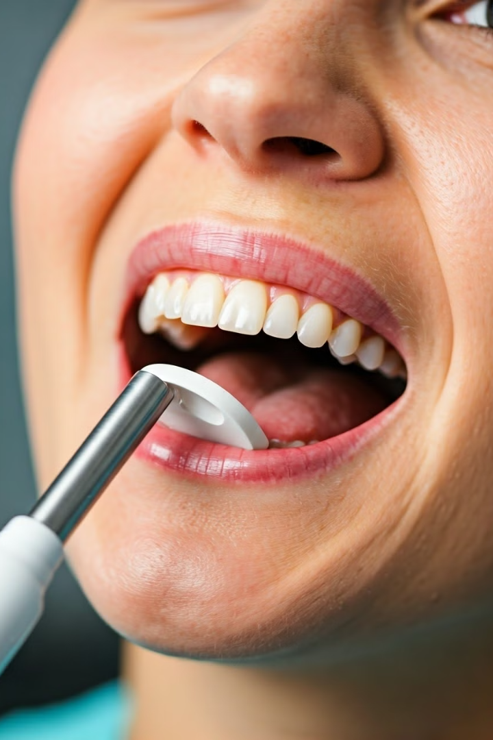



Ensuring Optimal Occlusion and Stability
Bite Adjustment
Refine the occlusal contacts to distribute forces evenly across the prosthesis.
Adhesive Reinforcement
Use specialized dental adhesives to enhance the retention and stability of the prosthesis.
Detailed Inspection
Carefully examine the prosthesis under magnification to identify any remaining issues.

Slide 7




Checking for Proper Phonetic Function
Speech Assessment
Evaluate the patient's ability to produce clear and natural-sounding speech with the prosthesis.
Adjustment Techniques
Make any necessary modifications to the prosthesis to improve phonetic function.
Verification
Confirm the patient's satisfaction with the clarity and comfort of their speech.

Slide 8
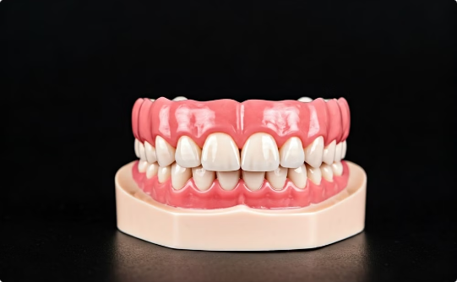
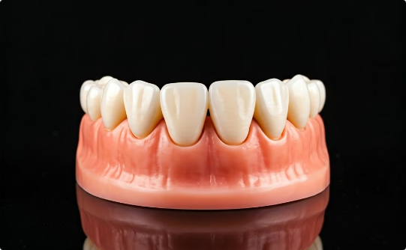
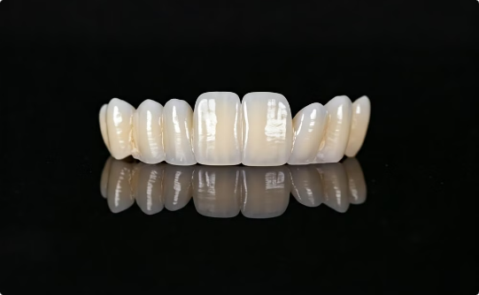
Adjusting the Aesthetics of the Prosthesis
Gum Line Refinement
Tooth Characterization
Shade and Finish
Carefully sculpt the gum-colored portion of the prosthesis to create a seamless transition.
Add subtle variations in color and texture to the prosthetic teeth for a more natural appearance.
Carefully match the prosthesis to the patient's existing teeth for a cohesive, aesthetic result.

Slide 9

Final Inspection and Patient Approval
Fit and Comfort
The prosthesis should feel secure and comfortable in the patient's mouth.
Occlusion
Proper contact and alignment with the opposing teeth is essential.
Phonetics
The patient should be able to speak clearly and naturally with the prosthesis.
Aesthetics
The prosthesis should blend seamlessly with the patient's natural teeth and gums.

Slide 10
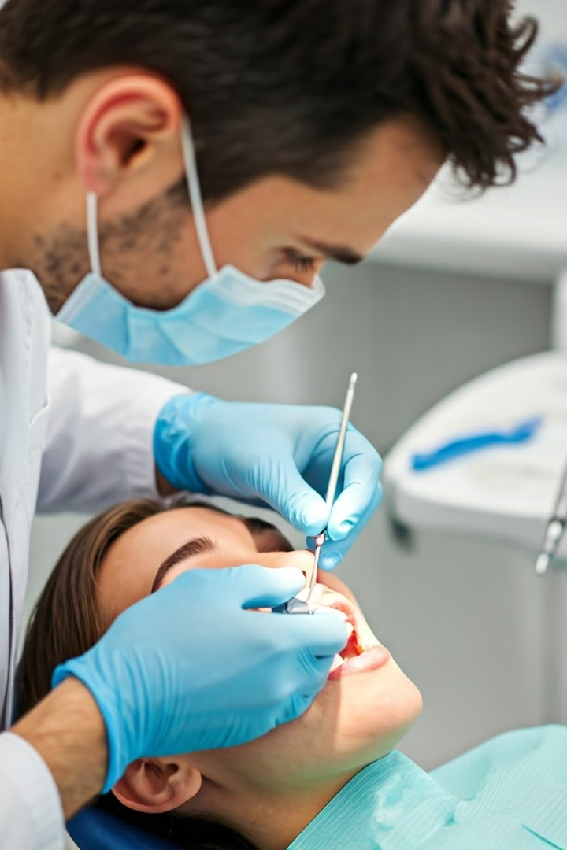
Placing the Prosthesis in the Patient's Mouth
Once all final adjustments have been made and the patient has approved the prosthesis, it can be carefully placed in the patient's mouth. This marks the culmination of the customization process, ensuring the patient receives a comfortable, functional, and aesthetically pleasing prosthetic solution.

