Slide 1
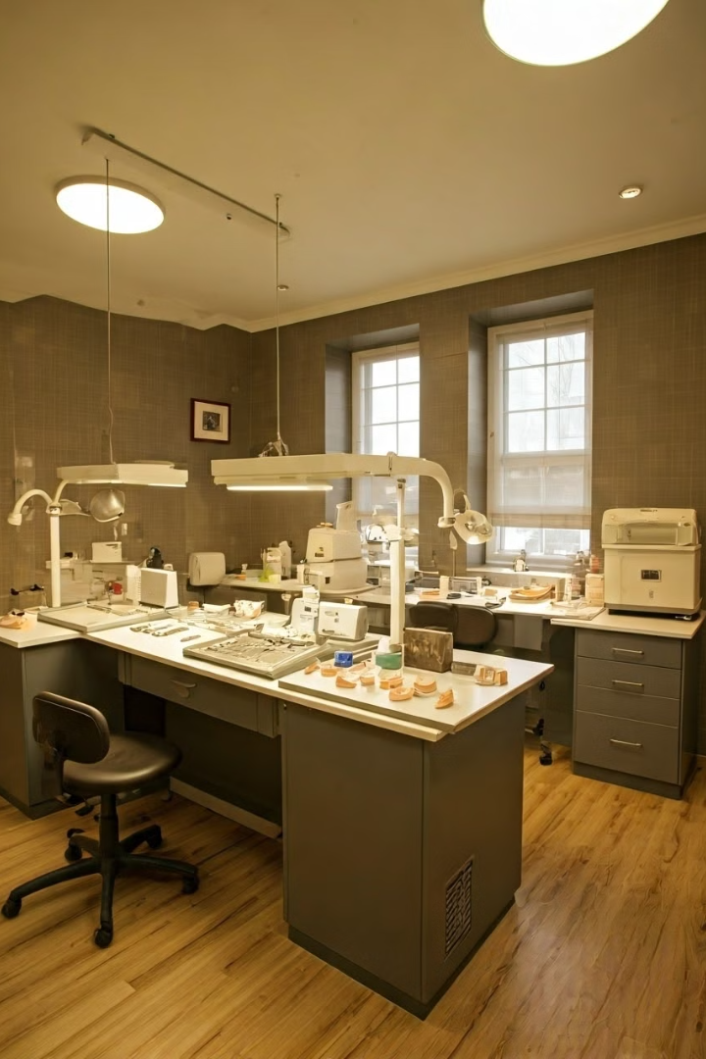
Prosthesis Design and Fabrication
The dental laboratory plays a crucial role in designing and fabricating the final prosthetic restoration, such as crowns, bridges, or dentures. This process involves careful planning, material selection, and precise craftsmanship to ensure a seamless and functional result for the patient.

Slide 2
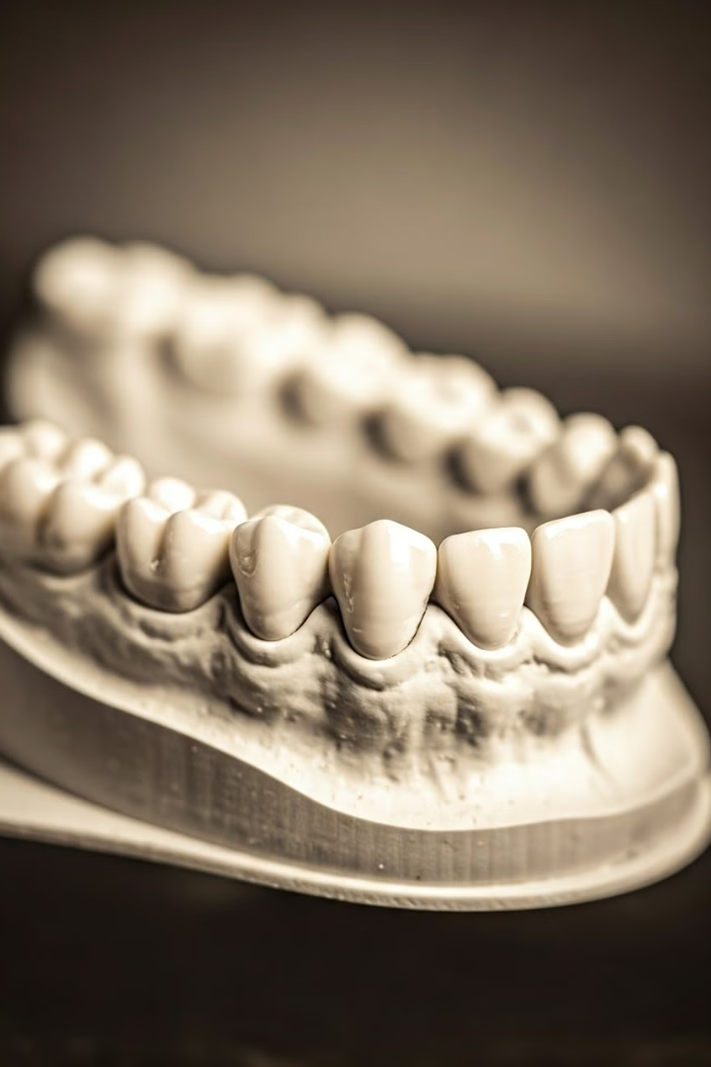
Importance of Impressions
Accurate Fit
Functional Design
A high-quality impression captures the precise details of the patient's oral structures, ensuring the prosthesis fits perfectly.
The impression provides the necessary information to design a restoration that aligns with the patient's bite and chewing patterns.
Aesthetic Considerations
Customized Approach
Each patient's oral anatomy is unique, requiring a tailored impression to create a personalized prosthetic solution.
The impression allows the lab to replicate the natural appearance of the patient's teeth and gums.

Slide 3
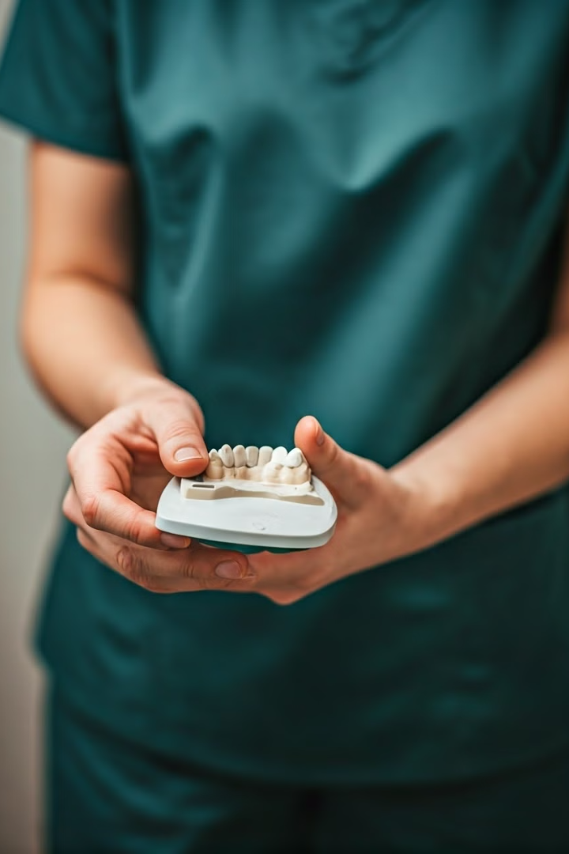
Impression-Taking Techniques
1
Preparation
Ensuring the patient's oral cavity is clean and dry for an accurate impression.
2
Tray Selection
Choosing the appropriate size and shape of the impression tray based on the patient's anatomy.
3
Impression Material
Carefully mixing and loading the impression material into the tray for a precise capture.

Slide 4
Dental Lab Workflow
Impression Receipt
Model Fabrication
Design and Crafting
The lab carefully inspects the impression for accuracy and any potential issues.
A highly detailed model is created from the impression to serve as the foundation for the restoration.
Skilled technicians use the model to design and fabricate the final prosthetic piece.

Slide 5
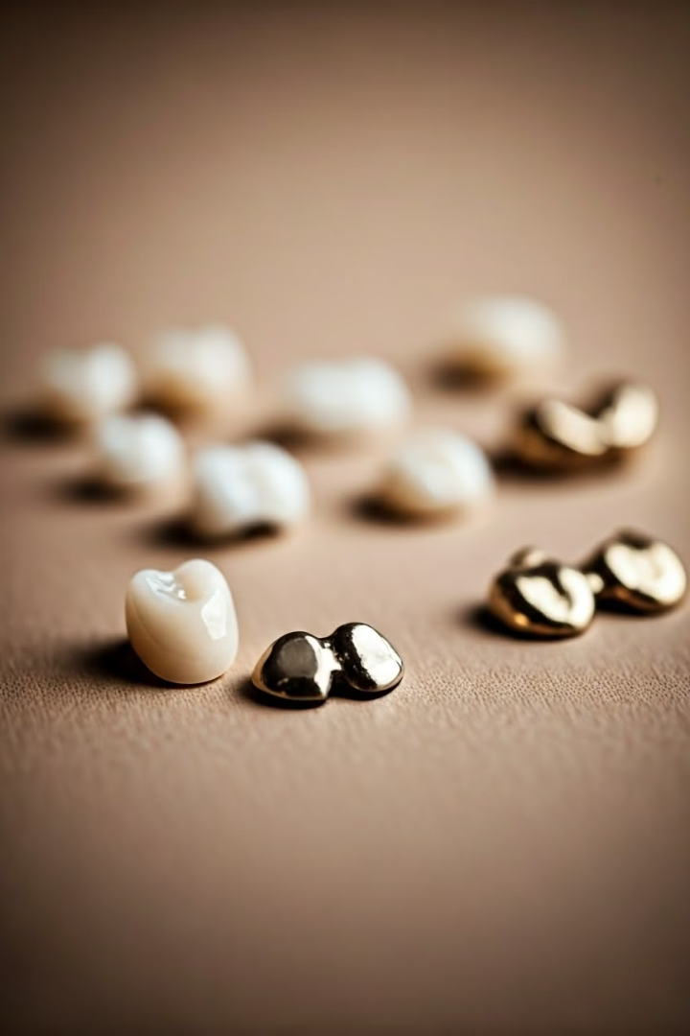
Restorative Materials
1
Ceramics
2
Composite Resins
Porcelain and other ceramic materials provide natural-looking, durable, and long-lasting restorations.
Tooth-colored composite resins offer a more affordable and versatile option for restorations.
3
Metal Alloys
4
Material Selection
Gold and other metal alloys are still used in some cases for their strength and longevity.
The lab carefully considers the patient's needs, oral environment, and aesthetic preferences when selecting the optimal restorative material.

Slide 6
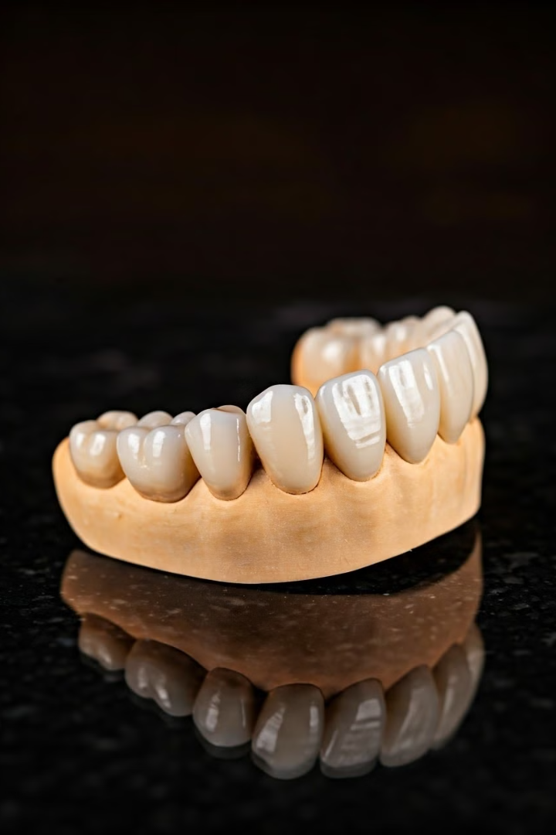
Ceramic Restorations
Durability
Ceramic materials are highly resistant to wear and tear, ensuring long-lasting performance.
Aesthetics
Ceramic restorations mimic the natural appearance of teeth, blending seamlessly with the patient's smile.
Biocompatibility
Ceramic materials are well-tolerated by the body, reducing the risk of allergic reactions.

Slide 7
Composite Resin Restorations
Versatility
Esthetic Qualities
Cost-Effectiveness
Composite resins can be used for a wide range of restorative treatments, from fillings to veneers.
Composite resins are formulated to mimic the appearance of natural teeth, providing an attractive result.
Composite resins are generally more affordable than ceramic alternatives, making them a viable option.

Slide 8
Digital Fabrication Methods
CAD/CAM Technology
3D Printing
Milling
Computer-aided design and manufacturing (CAD/CAM) systems allow for the digital design and fabrication of restorations.
Additive manufacturing techniques, such as 3D printing, enable the creation of custom-fit prosthetic pieces.
Computer-controlled milling machines can precisely shape and refine restorative materials to the desired form.

Slide 9
Quality Assurance Processes
1
Fit and Function
2
Aesthetic Evaluation
3
Material Verification
The lab thoroughly checks the restoration's fit, occlusion, and overall functionality before delivery.
Experienced technicians assess the restoration's color, shape, and natural appearance to meet patient expectations.
The lab ensures the selected materials meet the required standards for durability and biocompatibility.

Slide 10
Collaboration Between Clinician and Lab
Communication
Ongoing communication between the clinician and lab technicians is crucial to ensure the desired outcome.
Feedback and Iteration
The lab welcomes feedback from the clinician to make any necessary adjustments and refinements.
Shared Expertise
By combining their respective knowledge and skills, the clinician and lab can provide the best possible solution for the patient.

