Slide 1
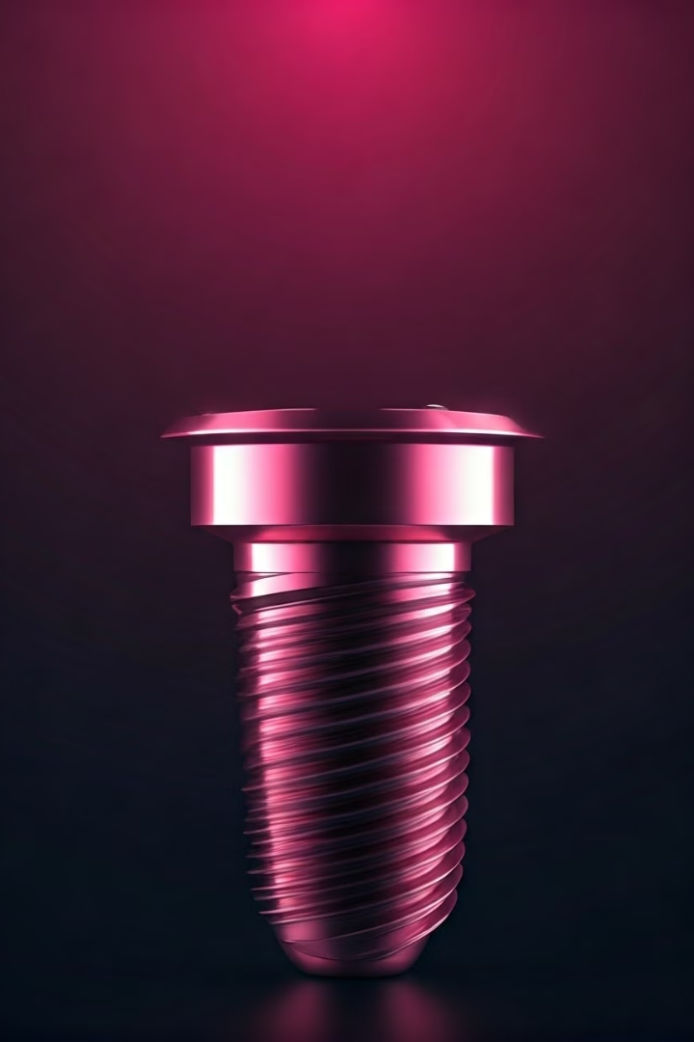
Implant Fabrication: Precision Engineering for Dental Restoration
At our state-of-the-art dental lab, we specialize in the precise fabrication of biocompatible dental implants tailored to each patient's unique needs. Our team of experts employs advanced engineering techniques to create durable, long-lasting solutions for optimal oral health and aesthetics.

Slide 2
Understanding the Anatomy: Designing Implants for Individual Needs
Customized Fit
Optimal Integration
Aesthetic Harmony
We carefully analyze the patient's jaw structure and dentition to design implants that seamlessly integrate with their unique oral architecture.
Our implants are engineered to promote strong osseointegration, ensuring a secure and stable foundation for the restoration.
The implant's shape, size, and color are meticulously crafted to blend naturally with the patient's surrounding teeth and gums.

Slide 3
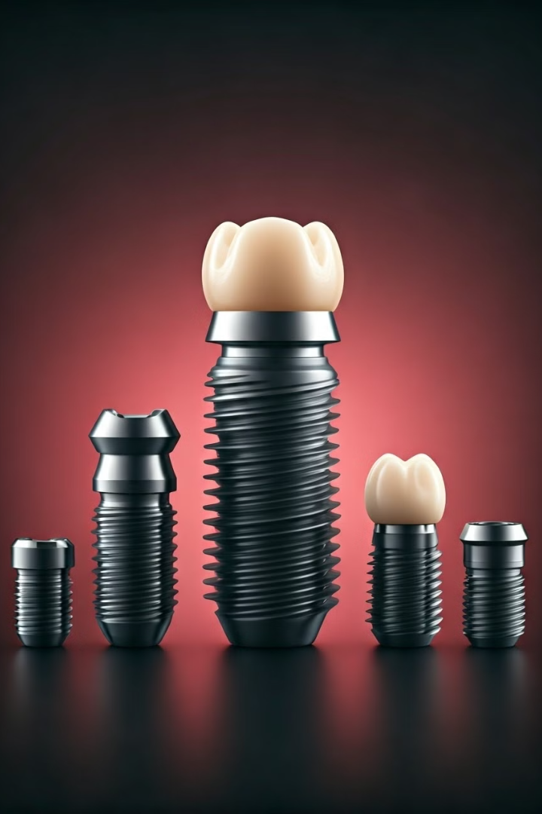
Biocompatible Materials: The Foundation of Implant Durability
Titanium
Ceramic
Renowned for its exceptional strength, corrosion resistance, and biocompatibility, titanium is the gold standard in implant fabrication.
Offering natural-looking aesthetics and hypoallergenic properties, ceramic implants are a popular choice for patients with metal sensitivities.
Zirconia
Rigorous Testing
This high-performance ceramic material combines superior strength, durability, and a tooth-like appearance for optimal results.
All our implant materials undergo extensive biocompatibility testing to ensure the highest levels of safety and reliability.

Slide 4
Titanium: The Gold Standard in Implant Fabrication
Strength
Corrosion Resistance
Biocompatibility
Titanium's exceptional durability and load-bearing capacity make it an ideal material for long-lasting dental implants.
The natural oxide layer on titanium protects the implant from corrosion, ensuring its longevity in the oral environment.
Titanium's excellent biocompatibility allows for seamless integration with the surrounding bone and soft tissues.

Slide 5
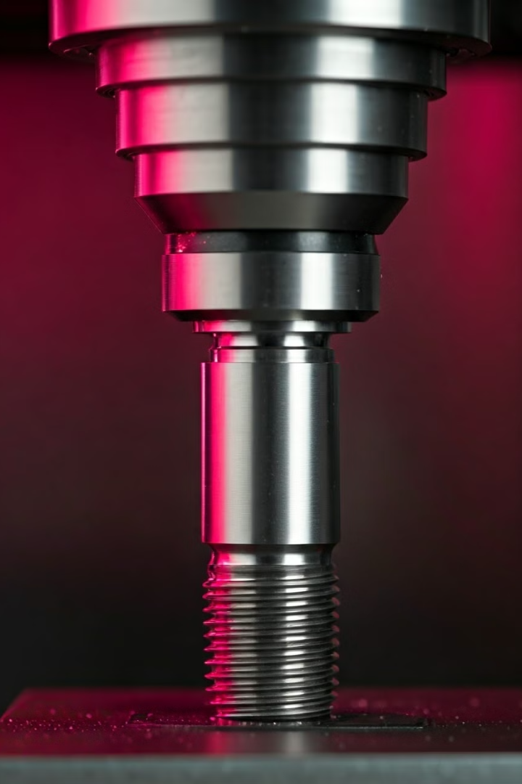
Precision Milling: Crafting the Implant's Optimal Shape
1
CAD Design
Our skilled technicians use advanced CAD software to meticulously design the implant's shape and dimensions based on the patient's unique needs.
2
CNC Milling
The implant is then precisely fabricated using state-of-the-art CNC milling machines, ensuring a perfect fit and optimal performance.
3
Quality Inspection
Every implant undergoes rigorous inspection and testing to verify its dimensional accuracy, surface finish, and compliance with strict quality standards.

Slide 6
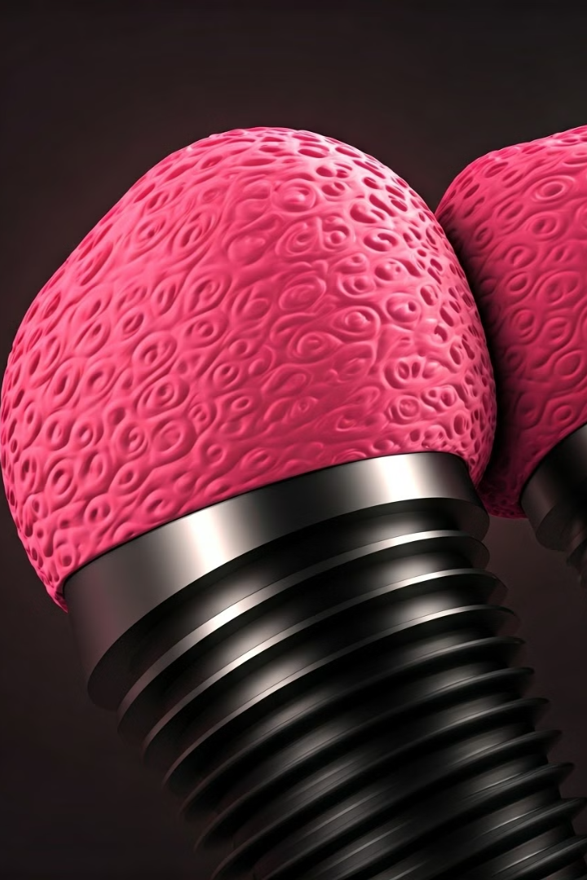
Surface Treatments: Enhancing Osseointegration
Etching
We utilize specialized etching techniques to create a micro-textured surface that promotes stronger bone-to-implant contact and improved osseointegration.
Anodization
Anodizing the implant's surface enhances its bioactivity, further facilitating the integration of the implant with the surrounding bone.
Coating
In some cases, we apply specialized coatings to the implant surface to encourage faster and more reliable osseointegration.

Slide 7
Computer-Aided Design (CAD): Personalized Implant Planning
1
Precise Positioning
2
Anatomical Considerations
3
Customized Design
Our CAD software allows us to virtually plan the optimal placement and angulation of the implant to maximize its stability and support.
The implant's shape, size, and features are meticulously tailored to each patient's unique oral anatomy and restoration requirements.
We carefully analyze the patient's bone density, nerve pathways, and other vital structures to ensure the implant's safe and effective integration.

Slide 8
3D Printing: Additive Manufacturing for Customized Implants
Precision Fabrication
Improved Fit
Innovative Solutions
Our state-of-the-art 3D printers allow us to fabricate customized implants with unparalleled accuracy and attention to detail.
The additive manufacturing process enables us to create implants that seamlessly integrate with the patient's unique jaw structure.
3D printing opens up new possibilities for designing complex implant geometries and incorporating advanced features for enhanced performance.

Slide 9
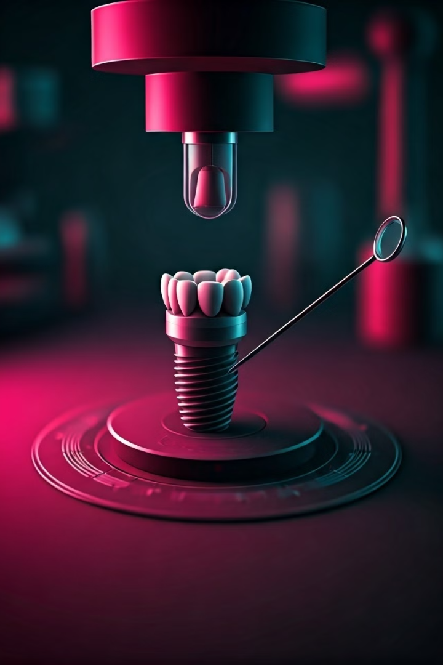
Quality Assurance: Ensuring Implant Integrity and Safety
Dimensional Accuracy
Rigorous measurements and inspections to verify the implant's precise fit and dimensions.
Surface Finish
Detailed analysis of the implant's surface texture and topography to ensure optimal biocompatibility.
Material Purity
Comprehensive testing to confirm the implant's composition and purity, meeting the highest industry standards.
Sterilization
Meticulous sterilization protocols to eliminate any risk of contamination or infection.

Slide 10
The Lab's Expertise: Delivering Superior Dental Implant Solutions
Experienced Team
Advanced Technology
Our lab is staffed by a dedicated team of dental technicians, engineers, and scientists with extensive expertise in implant fabrication.
We leverage the latest advancements in materials science, CAD/CAM, and additive manufacturing to deliver cutting-edge implant solutions.
Commitment to Excellence
Quality, safety, and patient satisfaction are our top priorities as we strive to exceed the expectations of our dental partners and their patients.

