Slide 1
Diagnosis and Treatment Planning for Dental Implants
Proper diagnosis and treatment planning are crucial for the success of dental implants. This involves leveraging advanced imaging techniques to thoroughly assess the patient's bone quality and quantity, enabling the selection of the optimal implant size and type for each individual case.

Slide 2
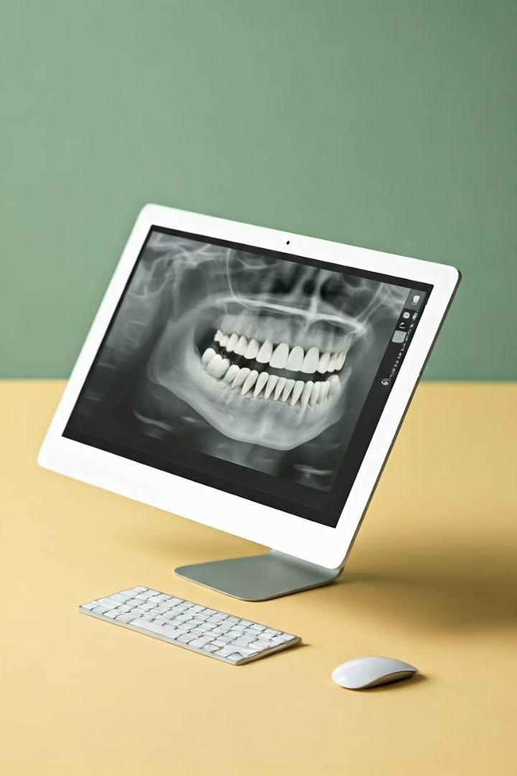
Importance of Imaging Techniques
1
Comprehensive Assessment
2
Implant Planning
Imaging data informs the selection of the appropriate implant size, shape, and placement for optimal results.
Imaging techniques provide detailed information about the patient's jaw structure, bone density, and overall oral health.
3
Minimizing Complications
Thorough pre-operative planning helps identify and mitigate potential issues, ensuring a successful implant procedure.

Slide 3
X-Ray Imaging for Bone Assessment
Panoramic X-Rays
Periapical X-Rays
Cephalometric X-Rays
Provide a comprehensive view of the entire jaw, allowing assessment of bone quantity and identifying any abnormalities.
Focus on specific areas, offering detailed information about the condition of individual teeth and surrounding bone.
Analyze the relationship between the jaws and facial structures, crucial for dental implant placement and aesthetic considerations.

Slide 4
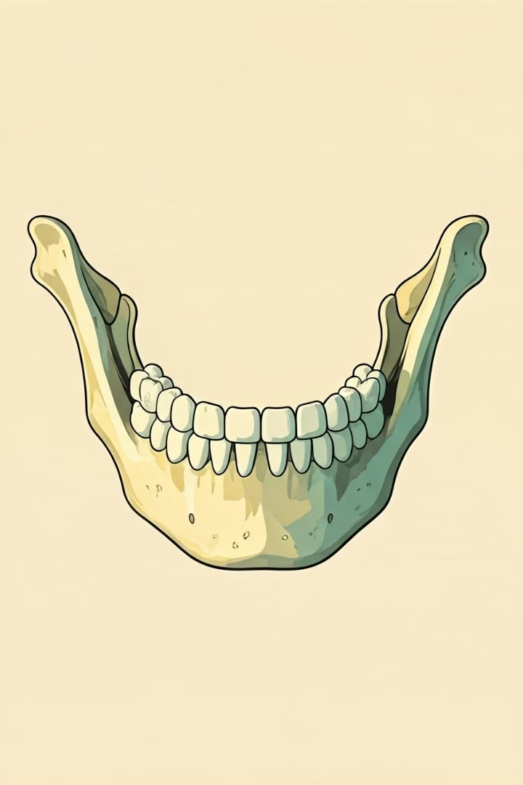
Cone Beam Computed Tomography (CBCT) Scans
High-Resolution Imaging
Identifying Anatomical Landmarks
CBCT scans provide a 3D representation of the jaw, enabling precise measurement and evaluation of bone dimensions.
CBCT data helps identify critical structures like nerves and sinuses, ensuring safe implant placement.
Evaluating Bone Quality
Customized Treatment Planning
The detailed CBCT images allow assessment of bone density and quality, informing the selection of appropriate implant type.
CBCT data can be integrated with CAD/CAM software to design and guide the implant placement process.

Slide 5
Analysis of Bone Quality and Quantity
Bone Quality
Bone Quantity
Bone Augmentation
Bone density and structure determine the quality of the implant's anchorage, influencing the choice of implant and surgical approach.
Adequate bone volume is crucial for successful implant placement, ensuring sufficient support and stability.
In cases of insufficient bone, procedures like bone grafting or sinus lifts may be necessary to create the required volume.

Slide 6
Selecting the Appropriate Implant Size
Accurate Measurements
Precise measurement of the available bone dimensions is essential to choose the optimal implant size.
Achieving a Proper Fit
The implant must be properly sized to ensure a secure fit and seamless integration with the surrounding bone.
Optimal Stability
The right implant size provides the necessary support and stability for long-term success and functionality.

Slide 7
Choosing the Optimal Implant Type
Implant Material
Implant Design
Single vs. Multiple Teeth
Titanium and zirconia are the most common materials, each with their own advantages in terms of biocompatibility and aesthetics.
Factors like shape, surface texture, and connection type influence the implant's ability to integrate with the surrounding bone.
The choice between single-unit or multi-unit implants depends on the specific needs and condition of the patient's dentition.

Slide 8
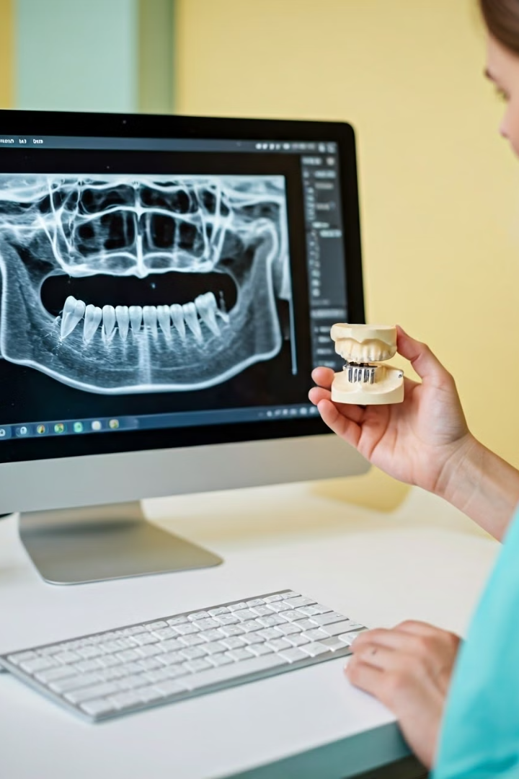
Integrating Imaging Data into Treatment Plan
Imaging Analysis
Comprehensive evaluation of the patient's bone quality, quantity, and anatomical structures.
Implant Selection
Choosing the appropriate implant size, type, and placement based on the imaging data.
Treatment Planning
Developing a personalized plan that incorporates the implant selection and surgical approach.

Slide 9
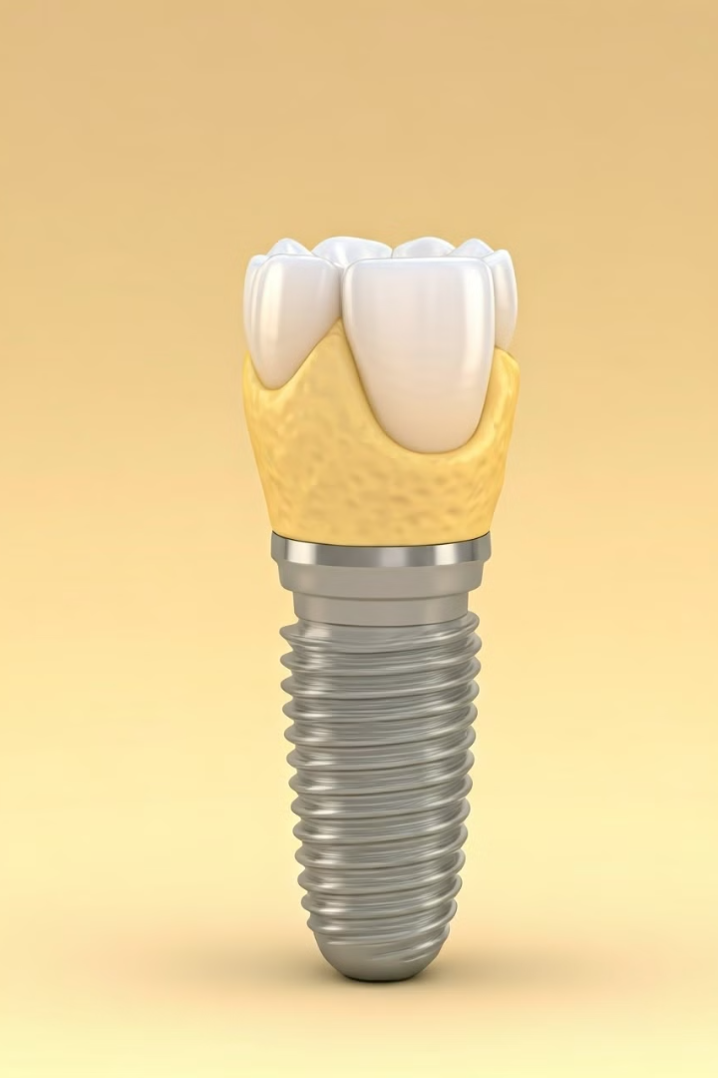
Factors Influencing Implant Success
Bone Integration
Oral Hygiene
Successful osseointegration, where the implant fuses with the surrounding bone, is crucial for long-term stability and function.
Proper oral hygiene practices, including regular cleaning and maintenance, help prevent peri-implant diseases and ensure implant longevity.
Patient Health
Surgical Technique
Factors like the patient's overall health, medical conditions, and lifestyle habits can impact the success of the implant procedure.
The skill and experience of the implant dentist, as well as the precision of the surgical execution, play a significant role in achieving optimal results.

Slide 10
Conclusion: Comprehensive Diagnosis for Optimal Outcomes
By leveraging advanced imaging techniques and comprehensive treatment planning, dentists can ensure the successful integration and long-term functionality of dental implants. This holistic approach helps minimize complications and deliver the best possible outcomes for patients.

